Slide 1
Module 3: Network Security Concepts
Instructor Materials
Enterprise Networking, Security, and Automation v7.0
(ENSA)
Notes:
Cisco Networking Academy Program
Enterprise Networking, Security, and Automationv7.0 (ENSA)
Module 3: Network Security Concepts

Slide 2
Instructor Materials – Module 3 Planning Guide
This PowerPoint deck is divided in two parts:
Instructor Planning Guide
Information to help you become familiar with the module
Teaching aids
Instructor Class Presentation
Optional slides that you can use in the classroom
Begins on slide # 13
Note: Remove the Planning Guide from this presentation before sharing with anyone.
For additional help and resources go to the Instructor Home Page and Course Resources for this course. You also can visit the professional development site on netacad.com, the official Cisco Networking Academy Facebook page, or Instructor Only FB group.
Notes:
2

Slide 3
What to Expect in this Module
To facilitate learning, the following features within the GUI may be included in this module:
Feature | Description
Animations | Expose learners to new skills and concepts.
Videos | Expose learners to new skills and concepts.
Check Your Understanding(CYU) | Per topic online quiz to help learners gauge content understanding.
Interactive Activities | A variety of formats to help learners gauge content understanding.
Syntax Checker | Small simulations that expose learners to Cisco command line to practice configuration skills.
PT Activity | Simulation and modeling activities designed to explore, acquire, reinforce, and expand skills.

Slide 4
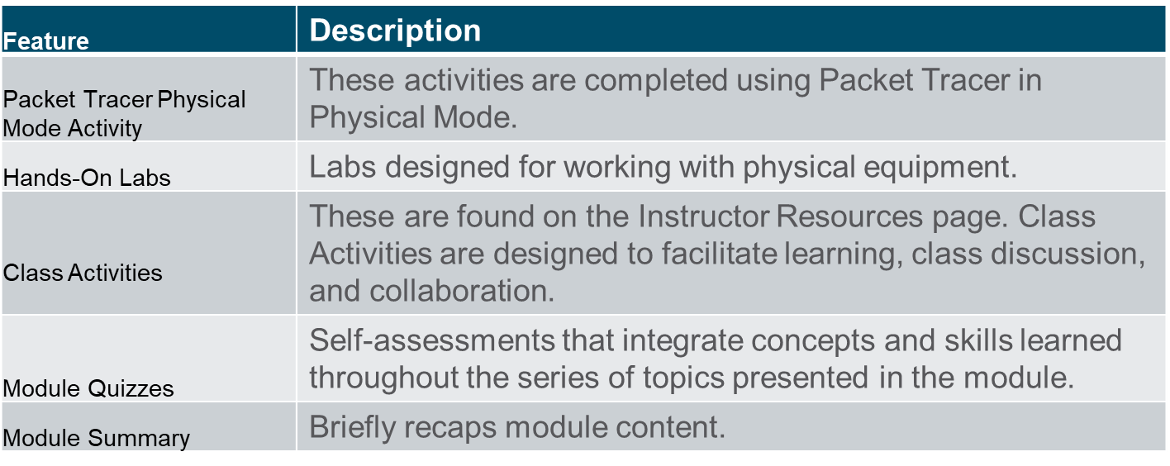
What to Expect in this Module (Cont.)
To facilitate learning, the following features may be included in this module:

Slide 5
Check Your Understanding
Check Your Understanding activities are designed to let students quickly determine if they understand the content and can proceed, or if they need to review.
Check Your Understanding activities do not affect student grades.
There are no separate slides for these activities in the PPT. They are listed in the notes area of the slide that appears before these activities.
Notes:
5

Slide 6
Packet Tracer Physical Mode Activities
These activities are completed using Packet Tracer in Physical Mode.
They are designed to emulate the corresponding Labs.
They can be used instead of the lab when access to physical equipment is not possible.
These activities often do not have the level of scaffolding that is present in PT activities that immediately precede these activities.
Notes:
6

Slide 7
Module 3: Activities
What activities are associated with this module?
Page # | Activity Type | Activity Name | Optional?
3.1.4 | Check Your Understanding | Current State of Cybersecurity | Recommended
3.2.6 | Check Your Understanding | Threat Actors | Recommended
3.3.1 | Video | Threat Actor Tools | Recommended
3.3.5 | Check Your Understanding | Threat Actor Tools | Recommended
3.4.4 | Check Your Understanding | Malware | Recommended
3.5.2 | Video | Reconnaissance Attacks | Recommended
3.5.4 | Video | Access and Social Engineering Attacks | Recommended
3.5.7 | Lab | Social Engineering | Recommended
Notes:
7

Slide 8
Module 3: Activities
What activities are associated with this module?
Page # | Activity Type | Activity Name | Optional?
3.5.8 | Video | Denial of Service Attacks | Recommended
3.5.10 | Check Your Understanding | Common Network Attacks | Recommended
3.6.1 | Video | Common IP and ICMP Attacks | Recommended
3.6.4 | Video | Amplification, Reflection and Spoofing Attacks | Recommended
3.6.7 | Check Your Understanding | IP Vulnerabilities and Threats | Recommended
3.7.6 | Check Your Understanding | TCP and UDP Vulnerabilities | Recommended
3.8.3 | Video | ARP Spoofing | Recommended
3.8.8 | Lab | Explore DNS Traffic | Recommended
Notes:
8

Slide 9
Module 3: Activities
What activities are associated with this module?
Page # | Activity Type | Activity Name | Optional?
3.9.6 | Check Your Understanding | Network Security Best Practices | Recommended
3.10.1 | Video | Cryptography | Recommended
3.10.10 | Check Your Understanding | Cryptography | Recommended
3.11.1 | Packet Tracer Physical Mode | Network Security Scenario | Recommended
3.11.3 | Module Quiz | Network Security Concepts | Recommended
Notes:
9

Slide 10
Module 3: Best Practices
Prior to teaching Module 3, the instructor should:
Review the activities and assessments for this module.
Try to include as many questions as possible to keep students engaged during classroom presentation.
Topic 3.1
Ask the students or have a class discussion
What is the most recent cybercrime that you have heard of?
Have you ever been the victim of a cybercrime?
Topic 3.2
Ask the students or have a class discussion
What do you think the main difference is between Gray-Hat Hackers and Hacktivists?
What is it that sets State-Sponsored Hackers apart from all the rest?
Notes:
10

Slide 11
Module 3: Best Practices (Cont.)
Topic 3.3
Ask the students or have a class discussion
What is the implication of having a highly sophisticated tool that is easy to use?
What are some examples of tools that could be used by threat actors but also have legitimate purposes?
Topic 3.4
Ask the students or have a class discussion
What would be the best type of malware to use to compromise all the systems in an organization?
Is the compromise of a host always immediately detectable?
Topic 3.5
Ask the students or have a class discussion
The depiction of threat actors in television and movies is common. From the TV/Films that you have watched, what types of network attacks were depicted?
Which attack is more serious, DoS or DDoS?
Topic 3.6
Ask the students or have a class discussion
Why is it so important to understand the details of the fields in an IPv4 or IPv6 header?
What is the primary concern in an address spoofing attack?
Notes:
11

Slide 12
Module 3: Best Practices (Cont.)
Topic 3.7
Ask the students or have a class discussion
What part of the 3-way handshake does a TCP SYN Flood attack depend upon to have an effect on the target?
Why is TCP Session Hijacking so difficult to accomplish?
Topic 3.8
Ask the students or have a class discussion
As critical to IPv4 operations as it is, what makes ARP so vulnerable?
What aspect of a DNS message is exploited during a DNS tunneling attack?
Topic 3.9
Ask the students or have a class discussion
What is a NGFW and how is t different from a standard firewall?
How does the CIA triangle relate to different industries like ICS vs Retail?
Topic 3.10
Ask the students or have a class discussion
What could be the impact of a misconfigured Firewall?
What is the primary difference between an IPS and an IDS?
Notes:
12

Slide 13
Module 3: Network Security Concepts
Enterprise Networking, Security, and Automation v7.0
(ENSA)
Notes:
Cisco Networking Academy Program
Enterprise Networking, Security, and Automationv7.0 (ENSA)
Module 3: Network Security Concepts

Slide 14
Module Objectives
Module Title: Network Security Concepts
Module Objective: Explain how vulnerabilities, threats, and exploits can be mitigated to enhance network security.
Topic Title | Topic Objective
Current State of Cybersecurity: | Describe the current state of cybersecurity and vectors of data loss.
Threat Actors | Describe tools used by threat actors to exploit networks.
Malware | Describe malware types.
Common Network Attacks | Describe common network attacks.
IP Vulnerabilities and Threats | Explain how IP vulnerabilities are exploited by threat actors.
TCP and UDP Vulnerabilities | Explain how TCP and UDP vulnerabilities are exploited by threat actors.
IP Services | Explain how IP services are exploited by threat actors.
Network Security Best Practices | Describe best practices for protecting a network.
Cryptography | Describe common cryptographic processes used to protect data in transit.
Notes:
14

Slide 15
Ethical Hacking Statement
In this module, learners may be exposed to tools and techniques in a “sandboxed”, virtual machine environment to demonstrate various types of cyber attacks. Experimentation with these tools, techniques, and resources is at the discretion of the instructor and local institution. If the learner is considering using attack tools for educational purposes, they should contact their instructor prior to any experimentation.
Unauthorized access to data, computer, and network systems is a crime in many jurisdictions and often is accompanied by severe consequences, regardless of the perpetrator’s motivations. It is the learner’s responsibility, as the user of this material, to be cognizant of and compliant with computer use laws.
Notes:
15

Slide 16
3.1 Current State of Cybersecurity
Notes:
3 – Network Security Concepts
3.1 - Current State of Cybersecurity

Slide 17
Current State of Cybersecurity Current State of Affairs
Cyber criminals now have the expertise and tools necessary to take down critical infrastructure and systems. Their tools and techniques continue to evolve.
Maintaining a secure network ensures the safety of network users and protects commercial interests. All users should be aware of security terms in the table.
Security Terms | Description
Assets | An asset is anything of value to the organization. It includes people, equipment, resources, and data.
Vulnerability | A vulnerability is a weakness in a system, or its design, that could be exploited by a threat.
Threat | A threat is a potential danger to a company’s assets, data, or network functionality.
Exploit | An exploit is a mechanism that takes advantage of a vulnerability.
Mitigation | Mitigation is the counter-measure that reduces the likelihood or severity of a potential threat or risk. Network security involves multiple mitigation techniques.
Risk | Risk is the likelihood of a threat to exploit the vulnerability of an asset, with the aim of negatively affecting an organization. Risk is measured using the probability of the occurrence of an event and its consequences.
Notes:
3 – Network Security Concepts
3.1 - Current State of Cybersecurity
3.1.1 – Current State of Affairs

Slide 18
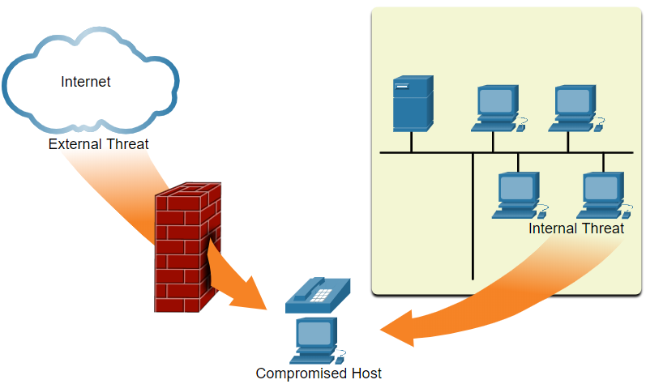
Current State of Cybersecurity Vectors of Network Attacks
An attack vector is a path by which a threat actor can gain access to a server, host, or network. Attack vectors originate from inside or outside the corporate network, as shown in the figure.
Internal threats have the potential to cause greater damage than external threats because internal users have direct access to the building and its infrastructure devices.
Notes:
3 – Network Security Concepts
3.1 - Current State of Cybersecurity
3.1.2 – Vectors of Network Attacks

Slide 19
Current State of Cybersecurity Data Loss
Data loss or data exfiltration is when data is intentionally or unintentionally lost, stolen, or leaked to the outside world. The data loss can result in:
Brand damage and loss of reputation
Loss of competitive advantage
Loss of customers
Loss of revenue
Litigation/legal action resulting in fines and civil penalties
Significant cost and effort to notify affected parties and recover from the breach
Network security professionals must protect the organization’s data. Various Data Loss Prevention (DLP) controls must be implemented which combine strategic, operational and tactical measures.
Notes:
3 – Network Security Concepts
3.1 - Current State of Cybersecurity
3.1.3 – Data Loss

Slide 20
Current State of Cybersecurity Data Loss (Cont.)
Data Loss Vectors | Description
Email/Social Networking | Intercepted email or IM messages could be captured and reveal confidential information.
Unencrypted Devices | If the data is not stored using an encryption algorithm, then the thief can retrieve valuable confidential data.
Cloud Storage Devices | Sensitive data can be lost if access to the cloud is compromised due to weak security settings.
Removable Media | One risk is that an employee could perform an unauthorized transfer of data to a USB drive. Another risk is that a USB drive containing valuable corporate data could be lost.
Hard Copy | Confidential data should be shredded when no longer required.
Improper Access Control | Passwords or weak passwords which have been compromised can provide a threat actor with easy access to corporate data.
Notes:
3 – Network Security Concepts
3.1 - Current State of Cybersecurity
3.1.3 – Data Loss (Cont.)
3.1.4 – Check Your Understanding – Current State of Cybersecurity

Slide 21
3.2 Threat Actors
Notes:
3 – Network Security Concepts
3.2 - Threat Actors

Slide 22
Threat Actors The Hacker
Hacker is a common term used to describe a threat actor
Hacker Type | Description
White Hat Hackers | These are ethical hackers who use their programming skills for good, ethical, and legal purposes. Security vulnerabilities are reported to developers for them to fix before the vulnerabilities can be exploited.
Gray Hat Hackers | These are individuals who commit crimes and do arguably unethical things, but not for personal gain or to cause damage. Gray hat hackers may disclose a vulnerability to the affected organization after having compromised their network.
Black Hat Hackers | These are unethical criminals who compromise computer and network security for personal gain, or for malicious reasons, such as attacking networks.
Notes:
3 – Network Security Concepts
3.2 - Threat Actors
3.2.1 – The Hacker

Slide 23
Threat Actors The Evolution of Hackers
The table displays modern hacking terms and a brief description of each.
Hacking Term | Description
Script Kiddies | These are teenagers or inexperienced hackers running existing scripts, tools, and exploits, to cause harm, but typically not for profit.
Vulnerability Broker | These are usually gray hat hackers who attempt to discover exploits and report them to vendors, sometimes for prizes or rewards.
Hacktivists | These are gray hat hackers who publicly protest organizations or governments by posting articles, videos, leaking sensitive information, and performing network attacks.
Cyber criminals | These are black hat hackers who are either self-employed or working for large cybercrime organizations.
State-Sponsored | These are either white hat or black hat hackers who steal government secrets, gather intelligence, and sabotage networks. Their targets are foreign governments, terrorist groups, and corporations. Most countries in the world participate to some degree in state-sponsored hacking
Notes:
3 – Network Security Concepts
3.2 - Threat Actors
3.2.2 – The Evolution of Hackers

Slide 24
Threat Actors Cyber Criminals
It is estimated that cyber criminals steal billions of dollars from consumers and businesses. Cyber criminals operate in an underground economy where they buy, sell, and trade attack toolkits, zero day exploit code, botnet services, banking Trojans, keyloggers, and much more. They also buy and sell the private information and intellectual property they steal. Cyber criminals target small businesses and consumers, as well as large enterprises and entire industries.
Notes:
3 – Network Security Concepts
3.2 - Threat Actors
3.2.3 – Cyber Criminals

Slide 25
Threat Actors Hacktivists
Two examples of hacktivist groups are Anonymous and the Syrian Electronic Army. Although most hacktivist groups are not well organized, they can cause significant problems for governments and businesses. Hacktivists tend to rely on fairly basic, freely available tools.
Notes:
3 – Network Security Concepts
3.2 - Threat Actors
3.2.4 – Hacktivists

Slide 26
Threat Actors State-Sponsored Hackers
State-sponsored hackers create advanced, customized attack code, often using previously undiscovered software vulnerabilities called zero-day vulnerabilities. An example of a state-sponsored attack involves the Stuxnet malware that was created to damage Iran’s nuclear enrichment capabilities.
Notes:
3 – Network Security Concepts
3.2 - Threat Actors
3.2.5 – State-Sponsored Hackers
3.2.6 – Check Your Understanding – Threat Actors

Slide 27
3.3 Threat Actor Tools
Notes:
3 – Network Security Concepts
3.3 - Threat Actor Tools

Slide 28
Threat Actor Tools Video – Threat Actor Tools
This video will cover the following:
Explain the penetration testing tools
Explain attack types
Notes:
3 – Network Security Concepts
3.3 - Threat Actor Tools
3.3.1 – Video – Threat Actor Tools

Slide 29
Threat Actor Tools Introduction to Attack Tools
To exploit a vulnerability, a threat actor must have a technique or tool. Over the years, attack tools have become more sophisticated, and highly automated. These new tools require less technical knowledge to implement.
Notes:
3 – Network Security Concepts
3.3 - Threat Actor Tools
3.3.2 – Introduction to Attack Tools

Slide 30
Threat Actor Tools Evolution of Security Tools
The table highlights categories of common penetration testing tools. Notice how some tools are used by white hats and black hats. Keep in mind that the list is not exhaustive as new tools are always being developed.
Penetration Testing Tool | Description
Password Crackers | Password cracking tools are often referred to as password recovery tools and can be used to crack or recover a password. Password crackers repeatedly make guesses in order to crack the password. Examples of password cracking tools include John the Ripper, Ophcrack, L0phtCrack, THC Hydra, Rainbow Crack, and Medusa.
Wireless Hacking Tools | Wireless hacking tools are used to intentionally hack into a wireless network to detect security vulnerabilities. Examples of wireless hacking tools include Aircrack-ng, Kismet, InSSIDer, KisMAC, Firesheep, and ViStumbler.
Network Scanning and Hacking Tools | Network scanning tools are used to probe network devices, servers, and hosts for open TCP or UDP ports. Examples of scanning tools include Nmap, SuperScan, Angry IP Scanner, and NetScanTools.
Packet Crafting Tools | These tools are used to probe and test a firewall’s robustness using specially crafted forged packets. Examples include Hping, Scapy, Socat, Yersinia, Netcat, Nping, and Nemesis.
Packet Sniffers | These tools are used to capture and analyze packets within traditional Ethernet LANs or WLANs. Tools include Wireshark, Tcpdump, Ettercap, Dsniff, EtherApe, Paros, Fiddler, Ratproxy, and SSLstrip.
Notes:
3 – Network Security Concepts
3.3 - Threat Actor Tools
3.3.3 – Evolution of Security Tools

Slide 31
Threat Actor Tools Evolution of Security Tools (Cont.)
Penetration Testing Tool | Description
Rootkit Detectors | This is a directory and file integrity checker used by white hats to detect installed root kits. Example tools include AIDE, Netfilter, and PF: OpenBSD Packet Filter.
Fuzzers to Search Vulnerabilities | Fuzzers are tools used by threat actors to discover a computer’s security vulnerabilities. Examples of fuzzers include Skipfish, Wapiti, and W3af.
Forensic Tools | These tools are used by white hat hackers to sniff out any trace of evidence existing in a computer. Example of tools include Sleuth Kit, Helix, Maltego, and Encase.
Debuggers | These tools are used by black hats to reverse engineer binary files when writing exploits. They are also used by white hats when analyzing malware. Debugging tools include GDB, WinDbg, IDA Pro, and Immunity Debugger.
Hacking Operating Systems | These are specially designed operating systems preloaded with tools optimized for hacking. Examples of specially designed hacking operating systems include Kali Linux, BackBox Linux.
Encryption Tools | Encryption tools use algorithm schemes to encode the data to prevent unauthorized access to the encrypted data. Examples of these tools include VeraCrypt, CipherShed, OpenSSH, OpenSSL, Tor, OpenVPN, and Stunnel.
Vulnerability Exploitation Tools | These tools identify whether a remote host is vulnerable to a security attack. Examples of vulnerability exploitation tools include Metasploit, Core Impact, Sqlmap, Social Engineer Toolkit, and Netsparker.
Vulnerability Scanners | These tools scan a network or system to identify open ports. They can also be used to scan for known vulnerabilities and scan VMs, BYOD devices, and client databases. Examples of tools include Nipper, Core Impact, Nessus, SAINT, and OpenVAS
Notes:
3 – Network Security Concepts
3.3 - Threat Actor Tools
3.3.3 – Evolution of Security Tools (Cont.)

Slide 32
Threat Actor Tools Attack Types
Attack Type | Description
Eavesdropping Attack | This is when a threat actor captures and “listens” to network traffic. This attack is also referred to as sniffing or snooping.
Data Modification Attack | If threat actors have captured enterprise traffic, they can alter the data in the packet without the knowledge of the sender or receiver.
IP Address Spoofing Attack | A threat actor constructs an IP packet that appears to originate from a valid address inside the corporate intranet.
Password-Based Attacks | If threat actors discover a valid user account, the threat actors have the same rights as the real user. Threat actors could use that valid account to obtain lists of other users, network information, change server and network configurations, and modify, reroute, or delete data.
Denial of Service Attack | A DoS attack prevents normal use of a computer or network by valid users. A DoS attack can flood a computer or the entire network with traffic until a shutdown occurs because of the overload. A DoS attack can also block traffic, which results in a loss of access to network resources by authorized users.
Man-in-the-Middle Attack | This attack occurs when threat actors have positioned themselves between a source and destination. They can now actively monitor, capture, and control the communication transparently.
Compromised-Key Attack | If a threat actor obtains a secret key, that key is referred to as a compromised key. A compromised key can be used to gain access to a secured communication without the sender or receiver being aware of the attack.
Sniffer Attack | A sniffer is an application or device that can read, monitor, and capture network data exchanges and read network packets. If the packets are not encrypted, a sniffer provides a full view of the data inside the packet
Notes:
3 – Network Security Concepts
3.3 - Threat Actor Tools
3.3.4 – Attack Types
3.3.5 – Check Your Understanding – Threat Actor Tools

Slide 33
3.4 Malware
Notes:
3 – Network Security Concepts
3.4 - Malware

Slide 34
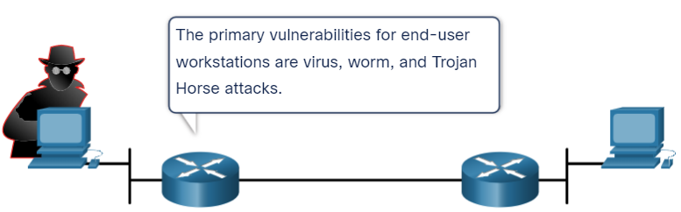
Malware Overview of Malware
Now that you know about the tools that hacker use, this topic introduces you to different types of malware that hackers use to gain access to end devices.
End devices are particularly prone to malware attacks. It is important to know about malware because threat actors rely on users to install malware to help exploit the security gaps.
Notes:
3 – Network Security Concepts
3.4 - Malware
3.4.1 – Overview of Malware

Slide 35
Malware Viruses and Trojan Horses
The first and most common type of computer malware is a virus. Viruses require human action to propagate and infect other computers.
The virus hides by attaching itself to computer code, software, or documents on the computer. When opened, the virus executes and infects the computer.
Viruses can:
Alter, corrupt, delete files, or erase entire drives.
Cause computer booting issues, and corrupt applications.
Capture and send sensitive information to threat actors.
Access and use email accounts to spread.
Lay dormant until summoned by the threat actor.
Notes:
3 – Network Security Concepts
3.4 - Malware
3.4.2 – Viruses and Trojan Horses

Slide 36
Malware Viruses and Trojan Horses (Cont.)
Modern viruses are developed for specific intent such as those listed in the table.
Types of Viruses | Description
Boot sector virus | Virus attacks the boot sector, file partition table, or file system.
Firmware viruses | Virus attacks the device firmware.
Macro virus | Virus uses the MS Office macro feature maliciously.
Program viruses | Virus inserts itself in another executable program.
Script viruses | Virus attacks the OS interpreter which is used to execute scripts.
Notes:
3 – Network Security Concepts
3.4 - Malware
3.4.2 – Viruses and Trojan Horses (Cont.)

Slide 37
Malware Viruses and Trojan Horses (Cont.)
Threat actors use Trojan horses to compromise hosts. A Trojan horse is a program that looks useful but also carries malicious code. Trojan horses are often provided with free online programs such as computer games. There are several types of Trojan horses as described in the table.
Type of Trojan Horse | Description
Remote-access | Trojan horse enables unauthorized remote access.
Data-sending | Trojan horse provides the threat actor with sensitive data, such as passwords.
Destructive | Trojan horse corrupts or deletes files.
Proxy | Trojan horse will use the victim's computer as the source device to launch attacks and perform other illegal activities.
FTP | Trojan horse enables unauthorized file transfer services on end devices.
Security software disabler | Trojan horse stops antivirus programs or firewalls from functioning.
Denial of Service (DoS) | Trojan horse slows or halts network activity.
Keylogger | Trojan horse actively attempts to steal confidential information, such as credit card numbers, by recording key strokes entered into a web form.
Notes:
3 – Network Security Concepts
3.4 - Malware
3.4.2 – Viruses and Trojan Horses (Cont.)

Slide 38
Malware Other Types of Malware
Malware | Description
Adware | Adware is usually distributed by downloading online software. Adware can display unsolicited advertising using pop-up web browser windows, new toolbars, or unexpectedly redirect a webpage to a different website. Pop-up windows may be difficult to control as new windows can pop-up faster than the user can close them.
Ransomware | Ransomware typically denies a user access to their files by encrypting the files and then displaying a message demanding a ransom for the decryption key. Users without up-to-date backups must pay the ransom to decrypt their files. Payment is usually made using wire transfer or crypto currencies such as Bitcoin.
Rootkit | Rootkits are used by threat actors to gain administrator account-level access to a computer. They are very difficult to detect because they can alter firewall, antivirus protection, system files, and even OS commands to conceal their presence. They can provide a backdoor to threat actors giving them access to the PC, and allowing them to upload files, and install new software to be used in a DDoS attack. Special rootkit removal tools must be used to remove them, or a complete OS re-install may be required.
Spyware | Like adware but, used to gather information about the user and send to threat actors without the user’s consent. Spyware can be a low threat, gathering browsing data, or it can be a high threat capturing personal and financial information.
Worm | A worm is a self-replicating program that propagates automatically without user actions by exploiting vulnerabilities in legitimate software. It uses the network to search for other victims with the same vulnerability. The intent of a worm is usually to slow or disrupt network operations
Notes:
3 – Network Security Concepts
3.4 - Malware
3.4.3 – Other Types of Malware
3.4.4 – Check Your Understanding - Malware

Slide 39
3.5 Common Network Attacks
Notes:
3 – Network Security Concepts
3.5 - Common Network Attacks

Slide 40
Common Network Attacks Overview of Common Network Attacks
When malware is delivered and installed, the payload can be used to cause a variety of network related attacks.
To mitigate attacks, it is useful to understand the types of attacks. By categorizing network attacks, it is possible to address types of attacks rather than individual attacks.
Networks are susceptible to the following types of attacks:
Reconnaissance Attacks
Access Attacks
DoS Attacks
Notes:
3 – Network Security Concepts
3.5 - Common Network Attacks
3.5.1 - Overview of Common Network Attacks

Slide 41
Common Network Attacks Video - Common Network Attacks
This video will explain the following techniques used in a reconnaissance attack:
Perform an information query on a target
Initiate a ping sweep of the target network
Initiate a port scan of active ip addresses
Run vulnerability scanners
Run exploitation tools
Notes:
3 – Network Security Concepts
3.5 - Common Network Attacks
3.5.2 - Video - Common Network Attacks

Slide 42
Common Network Attacks Reconnaissance Attacks
Reconnaissance is information gathering.
Threat actors use reconnaissance (or recon) attacks to do unauthorized discovery and mapping of systems, services, or vulnerabilities. Recon attacks precede access attacks or DoS attacks.
Notes:
3 – Network Security Concepts
3.5 - Common Network Attacks
3.5.3 - Reconnaissance Attacks

Slide 43
Common Network Attacks Reconnaissance Attacks (Cont.)
Some of the techniques used by malicious threat actors to conduct reconnaissance attacks are described in the table.
Technique | Description
Perform an information query of a target | The threat actor is looking for initial information about a target. Various tools can be used, including the Google search, organizations website, whois, and more.
Initiate a ping sweep of the target network | The information query usually reveals the target’s network address. The threat actor can now initiate a ping sweep to determine which IP addresses are active.
Initiate a port scan of active IP addresses | This is used to determine which ports or services are available. Examples of port scanners include Nmap, SuperScan, Angry IP Scanner, and NetScanTools.
Run vulnerability scanners | This is to query the identified ports to determine the type and version of the application and operating system that is running on the host. Examples of tools include Nipper, Core Impact, Nessus, SAINT, and Open VAS.
Run exploitation tools | The threat actor now attempts to discover vulnerable services that can be exploited. A variety of vulnerability exploitation tools exist including Metasploit, Core Impact, Sqlmap, Social Engineer Toolkit, and Netsparker.
Notes:
3 – Network Security Concepts
3.5 - Common Network Attacks
3.5.3 - Reconnaissance Attacks (Cont.)

Slide 44
Common Network Attacks Video – Access and Social Engineering Attacks
This video will cover the following:
Techniques used in access attacks (password attacks, spoofing attacks, trust exploitations, port redirections, man-in-the-middle attacks, buffer overflow attacks)
Techniques used in social engineering attacks (pretesting, phishing, spear phishing, spam, something for something, baiting, impersonation, tailgating, shoulder surfing, dumpster diving)
Notes:
3 – Network Security Concepts
3.5 - Common Network Attacks
3.5.4 - Video – Access and Social Engineering Attacks

Slide 45
Common Network Attacks Access Attacks
Access attacks exploit known vulnerabilities in authentication services, FTP services, and web services. The purpose of these types of attacks is to gain entry to web accounts, confidential databases, and other sensitive information.
Threat actors use access attacks on network devices and computers to retrieve data, gain access, or to escalate access privileges to administrator status.
Password Attacks: In a password attack, the threat actor attempts to discover critical system passwords using various methods. Password attacks are very common and can be launched using a variety of password cracking tools.
Spoofing Attacks: In spoofing attacks, the threat actor device attempts to pose as another device by falsifying data. Common spoofing attacks include IP spoofing, MAC spoofing, and DHCP spoofing. These spoofing attacks will be discussed in more detail later in this module
Other Access attacks include:
Trust exploitations
Port redirections
Man-in-the-middle attacks
Buffer overflow attacks
Notes:
3 – Network Security Concepts
3.5 - Common Network Attacks
3.5.5 - Access Attacks

Slide 46
Common Network Attacks Social Engineering Attacks
Social engineering is an access attack that attempts to manipulate individuals into performing actions or divulging confidential information. Some social engineering techniques are performed in-person while others may use the telephone or internet.
Social engineers often rely on people’s willingness to be helpful. They also prey on people’s weaknesses.
Notes:
3 – Network Security Concepts
3.5 - Common Network Attacks
3.5.6 - Social Engineering Attacks

Slide 47
Common Network Attacks Social Engineering Attacks (Cont.)
Social Engineering Attack | Description
Pretexting | A threat actor pretends to need personal or financial data to confirm the identity of the recipient.
Phishing | A threat actor sends fraudulent email which is disguised as being from a legitimate, trusted source to trick the recipient into installing malware on their device, or to share personal or financial information.
Spear phishing | A threat actor creates a targeted phishing attack tailored for a specific individual or organization.
Spam | Also known as junk mail, this is unsolicited email which often contains harmful links, malware, or deceptive content.
Something for Something | Sometimes called “Quid pro quo”, this is when a threat actor requests personal information from a party in exchange for something such as a gift.
Baiting | A threat actor leaves a malware infected flash drive in a public location. A victim finds the drive and unsuspectingly inserts it into their laptop, unintentionally installing malware.
Impersonation | This type of attack is where a threat actor pretends to be someone they are not to gain the trust of a victim.
Tailgating | This is where a threat actor quickly follows an authorized person into a secure location to gain access to a secure area.
Shoulder surfing | This is where a threat actor inconspicuously looks over someone’s shoulder to steal their passwords or other information.
Dumpster diving | This is where a threat actor rummages through trash bins to discover confidential documents
Notes:
3 – Network Security Concepts
3.5 - Common Network Attacks
3.5.6 - Social Engineering Attacks (Cont.)

Slide 48
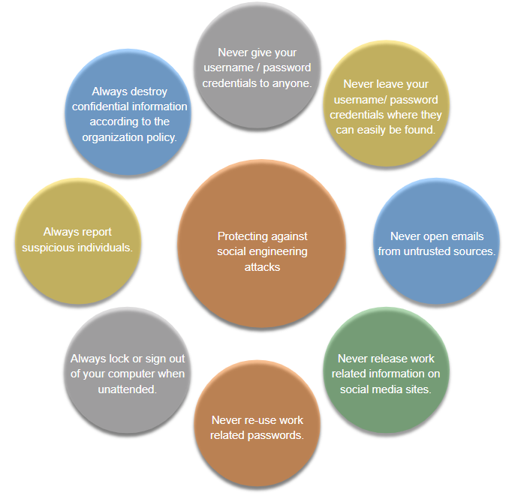
Common Network Attacks Social Engineering Attacks (Cont.)
The Social Engineering Toolkit (SET) was designed to help white hat hackers and other network security professionals create social engineering attacks to test their own networks.
Enterprises must educate their users about the risks of social engineering, and develop strategies to validate identities over the phone, via email, or in person.
The figure shows recommended practices that should be followed by all users.
Notes:
3 – Network Security Concepts
3.5 - Common Network Attacks
3.5.6 - Social Engineering Attacks (Cont.)

Slide 49
Common Network Attacks Lab - Social Engineering
In this lab, you will research examples of social engineering and identify ways to recognize and prevent it.
Notes:
3 – Network Security Concepts
3.5 - Common Network Attacks
3.5.7 - Lab - Social Engineering

Slide 50
Common Network Attacks Video – Denial of Service Attacks
This video will cover the following:
Techniques used in Denial-of-Service attacks (overwhelming quantity of traffic, maliciously formatted packets)
Techniques used in Distributed Denial of Service attacks (zombies)
Notes:
3 – Network Security Concepts
3.5 - Common Network Attacks
3.5.8 – Video – Denial of Service Attacks

Slide 51
Common Network Attacks DoS and DDoS Attacks
A Denial of Service (DoS) attack creates some sort of interruption of network services to users, devices, or applications. There are two major types of DoS attacks:
Overwhelming Quantity of Traffic - The threat actor sends an enormous quantity of data at a rate that the network, host, or application cannot handle. This causes transmission and response times to slow down. It can also crash a device or service.
Maliciously Formatted Packets - The threat actor sends a maliciously formatted packet to a host or application and the receiver is unable to handle it. This causes the receiving device to run very slowly or crash.
DoS attacks are a major risk because they interrupt communication and cause significant loss of time and money. These attacks are relatively simple to conduct, even by an unskilled threat actor.
A Distributed DoS Attack (DDoS) is similar to a DoS attack, but it originates from multiple, coordinated sources.
Notes:
3 – Network Security Concepts
3.5 - Common Network Attacks
3.5.9 - DoS and DDoS Attacks
3.5.10 – Check Your Understanding – Common Network Attacks

Slide 52
3.6 IP Vulnerabilities and Threats
Notes:
3 – Network Security Concepts
3.6 - IP Vulnerabilities and Threats

Slide 53
IP Vulnerabilities and Threats Video – Common IP and ICMP Attacks
This video will cover the following:
Techniques used in IP attacks (ICMP attacks, amplification and reflection attacks, address spoofing attacks, man-in-the-middle attacks, session hijacking)
Techniques used in ICMP attacks (ICMP echo request and echo reply, ICMP unreachable, ICMP mask reply, ICMP redirects, ICMP router discovery)
Notes:
3 – Network Security Concepts
3.6 - IP Vulnerabilities and Threats
3.6.1 - Video – Common IP and ICMP Attacks

Slide 54
IP Vulnerabilities and Threats IPv4 and IPv6
IP does not validate whether the source IP address contained in a packet actually came from that source. For this reason, threat actors can send packets using a spoofed source IP address. Security analysts must understand the different fields in both the IPv4 and IPv6 headers.
Some of the more common IP related attacks are shown in the table
IP Attack Techniques | Description
ICMP attacks | Threat actors use Internet Control Message Protocol (ICMP) echo packets (pings) to discover subnets and hosts on a protected network, to generate DoS flood attacks, and to alter host routing tables.
Amplification and reflection attacks | Threat actors attempt to prevent legitimate users from accessing information or services using DoS and DDoS attacks.
Address spoofing attacks | Threat actors spoof the source IP address in an IP packet to perform blind spoofing or non-blind spoofing.
Man-in-the-middle attack (MITM) | Threat actors position themselves between a source and destination to transparently monitor, capture, and control the communication. They could eavesdrop by inspecting captured packets, or alter packets and forward them to their original destination.
Session hijacking | Threat actors gain access to the physical network, and then use an MITM attack to hijack a session
Notes:
3 – Network Security Concepts
3.6 - IP Vulnerabilities and Threats
3.6.2 - IPv4 and IPv6

Slide 55
IP Vulnerabilities and Threats ICMP Attacks
Threat actors use ICMP for reconnaissance and scanning attacks. They can launch information-gathering attacks to map out a network topology, discover which hosts are active (reachable), identify the host operating system (OS fingerprinting), and determine the state of a firewall. Threat actors also use ICMP for DoS attacks.
Note: ICMP for IPv4 (ICMPv4) and ICMP for IPv6 (ICMPv6) are susceptible to similar types of attacks.
Networks should have strict ICMP access control list (ACL) filtering on the network edge to avoid ICMP probing from the internet. In the case of large networks, security devices such as firewalls and intrusion detection systems (IDS) detect such attacks and generate alerts to the security analysts.
Notes:
3 – Network Security Concepts
3.6 - IP Vulnerabilities and Threats
3.6.3 - ICMP Attacks

Slide 56
IP Vulnerabilities and Threats ICMP Attacks (Cont.)
Common ICMP messages of interest to threat actors are listed in the table.
ICMP Messages used by Hackers | Description
ICMP echo request and echo reply | This is used to perform host verification and DoS attacks.
ICMP unreachable | This is used to perform network reconnaissance and scanning attacks.
ICMP mask reply | This is used to map an internal IP network.
ICMP redirects | This is used to lure a target host into sending all traffic through a compromised device and create a MITM attack.
ICMP router discovery | This is used to inject bogus route entries into the routing table of a target host.
Notes:
3 – Network Security Concepts
3.6 - IP Vulnerabilities and Threats
3.6.3 -ICMP Attacks (Cont.)

Slide 57
IP Vulnerabilities and Threats Video – Amplification, Reflection, and Spoofing Attacks
This video will explain the amplification, reflection, and spoofing attack.
Notes:
3 – Network Security Concepts
3.6 - IP Vulnerabilities and Threats
3.6.4 -Video – Amplification, Reflection, and Spoofing Attacks

Slide 58
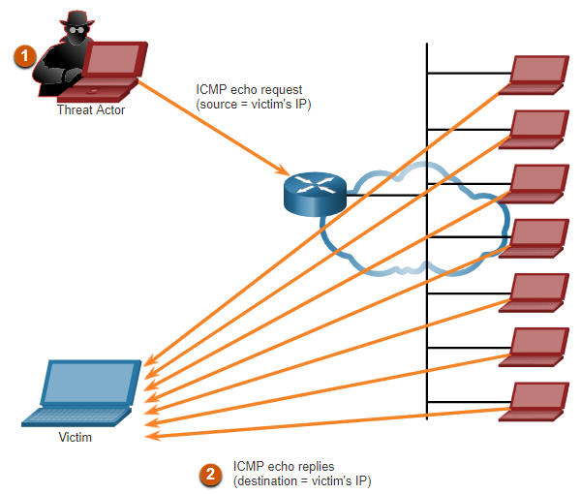
IP Vulnerabilities and Threats Amplification and Reflection Attacks
Threat actors often use amplification and reflection techniques to create DoS attacks. The example in the figure illustrates a Smurf attack is used to overwhelm a target host.
Note: Newer forms of amplification and reflection attacks such as DNS-based reflection and amplification attacks and Network Time Protocol (NTP) amplification attacks are now being used.
Threat actors also use resource exhaustion attacks to either to crash a target host or to consume the resources of a network.
Notes:
3 – Network Security Concepts
3.6 - IP Vulnerabilities and Threats
3.6.5 - Amplification and Reflection Attacks

Slide 59
IP Vulnerabilities and Threats Address Spoofing Attacks
IP address spoofing attacks occur when a threat actor creates packets with false source IP address information to either hide the identity of the sender, or to pose as another legitimate user. Spoofing is usually incorporated into another attack such as a Smurf attack.
Spoofing attacks can be non-blind or blind:
Non-blind spoofing - The threat actor can see the traffic that is being sent between the host and the target. Non-blind spoofing determines the state of a firewall and sequence-number prediction. It can also hijack an authorized session.
Blind spoofing - The threat actor cannot see the traffic that is being sent between the host and the target. Blind spoofing is used in DoS attacks.
MAC address spoofing attacks are used when threat actors have access to the internal network. Threat actors alter the MAC address of their host to match another known MAC address of a target host.
Notes:
3 – Network Security Concepts
3.6 - IP Vulnerabilities and Threats
3.6.6 - Address Spoofing Attacks
3.6.7 – Check Your Understanding – IP Vulnerabilities and Threats

Slide 60
3.7 TCP and UDP Vulnerabilities
Notes:
3 – Network Security Concepts
3.7 – TCP and UDP Vulnerabilities

Slide 61
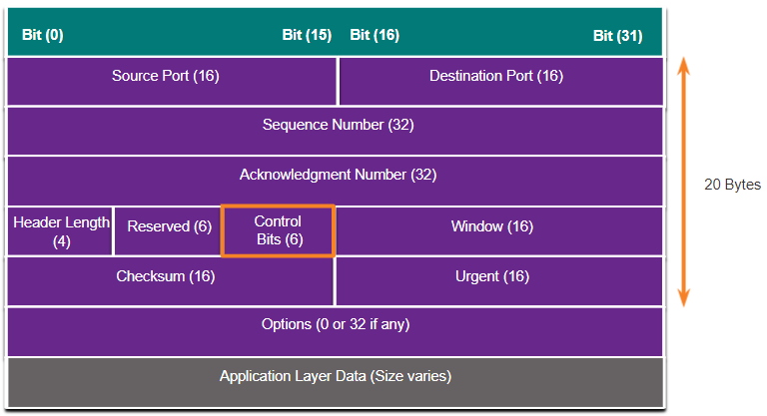
TCP and UDP Vulnerabilities TCP Segment Header
TCP segment information appears immediately after the IP header. The fields of the TCP segment and the flags for the Control Bits field are displayed in the figure.
The following are the six control bits of the TCP segment:
URG - Urgent pointer field significant
ACK - Acknowledgment field significant
PSH - Push function
RST- Reset the connection
SYN - Synchronize sequence numbers
FIN - No more data from sender
Notes:
3 – Network Security Concepts
3.7 – TCP and UDP Vulnerabilities
3.7.1 – TCP Segment Header

Slide 62
TCP and UDP Vulnerabilities TCP Services
TCP provides these services:
Reliable delivery - TCP incorporates acknowledgments to guarantee delivery. If a timely acknowledgment is not received, the sender retransmits the data. Requiring acknowledgments of received data can cause substantial delays. Examples of application layer protocols that make use of TCP reliability include HTTP, SSL/TLS, FTP, DNS zone transfers, and others.
Flow control - TCP implements flow control to address this issue. Rather than acknowledge one segment at a time, multiple segments can be acknowledged with a single acknowledgment segment.
Stateful communication - TCP stateful communication between two parties occurs during the TCP three-way handshake.
Notes:
3 – Network Security Concepts
3.7 – TCP and UDP Vulnerabilities
3.7.2 - TCP Services

Slide 63
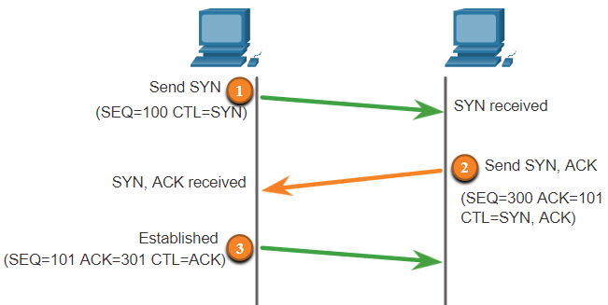
TCP and UDP Vulnerabilities TCP Services (Cont.)
A TCP connection is established in three steps:
The initiating client requests a client-to-server communication session with the server.
The server acknowledges the client-to-server communication session and requests a server-to-client communication session.
The initiating client acknowledges the server-to-client communication session.
Notes:
3 – Network Security Concepts
3.7 – TCP and UDP Vulnerabilities
3.7.2 - TCP Services (Cont.)

Slide 64
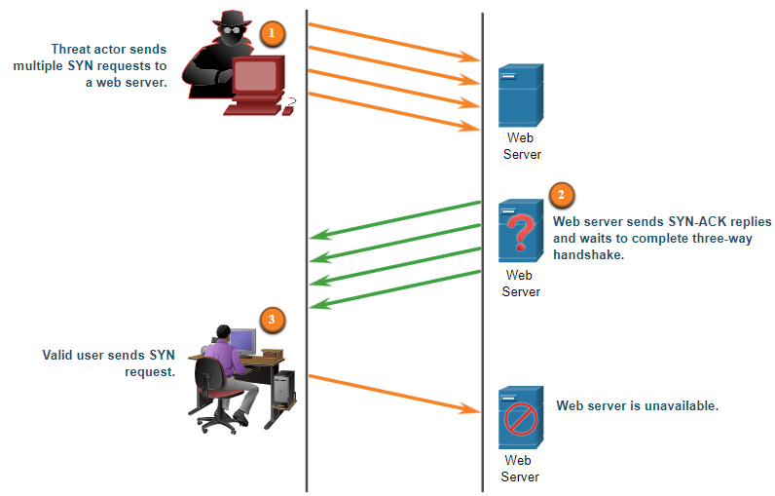
TCP and UDP Vulnerabilities TCP Attacks
TCP SYN Flood Attack
The threat actor sends multiple SYN requests to a webserver.
The web server replies with SYN-ACKs for each SYN request and waits to complete the three-way handshake. The threat actor does not respond to the SYN-ACKs.
A valid user cannot access the web server because the web server has too many half-opened TCP connections.
Notes:
3 – Network Security Concepts
3.7 – TCP and UDP Vulnerabilities
3.7.3 - TCP Attacks

Slide 65
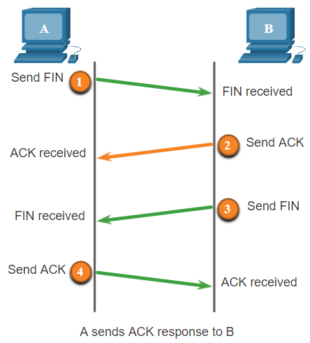
TCP and UDP Vulnerabilities TCP Attacks (Cont.)
Terminating a TCP session uses the following four-way exchange process:
When the client has no more data to send in the stream, it sends a segment with the FIN flag set.
The server sends an ACK to acknowledge the receipt of the FIN to terminate the session from client to server.
The server sends a FIN to the client to terminate the server-to-client session.
The client responds with an ACK to acknowledge the FIN from the server.
A threat actor could do a TCP reset attack and send a spoofed packet containing a TCP RST to one or both endpoints.
Notes:
3 – Network Security Concepts
3.7 – TCP and UDP Vulnerabilities
3.7.3 - TCP Attacks (Cont.)

Slide 66
TCP and UDP Vulnerabilities TCP Attacks (Cont.)
TCP session hijacking is another TCP vulnerability. Although difficult to conduct, a threat actor takes over an already-authenticated host as it communicates with the target. The threat actor must spoof the IP address of one host, predict the next sequence number, and send an ACK to the other host. If successful, the threat actor could send, but not receive, data from the target device.
Notes:
3 – Network Security Concepts
3.7 – TCP and UDP Vulnerabilities
3.7.3 - TCP Attacks (Cont.)

Slide 67
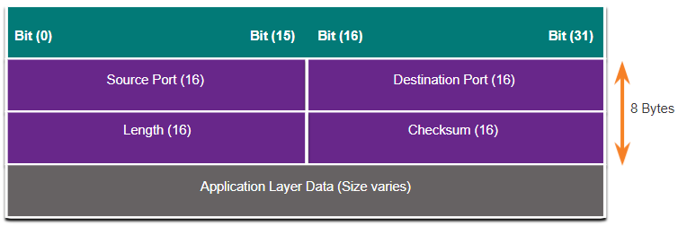
TCP and UDP Vulnerabilities UDP Segment Header and Operation
UDP is commonly used by DNS, TFTP, NFS, and SNMP. It is also used with real-time applications such as media streaming or VoIP. UDP is a connectionless transport layer protocol. It has much lower overhead than TCP because it is not connection-oriented and does not offer the sophisticated retransmission, sequencing, and flow control mechanisms that provide reliability.
These reliability functions are not provided by the transport layer protocol and must be implemented elsewhere if required.
The low overhead of UDP makes it very desirable for protocols that make simple request and reply transactions.
Notes:
3 – Network Security Concepts
3.7 – TCP and UDP Vulnerabilities
3.7.4 - UDP Segment Header and Operation

Slide 68
TCP and UDP Vulnerabilities UDP Attacks
UDP is not protected by any encryption. You can add encryption to UDP, but it is not available by default. The lack of encryption means that anyone can see the traffic, change it, and send it on to its destination.
UDP Flood Attacks: The threat actor uses a tool like UDP Unicorn or Low Orbit Ion Cannon. These tools send a flood of UDP packets, often from a spoofed host, to a server on the subnet. The program will sweep through all the known ports trying to find closed ports. This will cause the server to reply with an ICMP port unreachable message. Because there are many closed ports on the server, this creates a lot of traffic on the segment, which uses up most of the bandwidth. The result is very similar to a DoS attack.
Notes:
3 – Network Security Concepts
3.7 – TCP and UDP Vulnerabilities
3.7.5 - UDP Attacks
3.7.6 – Check Your Understanding – TCP and UDP Vulnerabilities

Slide 69
3.8 IP Services
Notes:
3 – Network Security Concepts
3.8 – IP Services

Slide 70
IP Services ARP Vulnerabilities
Hosts broadcast an ARP Request to other hosts on the segment to determine the MAC address of a host with a particular IP address. The host with the matching IP address in the ARP Request sends an ARP Reply.
Any client can send an unsolicited ARP Reply called a “gratuitous ARP.” When a host sends a gratuitous ARP, other hosts on the subnet store the MAC address and IP address contained in the gratuitous ARP in their ARP tables.
This feature of ARP also means that any host can claim to be the owner of any IP or MAC. A threat actor can poison the ARP cache of devices on the local network, creating an MITM attack to redirect traffic.
Notes:
3 – Network Security Concepts
3.8 – IP Services
3.8.1 – ARP Vulnerabilities

Slide 71
IP Services ARP Cache Poisoning
ARP cache poisoning can be used to launch various man-in-the-middle attacks.
PC-A requires the MAC address of its default gateway (R1); therefore, it sends an ARP Request for the MAC address of 192.168.10.1.
R1 updates its ARP cache with the IP and MAC addresses of PC-A. R1 sends an ARP Reply to PC-A, which then updates its ARP cache with the IP and MAC addresses of R1.
The threat actor sends two spoofed gratuitous ARP Replies using its own MAC address for the indicated destination IP addresses. PC-A updates its ARP cache with its default gateway which is now pointing to the threat actor’s host MAC address. R1 also updates its ARP cache with the IP address of PC-A pointing to the threat actor’s MAC address.
The ARP poisoning attack can be passive or active. Passive ARP poisoning is where threat actors steal confidential information. Active ARP poisoning is where threat actors modify data in transit or inject malicious data.
Notes:
3 – Network Security Concepts
3.8 – IP Services
3.8.2 – ARP Cache Poisoning

Slide 72
IP Services Video – ARP Spoofing
This video will explain an ARP spoofing attack.
Notes:
3 – Network Security Concepts
3.8 – IP Services
3.8.3 – Video – ARP Spoofing

Slide 73
IP Services DNS Attacks
The Domain Name Service (DNS) protocol defines an automated service that matches resource names, such as www.cisco.com, with the required numeric network address, such as the IPv4 or IPv6 address. It includes the format for queries, responses, and data and uses resource records (RR) to identify the type of DNS response.
Securing DNS is often overlooked. However, it is crucial to the operation of a network and should be secured accordingly.
DNS attacks include the following:
DNS open resolver attacks
DNS stealth attacks
DNS domain shadowing attacks
DNS tunneling attacks
Notes:
3 – Network Security Concepts
3.8 – IP Services
3.8.4 – DNS Attacks

Slide 74
IP Services DNS Attacks (Cont.)
DNS Open Resolver Attacks: A DNS open resolver answers queries from clients outside of its administrative domain. DNS open resolvers are vulnerable to multiple malicious activities described in the table.
DNS Resolver Vulnerabilities | Description
DNS cache poisoning attacks | Threat actors send spoofed, falsified record resource (RR) information to a DNS resolver to redirect users from legitimate sites to malicious sites. DNS cache poisoning attacks can all be used to inform the DNS resolver to use a malicious name server that is providing RR information for malicious activities.
DNS amplification and reflection attacks | Threat actors use DoS or DDoS attacks on DNS open resolvers to increase the volume of attacks and to hide the true source of an attack. Threat actors send DNS messages to the open resolvers using the IP address of a target host. These attacks are possible because the open resolver will respond to queries from anyone asking a question.
DNS resource utilization attacks | A DoS attack that consumes the resources of the DNS open resolvers. This DoS attack consumes all the available resources to negatively affect the operations of the DNS open resolver. The impact of this DoS attack may require the DNS open resolver to be rebooted or services to be stopped and restarted.
Notes:
3 – Network Security Concepts
3.8 – IP Services
3.8.4 – DNS Attacks (Cont.)

Slide 75
IP Services DNS Attacks (Cont.)
DNS Stealth Attacks: To hide their identity, threat actors also use the DNS stealth techniques described in the table to carry out their attacks.
DNS Stealth Techniques | Description
Fast Flux | Threat actors use this technique to hide their phishing and malware delivery sites behind a quickly-changing network of compromised DNS hosts. The DNS IP addresses are continuously changed within minutes. Botnets often employ Fast Flux techniques to effectively hide malicious servers from being detected.
Double IP Flux | Threat actors use this technique to rapidly change the hostname to IP address mappings and to also change the authoritative name server. This increases the difficulty of identifying the source of the attack.
Domain Generation Algorithms | Threat actors use this technique in malware to randomly generate domain names that can then be used as rendezvous points to their command and control (C&C) servers.
Notes:
3 – Network Security Concepts
3.8 – IP Services
3.8.4 – DNS Attacks (Cont.)

Slide 76
IP Services DNS Attacks (Cont.)
DNS Domain Shadowing Attacks: Domain shadowing involves the threat actor gathering domain account credentials in order to silently create multiple sub-domains to be used during the attacks. These subdomains typically point to malicious servers without alerting the actual owner of the parent domain.
Notes:
3 – Network Security Concepts
3.8 – IP Services
3.8.4 – DNS Attacks (Cont.)

Slide 77
IP Services DNS Tunneling
Threat actors who use DNS tunneling place non-DNS traffic within DNS traffic. This method often circumvents security solutions when a threat actor wishes to communicate with bots inside a protected network, or exfiltrate data from the organization. This is how DNS tunneling works for CnC commands sent to a botnet:
The command data is split into multiple encoded chunks.
Each chunk is placed into a lower level domain name label of the DNS query.
Because there is no response from the local or networked DNS for the query, the request is sent to the ISP’s recursive DNS servers.
The recursive DNS service will forward the query to the threat actor’s authoritative name server.
The process is repeated until all the queries containing the chunks of are sent.
When the threat actor’s authoritative name server receives the DNS queries from the infected devices, it sends responses for each DNS query, which contain the encapsulated, encoded CnC commands.
The malware on the compromised host recombines the chunks and executes the commands hidden within the DNS record.
To stop DNS tunneling, the network administrator must use a filter that inspects DNS traffic. Pay close attention to DNS queries that are longer than average, or those that have a suspicious domain name..
Notes:
3 – Network Security Concepts
3.8 – IP Services
3.8.5 – DNS Tunneling

Slide 78
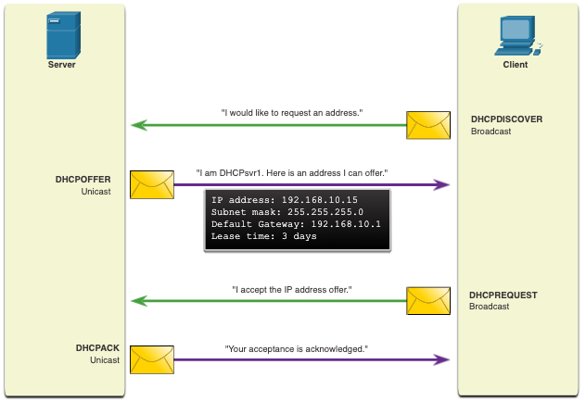
IP Services DHCP
DHCP servers dynamically provide IP configuration information to clients.
In the figure, a client broadcasts a DHCP discover message. The DHCP responds with a unicast offer that includes addressing information the client can use. The client broadcasts a DHCP request to tell the server that the client accepts the offer. The server responds with a unicast acknowledgment accepting the request.
Notes:
3 – Network Security Concepts
3.8 – IP Services
3.8.6 – DHCP

Slide 79
IP Services DHCP Attacks
A DHCP spoofing attack occurs when a rogue DHCP server is connected to the network and provides false IP configuration parameters to legitimate clients. A rogue server can provide a variety of misleading information:
Wrong default gateway - Threat actor provides an invalid gateway, or the IP address of its host to create a MITM attack. This may go entirely undetected as the intruder intercepts the data flow through the network.
Wrong DNS server - Threat actor provides an incorrect DNS server address pointing the user to a malicious website.
Wrong IP address - Threat actor provides an invalid IP address, invalid default gateway IP address, or both. The threat actor then creates a DoS attack on the DHCP client.
Notes:
3 – Network Security Concepts
3.8 – IP Services
3.8.7 – DHCP Attacks

Slide 80
IP Services DHCP Attacks (Cont.)
Assume a threat actor has successfully connected a rogue DHCP server to a switch port on the same subnet as the target clients. The goal of the rogue server is to provide clients with false IP configuration information.
The client broadcasts a DHCP Discover request looking for a response from a DHCP server. Both servers receive the message.
The legitimate and rogue DHCP servers each respond with valid IP configuration parameters. The client replies to the first offer received
The client received the rogue offer first. It broadcasts a DHCP request accepting the parameters from the rogue server. The legitimate and rogue server each receive the request.
Only the rogue server unicasts a reply to the client to acknowledge its request. The legitimate server stops communicating with the client because the request has already been acknowledged.
Notes:
3 – Network Security Concepts
3.8 – IP Services
3.8.7 – DHCP Attacks (Cont.)

Slide 81
IP Services Lab – Explore DNS Traffic
In this lab, you will complete the following objectives:
Capture DNS Traffic
Explore DNS Query Traffic
Explore DNS Response Traffic
Notes:
3 – Network Security Concepts
3.8 – IP Services
3.8.8 - Lab – Explore DNS Traffic

Slide 82
3.9 Network Security Best Practices
Notes:
3 – Network Security Concepts
3.9 – Network Security Best Practices

Slide 83
Network Security Best Practices Confidentiality, Availability, and Integrity
Network security consists of protecting information and information systems from unauthorized access, use, disclosure, disruption, modification, or destruction.
Most organizations follow the CIA information security triad:
Confidentiality - Only authorized individuals, entities, or processes can access sensitive information. It may require using cryptographic encryption algorithms such as AES to encrypt and decrypt data.
Integrity - Refers to protecting data from unauthorized alteration. It requires the use of cryptographic hashing algorithms such as SHA.
Availability - Authorized users must have uninterrupted access to important resources and data. It requires implementing redundant services, gateways, and links.
Notes:
3 – Network Security Concepts
3.9 – Network Security Best Practices
3.9.1 - Confidentiality, Availability, and Integrity

Slide 84
Network Security Best Practices The Defense-in-Depth Approach
To ensure secure communications across both public and private networks, you must secure devices including routers, switches, servers, and hosts. Most organizations employ a defense-in-depth approach to security. It requires a combination of networking devices and services working together.
Several security devices and services are implemented.
VPN
ASA Firewall
IPS
ESA/WSA
AAA Server
All network devices including the router and switches are hardened.
You must also secure data as it travels across various links.
Notes:
3 – Network Security Concepts
3.9 – Network Security Best Practices
3.9.2 – The Defense-in-Depth Approach

Slide 85
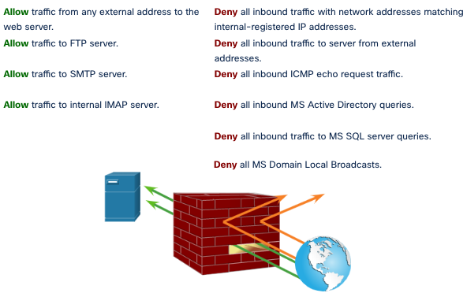
Network Security Best Practices Firewalls
A firewall is a system, or group of systems, that enforces an access control policy between networks.
Notes:
3 – Network Security Concepts
3.9 – Network Security Best Practices
3.9.3 - Firewalls

Slide 86
Network Security Best Practices IPS
To defend against fast-moving and evolving attacks, you may need cost-effective detection and prevention systems integrated into the entry and exit points of the network.
IDS and IPS technologies share several characteristics. IDS and IPS technologies are both deployed as sensors. An IDS or IPS sensor can be in the form of several different devices:
A router configured with Cisco IOS IPS software
A device specifically designed to provide dedicated IDS or IPS services
A network module installed in an adaptive security appliance (ASA), switch, or router
IDS and IPS technologies detect patterns in network traffic using signatures, which is a set of rules that used to detect malicious activity. IDS and IPS technologies can detect atomic signature patterns (single-packet) or composite signature patterns (multi-packet).
Notes:
3 – Network Security Concepts
3.9 – Network Security Best Practices
3.9.4 - IPS

Slide 87
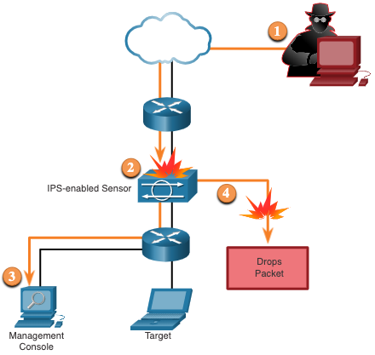
Network Security Best Practices IPS (Cont.)
The figure shows how an IPS handles denied traffic.
The threat actor sends a packet destined for the target laptop.
The IPS intercepts the traffic and evaluates it against known threats and the configured policies.
The IPS sends a log message to the management console.
The IPS drops the packet.
Notes:
3 – Network Security Concepts
3.9 – Network Security Best Practices
3.9.4 – IPS (Cont.)

Slide 88
Network Security Best Practices Content Security Devices
The Cisco Email Security Appliance (ESA) is a special device designed to monitor Simple Mail Transfer Protocol (SMTP). The Cisco ESA is constantly updated by real-time feeds from the Cisco Talos. This threat intelligence data is pulled by the Cisco ESA every three to five minutes.
The Cisco Web Security Appliance (WSA) is a mitigation technology for web-based threats. The Cisco WSA combines advanced malware protection, application visibility and control, acceptable use policy controls, and reporting.
Cisco WSA provides complete control over how users access the internet. The WSA can perform blacklisting of URLs, URL-filtering, malware scanning, URL categorization, web application filtering, and encryption and decryption of web traffic.
Notes:
3 – Network Security Concepts
3.9 – Network Security Best Practices
3.9.5 – Content Security Devices
3.9.6 – Check Your Understanding – Network Security Best Practices

Slide 89
3.10 Cryptography
Notes:
3 – Network Security Concepts
3.10 - Cryptography

Slide 90
Cryptography Video - Cryptography
This video will demonstrate security data using hashing and encryption.
Notes:
3 – Network Security Concepts
3.10 – Cryptography
3.10.1 - Video - Cryptography

Slide 91
Cryptography Securing Communications
Organizations must provide support to secure the data as it travels across links. This may include internal traffic, but it is even more important to protect the data that travels outside of the organization.
These are the four elements of secure communications:
Data Integrity - Guarantees that the message was not altered. Integrity is ensured by implementing either Message Digest version 5 (MD5) or Secure Hash Algorithm (SHA) hash-generating algorithms.
Origin Authentication - Guarantees that the message is not a forgery and does come from whom it states. Many modern networks ensure authentication with protocols, such as hash message authentication code (HMAC).
Data Confidentiality - Guarantees that only authorized users can read the message. Data confidentiality is implemented using symmetric and asymmetric encryption algorithms.
Data Non-Repudiation - Guarantees that the sender cannot repudiate, or refute, the validity of a message sent. Nonrepudiation relies on the fact that only the sender has the unique characteristics or signature for how that message is treated.
Cryptography can be used almost anywhere that there is data communication. In fact, the trend is toward all communication being encrypted.
Notes:
3 – Network Security Concepts
3.10 – Cryptography
3.10.2 – Securing Communications

Slide 92
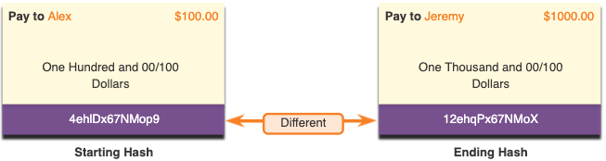
Cryptography Data Integrity
Hash functions are used to ensure the integrity of a message. They guarantee that message data has not changed accidentally or intentionally.
In the figure, the sender is sending a $100 money transfer to Alex. The sender wants to ensure that the message is not altered on its way to the receiver.
The sending device inputs the message into a hashing algorithm and computes its fixed-length hash of 4ehiDx67NMop9.
This hash is then attached to the message and sent to the receiver. Both the message and the hash are in plaintext.
The receiving device removes the hash from the message and inputs the message into the same hashing algorithm. If the computed hash is equal to the one that is attached to the message, the message has not been altered during transit. If the hashes are not equal, then the integrity of the message can no longer be trusted.
Notes:
3 – Network Security Concepts
3.10 – Cryptography
3.10.3 – Data Integrity

Slide 93
Cryptography Hash Functions
There are three well-known hash functions.
MD5 with 128-bit Digest: MD5 is a one-way function that produces a 128-bit hashed message. MD5 is a legacy algorithm that should only be used when no better alternatives are available. Use SHA-2 instead.
SHA Hashing Algorithm: SHA-1 is very similar to the MD5 hash functions. SHA-1 creates a 160-bit hashed message and is slightly slower than MD5. SHA-1 has known flaws and is a legacy algorithm. Use SHA-2 when possible.
SHA-2: This includes SHA-224 (224 bit), SHA-256 (256 bit), SHA-384 (384 bit), and SHA-512 (512 bit). SHA-256, SHA-384, and SHA-512 are next-generation algorithms and should be used whenever possible.
While hashing can be used to detect accidental changes, it cannot be used to guard against deliberate changes. This means that anyone can compute a hash for any data, if they have the correct hash function.
Therefore, hashing is vulnerable to man-in-the-middle attacks and does not provide security to transmitted data.
Notes:
3 – Network Security Concepts
3.10 – Cryptography
3.10.4 – Hash Functions

Slide 94
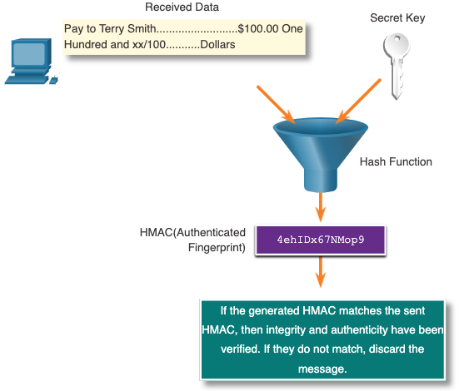
Cryptography Origin Authentication
To add authentication to integrity assurance, use a keyed-hash message authentication code (HMAC).
An HMAC is calculated using any cryptographic algorithm that combines a cryptographic hash function with a secret key.
Only parties who have access to that secret key can compute the digest of an HMAC function. This defeats man-in-the-middle attacks and provides authentication of the data origin.
Notes:
3 – Network Security Concepts
3.10 – Cryptography
3.10.5 – Origin Authentication

Slide 95
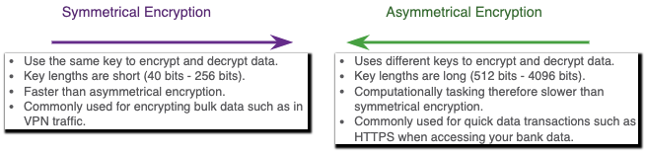
Cryptography Data Confidentiality
There are two classes of encryption used to provide data confidentiality. These two classes differ in how they use keys.
Symmetric encryption algorithms such as (DES), 3DES, and Advanced Encryption Standard (AES) are based on the premise that each communicating party knows the pre-shared key. Data confidentiality can also be ensured using asymmetric algorithms, including Rivest, Shamir, and Adleman (RSA) and the public key infrastructure (PKI).
The figure highlights some differences between each encryption algorithm method.
Notes:
3 – Network Security Concepts
3.10 – Cryptography
3.10.6 – Data Confidentiality

Slide 96
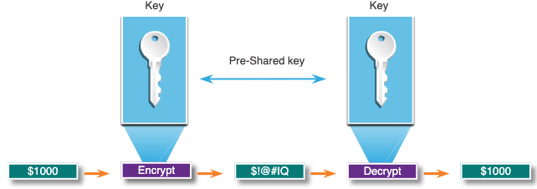
Cryptography Symmetric Encryption
Symmetric algorithms use the same pre-shared key, also called a secret key, to encrypt and decrypt data. A pre-shared key is known by the sender and receiver before any encrypted communications can take place.
Symmetric encryption algorithms are commonly used with VPN traffic because they use less CPU resources than asymmetric encryption algorithms.
When using symmetric encryption algorithms, the longer the key, the longer it will take for someone to discover the key. To ensure that the encryption is safe, use a minimum key length of 128 bits.
Notes:
3 – Network Security Concepts
3.10 – Cryptography
3.10.7 – Symmetric Encryption

Slide 97
Cryptography Symmetric Encryption (Cont.)
Symmetric Encryption Algorithms | Description
Data Encryption Algorithm (DES) | This is a legacy symmetric encryption algorithm. It can be used in stream cipher mode but usually operates in block mode by encrypting data in 64-bit block size. A stream cipher encrypts one byte or one bit at a time.
3DES (Triple DES) | This is a newer version of DES, but it repeats the DES algorithm process three times. It is considered very trustworthy when implemented using very short key lifetimes.
Advanced Encryption Standard (AES) | AES is a secure and more efficient algorithm than 3DES. It is a popular and recommended symmetric encryption algorithm. It offers nine combinations of key and block length by using a variable key length of 128-, 192-, or 256-bit key to encrypt data blocks that are 128, 192, or 256 bits long.
Software-Optimized Encryption Algorithm (SEAL) | SEAL is a faster alternative symmetric encryption algorithm to DES, 3DES, and AES. It uses a 160-bit encryption key and has a lower impact on the CPU compared to other software-based algorithms.
Rivest ciphers (RC) series algorithms | This algorithm was developed by Ron Rivest. Several variations have been developed, but RC4 is the most prevalent in use. RC4 is a stream cipher and is used to secure web traffic in SSL and TLS.
Notes:
3 – Network Security Concepts
3.10 – Cryptography
3.10.7 – Symmetric Encryption (Cont.)

Slide 98
Cryptography Asymmetric Encryption
Asymmetric algorithms, also called public-key algorithms, are designed so that the key that is used for encryption is different from the key that is used for decryption.
Asymmetric algorithms use a public key and a private key. The complementary paired key is required for decryption. Data encrypted with the public key requires the private key to decrypt. Asymmetric algorithms achieve confidentiality, authentication, and integrity by using this process.
Because neither party has a shared secret, very long key lengths must be used. Asymmetric encryption can use key lengths between 512 to 4,096 bits. Key lengths greater than or equal to 1,024 bits can be trusted while shorter key lengths are considered unreliable.
Notes:
3 – Network Security Concepts
3.10 – Cryptography
3.10.8 – Asymmetric Encryption

Slide 99
Cryptography Asymmetric Encryption (Cont.)
Examples of protocols that use asymmetric key algorithms include:
Internet Key Exchange (IKE) - This is a fundamental component of IPsec VPNs.
Secure Socket Layer (SSL) - This is now implemented as IETF standard Transport Layer Security (TLS).
Secure Shell (SSH) - This protocol provides a secure remote access connection to network devices.
Pretty Good Privacy (PGP) - This computer program provides cryptographic privacy and authentication. It is often used to increase the security of email communications.
Asymmetric algorithms are substantially slower than symmetric algorithms. Their design is based on computational problems, such as factoring extremely large numbers or computing discrete logarithms of extremely large numbers.
Because they are slow, asymmetric algorithms are typically used in low-volume cryptographic mechanisms, such as digital signatures and key exchange.
Notes:
3 – Network Security Concepts
3.10 – Cryptography
3.10.8 – Asymmetric Encryption (Cont.)

Slide 100
Cryptography Asymmetric Encryption (Cont.)
Asymmetric Encryption Algorithm | Key Length | Description
Diffie-Hellman (DH) | 512, 1024, 2048, 3072, 4096 | The Diffie-Hellman algorithm allows two parties to agree on a key that they can use to encrypt messages they want to send to each other. The security of this algorithm depends on the assumption that it is easy to raise a number to a certain power, but difficult to compute which power was used given the number and the outcome.
Digital Signature Standard (DSS) and Digital Signature Algorithm (DSA) | 512 - 1024 | DSS specifies DSA as the algorithm for digital signatures. DSA is a public key algorithm based on the ElGamal signature scheme. Signature creation speed is similar to RSA but is 10 to 40 times slower for verification.
Rivest, Shamir, and Adleman encryption algorithms (RSA) | 512 to 2048 | RSA is for public-key cryptography that is based on the current difficulty of factoring very large numbers. It is the first algorithm known to be suitable for signing as well as encryption. It is widely used in electronic commerce protocols and is believed to be secure given sufficiently long keys and the use of up-to-date implementations.
EIGamal | 512 - 1024 | An asymmetric key encryption algorithm for public-key cryptography which is based on the Diffie-Hellman key agreement. A disadvantage of the ElGamal system is that the encrypted message becomes very big, about twice the size of the original message and for this reason it is only used for small messages such as secret keys.
Elliptical curve techniques | 160 | Elliptic curve cryptography can be used to adapt many cryptographic algorithms, such as Diffie-Hellman or ElGamal. The main advantage of elliptic curve cryptography is that the keys can be much smaller.
Notes:
3 – Network Security Concepts
3.10 – Cryptography
3.10.8 – Asymmetric Encryption (Cont.)

Slide 101
Cryptography Diffie-Hellman
Diffie-Hellman (DH) is an asymmetric mathematical algorithm where two computers generate an identical shared secret key without having communicated before. The new shared key is never actually exchanged between the sender and receiver.
Here are three examples of instances when DH is commonly used:
Data is exchanged using an IPsec VPN.
Data is encrypted on the internet using either SSL or TLS.
SSH data is exchanged.
DH security uses unbelievably large numbers in its calculations.
Unfortunately, asymmetric key systems are extremely slow for any sort of bulk encryption. Therefore, it is common to encrypt the bulk of the traffic using a symmetric algorithm, such as 3DES or AES and then use the DH algorithm to create keys that will be used by the encryption algorithm.
Notes:
3 – Network Security Concepts
3.10 – Cryptography
3.10.9 – Diffie-Hellman

Slide 102
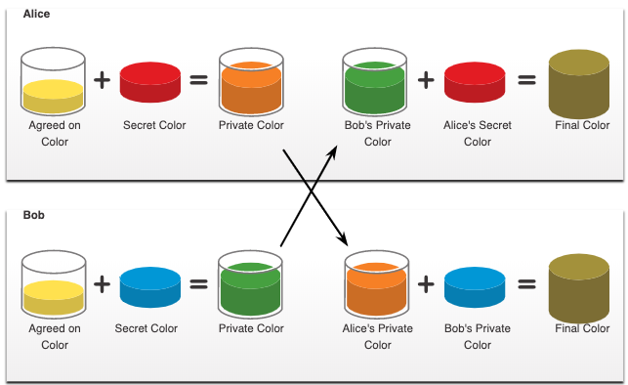
Cryptography Diffie-Hellman (Cont.)
The colors in the figure will be used instead of numbers to simplify the DH key agreement process. The DH key exchange begins with Alice and Bob agreeing on an arbitrary common color that does not need to be kept secret. The agreed upon color in our example is yellow.
Next, Alice and Bob will each select a secret color. Alice chose red while Bob chose blue. These secret colors will never be shared with anyone. The secret color represents the chosen secret private key of each party.
Alice and Bob now mix the shared common color (yellow) with their respective secret color to produce a private color. Therefore, Alice will mix the yellow with her red color to produce a private color of orange. Bob will mix the yellow and the blue to produce a private color of green.
Alice sends her private color (orange) to Bob and Bob sends his private color (green) to Alice.
Alice and Bob each mix the color they received with their own, original secret color (Red for Alice and blue for Bob.). The result is a final brown color mixture that is identical to the other’s final color mixture. The brown color represents the resulting shared secret key between Bob and Alice.
Notes:
3 – Network Security Concepts
3.10 – Cryptography
3.10.9 – Diffie-Hellman (Cont.)
3.10.10 – Check Your Understanding - Cryptography

Slide 103
3.11 Module Practice and Quiz
Notes:
3 – Network Security Concepts
3.11 - Module Practice and Quiz

Slide 104
Module Practice and Quiz Packet Tracer – Network Security Scenario – Physical Mode
In this Packet Tracer Physical Mode activity, you will complete the following objectives:
Part 1: Explore the Networks
Part 2: Implement Security Measures
Notes:
3 – Network Security Concepts
3.11 - Module Practice and Quiz
3.11.1– PTPM- Network Security Scenario

Slide 105
Module Practice and Quiz What Did I Learn In This Module?
Network security breaches can disrupt e-commerce, cause the loss of business data, threaten people’s privacy, and compromise the integrity of information.
Vulnerabilities must be addressed before they become a threat and are exploited. Mitigation techniques are required before, during, and after an attack.
An attack vector is a path by which a threat actor can gain access to a server, host, or network. Attack vectors originate from inside or outside the corporate network.
The term ‘threat actor’ includes hackers and any device, person, group, or nation state that is, intentionally or unintentionally, the source of an attack.
Attack tools have become more sophisticated and highly automated. These new tools require less technical knowledge to implement.
Common types of attacks are: eavesdropping, data modification, IP address spoofing, password-based, denial-of-service, man-in-the-middle, compromised-key, and sniffer.
The three most common types of malware are worms, viruses, and Trojan horses.
Networks are susceptible to the following types of attacks: reconnaissance, access, and DoS.
Types of access attacks are: password, spoofing, trust exploitations, port redirections, man-in-the-middle, and buffer overflow.
IP attack techniques include: ICMP, amplification and reflection, address spoofing, MITM, and session hijacking.
Notes:
3 – Network Security Concepts
3.11 - Module Practice and Quiz
3.11.2 – What Did I Learn In This Module?
3.11.3 – Module Quiz – Network Security Concepts

Slide 106
Module Practice and Quiz What Did I Learn In This Module?
Threat actors use ICMP for reconnaissance and scanning attacks. They launch information-gathering attacks to map out a network topology, discover which hosts are active (reachable), identify the host operating system (OS fingerprinting), and determine the state of a firewall. Threat actors often use amplification and reflection techniques to create DoS attacks.
TCP attacks include: TCPSYN Flood attack, TCP reset attack, and TCP Session hijacking. UDP Flood attacks send a flood of UDP packets, often from a spoofed host, to a server on the subnet. The result is very similar to a DoS attack.
Any client can send an unsolicited ARP Reply called a “gratuitous ARP.” This mean that any host can claim to be the owner of any IP or MAC. A threat actor can poison the ARP cache of devices on the local network, creating an MITM attack to redirect traffic.
DNS attacks include: open resolver attacks, stealth attacks, domain shadowing attacks, and tunneling attacks. To stop DNS tunneling, the network administrator must use a filter that inspects DNS traffic.
A DHCP spoofing attack occurs when a rogue DHCP server is connected to the network and provides false IP configuration parameters to legitimate clients.
Most organizations follow the CIA information security triad: confidentiality, integrity, and availability.
To ensure secure communications across both public and private networks, you must secure devices including routers, switches, servers, and hosts. This is known as defense-in-depth.
Notes:
3 – Network Security Concepts
3.11 - Module Practice and Quiz
3.11.2 – What Did I Learn In This Module?
3.11.3 – Module Quiz – Network Security Concepts

Slide 107
Module Practice and Quiz What Did I Learn In This Module?
A firewall is a system, or group of systems, that enforces an access control policy between networks.
To defend against fast-moving and evolving attacks, you may need an intrusion detection systems (IDS), or the more scalable intrusion prevention systems (IPS).
The four elements of secure communications are data integrity, origin authentication, data confidentiality, and data non-repudiation.
Hash functions guarantee that message data has not changed accidentally or intentionally.
Three well-known hash functions are MD5 with 128-bit digest, SHA hashing algorithm, and SHA-2.
To add authentication to integrity assurance, use a keyed-hash message authentication code (HMAC). HMAC is calculated using any cryptographic algorithm that combines a cryptographic hash function with a secret key.
Symmetric encryption algorithms using DES, 3DES, AES, SEAL, and RC are based on the premise that each communicating party knows the pre-shared key.
Data confidentiality can also be ensured using asymmetric algorithms, including Rivest, Shamir, and Adleman (RSA) and the public key infrastructure (PKI). Diffie-Hellman (DH) is an asymmetric mathematical algorithm where two computers generate an identical shared secret key without having communicated before.
Notes:
3 – Network Security Concepts
3.11 - Module Practice and Quiz
3.11.2 – What Did I Learn In This Module?
3.11.3 – Module Quiz – Network Security Concepts

Slide 108
Module 3: Network Security Concepts New Terms and Commands
Assets
Vulnerability
Threat
Exploit
Mitigation
Risk
Attack Vector
Denial of Service (DoS)
Distributed Denial of Service (DDoS)
Threat Actor
White Hat Hacker
Gray Hat Hacker
Black Hat Hacker
Vulnerability Broker
Hacktivist
Cyber Criminal
Rootkit
Fuzzer
Adware
Ransomware
Spyware
Phishing
Spear Phishing
Something for Something
Baiting
Tailgaiting
Shoulder Surfing
Dumpster Diving
Amplification Attacks
Redirection Attacks
SMURF Attack
Non-blind spoofing
Blind spoofing
TCP SYN Flood
TCP Reset Attack
TCP Session Hijacking

Slide 109
Module 3: Network Security Concepts New Terms and Commands
UDP Flooding
Gratuitous ARP
ARP Cache Poisoning
DNS Cache Poisoning
Fast Flux
Double IP Flux
DNS Tunneling
DHCP Spoofing
Confidentiality, Integrity, Availability (CIA)
Intrusion Prevention System (IPS
Intrusion Detection System (IDS)
IDS/IPS Signature
Hash Algorithms
Keyed-Hash Message Authentication Code (HMAC)
Symmetric Encryption
Asymmetric Encryption
Public Key
Diffie-Hellman
DES
3DES
Advanced Encryption Standard (AES)
Software-Optimize Encryption Algorithm (SEAL)
Rivest Ciphers (RC)
Digital Signature Standard (DSS)
Digital Signature Algorithm (DSA)
Rivest, Shamir, and Adleman encryption (RSA)
ElGamal
Elliptical Curve Cryptography

