Slide 1
Module 5: ACLs for IPv4 Configuration
Instructor Materials
Enterprise Networking, Security, and Automation v7.0 (ENSA)
Notes:
Cisco Networking Academy Program
Enterprise Networking, Security, and Automation v7.0 (ENSA)
Module 5: ACLs for IPv4 Configuration

Slide 2
Instructor Materials – Module 5 Planning Guide
This PowerPoint deck is divided in two parts:
Instructor Planning Guide
Information to help you become familiar with the module
Teaching aids
Instructor Class Presentation
Optional slides that you can use in the classroom
Begins on slide # 11
Note: Remove the Planning Guide from this presentation before sharing with anyone.
For additional help and resources go to the Instructor Home Page and Course Resources for this course. You also can visit the professional development site on netacad.com, the official Cisco Networking Academy Facebook page, or Instructor Only FB group.
Notes:
2

Slide 3
What to Expect in this Module
To facilitate learning, the following features within the GUI may be included in this module:
Feature | Description
Animations | Expose learners to new skills and concepts.
Videos | Expose learners to new skills and concepts.
Check Your Understanding(CYU) | Per topic online quiz to help learners gauge content understanding.
Interactive Activities | A variety of formats to help learners gauge content understanding.
Syntax Checker | Small simulations that expose learners to Cisco command line to practice configuration skills.
PT Activity | Simulation and modeling activities designed to explore, acquire, reinforce, and expand skills.

Slide 4
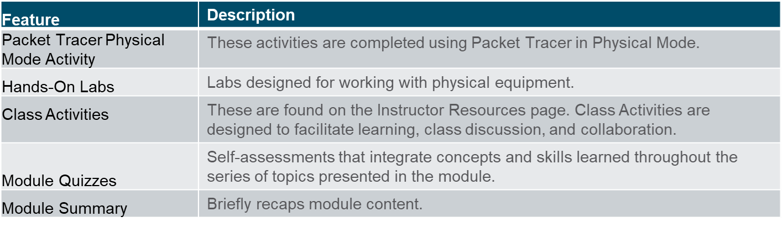
What to Expect in this Module (Cont.)
To facilitate learning, the following features may be included in this module:

Slide 5
Check Your Understanding
Check Your Understanding activities are designed to let students quickly determine if they understand the content and can proceed, or if they need to review.
Check Your Understanding activities do not affect student grades.
There are no separate slides for these activities in the PPT. They are listed in the notes area of the slide that appears before these activities.
Notes:
5

Slide 6
Packet Tracer Physical Mode Activities
These activities are completed using Packet Tracer in Physical Mode.
They are designed to emulate the corresponding Labs.
They can be used instead of the lab when access to physical equipment is not possible.
Packet Tracer Physical Mode activities may not have as much scaffolding as the PT activities that immediately precede them.
Notes:
6

Slide 7
Module 5: Activities
What activities are associated with this module?
Page # | Activity Type | Activity Name | Optional?
5.1.7 | Syntax Checker | Configure Standard IPv4 ACLs | Recommended
5.1.8 | Packet Tracer | Configure Numbered Standard IPv4 ACLs | Recommended
5.1.9 | Packet Tracer | Configure Named Standard IPv4 ACLs | Recommended
5.2.6 | Syntax Checker | Modify IPv4 ACLs | Recommended
5.2.7 | Packet Tracer | Configure and Modify Standard IPv4 ACLs | Recommended
5.3.4 | Syntax Checker | Secure the VTY Ports | Recommended
5.4.12 | Packet Tracer | Configure Extended IPv4 ACLs – Scenario 1 | Recommended
5.4.13 | Packet Tracer | Configure Extended IPv4 ACLs – Scenario 2 | Recommended
Notes:
7

Slide 8
Module 4: Activities (Cont.)
What activities are associated with this module?
Page # | Activity Type | Activity Name | Optional?
5.5.1 | Packet Tracer | IPv4 ACL Implementation Challenge | Recommended
5.5.2 | Packet Tracer Physical Mode | Packet Tracer - Configure and Verify Extended ACLs - Physical Mode | Recommended
5.5.2 | Lab | Configure and Verify Extended IPv4 ACLs | Recommended
5.5.4 | Module Quiz | ACLs for IPv4 Configuration | Recommended
Notes:
8

Slide 9
Module 5: Best Practices
Prior to teaching Module 5, the instructor should:
Review the activities and assessments for this module.
Try to include as many questions as possible to keep students engaged during classroom presentation.
After this Module, the Network Security Exam is available, covering Modules 3-5
Topic 5.1
Ask the students or have a class discussion
Give the students a scenario to permit or deny traffic on a network and have them write out an ACL in a text editor.
Have a class discussion on when to use a standard ACL.
Notes:
9

Slide 10
Module 5: Best Practices (Cont.)
Topic 5.2
Ask the students or have a class discussion
Have a class discussion on when a text editor or sequence numbers are appropriate to modify an ACL.
Give the students an example ACL that has errors in at least on ACE. Have the students use sequence numbers to replace the ACE and correct the ACL.
Topic 5.3
Ask the students or have a class discussion
Have a discussion on why an ACL would be applied to VTY lines.
Have students crate an ACL in a text editor to limit access to VTY lines.
Topic 5.4
Ask the students or have a class discussion
Have a discussion on proper placement of extended ACLs.
Ask students which show commands can be used to verify extended ACLs.
Notes:
10

Slide 11
Module 5: ACLs for IPv4 Configuration
Enterprise Networking, Security, and Automation v7.0 (ENSA)
Notes:
Cisco Networking Academy Program
Enterprise Networking, Security, and Automation v7.0 (ENSA)
Module 5: ACLs for IPv4 Configuration

Slide 12
Module Objectives
Module Title: ACLs for IPv4 Configuration
Module Objective: Implement IPv4 ACLs to filter traffic and secure administrative access.
Topic Title | Topic Objective
Configure Standard IPv4 ACLs | Configure standard IPv4 ACLs to filter traffic to meet networking requirements.
Modify IPv4 ACLs | Use sequence numbers to edit existing standard IPv4 ACLs.
Secure VTY Ports with a Standard IPv4 ACL | Configure a standard ACL to secure VTY access.
Configure Extended IPv4 ACLs | Configure extended IPv4 ACLs to filter traffic according to networking requirements.
Notes:
12
5 – ACLs for IPv4 Configuration
5.0.2 - What will I learn to do in this Module.

Slide 13
5.1 Configure Standard IPv4 ACLs
Notes:
5.0 - ACLs for IPv4 Configuration
5.1 – Configure Standard IPv4 ACLs

Slide 14
Configure Standard IPv4 ACLs Create an ACL
All access control lists (ACLs) must be planned. When configuring a complex ACL, it is suggested that you:
Use a text editor and write out the specifics of the policy to be implemented.
Add the IOS configuration commands to accomplish those tasks.
Include remarks to document the ACL.
Copy and paste the commands onto the device.
Always thoroughly test an ACL to ensure that it correctly applies the desired policy.
Notes:
5.0 - ACLs for IPv4 Configuration
5.1 – Configure Standard IPv4 ACLs
5.1.1 – Create an ACL

Slide 15
Configure Standard IPv4 ACLs Numbered Standard IPv4 ACL Syntax
To create a numbered standard ACL, use the access-list command.
Parameter | Description
access-list-number | Number range is 1 to 99 or 1300 to 1999
deny | Denies access if the condition is matched
permit | Permits access if the condition is matched
remark text | (Optional) text entry for documentation purposes
source | Identifies the source network or host address to filter
source-wildcard | (Optional) 32-bit wildcard mask that is applied to the source
log | (Optional) Generates and sends an informational message when the ACE is matched
Note: Use the no access-list access-list-number global configuration command to remove a numbered standard ACL.
Notes:
5.0 - ACLs for IPv4 Configuration
5.1 – Configure Standard IPv4 ACLs
5.1.2 – Numbered Standard IPv4 ACL Syntax

Slide 16
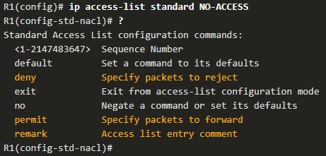
Configure Standard IPv4 ACLs Named Standard IPv4 ACL Syntax
To create a named standard ACL, use the ip access-list standard command.
ACL names are alphanumeric, case sensitive, and must be unique.
Capitalizing ACL names is not required but makes them stand out when viewing the running-config output.
Notes:
5.0 - ACLs for IPv4 Configuration
5.1 – Configure Standard IPv4 ACLs
5.1.3 – Named Standard IPv4 ACL Syntax

Slide 17
Configure Standard IPv4 ACLs Apply a Standard IPv4 ACL
After a standard IPv4 ACL is configured, it must be linked to an interface or feature.
The ip access-group command is used to bind a numbered or named standard IPv4 ACL to an interface.
To remove an ACL from an interface, first enter the no ip access-group interface configuration command.
Notes:
5.0 - ACLs for IPv4 Configuration
5.1 – Configure Standard IPv4 ACLs
5.1.4 – Apply a Standard IPv4 ACL

Slide 18
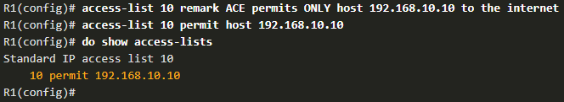
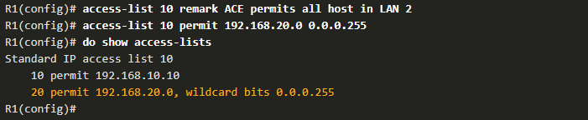

Configure Standard IPv4 ACLs Numbered Standard ACL Example
The example ACL permits traffic from host 192.168.10.10 and all hosts on the 192.168.20.0/24 network out interface serial 0/1/0 on router R1.
Notes:
5.0 - ACLs for IPv4 Configuration
5.1 – Configure Standard IPv4 ACLs
5.1.5 – Numbered Standard IPv4 ACL Example

Slide 19
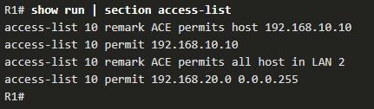
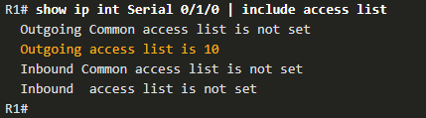
Configure Standard IPv4 ACLs Numbered Standard ACL Example (Cont.)
Use the show running-config command to review the ACL in the configuration.
Use the show ip interface command to verify the ACL is applied to the interface.
Notes:
5.0 - ACLs for IPv4 Configuration
5.1 – Configure Standard IPv4 ACLs
5.1.5 – Numbered Standard IPv4 ACL Example (Cont.)

Slide 20
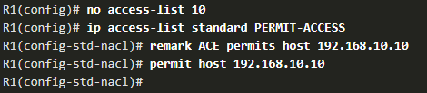
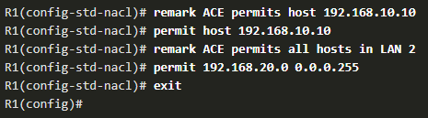

Configure Standard IPv4 ACLs Named Standard ACL Example
The example ACL permits traffic from host 192.168.10.10 and all hosts on the 192.168.20.0/24 network out interface serial 0/1/0 on router R1.
Notes:
5.0 - ACLs for IPv4 Configuration
5.1 – Configure Standard IPv4 ACLs
5.1.6 – Named Standard IPv4 ACL Example

Slide 21
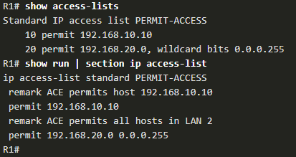
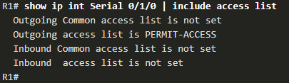
Configure Standard IPv4 ACLs Named Standard ACL Example (Cont.)
Use the show access-list command to review the ACL in the configuration.
Use the show ip interface command to verify the ACL is applied to the interface.
Notes:
5.0 - ACLs for IPv4 Configuration
5.1 – Configure Standard IPv4 ACLs
5.1.6 – Named Standard IPv4 ACL Example (Cont.)
5.1.7 – Syntax Checker – Configure Standard IPv4 ACLs

Slide 22
Configure Standard IPv4 ACLs Packet Tracer – Configure Numbered Standard IPv4 ACLs
In this Packet Tracer, you will complete the following objectives:
Plan an ACL Implementation.
Configure, Apply, and Verify a Standard ACL.
Notes:
5.0 - ACLs for IPv4 Configuration
5.1 – Configure Standard IPv4 ACLs
5.1.8 – Packet Tracer – Configure Numbered Standard IPv4 ACLs

Slide 23
Configure Standard IPv4 ACLs Packet Tracer – Configure Named Standard IPv4 ACLs
In this Packet Tracer, you will complete the following objectives:
Configure and Apply a Named Standard ACL.
Verify the ACL Implementation.
Notes:
5.0 - ACLs for IPv4 Configuration
5.1 – Configure Standard IPv4 ACLs
5.1.8 – Packet Tracer – Configure Numbered Standard IPv4 ACLs

Slide 24
5.2 Modify IPv4 ACLs
Notes:
5.0 - ACLs for IPv4 Configuration
5.2 – Modify IPv4 ACLs

Slide 25
Modify IPv4 ACLs Two Methods to Modify an ACL
After an ACL is configured, it may need to be modified. ACLs with multiple ACEs can be complex to configure. Sometimes the configured ACE does not yield the expected behaviors.
There are two methods to use when modifying an ACL:
Use a text editor.
Use sequence numbers.
Notes:
5.0 - ACLs for IPv4 Configuration
5.2 – Modify IPv4 ACLs
5.2.1 – Two Methods to Modify and ACL

Slide 26

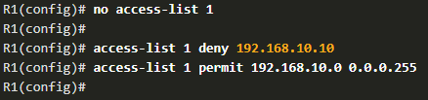
Modify IPv4 ACLs Text Editor Method
ACLs with multiple ACEs should be created in a text editor. This allows you to plan the required ACEs, create the ACL, and then paste it into the router interface. It also simplifies the tasks to edit and fix an ACL.
To correct an error in an ACL:
Copy the ACL from the running configuration and paste it into the text editor.
Make the necessary edits or changes.
Remove the previously configured ACL on the router.
Copy and paste the edited ACL back to the router.
Notes:
5.0 - ACLs for IPv4 Configuration
5.2 – Modify IPv4 ACLs
5.2.2 – Text Editor Method

Slide 27
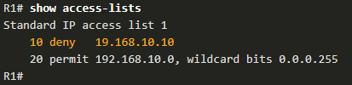
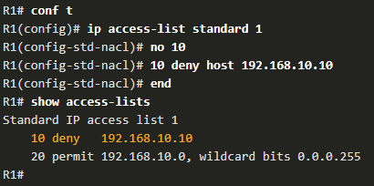
Modify IPv4 ACLs Sequence Number Method
An ACL ACE can be deleted or added using the ACL sequence numbers.
Use the ip access-list standard command to edit an ACL.
Statements cannot be overwritten using an existing sequence number. The current statement must be deleted first with the no 10 command. Then the correct ACE can be added using sequence number.
Notes:
5.0 - ACLs for IPv4 Configuration
5.2 – Modify IPv4 ACLs
5.2.3 – Sequence Number Method

Slide 28

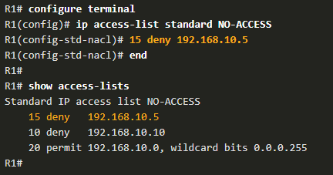
Modify IPv4 ACLs Modify a Named ACL Example
Named ACLs can also use sequence numbers to delete and add ACEs. In the example an ACE is added to deny hosts 192.168.10.11.
Notes:
5.0 - ACLs for IPv4 Configuration
5.2 – Modify IPv4 ACLs
5.2.4 – Modify a Named ACL Example

Slide 29
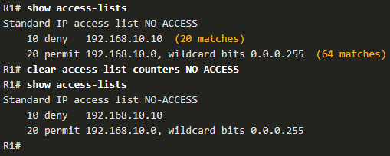
Modify IPv4 ACLs ACL Statistics
The show access-lists command in the example shows statistics for each statement that has been matched.
The deny ACE has been matched 20 times and the permit ACE has been matched 64 times.
Note that the implied deny any statement does not display any statistics. To track how many implicit denied packets have been matched, you must manually configure the deny any command.
Use the clear access-list counters command to clear the ACL statistics.
Notes:
5.0 - ACLs for IPv4 Configuration
5.2 – Modify IPv4 ACLs
5.2.5 – ACL Statistics
5.2.6 – Syntax Checker – Modify IPv4 ACLs

Slide 30
Modify IPv4 ACLs Packet Tracer – Configure and Modify Standard IPv4 ACLs
In this Packet Tracer, you will complete the following objectives:
Configure Devices and Verify Connectivity.
Configure and Verify Standard Numbered and Named ACLs.
Modify a Standard ACL.
Notes:
5.0 - ACLs for IPv4 Configuration
5.2 – Modify IPv4 ACLs
5.2.7 – Packet Tracer – Configure and Modify Standard IPv4 ACLs

Slide 31
5.3 Secure VTY Ports with a Standard IPv4 ACL
Notes:
5.0 - ACLs for IPv4 Configuration
5.3 – Secure VTY Ports with a Standard ACL

Slide 32
Secure VTY Ports with a Standard IPv4 ACL The access-class Command
A standard ACL can secure remote administrative access to a device using the vty lines by implementing the following two steps:
Create an ACL to identify which administrative hosts should be allowed remote access.
Apply the ACL to incoming traffic on the vty lines.
Notes:
5.0 - ACLs for IPv4 Configuration
5.3 – Secure VTY Ports with a Standard ACL
5.3.1 – The access-class Command

Slide 33
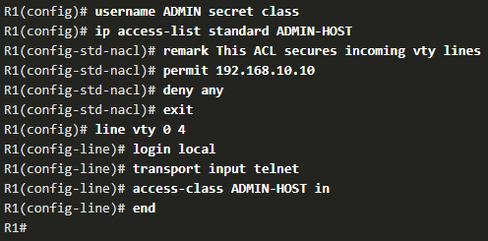
Secure VTY Ports with a Standard IPv4 ACL Secure VTY Access Example
This example demonstrates how to configure an ACL to filter vty traffic.
First, a local database entry for a user ADMIN and password class is configured.
The vty lines on R1 are configured to use the local database for authentication, permit SSH traffic, and use the ADMIN-HOST ACL to restrict traffic.
Notes:
5.0 - ACLs for IPv4 Configuration
5.3 – Secure VTY Ports with a Standard ACL
5.3.2 – Secure VTY Access Example

Slide 34
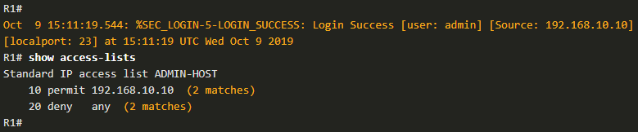
Secure VTY Ports with a Standard IPv4 ACL Verify the VTY Port is Secured
After an ACL to restrict access to the vty lines is configured, it is important to verify it works as expected.
To verify the ACL statistics, issue the show access-lists command.
The match in the permit line of the output is a result of a successful SSH connection by host with IP address 192.168.10.10.
The match in the deny statement is due to the failed attempt to create a SSH connection from a device on another network.
Notes:
5.0 - ACLs for IPv4 Configuration
5.3 – Secure VTY Ports with a Standard ACL
5.3.3 – Verify the VTY Port is Secured
5.3.4 – Syntax Checker – Secure the VTY Ports

Slide 35
5.4 Configure Extended IPv4 ACLs
Notes:
5.0 - ACLs for IPv4 Configuration
5.4 – Configure Extended IPv4 ACLs

Slide 36
Configure Extended IPv4 ACLs Extended ACLs
Extended ACLs provide a greater degree of control. They can filter on source address, destination address, protocol (i.e., IP, TCP, UDP, ICMP), and port number.
Extended ACLs can be created as:
Numbered Extended ACL - Created using the access-list access-list-number global configuration command.
Named Extended ACL - Created using the ip access-list extended access-list-name.
Notes:
5.0 - ACLs for IPv4 Configuration
5.4 – Configure Extended IPv4 ACLs
5.4.1 – Extended ACLs

Slide 37
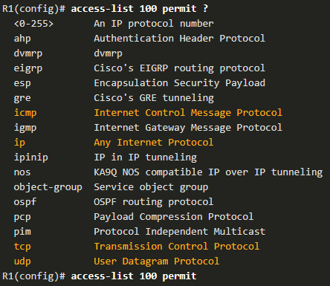
Configure Extended IPv4 ACLs Protocols and Ports
Protocol Options
Extended ACLs can filter on internet protocols and ports. Use the ? to get help when entering a complex ACE. The four highlighted protocols are the most popular options.
Notes:
5.0 - ACLs for IPv4 Configuration
5.4 – Configure Extended IPv4 ACLs
5.4.3 – Protocols and Ports

Slide 38
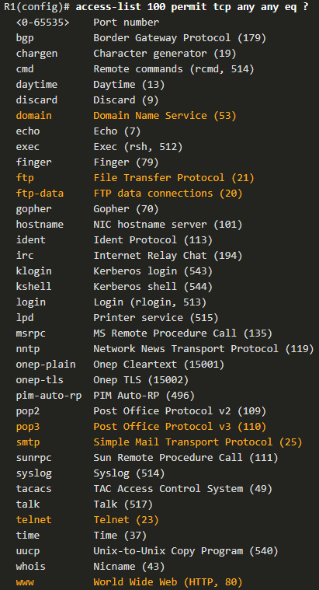
Configure Extended IPv4 ACLs Protocols and Ports (Cont.)
Selecting a protocol influences port options. Many TCP port options are available, as shown in the output.
Notes:
5.0 - ACLs for IPv4 Configuration
5.4 – Configure Extended IPv4 ACLs
5.4.3 – Protocols and Ports

Slide 39


Configure Extended IPv4 ACLs Protocols and Port Numbers Configuration Examples
Extended ACLs can filter on different port number and port name options.
This example configures an extended ACL 100 to filter HTTP traffic. The first ACE uses the www port name. The second ACE uses the port number 80. Both ACEs achieve exactly the same result.
Configuring the port number is required when there is not a specific protocol name listed such as SSH (port number 22) or an HTTPS (port number 443), as shown in the next example.
Notes:
5.0 - ACLs for IPv4 Configuration
5.4 – Configure Extended IPv4 ACLs
5.4.4 – Protocols and Port Numbers Configuration Examples

Slide 40
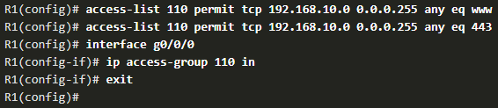
Configure Extended IPv4 ACLs Apply a Numbered Extended IPv4 ACL
In this example, the ACL permits both HTTP and HTTPS traffic from the 192.168.10.0 network to go to any destination.
Extended ACLs can be applied in various locations. However, they are commonly applied close to the source. Here ACL 110 is applied inbound on the R1 G0/0/0 interface.
Notes:
5.0 - ACLs for IPv4 Configuration
5.4 – Configure Extended IPv4 ACLs
5.4.5 – Apply a Numbered Extended IPv4 ACL

Slide 41
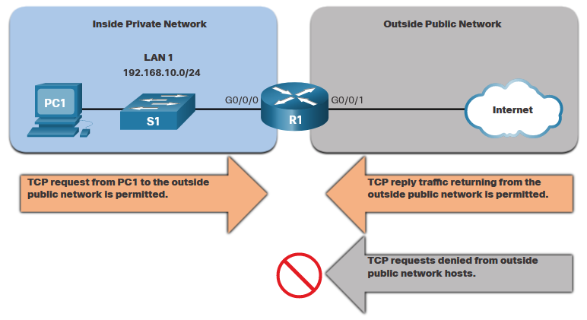
Configure Extended IPv4 ACLs TCP Established Extended ACL
TCP can also perform basic stateful firewall services using the TCP established keyword.
The established keyword enables inside traffic to exit the inside private network and permits the returning reply traffic to enter the inside private network.
TCP traffic generated by an outside host and attempting to communicate with an inside host is denied.
Notes:
5.0 - ACLs for IPv4 Configuration
5.4 – Configure Extended IPv4 ACLs
5.4.6 – TCP Established Extended ACL

Slide 42
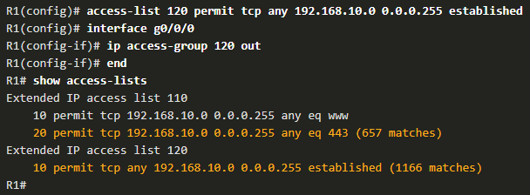
Configure Extended IPv4 ACLs TCP Established Extended ACL (Cont.)
ACL 120 is configured to only permit returning web traffic to the inside hosts. The ACL is then applied outbound on the R1 G0/0/0 interface.
The show access-lists command shows that inside hosts are accessing the secure web resources from the internet.
Note: A match occurs if the returning TCP segment has the ACK or reset (RST) flag bits set, indicating that the packet belongs to an existing connection.
Notes:
5.0 - ACLs for IPv4 Configuration
5.4 – Configure Extended IPv4 ACLs
5.4.6 – TCP Established Extended ACL (Cont.)

Slide 43

Configure Extended IPv4 ACLs Named Extended IPv4 ACL Syntax
Naming an ACL makes it easier to understand its function. To create a named extended ACL, use the ip access-list extended configuration command.
In the example, a named extended ACL called NO-FTP-ACCESS is created and the prompt changed to named extended ACL configuration mode. ACE statements are entered in the named extended ACL sub configuration mode.
Notes:
5.0 - ACLs for IPv4 Configuration
5.4 – Configure Extended IPv4 ACLs
5.4.7 – Named Extended IPv4 ACL Syntax

Slide 44
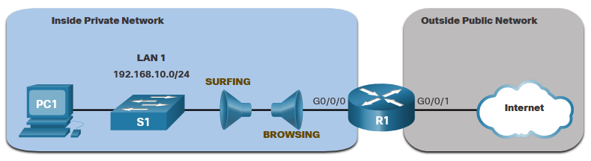
Configure Extended IPv4 ACLs Named Extended IPv4 ACL Example
The topology below is used to demonstrate configuring and applying two named extended IPv4 ACLs to an interface:
SURFING - This will permit inside HTTP and HTTPS traffic to exit to the internet.
BROWSING - This will only permit returning web traffic to the inside hosts while all other traffic exiting the R1 G0/0/0 interface is implicitly denied.
Notes:
5.0 - ACLs for IPv4 Configuration
5.4 – Configure Extended IPv4 ACLs
5.4.8 – Named Extended IPv4 ACL Example

Slide 45
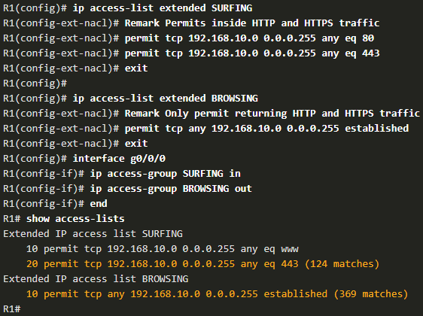
Configure Extended IPv4 ACLs Named Extended IPv4 ACL Example (Cont.)
The SURFING ACL permits HTTP and HTTPS traffic from inside users to exit the G0/0/1 interface connected to the internet. Web traffic returning from the internet is permitted back into the inside private network by the BROWSING ACL.
The SURFING ACL is applied inbound and the BROWSING ACL is applied outbound on the R1 G0/0/0 interface.
Notes:
5.0 - ACLs for IPv4 Configuration
5.4 – Configure Extended IPv4 ACLs
5.4.8 – Named Extended IPv4 ACL Example (Cont.)

Slide 46
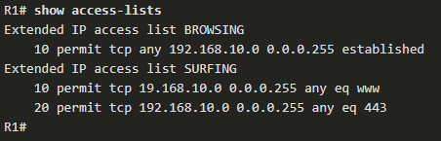
Configure Extended IPv4 ACLs Named Extended IPv4 ACL Example (Cont.)
The show access-lists command is used to verify the ACL statistics. Notice that the permit secure HTTPS counters (i.e., eq 443) in the SURFING ACL and the return established counters in the BROWSING ACL have increased.
Notes:
5.0 - ACLs for IPv4 Configuration
5.4 – Configure Extended IPv4 ACLs
5.4.8 – Named Extended IPv4 ACL Example (Cont.)

Slide 47
Configure Extended IPv4 ACLs Edit Extended ACLs
An extended ACL can be edited using a text editor when many changes are required. Or, if the edit applies to one or two ACEs, then sequence numbers can be used.
Example:
The ACE sequence number 10 in the SURFING ACL has an incorrect source IP networks address.
Notes:
5.0 - ACLs for IPv4 Configuration
5.4 – Configure Extended IPv4 ACLs
5.4.9 – Edit Extended ACLs

Slide 48
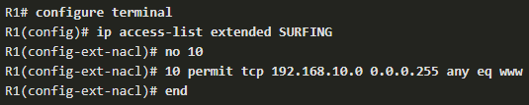
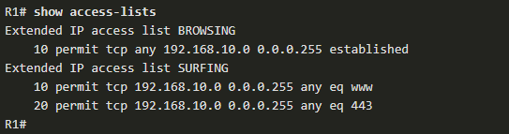
Configure Extended IPv4 ACLs Edit Extended ACLs (Cont.)
To correct this error the original statement is removed with the no sequence_# command and the corrected statement is added replacing the original statement.
The show access-lists command output verifies the configuration change.
Notes:
5.0 - ACLs for IPv4 Configuration
5.4 – Configure Extended IPv4 ACLs
5.4.9 – Edit Extended ACLs (Cont.)

Slide 49
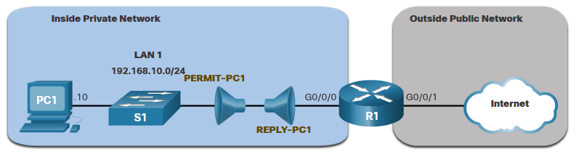
Configure Extended IPv4 ACLs Another Extended IPv4 ACL Example
Two named extended ACLs will be created:
PERMIT-PC1 - This will only permit PC1 TCP access to the internet and deny all other hosts in the private network.
REPLY-PC1 - This will only permit specified returning TCP traffic to PC1 implicitly deny all other traffic.
Notes:
5.0 - ACLs for IPv4 Configuration
5.4 – Configure Extended IPv4 ACLs
5.4.10 – Another Extended IPv4 ACL Example

Slide 50
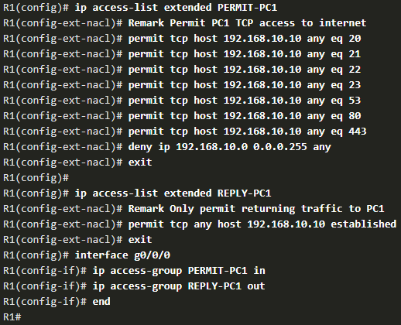
Configure Extended IPv4 ACLs Another Extended IPv4 ACL Example (Cont.)
The PERMIT-PC1 ACL permits PC1 (192.168.10.10) TCP access to the FTP, SSH, Telnet, DNS , HTTP, and HTTPS traffic.
The REPLY-PC1 ACL will permit return traffic to PC1.
The PERMIT-PC1 ACL is applied inbound and the REPLY-PC1 ACL applied outbound on the R1 G0/0/0 interface.
Notes:
5.0 - ACLs for IPv4 Configuration
5.4 – Configure Extended IPv4 ACLs
5.4.10 – Another Extended IPv4 ACL Example (Cont.)

Slide 51
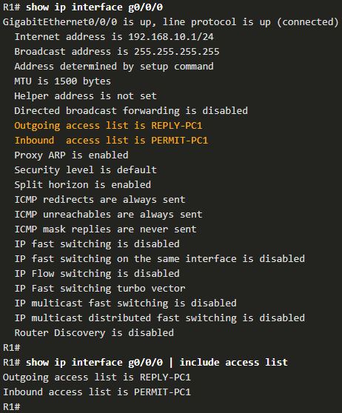
Configure Extended IPv4 ACLs Verify Extended ACLs
The show ip interface command is used to verify the ACL on the interface and the direction in which it was applied.
Notes:
5.0 - ACLs for IPv4 Configuration
5.4 – Configure Extended IPv4 ACLs
5.4.11 – Verify Extended ACLs

Slide 52
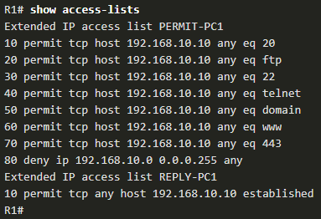
Configure Extended IPv4 ACLs Verify Extended ACLs (Cont.)
The show access-lists command can be used to confirm that the ACLs work as expected. The command displays statistic counters that increase whenever an ACE is matched.
Note: Traffic must be generated to verify the operation of the ACL.
Notes:
5.0 - ACLs for IPv4 Configuration
5.4 – Configure Extended IPv4 ACLs
5.4.11 – Verify Extended ACLs (Cont.)

Slide 53
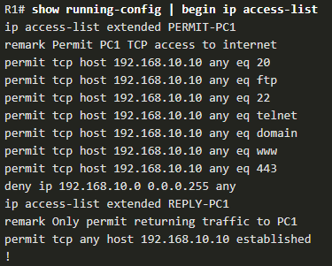
Configure Extended IPv4 ACLs Verify Extended ACLs (Cont.)
The show running-config command can be used to validate what was configured. The command also displays configured remarks.
Notes:
5.0 - ACLs for IPv4 Configuration
5.4 – Configure Extended IPv4 ACLs
5.4.11 – Verify Extended ACLs (Cont.)

Slide 54
Configure Extended IPv4 ACLs Packet Tracer – Configure Extended IPv4 ACLs - Scenario 1
In this Packet Tracer, you will complete the following objectives:
Configure, Apply, and Verify an Extended Numbered IPv4 ACL.
Configure, Apply, and Verify an Extended Named IPv4 ACL.
Notes:
5.0 - ACLs for IPv4 Configuration
5.4 – Configure Extended IPv4 ACLs
5.4.12 – Packet Tracer – Configure Extended IPv4 ACLs – Scenario 1

Slide 55
Configure Extended IPv4 ACLs Packet Tracer – Configure Extended IPv4 ACLs - Scenario 2
In this Packet Tracer, you will complete the following objectives:
Configure a Named Extended IPv4 ACL.
Apply and Verify the Extended IPv4 ACL.
Notes:
5.0 - ACLs for IPv4 Configuration
5.4 – Configure Extended IPv4 ACLs
5.4.13 – Packet Tracer – Configure Extended IPv4 ACLs – Scenario 2

Slide 56
5.5 Module Practice and Quiz
Notes:
5- ACLs for IPv4 Configuration
5.5 – Module Practice and Quiz

Slide 57
Module Practice and Quiz Packet Tracer – IPv4 ACL Implementation Challenge
In this Packet Tracer, you will complete the following objectives:
Configure a router with standard named ACLs
Configure a router with extended named ACLs
Configure a router with extended ACLs to meet specific communication requirements
Configure an ACL to control access to network device terminal lines
Configure the appropriate router interfaces with ACLs in the appropriate direction
Verify the operation of the configured ACLs
Notes:
5.0 - ACLs for IPv4 Configuration
5.5 – Module Practice and Quiz
5.5.1 – Packet Tracer – IPv4 ACL Implementation Challenge

Slide 58
Module Practice and Quiz Packet Tracer – Configure and Verify Extended IPv4 ACLs – Physical Mode Lab – Configure and Verify Extended IPv4 ACLs
In this Packet Tracer Physical Mode activity, you will complete the following objectives:
Build the Network and Configure Basic Device Settings
Configure VLANs on the Switches
Configure Trunking
Configure Routing
Configure Remote Access
Verify Connectivity
Configure and Verify Extended Access Control Lists
In this Lab, you will complete the following objectives:
Build the Network and Configure Basic Device Settings
Configure and Verify Extended IPv4 ACLs
Notes:
5.0 - ACLs for IPv4 Configuration
5.5 – Module Practice and Quiz
5.5.2 – PTPM and Lab – Configure and Verify Extended IPv4 ACLs

Slide 59
Module Practice and Quiz What did I learn in this module?
To create a numbered standard ACL, use the use the ip access-list standard access-list-name global configuration command.
Use the no access-list access-list-number global configuration command to remove a numbered standard ACL.
Use the show ip interface command to verify if an interface has an ACL applied to it.
To create a named standard ACL, use the ip access-list standard access-list-name global configuration command.
Use the no ip access-list standard access-list-name global configuration command to remove a named standard IPv4 ACL.
To bind a numbered or named standard IPv4 ACL to an interface, use the ip access-group {access-list-number | access-list-name} { in | out } global configuration command.
To remove an ACL from an interface, first enter the no ip access-group interface configuration command.
To remove the ACL from the router, use the no access-list global configuration command.
Notes:
5.0 - ACLs for IPv4 Configuration
5.5 – Module Practice and Quiz
5.5.3 – What did I learn in this module?

Slide 60
Module Practice and Quiz What did I learn in this module?
Extended ACLs can filter on source address, destination address, protocol (i.e., IP, TCP, UDP, ICMP), and port number.
To create a numbered extended ACL, use the Router(config)# access-list access-list-number {deny | permit | remark text} protocol source source-wildcard [operator [port]] destination destination-wildcard [operator [port]] [established] [log] global configuration command.
ALCs can also perform basic stateful firewall services using the TCP established keyword.
The show ip interface command is used to verify the ACL on the interface and the direction in which it was applied.
To modify an ACL, use a text editor or use sequence numbers.
An ACL ACE can also be deleted or added using the ACL sequence numbers.
Sequence numbers are automatically assigned when an ACE is entered.
Notes:
5.0 - ACLs for IPv4 Configuration
5.5 – Module Practice and Quiz
5.5.3 – What did I learn in this module?

Slide 61
Module 5: ACLs for IPv4 Configuration New Terms and Commands
numbered extended ACL named extended ACL numbered standard ACL named standard ACL ip access-list standard no ip access-list standard ip access-list extended ip access-list ip access-group show access-lists clear access-list counters access-class established

