Slide 1
Module 6: NAT for IPv4
Instructor Materials
Enterprise Networking, Security, and Automation v7.0 (ENSA)
Notes:
Cisco Networking Academy Program
Enterprise Networking, Security, and Automation v7.0 (ENSA)
Module 6: NAT for IPv4

Slide 2
Instructor Materials – Module 6 Planning Guide
This PowerPoint deck is divided in two parts:
Instructor Planning Guide
Information to help you become familiar with the module
Teaching aids
Instructor Class Presentation
Optional slides that you can use in the classroom
Begins on slide # 10
Note: Remove the Planning Guide from this presentation before sharing with anyone.
For additional help and resources go to the Instructor Home Page and Course Resources for this course. You also can visit the professional development site on netacad.com, the official Cisco Networking Academy Facebook page, or Instructor Only FB group.
Notes:
2

Slide 3
What to Expect in this Module
To facilitate learning, the following features within the GUI may be included in this module:
Feature | Description
Animations | Expose learners to new skills and concepts.
Videos | Expose learners to new skills and concepts.
Check Your Understanding(CYU) | Per topic online quiz to help learners gauge content understanding.
Interactive Activities | A variety of formats to help learners gauge content understanding.
Syntax Checker | Small simulations that expose learners to Cisco command line to practice configuration skills.
PT Activity | Simulation and modeling activities designed to explore, acquire, reinforce, and expand skills.

Slide 4
What to Expect in this Module (Cont.)
To facilitate learning, the following features may be included in this module:
Feature | Description
Hands-On Labs | Labs designed for working with physical equipment.
Class Activities | These are found on the Instructor Resources page. Class Activities are designed to facilitate learning, class discussion, and collaboration.
Module Quizzes | Self-assessments that integrate concepts and skills learned throughout the series of topics presented in the module.
Module Summary | Briefly recaps module content.

Slide 5
Check Your Understanding
Check Your Understanding activities are designed to let students quickly determine if they understand the content and can proceed, or if they need to review.
Check Your Understanding activities do not affect student grades.
There are no separate slides for these activities in the PPT. They are listed in the notes area of the slide that appears before these activities.
Notes:
5

Slide 6
Module 6: Activities
What activities are associated with this module?
Page # | Activity Type | Activity Name | Optional?
6.1.5 | Check Your Understanding | NAT Characteristics | Recommended
6.2.7 | Packet Tracer | Investigate NAT Operations | Recommended
6.3.3 | Check Your Understanding | NAT Advantages and Disadvantages | Recommended
6.4.5 | Packet Tracer | Configure Static NAT | Recommended
6.5.6 | Packet Tracer | Configure Dynamic NAT | Recommended
6.6.7 | Packet Tracer | Configure PAT | Recommended
6.8.1 | Packet Tracer | Configure NAT for IPv4 | Recommended
6.8.2 | Lab | Configure NAT for IPv4 | Recommended
6.8.4 | Module Quiz | NAT for IPv4 | Recommended
Notes:
6

Slide 7
Module 6: Best Practices
Prior to teaching Module 6, the instructor should:
Review the activities and assessments for this module.
Try to include as many questions as possible to keep students engaged during classroom presentation.
Topic 6.1
Ask the students or have a class discussion
Have a class discussion on the primary use of NAT and IPv4 address exhaustion.
Have students identify the four types of NAT addresses.
Topic 6.2
Ask the students or have a class discussion
Have a class discussion on the differences between NAT and PAT.
What happens to packets that are not carrying TCP or UDP segments?
Notes:
7

Slide 8
Module 6: Best Practices (Cont.)
Topic 6.3
Ask the students or have a class discussion
Have the students discuss the advantages and disadvantages of NAT.
When would Carrier Grade NAT (CGN) be used?
Topic 6.4
Ask the students or have a class discussion
Have students discuss scenarios of when to use static NAT.
Ask students which show commands can be used to verify NAT?
Topic 6.5
Ask the students or have a class discussion
Have students discuss scenarios of when to use dynamic NAT.
Have students outline the steps in analyzing a dynamic NAT translation.
Notes:
8

Slide 9
Module 6: Best Practices (Cont.)
Topic 6.6
Ask the students or have a class discussion
Have the students discuss scenarios of when to use PAT.
Have students outline the steps in analyzing a PAT translation.
Topic 6.7
Ask the students or have a class discussion
Have a class discussion on why IPv6 does not need NAT.
Notes:
9

Slide 10
Module 6: NAT for IPv4
Enterprise Networking, Security, and Automation v7.0 (ENSA)
Notes:
Cisco Networking Academy Program
Enterprise Networking, Security, and Automation v7.0 (ENSA)
Module 6: NAT for IPv6

Slide 11
Module Objectives
Module Title: NAT for IPv4
Module Objective: Configure NAT services on the edge router to provide IPv4 address scalability.
Topic Title | Topic Objective
NAT Characteristics | Explain the purpose and function of NAT.
Types of NAT | Explain the operation of different types of NAT.
NAT Advantages and Disadvantages | Describe the advantages and disadvantages of NAT.
Static NAT | Configure static NAT using the CLI.
Dynamic NAT | Configure dynamic NAT using the CLI.
PAT | Configure PAT using the CLI.
NAT64 | Describe NAT for IPv6.
Notes:
11
6 – NAT for IPv4
6.0.2 - What will I learn to do in this Module?

Slide 12
6.1 NAT Characteristics
Notes:
6.0 – NAT for IPv4
6.1 – NAT Characteristics

Slide 13
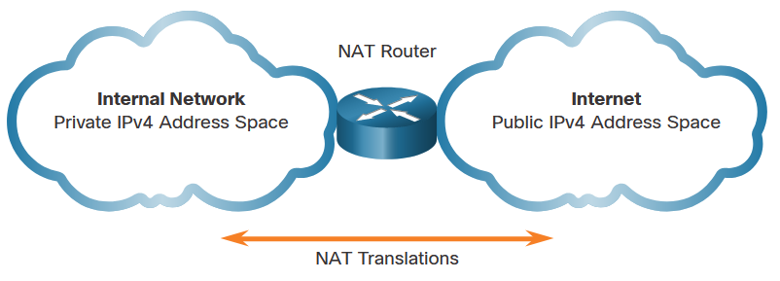
NAT Characteristics IPv4 Address Space
Networks are commonly implemented using private IPv4 addresses, as defined in RFC 1918.
Private IPv4 addresses cannot be routed over the internet and are used within an organization or site to allow devices to communicate locally.
To allow a device with a private IPv4 address to access devices and resources outside of the local network, the private address must first be translated to a public address.
NAT provides the translation of private addresses to public addresses.
Class | Activity Type | Activity Name
A | 10.0.0.0 – 10.255.255.255 | 10.0.0.0/8
B | 172.16.0.0 – 172.31.255.255 | 172.16.0.0/12
C | 192.168.0.0 – 192.168.255.255 | 192.168.0.0/16
Notes:
6.0 – NAT for IPv4
6.1 – NAT Characteristics
6.1.2 – IPv4 Address Space

Slide 14
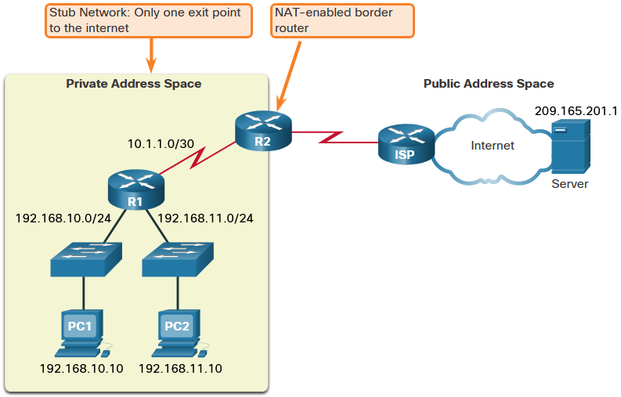
NAT Characteristics What is NAT
The primary use of NAT is to conserve public IPv4 addresses.
NAT allows networks to use private IPv4 addresses internally and translates them to a public address when needed.
A NAT router typically operates at the border of a stub network.
When a device inside the stub network wants to communicate with a device outside of its network, the packet is forwarded to the border router which performs the NAT process, translating the internal private address of the device to a public, outside, routable address.
Notes:
6.0 – NAT for IPv4
6.1 – NAT Characteristics
6.1.2 – What is NAT

Slide 15
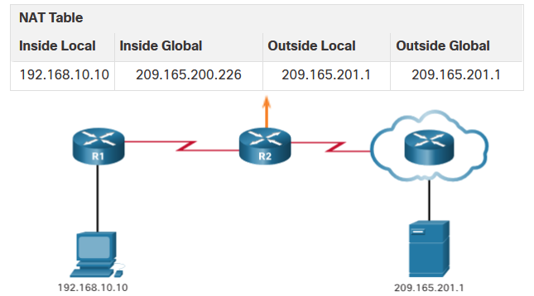
NAT Characteristics How NAT Works
PC1 wants to communicate with an outside web server with public address 209.165.201.1.
PC1 sends a packet addressed to the web server.
R2 receives the packet and reads the source IPv4 address to determine if it needs translation.
R2 adds mapping of the local to global address to the NAT table.
R2 sends the packet with the translated source address toward the destination.
The web server responds with a packet addressed to the inside global address of PC1 (209.165.200.226).
R2 receives the packet with destination address 209.165.200.226. R2 checks the NAT table and finds an entry for this mapping. R2 uses this information and translates the inside global address (209.165.200.226) to the inside local address (192.168.10.10), and the packet is forwarded toward PC1.
Notes:
6.0 – NAT for IPv4
6.1 – NAT Characteristics
6.1.3 – How NAT Works

Slide 16
NAT Characteristics NAT Terminology
NAT includes four types of addresses:
Inside local address
Inside global address
Outside local address
Outside global address
NAT terminology is always applied from the perspective of the device with the translated address:
Inside address - The address of the device which is being translated by NAT.
Outside address - The address of the destination device.
Local address - A local address is any address that appears on the inside portion of the network.
Global address - A global address is any address that appears on the outside portion of the network.
Notes:
6.0 – NAT for IPv4
6.1 – NAT Characteristics
6.1.4 – NAT Terminology

Slide 17
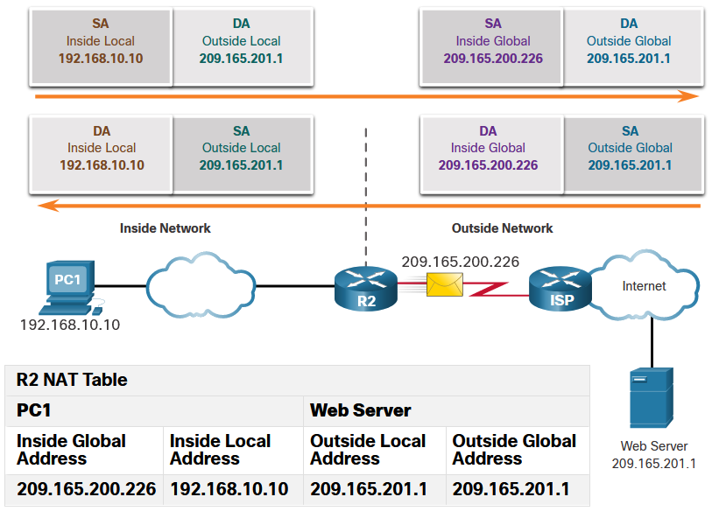
NAT Characteristics NAT Terminology (Cont.)
Inside local address
The address of the source as seen from inside the network. This is typically a private IPv4 address. The inside local address of PC1 is 192.168.10.10.
Inside global addresses
The address of source as seen from the outside network. The inside global address of PC1 is 209.165.200.226
Outside global address
The address of the destination as seen from the outside network. The outside global address of the web server is 209.165.201.1
Outside local address
The address of the destination as seen from the inside network. PC1 sends traffic to the web server at the IPv4 address 209.165.201.1. While uncommon, this address could be different than the globally routable address of the destination.
Notes:
6.0 – NAT for IPv4
6.1 – NAT Characteristics
6.1.4 – NAT Terminology (Cont.)
6.1.5 – Check Your Understanding – NAT Characteristics

Slide 18
6.2 Types of NAT
Notes:
6.0 – NAT for IPv4
6.2 – Types of NAT

Slide 19
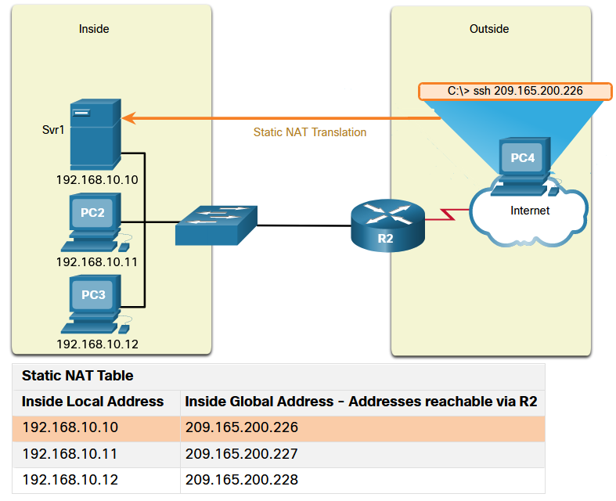
Types of NAT Static NAT
Static NAT uses a one-to-one mapping of local and global addresses configured by the network administrator that remain constant.
Static NAT is useful for web servers or devices that must have a consistent address that is accessible from the internet, such as a company web server.
It is also useful for devices that must be accessible by authorized personnel when offsite, but not by the general public on the internet.
Note: Static NAT requires that enough public addresses are available to satisfy the total number of simultaneous user sessions.
Notes:
6.0 – NAT for IPv4
6.2 – Types of NAT
6.2.1 – Static NAT

Slide 20
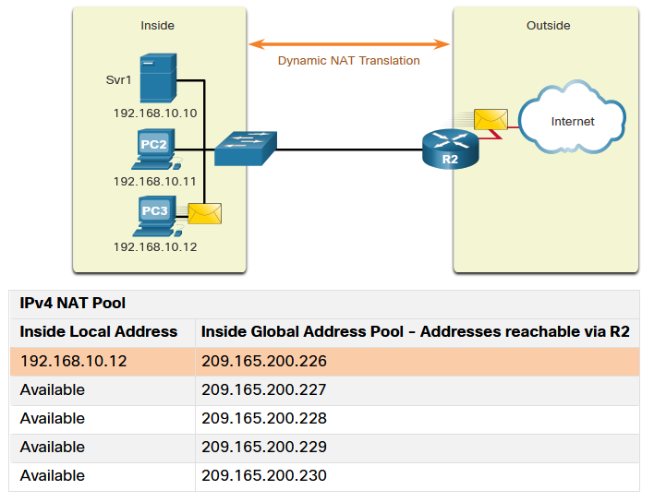
Types of NAT Dynamic NAT
Dynamic NAT uses a pool of public addresses and assigns them on a first-come, first-served basis.
When an inside device requests access to an outside network, dynamic NAT assigns an available public IPv4 address from the pool.
The other addresses in the pool are still available for use.
Note: Dynamic NAT requires that enough public addresses are available to satisfy the total number of simultaneous user sessions.
Notes:
6.0 – NAT for IPv4
6.2 – Types of NAT
6.2.2 – Dynamic NAT

Slide 21
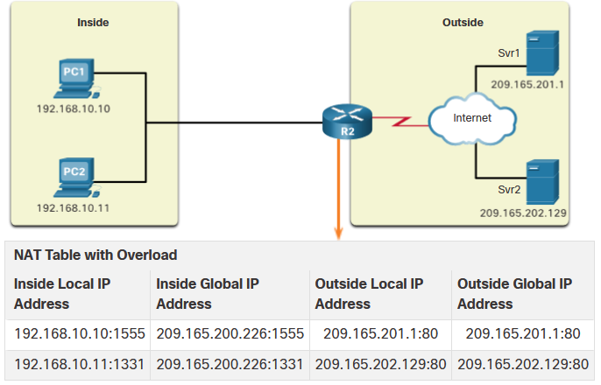
Types of NAT Port Address Translation
Port Address Translation (PAT), also known as NAT overload, maps multiple private IPv4 addresses to a single public IPv4 address or a few addresses.
With PAT, when the NAT router receives a packet from the client, it uses the source port number to uniquely identify the specific NAT translation.
PAT ensures that devices use a different TCP port number for each session with a server on the internet.
Notes:
6.0 – NAT for IPv4
6.2 – Types of NAT
6.2.3 – Port Address Translation

Slide 22
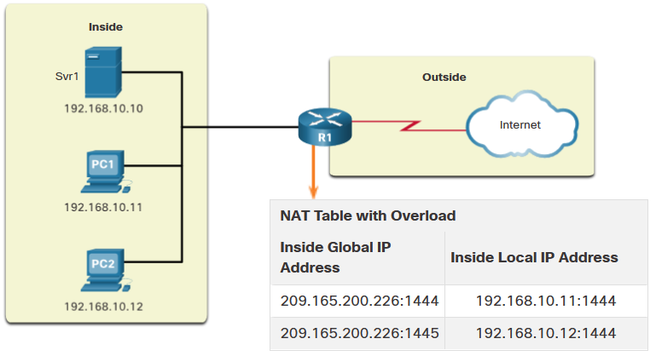
Types of NAT Next Available Port
PAT attempts to preserve the original source port. If the original source port is already used, PAT assigns the first available port number starting from the beginning of the appropriate port group 0-511, 512-1,023, or 1,024-65,535.
When there are no more ports available and there is more than one external address in the address pool, PAT moves to the next address to try to allocate the original source port.
The process continues until there are no more available ports or external IPv4 addresses in the address pool.
Notes:
6.0 – NAT for IPv4
6.2 – Types of NAT
6.2.4 – Next Available Port

Slide 23
Types of NAT NAT and PAT Comparison
Summary of the differences between NAT and PAT.
NAT - Only modifies the IPv4 addresses
PAT - PAT modifies both the IPv4 address and the port number.
NAT | PAT
One-to-one mapping between Inside Local and Inside Global addresses. | One Inside Global address can be mapped to many Inside Local addresses.
Uses only IPv4 addresses in translation process. | Uses IPv4 addresses and TCP or UDP source port numbers in translation process.
A unique Inside Global address is required for each inside host accessing the outside network. | A single unique Inside Global address can be shared by many inside hosts accessing the outside network.
Inside Global Address | Inside Local Address
209.165.200.226 | 192.168.10.10
Inside Global Address | Inside Local Address
209.165.200.226:2031 | 192.168.10.10:2031
Notes:
6.0 – NAT for IPv4
6.2 – Types of NAT
6.2.5 – NAT and PAT Comparison

Slide 24
Types of NAT Packets without a Layer 4 Segment
Some packets do not contain a Layer 4 port number, such as ICMPv4 messages. Each of these types of protocols is handled differently by PAT.
For example, ICMPv4 query messages, echo requests, and echo replies include a Query ID. ICMPv4 uses the Query ID to identify an echo request with its corresponding echo reply.
Note: Other ICMPv4 messages do not use the Query ID. These messages and other protocols that do not use TCP or UDP port numbers vary and are beyond the scope of this curriculum.
Notes:
6.0 – NAT for IPv4
6.2 – Types of NAT
6.2.6 – Packets without a Layer 4 Segment

Slide 25
Types of NAT Packet Tracer – Investigate NAT Operations
In this Packet Tracer, you will complete the following objectives:
Investigate NAT operation across the intranet
Investigate NAT operation across the internet
Conduct further investigations
Notes:
6.0 – NAT for IPv4
6.2 – Types of NAT
6.2.7 – Packet Tracer – Investigate NAT Operations

Slide 26
6.3 NAT Advantages and Disadvantages
Notes:
6.0 – NAT for IPv4
6.3 – NAT Advantages and Disadvantages

Slide 27
NAT Advantages and Disadvantages Advantages of NAT
NAT provides many benefits:
NAT conserves the legally registered addressing scheme by allowing the privatization of intranets.
NAT conserves addresses through application port-level multiplexing.
NAT increases the flexibility of connections to the public network.
NAT provides consistency for internal network addressing schemes.
NAT allows the existing private IPv4 address scheme to remain while allowing for easy change to a new public addressing scheme.
NAT hides the IPv4 addresses of users and other devices.
Notes:
6.0 – NAT for IPv4
6.3 – NAT Advantages and Disadvantages
6.3.1 – Advantages of NAT

Slide 28
NAT Advantages and Disadvantages Disadvantages of NAT
NAT does have drawbacks:
NAT increases forwarding delays.
End-to-end addressing is lost.
End-to-end IPv4 traceability is lost.
NAT complicates the use of tunneling protocols, such as IPsec.
Services that require the initiation of TCP connections from the outside network, or stateless protocols, such as those using UDP, can be disrupted.
Notes:
6.0 – NAT for IPv4
6.3 – NAT Advantages and Disadvantages
6.3.2 – Disadvantages of NAT
6.3.3 – Check Your Understanding – NAT Advantages and Disadvantages

Slide 29
6.4 Static NAT
Notes:
6.0 – NAT for IPv4
6.4 – Static NAT

Slide 30
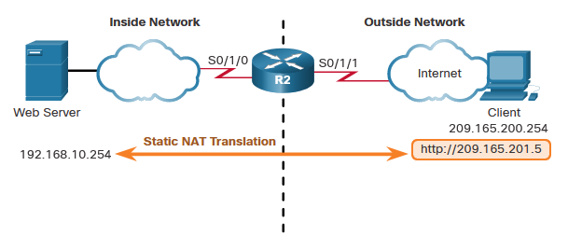
Static NAT Static NAT Scenario
Static NAT is a one-to-one mapping between an inside address and an outside address.
Static NAT allows external devices to initiate connections to internal devices using the statically assigned public address.
For instance, an internal web server may be mapped to a specific inside global address so that it is accessible from outside networks.
Notes:
6.0 – NAT for IPv4
6.4 – Static NAT
6.4.1 – Static NAT Scenario

Slide 31
Static NAT Configure Static NAT
There are two basic tasks when configuring static NAT translations:
Step 1 - Create a mapping between the inside local address and the inside global addresses using the ip nat inside source static command.
Step 2 - The interfaces participating in the translation are configured as inside or outside relative to NAT with the ip nat inside and ip nat outside commands.
R2(config)# ip nat inside source static 192.168.10.254 209.165.201.5
R2(config)#
R2(config)# interface serial 0/1/0
R2(config-if)# ip address 192.168.1.2 255.255.255.252
R2(config-if)# ip nat inside
R2(config-if)# exit
R2(config)# interface serial 0/1/1
R2(config-if)# ip address 209.165.200.1 255.255.255.252
R2(config-if)# ip nat outside
Notes:
6.0 – NAT for IPv4
6.4 – Static NAT
6.4.2 – Configure Static NAT

Slide 32
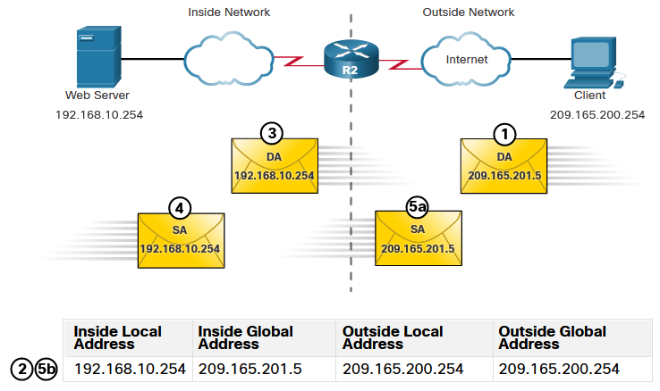
Static NAT Analyze Static NAT
The static NAT translation process between the client and the web server:
The client sends a packet to the web server.
R2 receives packets from the client on its NAT outside interface and checks its NAT table.
R2 translates the inside global address of to the inside local address and forwards the packet towards the web server.
The web server receives the packet and responds to the client using its inside local address.
(a) R2 receives the packet from the web server on its NAT inside interface with source address of the inside local address of the web server and (b) translates the source address to the inside global address.
Notes:
6.0 – NAT for IPv4
6.4 – Static NAT
6.4.3 – Analyze Static NAT

Slide 33
Static NAT Verify Static NAT
To verify NAT operation, issue the show ip nat translations command.
This command shows active NAT translations.
Because the example is a static NAT configuration, the translation is always present in the NAT table regardless of any active communications.
If the command is issued during an active session, the output also indicates the address of the outside device.
R2# show ip nat translations
Pro Inside global Inside local Outside local Outside global
--- 209.165.201.5 192.168.10.254 --- ---
Total number of translations: 1
R2# show ip nat translations
Pro Inside global Inside local Outside local Outside global
tcp 209.165.201.5 192.168.10.254 209.165.200.254 209.165.200.254
--- 209.165.201.5 192.168.10.254 --- ---
Total number of translations: 2
Notes:
6.0 – NAT for IPv4
6.4 – Static NAT
6.4.4 – Verify Static NAT

Slide 34
Static NAT Verify Static NAT (Cont.)
Another useful command is show ip nat statistics.
It displays information about the total number of active translations, NAT configuration parameters, the number of addresses in the pool, and the number of addresses that have been allocated.
To verify that the NAT translation is working, it is best to clear statistics from any past translations using the clear ip nat statistics command before testing.
R2# show ip nat statistics
Total active translations: 1 (1 static, 0 dynamic; 0 extended)
Outside interfaces:
Serial0/1/1
Inside interfaces:
Serial0/1/0
Hits: 4 Misses: 1
(output omitted)
Notes:
6.0 – NAT for IPv4
6.4 – Static NAT
6.4.4 – Verify Static NAT (Cont.)

Slide 35
Static NAT Packet Tracer – Configure Static NAT
In this Packet Tracer, you will complete the following objectives:
Test Access without NAT
Configure Static NAT
Test Access with NAT
Notes:
6.0 – NAT for IPv4
6.4 – Static NAT
6.4.5 – Packet Tracer – Configure Static NAT

Slide 36
6.5 Dynamic NAT
Notes:
6.0 – NAT for IPv4
6.5 – Dynamic NAT

Slide 37
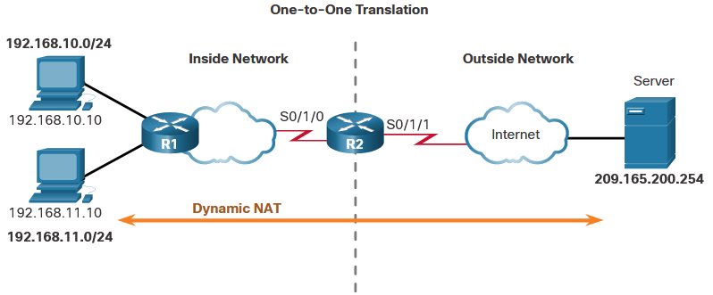
Static NAT Dynamic NAT Scenario
Dynamic NAT automatically maps inside local addresses to inside global addresses.
Dynamic NAT uses a pool of inside global addresses.
The pool of inside global addresses is available to any device on the inside network on a first-come first-served basis.
If all addresses in the pool are in use, a device must wait for an available address before it can access the outside network.
Notes:
6.0 – NAT for IPv4
6.5 – Dynamic NAT
6.5.1 – Dynamic NAT Scenario

Slide 38
Static NAT Configure Dynamic NAT
There are five tasks when configuring dynamic NAT translations:
Step 1 - Define the pool of addresses that will be used for translation using the ip nat pool command.
Step 2 - Configure a standard ACL to identify (permit) only those addresses that are to be translated.
Step 3 - Bind the ACL to the pool, using the ip nat inside source list command.
R2(config)# ip nat pool NAT-POOL1 209.165.200.226 209.165.200.240 netmask 255.255.255.224
R2(config)# access-list 1 permit 192.168.0.0 0.0.255.255
R2(config)# ip nat inside source list 1 pool NAT-POOL1
Notes:
6.0 – NAT for IPv4
6.5 – Dynamic NAT
6.5.2 – Configure Dynamic NAT

Slide 39
Static NAT Configure Dynamic NAT (Cont.)
There are five tasks when configuring dynamic NAT translations:
Step 4 - Identify which interfaces are inside.
Step 5 - Identify which interfaces are outside.
R2(config)# ip nat pool NAT-POOL1 209.165.200.226 209.165.200.240 netmask 255.255.255.224
R2(config)# access-list 1 permit 192.168.0.0 0.0.255.255
R2(config)# ip nat inside source list 1 pool NAT-POOL1
R2(config)# interface serial 0/1/0
R2(config-if)# ip nat inside
R2(config-if)# interface serial 0/1/1
R2(config-if)# ip nat outside
Notes:
6.0 – NAT for IPv4
6.5 – Dynamic NAT
6.5.2 – Configure Dynamic NAT (Cont.)

Slide 40
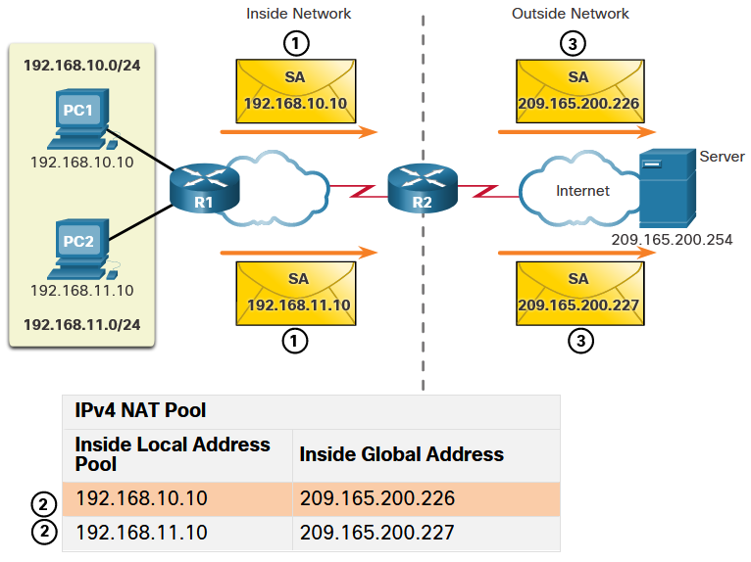
Static NAT Analyze Dynamic NAT – Inside to Outside
Dynamic NAT translation process:
PC1 and PC2 send packets requesting a connection to the server.
R2 receives the first packet from PC1, checks the ALC to determine if the packet should be translated, selects an available global address, and creates a translation entry in the NAT table.
R2 replaces the inside local source address of PC1, 192.168.10.10, with the translated inside global address of 209.165.200.226 and forwards the packet. (The same process occurs for the packet from PC2 using the translated address of 209.165.200.227.)
Notes:
6.0 – NAT for IPv4
6.5 – Dynamic NAT
6.5.3 – Analyze Dynamic NAT – Inside to Outside

Slide 41
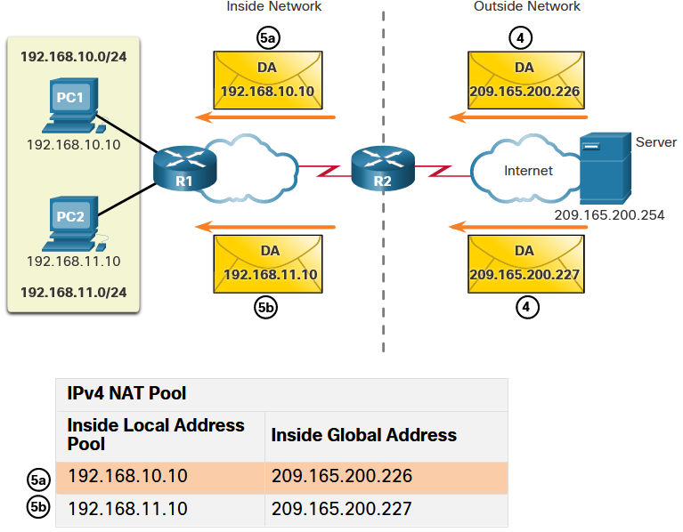
Static NAT Analyze Dynamic NAT – Outside to Inside
Dynamic NAT translation process:
The server receives the packet from PC1 and responds using the destination address of 209.165.200.226. The server receives the packet from PC2, it responds to using the destination address of 209.165.200.227.
(a) When R2 receives the packet with the destination address of 209.165.200.226; it performs a NAT table lookup and translates the address back to the inside local address and forwards the packet toward PC1. (b) When R2 receives the packet with the destination address of 209.165.200.227; it performs a NAT table lookup and translates the address back to the inside local address 192.168.11.10 and forwards the packet toward PC2.
Notes:
6.0 – NAT for IPv4
6.5 – Dynamic NAT
6.5.4 – Analyze Dynamic NAT – Outside to Inside

Slide 42
Static NAT Analyze Dynamic NAT – Outside to Inside (Cont.)
Dynamic NAT translation process:
PC1 and PC2 receive the packets and continue the conversation. The router performs Steps 2 to 5 for each packet.
Notes:
6.0 – NAT for IPv4
6.5 – Dynamic NAT
6.5.4 – Analyze Dynamic NAT – Outside to Inside (Cont.)

Slide 43
Static NAT Verify Dynamic NAT
The output of the show ip nat translations command displays all static translations that have been configured and any dynamic translations that have been created by traffic.
R2# show ip nat translations
Pro Inside global Inside local Outside local Outside global
--- 209.165.200.228 192.168.10.10 --- ---
--- 209.165.200.229 192.168.11.10 --- ---
R2#
Notes:
6.0 – NAT for IPv4
6.5 – Dynamic NAT
6.5.5 – Verify Dynamic NAT

Slide 44
Static NAT Verify Dynamic NAT (Cont.)
Adding the verbose keyword displays additional information about each translation, including how long ago the entry was created and used.
R2# show ip nat translation verbose
Pro Inside global Inside local Outside local Outside global
tcp 209.165.200.228 192.168.10.10 --- ---
create 00:02:11, use 00:02:11 timeout:86400000, left 23:57:48, Map-Id(In): 1,
flags:
none, use_count: 0, entry-id: 10, lc_entries: 0
tcp 209.165.200.229 192.168.11.10 --- ---
create 00:02:10, use 00:02:10 timeout:86400000, left 23:57:49, Map-Id(In): 1,
flags:
none, use_count: 0, entry-id: 12, lc_entries: 0
R2#
Notes:
6.0 – NAT for IPv4
6.5 – Dynamic NAT
6.5.5 – Verify Dynamic NAT (Cont.)

Slide 45
Static NAT Verify Dynamic NAT (Cont.)
By default, translation entries time out after 24 hours, unless the timers have been reconfigured with the ip nat translation timeout timeout-seconds command in global configuration mode. To clear dynamic entries before the timeout has expired, use the clear ip nat translation privileged EXEC mode command.
R2# clear ip nat translation *
R2# show ip nat translation
Command | Description
clear ip nat translation * | Clears all dynamic address translation entries from the NAT translation table.
clear ip nat translation inside global-ip local-ip [outside local-ip global-ip] | Clears a simple dynamic translation entry containing an inside translation or both inside and outside translation.
clear ip nat translation protocol inside global-ip global-port local-ip local-port [ outside local-ip local-port global-ip global-port] | Clears an extended dynamic translation entry.
Notes:
6.0 – NAT for IPv4
6.5 – Dynamic NAT
6.5.5 – Verify Dynamic NAT (Cont.)

Slide 46
Static NAT Verify Dynamic NAT (Cont.)
The show ip nat statistics command displays information about the total number of active translations, NAT configuration parameters, the number of addresses in the pool, and how many of the addresses have been allocated.
R2# show ip nat statistics
Total active translations: 4 (0 static, 4 dynamic; 0 extended)
Peak translations: 4, occurred 00:31:43 ago
Outside interfaces:
Serial0/1/1
Inside interfaces:
Serial0/1/0
Hits: 47 Misses: 0
CEF Translated packets: 47, CEF Punted packets: 0
Expired translations: 5
Dynamic mappings:
-- Inside Source
[Id: 1] access-list 1 pool NAT-POOL1 refcount 4
pool NAT-POOL1: netmask 255.255.255.224
start 209.165.200.226 end 209.165.200.240
type generic, total addresses 15, allocated 2 (13%), misses 0
(output omitted)
R2#
Notes:
6.0 – NAT for IPv4
6.5 – Dynamic NAT
6.5.5 – Verify Dynamic NAT (Cont.)

Slide 47
Static NAT Verify Dynamic NAT (Cont.)
The show running-config command and show s the NAT, ACL, interface, or pool commands with the required values.
R2# show running-config | include NAT
ip nat pool NAT-POOL1 209.165.200.226 209.165.200.240 netmask 255.255.255.224
ip nat inside source list 1 pool NAT-POOL1
Notes:
6.0 – NAT for IPv4
6.5 – Dynamic NAT
6.5.5 – Verify Dynamic NAT (Cont.)

Slide 48
Dynamic NAT Packet Tracer – Configure Dynamic NAT
In this Packet Tracer, you will complete the following objectives:
Configure Dynamic NAT
Verify NAT Implementation
Notes:
6.0 – NAT for IPv4
6.5 – Dynamic NAT
6.4.6 – Packet Tracer – Configure Dynamic NAT

Slide 49
6.6 PAT
Notes:
6.0 – NAT for IPv4
6.6 – PAT

Slide 50
PAT Configure PAT to Use a Single IPv4 Address
To configure PAT to use a single IPv4 address, add the keyword overload to the ip nat inside source command.
In the example, all hosts from network 192.168.0.0/16 (matching ACL 1) that send traffic through router R2 to the internet will be translated to IPv4 address 209.165.200.225 (IPv4 address of interface S0/1/1). The traffic flows will be identified by port numbers in the NAT table because the overload keyword is configured.
R2(config)# ip nat inside source list 1 interface serial 0/1/0 overload
R2(config)# access-list 1 permit 192.168.0.0 0.0.255.255
R2(config)# interface serial0/1/0
R2(config-if)# ip nat inside
R2(config-if)# exit
R2(config)# interface Serial0/1/1
R2(config-if)# ip nat outside
Notes:
6.0 – NAT for IPv4
6.6 – PAT
6.6.2 – Configure PAT to Use a Single IPv4 Address

Slide 51
PAT Configure PAT to Use an Address Pool
An ISP may allocate more than one public IPv4 address to an organization. In this scenario the organization can configure PAT to use a pool of IPv4 public addresses for translation.
To configure PAT for a dynamic NAT address pool, simply add the keyword overload to the ip nat inside source command.
In the example, NAT-POOL2 is bound to an ACL to permit 192.168.0.0/16 to be translated. These hosts can share an IPv4 address from the pool because PAT is enabled with the keyword overload.
R2(config)# ip nat pool NAT-POOL2 209.165.200.226 209.165.200.240 netmask 255.255.255.224
R2(config)# access-list 1 permit 192.168.0.0 0.0.255.255
R2(config)# ip nat inside source list 1 pool NAT-POOL2 overload
R2(config)# interface serial0/1/0
R2(config-if)# ip nat inside
R2(config-if)# interface serial0/1/0
R2(config-if)# ip nat outside
Notes:
6.0 – NAT for IPv4
6.6 – PAT
6.6.3 – Configure PAT to Use an Address Pool

Slide 52
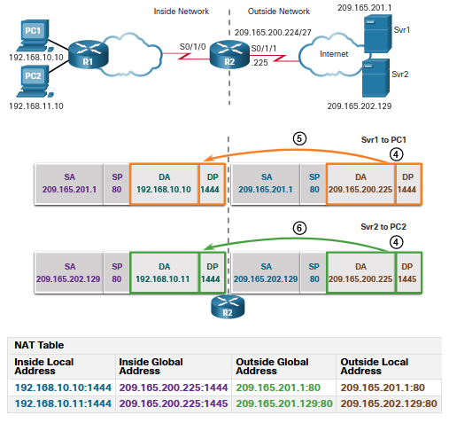
PAT Analyze PAT – Server to PC
PC1 and PC2 send packets to Svr1 and Svr2.
The packet from PC1 reaches R2 first. R2 modifies the source IPv4 address to 209.165.200.225 (inside global address). The packet is then forwarded towards Svr1.
The packet from PC2 arrives at R2. PAT changes the source IPv4 address of PC2 to the inside global address 209.165.200.225. PC2 has the same source port number as the translation for PC1. PAT increments the source port number until it is a unique value in its table. In this instance, 1445.
Notes:
6.0 – NAT for IPv4
6.6 – PAT
6.6.4 – Analyze PAT – Server to PC

Slide 53
PAT Analyze PAT – PC to Server
PC1 and PC2 send packets to Svr1 and Svr2.
The packet from PC1 reaches R2 first. R2 modifies the source IPv4 address to 209.165.200.225 (inside global address). The packet is then forwarded towards Svr1.
The packet from PC2 arrives at R2. PAT changes the source IPv4 address of PC2 to the inside global address 209.165.200.225. PC2 has the same source port number as the translation for PC1. PAT increments the source port number until it is a unique value in its table. In this instance, it is 1445.
Notes:
6.0 – NAT for IPv4
6.6 – PAT
6.6.5 – Analyze PAT – PC to Server

Slide 54
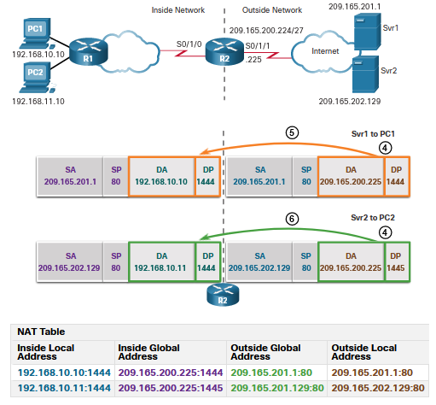
PAT Analyze PAT – Server to PC
The servers use the source port from the received packet as the destination port, and the source address as the destination address for the return traffic.
R2 changes the destination IPv4 address of the packet from Srv1 from 209.165.200.225 to 192.168.10.10, and forwards the packet toward PC1.
R2 changes the destination address of packet from Srv2. from 209.165.200.225 to 192.168.10.11. and modifies the destinations port back to its original value of 1444. The packet is then forwarded toward PC2.
Notes:
6.0 – NAT for IPv4
6.6 – PAT
6.6.5 – Analyze PAT – Server to PC

Slide 55
PAT Verify PAT
The same commands used to verify static and dynamic NAT are used to verify PAT. The show ip nat translations command displays the translations from two different hosts to different web servers. Notice that two different inside hosts are allocated the same IPv4 address of 209.165.200.226 (inside global address). The source port numbers in the NAT table differentiate the two transactions.
R2# show ip nat translations
Pro Inside global Inside local Outside local Outside global
tcp 209.165.200.225:1444 192.168.10.10:1444 209.165.201.1:80 209.165.201.1:80
tcp 209.165.200.225:1445 192.168.11.10:1444 209.165.202.129:80 209.165.202.129:80
R2#
Notes:
6.0 – NAT for IPv4
6.6 – PAT
6.6.6 – Verify PAT

Slide 56
PAT Verify PAT (Cont.)
The show ip nat statistics command verifies that NAT-POOL2 has allocated a single address for both translations. Also shown are the number and type of active translations, NAT configuration parameters, the number of addresses in the pool, and how many have been allocated.
R2# show ip nat statistics
Total active translations: 4 (0 static, 2 dynamic; 2 extended)
Peak translations: 2, occurred 00:31:43 ago
Outside interfaces:
Serial0/1/1
Inside interfaces:
Serial0/1/0
Hits: 4 Misses: 0
CEF Translated packets: 47, CEF Punted packets: 0
Expired translations: 0
Dynamic mappings:
-- Inside Source
[Id: 3] access-list 1 pool NAT-POOL2 refcount 2
pool NAT-POOL2: netmask 255.255.255.224
start 209.165.200.225 end 209.165.200.240
type generic, total addresses 15, allocated 1 (6%), misses 0
(output omitted)
R2#
Notes:
6.0 – NAT for IPv4
6.6 – PAT
6.6.6 – Verify PAT (Cont.)

Slide 57
Dynamic NAT Packet Tracer – Configure PAT
In this Packet Tracer, you will complete the following objectives:
Configure Dynamic NAT with Overload
Verify Dynamic NAT with Overload Implementation
Configure PAT using an Interface
Verify PAT Interface Implementation
Notes:
6.0 – NAT for IPv4
6.6 – Dynamic NAT
6.6.7 – Packet Tracer – Configure PAT

Slide 58
6.7 NAT64
Notes:
6.0 – NAT for IPv4
6.7 – NAT64

Slide 59
NAT64 NAT for IPv6?
IPv6 was developed with the intention of making NAT for IPv4 with translation between public and private IPv4 addresses unnecessary.
However, IPv6 does include its own IPv6 private address space, unique local addresses (ULAs).
IPv6 unique local addresses (ULA) are similar to RFC 1918 private addresses in IPv4 but have a different purpose.
ULA addresses are meant for only local communications within a site. ULA addresses are not meant to provide additional IPv6 address space, nor to provide a level of security.
IPv6 does provide for protocol translation between IPv4 and IPv6 known as NAT64.
Notes:
6.0 – NAT for IPv4
6.7 – NAT64
6.7.1 – NAT for IPv6?

Slide 60
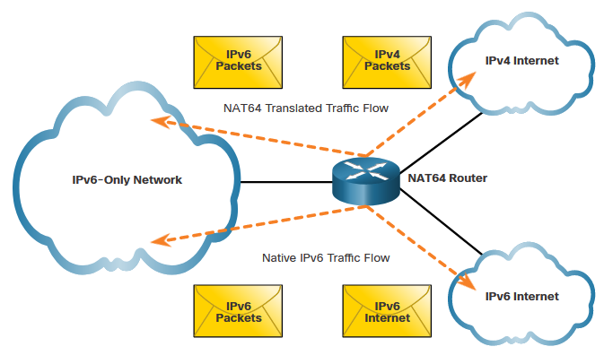
NAT64 NAT64
NAT for IPv6 is used in a much different context than NAT for IPv4.
The varieties of NAT for IPv6 are used to transparently provide access between IPv6-only and IPv4-only networks, as shown. It is not used as a form of private IPv6 to global IPv6 translation.
NAT for IPv6 should not be used as a long-term strategy, but as a temporary mechanism to assist in the migration from IPv4 to IPv6.
Notes:
6.0 – NAT for IPv4
6.7 – NAT64
6.7.2 – NAT64

Slide 61
6.8 Module Practice and Quiz
Notes:
6.0 – NAT for IPv4
6.8 – Module Practice and Quiz

Slide 62
Dynamic NAT Packet Tracer – Configure NAT for IPv4
In this Packet Tracer, you will complete the following objectives:
Configure Dynamic NAT with PAT
Configure Static NAT
Notes:
6.0 – NAT for IPv4
6.8 – Module Practice and Quiz
6.8.1 – Packet Tracer – Configure NAT for IPv4

Slide 63
Dynamic NAT Packet Tracer – Configure NAT for IPv4
In this Lab, you will complete the following objectives:
Build the Network and Configure Basic Device Settings
Configure and verify NAT for IPv4
Configure and verify PAT for IPv4
Configure and verify Static NAT for IPv4
Notes:
6.0 – NAT for IPv4
6.8 – Module Practice and Quiz
6.8.2 – Lab – Configure NAT for IPv4

Slide 64
Module Practice and Quiz What did I learn in this module?
There are not enough public IPv4 addresses to assign a unique address to each device connected to the internet.
The primary use of NAT is to conserve public IPv4 addresses.
In NAT terminology, the inside network is the set of networks that is subject to translation. The outside network refers to all other networks.
NAT terminology is always applied from the perspective of the device with the translated address.
Inside address are the address of the device which is being translated by NAT.
Outside address are the address of the destination device.
Local address is any address that appears on the inside portion of the network.
Global address is any address that appears on the outside portion of the network.
Static NAT uses a one-to-one mapping of local and global addresses.
Dynamic NAT uses a pool of public addresses and assigns them on a first-come, first-served basis.
Notes:
6.0 – NAT for IPv4
6.8 – Module Practice and Quiz
6.8.3 – What did I learn in this module?

Slide 65
Module Practice and Quiz What did I learn in this module? (Cont.)
Port Address Translation (PAT), also known as NAT overload, maps multiple private IPv4 addresses to a single public IPv4 address or a few addresses.
NAT increases forwarding delays because the translation of each IPv4 address within the packet headers takes time.
NAT complicates the use of tunneling protocols, such as IPsec, because NAT modifies values in the headers, causing integrity checks to fail.
The show ip nat translations command displays all static translations that have been configured and any dynamic translations that have been created by traffic.
To clear dynamic entries before the timeout has expired, use the clear ip nat translation privileged EXEC mode command.
IPv6 was developed with the intention of making NAT for IPv4 with translation between public and private IPv4 addresses unnecessary.
IPv6 unique local addresses (ULA) are similar to RFC 1918 private addresses in IPv4 but have a different purpose.
IPv6 does provide for protocol translation between IPv4 and IPv6 known as NAT64.
Notes:
6.0 – NAT for IPv4
6.8 – Module Practice and Quiz
6.8.3 – What did I learn in this module? (Cont.)
6.8.4 – Module Quiz – NAT for IPv4

Slide 66
Module 6: NAT for IPv4 New Terms and Commands
RFC1918 inside local address inside global address outside local address outside global address static NAT dynamic NAT PAT ip nat inside source static show ip nat translations show ip nat statistics ip nat outside ip nat inside ip nat pool clear ip nat translation * Overload NAT 64

