Slide 1
Section 1 - Question 1 - HDB Resale Portal
Candidate Ng Zong Yi · ngzongyi@gmail.com

Slide 2
FRAMING THE QUESTION
Quantify the impact of the HDB Resale Portal
Core Questions to address:
Is the HDB Resale Portal helpful?
did people actually adopt agent-free transactions, has adoption grown over time, and has it helped the resale market move faster?
Does adoption vary across Singapore?
Did it impact property agents' business?
How has the landscape changed, if at all?
what does the HDB resale market actually look like in 2025 vs. 2017, and how much of that is really down to the portal
Candidate Ng Zong Yi · ngzongyi@gmail.com

Slide 3
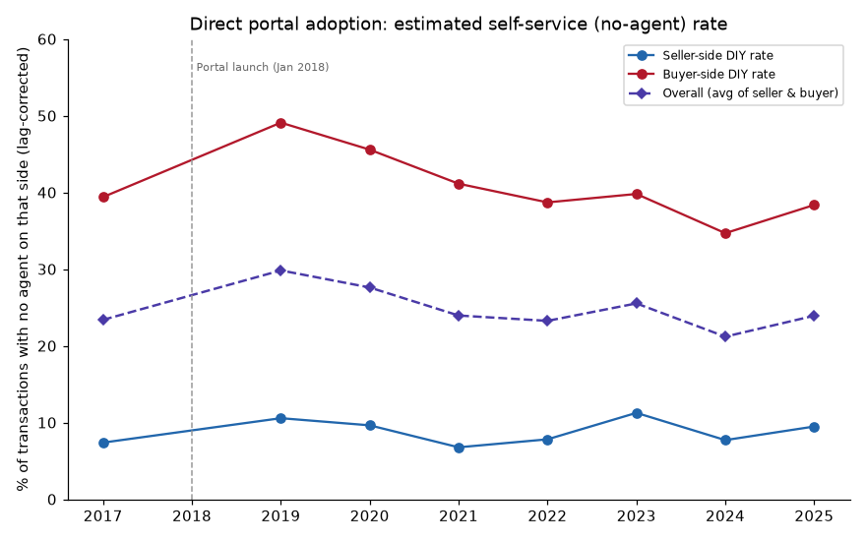
OBJECTIVE 1
Direct Adoption of the Portal
In short: the direct self-service rate hasn't grown since 2017 (~9-10% of sellers, ~35-40% of buyers transact with no agent — flat, not statistically significant), and the resale market didn't structurally speed up at launch either. The most important nuance: a real, temporary spike in self-service did occur in 2019-2020, fully reverting by 2021 — and we can rule out COVID-19 as the cause.
Candidate Ng Zong Yi · ngzongyi@gmail.com

Slide 4
OBJECTIVE 1
Direct Adoption of the Portal
Was the increase in self-service adoption immediately after the Resale Portal launch (2019–2020) driven by the portal itself, or by other external factors?
Could it be due to COVID?
The COVID-19 circuit breaker created a significant monthly reporting artifact. HDB registration volumes fell sharply during April–May 2020 due to paused processing, followed by a surge in June–July as the backlog was cleared.
Excluding the COVID-19 disruption period (April–July 2020) has minimal impact on the annual self-service rate. Seller DIY adoption increased slightly from 9.63% to 10.80%, while buyer adoption changed marginally from 45.57% to 46.09%. This suggests that the observed increase in 2020 was not driven by the temporary COVID-19 disruption.
month_start | transactions | seller engagement_rate | buyer engagement_rate
2020-02 | 1661 | 0.951 | 0.554
2020-03 | 1937 | 0.895 | 0.504
2020-04 | 424 | 4.002 | 2.090
2020-05 | 363 | 4.394 | 2.526
2020-06 | 2438 | 0.160 | 0.099
2020-07 | 2456 | 0.292 | 0.177
2020-08 | 2426 | 0.864 | 0.508
After accounting for alternative explanations (COVID-19, reporting lag), the evidence suggests the Resale Portal contributed to a genuine but short-lived increase in buyer self-service adoption during 2019–2020. In contrast, there is insufficient evidence to conclude that the portal had a similar impact on seller self-service adoption.
Candidate Ng Zong Yi · ngzongyi@gmail.com

Slide 5
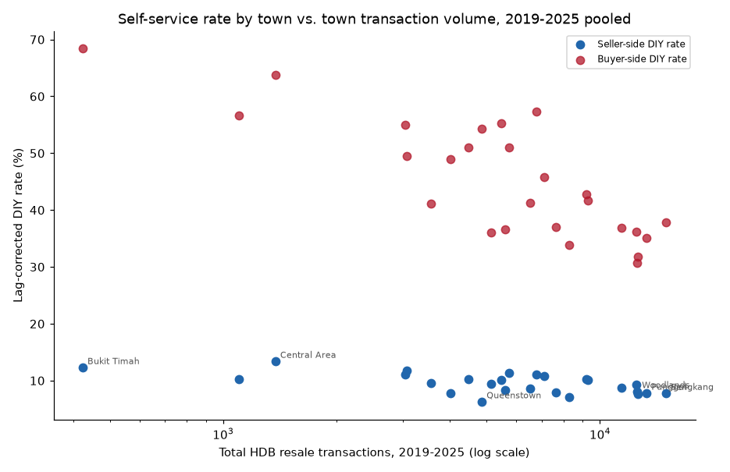
OBJECTIVE 2
Adoption Geography
Key Finding: portal adoption appears relatively stable, but this masks substantial geographic variation across HDB towns. From 2019–2025, seller self-service rates range from 6.3% to 13.4%, while buyer rates range from 31% to 68%.
Smaller towns consistently show higher self-service adoption, highlighting persistent geographic differences in portal usage.
town | transaction | seller diy_rate | buyer diy_rate
CENTRAL AREA | 1377 | 0.134 | 0.638
BUKIT TIMAH | 424 | 0.123 | 0.684
SERANGOON | 3064 | 0.117 | 0.495
TOA PAYOH | 5730 | 0.114 | 0.510
BISHAN | 3038 | 0.111 | 0.550
BUKIT MERAH | 6768 | 0.110 | 0.573
ANG MO KIO | 7108 | 0.108 | 0.458
MARINE PARADE | 1103 | 0.102 | 0.567
GEYLANG | 4472 | 0.102 | 0.510
HOUGANG | 9207 | 0.102 | 0.428
BEDOK | 9274 | 0.102 | 0.417
Smaller towns such as Central Area and Bukit Timah consistently exhibit higher self-service adoption than larger towns such as Sengkang, Punggol, and Woodlands.
Candidate Ng Zong Yi · ngzongyi@gmail.com

Slide 6
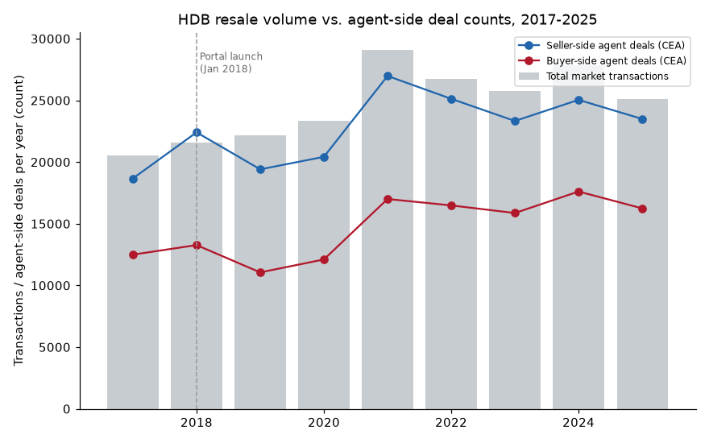
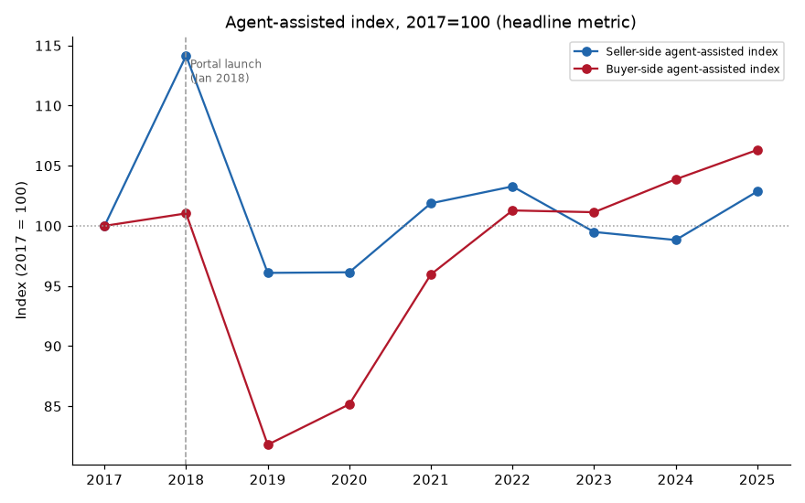
OBJECTIVE 3
Did it impact property agent’s business
Key Finding: Overall, the agent industry remained resilient following the Resale Portal's introduction. Since 2017, the agent workforce has grown by 22%, while productivity and market-share concentration have remained stable.
The key exception is agent churn, which turned negative in 2023–2024, with more agents exiting than entering the profession. As this occurred several years after the portal's launch and does not align with self-service adoption trends, it is more likely driven by broader market or industry factors.
The grey bars (overall market) and coloured lines (agent-handled transactions) move together, showing that agents have kept pace with market growth.
Agent market share remained broadly stable from 2017–2025, with only a temporary dip in 2019–2020 and no evidence of a sustained decline in agents' role.
Candidate Ng Zong Yi · ngzongyi@gmail.com

Slide 7
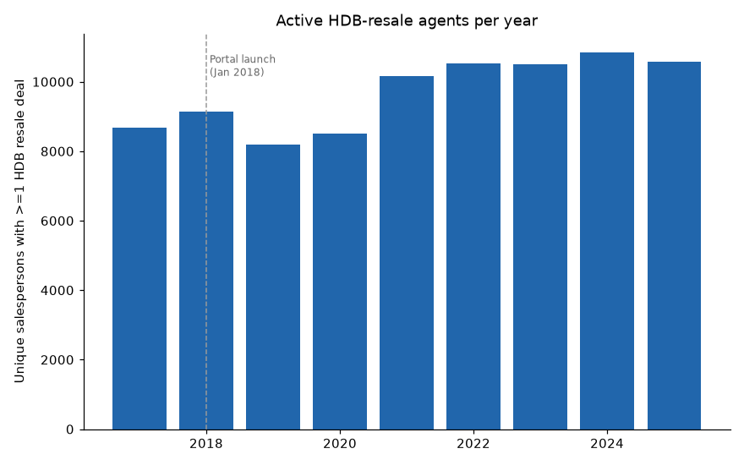
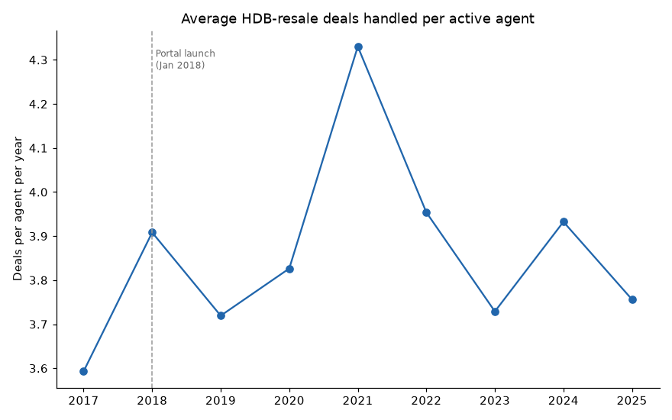
OBJECTIVE 3
Did it impact property agent’s business
Key Finding: Overall, the agent industry remained resilient despite the introduction of the Resale Portal. Since 2017, the agent workforce has grown by 22%, while productivity and market-share concentration have remained broadly stable.
Agents continue to handle a similar number of transactions as in 2017, with a temporary increase during the 2021 resale boom and no evidence of declining workload due to higher self-service adoption.
The number of active agents has continued to grow since 2017, with no evidence that the portal has reduced agent participation.
Candidate Ng Zong Yi · ngzongyi@gmail.com

Slide 8
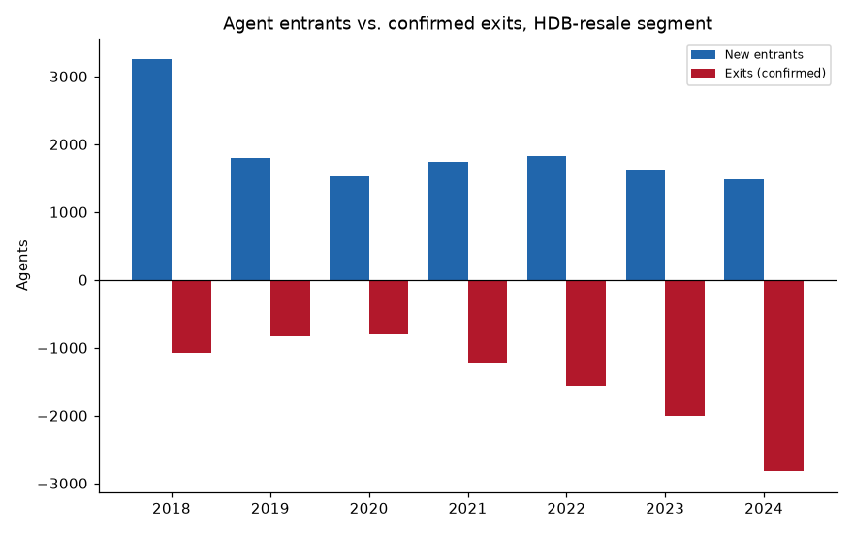
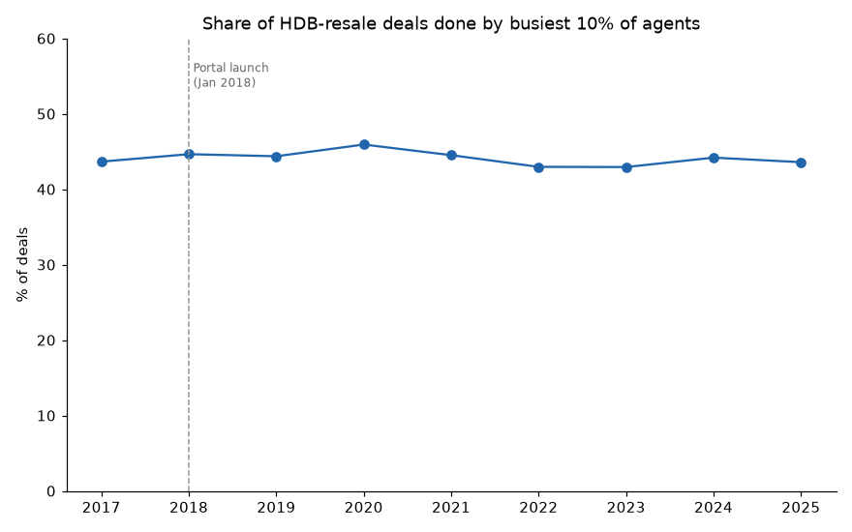
OBJECTIVE 3
Did it impact property agent’s business
Key Finding: The notable exception is agent churn, which turned negative in 2023–2024, with more agents exiting than entering the profession for the first time. As this shift occurred several years after the portal's launch and does not align with the relatively flat self-service adoption trend, it is likely influenced by broader market or industry factors rather than the portal alone.
New agent entries exceeded exits for most of the period, but 2023–2024 marked the first years where agent exits outpaced new entrants.
The top 10% of agents consistently handled a similar share of transactions from 2017–2025, with no evidence of increasing market concentration.
Candidate Ng Zong Yi · ngzongyi@gmail.com

Slide 9
OBJECTIVE 4
How has the landscape changed, since the launch of the Portal
Summary: The HDB resale market has changed substantially since 2017, but the evidence suggests these changes were driven primarily by broader market forces rather than the Resale Portal. This section examines how prices, transaction patterns, self-service adoption, and the agent industry have evolved over the past nine years to distinguish portal-related effects from wider market trends.
The resale market grew significantly, driven primarily by COVID-era demand and rising resale prices rather than the Resale Portal.
Self-service adoption remained broadly stable, with only a temporary increase in buyer adoption during 2019–2020 and no sustained shift away from agents.
The agent industry remained resilient, with workforce size, productivity, and market concentration staying broadly stable despite the portal's introduction.
Agent churn emerged as the key structural change, with more agents exiting than entering from 2023–2024, a trend that appears independent of portal adoption.
Overall, market changes over 2017–2025 were more closely linked to broader property market dynamics than to the Resale Portal itself.
Candidate Ng Zong Yi · ngzongyi@gmail.com

