Slide 1
Section 1 - Question 2 - COE Price Prediction Model
Candidate Ng Zong Yi · ngzongyi@gmail.com

Slide 2
FRAMING THE QUESTION
Objectives
Evaluate whether future Category A and B COE prices can be accurately predicted using only information available before each bidding exercise.
Quantify the independent impact of COE quota on prices, after controlling for other market and economic factors.
Estimate the price sensitivity to quota changes, providing actionable estimates (e.g. the impact of an additional 100 COEs) for policy planning.
Candidate Ng Zong Yi · ngzongyi@gmail.com

Slide 3
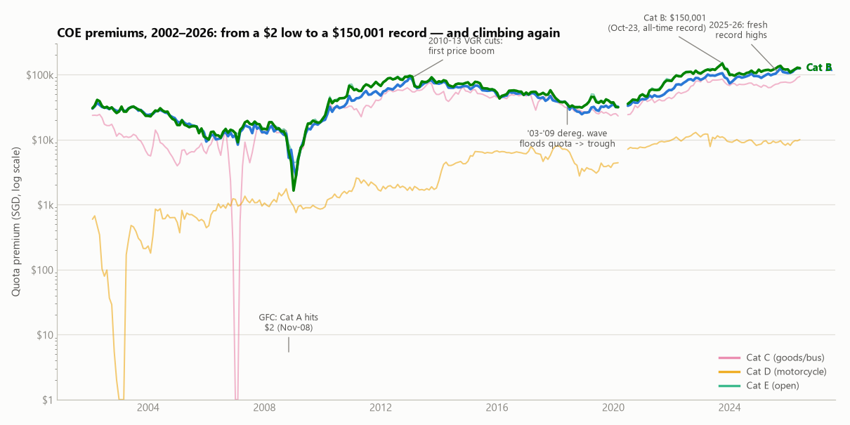
FRAMING THE QUESTION
Exploratory
Key Milestones in Singapore's COE Market
2008–2009 (Global Financial Crisis): Demand collapsed while quota increased from expiring COEs, driving Category A prices to a low of S$2.
2010–2013: Progressive reductions in the Vehicle Growth Rate (3% → 0.5%) tightened COE supply, resulting in a sharp rise in prices.
2014–2019: A surge in COE expiries expanded quota, leading to a sustained six-year decline in COE prices.
2022–Present: Strong post-COVID demand combined with lower COE supply pushed prices to record highs, with Category B reaching S$150,001 (Oct 2023) and new records continuing into 2025–2026.
Candidate Ng Zong Yi · ngzongyi@gmail.com

Slide 4
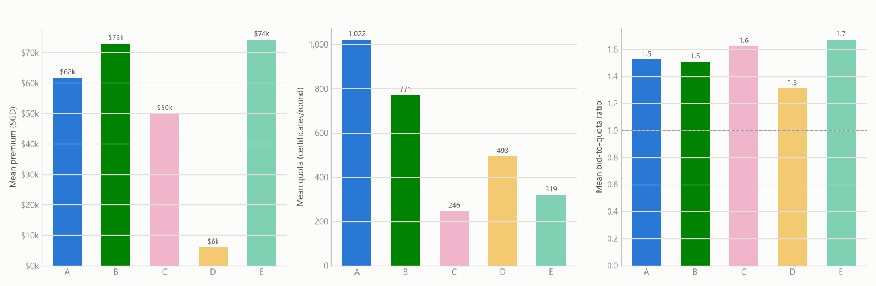
FRAMING THE QUESTION
Exploratory
COE categories exhibit distinct market dynamics—price, quota size, and demand pressure do not move together.
Category A has the largest quota, Category C has the smallest quota despite only mid-range prices and consistently high demand pressure.
Category D is the only category where low prices align with low demand pressure, suggesting different demand behaviour across categories.
These differences justify modelling each COE category separately, rather than applying a single model across all categories.
Candidate Ng Zong Yi · ngzongyi@gmail.com

Slide 5
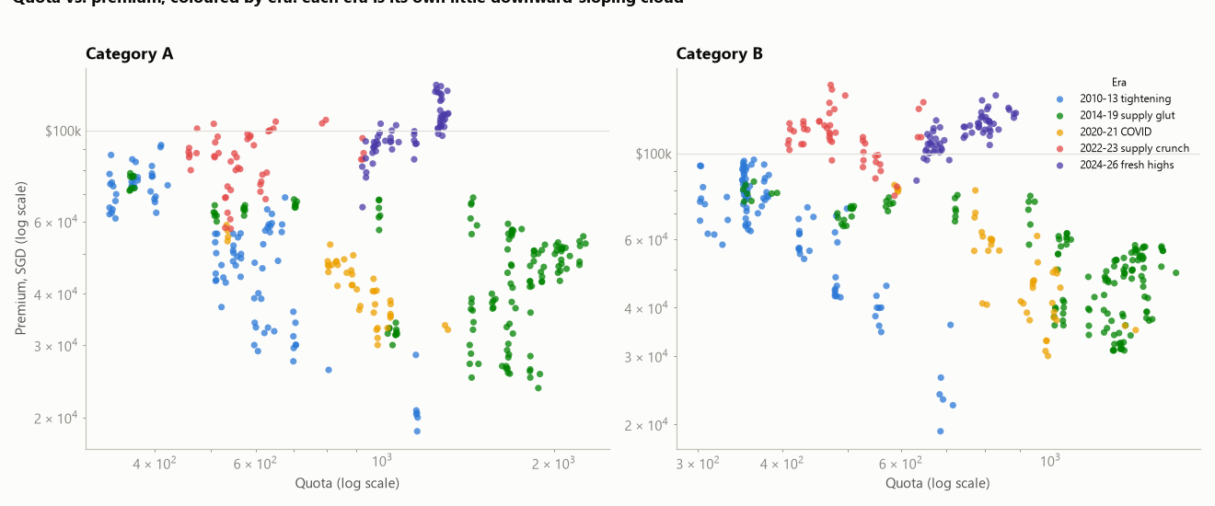
FRAMING THE QUESTION
Exploratory
The quota–price relationship differs across policy periods, rather than following a single consistent trend.
Within each policy era, higher quotas are associated with lower COE prices, as expected.
Differences between policy eras are much larger than variations within an era, meaning historical shifts can mask the true impact of quota.
This motivates controlling for policy era (or year) in the regression model to isolate the true effect of quota on COE prices.
Candidate Ng Zong Yi · ngzongyi@gmail.com

Slide 6
FRAMING THE QUESTION
Exploratory
The quota–price relationship differs across policy periods, rather than following a single consistent trend.
Within each policy era, higher quotas are associated with lower COE prices, as expected.
Differences between policy eras are much larger than variations within an era, meaning historical shifts can mask the true impact of quota.
This motivates controlling for policy era (or year) in the regression model to isolate the true effect of quota on COE prices.
Candidate Ng Zong Yi · ngzongyi@gmail.com

Slide 7
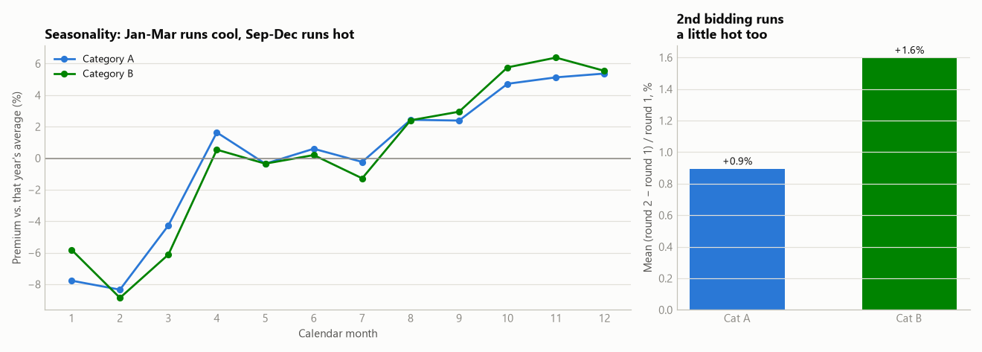
FRAMING THE QUESTION
Exploratory
Left: COE prices exhibit consistent seasonal patterns, with prices typically 4–9% below the annual average in Jan–Mar and 2–6% above in Sep–Dec.
Right: The second bidding exercise each month consistently clears at slightly higher prices than the first (+0.9% for Category A, +1.6% for Category B).
Both seasonal and bidding-round effects are included as control variables to isolate the true impact of quota on COE prices.
Candidate Ng Zong Yi · ngzongyi@gmail.com

Slide 8
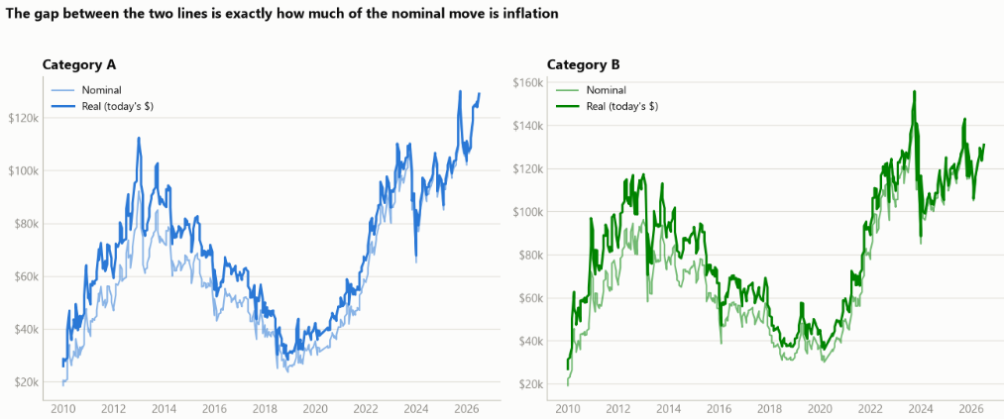
FRAMING THE QUESTION
Exploratory
Nominal vs. real: how much of the "record high" is just inflation?
COE prices have increased substantially in real terms, not just because of inflation.
Since 2010, Category A prices rose +280% nominal (+180% real) and Category B +200% nominal (+120% real), with roughly two-thirds of the increase reflecting genuine market effects.
Adjusting for inflation has little impact on the quota elasticity estimates, as the regression model already controls for year-specific effects.
Candidate Ng Zong Yi · ngzongyi@gmail.com

Slide 9
MODELLING
Explanatory Modelling
Estimating COE Quota Elasticity
Objective: Quantify how a 1% change in COE quota affects COE prices, while holding demand and other factors constant.
Method: A log-log regression is used so the coefficient directly represents the price elasticity of quota.
Model development: Four progressively richer models are built by adding controls for demand (Bid-to-Quota ratio), year effects, seasonality (quarter), and bidding round.
Robust estimation: Newey–West (HAC) standard errors are used to account for correlation between consecutive bidding exercises, providing more reliable statistical inference.
Candidate Ng Zong Yi · ngzongyi@gmail.com

Slide 10
MODELLING
Explanatory Modelling
Model | Category A elasticity | Category A R² | Category B elasticity | Category B R²
M1 plain (ln_premium ~ ln_quota) | -0.251 | 0.10 | -0.461 | 0.25
M2 + demand signal (ln_btq) | -0.235 | 0.10 | -0.463 | 0.25
M3 + year control | -0.313 | 0.94 | -0.432 | 0.93
M4 final (+ quarter, round) | -0.310 | 0.95 | -0.436 | 0.94
A naive regression (M1) performs poorly, explaining only 10% (Category A) and 25% (Category B) of price variation due to multi-year market cycles.
Adding year controls (M3) captures these market-wide effects, increasing model fit dramatically to 93–95% R² for both categories.
The corrected model also removes bias in the elasticity estimate, with a substantial adjustment for Category A and only a minor change for Category B.
Candidate Ng Zong Yi · ngzongyi@gmail.com

Slide 11
MODELLING
Explanatory Modelling
Category | Elasticity | 95% CI | p-value | R² | n
Category A | -0.310 | [-0.40, -0.22] | <0.001 | 0.945 | 391
Category B | -0.436 | [-0.61, -0.26] | <0.001 | 0.937 | 391
Robustness check | Result
Differencing (∆ instead of levels) | -0.12 (A) / -0.20 (B) -- same sign, significant
Real vs. nominal (CPI-deflated) | -0.30 vs -0.31 (A), -0.41 vs -0.44 (B) -- barely moves
Category interaction test | B is +0.11 steeper than A (p=0.003) -- real difference
Cross-category spillover | Not significant (p=0.80 / 0.18) -- treat as separate levers
Candidate Ng Zong Yi · ngzongyi@gmail.com

Slide 12
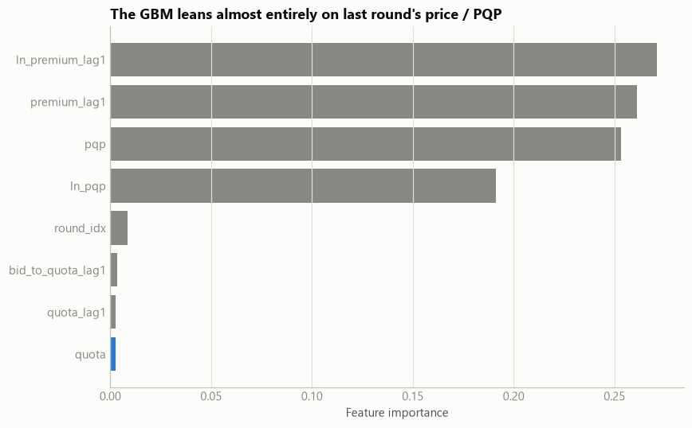
MODELLING
Explanatory Modelling
Model | MAE | RMSE | MAPE % | R²
1. Naive (last round) | 4,036 | 5,294 | 3.61 | 0.800
2. PQP as predictor | 3,987 | 5,257 | 3.55 | 0.803
3. Gradient Boosting | 4,868 | 6,146 | 4.28 | 0.730
4. Hybrid (persistence + elasticity) | 4,203 | 5,429 | 3.75 | 0.789
Simple baselines (e.g. last round's price or PQP) outperform more complex machine learning models for short-term COE price forecasting.
COE prices behave similarly to a random walk, making future prices inherently difficult to predict beyond recent market prices.
Quota has limited value for next-round prediction once recent prices are known, but it remains a significant driver of the overall COE price level.
Recommendation: Use PQP/last round's price for operational forecasting, and the elasticity model for evaluating the impact of quota policy changes.
Candidate Ng Zong Yi · ngzongyi@gmail.com

Slide 13
MODELLING
Back testing
To validate the elasticity model, we compared its predictions against a real quota increase introduced by LTA in May 2023.
Category | Quota change | Model-implied price change | Actual price change
Category A | +11.1% | -3.2% | -3.5%
Category B | +5.9% | -2.5% | -1.1%
Category A: The model closely matched reality. An 11.1% quota increase was predicted to reduce prices by 3.2%, while the actual price fell by 3.5%, showing excellent agreement in both direction and magnitude.
Category B: The model correctly predicted a price decline following a 5.9% quota increase, although the actual drop (1.1%) was smaller than the predicted 2.5% due to stronger demand, reflected by the higher bid-to-quota ratio (1.30 → 1.38).
Overall: The model reliably captures the direction and approximate magnitude of quota-driven price changes. Differences from actual outcomes are largely explained by concurrent changes in demand, making it best suited as a policy decision-support tool rather than an exact price forecasting model.
Candidate Ng Zong Yi · ngzongyi@gmail.com

