Slide 1
Section 2 - Demand Forecasting for Childcare Places
Candidate Ng Zong Yi · ngzongyi@gmail.com

Slide 2
FRAMING THE QUESTION
Problem Statement: Where Should Future Childcare Capacity Be Built?
Hypotheses
The analysis is built around three testable hypotheses, each evaluated against the evidence in Section 8.
If these hypotheses hold, the recommendations naturally separate into two strategies: build new capacity in high-growth BTO areas and relocate or right-size capacity in mature estates with declining demand.
# | Hypothesis | Supporting Evidence
H1 | The childcare shortage is driven by spatial misallocation, not an overall national capacity shortage. | Large variation in demand–supply gaps across subzones despite adequate national capacity.
H2 | BTO completions are a leading indicator of future childcare shortages. | Subzones with large BTO pipelines experience the fastest growth in childcare demand and the largest projected shortages.
H3 | Falling fertility will reduce demand in mature, non-BTO estates. | Mature estates with limited BTO activity show stable or declining child populations, making them potential candidates for capacity reallocation.
Candidate Ng Zong Yi · ngzongyi@gmail.com

Slide 3
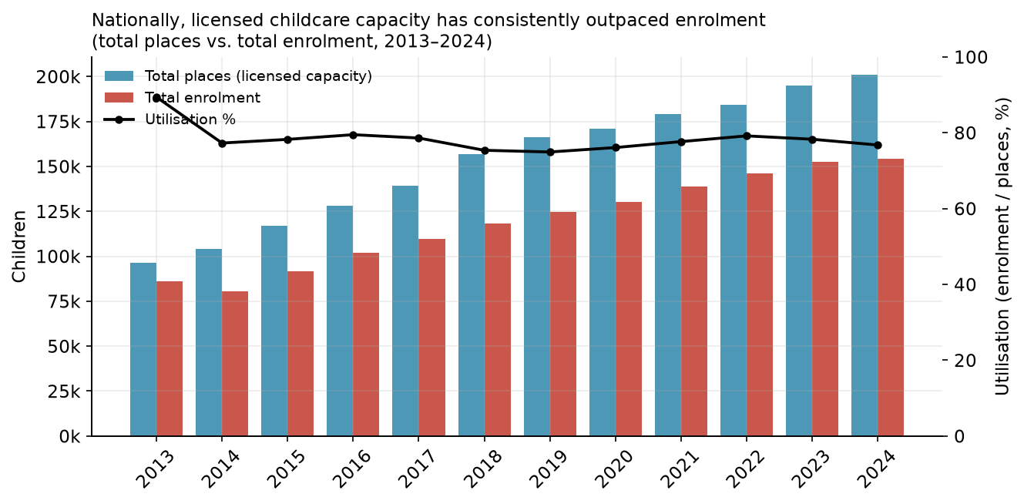
FRAMING THE QUESTION
Is Shortage due to misallocation or overall capacity shortage?
National childcare utilisation has remained below ~80%, suggesting Singapore's challenge is not an overall shortage of childcare places.
The issue is likely a geographic mismatch between where childcare capacity exists and where demand is concentrated, shifting the focus from building more centres to placing them in the right locations.
This validates that hypothesis by identifying regional demand–supply gaps and assessing whether observed cases (*The Big Read* illustrates it with named estates (Punggol acute, Tiong Bahru comfortable)) are reflected in the data.
Candidate Ng Zong Yi · ngzongyi@gmail.com

Slide 4
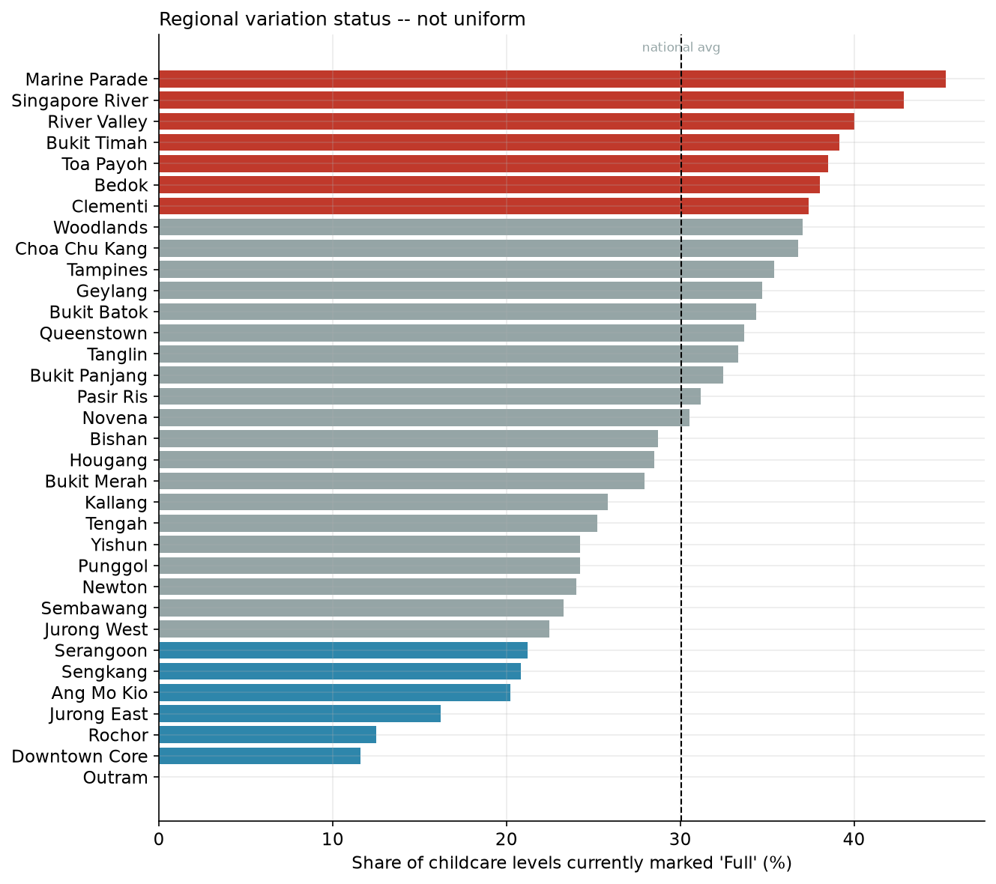
FRAMING THE QUESTION
Where are the Shortages?
The highest childcare occupancy is concentrated in mature, central estates such as Marine Parade, Singapore River, River Valley, Bukit Timah, and Toa Payoh.
Newer BTO towns such as Punggol, Tengah, Sengkang, and Bukit Batok are not the most capacity-constrained today, despite their projected demand growth.
These findings suggest different intervention strategies: expand capacity in fast-growing towns while addressing oversubscribed centres in mature estates through targeted expansion.
Candidate Ng Zong Yi · ngzongyi@gmail.com

Slide 5
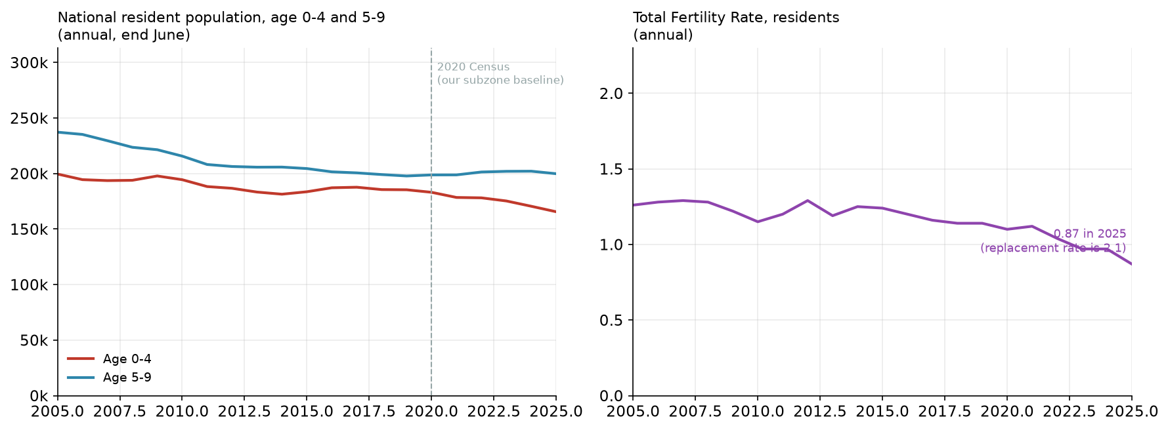
FRAMING THE QUESTION
Falling fertility will reduce demand in mature, non-BTO estates?
The national 0–4 child population has been declining in line with falling fertility rates, providing the baseline for understanding future childcare demand across subzones.
Candidate Ng Zong Yi · ngzongyi@gmail.com

Slide 6
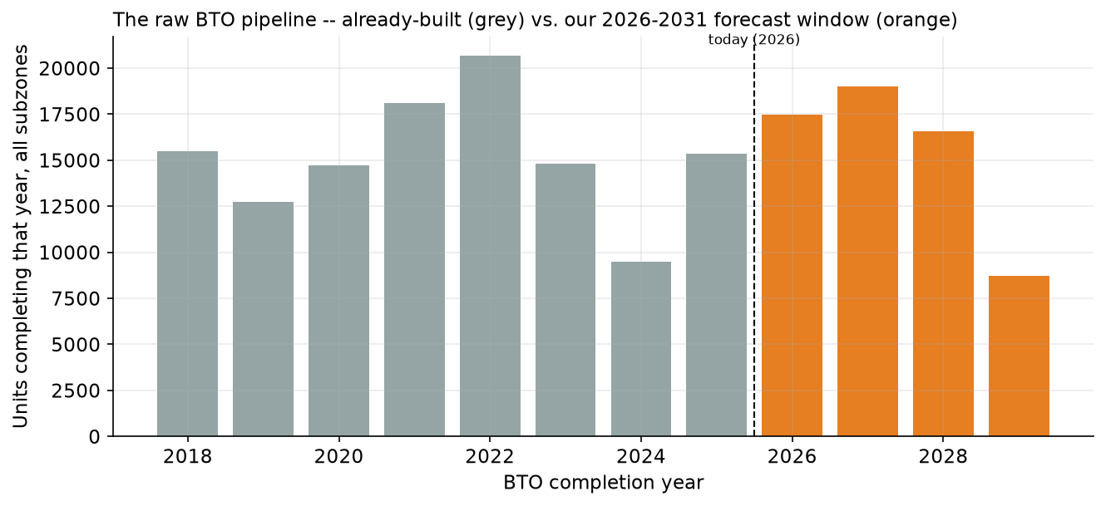
FRAMING THE QUESTION
BTO Forecast and its impact to Childcare Demand?
5.13% of Singapore's population falls within the 18-month to 6-year childcare age group (2020 Census).
Applying this to a 3.2-person average BTO household gives a baseline of 0.164 childcare-age children per BTO unit.
A 1.7× uplift is applied to reflect that BTO buyers are predominantly young, first-time families.
Final assumption: 0.28 childcare-age children per BTO unit, used throughout the demand forecast.
66% of the BTO pipeline (121,419 units) has already been completed, contributing an estimated ~34,000 additional childcare-age children beyond the 2020 Census baseline and justifying the BTO adjustment.
The remaining 61,840 units (2026–2031) are projected to add ~17,300 children, with demand phased in over time as projects are completed and occupied.
Candidate Ng Zong Yi · ngzongyi@gmail.com

Slide 7
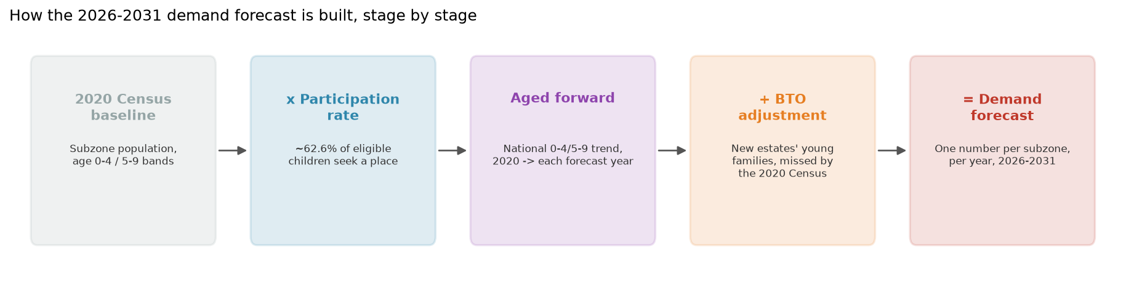
MODELLING THE FORECAST
Forecast Modelling
Estimate the eligible childcare population (18 months–6 years) by assuming an even age distribution within Census age bands: 18 months–4 years = 3.5/5 (70%) of the 0–4 population, and 5–6 years = 2/5 (40%) of the 5–9 population.
Estimate childcare demand by applying the 2020 national participation rate of 66%, calculated as 96,102 enrolled children ÷ 145,289 estimated eligible children, to convert the eligible population into expected enrolment.
Project future demand by first aging the baseline population using national child population trends, then adding BTO-driven demand based on 0.28 childcare-age children per completed BTO unit, phased in according to project completion and occupancy.
Output: annual childcare demand estimates for every subzone from 2026–2031, which are compared against existing childcare supply to identify future shortages.
Candidate Ng Zong Yi · ngzongyi@gmail.com

Slide 8
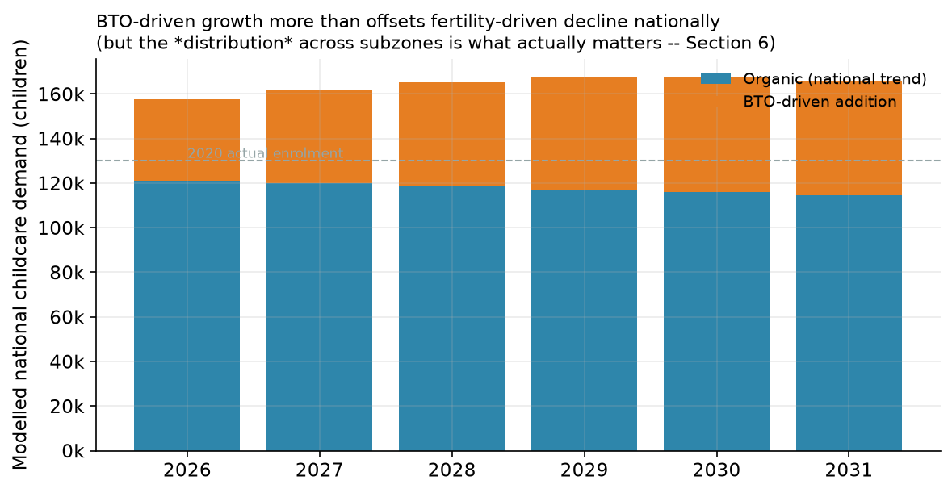
MODELLING THE FORECAST
Forecast Modelling
Aging forward + BTO: how national demand actually moves
Organic: national 0-4/5-9 trend aged forward from 2020 — tracking the fertility decline.
+ BTO-driven: each project phases in gradually — half-weight in its completion year, full from the year after. Not switched on overnight.
Net: BTO growth more than offsets the fertility decline — a modest +5% national rise, 2026→2031
Candidate Ng Zong Yi · ngzongyi@gmail.com

Slide 9
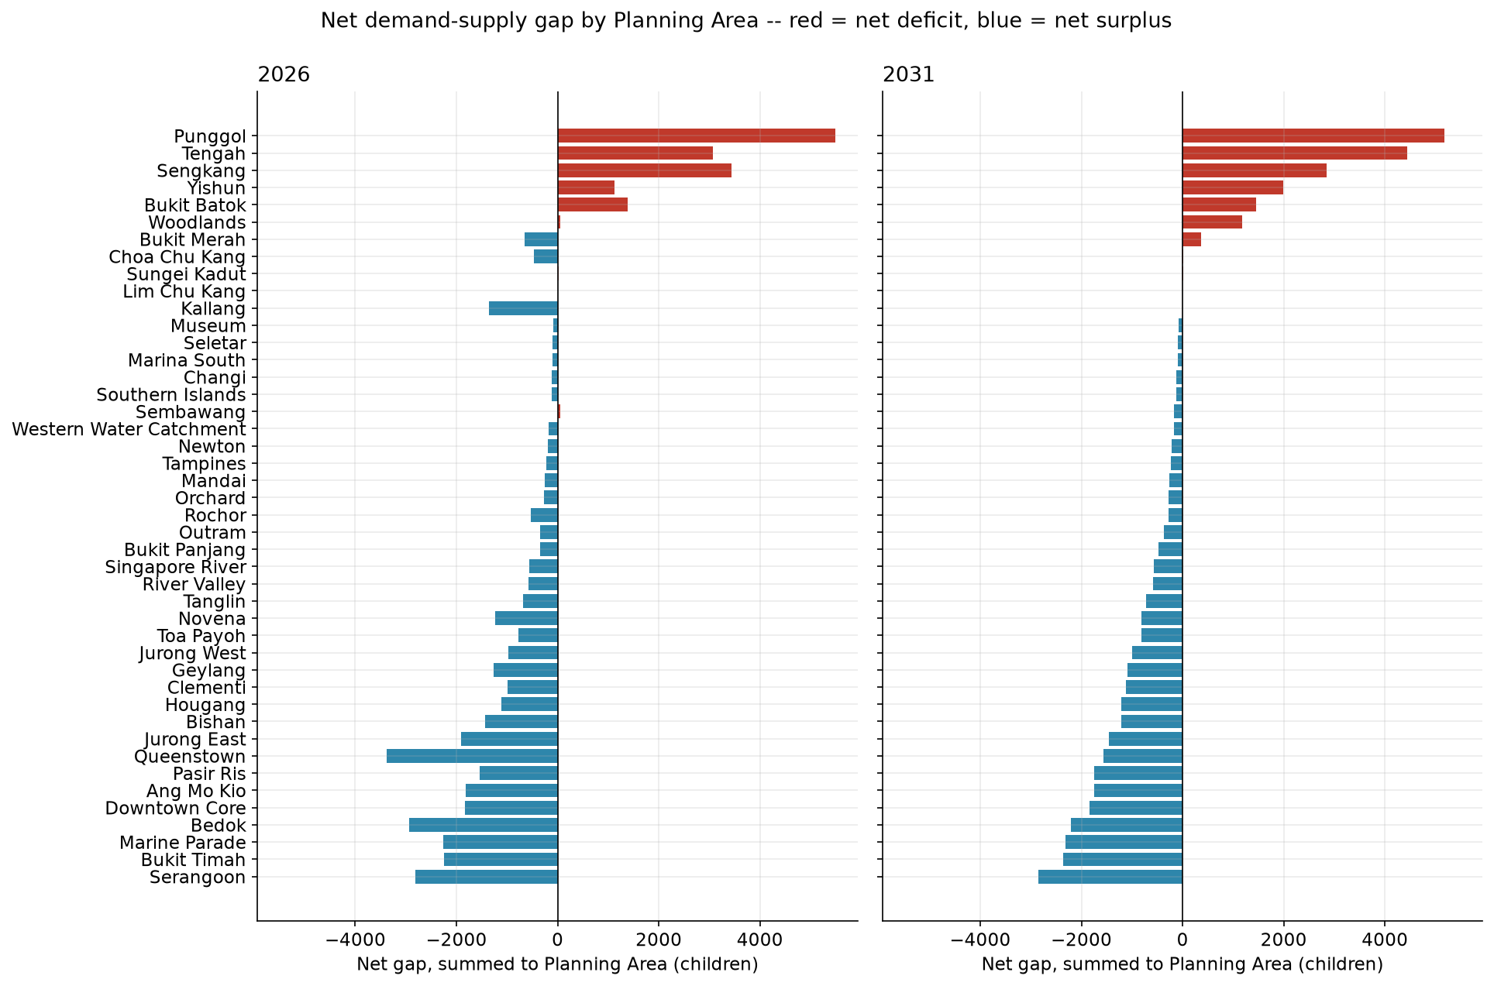
GAPS
Gap Analysis & Prioritization
Only 10 of 44 Planning Areas are projected to face a net childcare deficit by 2031, compared with 89 deficit subzones, as local surpluses and deficits offset each other when aggregated.
This shows that childcare shortages are primarily a subzone-level issue, with underserved subzones often hidden within Planning Areas that appear adequately served overall.
Punggol records the largest projected net deficit (+5,182 children), consistent with its large BTO pipeline and rapidly growing young-family population.
Serangoon records the largest projected net surplus (−2,852 children), making it a strong candidate for future capacity optimisation or relocation as demand shifts over time.
Candidate Ng Zong Yi · ngzongyi@gmail.com

Slide 10
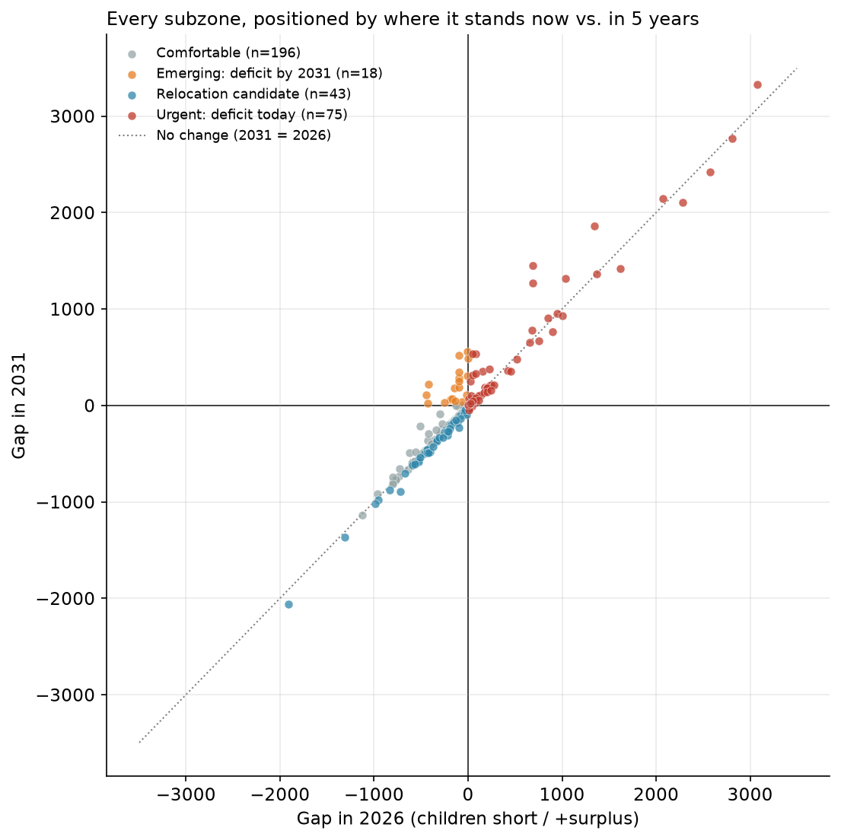
GAPS
Gap Analysis & Prioritization
The chart compares each subzone's childcare gap today (x-axis) against its projected gap in 2031 (y-axis).
Subzones above the diagonal line are projected to see worsening shortages, while those below are expected to improve over time.
Existing deficit subzones (red) largely remain in deficit or deteriorate further, indicating persistent capacity shortfalls.
Emerging deficit subzones (orange) are currently well served but are projected to fall into deficit by 2031, largely driven by upcoming BTO completions, while relocation candidates (green) become increasingly surplus over time.
Urgent (75): deficit today.
Emerging (18): fine today, deficit by 2031 — 100% have an active BTO pipeline.
Relocation candidates (43): growing surplus, 79% with zero BTO activity.
Comfortable (196): the rest.
Candidate Ng Zong Yi · ngzongyi@gmail.com

Slide 11
PRIORITIZATION
List 1 — build or relocate priority
subzone | planning_area | category | n_centres | gap_2026 | gap_2031 | centres_needed_2031 | bto_share_2031
Brickworks | Bukit Batok | Urgent: deficit today | 12 | 3073 | 3329 | 34 | 72%
Tampines North | Tampines | Urgent: deficit today | 1 | 2808 | 2766 | 28 | 86%
Yishun East | Yishun | Urgent: deficit today | 25 | 2575 | 2422 | 25 | 47%
Matilda | Punggol | Urgent: deficit today | 14 | 2070 | 2144 | 22 | 11%
Fernvale | Sengkang | Urgent: deficit today | 23 | 2281 | 2108 | 22 | 31%
Plantation | Tengah | Urgent: deficit today | 4 | 1346 | 1859 | 19 | 100%
Lower Seletar | Yishun | Urgent: deficit today | 6 | 689 | 1447 | 15 | 41%
Waterway East | Punggol | Urgent: deficit today | 24 | 1615 | 1419 | 15 | 17%
Northshore | Punggol | Urgent: deficit today | 16 | 1367 | 1366 | 14 | 100%
Park | Tengah | Urgent: deficit today | 5 | 1039 | 1317 | 14 | 100%
Garden | Tengah | Urgent: deficit today | 5 | 689 | 1271 | 13 | 100%
Keat Hong | Choa Chu Kang | Urgent: deficit today | 14 | 944 | 955 | 10 | 19%
Sembawang East | Sembawang | Urgent: deficit today | 9 | 1007 | 931 | 10 | 49%
Woodlands West | Woodlands | Urgent: deficit today | 8 | 853 | 909 | 10 | 48%
Woodlands South | Woodlands | Urgent: deficit today | 11 | 677 | 778 | 8 | 25%
Candidate Ng Zong Yi · ngzongyi@gmail.com

Slide 12
PRIORITIZATION
List 2 — Relocation Candidates
subzone | planning_area | n_centres | gap_2026 | gap_2031 | gap_trend
Woodlands East | Woodlands | 42 | -717 | -894 | -177
Tampines East | Tampines | 54 | -1906 | -2062 | -156
Sengkang Town Centre | Sengkang | 24 | -100 | -228 | -129
Jurong West Central | Jurong West | 21 | -217 | -306 | -89
Punggol Field | Punggol | 18 | -12 | -98 | -85
Yunnan | Jurong West | 22 | -406 | -483 | -78
Yishun South | Yishun | 16 | -424 | -493 | -69
Sembawang Central | Sembawang | 19 | -266 | -332 | -65
Yishun West | Yishun | 14 | -207 | -270 | -63
Pasir Ris Drive | Pasir Ris | 17 | -526 | -588 | -62
Peng Siang | Choa Chu Kang | 12 | -114 | -173 | -59
Midview | Woodlands | 14 | -369 | -426 | -57
Fajar | Bukit Panjang | 11 | -82 | -136 | -55
Frankel | Bedok | 24 | -1313 | -1365 | -51
Simei | Tampines | 14 | -440 | -489 | -48
Candidate Ng Zong Yi · ngzongyi@gmail.com

Slide 13
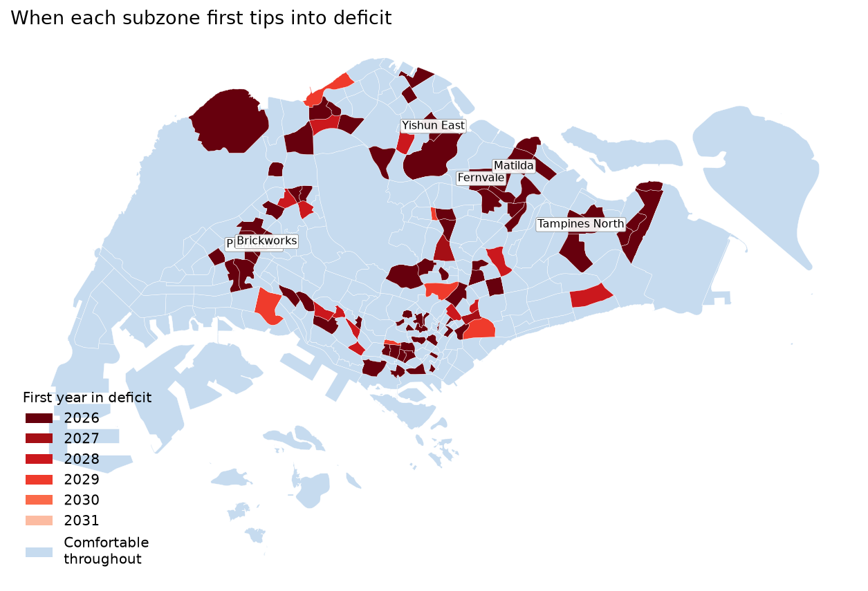
FORWARD LOOKING
Deficiency Roadmap Map
What the map shows: The darkest red areas represent subzones already facing childcare shortages today, concentrated across both mature estates and newer towns undergoing significant BTO development. Over time, additional BTO clusters gradually transition into deficit as new housing is completed and occupied. In contrast, the blue areas remain comfortably served throughout the forecast period, making them the strongest candidates for future capacity relocation rather than new centre construction.
Candidate Ng Zong Yi · ngzongyi@gmail.com

Slide 14
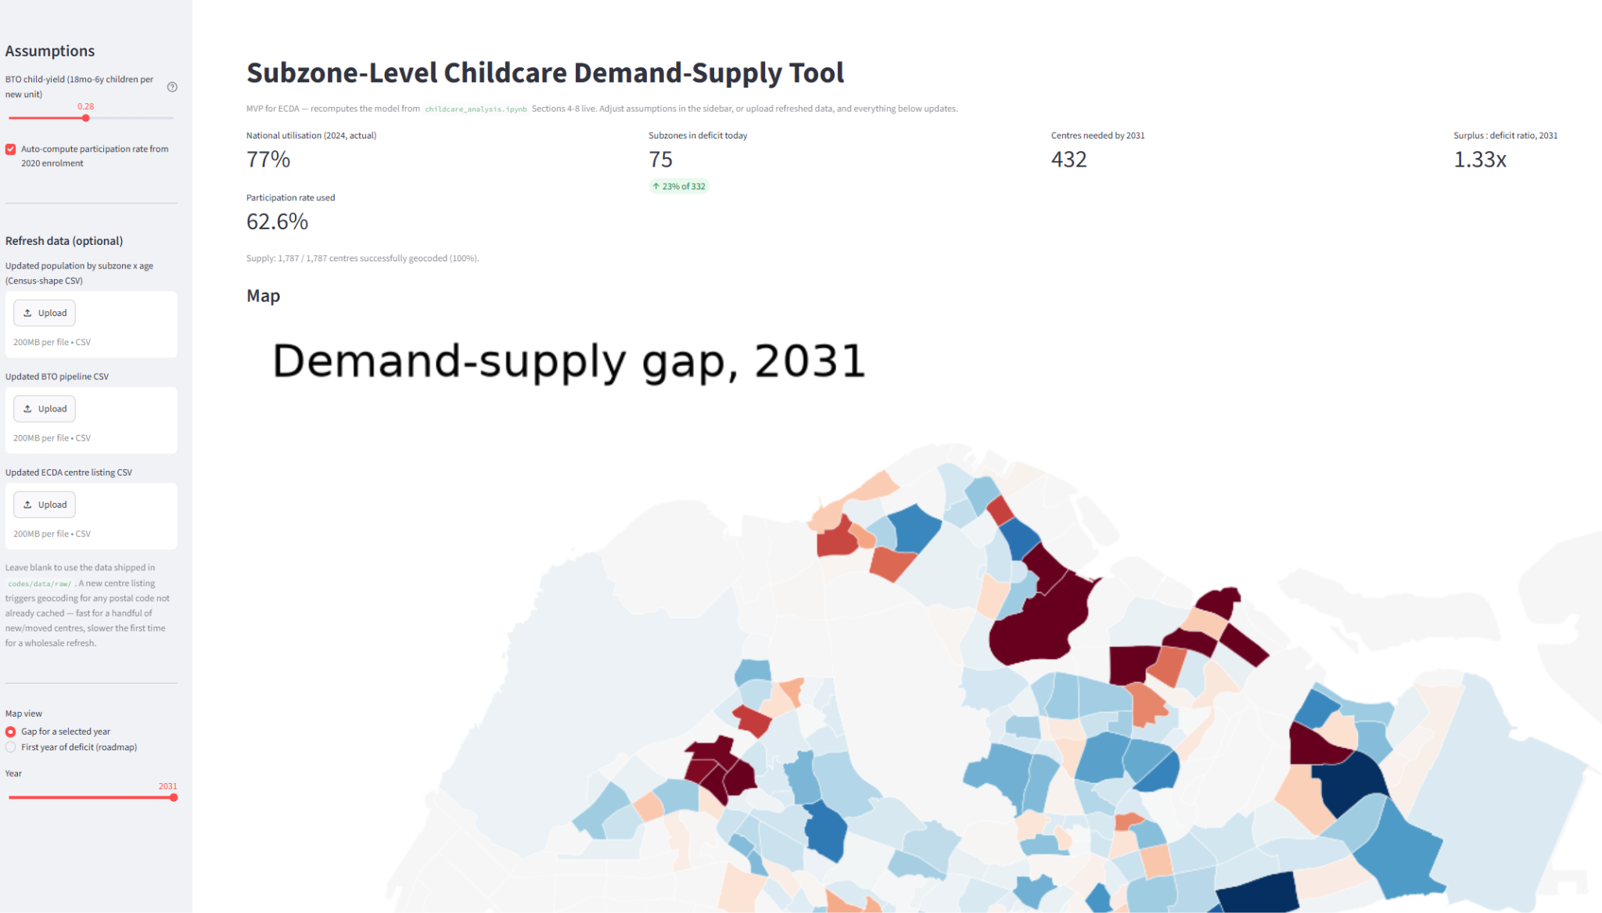
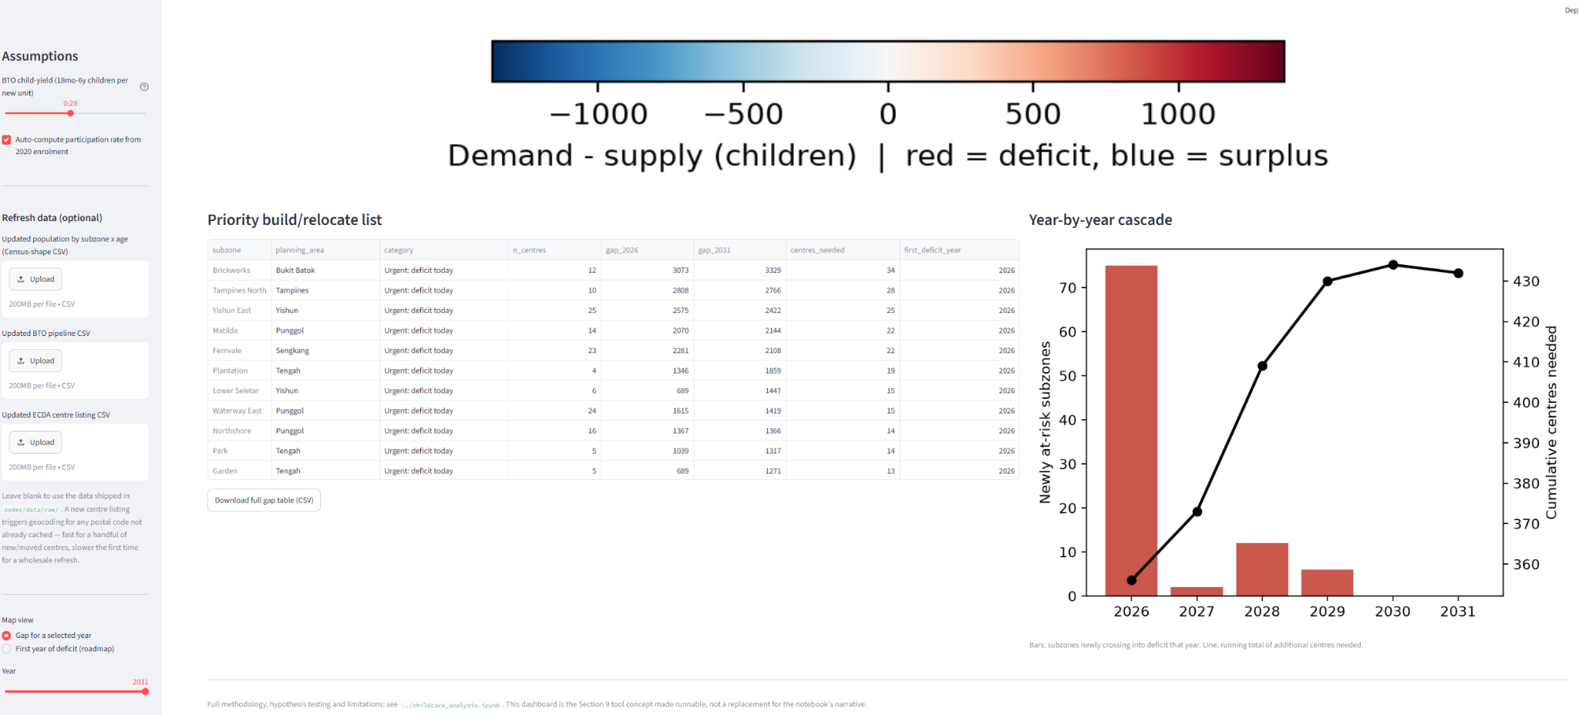
TOOLING
Forecast Tools
Live demand–supply forecasting: Instantly recalculates childcare gaps as assumptions (e.g. BTO child yield and participation rate) are adjusted, updating maps, KPIs, priority rankings, and charts in real time.
Interactive scenario analysis: Supports multiple map views (gap magnitude by forecast year or first year in deficit) and exports the resulting gap tables under the selected assumptions.
Data refresh capability: Allows users to upload updated population, BTO, or childcare centre datasets, with automatic recalculation and efficient re-geocoding of new centres.
How to run it:
From the section-2-case-study/codes/tool folder:
pip install -r requirements.txt
streamlit run app.py
Candidate Ng Zong Yi · ngzongyi@gmail.com

