Slide 1
CSE 460: VLSI Design (Lab)
Experiment 3 (Example)
with Mealy and Moore Type

Slide 2

Finite State Machine
In Combinational logic circuits, outputs are determined solely by the present values of the inputs.
In Sequential circuits, outputs depend both on the past behavior of the circuit and the present values of the inputs. The storage elements in terms of flip-flops can reserve the state information of the logic circuit at any given time.
The sequential circuits in which a clock signal is used to control the operation of the circuit, is called synchronous sequential circuits. These synchronous sequential circuits are known in general as Finite State Machines (FSMs).
The building blocks of a finite machine are combinational circuits and one or more flip-flops. Under the control of the clock signal, the flip-flops change their state as determined by the combinational logic.
Combinational
circuit
Flip-flops
Combinational
circuit
W
Q
Z
Clock

Slide 3
Finite State Machine
FSMs can be of two types:
Moore type FSM
The sequential circuits whose outputs depend only on the states of the circuit are of Moore type.
Mealy type FSM
The sequential circuits whose outputs depend on both the state and the present primary inputs are of Mealy type
Combinational
circuit
Flip-flops
Combinational
circuit
W
Q
Z
Clock

Slide 4
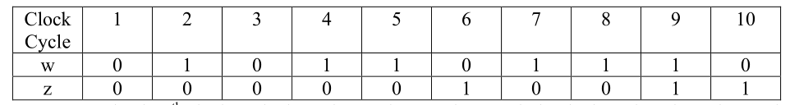
Moore Type FSM
Problem:
Suppose that we wish to design a circuit that meets the following specification:
The circuit has one input, w, and one output, z.
All changes in the circuit occur on the positive edge of a clock signal.
The output z is equal to 1 if during two immediately preceding clock cycles the input w was equal to 1. Otherwise, the value of z is equal to 0.
Input-output combination:

Slide 5

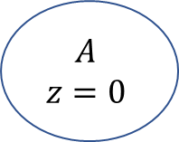

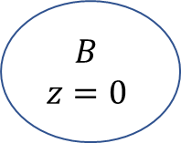



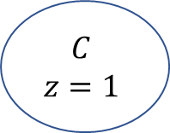

Moore Type FSM
$$w=1$$
$$A$$
$$z=0$$
$$B$$
$$z=0$$
$$w=0$$
Present State | Next State |  | Output z
 | w=0 | w=1
A | A | B | 0
B | A | C | 0
C | A | C | 1
$$w=0$$
$$w=1$$
$$w=0$$
$$C$$
$$z=1$$
Figure : State Table
$$w=1$$
Figure : State Diagram

Slide 6
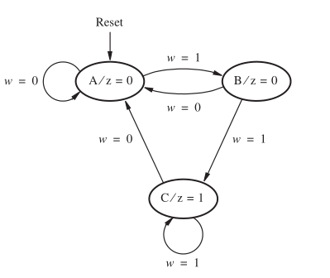
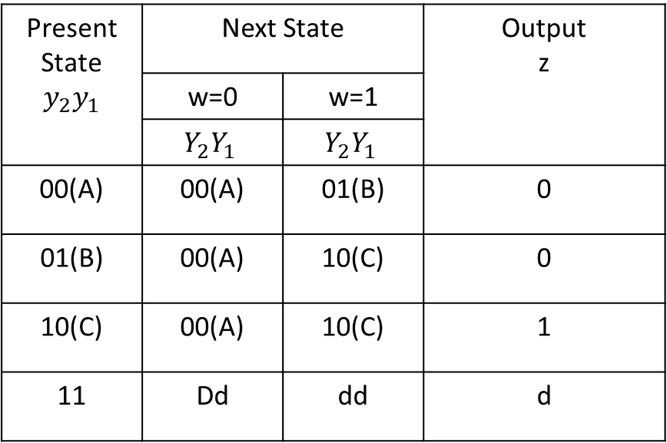
Moore Type FSM
Present State $$y_{2}y_{1}$$ | Next State |  | Output z
 | w=0 | w=1
 | $$Y_{2}Y_{1}$$ | $$Y_{2}Y_{1}$$
00(A) | 00(A) | 01(B) | 0
01(B) | 00(A) | 10(C) | 0
10(C) | 00(A) | 10(C) | 1
11 | Dd | dd | d
Figure : State Diagram

Slide 7
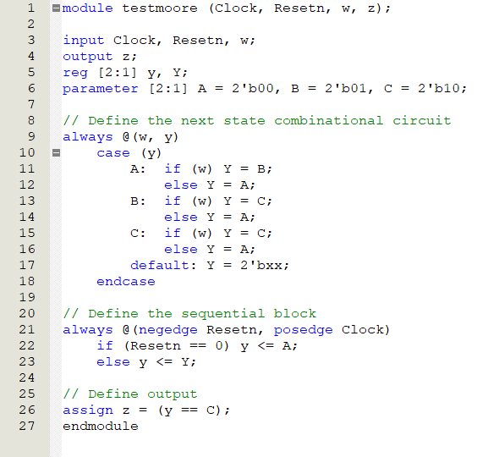
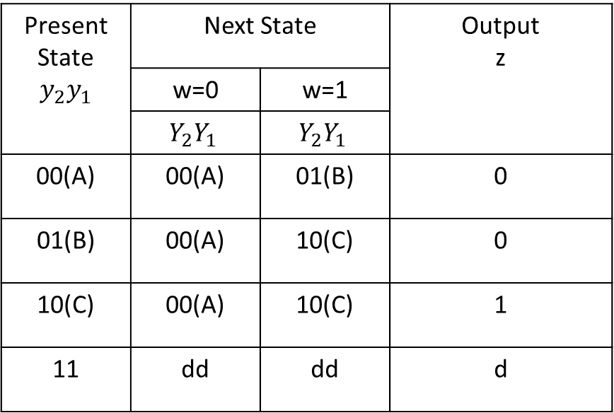
Moore Type FSM
Present State $$y_{2}y_{1}$$ | Next State |  | Output z
 | w=0 | w=1
 | $$Y_{2}Y_{1}$$ | $$Y_{2}Y_{1}$$
00(A) | 00(A) | 01(B) | 0
01(B) | 00(A) | 10(C) | 0
10(C) | 00(A) | 10(C) | 1
11 | dd | dd | d

Slide 8
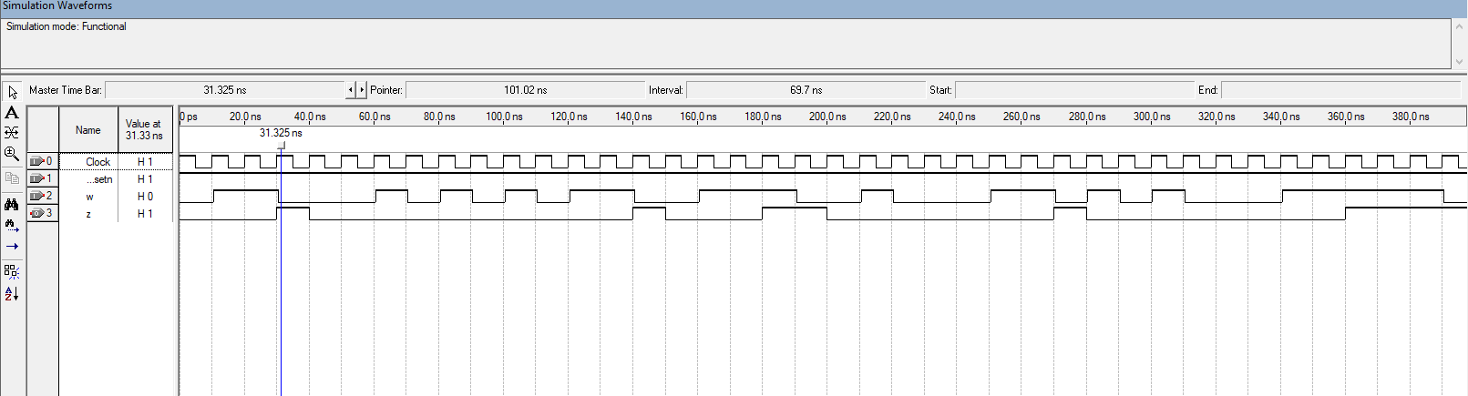
Moore Type FSM

Slide 9
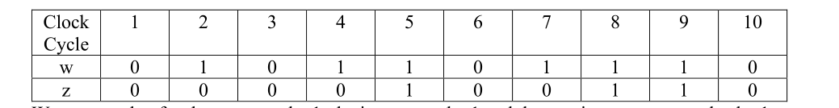
Mealy Type FSM
Problem:
We wish to design a circuit that meets the following specification:
The circuit has one input, w, and one output, z.
All changes in the circuit occur on the positive edge of a clock signal.
The output z is equal to 1 if during two immediate clock cycles the input w was equal to 1. Otherwise, the value of z is equal to 0.
Input-output combination:

Slide 10

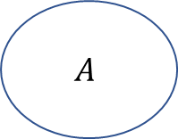



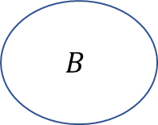
Mealy Type FSM
$w=1$ / $z=0$
Present State | Next State |  | Output z
 | w=0 | w=1 | w=0 | w=1
A | A | B | 0 | 0
B | A | B | 0 | 1
$$A$$
$$B$$
$w=0$ / $z=0$
$w=1$ / $z=1$
$w=0$ / $z=0$
Figure : State Table
Figure : State Diagram

Slide 11
Mealy Type FSM
Present State | Next State |  | Output z
 | w=0 | w=1 | w=0 | w=1
A | A | B | 0 | 0
B | A | B | 0 | 1
Present State | Next State |  | Output z
y
 | w=0 | w=1 | w=0 | w=1
 | Y | Y
0(A) | 0(A) | 1(B) | 0 | 0
1(B) | 0(A) | 1(B) | 0 | 1
Figure : State Table
Figure : State-assigned Table

Slide 12
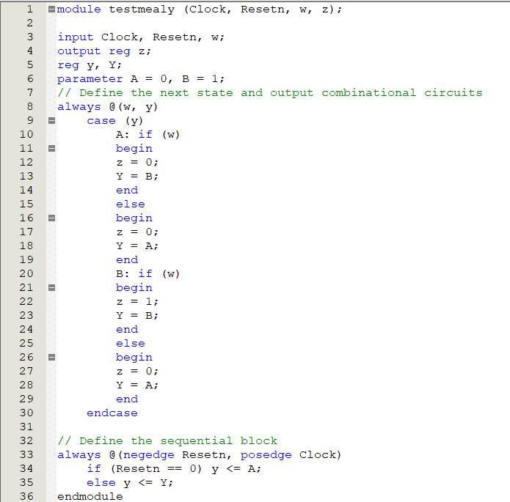
Mealy Type FSM
Present State | Next State |  | Output z
y
 | w=0 | w=1 | w=0 | w=1
 | Y | Y
0(A) | 0(A) | 1(B) | 0 | 0
1(B) | 0(A) | 1(B) | 0 | 1

Slide 13
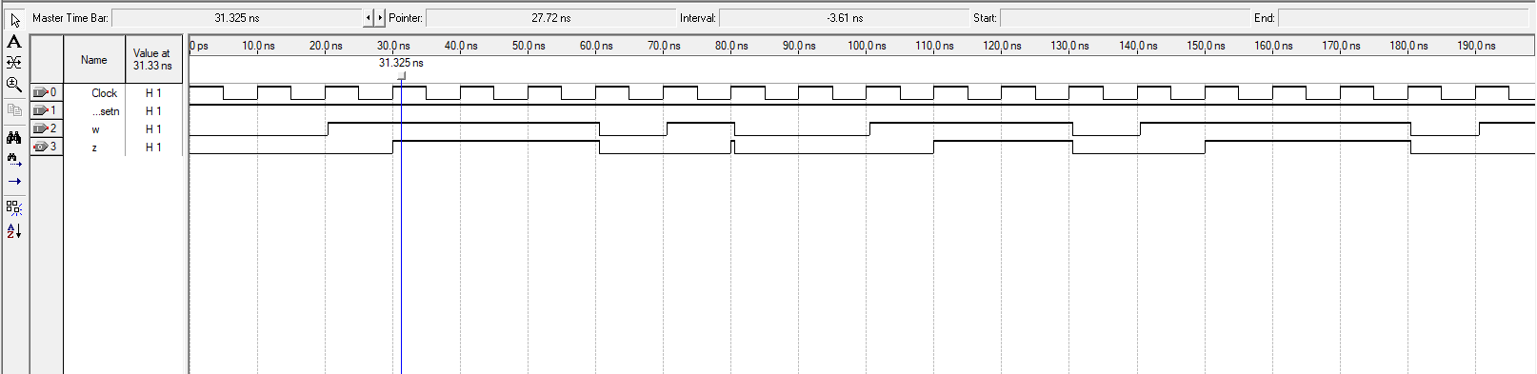
Mealy Type FSM

Slide 14
An Example
Problem: Derive the state diagram for an FSM that has an input w and an output z. The machine has to generate z = 1 when the previous four values of w were 1001 or 1111; otherwise, z = 0.Overlapping input patterns are allowed. An example of the desired behavior is
Clock cycle | 1 | 2 | 3 | 4 | 5 | 6 | 7 | 8 | 9 | 10 | 11 | 12 | 13 | 14 | 15 | 16 | 17
w | 0 | 1 | 0 | 1 | 1 | 1 | 1 | 0 | 0 | 1 | 1 | 0 | 0 | 1 | 1 | 1 | 1
z | 0 | 0 | 0 | 0 | 0 | 0 | 0 | 1 | 0 | 0 | 1 | 0 | 0 | 0 | 1 | 0 | 0

Slide 15
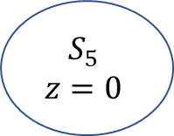




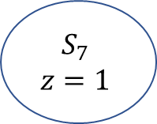





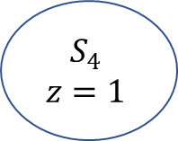








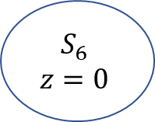


State diagram(Moore type)
$$S_{0}$$
$$z=0$$
$$w=1$$
$$S_{1}$$
$$z=0$$
$$w=1$$
$$S_{2}$$
$$z=0$$
$$w=1$$
$$S_{3}$$
$$z=0$$
$$w=1$$
$$S_{4}$$
$$z=1$$
$$w=1$$
$$w=0$$
$$w=0$$
$$S_{5}$$
$$z=0$$
$$w=0$$
$$w=0$$
$$w=0$$
$$w=0$$
$$w=0$$
$$S_{6}$$
$$z=0$$
$$w=0$$
$$w=1$$
$$w=1$$
$$S_{7}$$
$$z=1$$

Slide 16
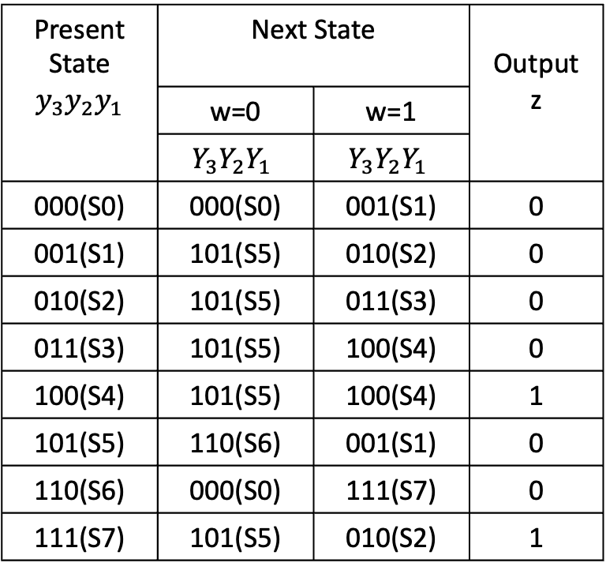
State table (Moore type)
Present State | Next State |  | Output z
 | w=0 | w=1
S0 | S0 | S1 | 0
S1 | S5 | S2 | 0
S2 | S5 | S3 | 0
S3 | S5 | S4 | 0
S4 | S5 | S4 | 1
S5 | S6 | S1 | 0
S6 | S0 | S7 | 0
S7 | S5 | S2 | 1
Present State $$y_{3}y_{2}y_{1}$$ | Next State |  | Output z
 | w=0 | w=1
 | $$Y_{3}Y_{2}Y_{1}$$ | $$Y_{3}Y_{2}Y_{1}$$
000(S0) | 000(S0) | 001(S1) | 0
001(S1) | 101(S5) | 010(S2) | 0
010(S2) | 101(S5) | 011(S3) | 0
011(S3) | 101(S5) | 100(S4) | 0
100(S4) | 101(S5) | 100(S4) | 1
101(S5) | 110(S6) | 001(S1) | 0
110(S6) | 000(S0) | 111(S7) | 0
111(S7) | 101(S5) | 010(S2) | 1
Figure : State Table
Figure : State-assigned Table

Slide 17
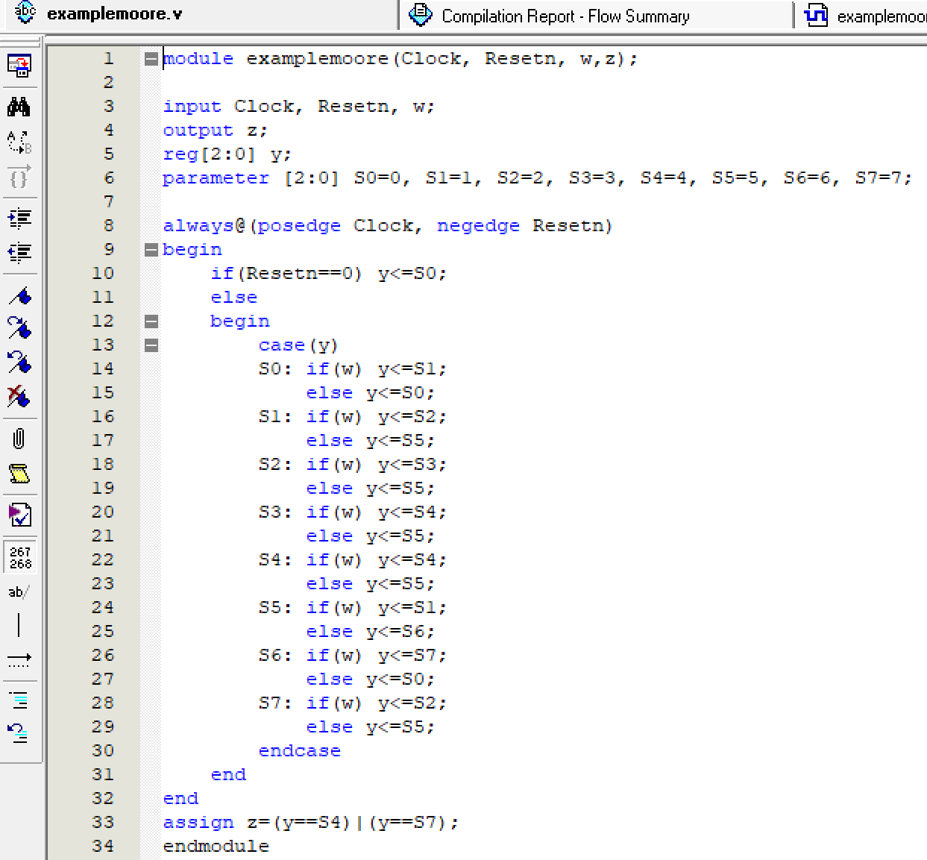
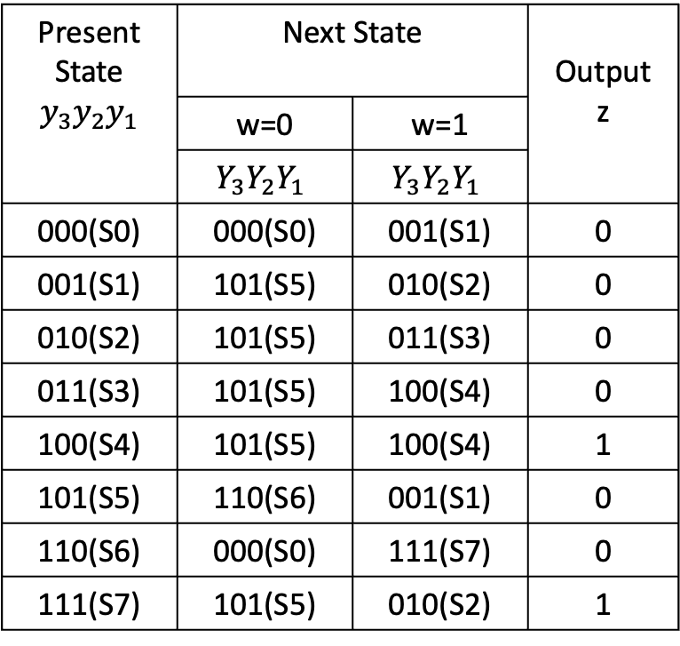
State assigned table (Moore Type)
Present State $$y_{3}y_{2}y_{1}$$ | Next State |  | Output z
 | w=0 | w=1
 | $$Y_{3}Y_{2}Y_{1}$$ | $$Y_{3}Y_{2}Y_{1}$$
000(S0) | 000(S0) | 001(S1) | 0
001(S1) | 101(S5) | 010(S2) | 0
010(S2) | 101(S5) | 011(S3) | 0
011(S3) | 101(S5) | 100(S4) | 0
100(S4) | 101(S5) | 100(S4) | 1
101(S5) | 110(S6) | 001(S1) | 0
110(S6) | 000(S0) | 111(S7) | 0
111(S7) | 101(S5) | 010(S2) | 1

Slide 18
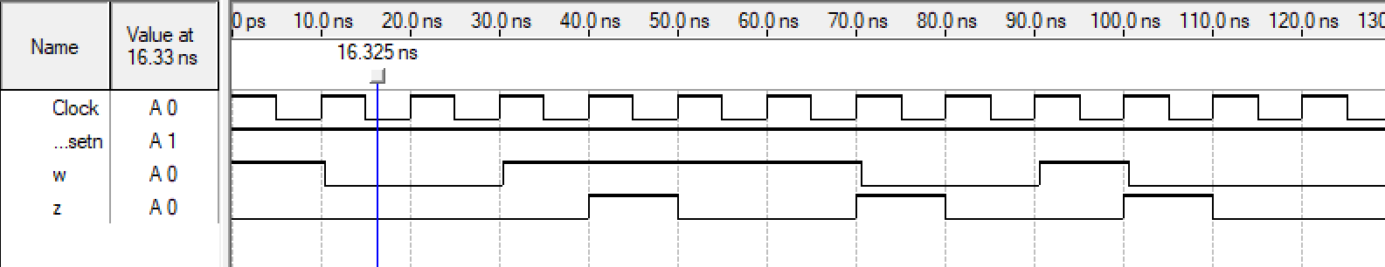
Timing diagrams (Moore Type)
Figure : Output waveform

Slide 19

An Example
Problem: Derive the state diagram of the Mealy version for the example FSM that is, the FSM will generate $z=1$ at the instant the input values of $w$ have the pattern $1111$ or $1001$. Overlapping of the input patterns are allowed.
Clock cycle | 1 | 2 | 3 | 4 | 5 | 6 | 7 | 8 | 9 | 10 | 11 | 12 | 13 | 14 | 15 | 16 | 17
w | 0 | 1 | 0 | 1 | 1 | 1 | 1 | 0 | 0 | 1 | 1 | 0 | 0 | 1 | 1 | 1 | 1
z | 0 | 0 | 0 | 0 | 0 | 0 | 1 | 0 | 0 | 1 | 0 | 0 | 0 | 1 | 0 | 0 | 1

Slide 20



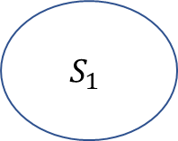





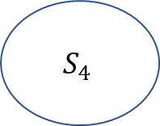

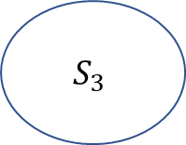


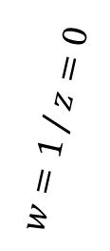



State diagram(Mealy type)
$w=1$ / $z=0$
$w=1$ / $z=0$
$w=1$ / $z=0$
$$S_{0}$$
$$S_{1}$$
$$S_{2}$$
$$S_{3}$$
$w=0$ / $z=0$
$w=1$ / $z=1$
$w=1$ / $z=0$
$w=0$ / $z=0$
$w=1$ / $z=1$
$w=0$ / $z=0$
$$S_{4}$$
$w=0$ / $z=0$
$w=0$ / $z=0$
$w=0$ / $z=0$
$$S_{5}$$

Slide 21
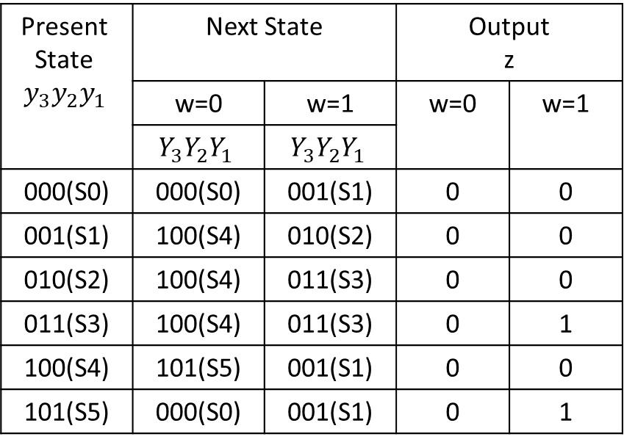
State table (Mealy type)
Present State | Next State |  | Output z
 | w=0 | w=1 | w=0 | w=1
S0 | S0 | S1 | 0 | 0
S1 | S4 | S2 | 0 | 0
S2 | S4 | S3 | 0 | 0
S3 | S4 | S3 | 0 | 1
S4 | S5 | S1 | 0 | 0
S5 | S0 | S1 | 0 | 1
Present State $$y_{3}y_{2}y_{1}$$ | Next State |  | Output z
 | w=0 | w=1 | w=0 | w=1
 | $$Y_{3}Y_{2}Y_{1}$$ | $$Y_{3}Y_{2}Y_{1}$$
000(S0) | 000(S0) | 001(S1) | 0 | 0
001(S1) | 100(S4) | 010(S2) | 0 | 0
010(S2) | 100(S4) | 011(S3) | 0 | 0
011(S3) | 100(S4) | 011(S3) | 0 | 1
100(S4) | 101(S5) | 001(S1) | 0 | 0
101(S5) | 000(S0) | 001(S1) | 0 | 1
Figure : State Table
Figure : State-assigned Table

Slide 22
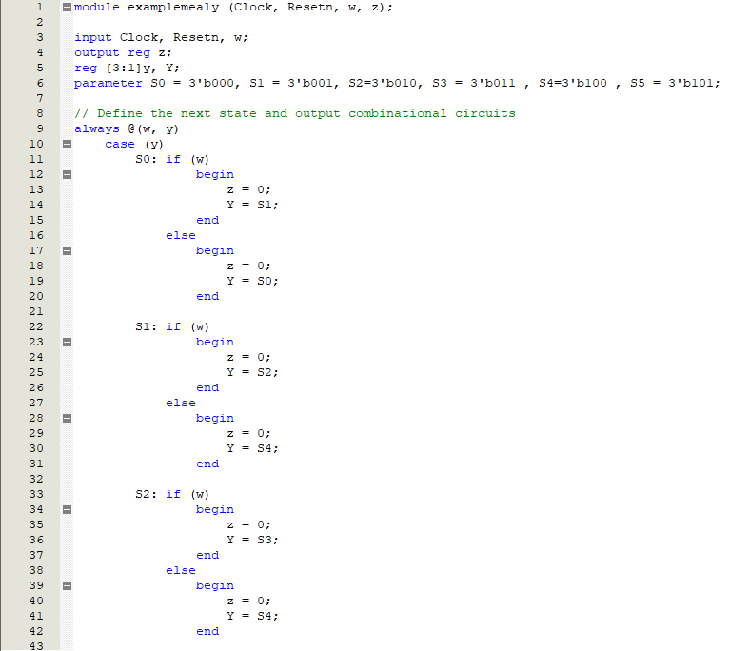
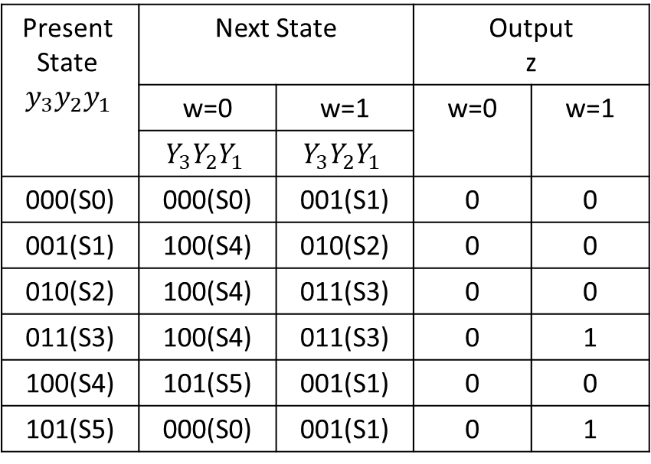
State assigned table (Mealy type)
Present State $$y_{3}y_{2}y_{1}$$ | Next State |  | Output z
 | w=0 | w=1 | w=0 | w=1
 | $$Y_{3}Y_{2}Y_{1}$$ | $$Y_{3}Y_{2}Y_{1}$$
000(S0) | 000(S0) | 001(S1) | 0 | 0
001(S1) | 100(S4) | 010(S2) | 0 | 0
010(S2) | 100(S4) | 011(S3) | 0 | 0
011(S3) | 100(S4) | 011(S3) | 0 | 1
100(S4) | 101(S5) | 001(S1) | 0 | 0
101(S5) | 000(S0) | 001(S1) | 0 | 1
Figure : Verilog code (part 1)
Figure : State-assigned Table
Figure : State-assigned Table

Slide 23
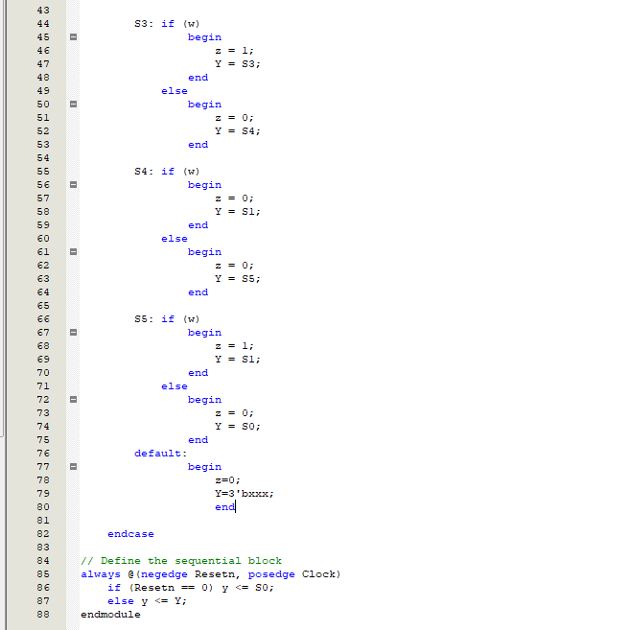
State assigned table (Mealy type)
Present State $$y_{3}y_{2}y_{1}$$ | Next State |  | Output z
 | w=0 | w=1 | w=0 | w=1
 | $$Y_{3}Y_{2}Y_{1}$$ | $$Y_{3}Y_{2}Y_{1}$$
000(S0) | 000(S0) | 001(S1) | 0 | 0
001(S1) | 100(S4) | 010(S2) | 0 | 0
010(S2) | 100(S4) | 011(S3) | 0 | 0
011(S3) | 100(S4) | 011(S3) | 0 | 1
100(S4) | 101(S5) | 001(S1) | 0 | 0
101(S5) | 000(S0) | 001(S1) | 0 | 1
Figure : Verilog code (part 2)
Figure : State-assigned Table

Slide 24
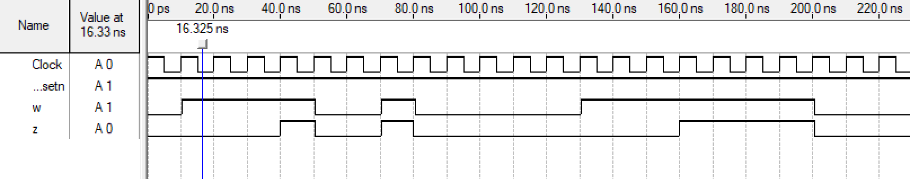
Timing diagrams (Mealy Type)
Figure : Output waveform

