Slide 1
GOMOKU ALGORITHM STUDY
MIN-MAX AND MONTE CARLO APPROACHING
    Jingtong Liu, Sun Wei, Weixun Ge, Xie Guochen

Slide 2
Introduction
Gomoku is an abstract strategy board game, also called Gobang or Five in a Row, played on a board of 15X15 intersections.
Complicated, not very complicated
Algorithm
    Minimax
    MonteCarlo

Slide 3
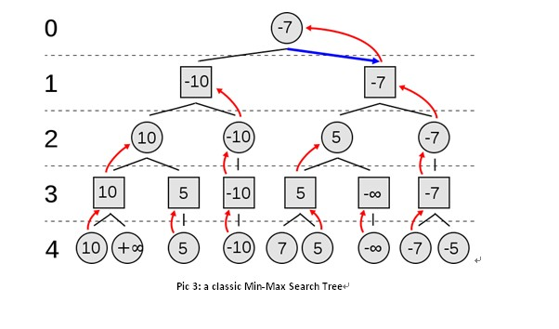
Minimax

Slide 4
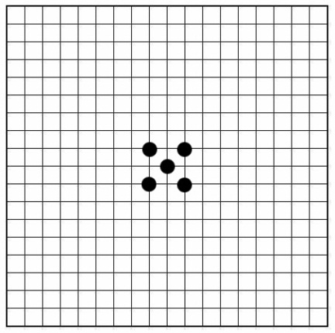
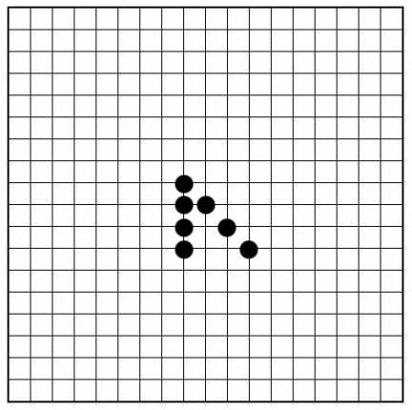
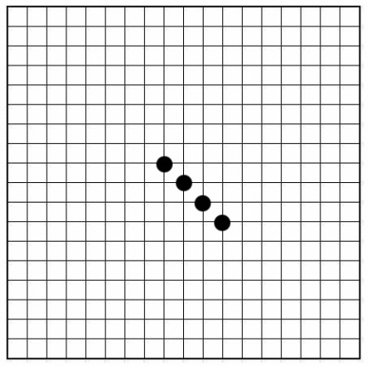
Minimax
Evaluation: total score of all patterns on the board
-800000
-970000
950000

Slide 5
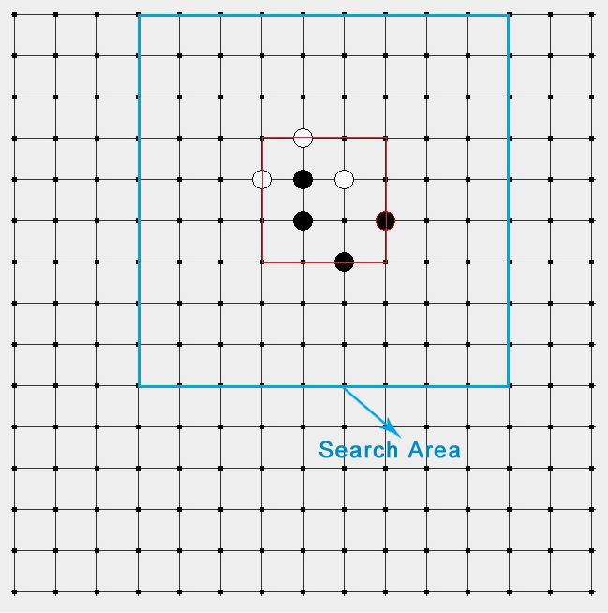
Minimax
Improvement

Slide 6
Why Monte? (Motivation)
For some games, Minimax works really well. But for some other games, the search tree could be very large.
It motivates us to implement an alternative algorithm called MonteCarlo Tree Search.
For some games, We believe, if we use simulate annealing with applying local Minimax search, the agent will get better than simply adopted Minimax search.

Slide 7
Assumptions(Modification later)
(1) Moves are performed randomly with the probabilities assigned by the method of simulated annealing,
(2) The value of a position is defined by the win rate of the given position
(3)To find the best move in a given position, play the game to the very end as suggested by (1) and then evaluate as in (2); play thousands of such random games, and the best move will be the one doing the best.
Unique game, so modifications later

Slide 8
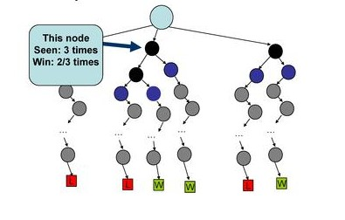
Win Time (Evaluation Function)

Slide 9
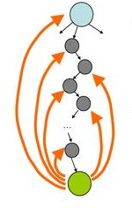
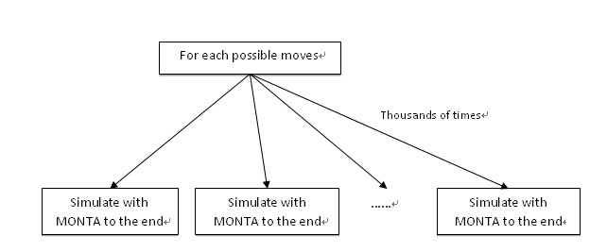
Updating the win time
Update the Win Time by each roll out.
The best move should always be played.

Slide 10
Issues we need to solve or improve
How to choose the roots to build the search tree
Two idiots play or something else?
Uniqueness of the game: Order of the moves is important

Slide 11
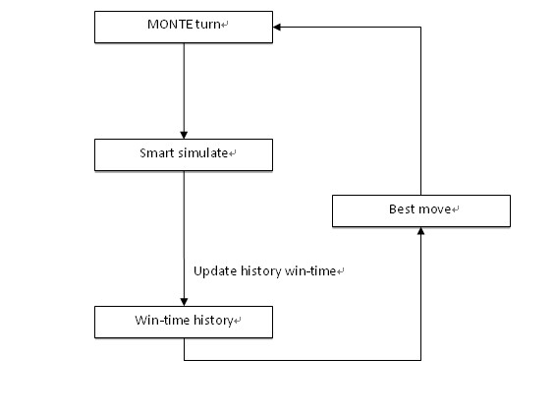
Monte Carlo Gomoku
Smart Simulate (trained by minimax as opponent)

Slide 12
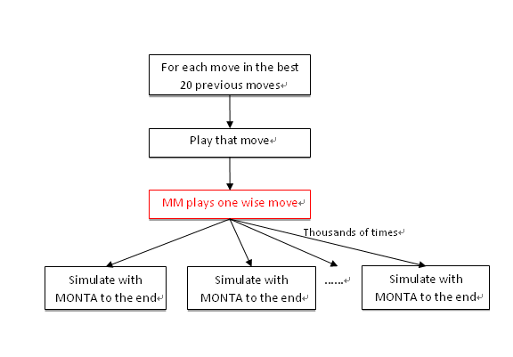
Smart Simulate (not all idiots)
When minimax trained twice, perform worse

Slide 13
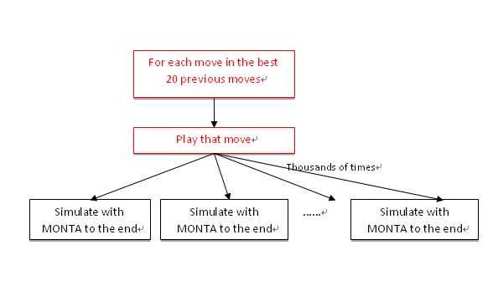
How to build the roots(Genetic Algorithm)
Instead of sing root or 5 roots, we enlarge it to 20.

Slide 14
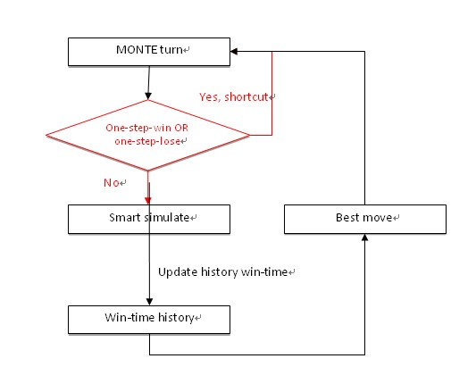
Order importance (short-cut)
Best moves should be played immediately.
Urgent moves are important than big moves.

Slide 15

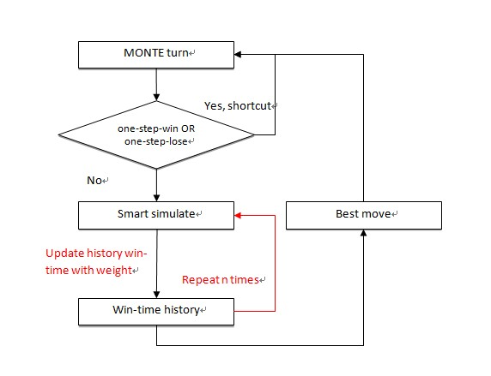
Win Time History(improvement)
If “win”, the win-time of all tried moves in this simulation increases by 1 as reward;
If “lost”, the win-time decreases by 2 as punishment;
If “tie”, win-time does not change.

Slide 16
Tests and results
 | Search area | Search tree node Count for 1st step | Avg search tree node count till 5st step/step | Avg search tree node count till Game End/step
Unimproved-Minimax(3) | Whole board | 1597360 | 1013302 | 642326
Improved-Minimax(3) | Limited area | 73870 | 135515 | 128551

Slide 17
Tests and results
 | opponent | Win rate W:L:T (n Games) | Monte Average time per step | MiniMaxAverage time per step | Average step per Game
Simulating Game For Each Root Move:1000 Repeat Smart Simulating : 1 MiniMax Training Depth: 2 | Minimax(3) | 14:15:0(30) Win:46% Lose:50% Tie:3.33% | 1.13s | 5.48s | 74
Simulating Game For Each Root Move:5000 Repeat Smart Simulating : 1 MiniMax Training Depth: 2 | Minimax(3) | 18:10:2(30) Win:60% Lose:33.33% Tie:6.67% | 1.58s | 5.21s | 75
Simulating Game For Each Root Move:10000 Repeat Smart Simulating : 1 MiniMax Training Depth: 2 | Minimax(3) | 7:2:1(10) Win:70% Lose:20% Tie:10% | 2.46s | 5.7s | 92
Simulating Game For Each Root Move:1000 Repeat Smart Simulating : 3 MiniMax Training Depth: 2 | Minimax(3) | 16:11:3(30) Win:53% Lose:36.37% Tie:10% | 3.43s | 4.67s | 82
Simulating Game For Each Root Move:5000 Repeat Smart Simulating : 3 MiniMax Training Depth: 2 | Minimax(3) | 7:1:2(10) Win:70% Lose:10% Tie:10% | 6.61s | 8.57s | 113
Simulating Game For Each Root Move:10000 Repeat Smart Simulating : 3 MiniMax Training Depth: 2 | Minimax(3) | 13:5:2(20) Win:65% Lose:25% Tie:10% | 8.2s | 7.7s | 94
Simulating Game For Each Root move trained by Minimax(2) twice and simulates Simulating Game For Each Root Move:10000 Repeat Smart Simulating : 1 MiniMax Training Depth: 2 | Minimax(3) | 4: 16(20) | 1.16s | 2.2s | 20

Slide 18
Conclusion
Monte Carlo approach shows its reliability on win-rate and its good time efficiency on performance. It’s a promising approach for more complicated games(e.g. Go)

Slide 19
Future
Map history and current win-time to [-1000, 1000]
Find out best simulation time to maximize win-rate
Find out best reward and punishment strategy

