Slide 1
GOMOKU ALGORITHM STUDY
MIN-MAX AND MONTE CARLO APPROACHING
    Jingtongliu, Sun wei, Ge weixun, Xie Guochen

Slide 2
Introduction
Gomoku is an abstract strategy board game, also called Gobang or Five in a Row, played on a board of 15X15 intersections.
Complicated, not very complicated
Algorithm
    Minimax
    MonteCarlo

Slide 3
Why Monte? (Motivation)
For some games, Minimax works really well. But for some other games, the search tree could be very large.
It motivates us to implement an alternative algorithm called MonteCarlo Tree Search.
For some games, We believe, if we use simulate annealing with applying local Minimax search, the agent will get better than simply adopted Minimax search.

Slide 4
Assumptions(Modification later)
(1) Moves are performed randomly with the probabilities assigned by the method of simulated annealing,
(2) The value of a position is defined by the win rate of the given position
(3)To find the best move in a given position, play the game to the very end as suggested by (1) and then evaluate as in (2); play thousands of such random games, and the best move will be the one doing the best.
Unique game, so modifications later

Slide 5
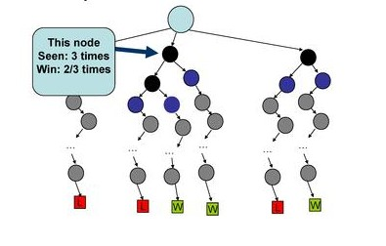
Win Time (Evaluation Function)

Slide 6
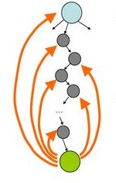
Updating the win time
Update the Win Time by each roll out.
The best move should always be played.

Slide 7
Issues we need to solve or improve
How to choose the roots to build the search tree
Two idiots play or something else?
Uniqueness of the game: Order of the moves is important

Slide 8
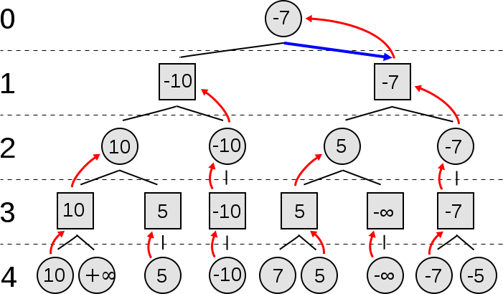
Minimax

Slide 9
Minimax
Evaluation Function:

Slide 10
Monte Carlo Gomoku
Trained by minimax (one step)
MONTE turn
Smart simulate
Best move
Update history win-time
Win-time history

Slide 11
Smart Simulate (not all idiots)
When minimax trained twice, perform worse
For each move in the best 20 previous moves
Play that move
MM plays one wise move
Thousands of times
Simulate with MONTA to the end
Simulate with MONTA to the end
……
Simulate with MONTA to the end

Slide 12
How to build the roots(Genetic Algorithm)
Instead of sing root or 5 roots, we enlarge it to 20.
For each move in the best 20 previous moves
Play that move
Thousands of times
Simulate with MONTA to the end
Simulate with MONTA to the end
……
Simulate with MONTA to the end

Slide 13
Order importance (short-cut)
Best moves should be played immediately.
Or Urgent moves are important than big moves.
MONTE turn
Yes, shortcut
One-step-win OR one-step-lose
No
Smart simulate
Best move
Update history win-time
Win-time history

Slide 14
Win Time History(improvement)
Update the win time history
MONTE turn
Yes, shortcut
one-step-win OR one-step-lose
No
Smart simulate
Best move
Update history win-time with weight
with
Repeat n times
Win-time history

Slide 15
Test, result and future

