Slide 1


Notes:
Hello and welcome to my use case called „Managing OpenNMS with Redmine“. My name is Marcel and I'm working as an administrator here in Fulda for a company which sells cleaning systems.
First of all you need to be warned. I don't have experience in speaking english. This is my first english and second appearance ever. But I don't want to be the only one who's presenting his use case in german. So I'll do my best.
OK. Let's start. We are using OpenNMS since 2 years for monitoring most of our infrastructure. As time passed I noticed that OpenNMS configs and changes had been more and more complex. And it became more difficult to keep track of things.

Slide 2
Topics
1. Overview
2. Activities
3. Tickets
4. News
5. Wiki
6. Project Archiv
7. Examples
Notes:
It didn't take a long time to solve this problem. Our developer already uses Redmine for his work. Redmine is a software project management system and our developer also integrated Apache Subversion for versioning source codes.
With Redmine he is able to create a ticket for every new request or an error and assign his new or changed source code to this ticket.
Basically my needs are the same. So i asked him to create a new Redmine project for my purposes.
Like OpenNMS, Redmine provides a web user interface to work with. And this web interface and it's workflow i will present you today. The first 6 topics will show you the main functions and the seventh point is a short practical example.

Slide 3
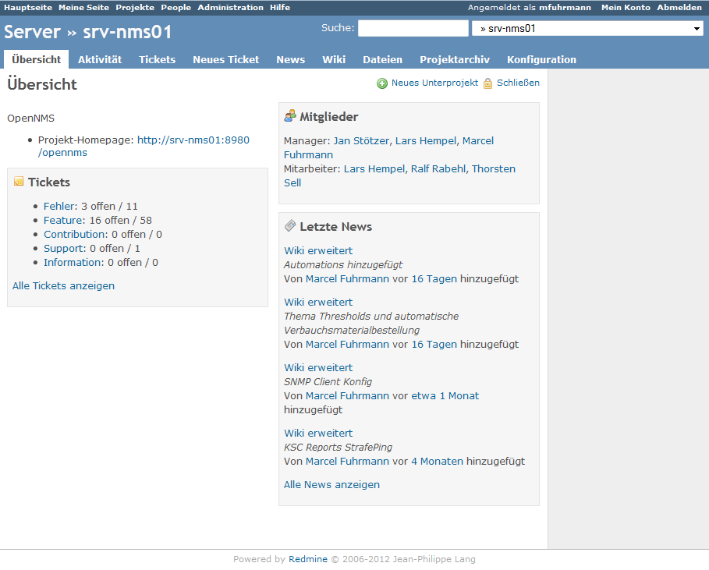
1. Overview
Notes:
Overview. There is not much to say.
There is one section for a project description. You can see an overview of all tickets, their tracker and how many open tickets exits, project members and their rights and project news..

Slide 4
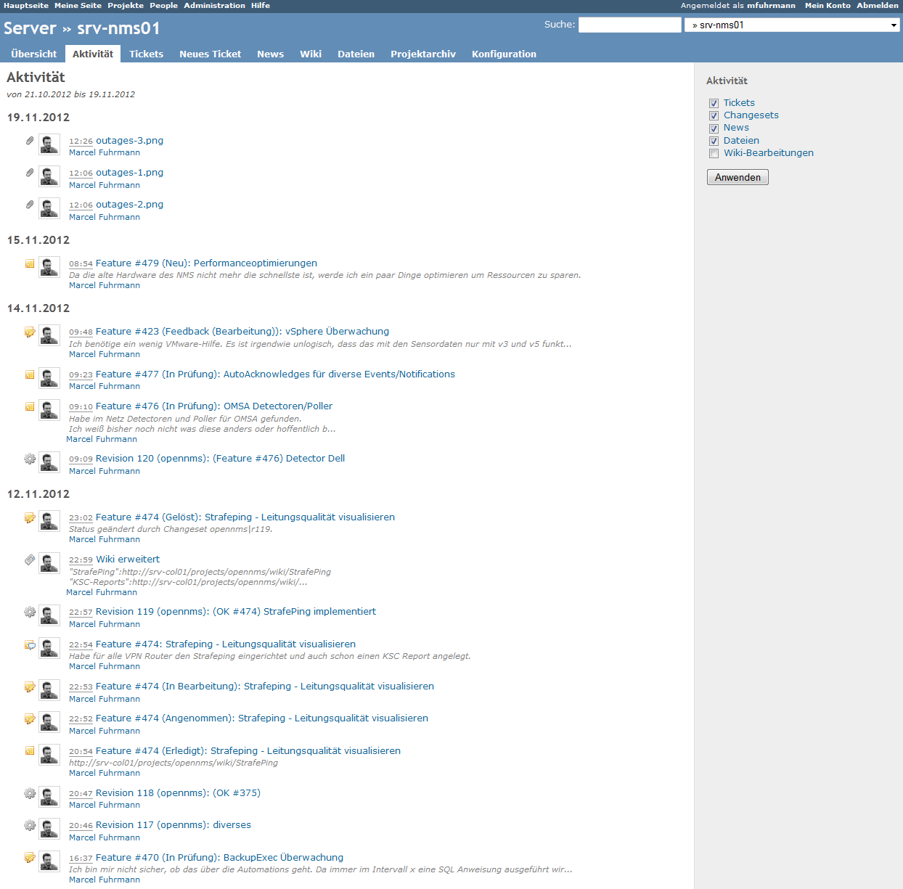
2. Activities
Notes:
The activities (german = Aktivitäten):
Some kind of boring in my environment, because i'm the only one who is using this system. You can see all changes historically listed. For example: new tickets, ticket changes or new source code revisions.

Slide 5
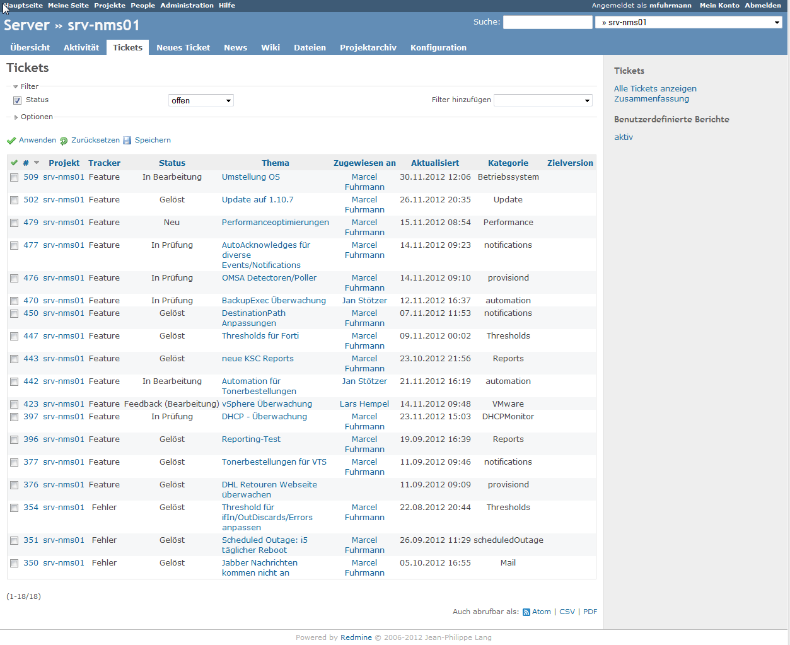
3. Tickets
Notes:
The ticket system:
There is just one rule: No changes without a ticket! Tickets need some basic information. They need a tracker. Normally i use just two trackers. „Feature“ or „Error“. A ticket can also and should be assigned to a category. For example „operating system“, „notifications“, „provisiond“ etc. Furthermore there is the ticket status which -and who would have thought it- shows the progress of a ticket.
At the top of this table you can set filters to get a better view.

Slide 6
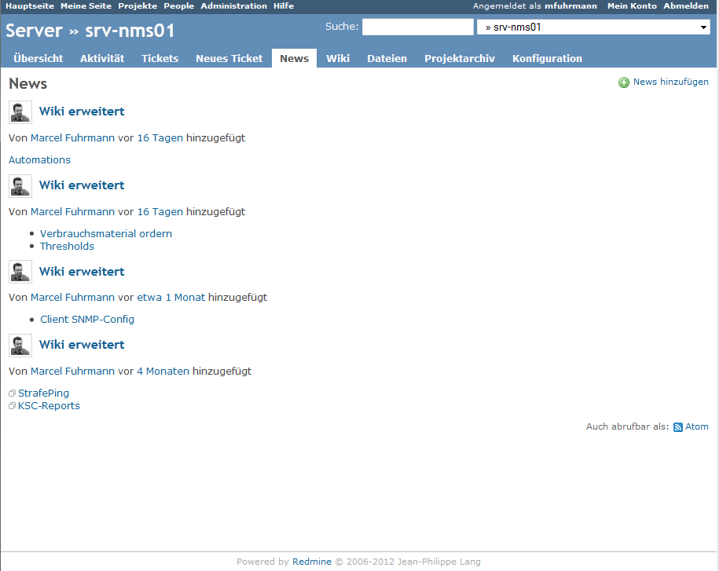
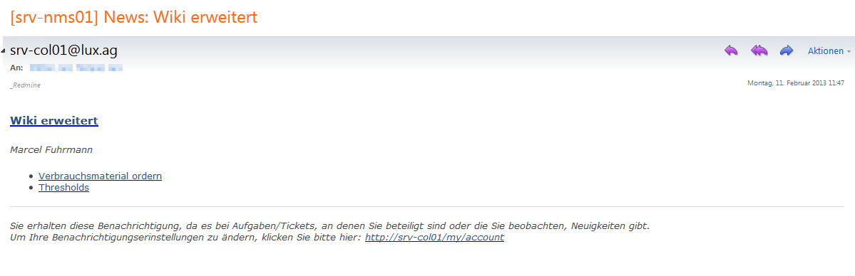
4. News
Notes:
The news:
I use them to publish information about greater changes, new implementations or new wiki entries. I've configured my Redmine OpenNMS project to send Emails for every news entry. So all project members will be informed. At this picture you can see a news „enhanced wiki“. It contains 2 links to the wiki pages Strafeping and KSC-Reports.
GGFS: EMAIL ZEIGEN

Slide 7
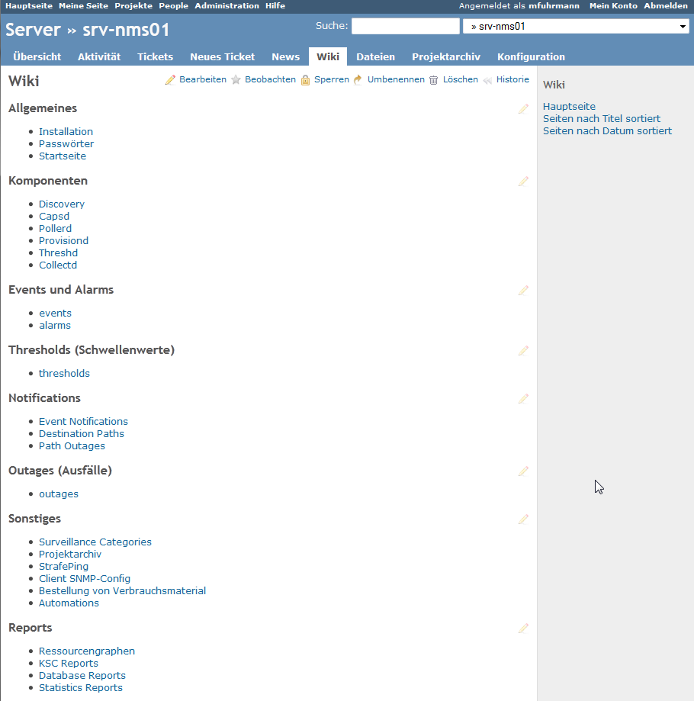
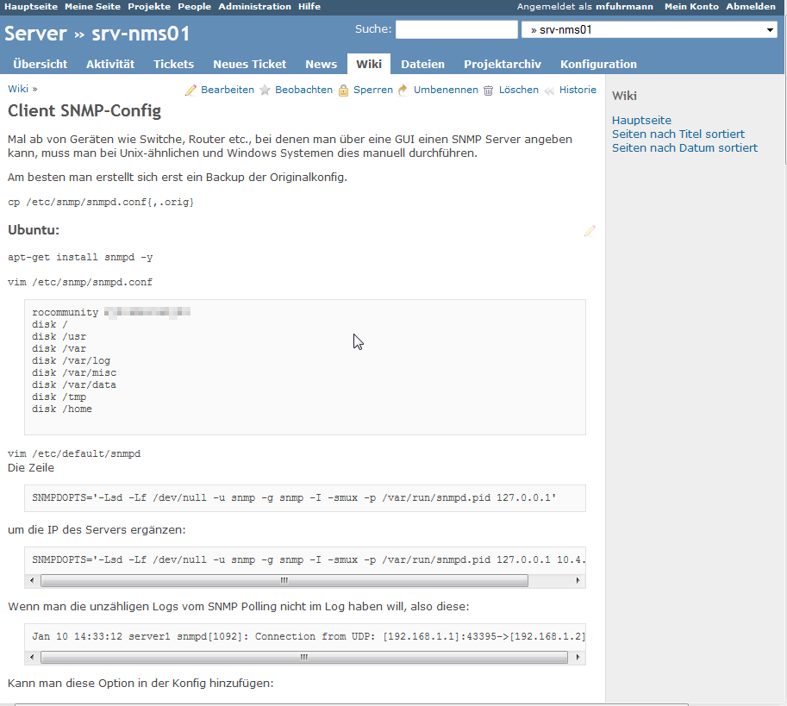
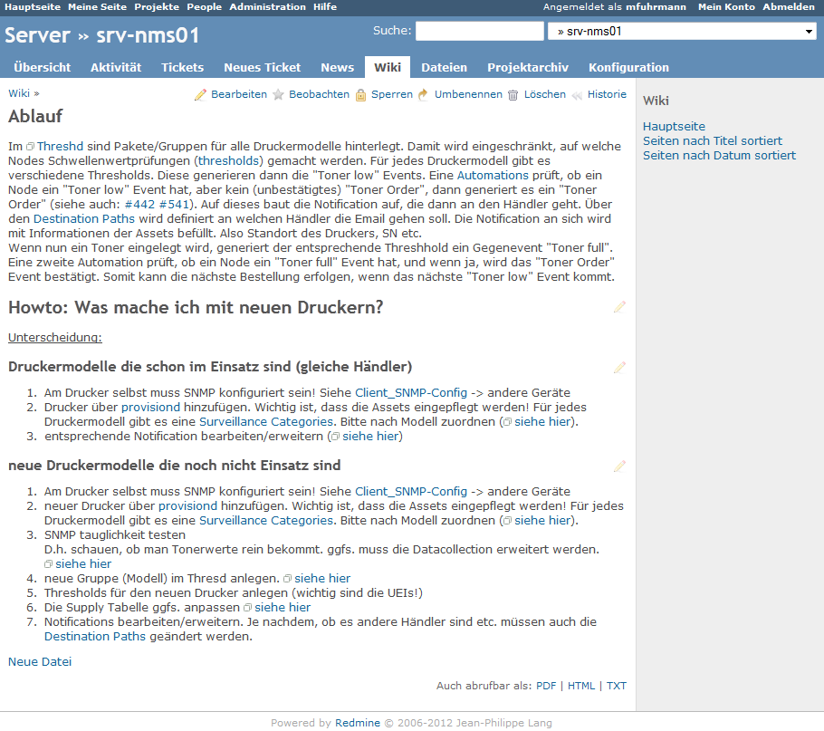
5. Wiki
Notes:
The wiki:
I'm the only one in our company who is administrating OpenNMS. So i'm trying to document everything. Most of it are definitions.
There is a documention about the installation of the operating system and OpenNMS itself. I've noticed functions and processes, described the function of OpenNMS daemons, terminologies or OpenNMS structures, so an third person can get very fast an overview how OpenNMS works in our environment. I've also noticed routines like update scenarios or using the provisiond to add/delete nodes. For example:The wiki about my automatic toner orders which documents the concept and the implementation. Or how to configure snmp on Debian/RedHat based distributions or Windows systems.

Slide 8
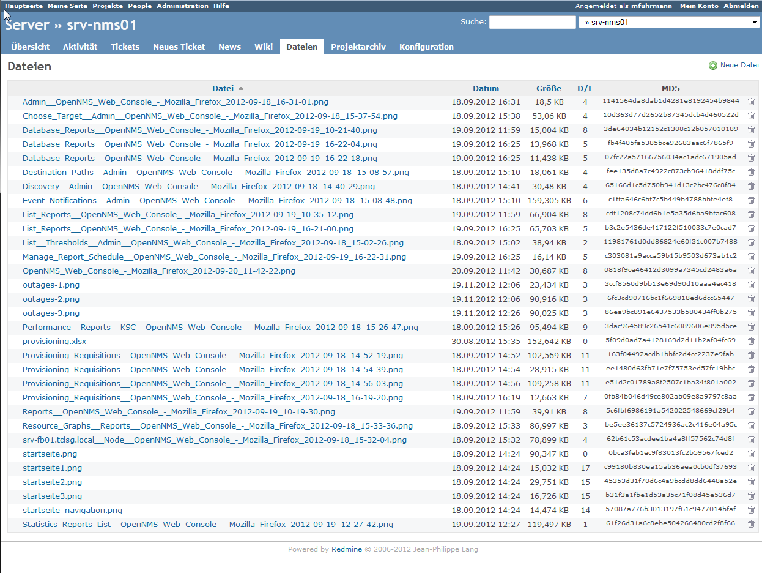
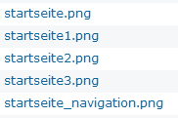
6. Files
Notes:
The files (german = Dateien):
You can add files to a project. In this project i use this function just for the wiki pictures. In other projects i provide manuals, client tools or something like that.

Slide 9
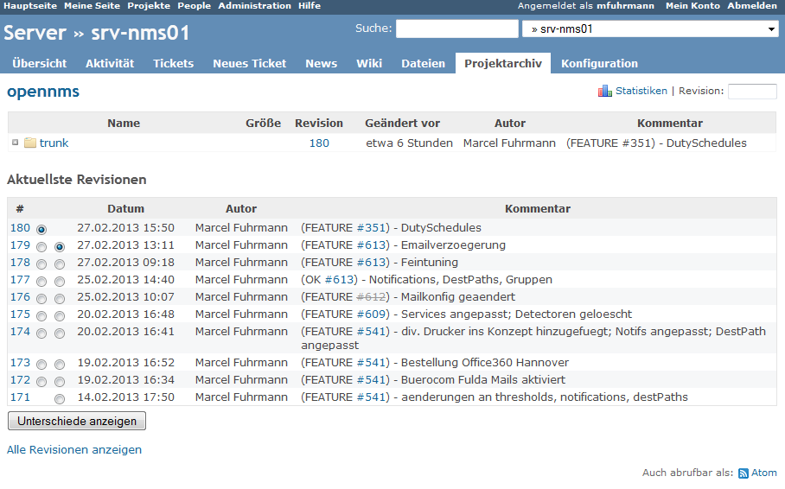
7. Project Archive
Notes:
The project archive:
Here you can see all revisions of my OpenNMS configuration. My example will show more about the project archive.

Slide 10
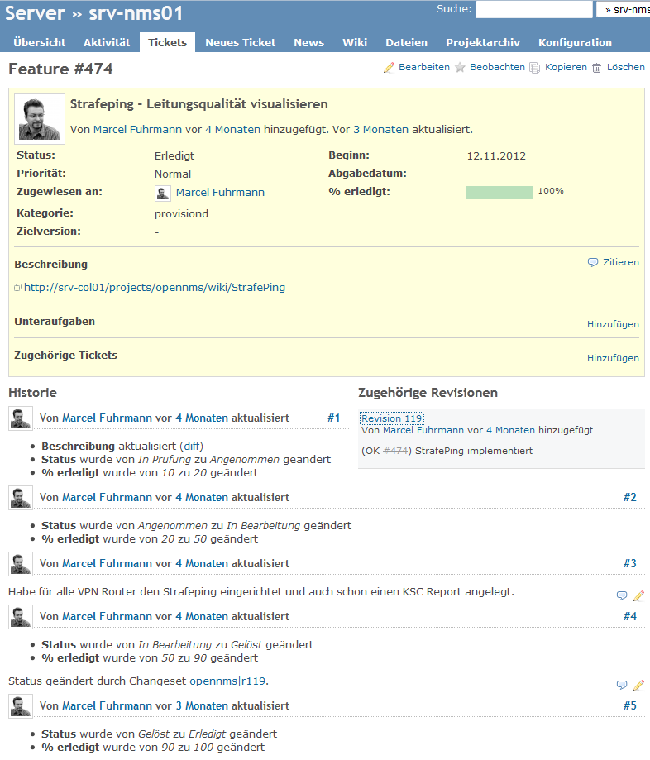

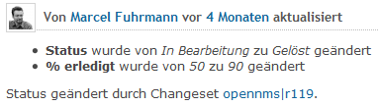
8. Example
Notes:
OK, lets combine all these parts.
I wanted strafepings for my branch offices. So I've created a ticket called „Strafeping – visualizing connection quality) (german= Leitungsqualität visualisieren).
I wasn't sure which category i had to take. I took provisiond because there were the most changes.
You can see the chronic of this ticket. The status: „Under Test to Accepted“ – „Accepted to In Process“ – then a litttle information what i've done: „All branch office router nodes got Strafeping configured and i've created a KSC report“ - then status change „In Process to Solved“ with changeset r119 – and „Solved to Done“. With status „Done“ the ticket is closed.
In bigger environments this sequence could be more interesting. Maybe a manager will cancel this ticket in status „Under Test“ because it is useless or something like that. I was lucky enough to implement this feature without any obstacles, because i'm the only NMS administrator.

Slide 11
8. Example
a provisiond group with a detector Strafeping
pollerd config had to be changed to poll my vpn routers
a KSC report which shows all Strafeping graphs
svn commit -m '(OK #474) Strafeping implementiert“ /etc/opennms/
Notes:
OK thats what i needed:
- a provisiond group with a detector Strafeping
- pollerd config had to be changed to poll my vpn routers
- a KSC report which shows all Strafeping graphs
After this configs i had to commit my changes to Redmine:
svn commit -m '(OK #474) Strafeping implementiert“ /etc/opennms/
Subversion creates a new revision for the commit. And Redmine knows, how to handle the phrase (OK hash ticketnumber). There is OK to set the Redmine ticket to status „done“ or FEATURE to let the ticket status untouched. The #ticketnumber is the reference to the ticket number.
Revision 129 HIER REIN und ein paar Wörter dazu!!
After that i've created a Wiki which describes the function of Strafeping in a few sentences and how to read the graph and a link to this graphs.

