Slide 1
OMC Test
By Nguyen Hong Duc

Slide 2
Agenda
Section 1: Data Exploration
Section 2: Business Acumen

Slide 3
Data Exploration

Slide 4
Data Exploration
* Open data_processing.ipynb file in python folder to see the detailed process.
Some important points:
Join orders dataset with customers dataset on ‘customer_id’ and drop the field.
Amend all the datetime columns with missing data by adding to the timestamps of the previous step with the average time’.
We will assume the total net sales will be the sum of payment_value from order payments data set. While most of the time, the payment_value of an order equals the sum of price and freight_value, there are some outliers/incorrect data.
Drop the geolocation dataset since there are a lot of typos to be corrected and it’s not needed.

Slide 5
Business Acumen

Slide 6
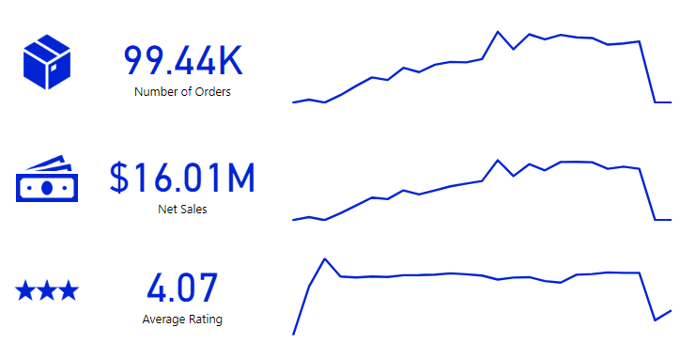
Business Acumen
* Open olist.pbix file in power_bi folder to open the elaborate workbook with various filters.
We are going to focus on three aspects of the business

Slide 7
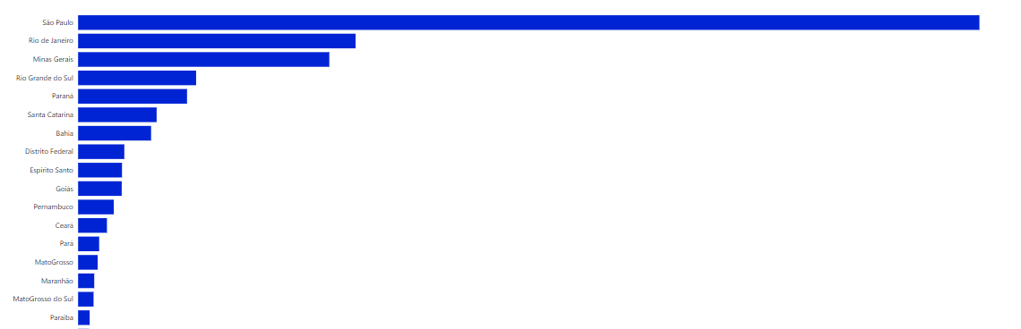
Order
How are order distributed geographically?
=> The order distribution aligns with the economic status of the states in Brazil. The business can see where they should focus on as far as market share is concerned.

Slide 8
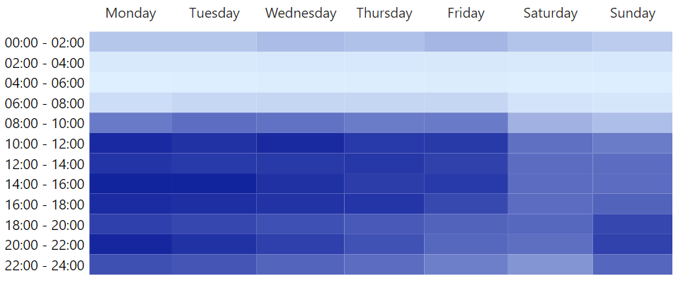
Order
How are orders distributed chronologically?
Traffic is the busiest during business hours
Understand purchasing behavior to better make business decisions
Number of purchases declines steadily throughout the week. The bottom is typically Sunday or Saturday.

Slide 9
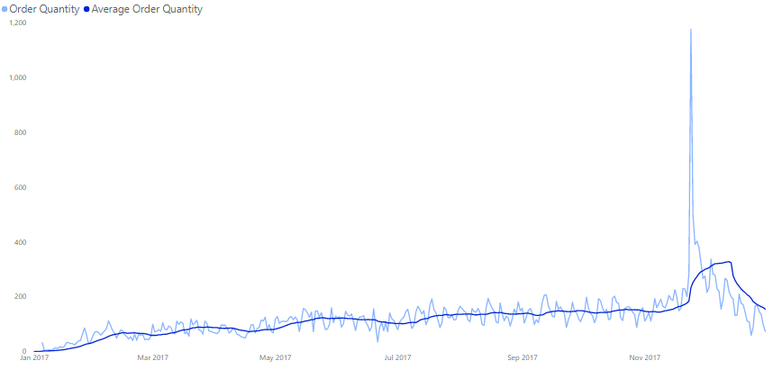
Order
Black Friday anomaly
Assuming a fiscal year is from Jan 1st to Dev 31st , we filter the data in that period to avoid consistency in the dataset.
Average running line indicate a stable rise in order through the year.

Slide 10
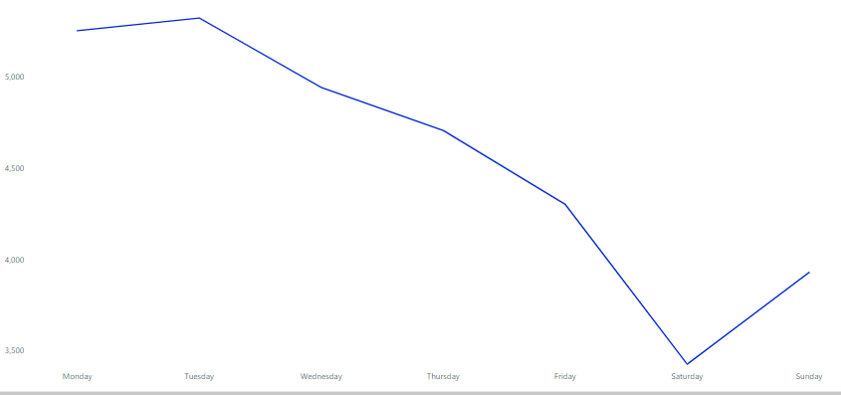
Order
Orders in a week follow a similar pattern, we can suggest to build model to predict the estimated number of orders for warehouse preparation, internet bandwidth…

Slide 11
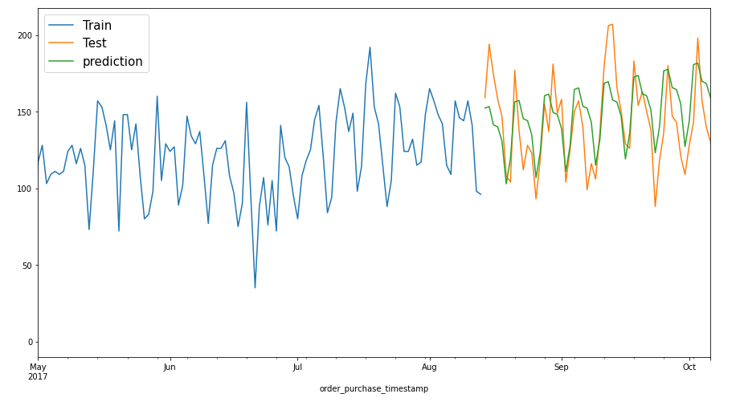
Order
Orders in a week follow a similar pattern, we can suggest to build model to predict the estimated number of orders for warehouse preparation, internet bandwidth… (open data_forecasting.ipynb file in python folder for more info).

Slide 12
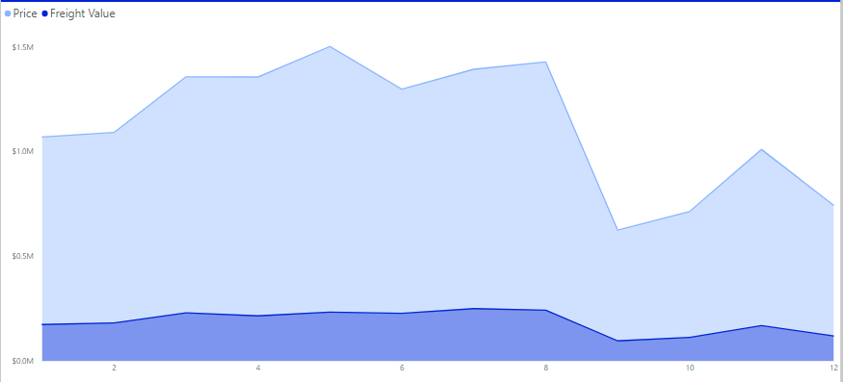
Net Sales
Orders and Net Sales trend appear to be parallel with each other.
Freight value/Price % stays consistently around 16%

Slide 13
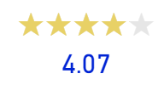
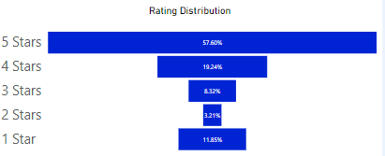
Ratings
Average rating reflects customer’s satisfaction with the service

Slide 14
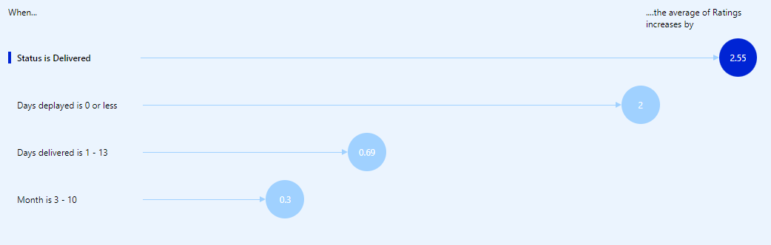
Ratings
Some metrics can greatly influence the feedback like the status of the order(whether it’s delivered or not; how late it is…) while some don’t matter that much (like seasonal factors like months)

Slide 15
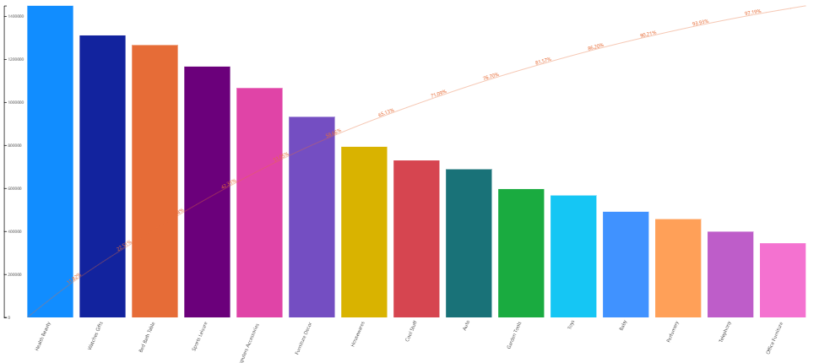
Other
Pareto chart shows that majority of the business sales come from just 10 products categories

Slide 16
Additional data to collect
The business can collect some datasets to better reach the goals:
Website engagement (engagement, timestamp, bounce rate, redirect site, ads info, search keywords…)
Customer dataset (gender, age, income, education, location…)
Ecommerce market dataset
…

Slide 17
Thank You

