Slide 1
Commitment without Regrets:
Online Learning in Stackelberg Security Games
Nika Haghtalab
Carnegie Mellon University
Joint work with Maria-Florina Balcan, Avrim Blum, Ariel Procaccia.

Slide 2

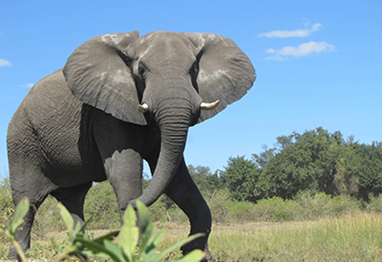



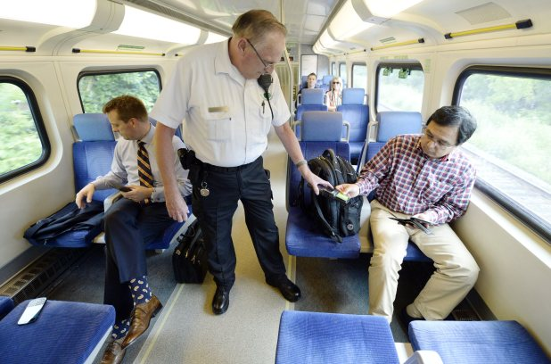
Security Games
Models that are deployed in real life.
Behind working of major security organizations.
Uncertainties lead to inefficiencies.
Algorithmic solutions with quantitative guarantees.
Examples: LAX, Flight Marshalls, Wildlife preservation, ….

Slide 3
It’s a game
Interactions between a defender and an attacker.
Defender’s strategy space:
Randomized deployment of resources to protect targets.
Attacker’s strategy space:
Which target to attack.
Utilities:
Both receive utilities depending on success/failure.
Stackelberg solution concept:
Attacker best-responds to defender’s randomized deployment.
Defender wants to find the best deployment.

Slide 4



One-shot Security Game
Resources
Targets (n)
Coverage probability
½
½
+½
½
+½
½
Attacker: Observes the mixed strategy and best responds.

Slide 5


Repeated Security Game
Resources
Targets
Defending against multiple attacker types.
Each attacker type has different but known preferences.
Attackers arrive in unknown order/frequency.
Defender’s goal:
Choose randomized strategies in an online fashion.

Slide 6

Commitments without regret
Online:
Commits to .
Commits to .
best responds to .
best responds to .
Gets utility (target & )
Gets utility (target & )
Offline:
Commits to the best fixed .
Regret:
Best Offline Utility
Algorithms Utility
# Targets
Goal: Alg with regret
Timeline
# Types

Slide 7


An example
Target | Fails | Succeeds | Succeeds
1 | -1 | 1 | 1
2 | -1 | 1 | ½
Attacks target 1
Prefers targets equally.
→ Optimal strategy: (½ , ½).
Prefers targets 1 and ½.
→ Optimal strategy: (⅓ , ⅔).
Attacks target 2

Slide 8
Offline Optimal
Regions: Where all types behave
consistently.
Total Offline Utility:
When is considered over one region.
→Optimum is an extreme point.
Only consider extreme points.
P₁, P₂: 1
P₁:1
P₂: 2
P₁, P₂: 2
No. of attacks on i
Utility of i under
Constant
Linear in
Linear in

Slide 9

Online Algorithm (types)
Algorithm:
Take the set of extreme points.
Give equal weights to all points.
Play a point with probability proportional to its weight.
Observe the attacker’s type, compute the payoff of all points.
Update all weights
Loss of action i
A.k.a Multiplicative Weight Update:
Logarithmic dependence on # points.
Result:
When we observe the type:
# targets
# types

Slide 10

Seeing the Best-Response
Sufficient: Unbiased estimator of the payoffs.
Exploration vs. Exploitation:
Each block represents one “big time step”.
Pick each strategy once at random → loss estimator.
Use loss estimator for the update rule in the next block.
Explore
Exploit
1, 2, … T
…
Exponentially many points to sample
Exponential regret

Slide 11

Smarter Sampling
Do we need to sample strategies individually?
Total utility of a point depends on the type frequency.
Sufficient to estimate the type frequency by observing the best response.
Example: Sample one point only.
→ The action reveals the attacker.

Slide 12
A Basis For Sampling
Type 2
Type 1
Expressing any other point as a linear combination of these vectors.
Attacking 1
Attacking 2
Attacking 1
Attacking 2
In general:
k-dimensional vectors → Basis of size k.
Subtleties: Choosing a barycentric basis (AK’08).
Result:
When we observe the best response:
12

Slide 13
Conclusion
Models that are deployed in real life:
Uncertainties cause inefficiencies.
Algorithms with guarantees.
Computational aspects:
Real life deployment: Heuristics in intermediate stages.
Affects the quality of the solution?
Sequence of unknown attackers types:
Negative results if there is no information about the attacker.
Mild natural assumptions?
Thanks!

