Slide 1


Sales Forecasting and Demand Prediction
TABLE OF CONTENTS
01
02
INTRODUCTION
DATA &
PREPROCESSING
03
04
MODELING
DEPLOYMENT

Slide 2
TABLE OF CONTENTS
01
02
03
04
INTRODUCTION
DATA &
PREPROCESSING
MODELING
DEPLOYMENT

Slide 3

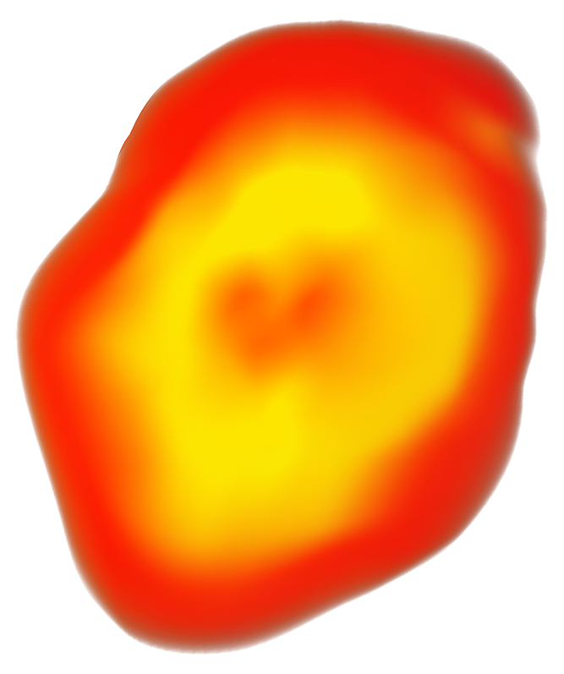

01
INTRODUCTION
The Problem:
Retail giants like Walmart lose millions due to inefficient inventory management.
Stockouts: Customers leave empty-handed → lost revenue.
Overstock: Excess inventory occupies space → increased holding costs.
Challenge: Predicting sales spikes during major holidays (Super Bowl, Thanksgiving, Christmas) is difficult.

Slide 4
The Problem:
Retail giants like Walmart lose millions due to inefficient inventory management.
Stockouts: Customers leave empty-handed → lost revenue.
Overstock: Excess inventory occupies space → increased holding costs.
Challenge: Predicting sales spikes during major holidays (Super Bowl, Thanksgiving, Christmas) is difficult.
Impact
Our Solution
Provides a data-driven tool to optimize stock levels.
Helps maximize profits and reduce losses from mismanaged inventory.
Developed a Machine Learning model that accurately forecasts weekly sales for 45 stores.
Accounts for seasonality, holidays, and economic factors (Fuel Price, CPI, Unemployment).

Slide 5
DATA & PREPROCESSING
Our Solution
Developed a Machine Learning model that accurately forecasts weekly sales for 45 stores.
Accounts for seasonality, holidays, and economic factors (Fuel Price, CPI, Unemployment).
Impact
Provides a data-driven tool to optimize stock levels.
Helps maximize profits and reduce losses from mismanaged inventory.
By : Ahmed Abdelkader Nasser Hossam
02

Slide 6
02
DATA & PREPROCESSING
Data Overview
Examined the structure, size, and types of variables to understand the data landscape.
Identified key fields needed for forecasting such as sales, dates, store attributes, and economic indicators.
By : Ahmed Abdelkader Nasser Hossam
Data Integration
Merged features with stores to enrich store-level attributes. Merged combined data with train and test:
Created train_merged
Created test_merged
Sorted datasets by Store, Dept, and Date to ensure proper time-series alignment.

Slide 7
Data Overview
Handling Duplicates & Data Integrity
Removed duplicate rows from all datasets.
Validated dataset consistency after merging.
Ensured column names and formats were aligned across train & test.
Examined the structure, size, and types of variables to understand the data landscape.
Identified key fields needed for forecasting such as sales, dates, store attributes, and economic indicators.
Data Integration
Identified missing values across all columns.
Created binary flags for MarkDown missingness (e.g., MarkDown1_is_missing).
Filled all missing values (NaN) with 0 for stability in modeling.
Checked for remaining missing values after imputation.
Merged features with stores to enrich store-level attributes. Merged combined data with train and test:
Created train_merged
Created test_merged
Sorted datasets by Store, Dept, and Date to ensure proper time-series alignment.
Missing Values Treatment

Slide 8
Handling Duplicates & Data Integrity
Removed invalid sales entries where Weekly_Sales ≤ 0.
Applied cube-root transformation to reduce skewness (cbrt(Weekly_Sales)).
Used IQR method to detect potential outliers.
Calculated outlier counts and proportions for reporting.
Outlier Detection & Transformation
Removed duplicate rows from all datasets.
Validated dataset consistency after merging.
Ensured column names and formats were aligned across train & test.
Missing Values Treatment
Identified missing values across all columns.
Created binary flags for MarkDown missingness (e.g., MarkDown1_is_missing).
Filled all missing values (NaN) with 0 for stability in modeling.
Checked for remaining missing values after imputation.
Created aggregated features like:
Total weekly sales per date
Holiday vs Non-Holiday sales
Created grouped/binned features:
Fuel Price group
Temperature/Sales combined metric
Added transformed target: Weekly_Sales_cbrt.
Feature Engineering

Slide 9
Outlier Detection & Transformation
Time-Series Preparation
Removed invalid sales entries where Weekly_Sales ≤ 0.
Applied cube-root transformation to reduce skewness (cbrt(Weekly_Sales)).
Used IQR method to detect potential outliers.
Calculated outlier counts and proportions for reporting.
Feature Engineering
Indexed dataset by Date for time-series operations.
Resampled weekly sales for:
Overall sales trend
Holiday week trends
Non-holiday week trends
Ran ADF test to check stationarity of weekly sales.
Created aggregated features like:
Total weekly sales per date
Holiday vs Non-Holiday sales
Created grouped/binned features:
Fuel Price group
Temperature/Sales combined metric
Added transformed target: Weekly_Sales_cbrt.
Selected numeric columns for correlation analysis.
Generated a correlation matrix and heatmap.
Identified key relationships between sales and feature variables.
Correlation & Numerical Analysis

Slide 10
Time-Series Preparation
Test Data Preparation
Indexed dataset by Date for time-series operations.
Resampled weekly sales for:
Overall sales trend
Holiday week trends
Non-holiday week trends
Ran ADF test to check stationarity of weekly sales.
Correlation & Numerical Analysis
Selected numeric columns for correlation analysis.
Generated a correlation matrix and heatmap.
Identified key relationships between sales and feature variables.
Applied the same cleaning steps on test_merged:
Missing value handling
Duplicate removal
Type conversions
Sorting & alignment
Ensured column consistency between train and test before modeling.

Slide 11
Test Data Preparation
By : Eyad Mostafa
Marwan Ayman
Applied the same cleaning steps on test_merged:
Missing value handling
Duplicate removal
Type conversions
Sorting & alignment
Ensured column consistency between train and test before modeling.
03
Modeling

Slide 12
03
Modeling
Modeling Overview
Goal: build robust models to forecast weekly sales using cleaned and engineered data.
Approach: test multiple tree-based regressors, evaluate with weighted metrics, and produce final ensemble predictions.
Deliverables: trained pipeline, model artifacts, and submission files for evaluation.
By : Eyad Mostafa
Marwan Ayman
Data for Modeling
Used the cleaned train_merged as training data and test_merged for predictions.
Target variable: Weekly_Sales.
Features: mix of store metadata, temporal features, holiday indicators, and economic variables (CPI, Fuel Price, Unemployment).

Slide 13
Modeling Overview
Feature Engineering (Modeling-specific)
Extracted time features: Day, Week, Month, Year.
Created event/holiday features: SuperBowlWeek, LaborDay, Thanksgiving, Christmas and days-to-event counters.
One-hot encoded store Type and converted boolean holiday flag to integer.
Imputed missing economic indicators (CPI, Unemployment) and filled remaining gaps.
Goal: build robust models to forecast weekly sales using cleaned and engineered data.
Approach: test multiple tree-based regressors, evaluate with weighted metrics, and produce final ensemble predictions.
Deliverables: trained pipeline, model artifacts, and submission files for evaluation.
Data for Modeling
Used the cleaned train_merged as training data and test_merged for predictions.
Target variable: Weekly_Sales.
Features: mix of store metadata, temporal features, holiday indicators, and economic variables (CPI, Fuel Price, Unemployment).
Train/Validation Strategy & Metrics
Split data into training and validation sets (e.g., 80/20).
Used K-Fold cross-validation for hyperparameter search.
Evaluation metrics:
WMAE (Weighted MAE) — increased weight for holiday weeks.
RMSE — root mean squared error for scale-sensitive assessment.

Slide 14
Feature Engineering (Modeling-specific)
Models Evaluated
Multiple regression models tested: Random Forest, Extra Trees, LightGBM, XGBoost, CatBoost.
Feature engineering included:
Temporal features (Year, Week, Day)
Holiday flags and days to major holidays
Store & department details, store type and size
Evaluation Metrics:
Weighted Mean Absolute Error (WMAE): 2641
Root Mean Squared Error (RMSE) also tracked for comparison
Kaggle Performance: Ranked #20 on Walmart dataset leaderboard
Extracted time features: Day, Week, Month, Year.
Created event/holiday features: SuperBowlWeek, LaborDay, Thanksgiving, Christmas and days-to-event counters.
One-hot encoded store Type and converted boolean holiday flag to integer.
Imputed missing economic indicators (CPI, Unemployment) and filled remaining gaps.
Train/Validation Strategy & Metrics
Split data into training and validation sets (e.g., 80/20).
Used K-Fold cross-validation for hyperparameter search.
Evaluation metrics:
WMAE (Weighted MAE) — increased weight for holiday weeks.
RMSE — root mean squared error for scale-sensitive assessment.

Slide 15
Models Evaluated
Feature Importance & Selection
Multiple regression models tested: Random Forest, Extra Trees, LightGBM, XGBoost, CatBoost.
Feature engineering included:
Temporal features (Year, Week, Day)
Holiday flags and days to major holidays
Store & department details, store type and size
Evaluation Metrics:
Weighted Mean Absolute Error (WMAE): 2624
Root Mean Squared Error (RMSE) also tracked for comparison
Kaggle Performance: Ranked ~#30 on Walmart dataset leaderboard
Computed permutation importances on validation set to rank predictors.
Selected a compact feature subset (store, dept, size, holiday, time features) for pruned-model experiments.
Visualized correlations and importances to guide feature pruning.
Hyperparameter Tuning
Performed GridSearchCV with K-Fold CV on pruned features for RandomForest.
Optimized parameters such as n_estimators, max_depth, and splitting leaf settings using WMAE as the refit objective.

Slide 16
Hyperparameter Tuning
Ensemble & Final Pipeline
Feature Importance & Selection
Computed permutation importances on validation set to rank predictors.
Selected a compact feature subset (store, dept, size, holiday, time features) for pruned-model experiments.
Visualized correlations and importances to guide feature pruning.
Trained final models on full training data and generated test predictions.
Built a MeanEnsemble that averages RandomForest and ExtraTrees predictions for robustness.
Packaged preprocessing + ensemble inside a scikit-learn Pipeline (ColumnTransformer for categorical, boolean, numeric pipelines).
Performed GridSearchCV with K-Fold CV on pruned features for RandomForest.
Optimized parameters such as n_estimators, max_depth, and splitting leaf settings using WMAE as the refit objective.
Generated multiple submission CSVs (individual models, pruned-models, ensemble).
Saved final trained pipeline as a joblib artifact for reproducibility and deployment.
Produced evaluation reports and feature-importance tables for model interpretation.
Outputs & Artifacts

Slide 17
Outputs & Artifacts
Key Takeaways & Next Steps
Ensemble & Final Pipeline
Trained final models on full training data and generated test predictions.
Built a MeanEnsemble that averages RandomForest and ExtraTrees predictions for robustness.
Packaged preprocessing + ensemble inside a scikit-learn Pipeline (ColumnTransformer for categorical, boolean, numeric pipelines).
Generated multiple submission CSVs (individual models, pruned-models, ensemble).
Saved final trained pipeline as a joblib artifact for reproducibility and deployment.
Produced evaluation reports and feature-importance tables for model interpretation.
Tree-based ensembles + targeted feature engineering work well for retail demand forecasting.
Holidays and store-level attributes are strong demand drivers — WMAE ensures holidays are prioritized.
Next steps: tune boosting models (LGBM/CatBoost/XGBoost) further, experiment with stacking ensembles, and incorporate lag/rolling features or external promotions data.

Slide 18
Deployment
Key Takeaways & Next Steps
Tree-based ensembles + targeted feature engineering work well for retail demand forecasting.
Holidays and store-level attributes are strong demand drivers — WMAE ensures holidays are prioritized.
Next steps: tune boosting models (LGBM/CatBoost/XGBoost) further, experiment with stacking ensembles, and incorporate lag/rolling features or external promotions data.
By : Ahmed Mohamed
03

Slide 19
03
Deployment
Built a web interface for the sales forecasting model.
Users can input store, department, date, and store info.
Communicates with a backend API to get predictions.
By : Ahmed Mohamed
Deployment Overview
User Input Section
Store & Department: numeric inputs for store ID and department ID.
Store Details: store type (A/B/C) and store size.
Date Information: year, week, day.
Holiday Flag: checkbox to mark if the date is a holiday.
Inputs are organized using columns for layout clarity.

Slide 20
Deployment Overview
Prediction Trigger
Built a web interface for the sales forecasting model.
Users can input store, department, date, and store info.
Communicates with a backend API to get predictions.
Predict Button: user clicks to request sales forecast.
Prepares a JSON payload with all input values.
Sends data to the API endpoint using a POST request.
API Interaction
User Input Section
Store & Department: numeric inputs for store ID and department ID.
Store Details: store type (A/B/C) and store size.
Date Information: year, week, day.
Holiday Flag: checkbox to mark if the date is a holiday.
Inputs are organized using columns for layout clarity.
API URL: http://127.0.0.1:8000/predict (local FastAPI server).
POST Request: sends user input for prediction.
Receives forecasted sales in JSON format.
Handles connection errors or unexpected responses gracefully.

Slide 21
Prediction Trigger
Output Display
Shows forecasted weekly sales in a user-friendly format.
Includes an expandable section to show full prediction details.
Error messages are displayed if the API fails or inputs are invalid.
Predict Button: user clicks to request sales forecast.
Prepares a JSON payload with all input values.
Sends data to the API endpoint using a POST request.
API Interaction
API URL: http://127.0.0.1:8000/predict (local FastAPI server).
POST Request: sends user input for prediction.
Receives forecasted sales in JSON format.
Handles connection errors or unexpected responses gracefully.
Key Features of Deployment
Interactive and intuitive UI using Streamlit.
Real-time prediction from the trained model.
Error handling ensures smooth user experience.
Ready for integration with backend API for scalable deployment.

Slide 22
Output Display
Built a web interface for the sales forecasting model.
Users can input store, department, date, and store info.
Communicates with a backend API to get predictions.
Shows forecasted weekly sales in a user-friendly format.
Includes an expandable section to show full prediction details.
Error messages are displayed if the API fails or inputs are invalid.
Key Features of Deployment
User Input Section
Interactive and intuitive UI using Streamlit.
Real-time prediction from the trained model.
Error handling ensures smooth user experience.
Ready for integration with backend API for scalable deployment.
Store & Department: numeric inputs for store ID and department ID.
Store Details: store type (A/B/C) and store size.
Date Information: year, week, day.
Holiday Flag: checkbox to mark if the date is a holiday.
Inputs are organized using columns for layout clarity.

Slide 23
Thanks For Listening

