Slide 1

GPT-2 Based Persona Chatbot
A chatbot that can talk like a human.
Learns from user feedback over time.
DKH3_AIS3_SI1

Slide 2
Team Members & Roles
Bassant Nasser:
Data Engineer – Data Collection & Preprocessing
Hassan Zoghly:
Project Leader - Machine Learning Engineer – Model Development & Training
Fatma Sabry:
AI Researcher – Advanced Techniques & Continuous Learning
Ahmed Saad:
Deployment

Slide 3
OVERVIEW
Project Idea:
Make a chatbot that maintains conversation personas and responds naturally.
Objective:
Create an AI that understands dialogue context.
Preprocess and structure chat datasets.
Train a model to give smart responses.
Evaluate the chatbot using BLEU, ROUGE, BERTScore.
Improve over time using user feedback.

Slide 4
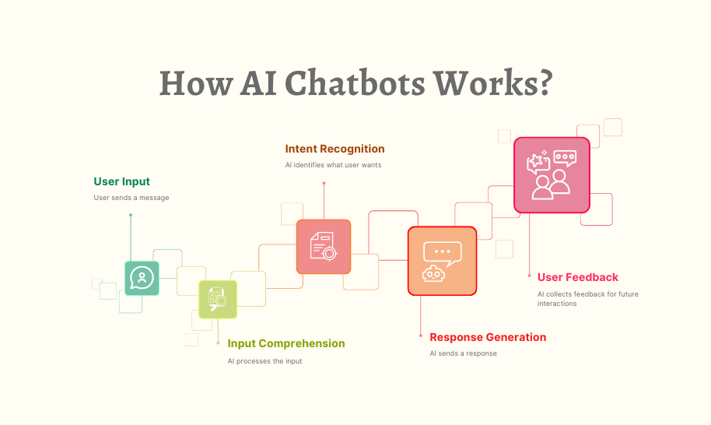

Slide 5
Data Engineering
Dataset Description
Title: Persona Dialogue Dataset
Content:
A collection of multi-turn conversations built around human personas.
Each pair includes a context and a response.
Purpose: make the chatbot more social, expressive, and consistent.
The dataset reflects conversational scenarios like:
  “How are you?”
  “What are you doing today?”
  Friendly emotional responses.
Dataset Link: https://huggingface.co/datasets/Cynaptics/persona-chat

Slide 6
Data Preprocessing
Cleaned and normalized dialogue text
  Lowercasing
  Removing emojis / strange symbols
  Fixing spacing and punctuation
Removed irrelevant or extremely short conversation pairs
Standardized persona persona-text format
Split data into:
  80% Training
  10% Validation
  10% Test
Prepared input for GPT-2 using:
  Tokenization
  Special tokens
  Dialogue formatting
Final preprocessed dataset size: (20000)

Slide 7
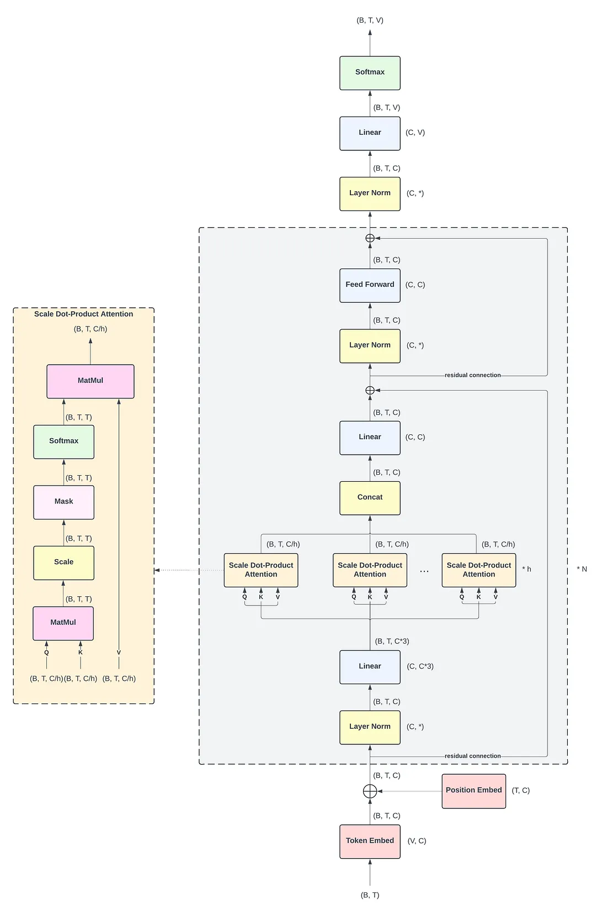
Model Architecture
Model Architecture (GPT-2 Fine-Tuning):
Base model: GPT-2 Small (124M parameters)
Added a custom conversational head for dialogue
generation
Fine-tuned on persona-based conversational data
Used causal language modeling with next-token
prediction
Implemented early stopping to avoid overfitting
Integrated into a modular system for deployment
and retraining
Training Configuration
Batch Size: (4)
Epochs: (6)
Loss Function: Cross-Entropy
Hardware: GPU acceleration
Training goal: minimize perplexity and improve naturalness of responses

Slide 8
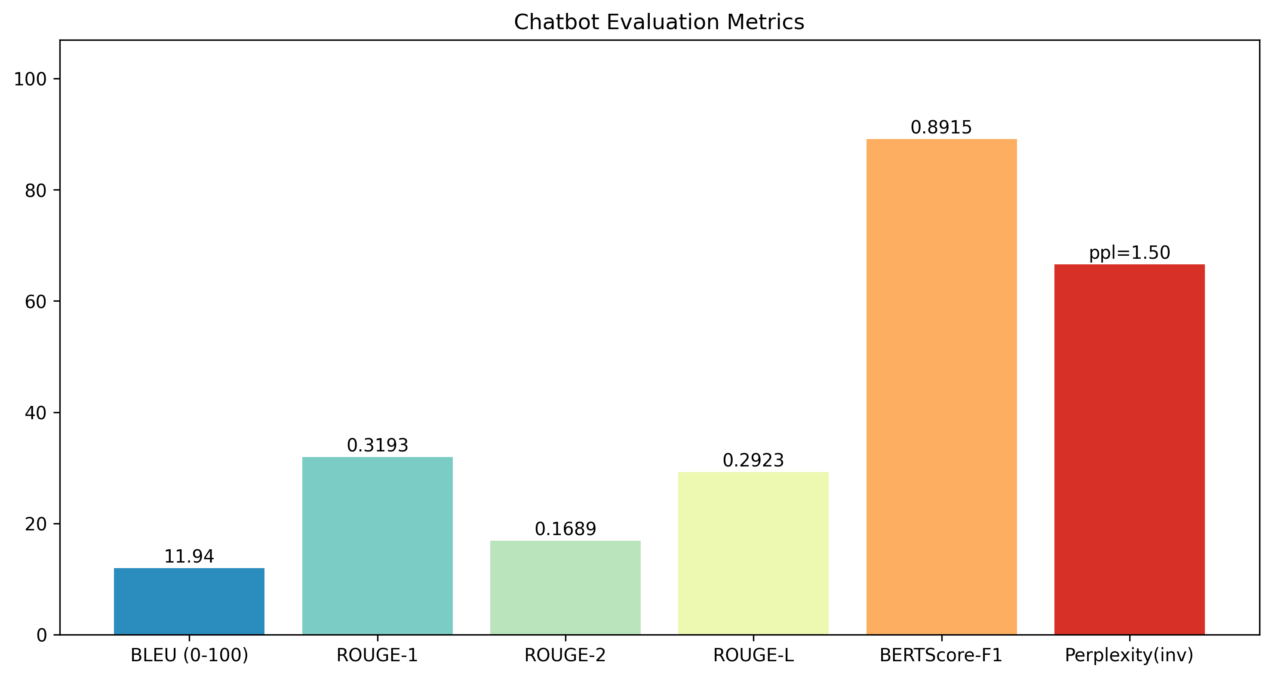
Evaluation Metrics
Loss — Measures prediction quality
Perplexity — Lower = more confident model
BLEU Score — Measures similarity to ground-truth responses
ROUGE (1, 2, L) — Measures overlapping words/sequences
BERTScore (P/R/F1) — Semantic similarity using contextual embeddings

Slide 9
Continuous Learning Pipeline
Continuous Learning System
The chatbot collects user feedback during deployment
After every 50 feedback samples, the system triggers:
  Data collection & cleaning
  Fine-tuning GPT-2 again
  Updating the deployed model
Ensures the chatbot improves and adapts to user behavior
Allows long-term quality improvement

Slide 10
Future Development & Marketing Ideas
Integrate with social media or messaging apps.
Add multiple languages.
Deploy as a customer service solution.
Improve personalization per user.
Add gamification to boost engagement.

