Slide 1
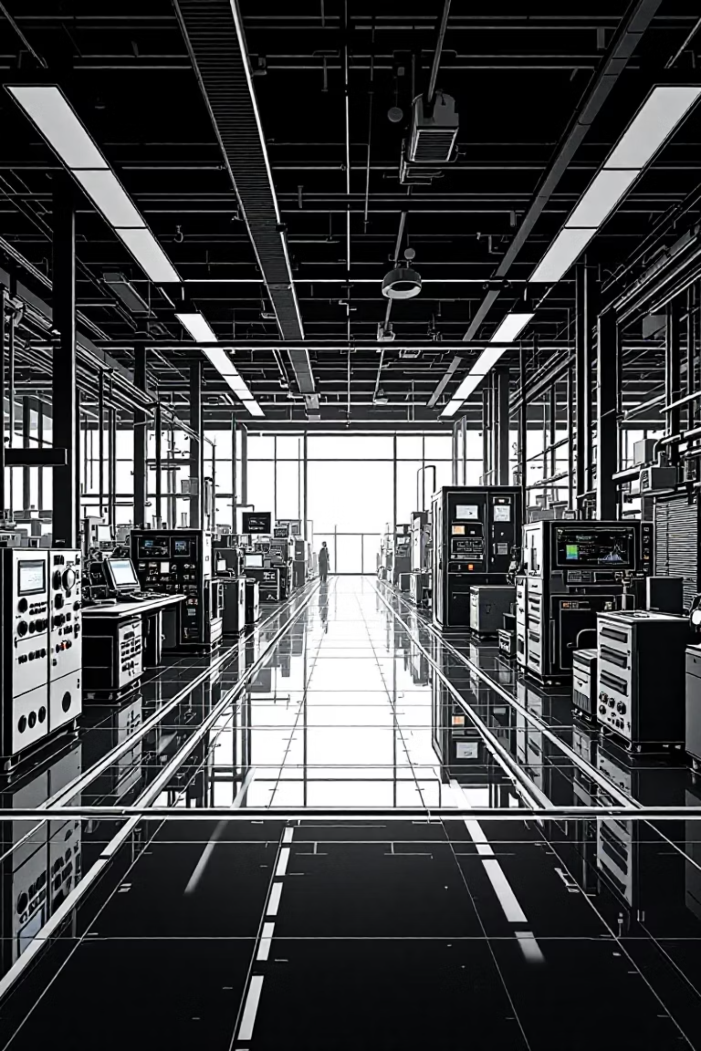
Project Idea — Smart Maintenance & Operations Dashboard

Slide 2
The Challenge
The project is a unified, real-time maintenance and production intelligence dashboard designed for factories and industrial operations. Every day, massive amounts of data are generated by machines, operators, sensors, production batches, and maintenance logs. Managers and directors do not have the time to analyze thousands of raw data points to make quick decisions.
This dashboard solves that problem by converting complex operational data into simple, actionable visuals—allowing leaders to make decisions instantly, reduce downtime, optimize productivity, and improve safety and quality.

Slide 3
📌 Why This Project Is Important
1
Speed of Decision-Making
Industrial environments move fast. A small delay in detecting a machine failure or quality issue can cost hours of downtime and thousands of dollars. A real-time dashboard ensures the right people see problems the moment they happen.
2
Improved Machine Availability
Predictive maintenance and live monitoring reduce unplanned downtime, which increases production capacity and protects expensive equipment.
3
Higher Product Quality
With real-time quality metrics, defect tracking, and yield analysis, managers can identify quality issues early before they turn into customer complaints.
4
Workforce Optimization
Operator data, safety scores, and shift assignments help management distribute labor more effectively and identify training needs.
5
Cost Control
By analyzing cost per unit, cost breakdowns, and maintenance spending, companies can quickly identify inefficiencies and drive continuous improvement.

Slide 4
📌 Project Explanation (by Dashboard Modules)
Live Floor Panel
Production Batches Panel
Shows real-time machine status:
Tracks the entire production process:
Active Machines vs Down Machines
Batch progress over time
Reasons for Downtime
Department performance
Department Overview
Quality metrics for each batch
This helps supervisors instantly see bottlenecks and take action.
Machines involved
Operators working
Live machine activities
This provides end-to-end visibility for every order.

Slide 5
Dashboard Modules (Continued)
Fleet & Machine Management Panel
Operator Management
Alert Center (Predictive Maintenance)
Centralized place to manage workforce performance:
Shows comprehensive machine intelligence:
A smart system that:
Operator performance metrics
Predicts which machines will need maintenance soon
Real-time sensor readings
Safety score
Today's production output
Productivity data
Detects safety risks
Machine metadata & history
Shift assignment and attendance
Displays alerts with priority levels
Maintenance logs
Machine safety indicators
Helps management build a safer and more skilled workforce.
This reduces unexpected failures and increases safety compliance.
This helps maintenance teams and engineers monitor and maintain the whole fleet efficiently.

Slide 6
Additional Dashboard Modules
Cost Analysis Panel
Quality Control & Yield Analysis
Tracks financial KPIs such as:
Analyzes production quality:
Cost Per Unit Trends
Yield trends
Cost Breakdown (materials, labor, downtime, maintenance)
Top defects by operator or machine (Pareto)
Yield performance by department
Helps leaders understand where the money goes and how to reduce costs.
This helps identify problem areas and improve product consistency.

Slide 7
📌 Best Points / Key Strengths of the Project
Real-time monitoring across the entire factory
Predictive maintenance using smart analytics
Not just maintenance, but production, quality, operators, and cost.
Prevents machine failures instead of reacting to them.
360° view of operations
Improves communication between departments
One dashboard replaces many disconnected reports and Excel sheets.
Everyone sees the same reliable data: maintenance, production, quality, and management.
Boosts productivity and reduces downtime
Customizable & scalable
Problems can be solved within minutes instead of hours.
You can add more machines, departments, or new modules easily.

Slide 8
📌 Recommendations to Improve the Project
1
Add AI-driven root cause analysis
Automatically analyze patterns when a machine frequently fails and suggest the most likely cause.
2
Add digital work orders system
Technicians can receive tasks directly from the dashboard.
3
Add mobile notifications
Alerts for downtime, quality issues, or machine safety can go directly to a manager's phone.
4
Add spare part inventory management
Link predicted maintenance to spare parts availability.
5
Add energy consumption tracking
Monitor electrical load for each machine to optimize costs.
6
Add KPI benchmarking
Compare departments or shifts to highlight excellence or underperformance.
7
Add automated reports
Daily/weekly reports sent to email with insights and summaries.

Slide 9
📌 How to Market This Project 🎯
Target Audience
Factory directors
Operations managers
Maintenance teams
Production managers
Quality control departments
Marketing Strategy
1
Focus on ROI
2
Use before & after storytelling
Show how the system reduces downtime, improves productivity, decreases maintenance cost, and saves management time. Use real examples if possible (e.g., "reduced downtime by 20%").
Show how factories currently operate with slow reporting, manual tracking, missed failures, and expensive downtime. Then show your dashboard replacing all of this instantly.

