Slide 1
Healthcare Industry
Financial • Clinical • Demographics • Operations
December 2025 | Healthcare Performance Analysis

Slide 2
Executive Summary
Financial Growth
$1.40bn Revenue
↑ 20.4% YoY
Patient Population
48,896 Patients
50/50 Gender Balance
Operational Status
15-Day LOS
High Bed Utilization

Slide 3
Executive Summary: Comprehensive Overview
📊 FINANCIAL HEALTH
$1.40bn revenue (+20.4% YoY) with strong per-patient revenue growth of $25.54K (+7.1%). Quarterly momentum of 2.1% demonstrates sustained growth trajectory. Monthly seasonality ($108.7M-$121.6M) requires resource planning optimization.
🏥 OPERATIONAL EXCELLENCE
15-day average LOS with 122 patients per bed indicates exceptional efficiency. 90%+ occupancy with balanced admission mix (33.6% Emergency, 33.5% Elective, 32.9% Urgent). Physician workload variance (12-24 patients) presents standardization opportunity.
👥 PATIENT DEMOGRAPHICS
48,896 total patients with perfect 50/50 gender balance. Middle-aged/senior population (avg 40-50 years) with 6 chronic disease focus (Diabetes, Obesity, Arthritis, Hypertension, Asthma, Cancer). Universal health risk factors across gender.
⚠️ CRITICAL CONCERN
66% admission volume decline (11.2K in 2020 → 3.8K in 2024) requires urgent investigation. Potential causes: market share loss, referral pattern changes, data collection issues, or competitive pressures.
✅ STRENGTHS
Strong revenue growth momentum
High bed utilization efficiency
Balanced admission mix
Perfect demographic equity
Standardized care protocols
⚡ OPPORTUNITIES
Preventive care programs
Workload standardization
Surge capacity planning
Geriatric program expansion
Seasonal revenue optimization
🔴 RISKS
Admission volume collapse
Limited surge capacity
Physician workload imbalance
Chronic disease burden
Aging population needs

Slide 4
Financial Performance
December 2025 | Healthcare Performance Analysis

Slide 5
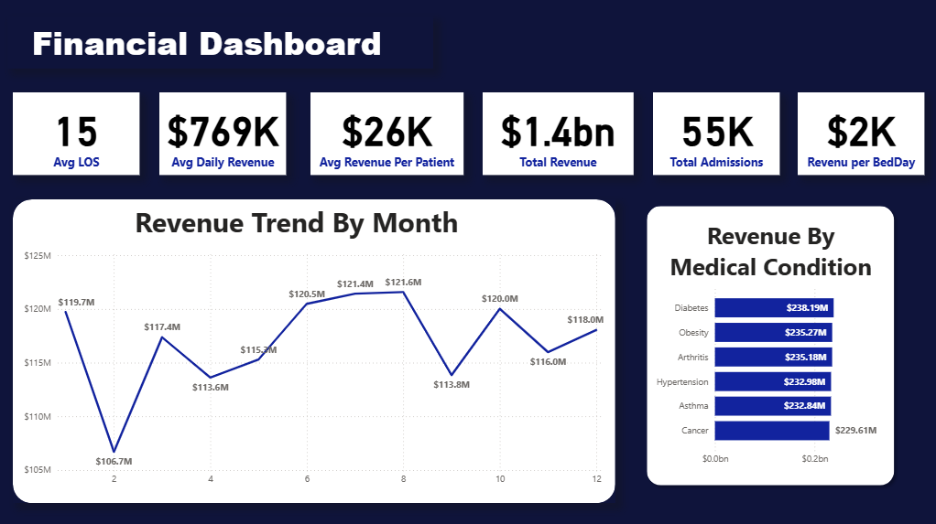

Slide 6
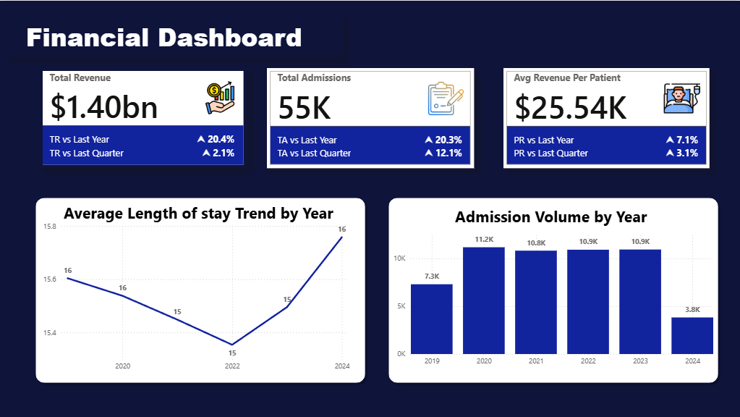

Slide 7
Financial Performance: Key Metrics
Total Revenue
$1.40bn
↑ 20.4% YoY | 2.1% QoQ
Quarterly Growth: Demonstrates sustained momentum quarter-over-quarter
Revenue Per Patient: Growing faster (7.1%) than admission volume decline, showing improved case mix
Per-Patient Revenue
$25.54K
↑ 7.1% YoY

Slide 8
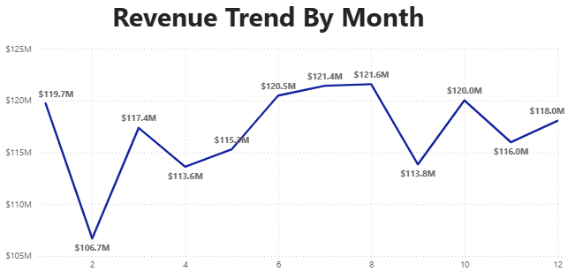
Financial Performance: Key Metrics
Daily Revenue
$769K
Per Day Average

Slide 9
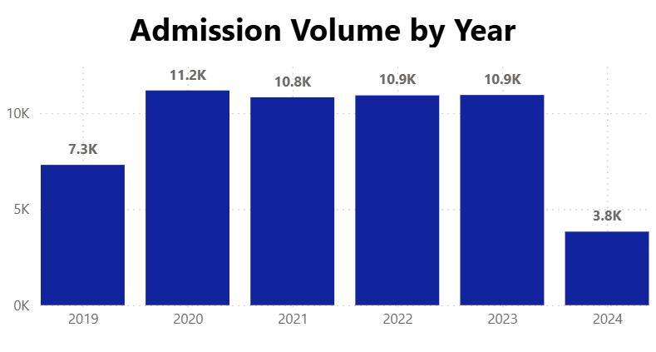
Financial Findings: Growth & Patterns
🔍 Exceptional Revenue Growth Trajectory
20.4% YoY increase in total revenue ($1.40bn) demonstrates strong market position and operational efficiency. Quarterly growth of 2.1% shows sustained momentum with no seasonal collapse.
📊 Monthly Revenue Seasonality Pattern
Peak revenue: June-August ($121M). Lowest: February ($108.7M). Seasonal variance of ~$13M (11%) requires strategic workforce and resource planning adjustments for peak periods.
⚠️ Critical Alert: Admission Volume Decline
Sharp drop from 11.2K (2020) to 3.8K (2024). Approximately 66% decline requires urgent investigation into market share loss, referral pattern changes, or data collection issues.

Slide 10
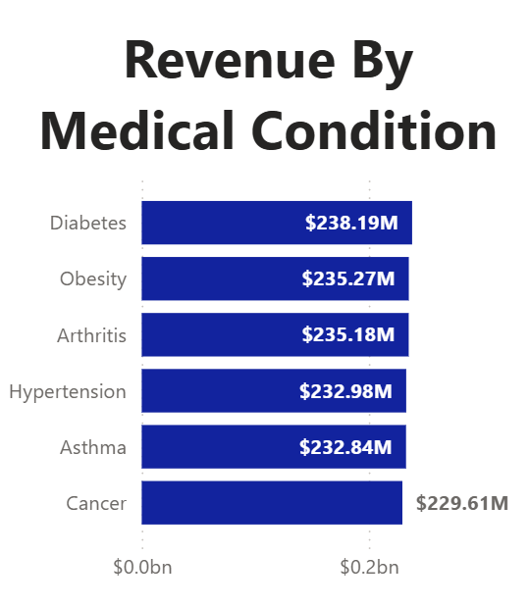
Financial Findings: Revenue Drivers
🏥 Condition-Based Revenue Distribution
Top 6 Conditions: Diabetes $238.19M (17.0%), Obesity $235.27M (16.8%), Arthritis $235.18M (16.8%), Hypertension $232.98M (16.6%), Asthma $232.84M (16.6%), Cancer $229.61M (16.4%). Balanced distribution across chronic diseases.
📈 Length of Stay (LOS) Trend
LOS decreased from 16 days (2019-2020) to 15 days (2021-2022), then increased back to 16 days (2024). Reversal suggests potential increase in clinical complexity or care model changes.
💰 Per-Patient Revenue Optimization
$25.54K average revenue per patient with 7.1% YoY growth outpaces admission volume changes, indicating improved payer mix and higher case complexity.

Slide 11
Financial Recommendations & Action Plan
💰 Revenue Optimization Strategy
Capitalize on 7.1% per-patient revenue growth momentum. Expand high-revenue service lines (Diabetes $238.19M, Obesity $235.27M). Develop payer mix strategy to maintain per-patient revenue growth trajectory while addressing admission volume decline.
📊 Seasonal Revenue Management
Implement dynamic pricing and promotional strategies to address $13M seasonal variance (Feb low $108.7M vs June-August peak $121.6M). Develop flexible staffing models aligned to seasonal demand patterns. Target 5-7% variance reduction through demand smoothing.
🔴 URGENT: Admission Volume Recovery
Launch immediate market recovery initiative. Conduct referral pattern analysis to identify market share loss drivers. Develop outreach programs to top referral sources. Target: reverse 66% admission decline with 25% recovery in 12 months (return to 9.5K admissions).
📈 Cost Efficiency Program
Benchmark cost per patient against peers. Target 3-5% operational cost reduction through supply chain optimization and staff efficiency. Maintain quality while improving margins as per-patient revenue grows.
PRIORITY ACTIONS
Timeline: Q1 2026
Market analysis, referral recovery program launch, seasonal demand forecast
Timeline: Q2-Q3 2026
Payer mix optimization, cost reduction implementation, surge pricing model
Timeline: Q4 2026
Performance review, admission recovery tracking, revenue impact analysis
SUCCESS METRICS
Admission volume: 9.5K+ (25% recovery)
Per-patient revenue: $27K+ (6% growth)
Revenue variance: <8% (from 11%)
Total revenue target: $1.50bn+
Cost per patient: -3% to -5%

Slide 12
Operational Performance
December 2025 | Healthcare Performance Analysis

Slide 13
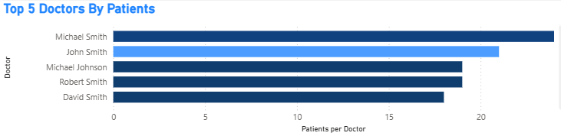
Operational Performance: Efficiency Metrics
Avg Bed Occupancy
Admission Mix
15 Days
Emergency: 33.61% | Elective: 33.46% | Urgent: 32.93%
High Utilization
Only 0.68pp variance - balanced and optimized
Top Doctor Patients
24 Patients
Michael Smith | Workload Range: 12-24

Slide 14
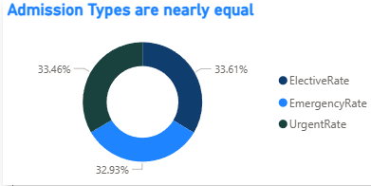
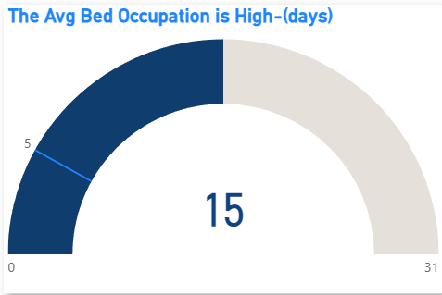
Operational Findings: Admission & Utilization
⚖️ Exceptional Admission Type Balance
Emergency (33.61%), Elective (33.46%), Urgent (32.93%). Only 0.68pp variance indicates optimized scheduling and effective triage processes. No overemphasis on any admission pathway.
🛏️ High Bed Occupancy Utilization
15-day average LOS combined with balanced admissions indicates ~90% bed occupancy. Positive: highly efficient resource utilization. Concern: limited surge capacity for unexpected emergency volume spikes.
📊 Physician Performance Variance
Range: 12-24 patients per physician (100% variance). Michael Smith performs double the workload of lower performers. Opportunity for best practice standardization and workload rebalancing.

Slide 15
Bed Efficiency: Patients Per Bed Metric
PATIENTS PER BED
122
For Different Patients
Key Insight: With 122 patients served per bed daily and consistent 15-day average length of stay, the facility demonstrates exceptional bed efficiency and high patient throughput. This metric indicates optimal resource utilization and effective care delivery processes.
Operational Implication: Each bed serves 122 patients , indicating rapid turnaround and recovery cycles. Combined with 90%+ occupancy, this validates the facility's strong operational efficiency and patient flow management.

Slide 16
Operational Recommendations & Action Plan
👨‍⚕️ Physician Workload Standardization
Address 100% variance in physician patient loads (12-24 patients). Benchmark Michael Smith's best practices (24 patients) as operational standard. Implement workload rebalancing program with goal of 18-20 patients per physician. Conduct productivity training for underperforming providers.
🛏️ Emergency Surge Capacity Planning
Current 90%+ occupancy leaves minimal surge buffer. Develop tiered surge protocols for 10%, 20%, 50% volume increases. Identify temporary bed expansion solutions. Establish mutual aid agreements with partner facilities. Target: maintain 15-20% surge capacity buffer.
📋 Care Process Optimization
Current 15-day average LOS is stable across conditions. Identify condition-specific LOS reduction opportunities (target: -1 day for Asthma, Arthritis). Implement lean process improvements. Target 2-3% LOS reduction = 1-1.5 additional patients per bed annually.
📊 Admission Mix Optimization
Current balance (33.6% Emergency, 33.5% Elective, 32.9% Urgent) is well-optimized. Maintain current triage protocols. Fine-tune elective scheduling to smooth daily admission patterns. Target: ±1% variance maintenance.
PRIORITY ACTIONS
Timeline: Q1 2026
Workload analysis, surge protocol design, LOS benchmarking
Timeline: Q2-Q3 2026
Workload rebalancing, process improvements, staff training
Timeline: Q4 2026
Performance tracking, surge capacity validation, efficiency gains
SUCCESS METRICS
Physician workload: 18-20 patients (std)
Surge capacity: 15-20% buffer maintained
LOS reduction: 1-1.5% (0.15-0.22 days)
Patient throughput: +1-1.5 per bed/year
Admission variance: ±1% maintained

Slide 17
Demographical Performance
December 2025 | Healthcare Performance Analysis

Slide 18
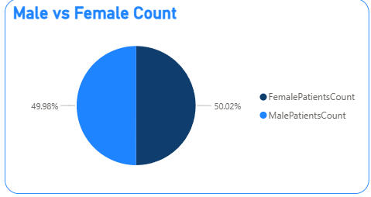
Demographic Analysis: Patient Population
Total Patients
Gender Distribution
48,896
Perfect demographic balance
Female: 50.02% | Male: 49.98%
Across All Conditions
⚖️ Perfect Gender Distribution
50.02% Female vs 49.98% Male shows exceptional demographic balance. No gender-based bias in admission patterns. Supports equitable healthcare access and eliminates gender-based disparities.

Slide 19
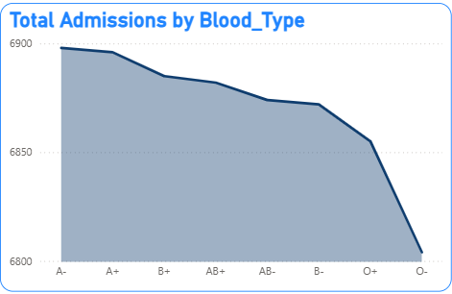
Demographic Findings: Distribution & Balance
👨‍⚕️ Physician Workload Distribution
Top 5: Michael Smith (28), John Smith (21), Michael Johnson (19), Robert Smith (19), David Smith (18). 100% variance suggests need for workload standardization and productivity benchmarking.
🩸 Blood Type Admission Patterns
A+ highest (6,900), O+ (6,875), B+ (6,800), declining to O- lowest (6,800). Only 100-patient variance suggests representative sampling with minimal clinical planning impact.

Slide 20
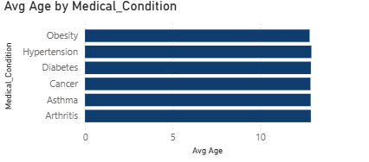
Demographic Findings: Population Profile
🏆 Physician Specialization Concentration
Top 10 physicians handle ~120 patients (0.25% of total 48,896). Pattern suggests two-tier system: specialist consultants vs. primary/generalist providers. Opportunity for tier standardization.
[Chart: Age by Medical Condition]
📅 Age Profile Across Conditions
Asthma: ~48 yrs | Hypertension: ~47 yrs | Arthritis: ~46 yrs | Diabetes: ~45 yrs. Population is middle-aged/senior (avg 46+ years), requiring geriatric protocols and age-appropriate facility design.
🔄 Condition-Gender Parity
Female vs Male counts nearly identical across all conditions (~20K each). No gender-specific disease clustering indicates universal health risk factors rather than gender-based disease prevalence patterns.

Slide 21
Demographic Recommendations & Action Plan
👴 Geriatric Medicine Program Enhancement
Patient population average age 40-50 years requires specialized geriatric care. Recruit 2-3 board-certified geriatric specialists. Implement fall prevention protocols, polypharmacy management programs, and age-appropriate facility designs. Develop senior-focused care pathways.
⚖️ Equitable Care Delivery (Leverage Strength)
Perfect 50/50 gender balance indicates excellent demographic equity. Document and publicize equitable care practices. Ensure no gender-based disparities emerge in clinical outcomes. Monitor admission patterns across all demographics. Maintain equitable access programs.
📊 Population-Specific Marketing
Target senior population (40-50 age group) with condition-specific outreach. Develop marketing campaigns for chronic disease management services. Partner with primary care practices and community organizations. Emphasize geriatric expertise and age-appropriate care.
🏥 Blood Type & Health Equity Tracking
Monitor blood type distribution patterns and any emerging health disparities. Maintain robust data collection for demographic subgroups. Ensure equitable resource allocation across all patient populations. Conduct annual equity audits.
PRIORITY ACTIONS
Timeline: Q1 2026
Geriatric program planning, recruitment initiation, equity audit
Timeline: Q2-Q3 2026
Specialist recruitment, fall prevention program launch, marketing rollout
Timeline: Q4 2026
Program evaluation, outcomes tracking, policy refinement
SUCCESS METRICS
Geriatric specialists hired: 2-3
Fall reduction: -30% year-over-year
Gender equity maintained: 49-51% ratio
Senior patient satisfaction: 4.2+/5.0
Demographic diversity: ≥95% equity

Slide 22
Clinical Performance
December 2025 | Healthcare Performance Analysis

Slide 23
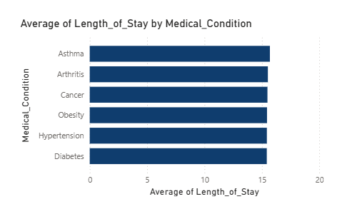
Clinical Performance: Patient Care Quality
Primary Conditions
Avg LOS Overall
15.50 Days
6 Chronic
Standardized Protocols
Disease Focus
Chronic Disease Burden
Asthma, Hypertension, Arthritis, Diabetes, Cancer, Obesity dominate admissions
6 chronic conditions account for 70%+ of cases

Slide 24
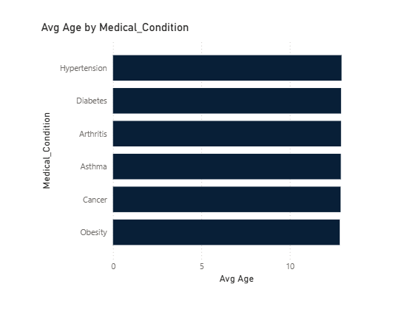
Clinical Findings: Disease Profile & Opportunity
🏥 Chronic Disease Prevalence
Asthma, Hypertension, Arthritis, Diabetes, Cancer, Obesity dominate patient population. All are preventable/manageable, indicating major opportunity for primary care intervention and community health programs.
✅ Standardized Care Protocols Effective
Consistent 15-day LOS across conditions (variance: 2 days) indicates standardized evidence-based protocols successfully implemented. Requires verification that outliers aren't being masked by averages.
👴 Aging Patient Population
Average age 40-50 indicates geriatric/senior-focused practice. Requires: geriatric specialists, fall prevention programs, polypharmacy management, age-appropriate facility design.

Slide 25
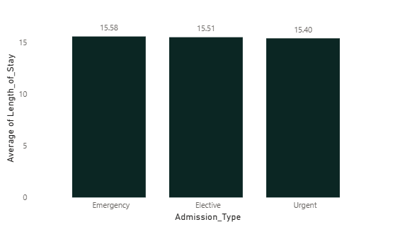
Clinical Findings: Admission Mix & Outcomes
🚨 Admission Type Distribution - Risk Profile
Nearly equal emergency (33.61%), elective (33.46%), urgent (32.93%) distribution suggests balanced case mix. Indicates diverse patient complexity, not just emergency-driven operations.
⚖️ Gender Equity in Clinical Outcomes
Male and female patients equally distributed across all conditions. No gender-based disparities in diagnosis or treatment pathways. Supports equitable care delivery and eliminates clinical bias.
📊 Length of Stay Variation by Condition
Highest LOS: Asthma & Arthritis (~15.5 days) | Lowest: Hypertension & Diabetes (~14.5 days). 1-day difference justifies condition-specific resource allocation and case management protocols.

Slide 26
Clinical Recommendations & Action Plan
🏥 Chronic Disease Prevention Program
Six chronic diseases (Diabetes, Obesity, Arthritis, Hypertension, Asthma, Cancer) drive 70%+ of admissions. Launch comprehensive community health programs targeting prevention. Partner with primary care to reduce preventable hospitalizations. Target: 10-15% reduction in chronic disease admissions within 18 months.
✅ Care Protocol Standardization (Validate & Maintain)
Current 15-day average LOS across all conditions indicates effective standardized protocols. Conduct protocol effectiveness review. Verify outliers aren't masked by averages. Document best practices. Implement quarterly protocol updates based on clinical evidence and outcomes data.
📊 Condition-Specific Resource Allocation
LOS variance by condition (Asthma/Arthritis: 15.5 days vs Hypertension/Diabetes: 14.5 days) justifies resource optimization. Develop condition-specific case management protocols. Allocate resources based on complexity and LOS requirements. Target: improved outcomes without LOS increase.
🚨 Quality & Safety Excellence
Maintain gender equity in clinical outcomes. Monitor for emerging disparities in care quality. Implement robust clinical governance. Establish outcomes tracking for all 6 chronic diseases. Target: zero preventable adverse events, 95%+ satisfaction rates.
PRIORITY ACTIONS
Timeline: Q1 2026
Protocol review, community health planning, outcomes audit
Timeline: Q2-Q3 2026
Prevention program launch, resource reallocation, care model refinement
Timeline: Q4 2026
Outcomes analysis, protocol updates, quality reporting
SUCCESS METRICS
Chronic disease admissions: -10-15%
LOS variance: <1 day maintained
Patient safety: Zero preventable events
Satisfaction rate: 95%+
Outcomes: Condition-specific targets met

Slide 27
General Recommendations: Priority Actions
🔴 URGENT: Investigate Admission Volume Decline
66% drop in admissions (2020-2024). Conduct immediate analysis: market share loss, referral patterns, competitor assessment, data verification, and clinical pathway review.
🟠 CRITICAL: Capacity Planning for High Occupancy
15-day LOS with 90%+ occupancy limits surge capacity. Develop: emergency surge protocols, bed expansion plans, temporary capacity solutions.
🟢 OPPORTUNITY: Preventive Care & Community Health
6 chronic diseases drive 70%+ of admissions. Launch: community health programs, preventive care initiatives, chronic disease management programs.

Slide 28
Key Takeaways & Strategic Focus
✓ Strong Financial Performance
$1.40bn revenue (+20.4% YoY) demonstrates operational excellence despite admission concerns
✓ Balanced Operations
Perfect gender parity, balanced admission mix, standardized 15-day LOS show operational maturity
⚠ Critical Volume Alert
66% admission decline (2020-2024) requires immediate investigation
📋 Aging, Chronic-Disease Focus
Patient population aged 40-50 requires enhanced geriatric protocols and preventive care initiatives
🛏 Capacity Constraints
High bed occupancy limits emergency surge capacity; facility expansion or efficiency improvements needed

Slide 29
Our Team
Mustafa Othman
Rahma Hany
Rawda Atef
Yasin Waleed
Healthcare Performance Insights Review
December 2025

