Slide 1
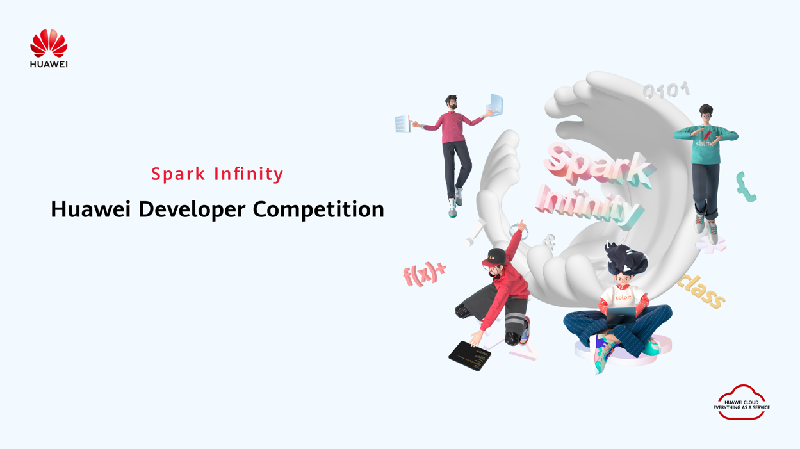
Challenge Name: AI-Powered Innovations
Project Name: Student Churn
Team Name: Eagles
Organization: Ain Shams University
Email/Phone: georgtawadrous@gmail.com

Slide 2
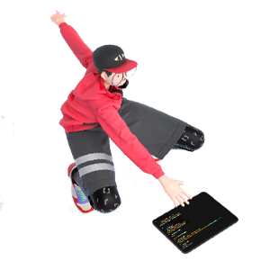

Project Overview
Overview
Project Name | Student Churn
Team Name | Eagles
Contacts | eng.mecheal@gmail.com, georgtawadrous@gmail.com, markmaged735@gmail.com
Technical Field | Serverless Architectures, Cloud Native, MLOps, ML, LLMs
Technologies | ML, ModelArts, FunctionGraphs, RDS, ECS
Keywords | AI Counselor Chat (RAG), Student Churn Prediction, Real-Time Inference, MLOps, Event-Driven Architecture, Huawei Cloud, Decision Support System
Applicable Fields | Education, Business
Description (in 200 words) | The AI-Powered Student Retention System is a sophisticated Machine Learning Operations (MLOps) solution built entirely on the Huawei Cloud platform, designed to combat student attrition through automation and proactive intervention. The core innovation lies in its event-driven architecture. When new student data is uploaded to OBS, FunctionGraph automatically orchestrates the parallel ETL process (via ECS to the RDS Feature Store) and the model training on ModelArts. The system ensures that the churn prediction model is always current by deploying it as a Real-Time Prediction Service API Endpoint on ModelArts. The user interface, a Streamlit dashboard, consumes this real-time inference to provide instant risk scores. Crucially, the application features an integrated Retrieval-Augmented Generation (RAG) system (the "AI Counselor Chat"). This Generative AI component, powered by DeepSeek, Qwen & Gemini, synthesizes the real-time prediction and the student's detailed profile to generate personalized, conversational retention advice. By seamlessly combining an automated pipeline, real-time prediction, and contextual AI-driven guidance, the project moves institutions from reactive reporting to a proactive decision support system, directly leading to increased student retention and optimized resource allocation.

Slide 3

Contents
1
Team Introduction
2
Project Introduction
3
Technical Architecture
4
Functions
5
Innovations
6
Business Value
7
Demo & Follow-up Plan
8
Achievements

Slide 4

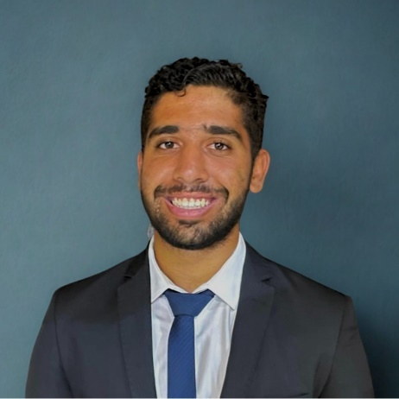


Team Introduction
Micheal Samuel
Mark Maged
George Tawadrous
Edu: Modern Academy Maadi
Electrical, Electronics and
Communication Engineering
Role: Data Analysis & SQL
Experience：Excellent with honors|NRO TAC|Microwave Transmission|DWDM|Submarine Cables|Technical support|IP|Network|MPLS|Optical Fiber
Edu: Ain Shams University
Computer Science
Role: ML Modelling and Engineering
Experience：AI Engineering, Deep Learning, Machine Learning
Edu: Ain Shams University
Computer and Systems
Engineering
Role: Cloud Solution Architect , DevOps and MLOps
Experience：Grade @ uni: Excellent/Full Stack Web Development/Flutter Mobile Development/ML Modelling/ Huawei Cloud Certified Engineer
https://www.linkedin.com/in/mark-maged/
https://www.linkedin.com/in/the3miaphysite3engineer3/
https://www.linkedin.com/in/micheal-samwel/

Slide 5
Project Introduction
The AI-Powered Student Retention System is a cutting-edge MLOps solution built on the Huawei Cloud platform, specifically designed to combat student attrition within educational institutions. Leveraging predictive analytics and state-of-the-art Generative AI, this project transforms passive data into proactive, actionable insights, marking a significant step forward in academic support and resource optimization.
🎯 The Challenge
Student dropout (churn) represents a major financial, reputational, and administrative challenge for educational providers. Traditional retention methods are often reactive and generalized, failing to intervene effectively before a student is irreversibly disengaged.
✨ The Solution
This system addresses the challenge by establishing an automated, event-driven pipeline that provides two critical outputs:
Predictive Churn Risk: A high-accuracy machine learning model (trained via ModelArts) that analyzes student demographic and academic data to classify their outcome as Dropout, Enrolled, or Graduate.
AI-Driven Intervention Advice: A unique Retrieval-Augmented Generation (RAG) system embedded within a Streamlit dashboard, providing counselors with personalized, conversational advice (the "AI Counselor Chat") for retaining specific at-risk students.

Slide 6
Technical Architecture
Event-Driven MLOps Pipeline Core: The system initiates automatically when new student data is uploaded to OBS (Object Storage Service). This event triggers a FunctionGraph (FG) serverless function, which acts as the central orchestrator, ensuring a zero-touch, automated start to the data processing and training pipeline.
Parallel Data Engineering and Feature Store: The FunctionGraph invokes an ECS 1 (Node.js) server for robust ETL. This process converts the raw data, executes complex SQL scripts (like 02_feature_extraction.sql), and loads the structured, feature-engineered data into RDS (MySQL), which serves as the central feature and reporting store.
Automated ML Training and Real-Time Deployment: The FunctionGraph concurrently triggers ModelArts to train the churn prediction model (e.g., XGBoost). Post-training, the model is automatically deployed as a Real-Time Prediction Service on ModelArts, providing a low-latency API endpoint for live inference, decoupling prediction logic from the frontend application.
Application Layer and Real-Time Inference: The user interface is hosted on ECS 2 running Streamlit. This application retrieves data visualizations from RDS and, critically, sends student data in real-time to the ModelArts Prediction Service Endpoint to receive instant churn risk scores, ensuring the application always uses the production-grade model.
Generative AI-Driven Retention Strategy (RAG): The application features a unique AI Counselor Chat powered by DeepSeek, Qwen & Gemini (as implied by the RAG system and imports in streamlit.py). This Retrieval-Augmented Generation (RAG) system uses the student's real-time risk score and retrieved profile data as context to generate personalized, conversational, and actionable retention advice.

Slide 7
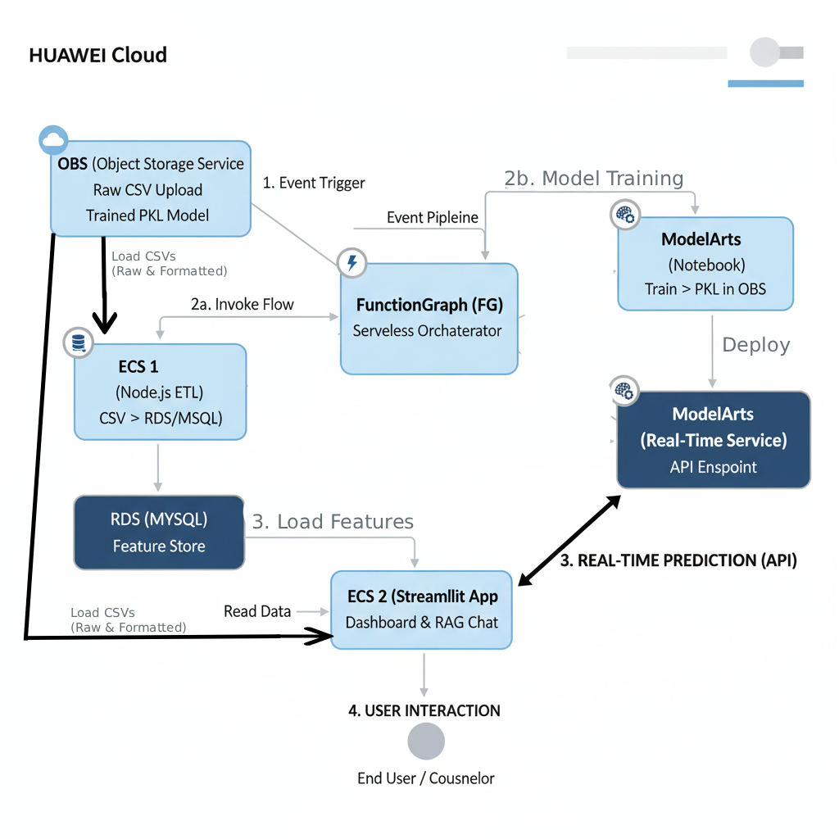
Technical Architecture : Solution Overview
Solution deployment architecture diagram
Service Description
Event-Driven Data Ingestion (OBS & FunctionGraph):
The entire pipeline is initiated by an event: a new CSV file (students_churn.csv) is uploaded to OBS (Object Storage Service).
This event triggers the serverless orchestrator, FunctionGraph (FG), ensuring the workflow is fully automated and immediately responsive to new data.
Parallel ETL and Feature Engineering (ECS 1 & RDS):
FunctionGraph invokes ECS 1 (Node.js) to handle the critical ETL process. The Node.js application converts the CSV and loads it into the RDS (MySQL) database.
SQL scripts (00_create_dataset.sql, 02_feature_extraction.sql) are executed on RDS to create tables and generate derived features (e.g., pass rates, average grades), establishing RDS as the reliable Feature Store.
Managed Model Training (ModelArts Notebook):
Concurrently, FunctionGraph triggers a ModelArts Jupyter Notebook. The notebook is responsible for reading data, preprocessing, training the prediction model, and saving the resulting model and scaler objects (.pkl) back to OBS.
Real-Time Model Deployment (ModelArts Service):
The trained model from OBS is registered and deployed by ModelArts as a high-availability Real-Time Prediction Service (API Endpoint). This standardizes inference and decouples the heavy ML model from the application server.
Application Front-End and Data Access (ECS 2 & RDS):
ECS 2 hosts the user-facing Streamlit dashboard. It retrieves aggregated data and reporting metrics from the RDS (MySQL) Feature Store for dashboard visualizations.
Low-Latency Inference via API:
For live predictions, the Streamlit application does not load the PKL file; instead, it sends student features directly to the ModelArts Real-Time Service API Endpoint. This ensures predictions are fast, scalable, and use the centrally managed production model.
AI-Driven Recommendation Engine (RAG/DeepSeek/Qwen/Gemini):
The Streamlit application integrates a unique AI Counselor Chat via a Retrieval-Augmented Generation (RAG) system powered by DeepSeek, Qwen & Gemini. The RAG system combines the real-time churn prediction score with the student's detailed profile (retrieved from RDS) to generate nuanced, contextual, and actionable retention advice for the end-user.

Slide 8
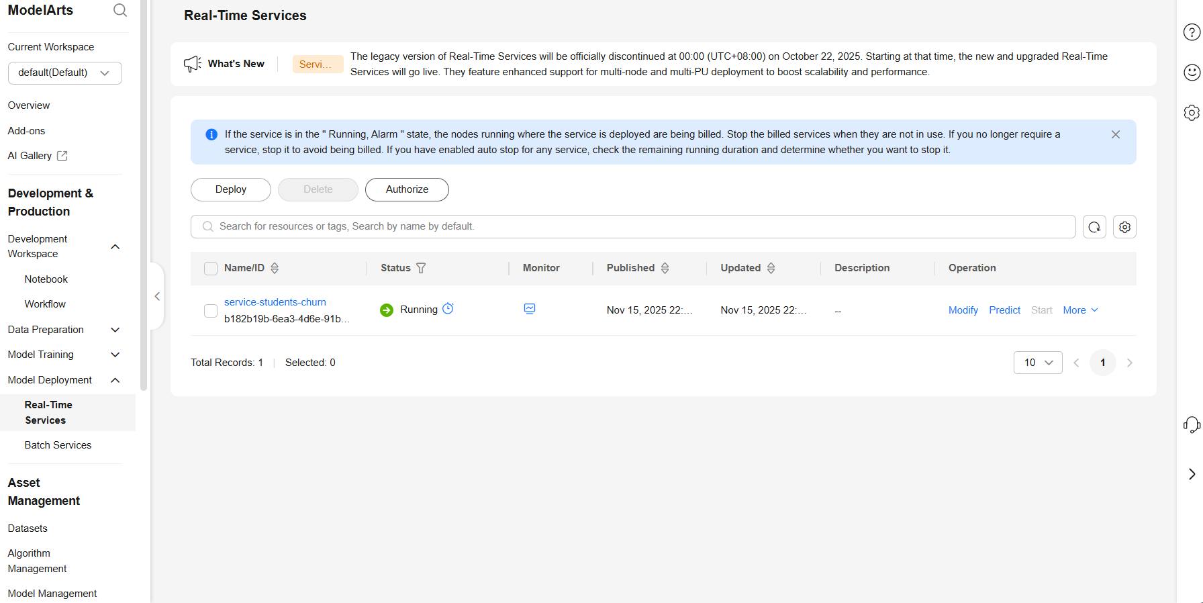
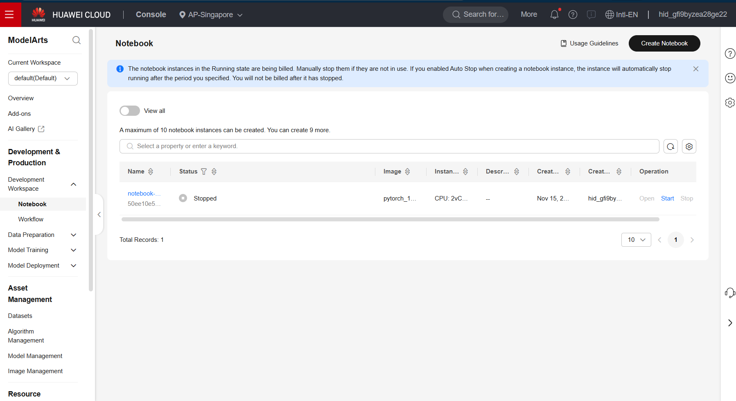
Technical Architecture : Huawei Cloud Service Dashboard
Using Huawei Cloud ModelArt Deployment
Using Huawei Cloud ModelArt for AI training

Slide 9
Functions
⚙️ Technical Architecture: 7-Point Summary
Event-Driven Pipeline Core (OBS & FunctionGraph): The entire MLOps workflow is event-driven. An upload of the raw student data CSV to OBS (Object Storage Service) immediately triggers the FunctionGraph (FG) serverless orchestrator. This eliminates the need for manual scheduling or polling, ensuring the pipeline starts automatically with new data.
Parallel Data Processing Initiation: FunctionGraph concurrently invokes two main processing flows:
ECS 1 (Node.js ETL) for database operations.
ModelArts for model training.
Data Persistence and Feature Engineering (ECS 1 & RDS):
The Node.js application running on ECS 1 performs the ETL, transforming the CSV data and persisting it to RDS (MySQL).
This step is crucial for running the necessary SQL feature extraction scripts (02_feature_extraction.sql), turning raw data into calculated features like First_sem_pass_rate and Average_grade, making RDS the central Feature Store.
Model Training and Asset Management (ModelArts):
The ModelArts Jupyter Notebook trains the churn prediction model (e.g., XGBoost) and saves the final trained model (.pkl file) and scaler object back to OBS for secure versioning and storage.
Real-Time Model Deployment (ModelArts Service):
The trained model is promoted and deployed via ModelArts as a dedicated Real-Time Prediction Service. This action creates a robust, scalable API endpoint, allowing the application layer to consume predictions instantly without having to load the large model file into memory on the Streamlit ECS.
Application Delivery and Low-Latency Inference (ECS 2):
The ECS 2 running the Streamlit dashboard acts as the application gateway. It fetches structured data for visualization from RDS and makes direct API calls to the ModelArts Real-Time Service for on-demand churn predictions.
AI-Driven Decision Support (RAG System):
The Streamlit application features the unique AI Counselor Chat. This system uses Retrieval-Augmented Generation (RAG) powered by Gemini, DeepSeek, Qwen. It synthesizes the real-time churn prediction score with the student's contextual feature data to generate personalized, human-like intervention and retention advice.

Slide 10
Inovations
Hyper-Automated, Event-Driven MLOps Loop:
The architecture achieves zero-touch automation by using the OBS to FunctionGraph (FG) sequence as the primary trigger. This is a robust MLOps practice that ensures that model retraining and redeployment (when a new students_churn.csv is uploaded) is an immediate, hands-off process, minimizing model drift and operational overhead.
Real-Time Decoupled Inference with ModelArts:
Unlike systems where the web app (ECS 2/Streamlit) manually loads the model (.pkl file), this solution deploys the model as a ModelArts Real-Time Service API Endpoint. This key innovation allows the Streamlit app to request low-latency predictions via a standard API call, ensuring scalability, faster application startup times, and easy model version management.
RDS as a Dynamic Feature Store:
The system utilizes RDS (MySQL) not just for raw data storage, but as a formal Feature Store. The ETL process runs complex feature generation SQL scripts (02_feature_extraction.sql) directly on the database. This ensures that features like First_sem_pass_rate are standardized, reusable, and immediately available for both model training and real-time dashboard visualization.
Generative AI-Powered Personalized Intervention (RAG):
The most significant innovation is the integration of a Retrieval-Augmented Generation (RAG) system powered by DeepSeek, Qwen & Gemini. Instead of just outputting a risk score (e.g., 90% chance of dropout), the system uses the score and the student's entire profile (the "retrieved data") as context to generate nuanced, conversational retention advice ("AI Counselor Chat"). This shifts the tool from being a simple predictor to an active decision support system.
Simplified Frontend Development with Production ML Integration:
By using Streamlit on ECS 2 for the front end, the solution prioritizes fast development and iteration. Crucially, the frontend focuses solely on UI/UX, while delegating the heavy computation (ML inference to the ModelArts API and Generative AI to the DeepSeek, Qwen & Gemini service), resulting in a lean, fast, and highly interactive counselor application.
Full Huawei Cloud Service Stack:
The entire architecture is built exclusively on Huawei Cloud Services (OBS, FunctionGraph, ECS, RDS, ModelArts), demonstrating an efficient, cohesive, and optimized use of a single-vendor cloud ecosystem for end-to-end MLOps deployment.

Slide 11
Business Value
Direct Increase in Student Retention and Revenue:
Value: The core function of the system is to identify high-risk students before they drop out. By enabling targeted, timely intervention (guided by the AI Counselor Chat), institutions can directly reduce churn.
Impact: Every retained student represents saved tuition revenue, leading to a substantial positive return on investment.
Optimized Resource Allocation and Operational Efficiency:
Value: The prediction service allows counselors and administrators to move away from broad, untargeted outreach. The system instantly highlights the students with the highest risk scores.
Impact: Staff time and intervention resources (e.g., tutoring, financial aid counseling) are prioritized efficiently, maximizing the impact of limited human capital.
Data-Driven Policy Formulation:
Value: The structured data in RDS and the aggregated metrics in the Streamlit dashboard provide deep insights into the root causes of dropout (e.g., poor first-semester grades, debt status, specific courses).
Impact: Institutions can leverage this data to make informed strategic decisions regarding curriculum changes, support service expansion, or revision of admission criteria.
Enhanced Student Experience and Reputation:
Value: Proactive intervention demonstrates a genuine commitment to student welfare. The personalized advice from the RAG system makes the interaction feel tailored and supportive.
Impact: Improves student satisfaction and retention, leading to positive word-of-mouth and a stronger institutional reputation.
Future-Proof MLOps Infrastructure:
Value: The automated, Huawei Cloud-native architecture (OBS to FunctionGraph to ModelArts) establishes a robust, scalable foundation.
Impact: This infrastructure can be easily adapted to support other predictive applications (e.g., course placement, enrollment forecasting) with minimal refactoring, yielding long-term infrastructure savings.

Slide 12
Demo & Follow-up Plan
Demo
http://159.138.88.64/
https://drive.google.com/drive/folders/1ay4nWDDlgewaPb4Ky_L81dtEtqeeXNoo?usp=sharing
Implement Feedback Loop for Model Drift Correction:
Action: Integrate a simple mechanism in the Streamlit application to record the outcome of a counselor's intervention (e.g., "Student retained," "Still dropped out").
Goal: Use this ground truth data to continuously monitor model performance and automatically trigger retraining/recalibration when performance metrics (e.g., AUC, F1-Score) drop below a threshold, ensuring sustained accuracy.
Integrate with Institutional SIS/LMS (Real-Time Data Feeds):
Action: Move data ingestion from batch CSV uploads (to OBS) to direct, streaming integration with the institution's Student Information System (SIS) or Learning Management System (LMS).
Goal: Enable true real-time prediction based on the latest student activity (e.g., recent test scores, attendance logs) for even faster intervention response times.
Expand RAG System Knowledge Base:
Action: Augment the RAG system's knowledge base by indexing all official institutional documents, academic policies, course prerequisites, and counseling protocols.
Goal: Allow the "AI Counselor Chat" to provide definitive, policy-backed advice (e.g., "Based on policy 4.A, this student is eligible for a course withdrawal without penalty").
A/B Testing and Controlled Intervention Trials:
Action: Design a controlled experiment where a predicted "at-risk" group is split: one half receives the AI-guided intervention, and the other receives the standard intervention.
Goal: Quantify the exact lift in retention attributable to the AI system to formally validate the project's ROI.
Model Explainability and Trust (XAI):
Action: Integrate explainability tools (e.g., SHAP, LIME, which can be done in ModelArts) into the prediction service.
Goal: Provide counselors with an "explanation score" alongside the risk score (e.g., "Student is high risk primarily due to low First_sem_pass_rate and high Debtor status"), building trust and directing the human counselor's focus.

Slide 13
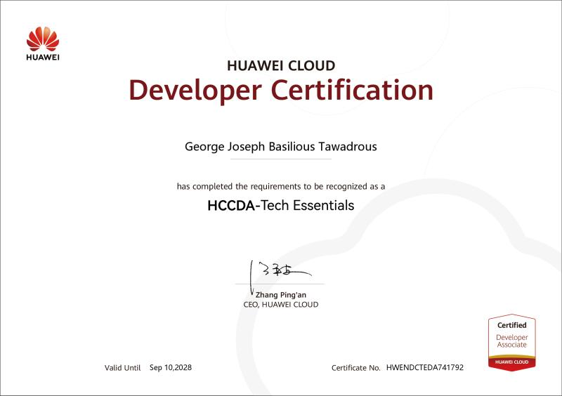
Achievements (HCCDX Certificates)

Slide 14

Achievements (HCCDX Certificates)

Slide 15
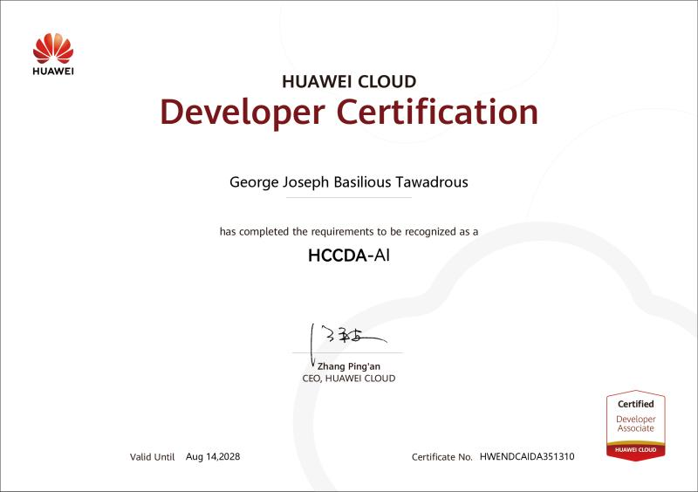
Achievements (HCCDX Certificates)

Slide 16
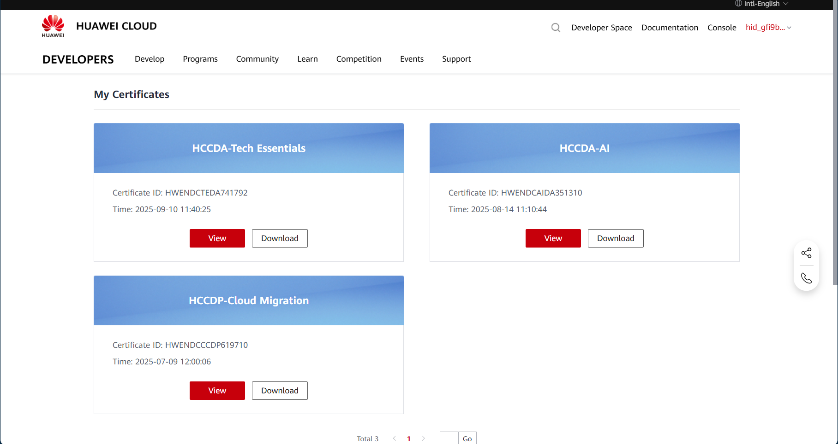
Achievements (HCCDX Certificates)

Slide 17
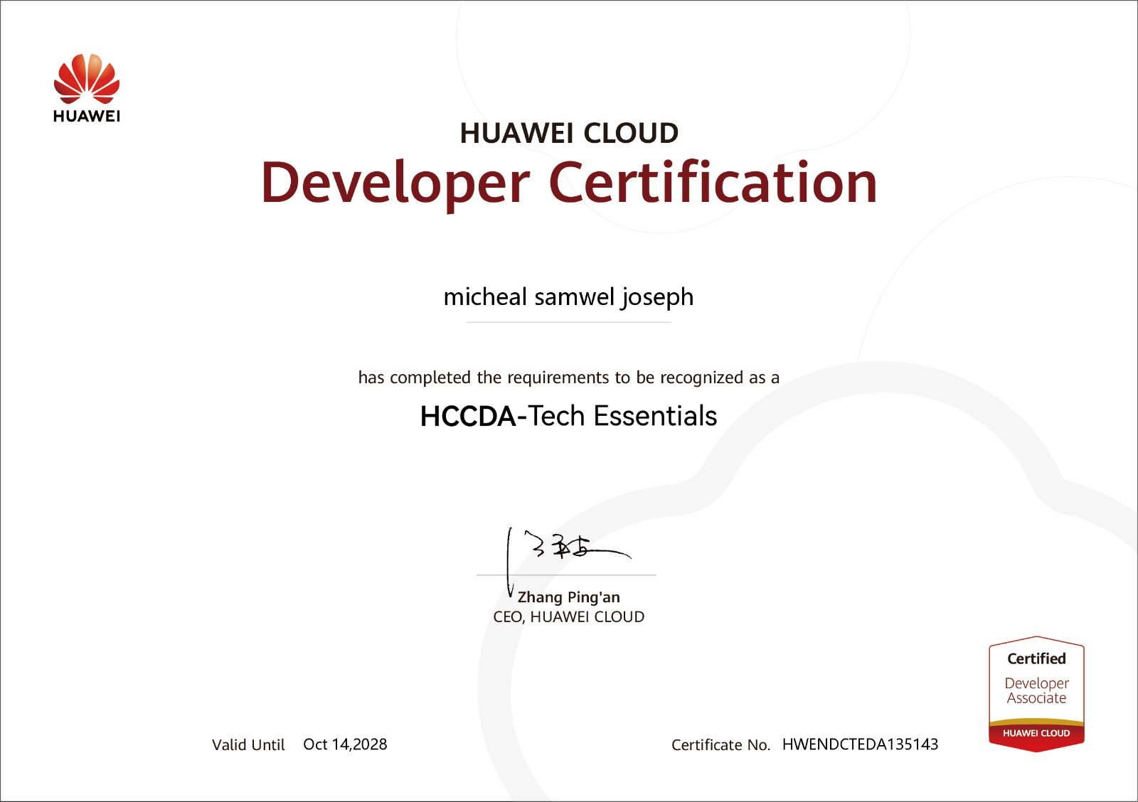
Achievements (HCCDX Certificates)

Slide 18
THANK YOU

