Slide 1


Slide 2
Web
Testing

Slide 3
Web
Testing

Slide 4
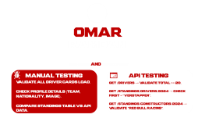


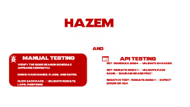
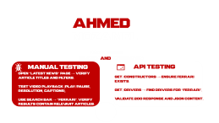
Web
Testing

Slide 5
Testing

Slide 6


MOHAMED
YASSER
Home PagE AND Navigation
Manual Testing
Api testing
Verify navigation bar link
(Home, News, Drivers, Teams).
Confirm images and banners load properly.
GET /status → verify server health.
GET /seasons → check 200 response & JSON format.

Slide 7
HAZEM
SHERIF
Race Schedule AND Results
Manual Testing
Api testing
Verify the 2025 season schedule appears correctly.
Check race names, flags, and dates.
Click each race → validate results, laps, positions.
GET /schedule/2024 → validate 24 races.
GET /results/2024/1 → validate race name = “Bahrain Grand Prix”.
Negative test: /results/2050/1 → expect error or 404.

Slide 8
OMAR
RAMDAN
Drivers AND Standings
Manual Testing
Api testing
Validate all driver cards load.
Check profile details (team, nationality, image).
Compare standings table vs API data.
GET /drivers → validate total >= 20.
GET /standings/drivers/2024 → check first = “Verstappen”.
GET /standings/constructors/2024 → validate “Red Bull Racing”.

Slide 9
AHMED
MOZAMEL
News Videos
Search and Integration
Manual Testing
Api testing
Open “Latest News” page → verify article titles and filters.
Test video playback (play/pause, resolution, captions).
Use search bar → “Ferrari”, verify results contain relevant articles.
GET /constructors → ensure Ferrari exists.
GET /drivers → find drivers for “Ferrari”.
Validate 200 response and JSON content.

Slide 10
AHMED
EHAB
AUTOMATION TESTING
Formula 1 website by developing automated test scripts using Selenium WebDriver, TestNG, and Java.
The work included building a structured automation framework, validating core website functionalities, executing test scenarios across different flows, and ensuring consistent performance and reliability.
This automation effort increased test coverage, reduced manual testing time, and enhanced overall quality of the platform.

Slide 11
Q A
THANKS

Slide 12
THANKS

