Slide 1
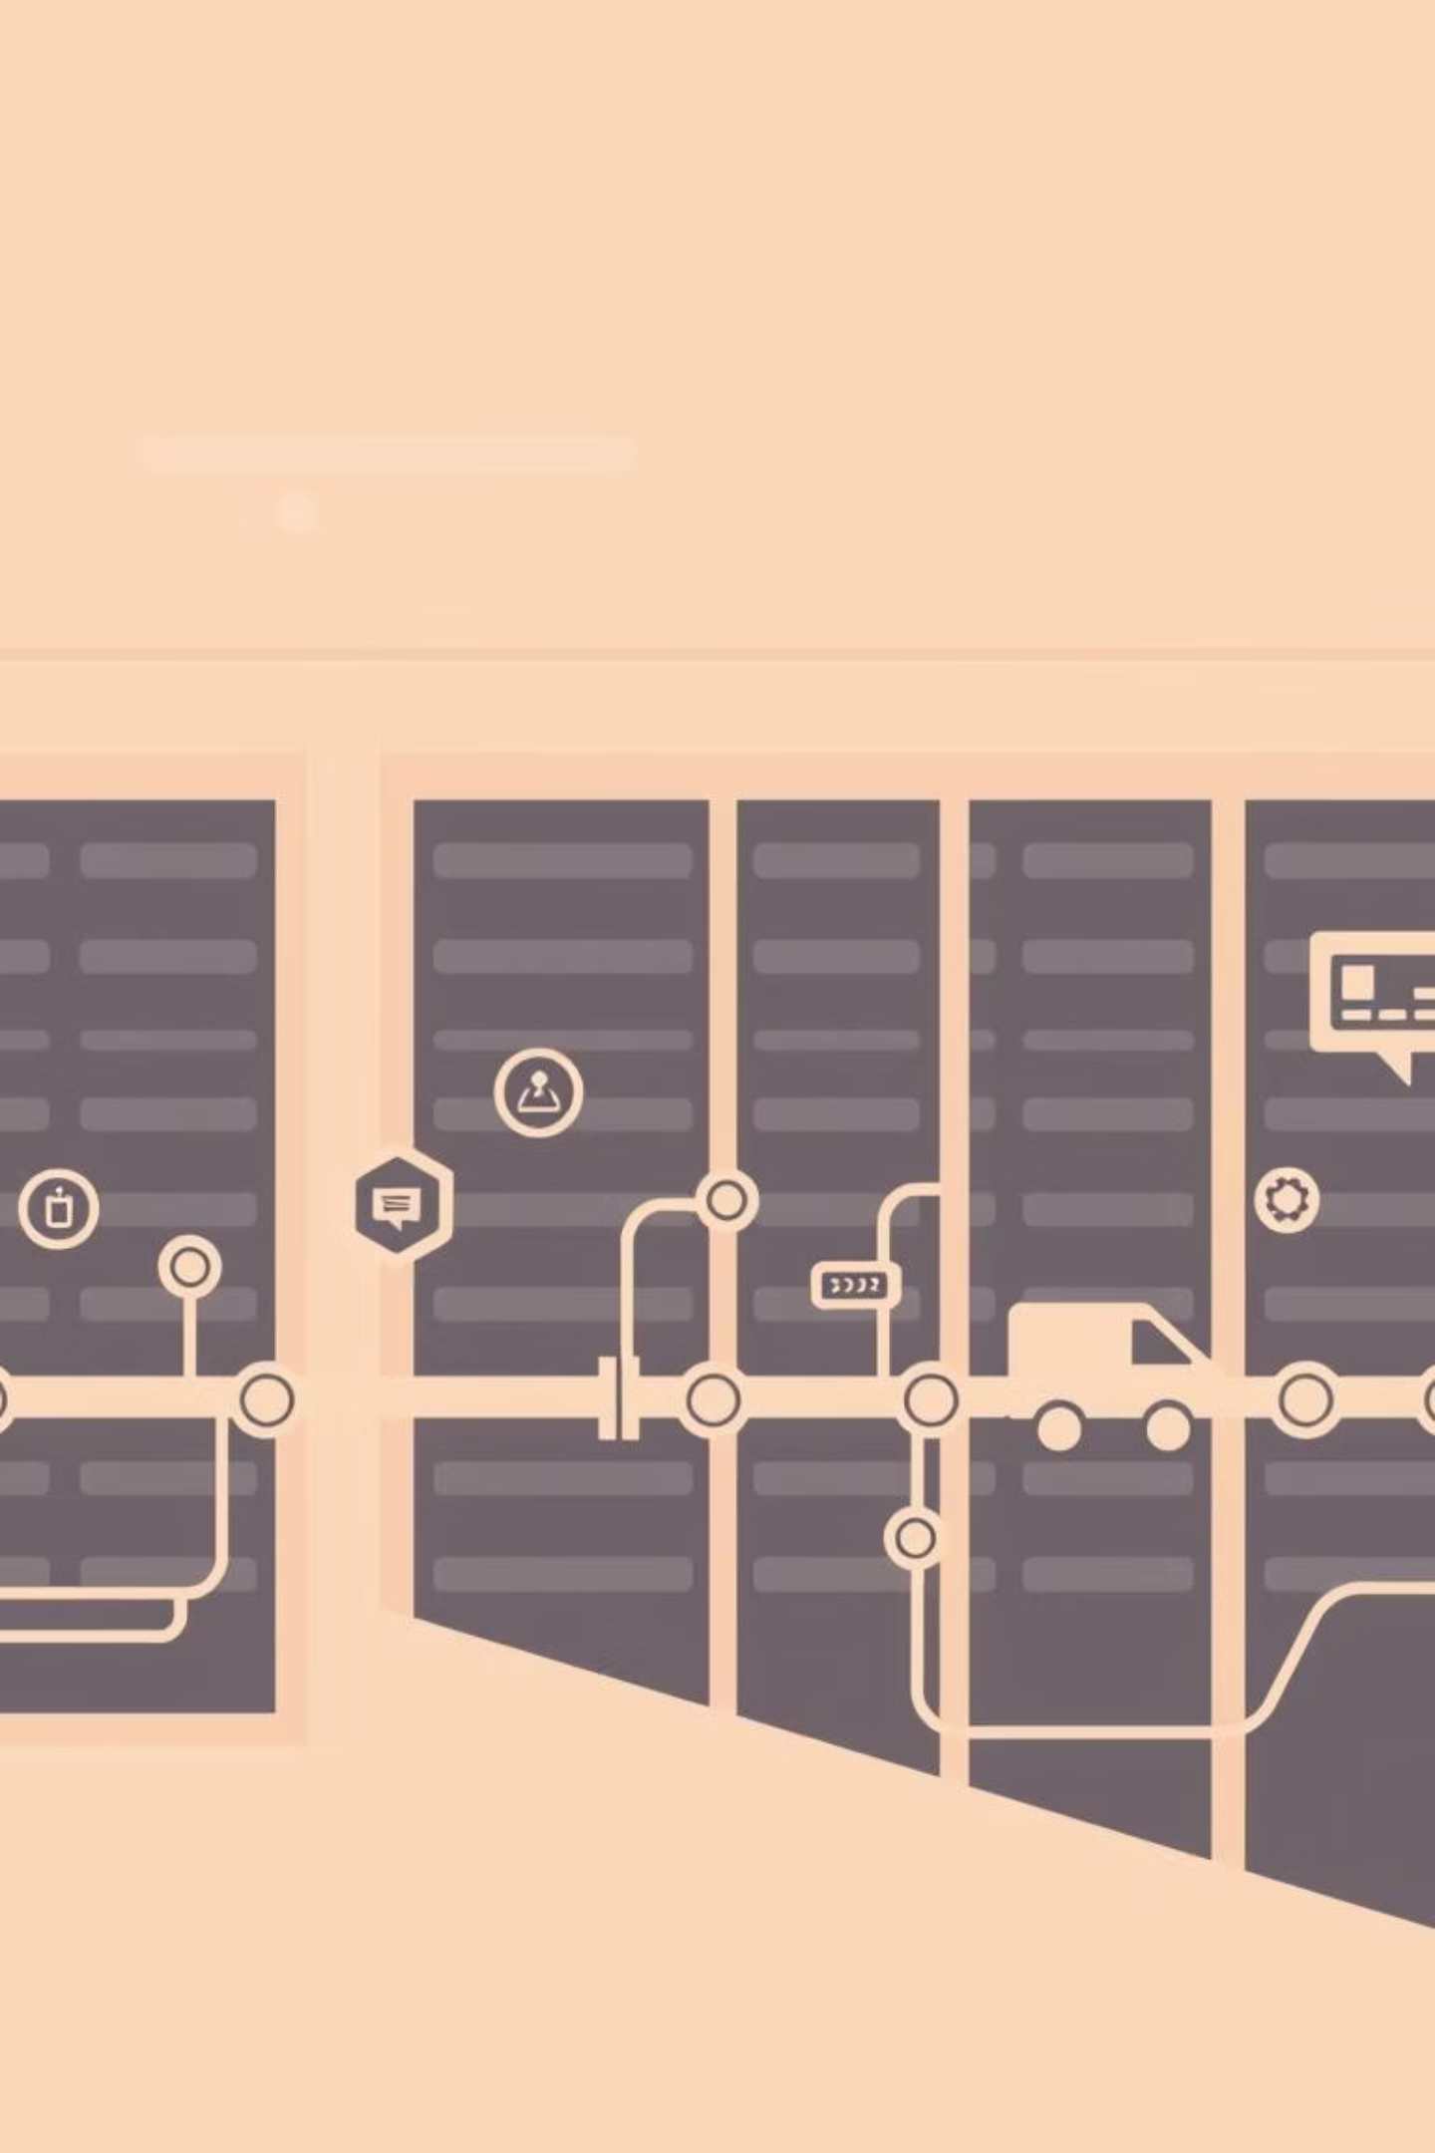
DevOps Capstone Project: Todo List Application
Team D Members:
Soha Ashraf Eltokhy.​
Haneen Sabry Abdelazeem.​
Ali Tarek Ali.​
Michael Fayez Beshara.
Github Repo: https://github.com/nhahub/NHA-244

Slide 2

Architectural Overview & Project Phases
Application & Containerization
Orchestration & Automation
A Node.js Todo List application (Express.js + MongoDB) is containerized with Docker, using multi-stage builds.
Kubernetes (minikube) orchestrates the application, while Ansible automates VM provisioning.
CI/CD & Registry
Infrastructure
GitHub Actions manages the CI/CD pipeline, pushing images to Docker Hub.
The application is deployed on an Ubuntu VM.
Project Phases: A Structured Approach
01
02
Phase 1: Application Dockerisation
Phase 2: VM Automation with Ansible
The application was Dockerised using a multi-stage Dockerfile. Images were built, tested, and pushed to Docker Hub.
Ansible automated VM provisioning, installing Docker, kubectl, minikube, and MongoDB.
03
04
Phase 3: Kubernetes Deployment
Phase 4: CI/CD Pipeline
Kubernetes manifests were crafted and the application deployed with 2 replicas. It was exposed via NodePort.
A GitHub Actions workflow was established for automated Docker image builds. This integrated with Docker Hub using a multi-tag strategy.

Slide 3
Triggering the CI/CD Pipeline: Live Demo
Step 1: Make a Code Change
Navigate to the application repository: cd ~/Desktop/capstone-project/Todo-List-nodejs. Edit the homepage file views/home.ejs, for instance, by modifying line 27 to "Todos - Live Demo".
Step 2: Commit and Push Changes
Stage the changes with git add views/home.ejs, then commit with a descriptive message like "Demo: Update homepage for presentation". Finally, push to GitHub using git push origin master to automatically trigger the CI/CD pipeline.

Slide 4
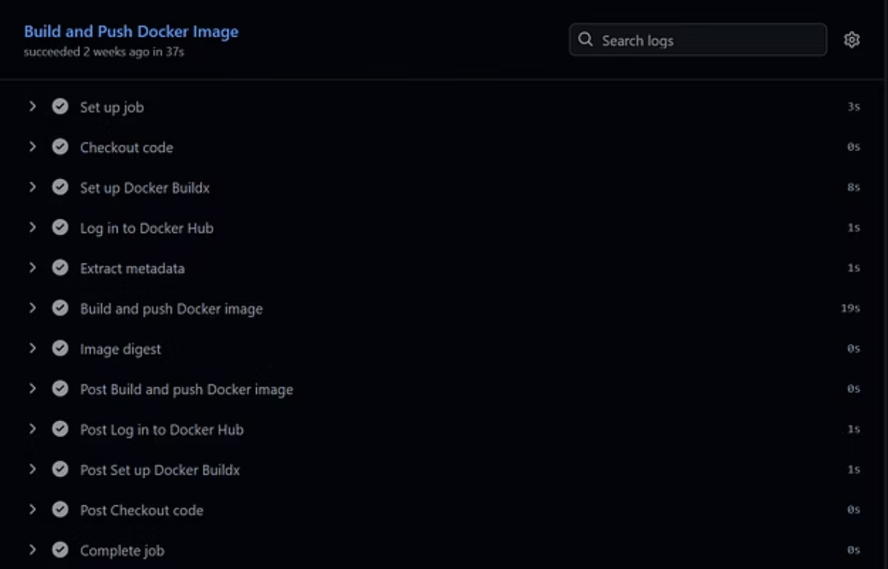
Monitoring the CI/CD Pipeline and Image Verification
Step 3: Monitor CI/CD Pipeline
The pipeline should show the following stages, expected to complete within 40-60 seconds:
Checkout code
Set up Docker Buildx
Login to Docker Hub
Build and push Docker image
Image tagged with latest and master-
https://github.com/alitarek-dot/Todo-List-nodejs/actions
Step 4: Verify New Image on Docker Hub
Check Docker Hub to confirm the new image has been pushed. Look for the master- tag; its timestamp should align with push time.
https://hub.docker.com/r/alitarek123/todo-list-nodejs/tags

Slide 5
Deploying to Kubernetes & Verifying Changes
Step 5: Deploy Updated Image to Kubernetes
Step 6: Verify Changes in Browser
SSH into the VM: ssh -i ~/.ssh/vm_ansible alitarek@192.168.74.128. Then, update the Kubernetes deployment using the new image tag. Monitor the rollout status to ensure successful deployment and verify pods are running with the new image.
Access the application at http://192.168.74.128:30080. The homepage should now display your updated text. A quick browser refresh might be needed to see the changes.
Accessing the Application
The primary access method is via the URL: http://192.168.74.128:30080
Verification Commands
Check pod status: kubectl get pods -n todo-app
Check service details: kubectl get svc -n todo-app
View application logs: kubectl logs -n todo-app -l app=todo-app --tail=50
Test from inside minikube: docker exec minikube curl -s http://10.244.0.3:4000 | grep ""

Slide 6
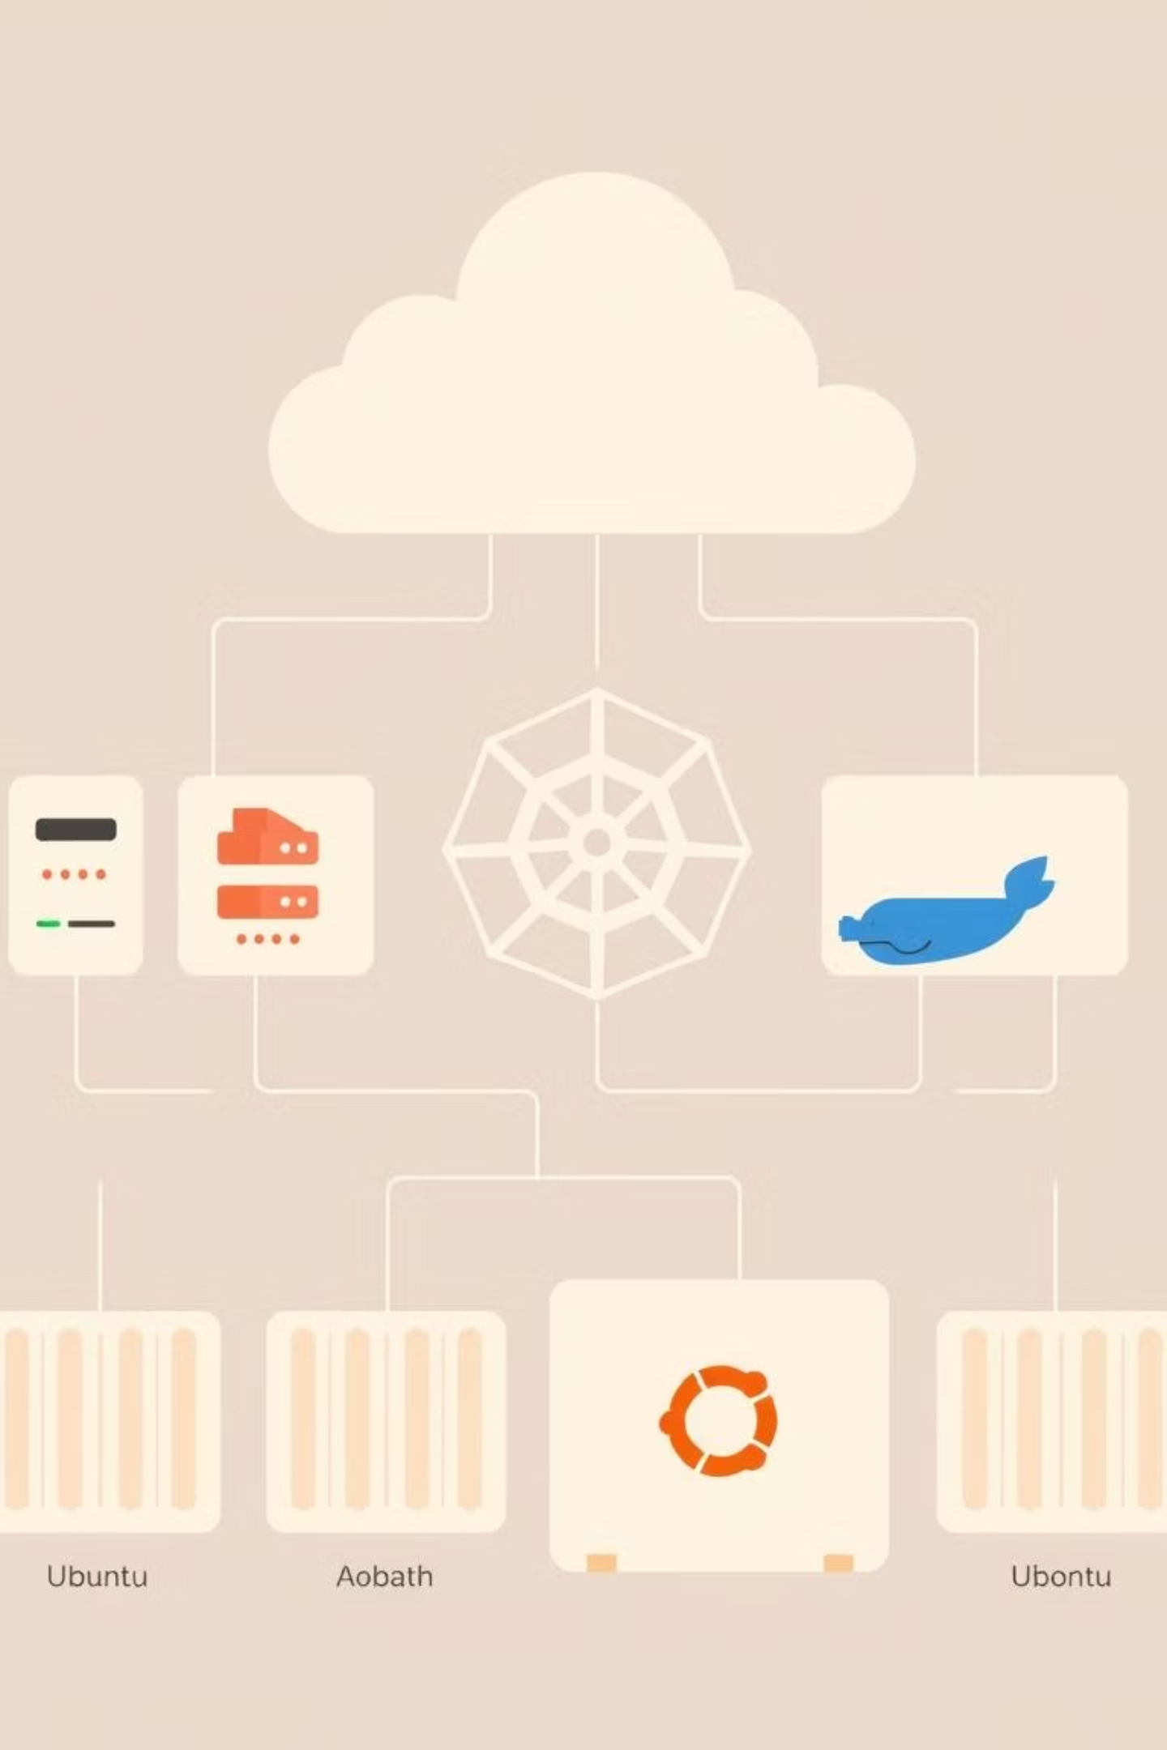
Key Metrics & Details
Infrastructure Specifications
Docker Image Details
VM OS: Ubuntu 24.04.3 LTS
Repository: alitarek123/todo-list-nodejs
VM IP: 192.168.74.128
Minikube IP: 192.168.49.2
Image Size: ~209MB (optimized multi-stage build)
Kubernetes Version: v1.34.0
Container Runtime: Docker
Base Image: node:18-slim
Minikube Resources: 2 CPUs, 2GB RAM
Architecture: linux/amd64
Latest Tag: master-7048b27
Application Details
MongoDB Configuration
Replicas: 2 pods for high availability
Deployment: Docker container on VM (outside Kubernetes)
Container Port: 4000
Service Type: NodePort (30080)
Version: MongoDB 7 (jammy)
Health Checks: Liveness and readiness probes configured
Port: 27017
Database: todolistDb
Resource Limits: CPU and memory constraints applied
Authentication: Enabled with credentials stored in K8s secrets

Slide 7
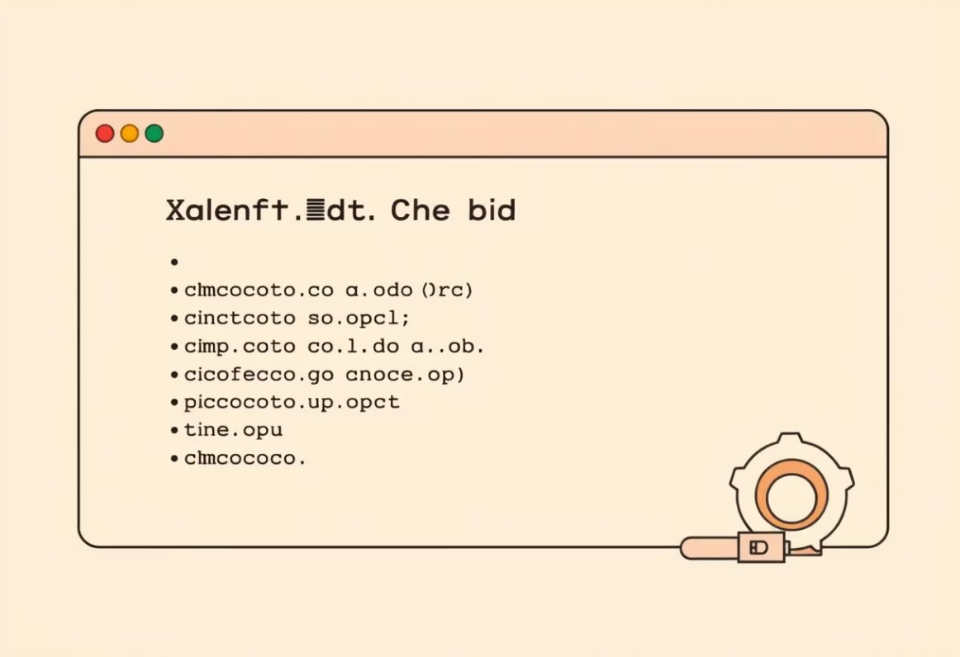

Troubleshooting Guide
If Application is Not Accessible
If CI/CD Pipeline Fails
Check minikube status: minikube status
Check GitHub Actions logs: Review the failed workflow run details.
Restart minikube if needed: minikube delete && minikube start --driver=docker --cpus=2 --memory=2048 --force
Common issues: Docker Hub credentials expiration, build timeouts due to rate limits, or Dockerfile syntax errors.
Reapply Kubernetes manifests: Use kubectl apply -f - for all manifest files.
Wait for pods to be ready: kubectl wait --for=condition=ready pod -l app=todo-app -n todo-app --timeout=120s

Slide 8


Issues Faced & Solutions
Issue 1: Disk Space Critically Low
Issue 2: MongoDB Connectivity
Problem: VM disk at 98% capacity, preventing minikube from starting.
Problem: Application pods couldn't connect to MongoDB on VM host due to network isolation.
Solution: Cleaned Docker system, removed minikube cache, trimmed journal logs, and cleaned apt cache, freeing ~1GB of disk space.
Solution: Deployed MongoDB inside Kubernetes with PersistentVolumeClaim, Deployment, and ClusterIP Service, resolving cross-network communication issues.
Issue 3: Secret Key Mismatch
Issue 4: External Application Access
Problem: MongoDB pod failing due to incorrect secret key references.
Problem: Application accessible inside minikube but not from outside the VM.
Solution: Corrected environment variable references in mongodb-deployment.yaml to match Kubernetes secret keys.
Solution: Configured iptables NAT rules to forward VM IP traffic to minikube's NodePort, enabling external access.
Each challenge presented an opportunity to deepen our understanding of DevOps principles, from resource management to network configuration and secure credential handling. The iterative process of identifying, diagnosing, and resolving these issues was crucial to the project's success.

Slide 9
Security Considerations & Technologies Used
Implemented Security Measures
Technologies & Tools Used
Container Hardening
Application
Node.js
18
Non-root container user, dropped Linux capabilities, and no privilege escalation allowed.
Express.js
Latest
Database
MongoDB
7-jammy
Authentication & Secrets
Containerisation
Docker
29.0.4
MongoDB authentication enabled, credentials stored securely in Kubernetes Secrets and GitHub secrets for CI/CD.
Orchestration
Kubernetes (minikube)
1.34.0
CLI Tools
kubectl
1.31.0
Infrastructure Security
Automation
Ansible
Latest
SSH key-based authentication for Ansible automation, and resource limits to prevent exhaustion.
CI/CD
GitHub Actions
Latest
Registry
Docker Hub
-
OS
Ubuntu
24.04.3 LTS
Security was a paramount consideration throughout the project, ensuring robust protection from code to deployment. Key technologies and tools underpin every aspect of this modern DevOps pipeline.

Slide 10
2nd Approach
Hosting the application on EC2 server "AWS cloud"

Slide 11

2nd Approach: Hosting the application on EC2 server "AWS cloud" Using Docker Compose
Setup and Containerization. (Docker contentainers).
Infrastructure Provisioning & Deployment. (Ansible Configurations).
Monitoring, Visualization.(Prometheus and Granfana).

Slide 12
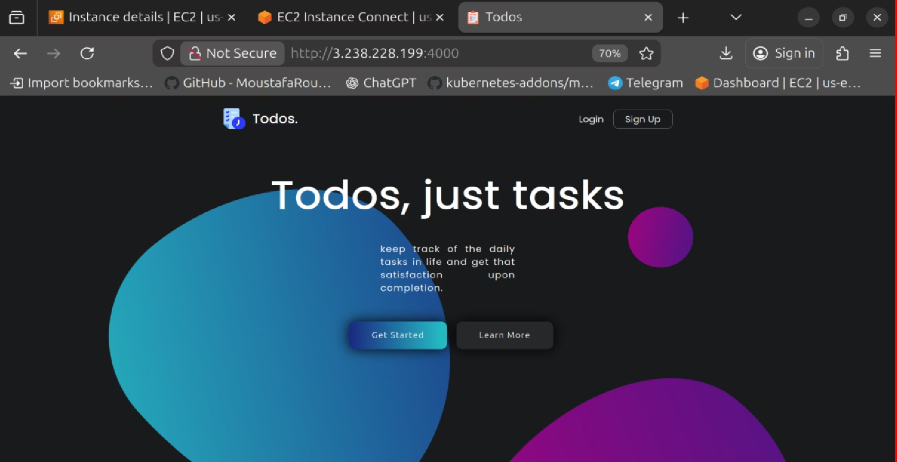
2nd Approach

Slide 13
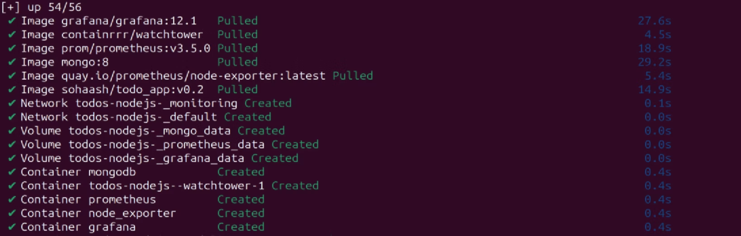
2nd Approach
Docker Compose

Slide 14
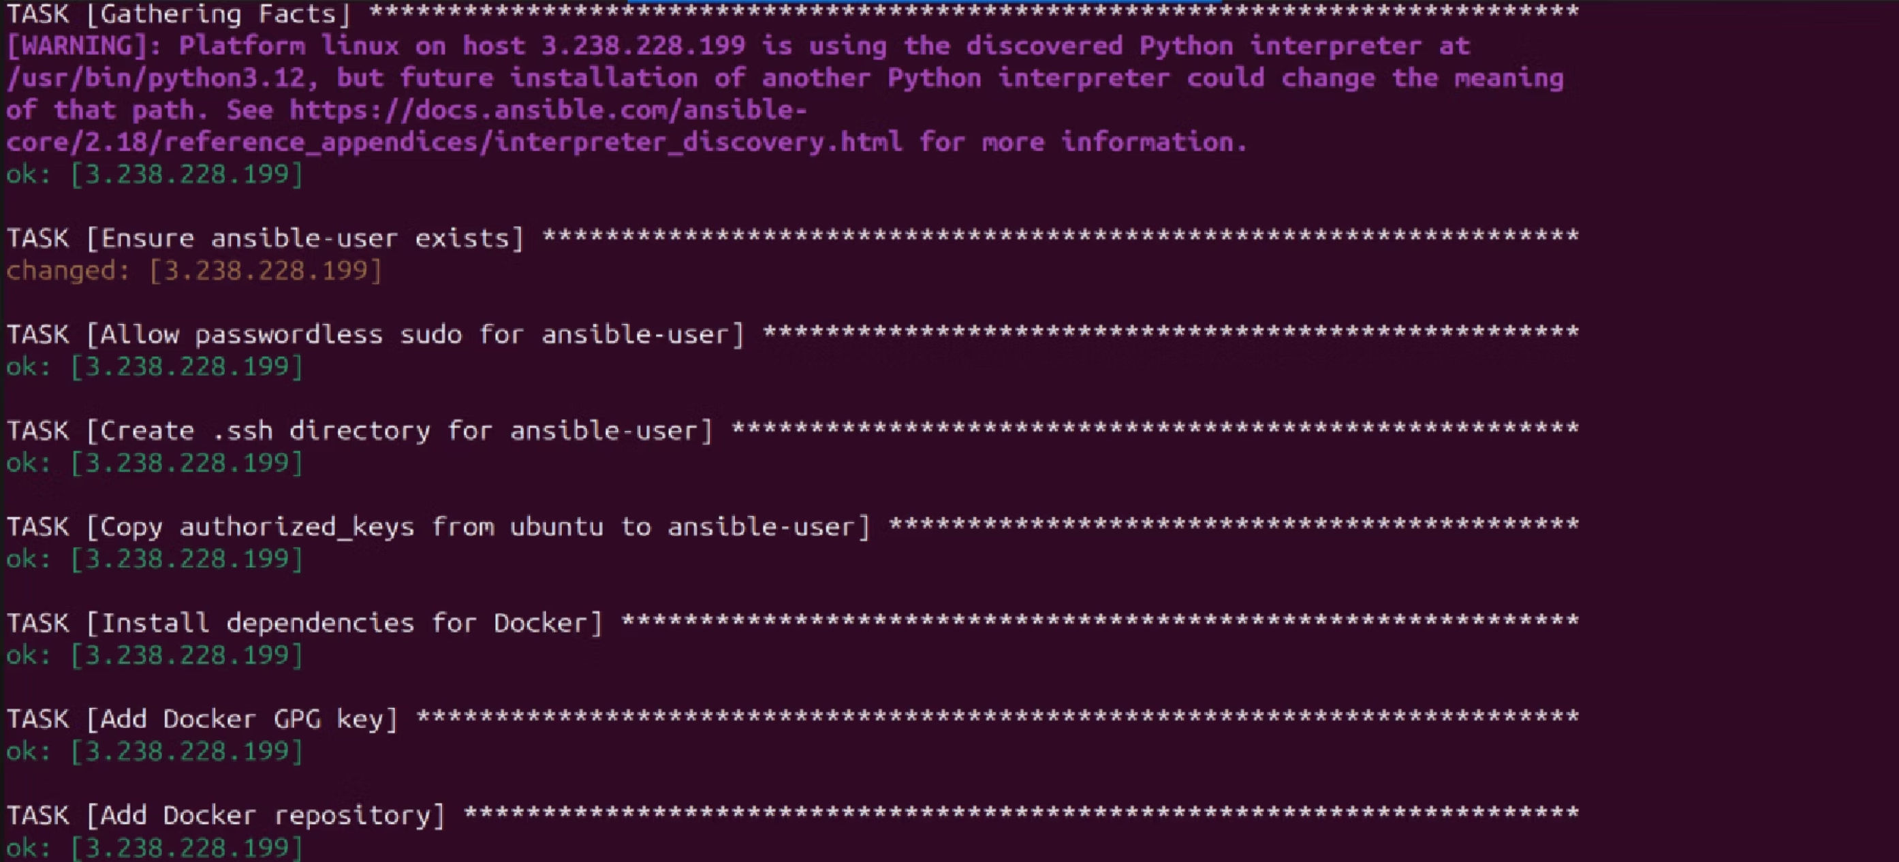
2nd Approach
playbook.yaml

Slide 15
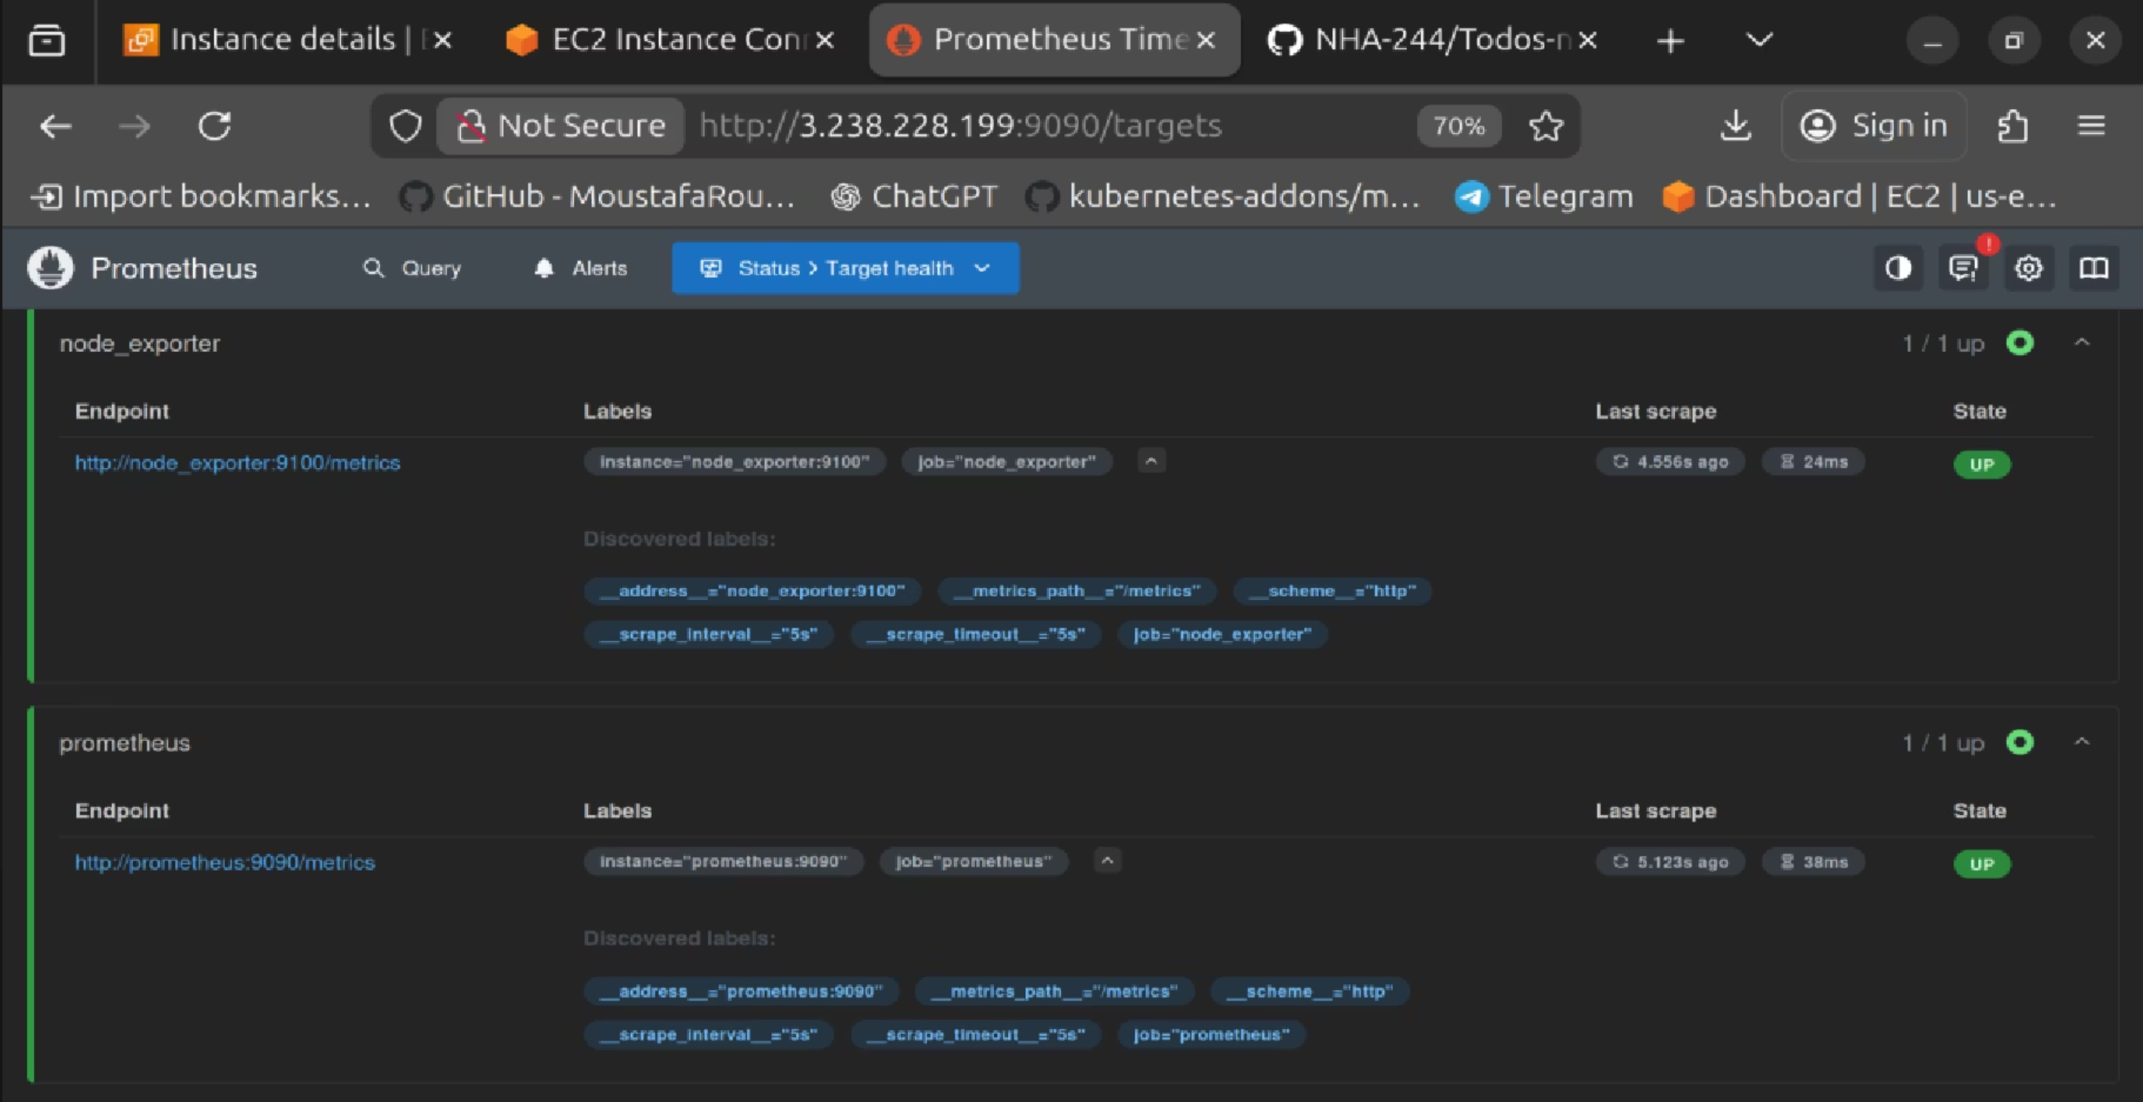
2nd Approach

Slide 16
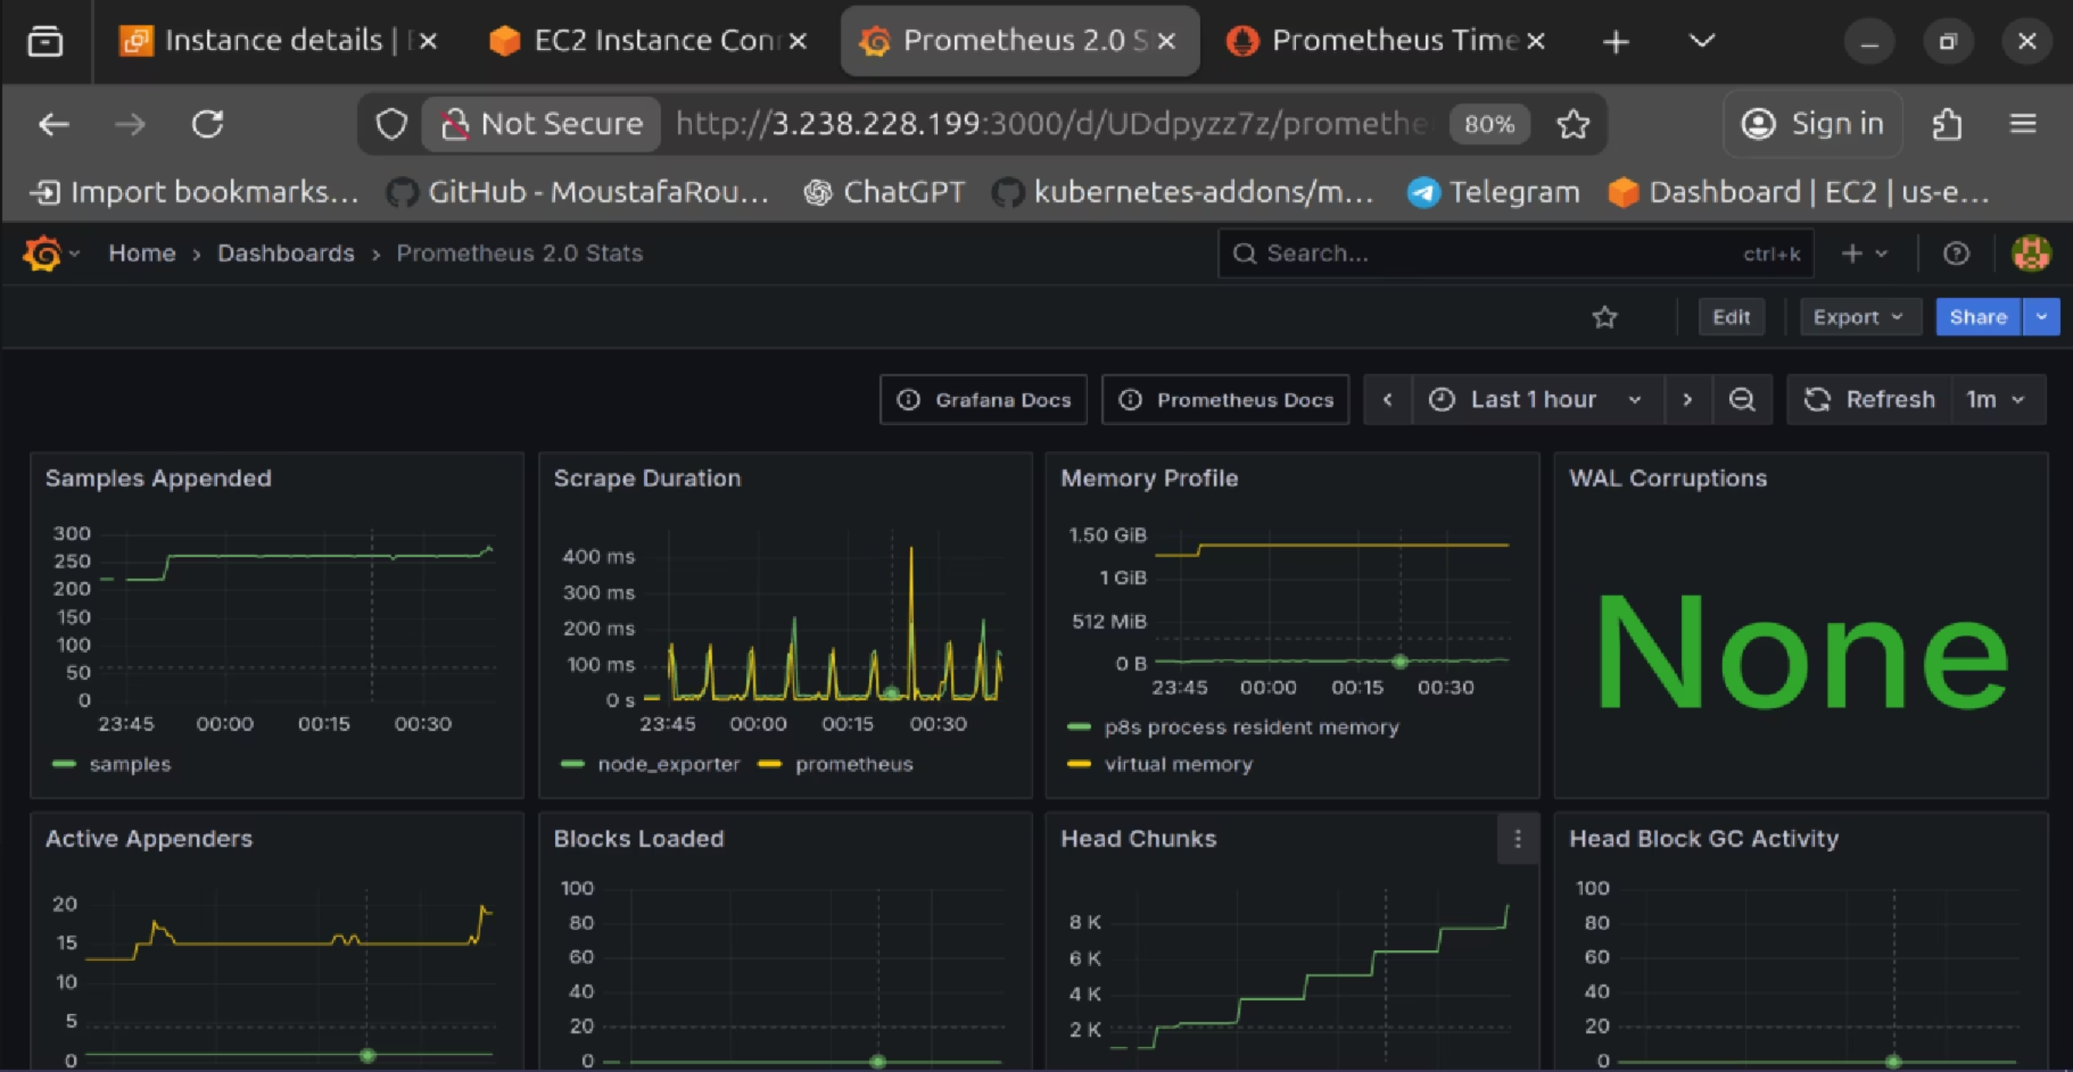
2nd Approach

Slide 17

DevOps Capstone Project: Todo List Application
Thank You
Thank you for your attention. We appreciate you taking the time to learn about our project.

