Slide 1

ORANGE HRM Open-Source HR Management System

Slide 2
01
TABLE OF CONTENTS
Introduction
02
Team Members
03
Project Objectives
04
Key Features
05
Problems Solved by OrangeHRM
06
Why Testing Matters in HR Systems
07
End-to-End QA & Technical Contributions

Slide 3
Introduction
OrangeHRM is a widely used open-source Human Resource Management System that supports employee data, leave management, recruitment, performance, and administrative workflows.
Our project focuses on analyzing the platform’s modules, understanding its requirement specifications, and examining how software testing ensures a reliable and smooth HR experience.

Slide 4

Team Members
Muhammed Moghazy Ghonaim
Rowan Sherif Salh
Team Leader
Ammar Mahmoud Eid
Malak Ashraf Rezk
Muhammed Hany Hamdy
Reem Mohamed Ahmed

Slide 5
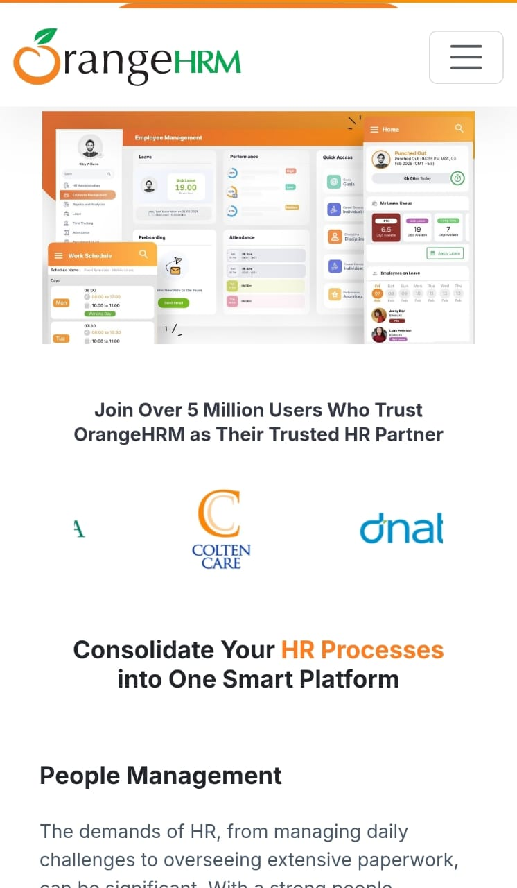
Project Objectives
Understand OrangeHRM modules & workflows
Analyze system requirements (SRS)
Evaluate usability and HR process flow
Perform functional, automation, API testing and Manual testing
Identify system issues and improvement opportunities
Document findings and recommendations

Slide 6
Key Features of OrangeHRM
Employee Management (PIM)
Add, update, and manage complete employee profiles and records.
Leave Management
Apply, track, and approve leave requests with a clear workflow.
Attendance & Timesheets
Record attendance and working hours accurately.
Recruitment Module
Manage job vacancies, candidates, and the hiring process.
Performance Management
Set goals, conduct evaluations, and review employee performance.
Admin & Role Management
Configure user roles, permissions, and organization settings.
Reporting & Analytics
Generate HR, attendance, and leave reports for decision-making.

Slide 7
Problems Solved by OrangeHRM
Scattered Employee Data → Centralizes all HR information in one secure system.
Manual Leave Requests → Automates request/approval workflows.
Weak Attendance Tracking → Provides accurate digital timesheets and attendance logs.
Slow Recruitment Process → Streamlines candidate tracking and interview management.
Unclear Performance Reviews → Offers structured evaluation tools.
Permission Issues → Ensures secure access using role-based permissions.
Lack of HR Insights → Generates detailed reports that support data-driven decisions.

Slide 8
Why Testing Matters in HR Systems
HR data is sensitive, so correctness is critical.
Ensures accurate employee records, leave balances, and payroll-related workflows.
Reduces operational errors for HR teams and supervisors.
Enhances system usability and employee satisfaction.
Helps ensure roles and permissions are applied safely.

Slide 9
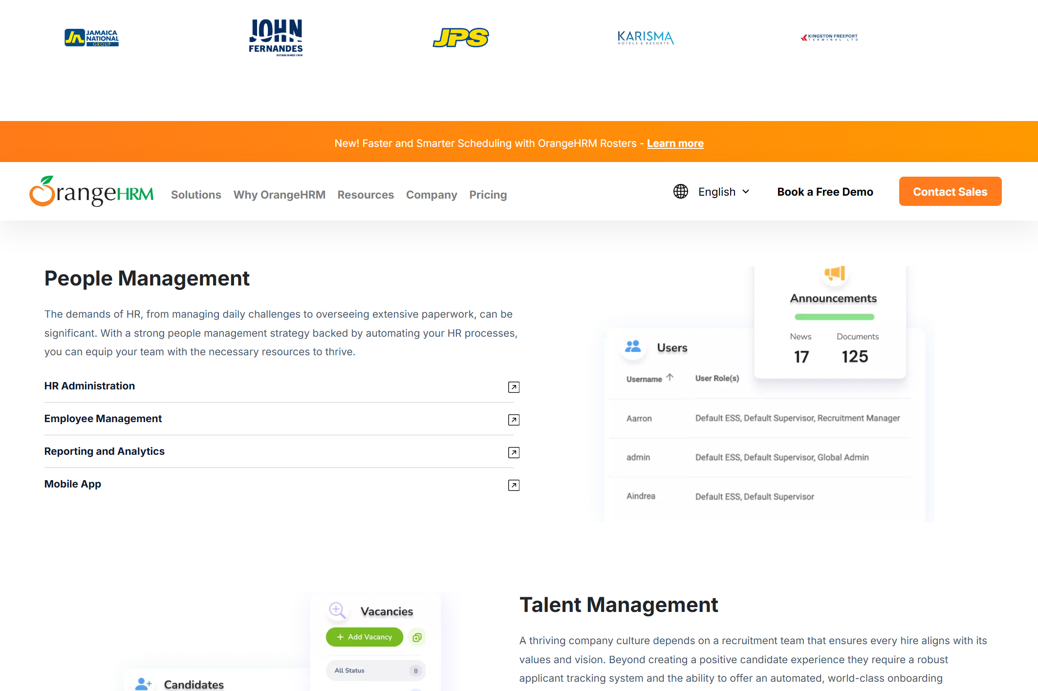
End-to-End QA & Technical Contributions
Manual Testing
Black Box Testing Techniques
White Box Testing Techniques
Experience-Based Techniques
Functional Testing
Non-Functional Testing
Test Design Techniques
Bug Reporting Techniques
Automation Testing
Api Testing

