Slide 1
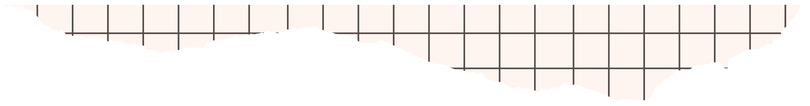






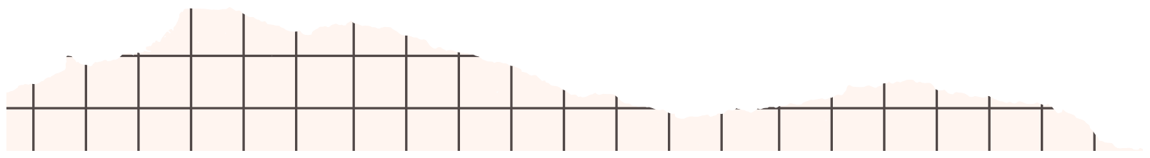
Stock UP
PRESENTATION
“managing inventory, suppliers, orders, and products”

Slide 2


INTRODUCTION
- Our project is to organize and automate all warehouse operations.
- It provides an easy way to manage products, track stock levels.
- The system ensures accuracy, reduces human errors, and gives
real-time visibility over all inventory.
Our Goal:
- Build a simple and efficient platform for warehouse management.
- Enable fast tracking of products and quantities in stock.
- Reduce manual work by digitalizing all inventory operations.
- Provide a secure system with clear roles for admin and staff.

Slide 3


TEAM
Osama Helmy
Hazem Hamdy
Moaaz Magdy
Mohamed Elhofy

Slide 4


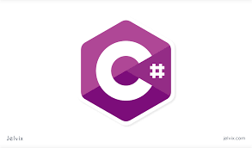
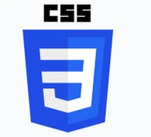

Technology Used
HTML
Used to Structure the website.
C#
Used To Structure The Back-end
CSS
SQL
Used to Style The Website.
Database management and quering with entity.

Slide 5
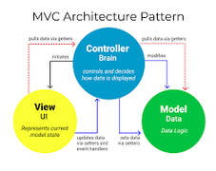




Technology Used
MVC
GitHub
separate concerns organize our ASP.NET Core project more effectively.
manage our ASP.NET Core MVC project efficiently.
.NET
VS COMMUINTY
Back-End Framework.
Used for Developing the website.

Slide 6

OBJECTIVES
- Efficient Inventory Management – Track stock in real-time and reduce errors.
- Automation of Operations – Streamline incoming, outgoing, and stock updates..
- Data-Driven Decisions –Provide reports to help plan purchases and sales.
- User-Friendly & Secure System – Easy for staff to use with controlled access.

Slide 7


Target Audience
  Warehouse Managers – Need full control over stock and reporting.
  Store Staff / Inventory Clerks – Handle daily stock operations efficiently.
  Business Owners – Want insights into inventory trends and decision-making.
  Suppliers / Partners – Track orders and deliveries through the system.
Platform Roles Content
  Admin: Manages users, products, warehouses.
  Stock Manager: POSTS JOB OFFERS AND REVIEWS APPLICANTS.
  Customer: MONITORS AND MANAGES PLATFORM DATA.
  Supplier: Receives purchase orders.

Slide 8

PLATFORM FEATURES
  User Management: Admin control roules & permissions.
  Product Management: Add, update, categorize products.
  Inventory Tracking: Monitor stock levels in real time.
  Order Management: Create, process, and track orders.
  Supplier Integration: Manage purchase orders & deliveries.
  Reports & Analytics: View inventory & sales & activity insights.
  Notifications : Alerts for low stock and order updates.

Slide 9

DATABASE DESIGN
Database Desin Using The Entity Framework:
  ORM (object-Relational Mapping): Used Entity Framework to connect the application with the database without manually writing most SQL queriesCreated model classes (entities) that represent database tables such as: Users, Products, Categories, Warehouses, StockMovements, Orders, OrderItems, Suppliers, Deliveries.
  Table Relationships:
    Defined clear relationships between entities, for example:
        Users ↔ Roles → Many-to-One Products ↔ Categories → Many-to-One
        Orders ↔ Users (Customers) → Many-to-One Orders ↔ OrderItems → One-to-Many
        Suppliers ↔ Products → Many-to-Many Orders ↔ Deliveries → One-to-One
        Products ↔ Warehouses → Many-to-Many through StockMovements
  SQL Server as a Database:
  Chosen for its high performance, reliable transaction handling, and scalability.
  Supports complex queries needed for stock analytics, inventory status, order history, and warehouse reporting.
  Works efficiently with Entity Framework for migrations, seeding, and schema updates.

Slide 10


DATABASE INTEGRATION
  We used EF Core to connect our models with the database Operations: Create, Read, Update, Delete (CRUD) Auto-generates tables and migrations from models .
  Simplifies data access and manipulation

Slide 11

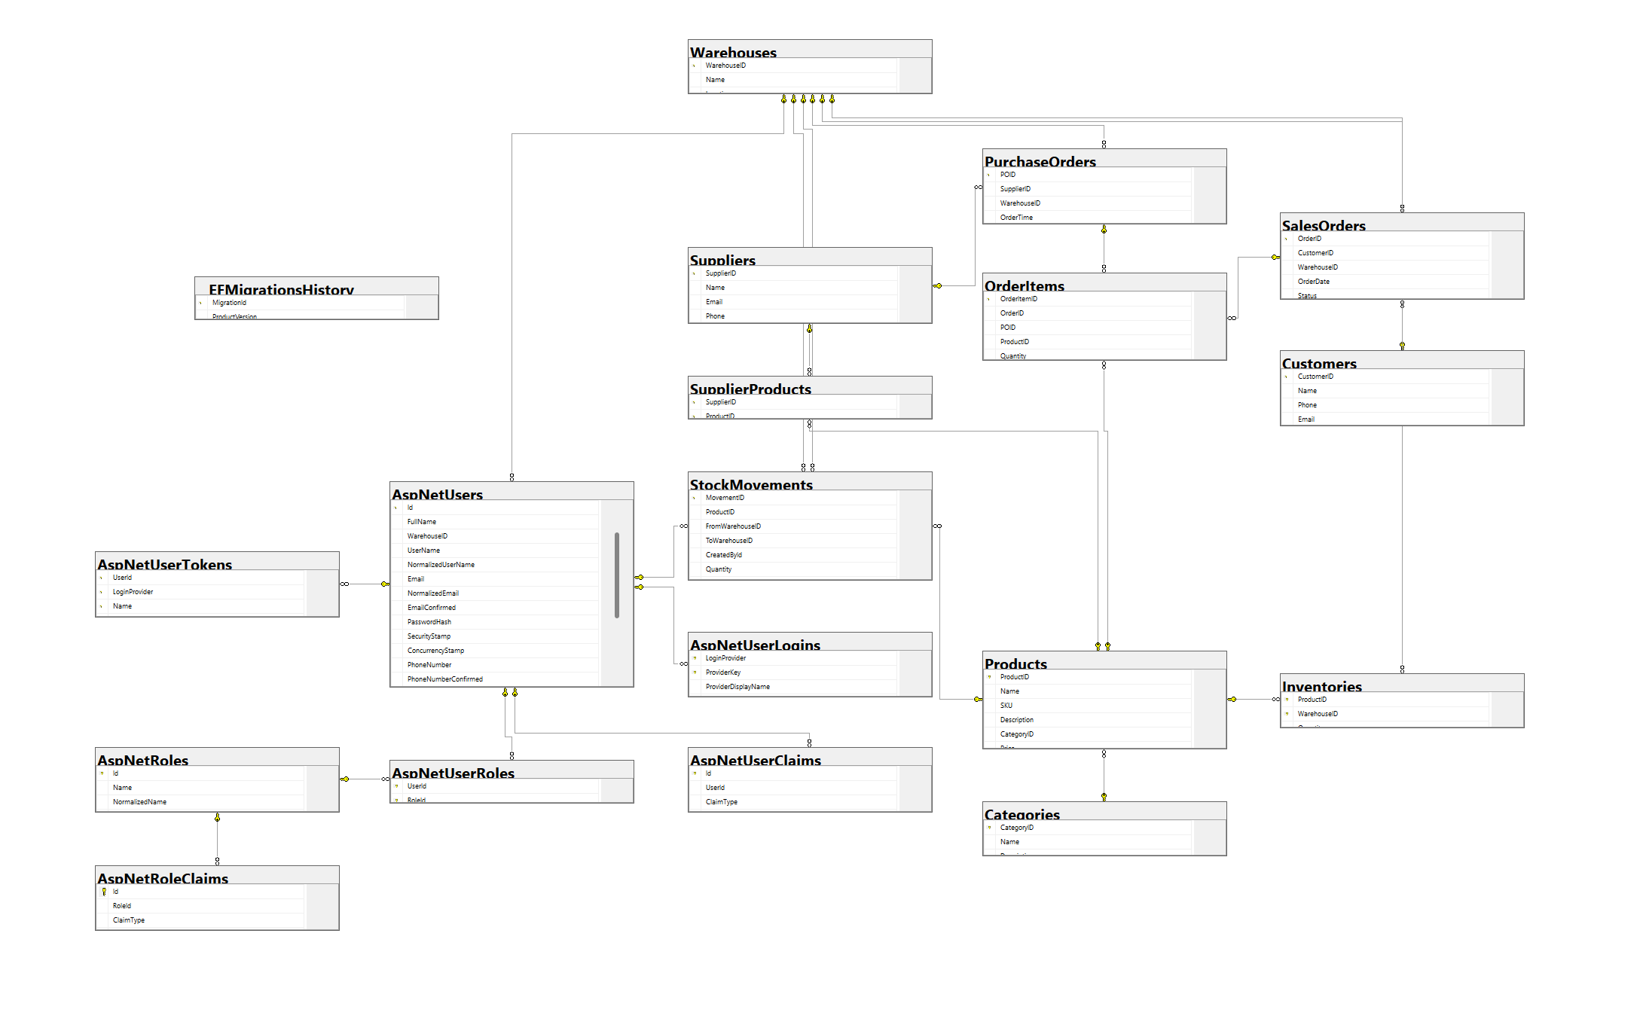
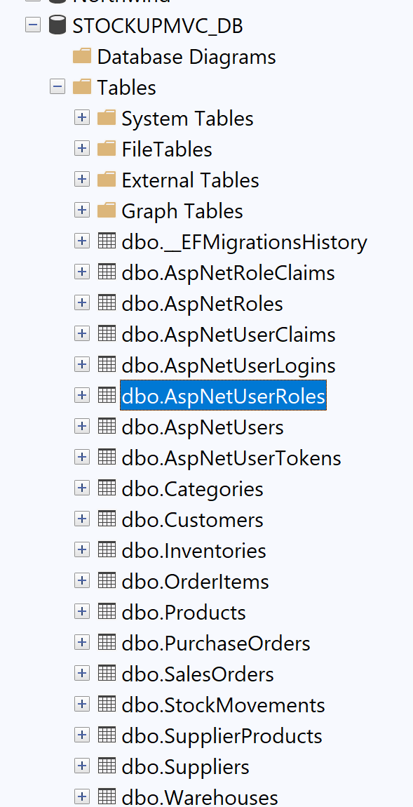
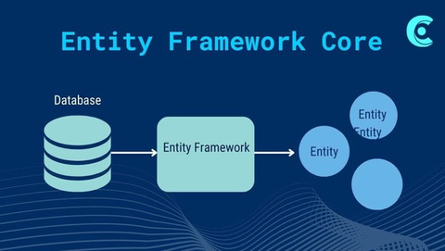
ERD Overview

Slide 12

SYSTEM ARCHITECTURE
  Frontend: Handles UI, forms, and API requests
  Backend: Core business logic + REST APIs
  Database: SQL Server managed through Entity Framework
  Auth: Role-based access control
  Integration: Supplier, delivery, and notification services

Slide 13

PLATFORM WORKFLOW
Login / Role Access
Manage Products & Stock
Place & Process Orders
Supplier & Delivery Updates
Reports & Notifications

Slide 14
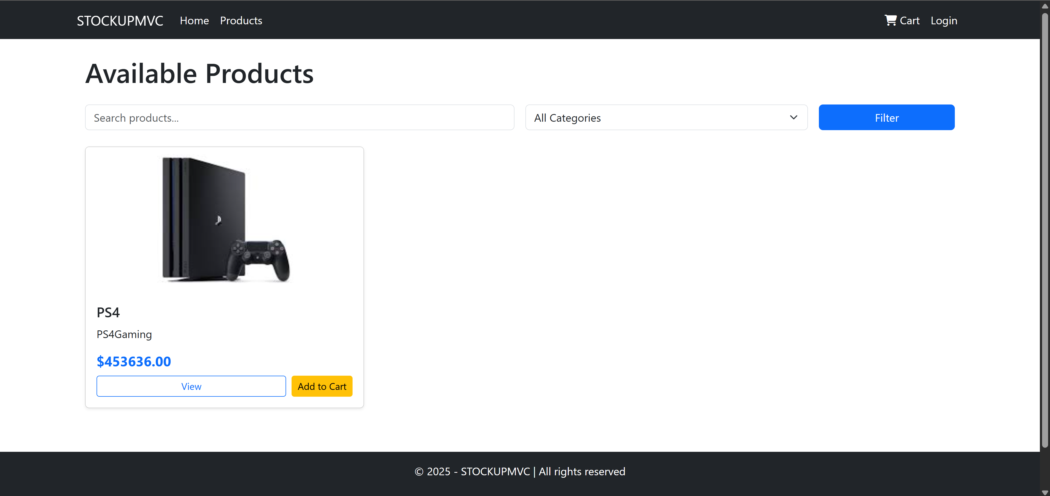

Home Page

Slide 15

LOGIN & REGISTRATION PAGE
  Role-based form (Admin, Stock Manager, Customer, Supplier, Delivery).
  Fields: email, password.

Slide 16
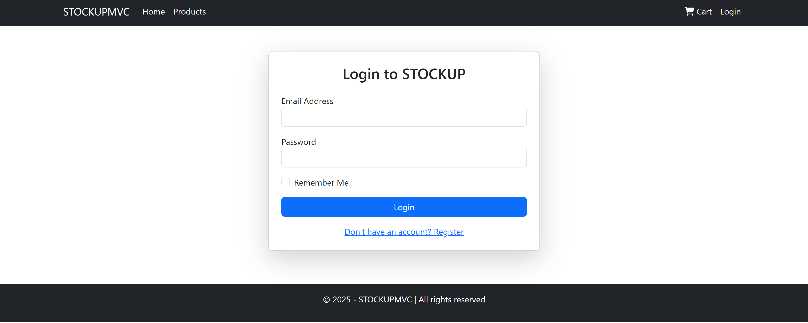
LOGIN & REGISTRATION PAGE

Slide 17

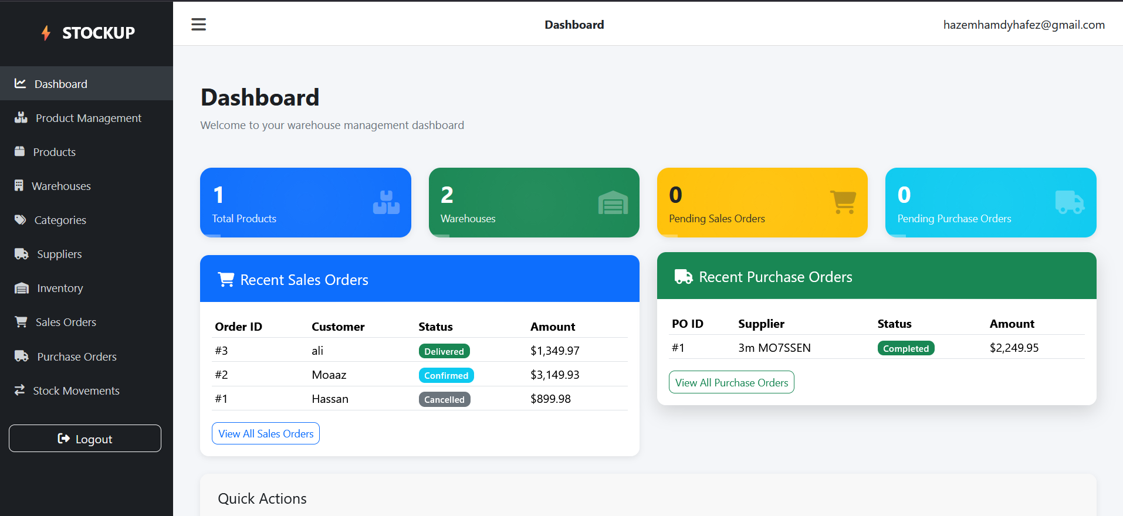
Dashboard Page
  Purpose: Central hub for quick access to all sections
  Features:
    Quick links to Products, Stock Movements, Sales Orders, Purchase Orders
    Displays recent sales orders with ID, Customer, Date, Status, and Total
  Benefit: Gives users an overview of key metrics and pending actions

Slide 18
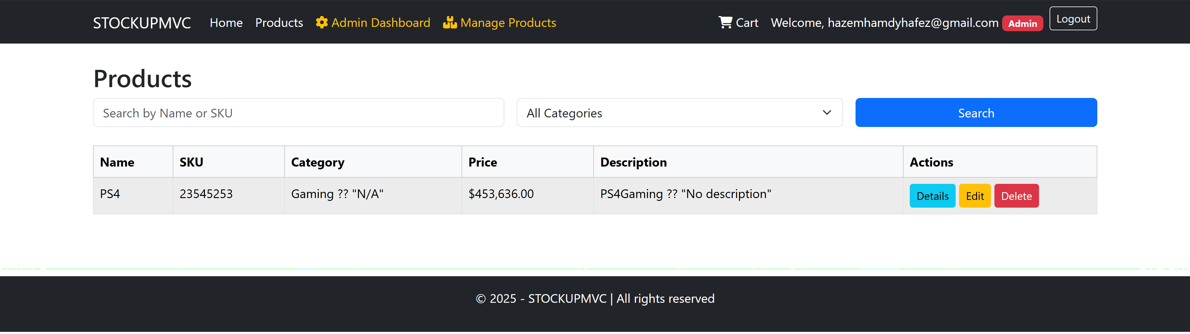
Products Page
  Purpose: Manage all warehouse items
  Features:
    Add, edit, or delete products
    Assign products to categories and warehouses
    View stock levels per product
  Benefit: Keeps product information accurate and up-to-date

Slide 19


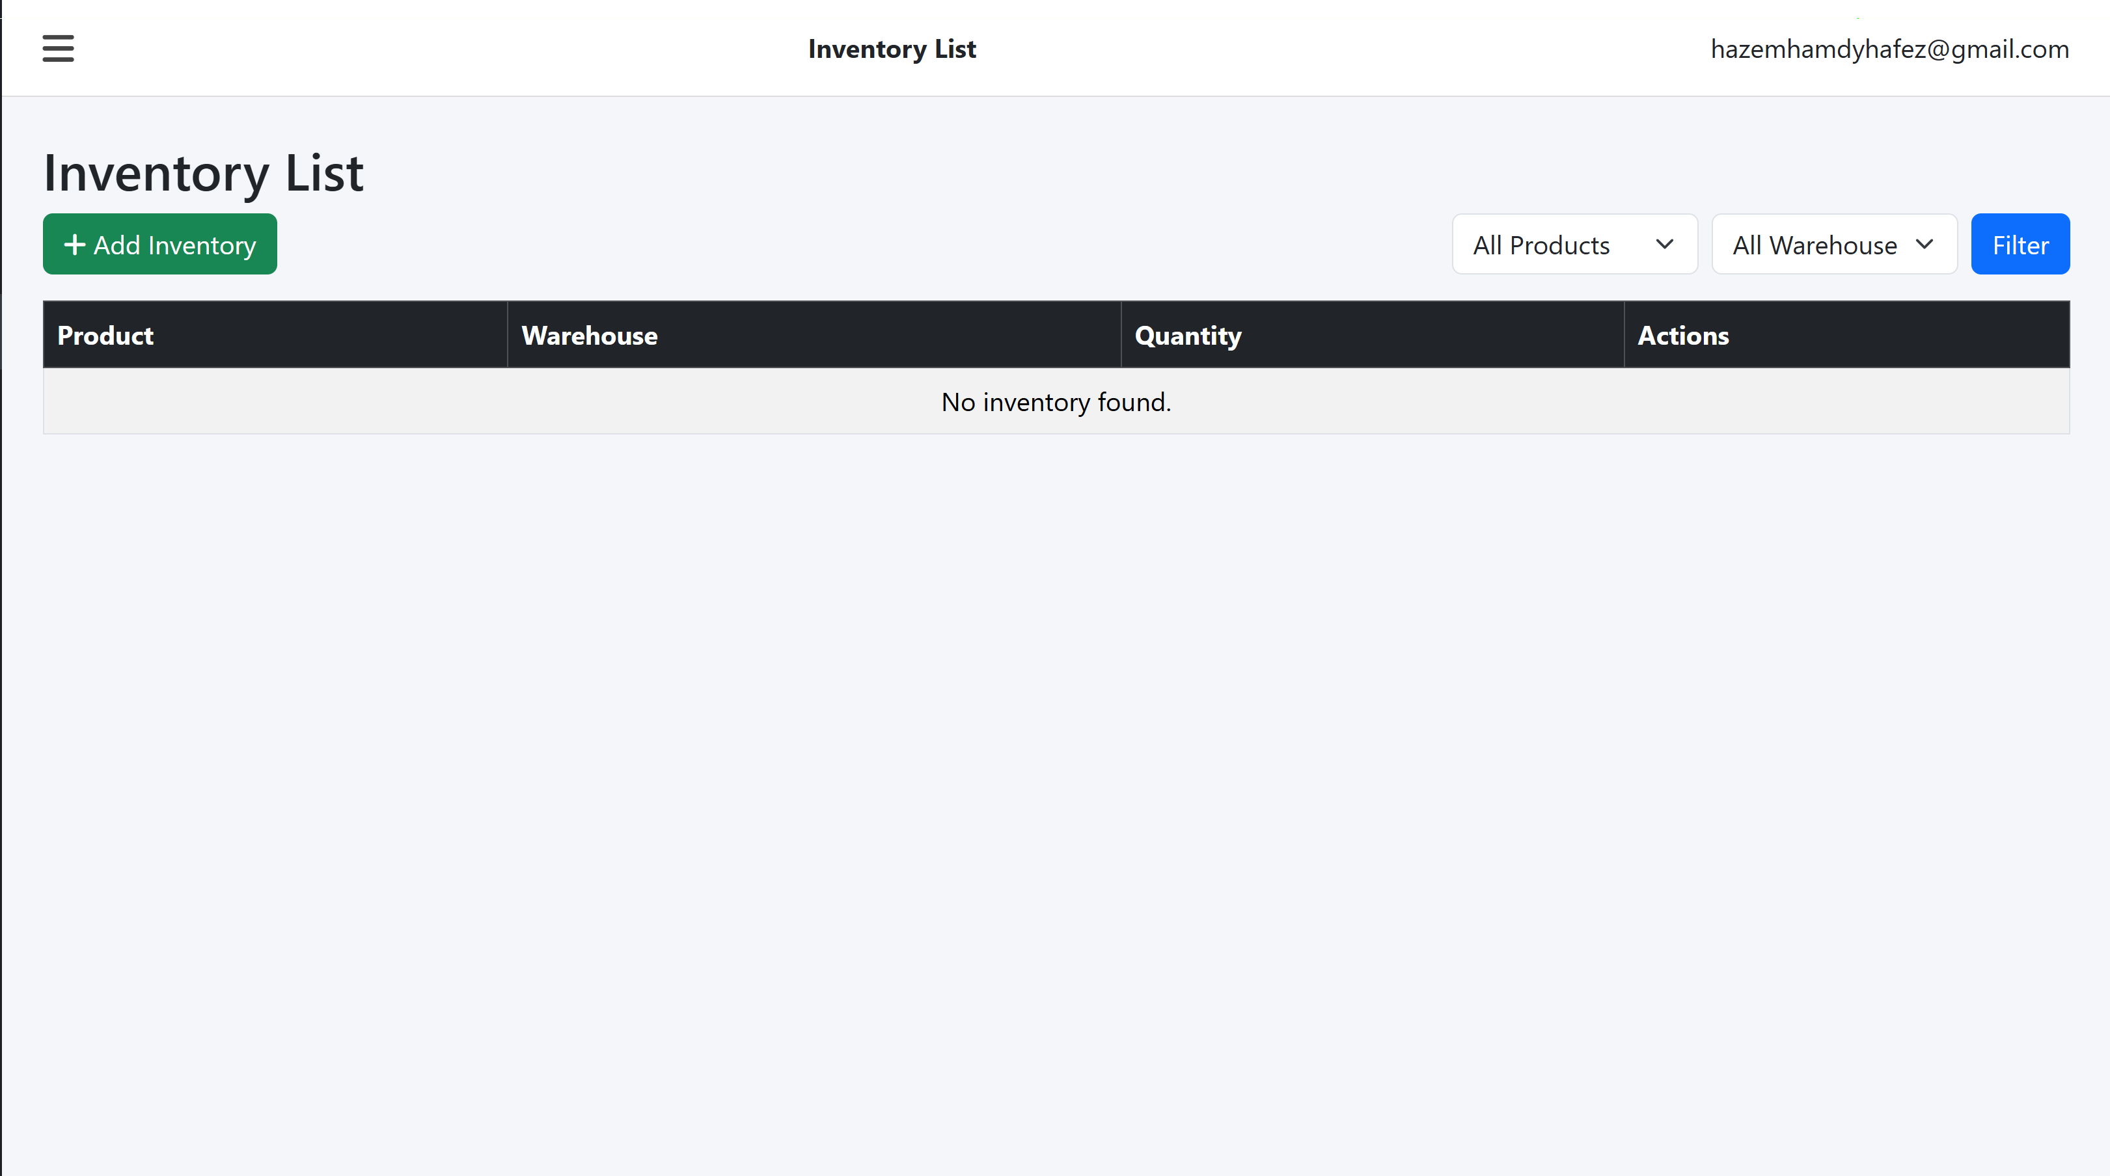
Stock Movements Page
Purpose: Track inventory in/out flows
Features:
    Record stock additions, transfers, and withdrawals
    Monitor warehouse stock adjustments
    Generate movement history reports
Benefit: Ensures accurate inventory tracking

Slide 20
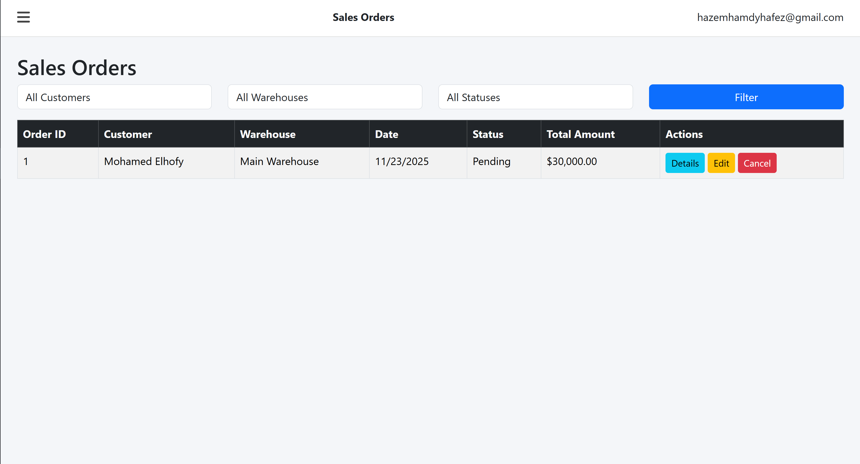
Sales Orders Page
  Purpose: Handle customer orders
  Features:
    View all sales orders with details (ID, Customer, Date, Status, Total)
    Update order status (Pending, Completed, etc.)
    Filter orders by date or customer
  Benefit: Streamlines order management and fulfillment

Slide 21

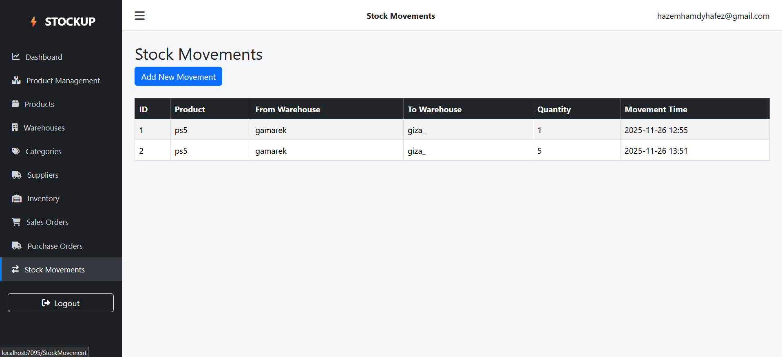
Purchase Orders Page
  Purpose: Manage supplier orders
  Features:
    Create new purchase orders to suppliers
    Track delivery status and order confirmations
    Maintain supplier-product relationships
  Benefit: Streamlines order management and fulfillment

Slide 22


Sidebar / Navigation
  Purpose: Easy access to all main modules
  Features:
    Links to Dashboard, Products, Inventory, Sales Orders, Purchase Orders, Stock Movements
    Logout button for secure exit
  Benefit: Enhances navigation and user experience

Slide 23

Controllers in OUR Project
  AccountController: Handles authentication and user account operations.
  UsersController: Manage user Manages user data and roles.
  HomeController: Provides main dashboard and general pages.
  ProductsController: Manages product CRUD operations.
  CategoryController: Handles product categories and classification.
  InventoryController: Controls stock levels, adjustments, and availability.
  StockMovementController: Tracks stock in/out and internal transfers.
  WarehouseController: Manages warehouse data and locations.
  SupplierController: Handles supplier information and interactions.
  PurchaseOrderController: Manages purchasing workflows and restocking.
  SalesOrderController: Handles sales orders and customer requests.
  CartController: Manages cart operations for order creation.

Slide 24


CONCLUSION
Built a complete, reliable full-stack Stock House system.
Improved workflow through automated stock management.
Provided a scalable foundation for future enhancements.
Showcased strong end-to-end full-stack development skills.

Slide 25


Future Plans
What is next?
Mobile app Version Real Enhance
Add advanced features (analytics, alerts).
Improve performance and scalability.

Slide 26



THANK YOU
Do you have any Questions?
Project Repo link: https://github.com/moaazbaghdad/NHA-261_notorg.

