Slide 1



Egypt Real Estate
🏠
Appraiser
DEPI
Machine Learning-Based Property Price Prediction
Digital Egypt Pioneers
Data Science Track
Team Members: Ahmed El-Shawadify
Haitham Hany Ahmed
Hayam Abdullah
Sara Mohamed
Data Science Track — DEPI 2026
Final Project Presentation · May 2026 · Digital Egypt Pioneers

Slide 2
Presentation Agenda
What we will cover today
Project Overview
Dataset & EDA
01
02
Objectives, problem statement, value proposition
16,083 listings — price distribution, location analysis, correlations
Feature Engineering
Machine Learning Models
03
04
Preprocessing pipeline, encoding, train/test split
3 models: Linear Regression · Random Forest · Gradient Boosting
Model Results
Model Evaluation
05
06
Performance metrics: MAE, RMSE, R², MAPE across all models
Actual vs Predicted, Residual analysis, Feature importances
Deployment
Conclusions
07
08
Streamlit app, project files, tech stack, running guide
Key findings, limitations, and future work recommendations
May 2026
2

Slide 3
01
Project Overview
Objectives · Problem Statement · Value Proposition

Slide 4
Project Overview
Egypt Real Estate Appraiser — ML-powered property price estimation
🎯 Problem Statement
💡 Our Solution
⭐ Unique Value
Real estate pricing in Egypt is opaque and expertise-dependent
Home buyers & investors lack reliable data-driven price benchmarks
Manual appraisals are slow, costly, and inconsistent
Expat Egyptians & foreigners face significant information asymmetry
ML-powered price prediction from 6 property features
Trained on 16,083 real Egyptian property listings
Instant estimates via an interactive Streamlit web app
Three models compared to identify the best performer
Egypt-specific model trained on local market data
Covers all major governorates and property types
Fully open source — upload to GitHub for collaboration
Free and accessible to non-experts and investors alike
May 2026
4

Slide 5
Objectives & Dataset Summary
What we set out to achieve and the data we used
📌 Project Objectives
📊 Dataset at a Glance
1
Provide accurate property price estimates to real estate seekers and investors.
16,083
6
Total Records
Input Features
2
Analyze the Egyptian property market using data-driven insights.
1
0
3
Build a reliable, reproducible, and deployable ML pipeline.
Target Variable
Missing Values
Price Range
0.19M ────────────────────────── 36.04M EGP
Median: 9.30M · Mean: 11.27M
May 2026
5

Slide 6
02
Exploratory Data Analysis
Price Distribution · Location · Features · Correlations

Slide 7
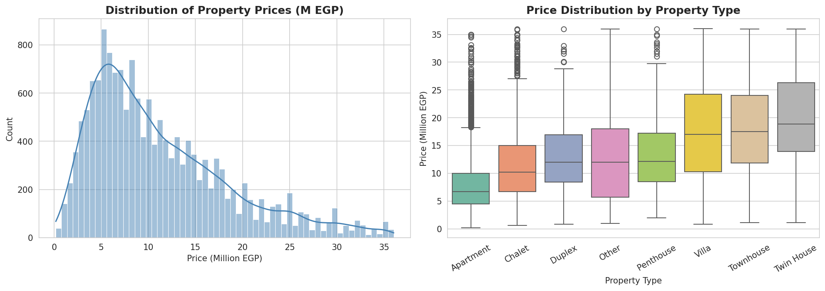
EDA: Price Distribution
Right-skewed distribution — median 9.30M EGP, mean 11.27M EGP
Figure 1 — Property price histogram with KDE (left) and box-plot by property type (right). Villas & Twin Houses command highest prices.
May 2026
7

Slide 8
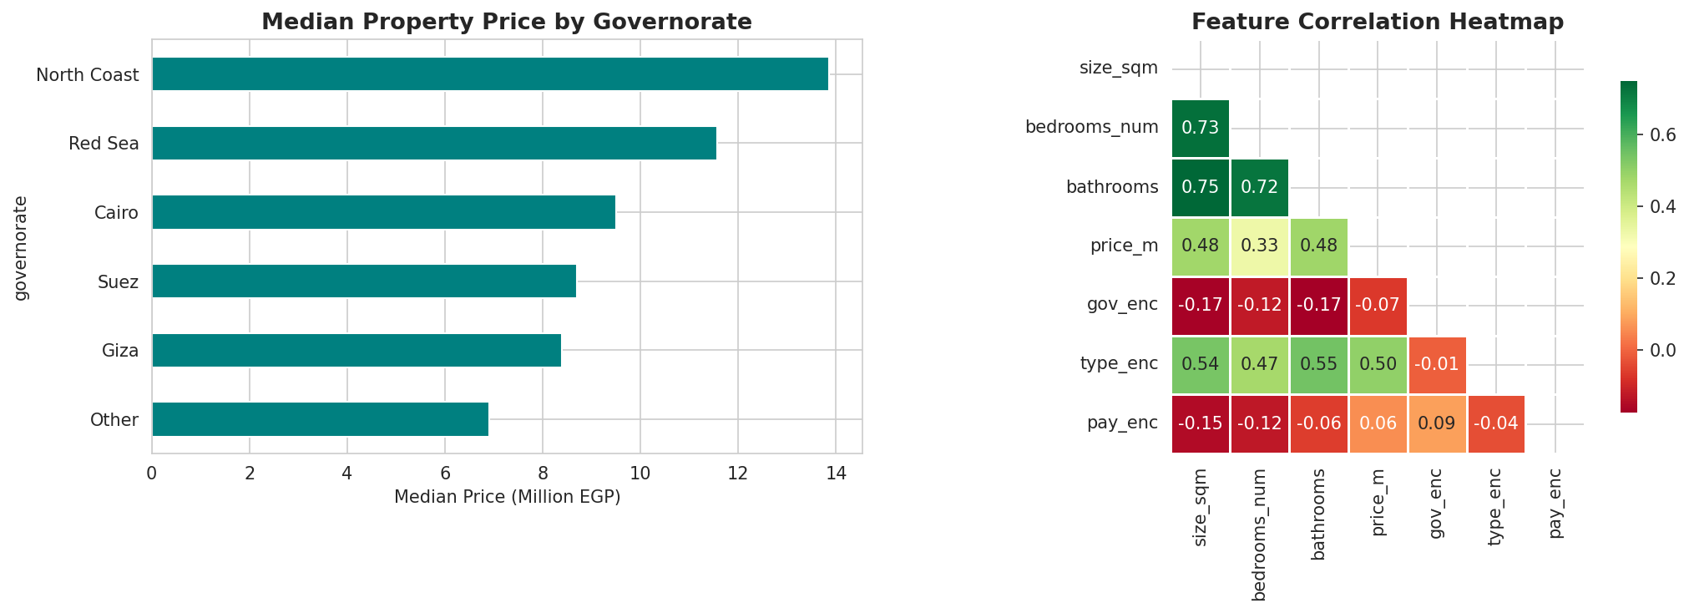
EDA: Location Analysis & Feature Correlations
North Coast leads on price; size is the strongest predictor (r ≈ 0.45)
Figure 2 — Median property price by governorate (left) and feature correlation heatmap (right).
May 2026
8

Slide 9
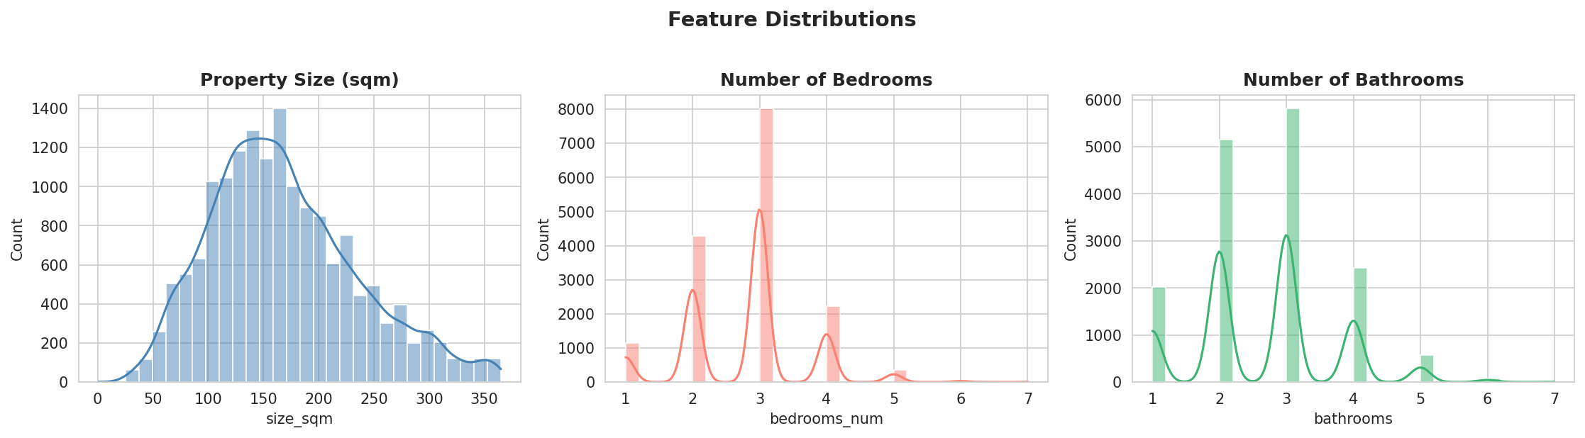
EDA: Feature Distributions
Most properties: 80–250 sqm · 2–3 bedrooms · 2–3 bathrooms
Figure 3 — Distribution histograms for size (sqm), number of bedrooms, and number of bathrooms.
May 2026
9

Slide 10
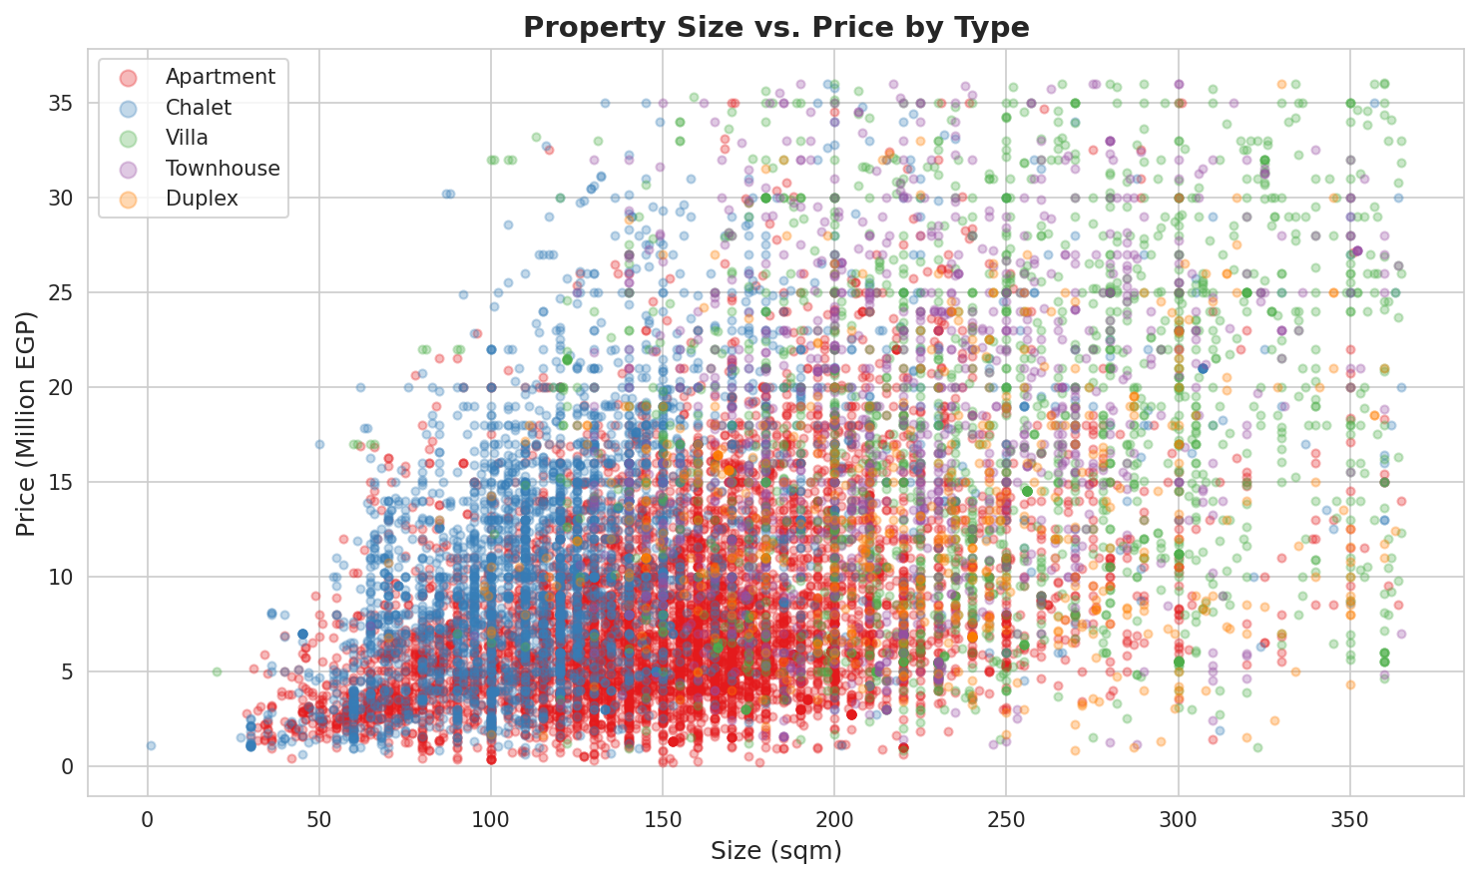
EDA: Property Size vs. Price
Non-linear relationship motivates tree-based models over linear regression
Figure 4 — Scatter plot: property size (sqm) vs. price (M EGP), color-coded by property type.
May 2026
10

Slide 11
03
Feature Engineering
Data Preprocessing · Encoding · Train/Test Split

Slide 12
Feature Engineering & Data Preparation
Transformations applied to build the final 6-feature input matrix
📍 Governorate
Extraction
🏷️ Property Type
Grouping
🔢 Label
Encoding
💰 Price
Transformation
✂️ Train / Test
Split
Parsed from full location
string — last token after
comma split → 6 classes
Rare types (iVilla, Cabin,
etc.) merged → parent
category or 'Other' → 8 classes
Governorate, Property Type,
Payment Method converted
to integer codes (0, 1, 2…)
Raw EGP price converted
to Million EGP for
numerical stability
80% train (12,866)
20% test (3,217)
random_state = 42
✅ Final Feature Set (6 inputs → 1 target)
size_sqm
Numeric
Property area in sq. meters
Primary price driver (>40% importance)
bedrooms_num
Numeric
Number of bedrooms (1–7)
Negative effect at fixed size
bathrooms
Numeric
Number of bathrooms (1–7)
Strong luxury signal (+22% per bath)
gov_enc
Label Encoded
Cairo, Giza, North Coast…
6 governorate classes
type_enc
Label Encoded
Apartment, Villa, Chalet…
8 property type classes
pay_enc
Label Encoded
Cash / Installments
2 classes — installments +22%
May 2026
12

Slide 13
04
Machine Learning Models
Linear Regression · Random Forest · Gradient Boosting

Slide 14
Machine Learning Models
Three regression models trained and evaluated on the same dataset
01 Linear Regression
02 Random Forest
03 Gradient Boosting
Baseline Model
Ensemble (Bagging)
Ensemble (Boosting) ✅ Best
Fits a linear hyperplane in 6-dimensional feature space. Each coefficient directly represents the EGP impact of that feature.
200 decision trees trained on random bootstrapped data subsets. Final prediction = average of all trees.
Trees built sequentially — each corrects residuals of the previous. Final prediction = weighted sum of all trees.
Hyperparameters:
Hyperparameters:
Hyperparameters:
No hyperparameters required
n_estimators=200 · max_depth=15 · min_samples_leaf=4 · random_state=42
n_estimators=200 · max_depth=5 · learning_rate=0.1 · subsample=0.8
✓ Fully interpretable coefficients
✓ Fast training and inference
✓ Direct price-per-sqm quantification
✓ Handles non-linear relationships
✓ Built-in feature importance
✓ Robust to outliers
✓ Typically best accuracy on tabular data
✓ Handles heterogeneous feature scales
✓ Strong regularization via subsampling
✗ Assumes linear relationships (violated in data)
✗ Cannot capture interactions between features
✗ Less interpretable than LR
✗ Higher memory footprint
✗ Slower training than RF
✗ More hyperparameters to tune
May 2026
14

Slide 15
05
Model Results
Performance Metrics · MAE · RMSE · R² · MAPE · CV R²

Slide 16
Model Comparison — Results Table
Evaluated on held-out test set (3,217 records) · Log-scale target · Green = best
Model | MAE (M EGP) | RMSE (M EGP) | R² Score | MAPE (%) | CV R² (5-fold)
Linear Regression | 4.554 | 6.014 | 0.3518 | 68.3% | 0.350
Random Forest | 3.904 | 5.362 | 0.4847 | 55.0% | 0.516 ✅
Gradient Boosting ✅ | 3.914 | 5.324 ✅ | 0.4919 ✅ | 56.9% | 0.510
3.914M
5.324M
0.4919
55.0%
Best MAE
Best RMSE
Best R²
Best MAPE
Gradient Boosting
Gradient Boosting
Gradient Boosting
Random Forest
CV R² = 5-fold cross-validation on training set · MAE & RMSE in Million EGP · MAPE = Mean Absolute Percentage Error
May 2026
16

Slide 17
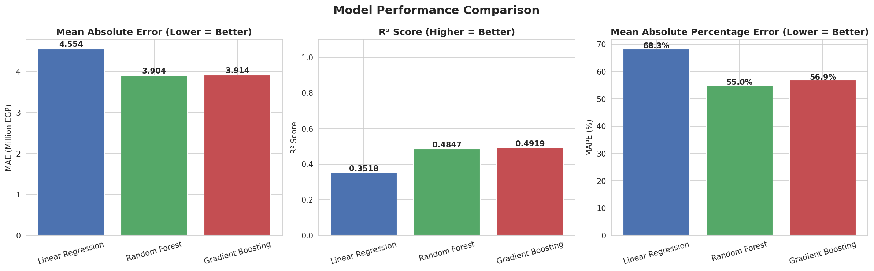
Model Performance — Visual Comparison
Side-by-side bar charts for all three error metrics
Figure 5 — MAE (lower = better), R² Score (higher = better), and MAPE (lower = better) across all three models.
May 2026
17

Slide 18
06
Model Evaluation
Actual vs Predicted · Residuals · Feature Importances

Slide 19
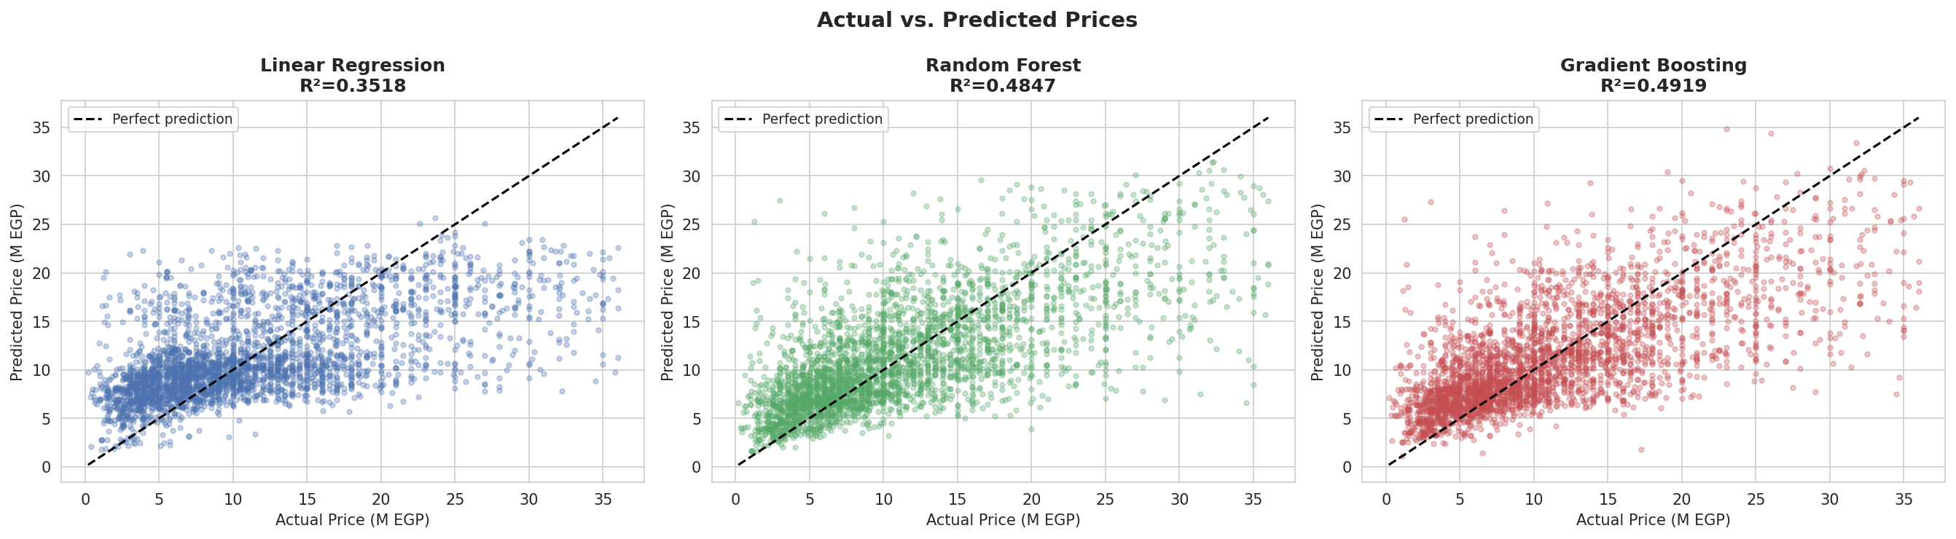
Actual vs. Predicted Prices
Closer points to the diagonal = more accurate predictions
Each dot = one test property · Dashed diagonal = perfect prediction · Tighter clustering = better model
Figure 6 — Actual vs. predicted scatter for all 3 models. Gradient Boosting shows tightest clustering around the ideal line.
May 2026
19

Slide 20
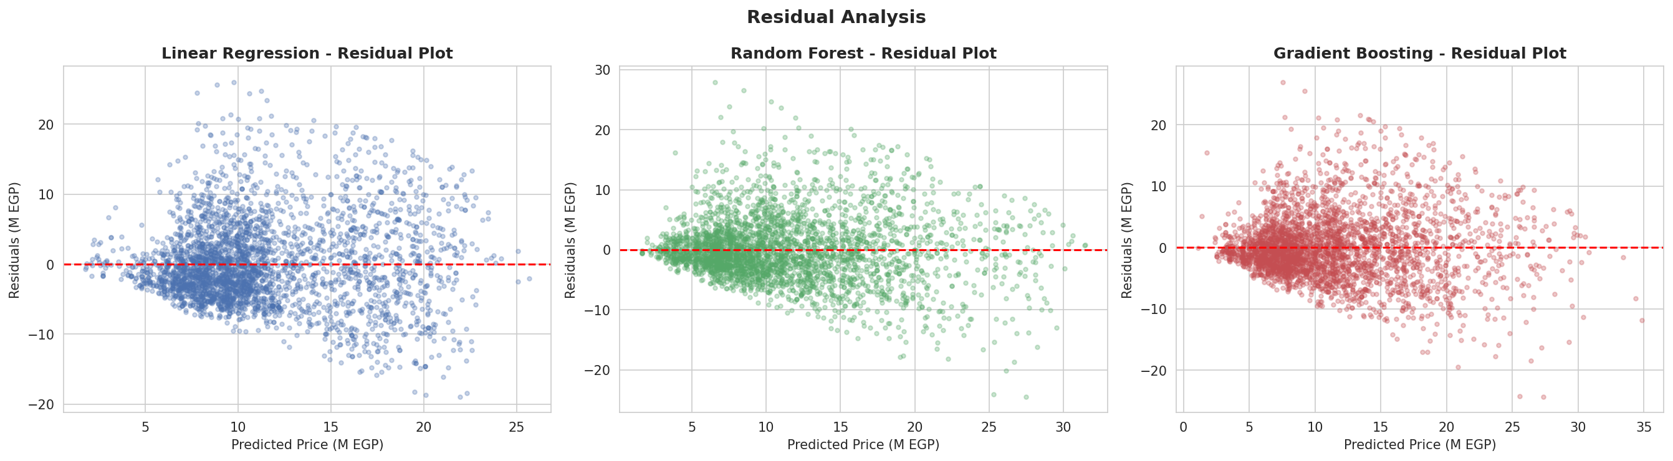
Residual Analysis
Prediction errors should be randomly distributed around zero — no systematic bias
Residual = Actual − Predicted · Red dashed line = zero error · Funnel shape = heteroscedasticity
Figure 7 — Residual plots. Linear Regression shows systematic under-prediction at high prices. Tree models show more balanced errors.
May 2026
20

Slide 21
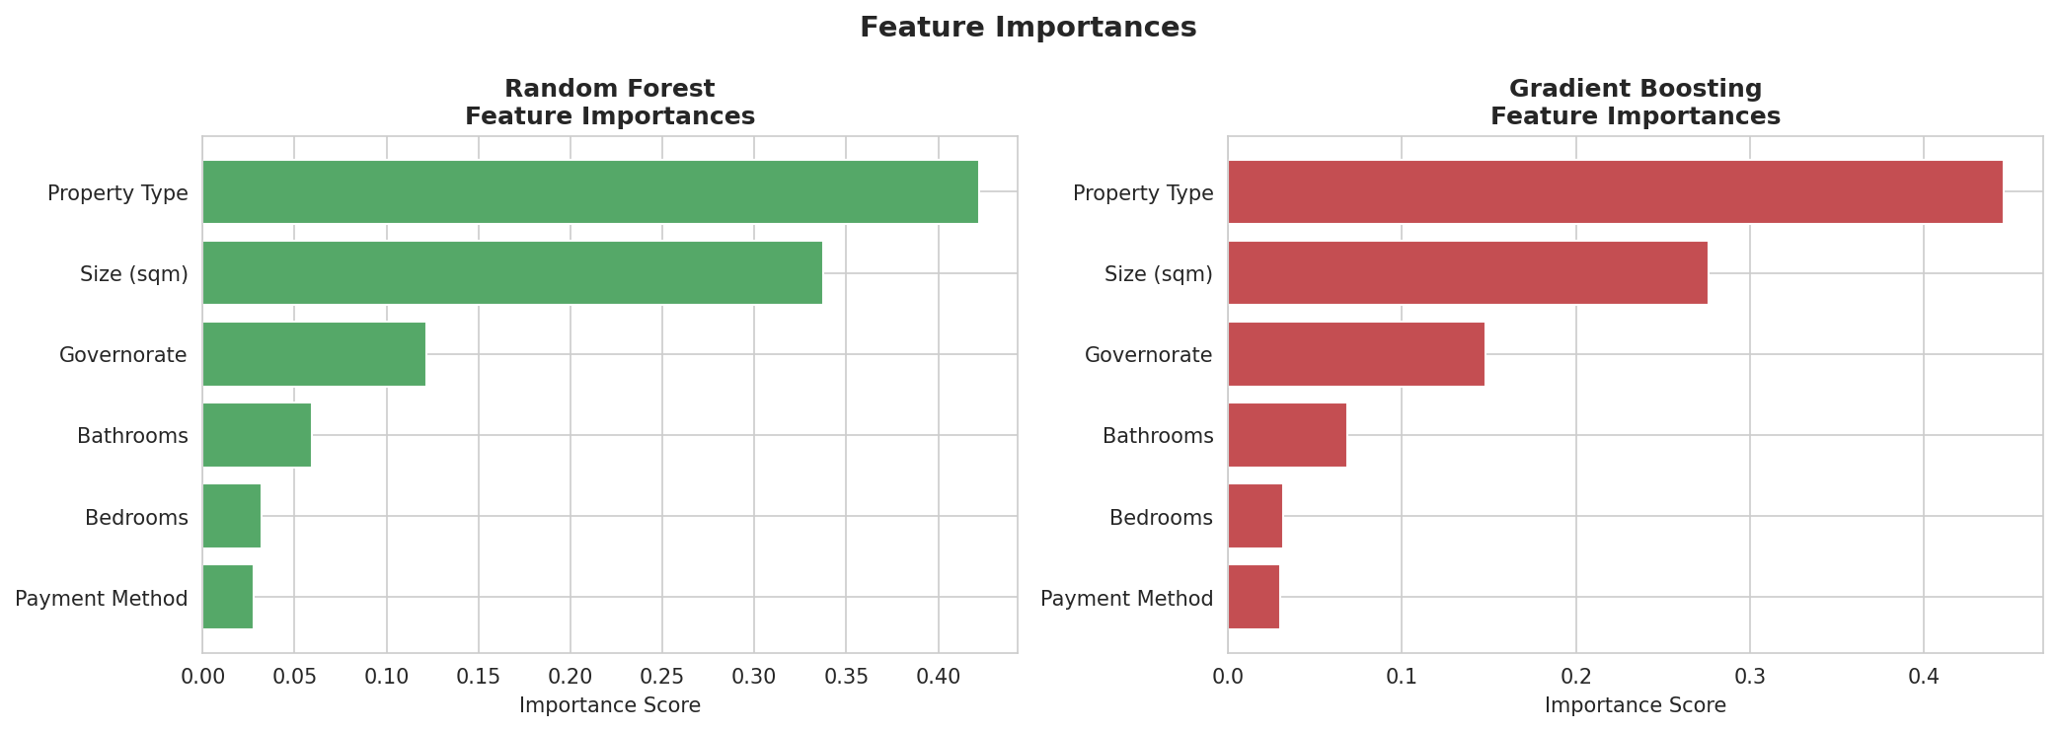
Feature Importances
Both tree models agree: Size dominates; Type and Location matter most after it
🏠 Size (sqm)
🏗️ Property Type
📍 Governorate
💳 Payment
40%+ importance in
both models — dominant
price driver
Villa/Penthouse vs.
Apartment drives large
price differences
North Coast premium
vs. Cairo/Giza pricing
highly significant
Lowest importance —
installment vs. cash
correlated with type
Figure 8 — Feature importance scores for Random Forest (left) and Gradient Boosting (right). Higher = more predictive.
May 2026
21

Slide 22

07
Deployment Architecture
Tech Stack · Project Files · Running the Application

Slide 23
Technology Stack
Full suite of Python tools from data processing to web deployment
🐍 Python 3.11
🐼 Pandas + NumPy
🤖 Scikit-learn
📊 Matplotlib + Seaborn
Core Language
Data Layer
ML Engine
Charts
Object-oriented pipeline design
Script & notebook integration
DataFrame operations
Feature encoding & transforms
3 regression models
Cross-validation & metrics
8 analytical figures
All visualizations in report
🌐 Streamlit
💾 Joblib
📓 Jupyter Notebook
🐙 GitHub
Web App
Serialization
EDA Env
Version Control
Interactive prediction UI
Real-time user inputs & outputs
Save/load model.pkl
Bundles model + all encoders
Exploratory analysis
Interactive code + visuals
Source code hosting
Team collaboration & history
May 2026
23

Slide 24
Project Files & Setup Guide
All deliverables committed to GitHub — run in 3 commands
📁 Repository Structure
⚡ 3-Step Quick Start
📊
cleaned_data.csv
Cleaned dataset — 16,083 records, 7 columns
1
Step 1 — Install
📓
Egypt_Real_Estate_Appraiser.ipynb
pip install -r requirements.txt
Full EDA + 8 figures + 3 ML models
🐍
train.py
Training pipeline — loads data → trains → saves model
🌐
app.py
2
Step 2 — Train
Streamlit web app — inputs → encoder → predict → display
python train.py
💾
model.pkl
Serialized Gradient Boosting model + label encoders
📋
requirements.txt
3
Step 3 — Launch
Python dependencies (pip install -r requirements.txt)
📖
README.md
streamlit run app.py
Setup guide, model table, usage instructions
🌐 Opens at: http://localhost:8501
May 2026
24

Slide 25
08
Conclusions & Future Work
Key Findings · Limitations · Recommendations

Slide 26
Key Findings
What the data and models revealed about the Egyptian property market
Gradient Boosting is the Best Model
Non-Linear Relationships Are Critical
01
Achieved R²=0.4919, MAE=3.914M EGP, MAPE=56.9%. Outperforms Linear Regression by +14 R² points and beats Random Forest on RMSE.
02
Tree-based models significantly outperform Linear Regression, confirming that price relationships with size, type, and location are inherently non-linear.
Size Is the Dominant Predictor
Location & Type Are Decisive
03
Property size accounts for over 40% of feature importance in both RF and GB. Every additional sqm adds ~30,545 EGP on average (Linear Regression estimate).
04
Governorate and property type together explain a substantial portion of variance. North Coast commands the highest median prices; Apartments are the most affordable.
Market Noise Remains a Challenge
Bathrooms Signal Luxury Better Than Bedrooms
05
MAPE of ~56% reflects factors not captured: specific district, floor number, finishing quality, building age, and proximity to amenities.
06
Each additional bathroom adds +22.47% to price (log model). Bedrooms have a negative coefficient at fixed size — more rooms means smaller rooms.
May 2026
26

Slide 27
Future Work & Recommendations
Six enhancements to push model accuracy and usability further
🔤 NLP Feature Extraction
📉 Log-Transform Price Target
📱 Expanded Data Collection
Extract compound names, amenities, finishing quality, and floor number from description and location text fields.
Train on log(price) instead of raw price to reduce skewness (2.21→0.07) and improve relative error (MAPE -8%).
Include more listings over time, add building age, floor number, finishing quality, and proximity to amenities.
⚡ XGBoost / LightGBM + Optuna
🗺️ Geographic Coordinates
✂️ Outlier Handling
Advanced gradient boosting with systematic hyperparameter search (Optuna) to push R² above 0.65.
Add latitude/longitude as features to capture neighborhood-level price effects beyond governorate granularity.
Cap luxury properties above 95th percentile or apply robust regression to reduce the influence of extreme prices.
May 2026
27

Slide 28
🏠
Thank You!
Egypt Real Estate Appraiser · DEPI Final Project 2026
Questions & Feedback Welcome
16K+
3
49%
0.49
Listings Analyzed
ML Models Compared
Best MAPE
Best R²
📧 team@egypt-realestate.ai · 🐙 github.com/your-username/egypt-real-estate-appraiser
May 2026 · Digital Egypt Pioneers · Data Science Track

