Slide 1


Egypt Real Estate
🏠
Appraiser
DEPI
ML-Based Property Price Prediction
Digital Egypt Pioneers
Data Science Track
Dubizzle Scrape | 74,240 Records
Team: Ahmed El-Shawadify -Haitham Hany -Sara Mohamed -Hayam Abdullah
0.76
3.53M
27.87%
8
R² Score
MAE (EGP)
MAPE
Type Models
DEPI Final Project · May 2026

Slide 2
Agenda
Project Idea
Literature Review
01
02
Problem · Solution · Value proposition
Kaggle → data.xlsx → Dubizzle · Accuracy improvement
Data Collection
Data Structure & EDA
03
04
Two-stage aiohttp scraping · 107K URLs → 74K records
Features · Location fix · New variables · Correlations
ML Models & Results
Evaluation
05
06
Stratified RF+GB · R²=0.758 · MAPE=27.87%
Actual vs Predicted · Feature Importances
Deployment
Team & Deliverables
07
08
Local + Streamlit Cloud · Tech Stack · GitHub
Roles · Future work
May 2026
2

Slide 3
01
Project Idea
Problem · Solution · Unique Value Proposition

Slide 4
Project Idea
🎯 Problem
💡 Solution
⭐ Unique Value
Property pricing in Egypt is opaque
Buyers lack data-driven benchmarks
Manual appraisals are slow & costly
No publicly reliable estimation tool
74,240 scraped Dubizzle listings
8 stratified ML models (one per type)
Inputs: area, bedrooms, location, ownership, payment, completion
Streamlit web app — live predictions
Egypt-specific scraped data
Dubizzle live — refreshable monthly
City+District granularity (1,473 areas)
Ownership+Completion+Payment features
Open source on GitHub
May 2026
4

Slide 5
02
Literature Review
Kaggle → data.xlsx (first scrape) → Dubizzle Final

Slide 6
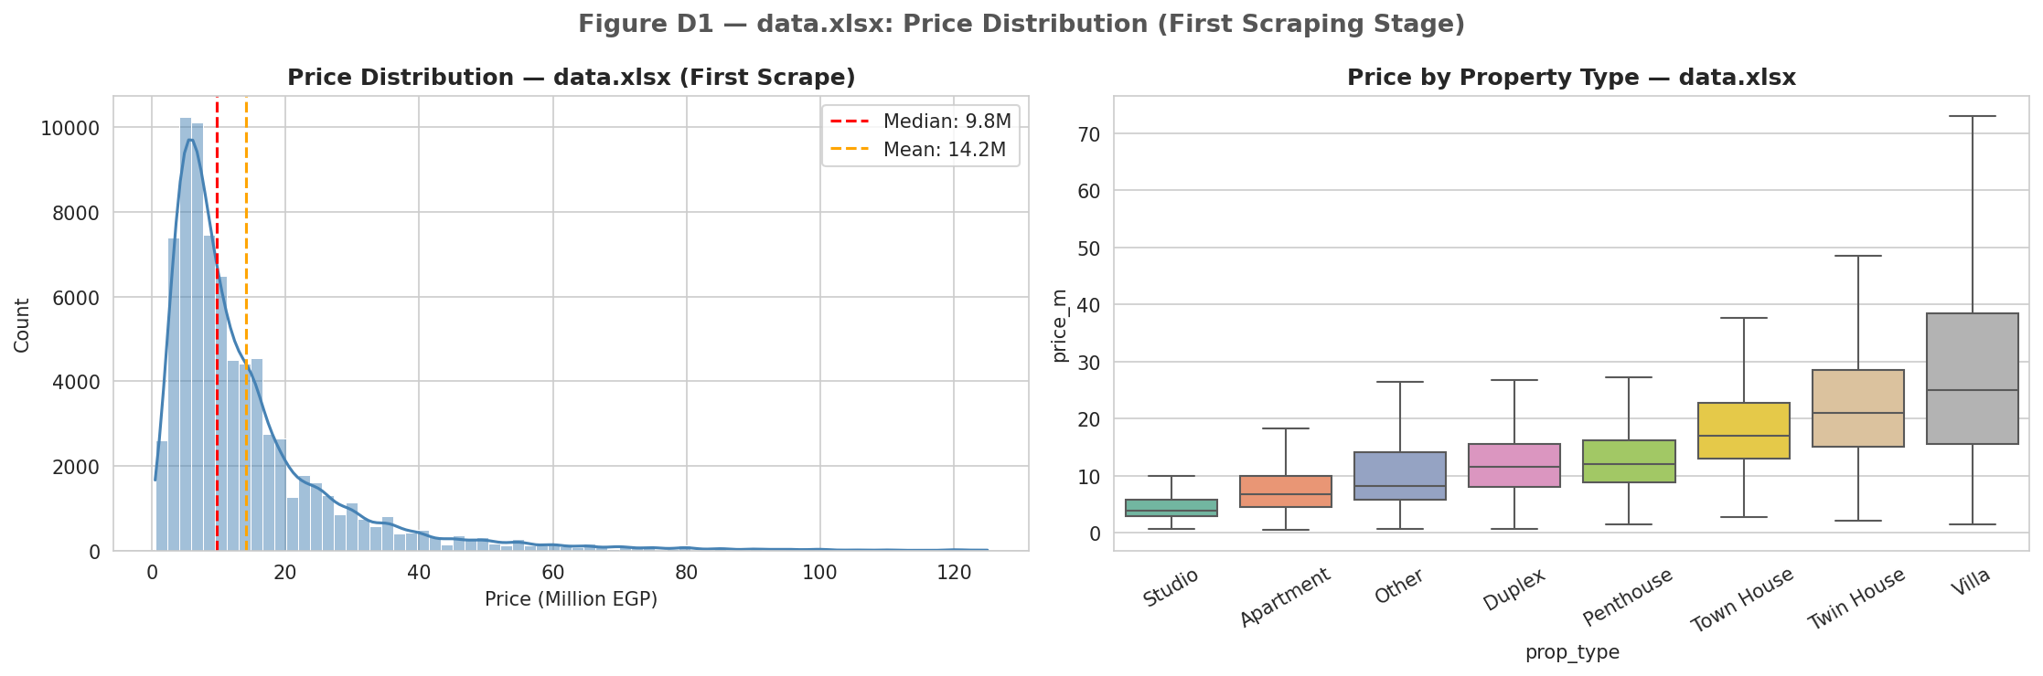
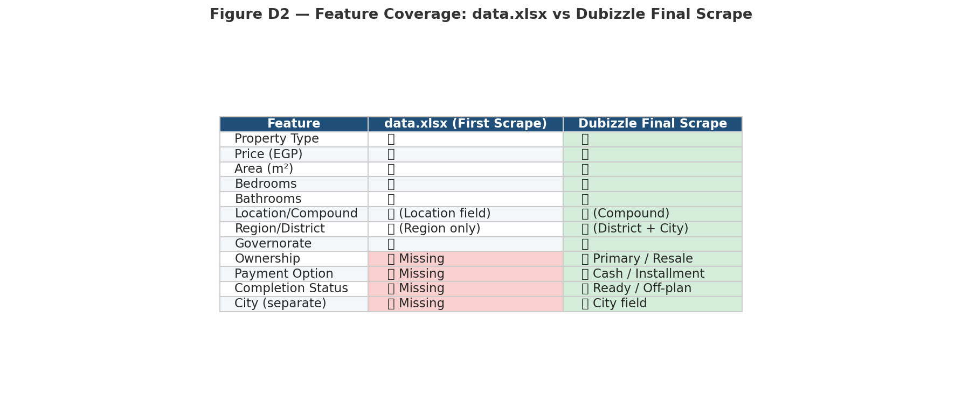

Three-Stage Dataset Evolution
data.xlsx = team's first own scraping attempt (same schema as Kaggle; no Ownership/Payment/Completion yet)
Dataset | Source / Origin | Records | R² | MAPE | New Features
Kaggle | PropertyFinder.eg (public) | 16,083 | 0.49 | 56.9% | None
data.xlsx | Team's first Dubizzle scrape | 81,076 | 0.69 | 33.0% | None yet
Dubizzle Final ✅ | Improved scrape + new fields | 74,240 | 0.758 | 27.87% | Own+Pay+Compl
data.xlsx EDA charts — confirming missing features drove the improved scraping schema:
Fig D1 — data.xlsx price distribution (no Ownership/Payment/Completion)
Fig D2 — Feature coverage gap between data.xlsx and Dubizzle Final
May 2026
6

Slide 7
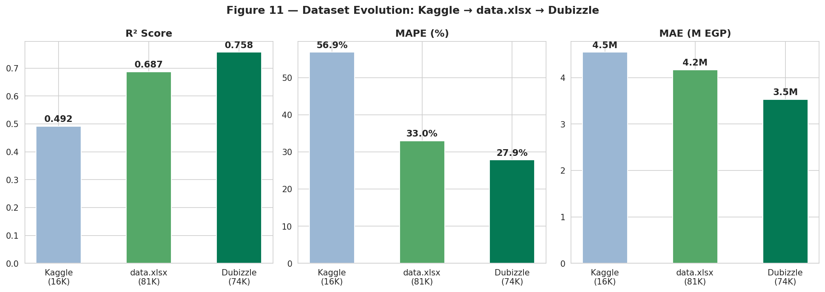
Accuracy Improvement Across All Three Versions
Figure 11 — R², MAPE, MAE: Kaggle → data.xlsx → Dubizzle Final
Figure 11 — MAPE halved (57% → 27.87%) and R² improved 54% from Kaggle baseline to final Dubizzle scrape.
May 2026
7

Slide 8
03
Data Collection
Two-Stage aiohttp Scraping · No Browser Required

Slide 9
Two-Stage Scraping Pipeline
aiohttp async · 40 concurrent workers · Auto-resume · Batch Excel save
Stage 1 — URL Collection
Stage 2 — dubizzle_scraper.py (aiohttp)
Visit category + city listing pages
Extract all 24 listing URLs per page
Paginate: ?page=N until end
Save URL + city + type label
Result: URLs.xlsx — 107,276 URLs
Reads URLs.xlsx (107,276 URLs)
40 async workers — no browser
Auto-resume via .checkpoint.csv
Batch Excel save every 1,000 rows
Backoff on HTTP 429/403
Status: OK / 404 / 502 / TIMEOUT
# Stage 1 (URL collector)
for category in CATEGORIES:
for city in CITIES:
urls = get_links(page_url)
save_to_xlsx(urls)
python dubizzle_scraper.py
python dubizzle_scraper.py --limit 500
python dubizzle_scraper.py --workers 20
python dubizzle_scraper.py --resume
May 2026
9

Slide 10
Scraping Results
107,276 URLs · 99.3% success rate · 74,240 final clean records
107,276
106,532
74,240
1,473
URLs Collected
Status OK
(99.3%)
Clean Records
(final)
City+District
Combinations
Feature | Values | Encoding | data.xlsx had it?
Property Type | 9 → 8 normalized | Stratified (own model) | ✅
Price + Area | 0.5M–110M EGP | log(price_m) target | ✅
City + District | 1,473 combinations | Label encoded | ❌ (Region only)
Ownership | Primary / Resale | 1 / 0 / 0.5 | ❌ NEW
Payment Option | Cash / Installment | 1 / 0 / 0.5 | ❌ NEW
Completion Status | Ready / Off-plan | 1 / 0 / 0.5 | ❌ NEW
May 2026
10

Slide 11
04
Data Structure & EDA
Features · New Feature Impact · Correlations

Slide 12
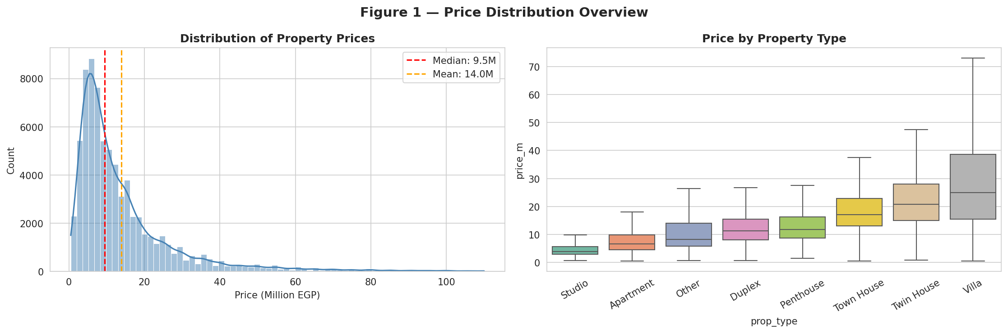
EDA: Price Distribution
74,240 listings · Median 9.5M EGP
Figure 1 — Right-skewed (skewness 2.63). Studios and Apartments are most affordable; Villas command the highest prices.
May 2026
12

Slide 13
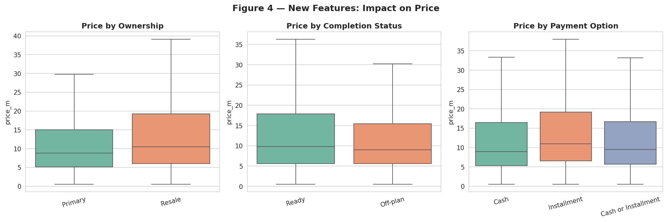
EDA: New Features Impact on Price
Primary + Ready + Cash = highest prices across all comparisons
Figure 4 — These three features (Ownership, Completion, Payment) were absent in data.xlsx and Kaggle datasets.
May 2026
13

Slide 14
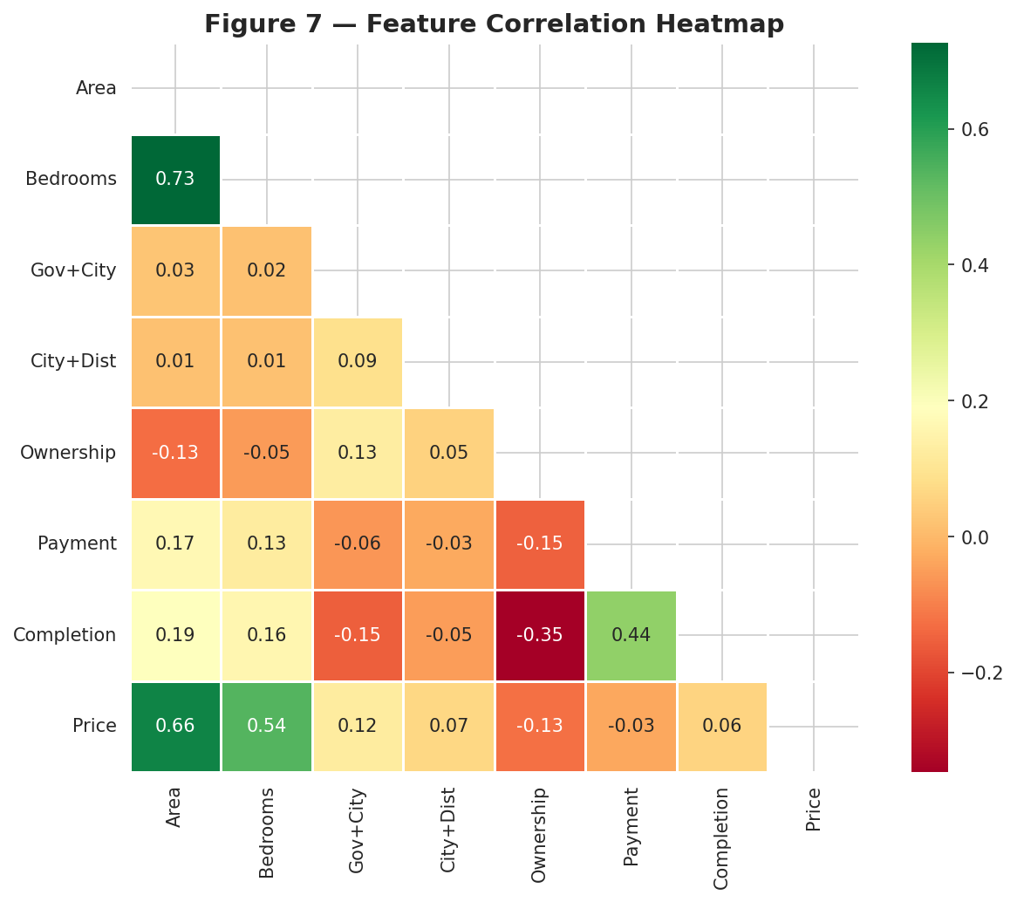
EDA: Feature Correlations
City+District and Area are the two strongest predictors
Figure 7 — City+District (r≈0.42) dominates. Ownership, Payment, Completion add independent signal not in prior datasets.
May 2026
14

Slide 15
05
Programming & ML Models
Stratified RF + GB · Features · Results

Slide 16
ML Results — Stratified Models
Global: R²=0.7576 MAE=3.532M EGP MAPE=27.87%
Type | Model | n | MAE | R² | MAPE
Apartment | Random Forest | 43,399 | 2.056 | 0.534 | 28.1%
Villa | Random Forest | 13,975 | 7.933 | 0.602 | 29.6%
Town House | Gradient Boosting | 5,565 | 3.816 | 0.561 | 24.1% ★
Twin House | Gradient Boosting | 3,387 | 4.512 | 0.633 | 23.2% ★
Duplex | Gradient Boosting | 3,435 | 3.322 | 0.410 | 31.4%
Studio | Random Forest | 994 | 1.224 | 0.588 | 25.0%
Global ✅ | — | 74,240 | 3.532 | 0.758 | 27.87%
3.532M
0.7576
27.87%
99.3%
Best MAE
Best R²
Best MAPE
Scrape Success
May 2026
16

Slide 17
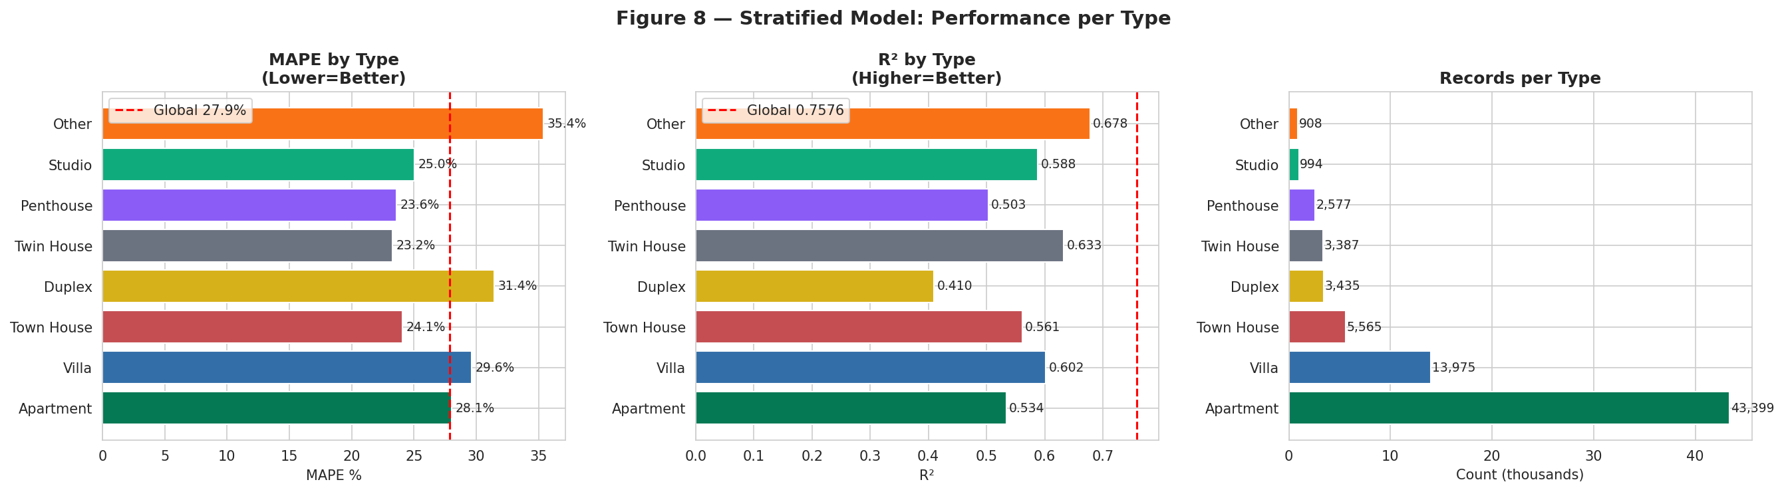
Performance per Property Type
Figure 8 — MAPE, R², and record count per type
Figure 8 — Town House (24.1%) and Twin House (23.2%) have the best MAPE.
May 2026
17

Slide 18
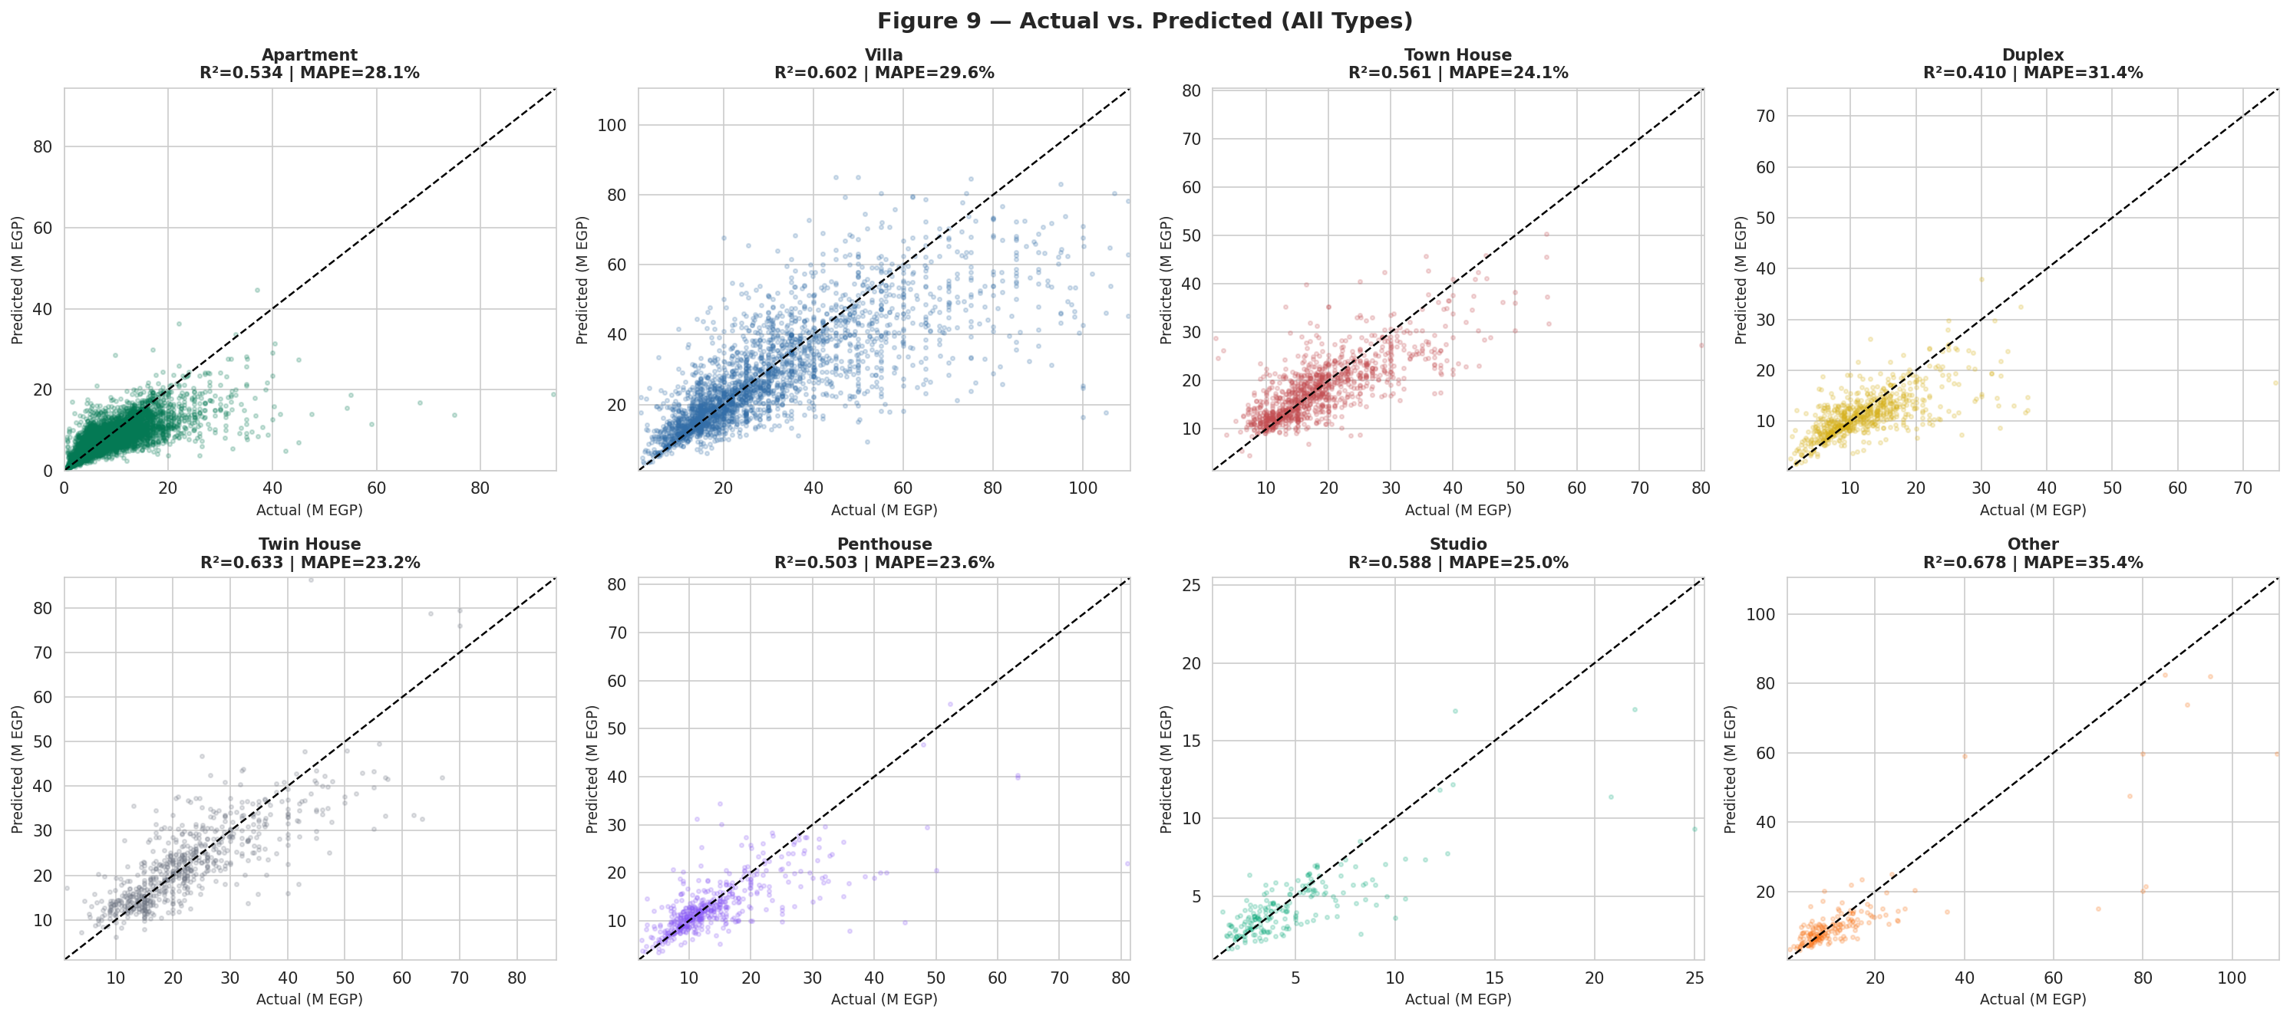
Actual vs. Predicted
Figure 9 — All 8 property types on 20% held-out test set
Figure 9 — Tighter clustering around the diagonal = better predictions.
May 2026
18

Slide 19
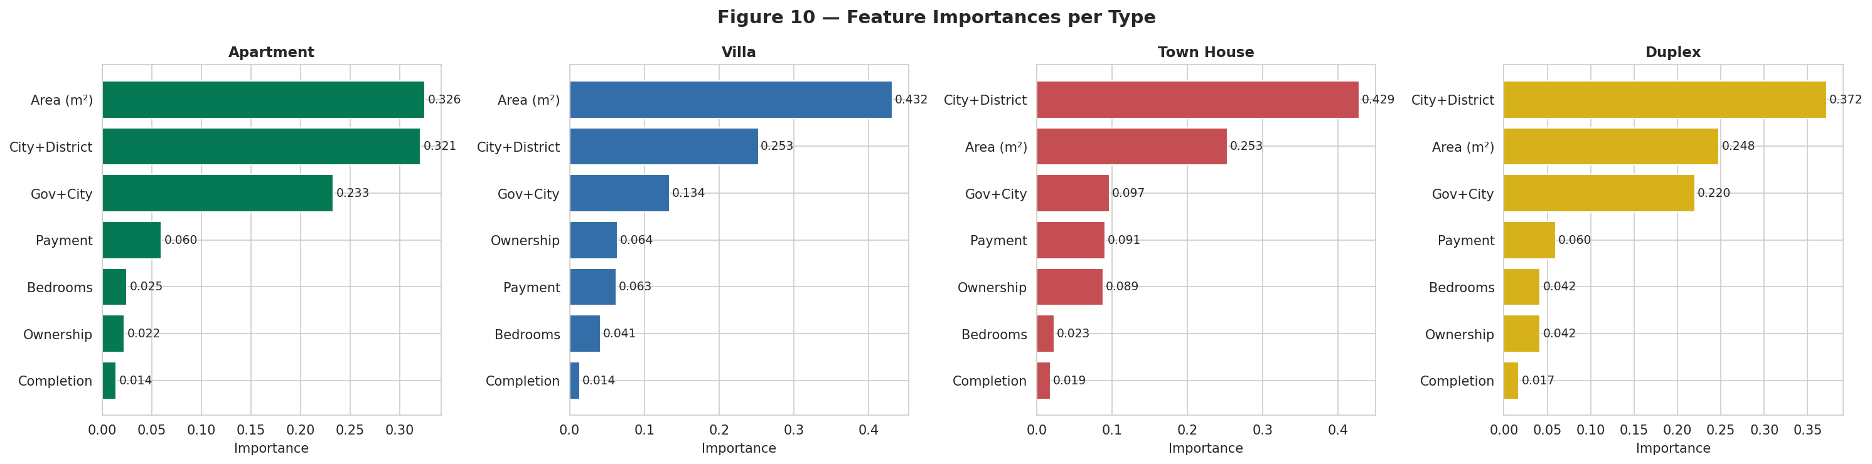
Feature Importances
Figure 10 — City+District dominates all four top property types
Figure 10 — City+District is consistently the most important feature, confirming location as the primary price driver.
May 2026
19

Slide 20
06
Deployment
Local + Streamlit Community Cloud · GitHub

Slide 21
Deployment — Local & Streamlit Community Cloud
Slide 7 — Live Application
💻 Local Setup
☁️ Streamlit Cloud
🐙 GitHub Files
pip install -r requirements.txt
python train.py → model_final.pkl
streamlit run app.py
Opens at http://localhost:8501
Cascading: Governorate → City → District
Per-type model accuracy shown live
Push code to GitHub (excl. model_final.pkl)
Go to share.streamlit.io → New app
Select repo · branch: main · file: app.py
Deploy → app.streamlit.app
App Settings → Files → upload model_final.pkl
Live at: your-app.streamlit.app
app.py · train.py
dubizzle_scraper.py
Egypt_RE_Appraiser_Final.ipynb
requirements.txt
requirements_scraper.txt
README.md · .gitignore
May 2026
21

Slide 22
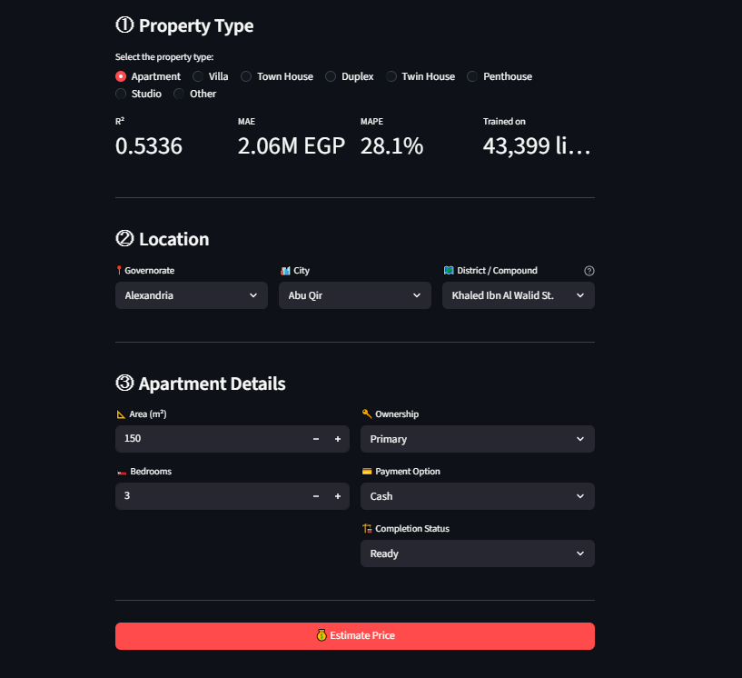
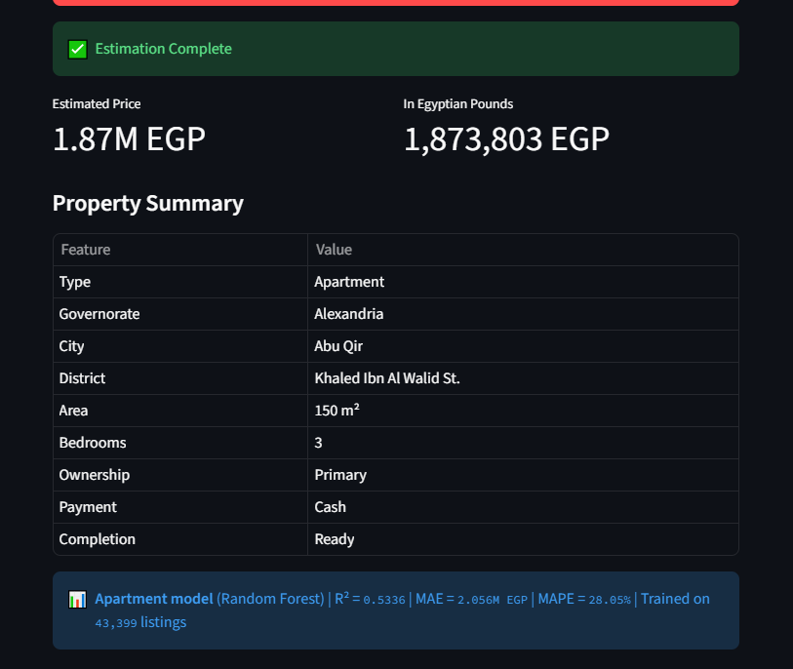
Streamlit App — Screenshots
📸
📸
Screenshot 1: Main Interface
Screenshot 2: Prediction Result
Property type selector + cascading location dropdowns + detail inputs
Estimated price + property summary table + model accuracy info
May 2026
22

Slide 23
07
Project Team & Deliverables

Slide 24
Project Team & Deliverables
Member 1 — Data Engineer
Member 2 — Data Analyst
Built Stage 1 URL collector (107K URLs)
Built Stage 2 aiohttp scraper (99.3% success)
Managed scraping infra & anti-detection
Final dataset validation & QA
Data cleaning + district fix logic
EDA: 11 analytical figures
Feature engineering & encoding
Log-transform & outlier analysis
Member 3 — ML Engineer
Member 4 — Documentation
Stratified model training (RF + GB)
Hyperparameter selection & CV evaluation
Streamlit app development & cloud deploy
model_final.pkl bundle creation
9-section project documentation
DEPI presentation design (28 slides)
GitHub README & project setup guide
Literature review & proposal write-up
May 2026
24

Slide 25
🏠
Thank You!
Egypt Real Estate Appraiser · Dubizzle Scrape · DEPI 2026
Questions & Feedback Welcome
74K
0.758
27.9%
8
Records
Scraped
Best
R²
Best
MAPE
Property
Models
🔗 github · 🌐 streamlit app
May 2026 · Digital Egypt Pioneers · Data Science Track

