Slide 1
PROJECT DOCS
CaloriX
A full-stack calorie & nutrition tracking platform
FastAPI • React (Vite) • scikit-learn ML engine • Google Gemini AI
Engineering Overview & Architecture Reference

Slide 2
INTRODUCTION
What is CaloriX?
4
Core domains
CaloriX combines four pillars into one cohesive nutrition platform: 1. A FastAPI backend exposing a versioned REST API (/api/v1) 2. A React (Vite) single-page frontend consuming that API 3. A scikit-learn ML engine for food classification & recommendations 4. Google Gemini-powered AI features — meal suggestions, food-photo
analysis, and a conversational coach with tool-calling
Auth, Profile, Meals, Chat
8
API route groups
health, auth, profile, meals…
2
AI surfaces
Generative + classical ML
CaloriX — Project Documentation
2

Slide 3
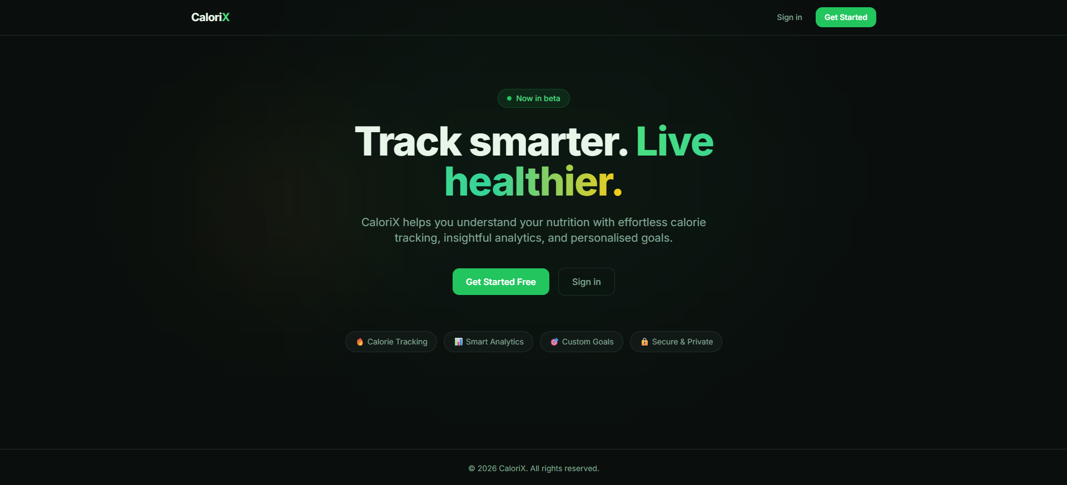
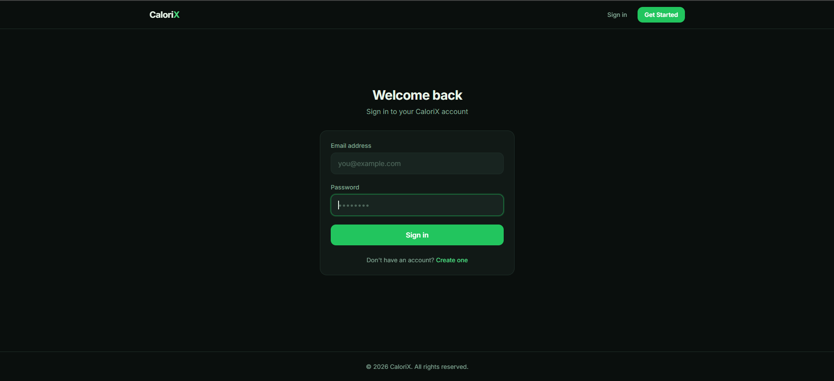
PRODUCT TOUR
Landing & Authentication
SIGN IN
Register mirrors this form with username + confirm-password fields, then auto-logs the new user in.
Marketing landing page — hero pitch, feature pills, and dual CTAs (Get Started / Sign in).
CaloriX — Project Documentation
3

Slide 4
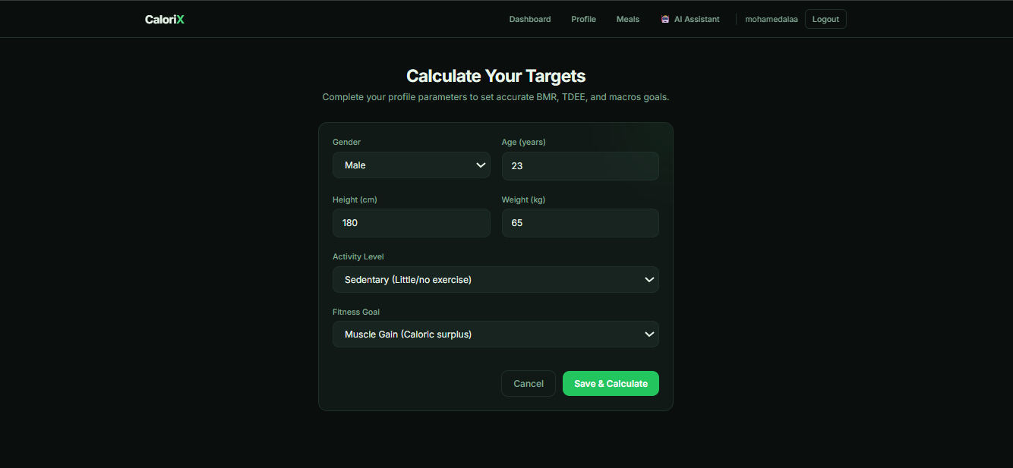
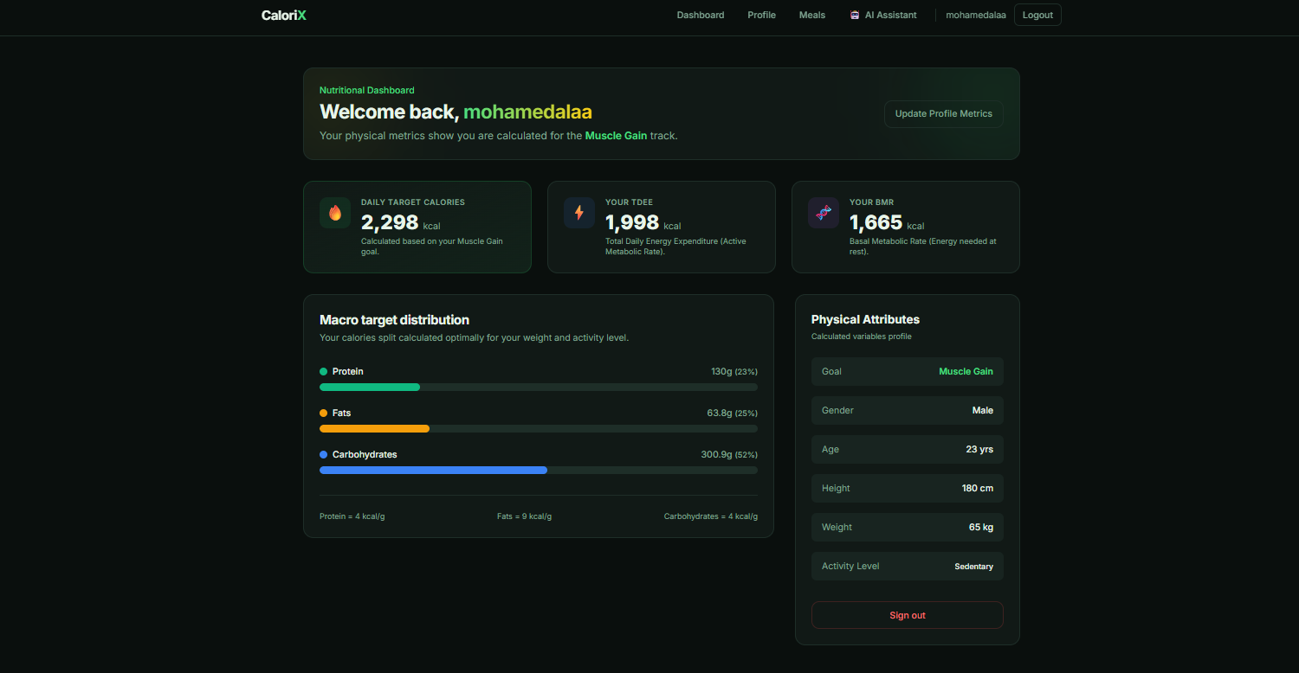
PRODUCT TOUR
Onboarding & Dashboard
The Profile form drives every downstream number: BMR, TDEE, calorie target, and macro split are all recalculated on save.
Dashboard renders BMR/TDEE/target cards, a macro-distribution breakdown, and the physical-attributes summary in one view.
CaloriX — Project Documentation
4

Slide 5
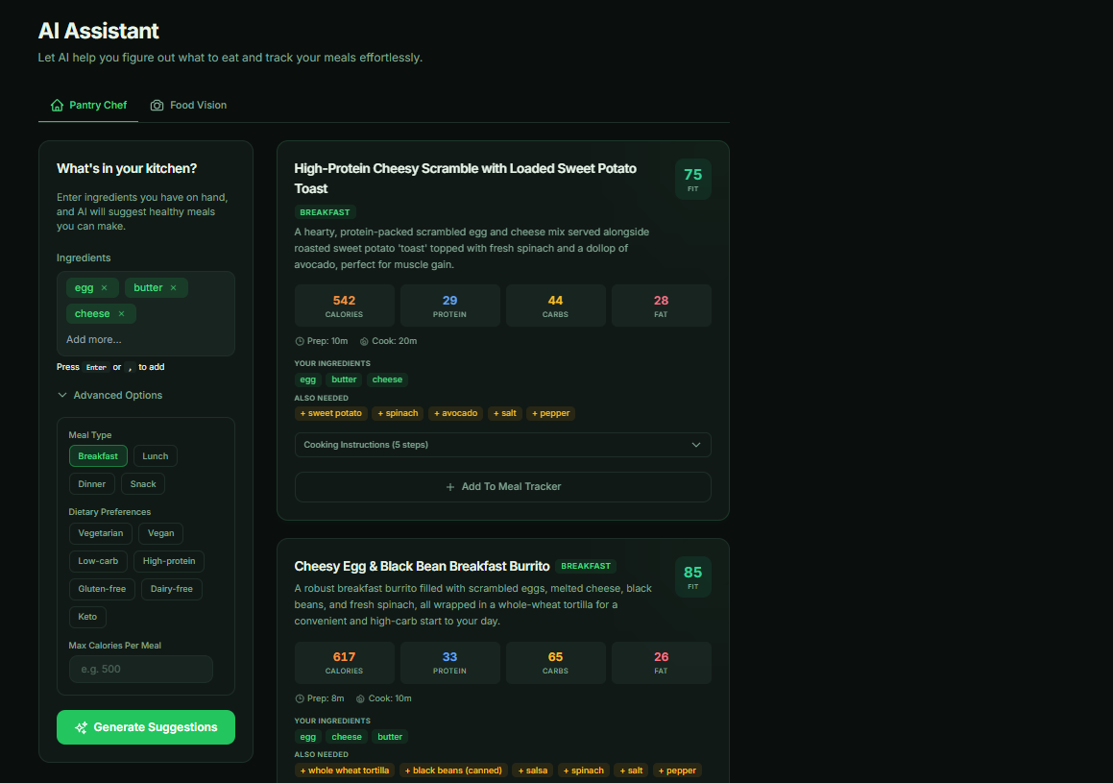
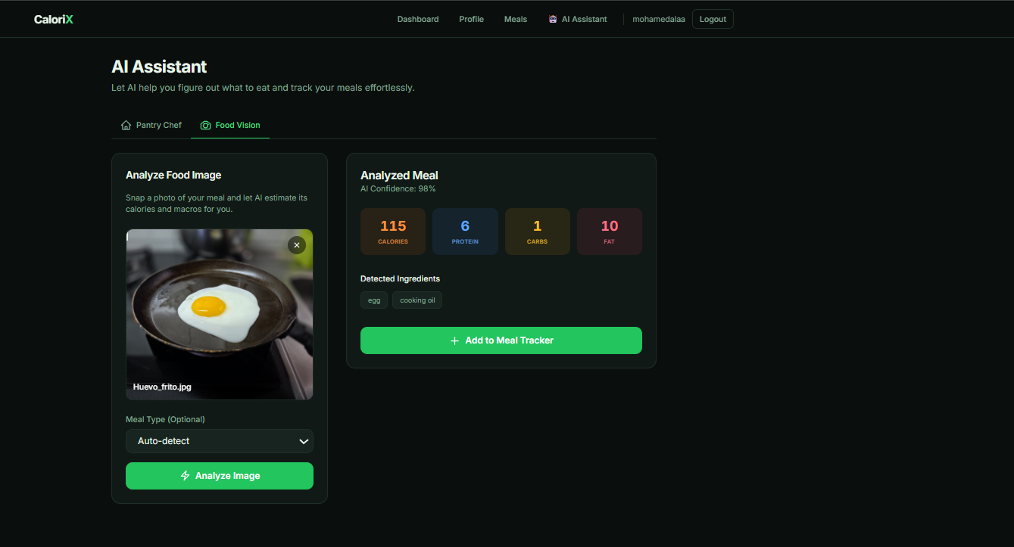
PRODUCT TOUR
AI Assistant in Action
PANTRY CHEF
FOOD VISION
Pantry Chef turns on-hand ingredients into ranked meal suggestions with a fit score, macros, and one-click add-to-tracker. Food Vision analyzes an uploaded photo (Gemini vision) and returns calories, macros, and detected ingredients with a confidence score.
CaloriX — Project Documentation
5

Slide 6
FOUNDATIONS
Tech Stack
⚙
Backend
⌘
Frontend
◈
ML Engine
FastAPI · SQLAlchemy · Pydantic-Settings · python-jose (JWT) · passlib/bcrypt · Uvicorn
React 18 · Vite · React Router v6 · Axios · Tailwind CSS · react-markdown
scikit-learn classifier + label encoder · TF-IDF nearest neighbors · pandas / joblib
✦
Generative AI
▣
Data
⌗
Auth
Google Gemini 2.5 Flash (text + vision) · function-calling tool schemas
SQLite (calorixx.db) · CSV nutrition dataset · no migrations (create_all)
JWT access + refresh tokens · bcrypt password hashing · bearer-token middleware
CaloriX — Project Documentation
6

Slide 7
ARCHITECTURE
High-Level Architecture
HTTP / JSON
(axios, bearer token)
React Frontend
FastAPI Backend
Vite dev server
port 5173
/api/v1/* · uvicorn
port 8000 / 8001
SQLite Database
Google Gemini API
Local ML Models
calorixx.db
text + vision
joblib .pkl files
The frontend talks exclusively to the FastAPI backend via axios (services/api.js). A 401 response clears the stored token and redirects to /login.
CaloriX — Project Documentation
7

Slide 8
BACKEND
Project Layout
apiv1/
api/v1/
auth
auth/
auth, health, profile, meals, ml, ai, metrics, ai_chat routers
get_current_user & get_optional_ai_user dependencies
core
core/
database
database/
Settings (pydantic-settings) + password hashing / JWT
SQLAlchemy engine, session, declarative Base
models
models/
schemas
schemas/
User, UserProfile, Meal, ChatSession, ChatMessage
Pydantic request/response models per domain
services
services/
ml
ml/
Business logic — one service class per domain
Trained artifacts: classifier, scaler, encoder, recommender, CSV
CaloriX — Project Documentation
8

Slide 9
BACKEND
Database Models & Authentication
User
UserProfile
id, email, username, hashed_password. 1:1 UserProfile, 1:many Meal (both cascade delete).
age, gender, height/weight, activity_level, goal → calculated bmr, tdee, calorie & macro targets.
Meal
ChatSession / ChatMessage
food_name, calories, protein/carbs/fat, meal_type, meal_date, is_ai_predicted flag.
Session has title + rolling summary; ordered messages with role (user/model).
Authentication Flow
register → bcrypt hash, 409 on duplicate · login → { access_token, refresh_token } · GET /auth/me via Bearer token · get_optional_ai_user allows anonymous AI calls unless REQUIRE_AI_AUTH=true
CaloriX — Project Documentation
9

Slide 10
BACKEND
API Reference — /api/v1/*
Route | Purpose
/health | Liveness check
/auth | register, login, me
/profile | BMR / TDEE / macro profile
/meals | CRUD meal logging
/ml | Food classification, similarity, search
/ai | Gemini meal suggestions & image analysis*
/metrics | Dashboard analytics
/ai-chat | Chat sessions + coach messaging
Interactive Docs
Swagger UI at /docs
ReDoc at /redoc
All routers are aggregated under a single /api/v1 prefix via api/router.py.
* /ai routes are optional-auth unless REQUIRE_AI_AUTH=true, and return 503 if GEMINI_API_KEY is unset.
CaloriX — Project Documentation
10

Slide 11
BACKEND
Services — Business Logic Layer
UserService
ProfileService
MealService
Registration with duplicate checks, authentication, token issuance.
Mifflin-St Jeor BMR, TDEE via activity multiplier, goal-based calorie targets, macro split.
CRUD for meals + get_daily_summary (totals vs. targets, remaining calories).
MetricsService
MLService
AIService
Aggregates meals into stat cards, 7-day chart, macro %, goal progress, insights.
Singleton loading classifier/scaler/encoder/recommender + CSV at import time.
Wraps Gemini for meal suggestions, image analysis, and the tool-calling coach.
+ ChatService / PromptBuilder — manages chat sessions, builds system + context + history prompts, auto-summarizes older messages via Gemini.
CaloriX — Project Documentation
11

Slide 12
INTELLIGENCE LAYER
AI & ML Subsystems
Generative AI (Gemini)
Classical ML (scikit-learn)
• Uses gemini-2.5-flash for both text and vision • Strict-JSON prompts; responses stripped of Markdown fences, parsed, then field-validated • User context (remaining calories/macros, goal) injected into meal-suggestion prompts • AI Coach uses function-calling: add_meal, delete_meal, update_weight • Tools enabled only on a mutation-intent heuristic (keyword match) to save latency/cost • ToolDispatcher normalizes argument names and returns a function_response to Gemini
• Loaded once at process start (singleton pattern) • Feature engineering derives density/ratio features for parity between training & inference • predict() → food category via classifier + label encoder • get_similar_foods() → scaled numeric features + TF-IDF text vector, nearest-neighbors index • search_foods() → case-insensitive substring match over the nutrition CSV
CaloriX — Project Documentation
12

Slide 13
FRONTEND
Layout, Routing & State
Project Layout
Routing
main.jsx — bootstrap, Router, AuthProvider App.jsx — route table layouts/MainLayout — header/nav/footer shell context/AuthContext — auth state & token persistence components/ — ProtectedRoute, GuestRoute, ai/* pages/ — Home, Login, Dashboard, Profile, MealTracker, Metrics, AIAssistant, AIChat services/ — one Axios wrapper per backend resource
React Router v6, all nested under one MainLayout. ProtectedRoute shows a spinner while auth resolves, then redirects unauthenticated users to /login (preserving intended destination). GuestRoute does the inverse for /login and /register.
Services & API Client
services/api.js is a shared Axios instance: baseURL http://localhost:8001/api/v1, request interceptor attaches the Bearer token, response interceptor clears the token and redirects to /login on 401.
CaloriX — Project Documentation
13

Slide 14
FRONTEND
Key Pages & Components
Dashboard
MealTracker
AIAssistant
Profile CTA if none exists; otherwise BMR/TDEE/calorie cards + macro breakdown.
Autocomplete, AI category auto-detect, similar-food suggestions, daily summary.
“Pantry Chef” (ingredient-based suggestions) + “Food Vision” (photo analysis) tabs.
AIChat
Metrics
Profile
Session sidebar + Markdown chat pane; can trigger backend tool calls transparently.
7D/30D/90D toggle; KPI cards, calorie bars, macro split, goal progress, activity feed.
Age/gender/height/weight/activity/goal form with client-side range validation.
CaloriX — Project Documentation
14

Slide 15
GETTING STARTED
Setup & Environment Variables
Backend
Backend .env
python -m venv .venv
source .venv/bin/activate
pip install -r requirements.txt
cp .env.example .env
uvicorn app.main:app --reload --port 8001
DATABASE_URL=sqlite:///./calorixx.db
SECRET_KEY=<random, e.g. openssl rand -hex 32>
ALGORITHM=HS256
ACCESS_TOKEN_EXPIRE_MINUTES=30
REFRESH_TOKEN_EXPIRE_DAYS=7
CORS_ORIGINS=["http://localhost:5173"]
GEMINI_API_KEY=<your key>
REQUIRE_AI_AUTH=false
DEBUG=false
Swagger UI at :8001/docs. Tables auto-create on startup against SQLite. ML artifacts must exist under app/ml/ or MLService raises on import.
Frontend
Frontend: no .env is read by Vite — the API base URL is hardcoded in src/services/api.js.
cd frontend && npm install && npm run dev
Vite dev server on :5173. Its proxy targets :8000, but api.js hardcodes :8001 — align the two.
CaloriX — Project Documentation
15

Slide 16
HOUSEKEEPING
Known Gaps & Notes for Contributors
!
Port mismatch
!
No DB migrations
!
Placeholder SECRET_KEY
vite.config.js proxy targets :8000, but api.js calls :8001 directly. Pick one convention.
Schema relies on create_all, which won't alter existing tables. Introduce Alembic before production changes.
Must be overridden outside local development.
!
Goal-progress is a proxy
!
Heuristic mutation intent
!
Silent summarization failures
Computed from calorie-target adherence, not real weight-loss progress (no target_weight field yet).
AI coach tool access is enabled via keyword matching — may mis-classify ambiguous phrasing.
except Exception: pass in ChatService.handle_message lets history grow unbounded on Gemini failure.
!
Image-analysis field drift
Frontend reads food_name/meal_type/reasoning; backend schema returns detected_food_items/predicted_meal_category/notes.
CaloriX — Project Documentation
16

Slide 17
APPENDIX
AI Pipeline Notebook Walkthrough
CaloriX_AI_Pipeline.ipynb — every cell's code alongside its executed output, in order.
CaloriX — Project Documentation
17

Slide 18
AI PIPELINE NOTEBOOK
Cell 1
#0
import numpy as np
import pandas as pd
from pathlib import Path
import json
import joblib
import matplotlib.pyplot as plt
from sklearn.preprocessing import StandardScaler, OneHotEncoder
from sklearn.preprocessing import LabelEncoder
from sklearn.ensemble import RandomForestClassifier
from sklearn.feature_extraction.text import TfidfVectorizer
from sklearn.metrics.pairwise import cosine_similarity
from sklearn.model_selection import train_test_split
from sklearn.metrics import accuracy_score
from sklearn.compose import ColumnTransformer
from sklearn.neighbors import NearestNeighbors
from scipy.sparse import hstack
from sklearn.pipeline import Pipeline
from sklearn.metrics import classification_report
CaloriX — Project Documentation
18

Slide 19
AI PIPELINE NOTEBOOK
Cell 2
#1
DATASET_PATH = Path("CaloriX_Nutrition_Dataset.csv")
df = pd.read_csv(DATASET_PATH)
print(df.shape)
df.head()
OUTPUT
(8094, 23)
food_id food_name \
0 169831 APPLEBEE'S, 9 oz house sirloin steak
1 169008 APPLEBEE'S, Double Crunch Shrimp
2 169010 APPLEBEE'S, KRAFT, Macaroni & Cheese, from kid...
3 169841 APPLEBEE'S, chicken tenders platter
4 169012 APPLEBEE'S, chicken tenders, from kids' menu
category serving_size_g calories protein_g carbs_g fat_g \
0 Restaurant Foods 157.0 791.0 26.85 0.00 9.08
1 Restaurant Foods 206.0 1352.0 12.31 25.96 18.90
...
CaloriX — Project Documentation
19

Slide 20
AI PIPELINE NOTEBOOK
Cell 3
#2
print("=" * 60)
print(df.info())
print("=" * 60)
print(df.describe().T)
OUTPUT
============================================================
<class 'pandas.DataFrame'>
RangeIndex: 8094 entries, 0 to 8093
Data columns (total 23 columns):
# Column Non-Null Count Dtype
--- ------ -------------- -----
0 food_id 8094 non-null int64
1 food_name 8094 non-null str
2 category 8094 non-null str
3 serving_size_g 8094 non-null float64
4 calories 8094 non-null float64
5 protein_g 8094 non-null float64
...
CaloriX — Project Documentation
20

Slide 21
AI PIPELINE NOTEBOOK
Cell 4
#3
print("Missing Values")
display(df.isna().sum())
print()
print("Duplicates")
display(df.duplicated().sum())
OUTPUT
Missing Values
food_id 0
food_name 0
category 0
serving_size_g 0
calories 0
protein_g 0
carbs_g 0
fat_g 0
fiber_g 0
sugar_g 0
...
CaloriX — Project Documentation
21

Slide 22
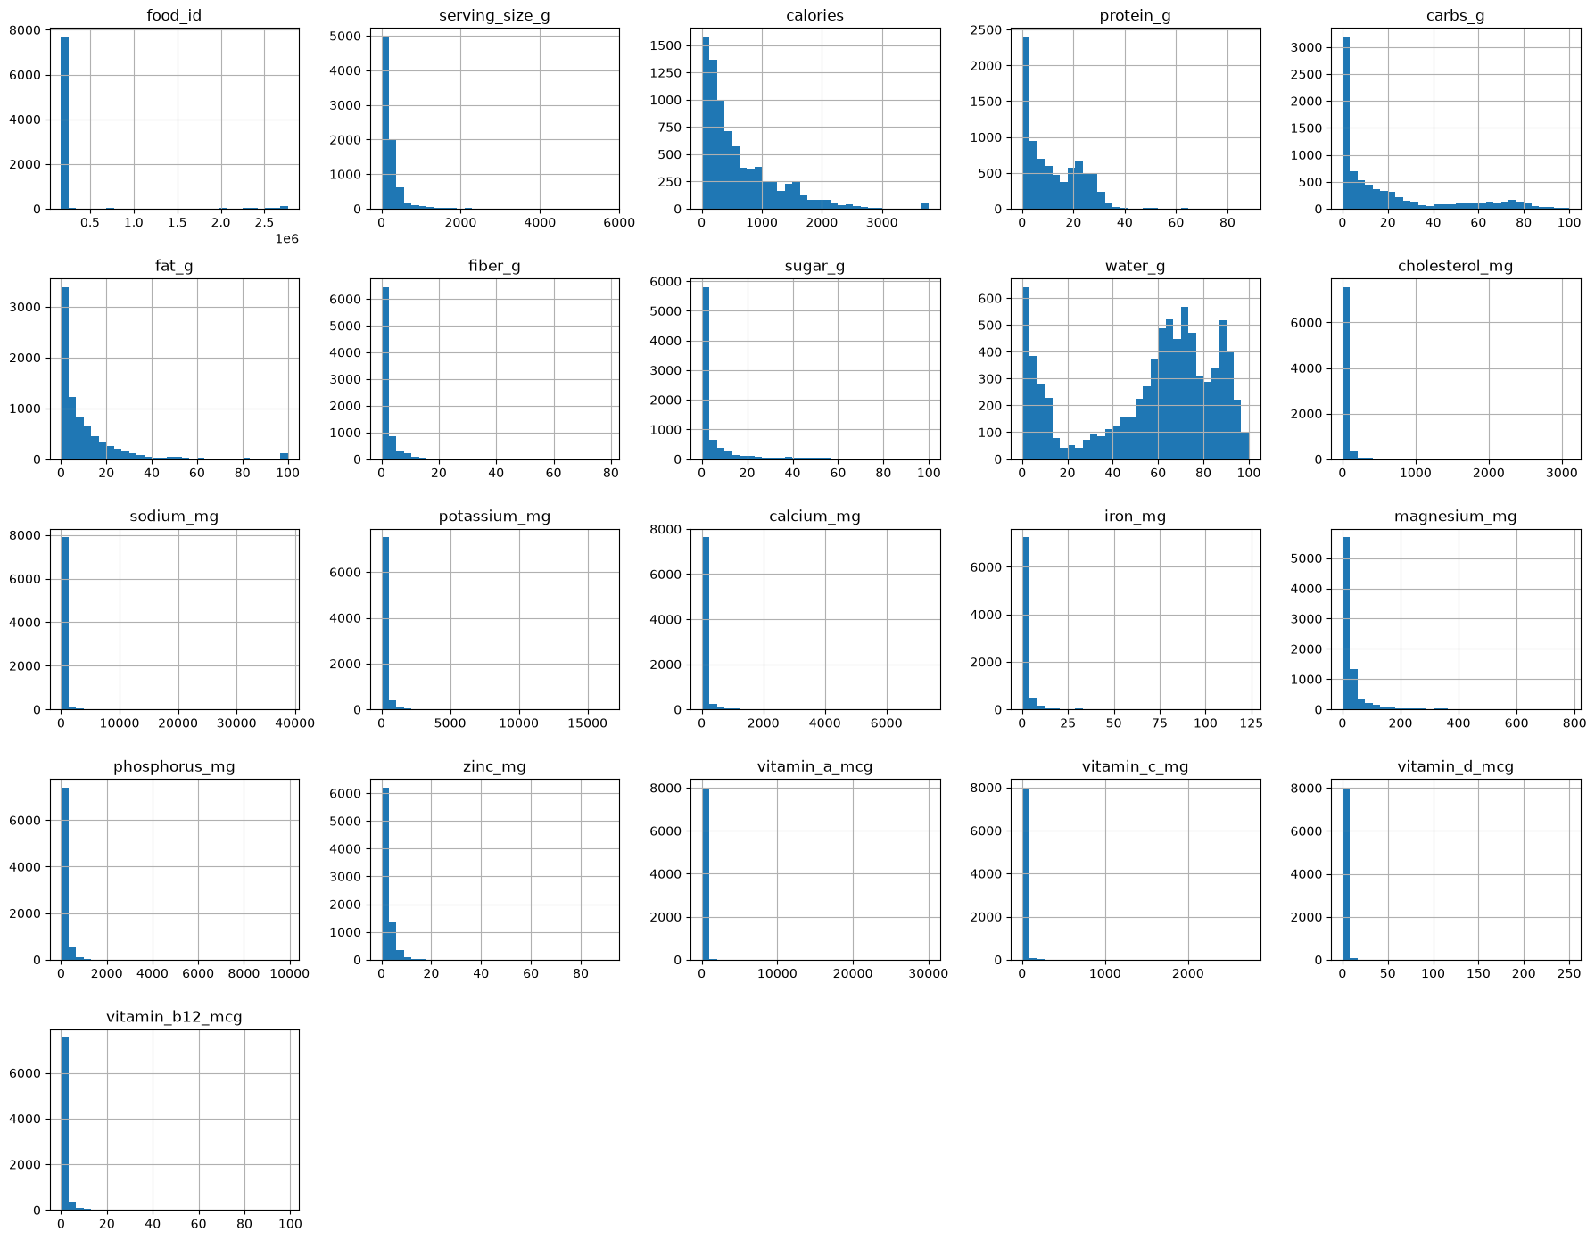
AI PIPELINE NOTEBOOK
Cell 5
#4
numeric_columns = df.select_dtypes(include=np.number).columns
df[numeric_columns].hist(
figsize=(18,14),
bins=30
)
plt.tight_layout()
plt.show()
CaloriX — Project Documentation
22

Slide 23
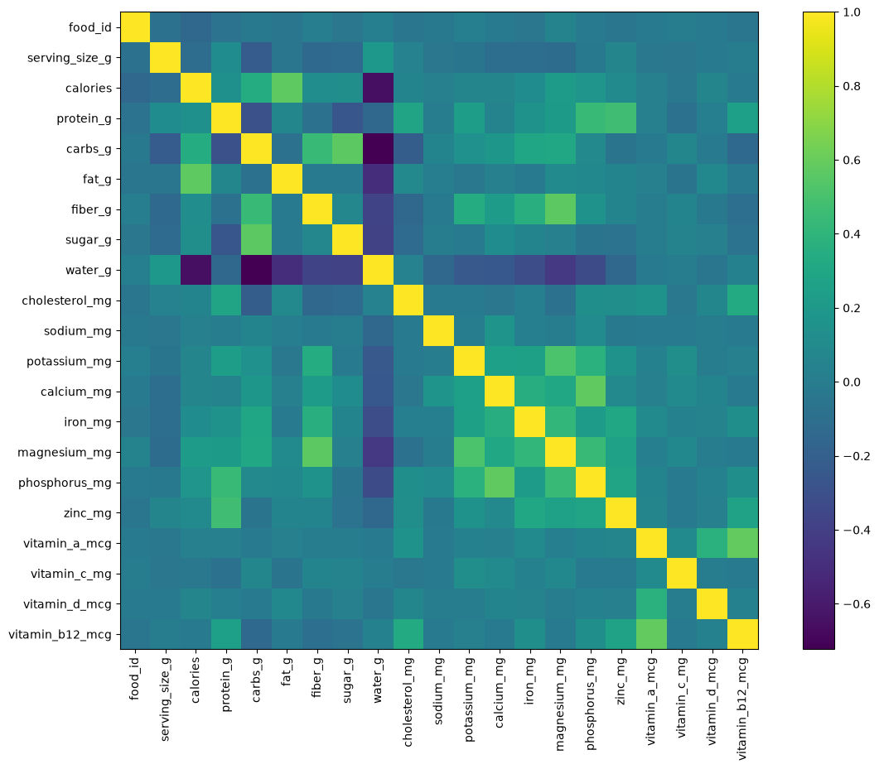
AI PIPELINE NOTEBOOK
Cell 6
#5
plt.figure(figsize=(14,10))
corr = df[numeric_columns].corr()
plt.imshow(corr)
plt.xticks(
range(len(corr.columns)),
corr.columns,
rotation=90
)
plt.yticks(
range(len(corr.columns)),
corr.columns
)
plt.colorbar()
plt.show()
CaloriX — Project Documentation
23

Slide 24
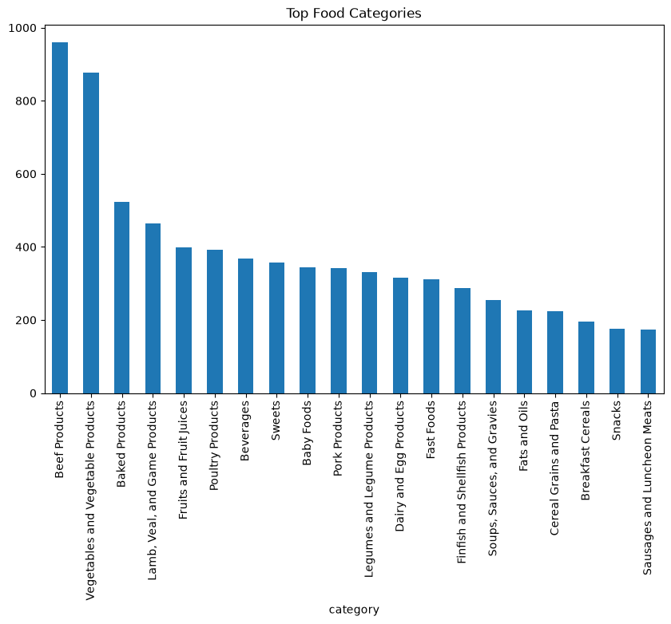
AI PIPELINE NOTEBOOK
Cell 7
#6
plt.figure(figsize=(10,6))
df["category"].value_counts().head(20).plot.bar()
plt.title("Top Food Categories")
plt.show()
CaloriX — Project Documentation
24

Slide 25
AI PIPELINE NOTEBOOK
Cell 8
#7
print(df.columns.tolist())
OUTPUT
['food_id', 'food_name', 'category', 'serving_size_g', 'calories', 'protein_g', 'carbs_g'...
CaloriX — Project Documentation
25

Slide 26
AI PIPELINE NOTEBOOK
Cell 9
#8
feature_df = df.copy()
feature_df["calorie_density"] = (
feature_df["calories"] /
feature_df["serving_size_g"]
).round(3)
feature_df["protein_ratio"] = (
feature_df["protein_g"] /
feature_df["calories"].replace(0, 1)
).round(4)
feature_df["carb_ratio"] = (
feature_df["carbs_g"] /
feature_df["calories"].replace(0, 1)
).round(4)
feature_df["fat_ratio"] = (
feature_df["fat_g"] /
feature_df["calories"].replace(0, 1)
).round(4)
feature_df.head()
OUTPUT
food_id food_name \
0 169831 APPLEBEE'S, 9 oz house sirloin steak
1 169008 APPLEBEE'S, Double Crunch Shrimp
2 169010 APPLEBEE'S, KRAFT, Macaroni & Cheese, from kid...
3 169841 APPLEBEE'S, chicken tenders platter
4 169012 APPLEBEE'S, chicken tenders, from kids' menu
category serving_size_g calories protein_g carbs_g fat_g \
0 Restaurant Foods 157.0 791.0 26.85 0.00 9.08
1 Restaurant Foods 206.0 1352.0 12.31 25.96 18.90
2 Restaurant Foods 180.0 600.0 5.01 21.08 4.34
3 Restaurant Foods 209.0 297.0 19.62 17.98 16.24
...
CaloriX — Project Documentation
26

Slide 27
AI PIPELINE NOTEBOOK
Cell 10
#9
feature_df["high_protein"] = (
feature_df["protein_g"] >= 20
).astype(int)
feature_df["low_carb"] = (
feature_df["carbs_g"] <= 15
).astype(int)
feature_df["high_fiber"] = (
feature_df["fiber_g"] >= 5
).astype(int)
feature_df["low_fat"] = (
feature_df["fat_g"] <= 5
).astype(int)
feature_df["high_sodium"] = (
feature_df["sodium_mg"] >= 600
).astype(int)
CaloriX — Project Documentation
27

Slide 28
AI PIPELINE NOTEBOOK
Cell 11
#10
feature_df["text"] = (
feature_df["food_name"].fillna("") +
" " +
feature_df["category"].fillna("")
)
CaloriX — Project Documentation
28

Slide 29
AI PIPELINE NOTEBOOK
Cell 12
#11
feature_df[
[
"food_name",
"text"
]
].head()
OUTPUT
food_name \
0 APPLEBEE'S, 9 oz house sirloin steak
1 APPLEBEE'S, Double Crunch Shrimp
2 APPLEBEE'S, KRAFT, Macaroni & Cheese, from kid...
3 APPLEBEE'S, chicken tenders platter
4 APPLEBEE'S, chicken tenders, from kids' menu
text
0 APPLEBEE'S, 9 oz house sirloin steak Restauran...
1 APPLEBEE'S, Double Crunch Shrimp Restaurant Foods
2 APPLEBEE'S, KRAFT, Macaroni & Cheese, from kid...
3 APPLEBEE'S, chicken tenders platter Restaurant...
...
CaloriX — Project Documentation
29

Slide 30
AI PIPELINE NOTEBOOK
Cell 13
#12
# ============================================================
# Generate meal_type labels
# ============================================================
def infer_meal_type(row):
name = str(row["food_name"]).lower()
category = str(row["category"]).lower()
calories = row["calories"]
protein = row["protein_g"]
carbs = row["carbs_g"]
fat = row["fat_g"]
breakfast_keywords = [
"egg",
"oat",
"cereal",
"milk",
"yogurt",
"cheese",
"toast",
"bread",
"pancake",
"waffle",
...
CaloriX — Project Documentation
30

Slide 31
AI PIPELINE NOTEBOOK
Cell 14
#13
feature_df["meal_type"] = feature_df.apply(
infer_meal_type,
axis=1
)
feature_df[
[
"food_name",
"meal_type"
]
].head(20)
OUTPUT
food_name meal_type
0 APPLEBEE'S, 9 oz house sirloin steak Breakfast
1 APPLEBEE'S, Double Crunch Shrimp Snack
2 APPLEBEE'S, KRAFT, Macaroni & Cheese, from kid... Breakfast
3 APPLEBEE'S, chicken tenders platter Snack
4 APPLEBEE'S, chicken tenders, from kids' menu Snack
5 APPLEBEE'S, chili Snack
6 APPLEBEE'S, coleslaw Snack
7 APPLEBEE'S, crunchy onion rings Snack
8 APPLEBEE'S, fish, hand battered Snack
9 APPLEBEE'S, french fries Snack
10 APPLEBEE'S, mozzarella sticks Snack
...
CaloriX — Project Documentation
31

Slide 32
AI PIPELINE NOTEBOOK
Cell 15
#14
feature_df["meal_type"].value_counts()
OUTPUT
meal_type
Lunch 2353
Snack 2092
Dinner 1849
Breakfast 1800
Name: count, dtype: int64
CaloriX — Project Documentation
32

Slide 33
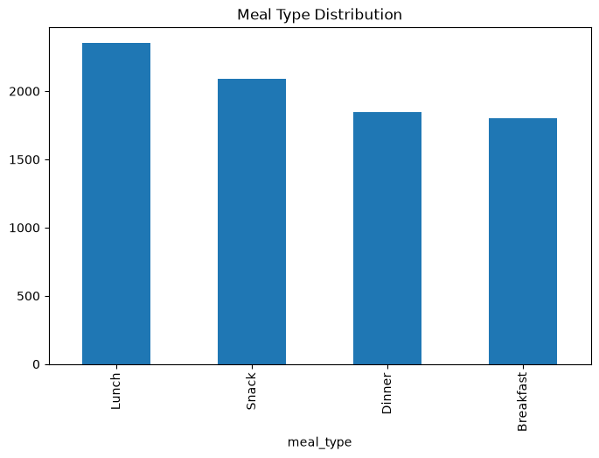
AI PIPELINE NOTEBOOK
Cell 16
#15
feature_df["meal_type"].value_counts().plot.bar(figsize=(8,5))
plt.title("Meal Type Distribution")
plt.show()
CaloriX — Project Documentation
33

Slide 34
AI PIPELINE NOTEBOOK
Cell 17
#16
numeric_features = [
"serving_size_g",
"calories",
"protein_g",
"carbs_g",
"fat_g",
"protein_density",
"fat_density",
"carb_density",
"calorie_density",
"protein_ratio",
"fat_ratio",
"carb_ratio",
"energy_density"
]
categorical_features = [
"category",
"cuisine"
]
CaloriX — Project Documentation
34

Slide 35
AI PIPELINE NOTEBOOK
Cell 18
feature_df["cuisine"] = "Unknown"
feature_df["protein_density"] = (
feature_df["protein_g"] /
feature_df["serving_size_g"].replace(0, 1)
)
feature_df["fat_density"] = (
feature_df["fat_g"] /
feature_df["serving_size_g"].replace(0, 1)
)
feature_df["carb_density"] = (
feature_df["carbs_g"] /
feature_df["serving_size_g"].replace(0, 1)
)
feature_df["energy_density"] = (
feature_df["calories"] /
(
feature_df["protein_g"] +
feature_df["carbs_g"] +
feature_df["fat_g"]
).replace(0, 1)
)
...
CaloriX — Project Documentation
35

Slide 36
AI PIPELINE NOTEBOOK
Cell 19
required_columns = numeric_features + categorical_features
missing = [c for c in required_columns if c not in feature_df.columns]
print("Missing:", missing)
OUTPUT
Missing: []
CaloriX — Project Documentation
36

Slide 37
AI PIPELINE NOTEBOOK
Cell 20
preprocessor = ColumnTransformer(
transformers=[
(
"num",
StandardScaler(),
numeric_features
),
(
"cat",
OneHotEncoder(handle_unknown="ignore"),
categorical_features
)
]
)
print("Preprocessor created.")
OUTPUT
Preprocessor created.
CaloriX — Project Documentation
37

Slide 38
AI PIPELINE NOTEBOOK
Cell 21
from sklearn.pipeline import Pipeline
from sklearn.ensemble import RandomForestClassifier
classifier_pipeline = Pipeline(
steps=[
(
"preprocessor",
preprocessor
),
(
"classifier",
RandomForestClassifier(
n_estimators=300,
random_state=42,
n_jobs=-1
)
)
]
)
print("Pipeline created.")
OUTPUT
Pipeline created.
CaloriX — Project Documentation
38

Slide 39
AI PIPELINE NOTEBOOK
Cell 22
training_columns = numeric_features + categorical_features
X = feature_df[training_columns]
y = feature_df["meal_type"]
X_train, X_test, y_train, y_test = train_test_split(
X,
y,
test_size=0.2,
random_state=42,
stratify=y
)
print(X_train.shape)
print(X_test.shape)
OUTPUT
(6475, 15)
(1619, 15)
CaloriX — Project Documentation
39

Slide 40
AI PIPELINE NOTEBOOK
Cell 23
classifier_pipeline.fit(
X_train,
y_train
)
print("Training completed.")
OUTPUT
Training completed.
CaloriX — Project Documentation
40

Slide 41
AI PIPELINE NOTEBOOK
Cell 24
pred = classifier_pipeline.predict(X_test)
accuracy = accuracy_score(
y_test,
pred
)
print(f"Accuracy: {accuracy:.4f}")
print()
print(classification_report(
y_test,
pred
))
OUTPUT
Accuracy: 0.8079
precision recall f1-score support
Breakfast 0.76 0.60 0.67 360
Dinner 0.83 0.79 0.81 370
Lunch 0.79 0.91 0.85 471
Snack 0.85 0.88 0.86 418
accuracy 0.81 1619
macro avg 0.81 0.80 0.80 1619
weighted avg 0.81 0.81 0.80 1619
...
CaloriX — Project Documentation
41

Slide 42
AI PIPELINE NOTEBOOK
Cell 25
from pathlib import Path
MODELS_DIR = Path("models")
MODELS_DIR.mkdir(exist_ok=True)
CaloriX — Project Documentation
42

Slide 43
AI PIPELINE NOTEBOOK
Cell 26
import joblib
joblib.dump(
classifier_pipeline,
MODELS_DIR / "best_meal_classifier.pkl"
)
print("Meal classifier saved.")
OUTPUT
Meal classifier saved.
CaloriX — Project Documentation
43

Slide 44
AI PIPELINE NOTEBOOK
Cell 27
scaler_bundle = {
"preprocessor": preprocessor,
"numeric_features": numeric_features,
"categorical_features": categorical_features
}
joblib.dump(
scaler_bundle,
MODELS_DIR / "feature_scaler.pkl"
)
print("Feature scaler saved.")
CaloriX — Project Documentation
44

Slide 45
AI PIPELINE NOTEBOOK
Cell 28
feature_df["search_text"] = (
feature_df["food_name"].fillna("") +
" " +
feature_df["category"].fillna("") +
" " +
feature_df["cuisine"].fillna("")
)
tfidf = TfidfVectorizer(
stop_words="english",
ngram_range=(1, 2),
min_df=2
)
...
CaloriX — Project Documentation
45

Slide 46
AI PIPELINE NOTEBOOK
Cell 29
nn_model = NearestNeighbors(
metric="cosine",
algorithm="brute",
n_neighbors=20
)
nn_model.fit(text_vectors)
print("NearestNeighbors trained.")
OUTPUT
NearestNeighbors trained.
CaloriX — Project Documentation
46

Slide 47
AI PIPELINE NOTEBOOK
Cell 30
food_recommender = {
"tfidf": tfidf,
"nn_model": nn_model,
"food_frame": feature_df,
"numeric_columns": numeric_features
}
CaloriX — Project Documentation
47

Slide 48
AI PIPELINE NOTEBOOK
Cell 31
joblib.dump(
food_recommender,
MODELS_DIR / "food_recommender.pkl"
)
print("Food recommender saved.")
OUTPUT
Food recommender saved.
CaloriX — Project Documentation
48

Slide 49
AI PIPELINE NOTEBOOK
Cell 32
from sklearn.preprocessing import LabelEncoder
import joblib
label_encoder = LabelEncoder()
label_encoder.fit(feature_df["meal_type"])
joblib.dump(
label_encoder,
MODELS_DIR / "label_encoder.pkl"
)
print("Label encoder saved.")
OUTPUT
Label encoder saved.
CaloriX — Project Documentation
49

Slide 50
AI PIPELINE NOTEBOOK
Cell 33
import json
metadata = {
"version": "2.0",
"dataset": "USDA Foundation + SR Legacy",
"foods": len(feature_df),
"feature_names": numeric_features + categorical_features,
"feature_columns": numeric_features + categorical_features,
"num_features": len(numeric_features + categorical_features),
"meal_classes": label_encoder.classes_.tolist(),
"classifier": "Pipeline(RandomForestClassifier)",
"classifier_accuracy": float(accuracy),
"recommendation_model": "NearestNeighbors + TF-IDF"
}
...
CaloriX — Project Documentation
50

Slide 51
AI PIPELINE NOTEBOOK
Cell 34
feature_df.to_csv(
MODELS_DIR / "CaloriX_Nutrition_Dataset_Clean.csv",
index=False,
encoding="utf-8-sig"
)
print("Dataset saved.")
OUTPUT
Dataset saved.
CaloriX — Project Documentation
51

Slide 52
AI PIPELINE NOTEBOOK
Cell 35
from pathlib import Path
print("=" * 60)
for file in sorted(Path(MODELS_DIR).iterdir()):
print(file.name)
print("=" * 60)
OUTPUT
============================================================
best_meal_classifier.pkl
CaloriX_Nutrition_Dataset_Clean.csv
feature_scaler.pkl
food_recommender.pkl
label_encoder.pkl
metadata.json
============================================================
CaloriX — Project Documentation
52

Slide 53
Questions & Contributions Welcome
CaloriX — FastAPI · React · scikit-learn · Gemini
Swagger docs: /docs · ReDoc: /redoc

