Slide 1
VidEx
VidEx — Multimodal RAG Video Intelligence
Transforming Educational Videos into Interactive, Queryable Knowledge Bases
Graduation Project Defense | Digital Egypt Pioneers Initiative (DEPI)
PRESENTED BY
David Ashraf
Ziad Bassem
Mostafa Nasser
Ahmed Ismail
Ramy Safwat

Slide 2
PROBLEM SPACE
The Educational Video Bottleneck
!
The Search Friction
Students waste hours scrubbing through long video timelines just to find a single localized concept.
Manual search today: scrub, guess, repeat
Hours lost per lecture locating one concept
!
The Navigation Gap
No direct indexing exists to connect spoken keywords to physical video timestamps.
✕
✕
✕
✕
✕
0:00
2:13:44
!
The Efficiency Loss
Finding specific equations, code blocks, or slides is manually exhausting.
seek → rewind → seek again…

Slide 3
PROBLEM SPACE
The Visual Blindness of Deployed AI
✕
✓
STANDARD AUDIO-ONLY AI (ASR)
MULTIMODAL VISION — THE VIDEX APPROACH
–
Audio-Only Limitations
✓
Hears the Lecture
Traditional transcribers (ASR) capture speech but completely ignore visual slide context.
Full speech transcription anchored to precise timestamps.
–
Ignored Visual Assets
✓
Sees the Screen
On-screen code blocks, complex mathematical equations, and slide diagrams are lost.
Slides, code, equations, and diagrams are indexed as searchable visual evidence.
⚠
Contextual Disconnection — if a professor points to a chart on-screen without speaking its exact name, the information becomes unsearchable.

Slide 4
PROBLEM SPACE
Lack of Grounded Evidence & Citations
!
Generative answers without a source of truth
1
Hallucination Risk
Generative AI tools often fabricate facts when answering video-specific queries due to a lack of video-grounded data.
2
Missing Source of Truth
Textual answers from standard LLMs are not tied to physical frames.
3
No Accountability
Users cannot verify the AI’s explanation without manually watching the entire video again.

Slide 5
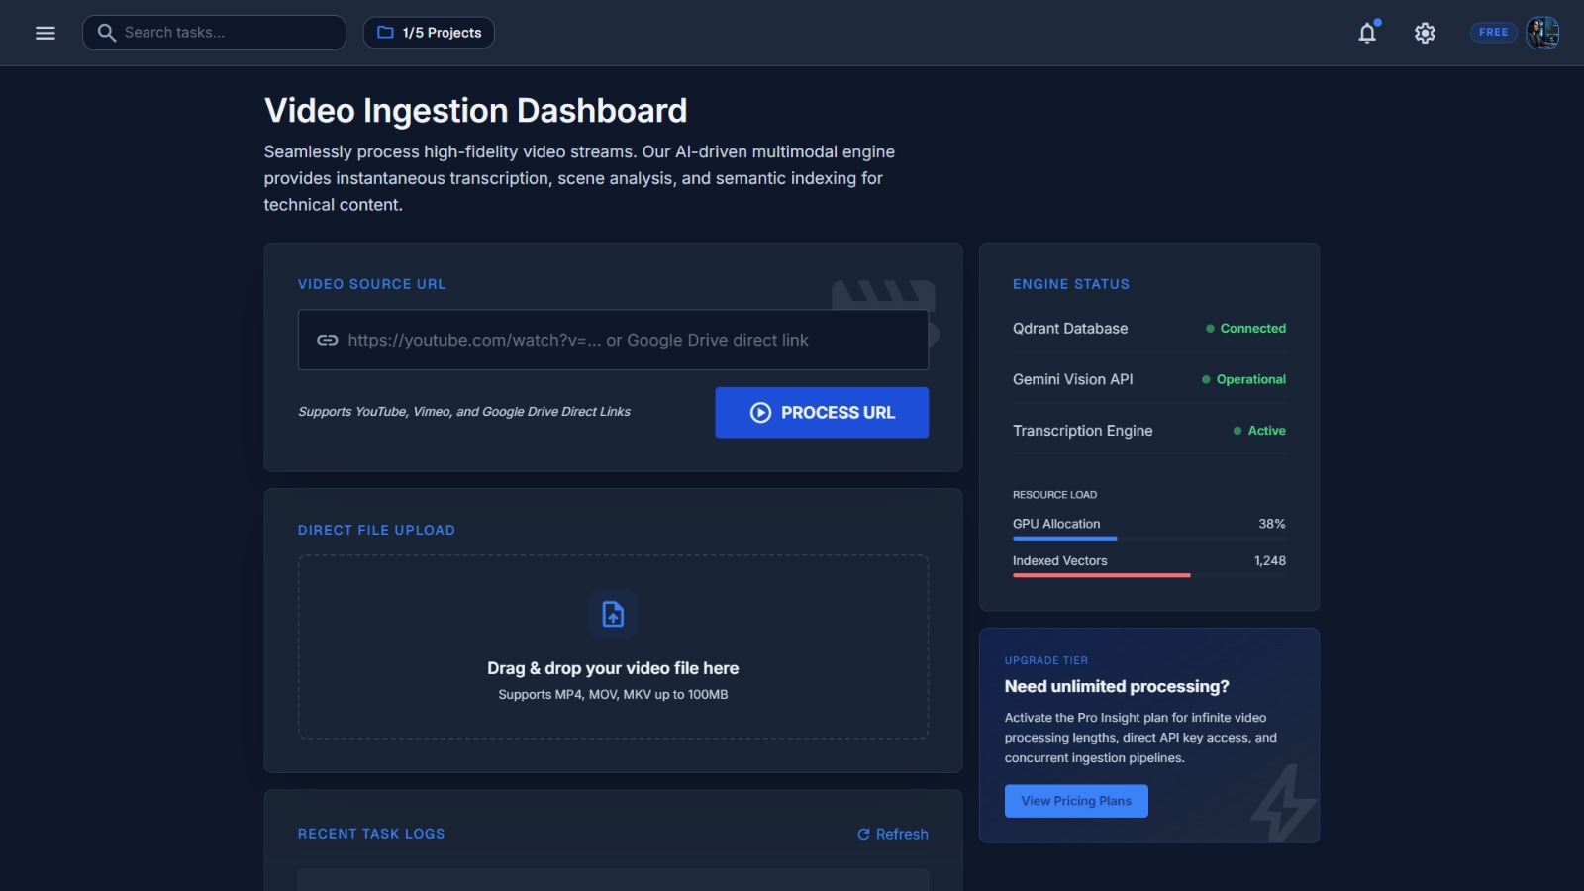
THE SOLUTION
The VidEx Breakthrough
✓
Multimodal Integration
An intelligent RAG platform indexing both spoken dialogue and sequential keyframe visual data simultaneously.
✓
Semantic Search
Translates raw video archives into structured, fully searchable vector databases.
✓
Verifiable Answers
Generates contextual explanations with clickable, interactive timestamp citations.

Slide 6
ARCHITECTURE & SUBSYSTEMS
High-Level Architecture Pipeline
INGESTION PIPELINE asynchronous · GPU-heavy · offline
Video Source
Upload · YouTube · Drive
GPU Compute (Modal)
Whisper ASR + SigLIP encoders
Qdrant Cloud DB
Text + image vector collections
QUERY-SERVING PIPELINE synchronous · CPU-light · real-time
User Query
Text and/or screenshot
FastAPI
Routing · auth · validation
RRF Fusion
Dual-index retrieval merge
Gemini LLM
Cited answer
Modular Architecture — decouples heavy GPU-based offline ingestion from lightweight CPU-based online user requests.

Slide 7
AI MODELS & ALGORITHMS
End-to-End Ingestion Workflow Pipeline
1. Ingest
2. Isolate
3. Vectorize
4. Store
Fetch video resources from local storage, Google Drive, or YouTube URLs.
Extract audio tracks and segment visual frames.
Generate contextual embeddings using deep learning encoders.
Index embeddings into deterministic points within the vector database.
One asynchronous pipeline turns raw video into a queryable knowledge base

Slide 8
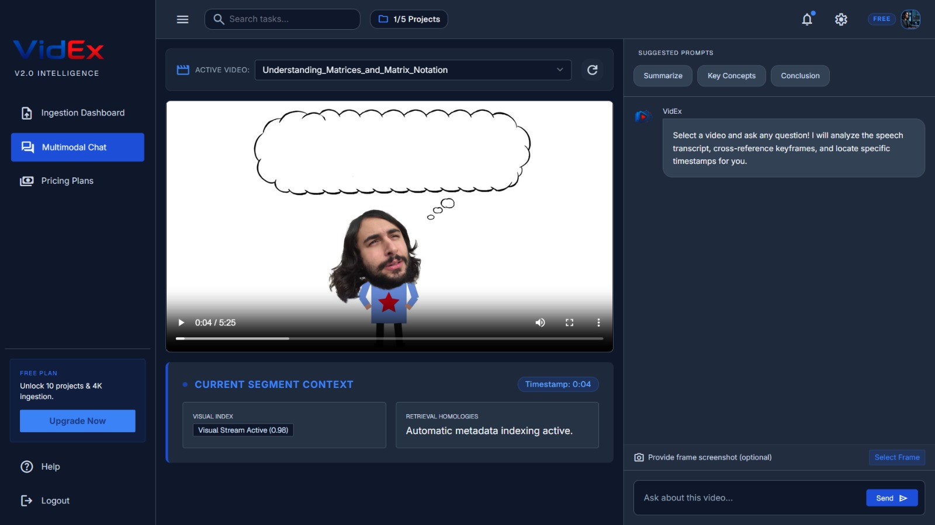
ARCHITECTURE & SUBSYSTEMS
Component Archetype: Frontend SPA
</>
Core Stack
Built with pure Vanilla JS and Tailwind CSS for rapid client rendering without bulky library dependencies.
◐
Design Theme
Clean, interactive modern UI optimized for long-session readability.
⇄
Dynamic Synchronization
Seamlessly pairs video player controls with LLM chat updates.

Slide 9
ARCHITECTURE & SUBSYSTEMS
Client-Side Page Component Matrix
•••
01
▦
02
⧉
03
$
04
Auth Page
Dashboard View
Workspace Canvas
Subscriptions
Secure sign-up / login panels utilizing JWT token sessions.
Central hub for video management, status tracking, and collections.
Split screen combining the synchronized media player and interactive chat workspace.
Commercial scaling presentation layout.
Four decoupled client views, one lightweight SPA shell

Slide 10
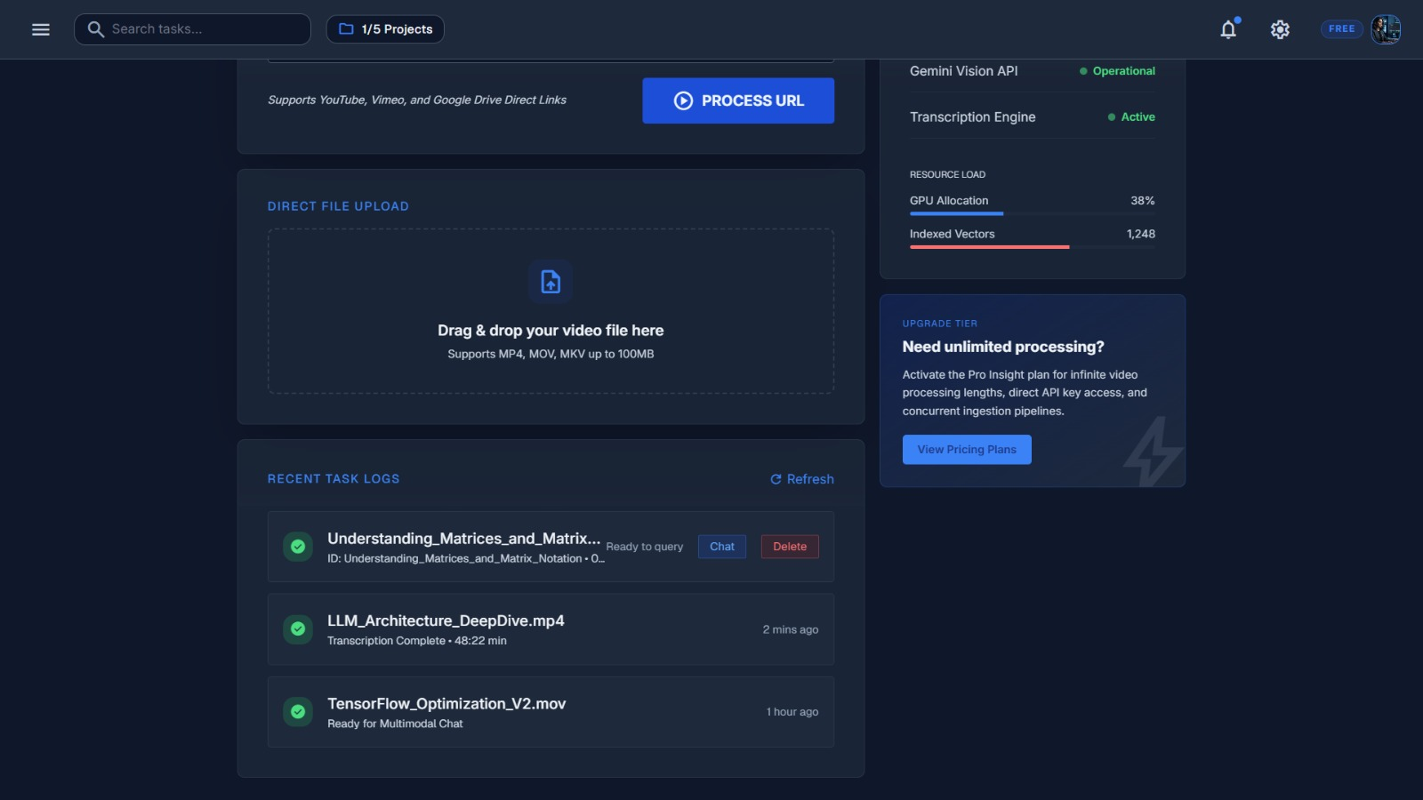
WALKTHROUGH · STEP 1 OF 3
User Journey Step 1: Library Ingestion
↑
Easy Uploads
Drag-and-drop local video files directly into the dashboard interface.
∞
Link Integration
Paste YouTube links or Google Drive file URLs for immediate processing.
▰
Real-Time Tracking
Clear progress bars show the active status of the background indexing jobs.

Slide 11
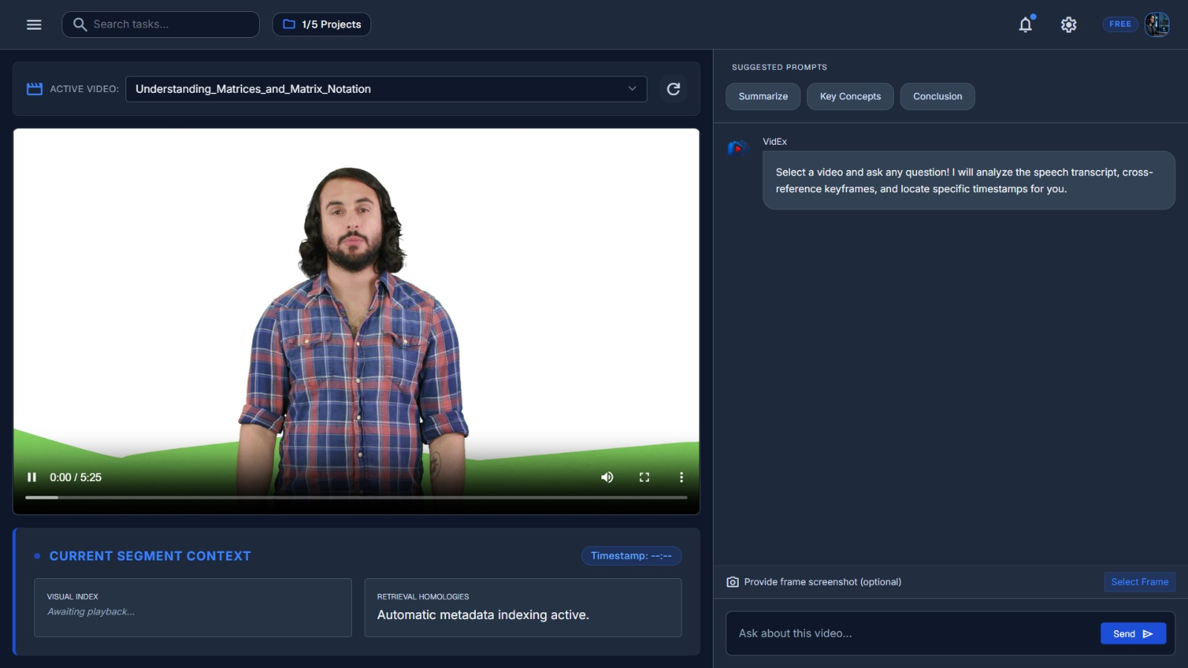
WALKTHROUGH · STEP 2 OF 3
User Journey Step 2: Contextual Chat
⧉
Interactive Workspace
Combines the video player and chat interface side-by-side in a single view.
M↓
Rich Formatting
Answers are rendered in Markdown with code highlighting and structured lists.
❞
Conversational Interface
Users can query complex video content as if they were talking directly to a tutor.

Slide 12
WALKTHROUGH · STEP 3 OF 3
User Journey Step 3: Source Verification
[t]
Hyperlinked Badges
Highlights citation badges (e.g., [12:34]) next to generated facts.
The professor derives the loss gradient using the chain rule, then simplifies the update step…
[12:34]
▲
click
►
Time Seek Integration
Clicking a badge instantly seeks and plays the video from that exact timestamp.
✓
Empirical Trust
Enables immediate verification of the AI's responses against the original source lecture.
12:34

Slide 13
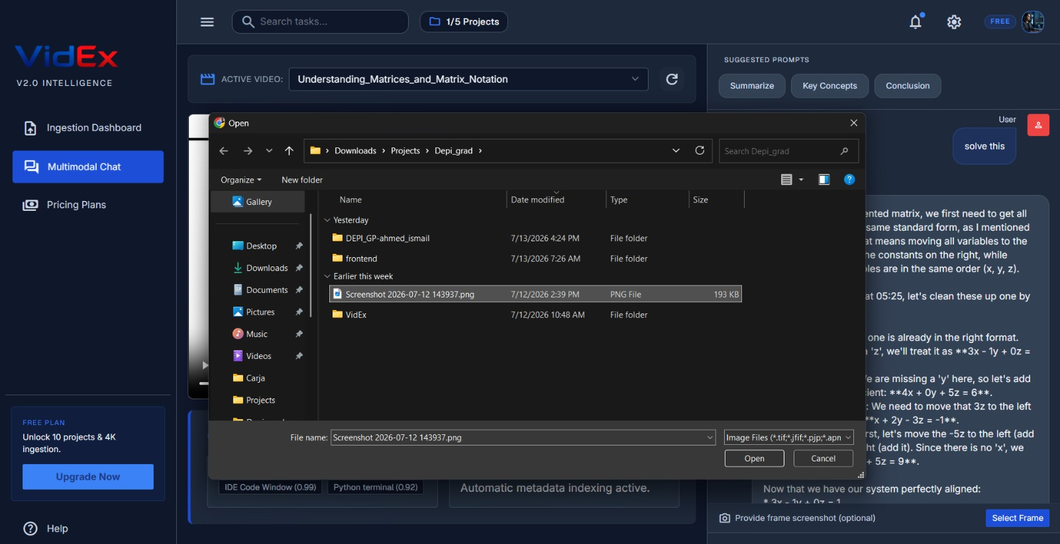
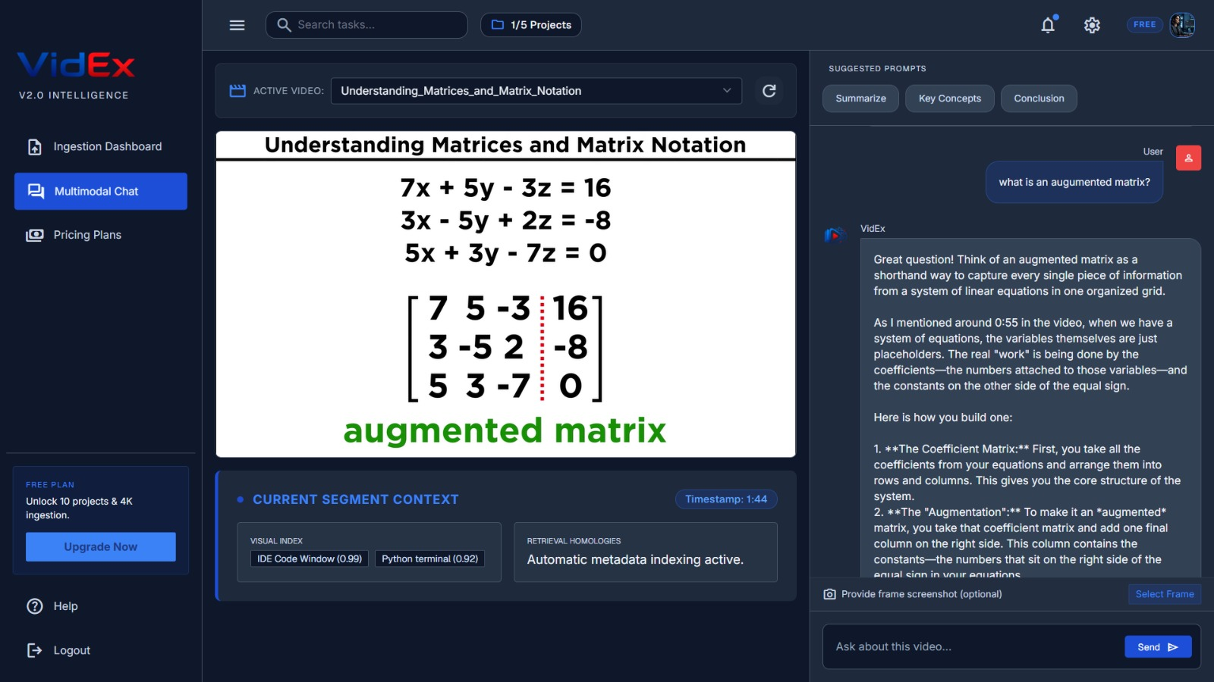
USER EXPERIENCE
Advanced Feature: Screenshot Analysis
Visual Prompts
Cross-Modal Verification
Visual Explanations
Users can upload direct screenshots of slides alongside their text questions.
SigLIP maps the image to the video's indexed frame database to locate the exact milestone.
Gemini analyzes the visual context to explain what is shown in the slide.

Slide 14
AI MODELS & ALGORITHMS
Audio Processing Layer: OpenAI Whisper
W
Model Selection
30 s windows · 25 s stride · 5 s overlap
Whisper 'base' model is deployed to secure high accuracy with low latency overhead.
audio track →
▥
chunk 1 · 30,000 ms
Temporal Windowing
Divides audio signals into distinct 30,000 ms duration chunks.
chunk 2 · 30,000 ms
⇉
Context Protection
chunk 3 · 30,000 ms
Integrates a 5,000 ms sliding step overlap to prevent sentences from being cut off at chunk boundaries.
5,000 ms overlap — shared context keeps sentences whole across boundaries

Slide 15
AI MODELS & ALGORITHMS
Computer Vision Quality Optimization
⅛
Sub-Sampling
8 raw candidate frames / segment
Extracts 8 raw candidate frames per temporal segment to reduce database bloat.
Luminance filter
☀
Luminance Filter
Drops dark/black transition frames below a set brightness threshold.
Blur rejection
◎
Blur Rejection
Uses Laplacian variance math to calculate and discard out-of-focus imagery.
pHash dedup
≡
pHash Deduplication
Employs Perceptual Hashing (pHash) metrics to filter out redundant slide frames.
unique, sharp, informative keyframes

Slide 16
AI MODELS & ALGORITHMS
Cross-Modal Vector Spaces: Google SigLIP
S
Model Variant
One coordinate space for words and pixels
Deploys siglip-base-patch16-224 as the core cross-modal encoder.
“gradient descent”
text query
▦ lecture keyframe
slide image
768
Unified Dimension
Maps both text strings and visual keyframes into a shared 768-dimensional space.
σ
Sigmoid Loss Advantage
shared 768-D
vector space
Replaces CLIP's softmax loss with a pairwise sigmoid loss to improve scaling and search performance.
same coordinate → cross-modal match

Slide 17
AI MODELS & ALGORITHMS
Vector DB Foundations: Qdrant Cloud
⛁
Dual-Collection Strategy
collection: transcripts · keyframes
Decouples text transcripts from image frame indexes in separate namespaces.
id: uuid5(vid, 0, 00:00)
payload: { video_id, chunk_index, timestamp }
#
Deterministic Points
id: uuid5(vid, 1, 00:25)
payload: { video_id, chunk_index, timestamp }
Uses UUID5 hashes generated from (video_id, chunk_index, timestamp) to create point IDs.
id: uuid5(vid, 2, 00:50)
payload: { video_id, chunk_index, timestamp }
=
Idempotency Enforced
Prevents duplicate entries when re-uploading the same video.
id: uuid5(vid, 3, 01:15)
payload: { video_id, chunk_index, timestamp }
768-D vector + timestamp payload on every point

Slide 18
AI MODELS & ALGORITHMS
Retrieval Mechanics: Dual-Index Search
User Query
“Where is backpropagation derived?”
Parallel Execution — queries run simultaneously to avoid processing lag.
TEXT QUERY ROUTE
VISION QUERY ROUTE
Searches Qdrant's transcript collection to locate relevant spoken keywords.
Translates the query using SigLIP to search the indexed keyframe collections.
Ranked Fusion (RRF)
both result lists merged — next slide

Slide 19
AI MODELS & ALGORITHMS
Context Unification: Reciprocal Rank Fusion
RRF_Score(d ∈ D) = Σ_{m∈M} 1 ∕ ( k + r_{m}(d) )
one score per video segment, summed across the text and vision retrievers
1
2
3
The RRF Advantage
Consistent Performance
Formula Variables
Blends separate text and image rankings, outperforming simple cosine score averaging.
Prioritizes video segments that rank high in both spoken content and visual context.
k is a smoothing constant; rₘ(d) represents the document’s rank inside retrieval model m.

Slide 20
AI MODELS & ALGORITHMS
Generation Engine: Gemini 3.1 Flash Lite
RRF Context
top-ranked transcript chunks
Structured, cited answer
◆ Gemini 3.1
Flash Lite
multimodal synthesis
“Backpropagation is derived by applying the chain rule to the loss…”
[12:34] [15:02]
Visual Frames
matching keyframes
System Prompt
grounding instructions
Multimodal Synthesis
Factual Grounding
Dynamic Citations
Uses Gemini 3.1 Flash Lite to process both text and visual inputs for ultra-fast generation times.
Constrains the model's responses to the retrieved video segments to prevent hallucinations.
Automatically attaches timestamp links to facts, mapping them back to the exact video source.

Slide 21
USER EXPERIENCE
State Preservation & Rolling Summarization
500
History Limitations
Older turns collapse — recent turns stay verbatim
Implements a 500-token limit on active chat history to maintain fast response times.
older turns 1–8…
User: “And the learning rate?”
≋
Summarization Engine
VidEx: “Set to 0.001 at [22:10]…”
Uses Gemini to summarize older conversation turns, keeping the core context intact.
SUMMARY BLOCK
compressed context of turns 1–8
recent turns — kept in full
↓$
Token Optimization
Prevents long-running chat sessions from exceeding API limits or spiking costs.
≤ 500 tokens of active history sent with every request

Slide 22
ARCHITECTURE & SUBSYSTEMS
Component Archetype: Core Backend Engine
FastAPI Core
High-performance, ASGI-compliant backend framework managing routing and payload serialization.
✓
Pydantic Validation
Employs strict Pydantic v2 schemas to validate data inputs and API contracts across all database layers.
•••
Path Protections
Integrated JWT middleware securing user workspaces and sensitive API paths.

Slide 23
ARCHITECTURE & SUBSYSTEMS
Multi-Tier Optimization Protocols
Query Cache
Inference Cache
Lazy Initialization
Deploys an LRU cache to instantly return responses for recurring questions with 0 ms model latency.
Uses local disk-based hashing to bypass redundant embedding calculations on overlapping image frames.
Delays heavy model boot operations until actual user requests require them.
LRU · in-memory
Disk · content-hash
Deferred boot
Three layers of caching keep the online path fast and the GPU bill low

Slide 24
ARCHITECTURE & SUBSYSTEMS
Serverless GPU Compute: Modal GPU Node
▲
On-Demand Scaling
Container lifecycle on video upload
Spins up Nvidia T4 GPU instances dynamically on video upload.
Upload event received
API enqueues ingestion job
0
Resource Efficiency
Container boots — Nvidia T4 GPU
Image + model weights loaded
Automatically scales down to zero when idle to save computational resources.
Whisper + SigLIP inference runs
Audio & keyframes vectorized
⛶
Network Isolation
Offloads intensive Whisper and SigLIP inference tasks from the main API web server.
Scale to zero
Idle → container released, cost stops

Slide 25
EVALUATION & CLOSING
Production Readiness: Container Architecture
VidEx application code
▣
Docker Containerization
Fully containerized using production-ready Docker base images.
FFmpeg — statically compiled binaries
≡
Optimized Layers
Integrates lightweight Python environments and statically compiled FFmpeg binaries.
Lightweight Python environment
Production-ready Docker base image
HF
Cloud Compatibility
Optimized for direct deployment on Hugging Face Spaces registries.
docker image — layered build

Slide 26
QUALITY ASSURANCE
System Integrity & Testing Suites
TEST SUITE
WHAT IT VERIFIES
STATUS
Pytest Integration
Automated testing suites ensure system stability across updates.
✓
Pydantic Schema Tests
Verifies vector coordinate lengths, scoring boundaries, and data formats.
✓
Chunk Window Tests
Confirms correct overlaps are maintained to prevent data loss.
✓
URL Sanitization Tests
Validates link security checks to prevent malformed URL imports.
✓
Every merge runs the full suite — green across the board

Slide 27
EVALUATION & CLOSING
Commercial Scaling & Subscription Architecture
MOST POPULAR
GET STARTED
Premium
SCALE UP
Free
Enterprise
✓
Unlimited uploads
✓
1 video upload
✓
Custom database nodes
✓
60-minute duration caps
✓
10-minute maximum duration
✓
Dedicated computing power
✓
Full cross-modal search
✓
Standard text search
✓
Customizable SLAs
✓
Screenshot analysis

Slide 28
EVALUATION & CLOSING
Technical Obstacles & Resolution Log
⚑ CHALLENGE
🛡 RESOLUTION
1
Video Bloat
Generating thousands of frames spiked vector database costs.
Resolved
Filtered duplicate and blurry frames using pHash and Laplacian variance.
2
GPU Latency
Running Whisper and SigLIP slowed down the main web servers.
Resolved
Moved processing to serverless Modal GPU endpoints.
3
Text Clipping
Clean 30-second audio cuts broke sentences in half.
Resolved
Added a 5,000 ms sliding stride overlap.

Slide 29
EVALUATION & CLOSING
Future Milestones & Features Roadmap
MILESTONE 1
MILESTONE 2
MILESTONE 3
文A
OCR
◉—◉
Multilingual Support
OCR Keyframe Extraction
Knowledge Graphs
Upgrading transcription steps to support multi-language video lectures.
Adding direct OCR filters to extract and index on-screen text, whiteboard handwriting, and code blocks.
Connecting concept maps across multiple videos to enable comprehensive syllabus-wide search.
From validated RAG pipeline to syllabus-wide intelligence

Slide 30
Thank You
VidEx — Multimodal RAG Video Intelligence Platform
● Open for Committee Questions & Live Demonstration
Graduation Project Technical Defense · Digital Egypt Pioneers Initiative (DEPI)
CORE STACK
Python
FastAPI
Gemini
Qdrant
Modal
Docker

