Slide 1


MENTAL HEALTH & LIFESTYLE ANALYSIS
Data Analytics Project
Prepared By
Maryam Ahmed Mohamed Ibrahim Mayar Abdelrasoul Mahmoud Hana Mohamed Mahmoud Elgawish Rawan Mousa Alwani Mohamed Malak Ahmed Helmy Ibrahim Malak Ibrahim abdo

Slide 2




Project Objective
● Analyze mental health and lifestyle data.
● Design and build a Data Warehouse using Star Schema
● Perform the ETL process using SSIS ● Identify patterns and trends related to mental health and lifestyle
● Support data-driven decision-making through meaningful insights

Slide 3


Target Audience
Healthcare Professionals | :To monitor mental health indicators, analyze stress levels, sleep patterns, and lifestyle habits, helping them better understand the factors associated with mental well-being
Researchers | :To explore relationships between demographic characteristics, lifestyle habits, and mental health conditions, supporting statistical analysis and future research
HR Departments & Organizations | :To gain insights into work-related factors such as working hours, stress levels, and employee well-being, helping organizations create healthier work environments.
Public Health Organizations & Decision Makers | :To understand population-level trends, identify potential health concerns, and support awareness campaigns and public health planning.

Slide 4



Dataset Overview
Dataset Summary
Source: Kaggle
Number of Records: 50,000
Number of Features: 17
Dataset Information
Our project is based on the Mental Health & Lifestyle Dataset, which contains information about individuals' demographic characteristics, lifestyle habits, and mental health indicators.
Main Attributes
👤 Demographic Information
Age
Gender
Occupation
Country
🩺 Mental Health Indicators
Mental Health Condition
Severity
Consultation History
Stress Level
Medication Usage
🌱 Lifestyle Habits
Sleep Hours
Work Hours
Physical Activity
Social Media Usage
Diet Quality
Smoking Habit
Alcohol Consumption
Dataset Categories
Demographic Information
Lifestyle Habits
Mental Health Indicators

Slide 5

Data Engineering
Data Engineering Process
To prepare the dataset for analysis, we built an ETL pipeline using SQL Server Integration Services (SSIS). The processed data was then loaded into a dimensional data warehouse following the Star Schema model to improve reporting performance and simplify analysis.
ETL Process
Clean the data
Convert data type
Create derived column
Handle Slowly Changing Dimensions (SCD)

Slide 6
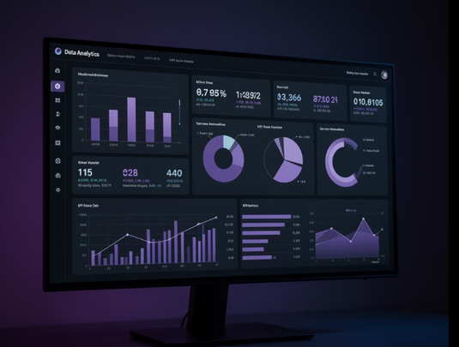

DAX Measures
To support interactive reporting, several DAX measures were created for KPI cards and dashboard calculations.
Main Measures
Total Patients
Average Age
Average Sleep Hours
High Stress
Medication Usage
Condition Rate

Slide 7
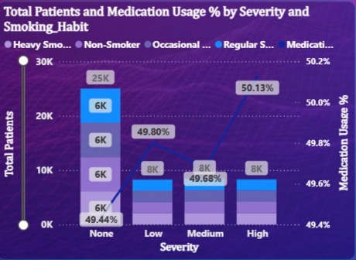
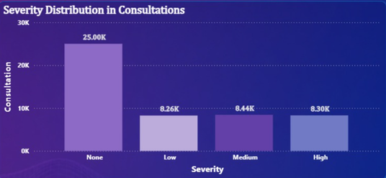

DASHBOARD OVERVIEW
The Overview Dashboard provides a high-level summary of the dataset through key performance indicators (KPIs) and interactive visualizations. It helps users quickly understand the overall distribution of respondents, demographic characteristics, and mental health indicators before exploring the data in more detail.
Key Components
KPI Cards summarizing the most important metrics.
Demographic distribution of respondents.
Mental health condition overview.
Country-wise analysis.
Interactive filters for dynamic exploration.

Slide 8
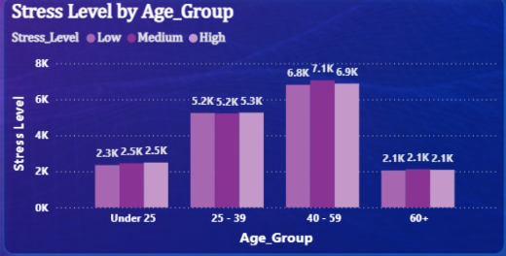

Lifestyle Analysis Dashboard
Key Insights
The average sleep duration is 7.01 hours.
33.41% of participants experience high levels of stress. The risk of burnout stands at 7.85%
Average social media usage is 3.27 hours per day.
The majority of patients sleep 8 hours or more.
Dietary quality is distributed relatively evenly across
healthy,average, and unhealthy categories.
Smoking rates are higher among the 40–59 age group .
Purpose
This dashboard analyzes lifestyle habits and their relationship with mental health

Slide 9
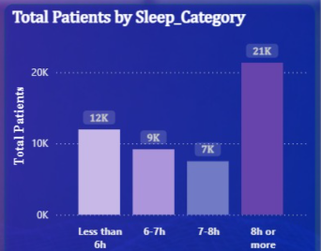
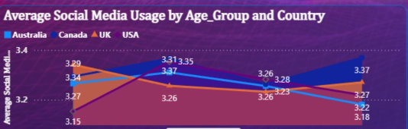

Lifestyle Details Dashboard
Conclusion
Key Insights
Age appears to have a stronger relationship with stress than gender, while occupation shows only small differences in mental health distribution.
Sleep duration is very similar across genders (around 7 hours).
Females have slightly higher average work hours than males.
Mental health conditions are distributed fairly evenly across occupations.
The 40–59 age group records the highest stress levels.
Sleep duration remains relatively stable across different age groups

Slide 10


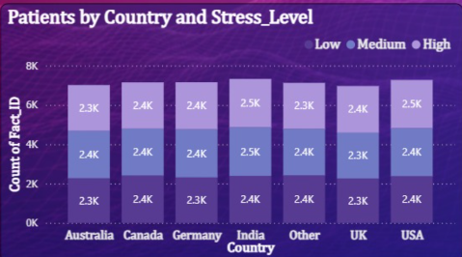
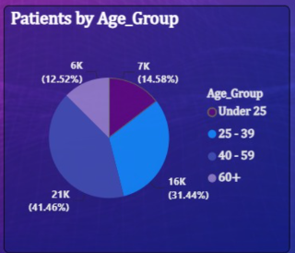

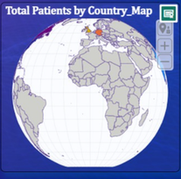
Health Status Dashboard
Key Insights
Most patients fall into the "None" severity category.
Medication usage remains close to 50% across all severity levels.
Nearly 25,000 patients required mental health consultations.
Approximately half of the participants reported poor mental health conditions.
Smoking habits are represented across all severity categories

Slide 11

Conclusion
Through analyzing the Mental Health dataset, we found that mental health is influenced by multiple demographic, lifestyle, and health-related factors. The analysis showed that middle-aged individuals (40–59 years) experience the highest stress levels, while sleep duration remains relatively consistent across different age groups and genders. Lifestyle habits such as smoking, diet quality, and social media usage appear to be associated with stress and mental well-being. Although most participants were classified as having no severe mental health condition, consultation and medication usage remained significant, highlighting the importance of early detection and continuous mental health support. Overall, the dashboard provides clear insights that can help healthcare professionals and decision-makers better understand mental health patterns and support data-driven decisions

Slide 12

THANK YOU!

