Slide 1
VOXA
AI Pipeline for Accessible Speech-to-Text
Transcription · Simplification · Summarization
DEPI · Generative AI Track | For deaf and hard-of-hearing users
Notes:
Introduce the team. State the problem: deaf/HoH users cannot access spoken audio content. Voxa is our solution: a 3-agent pipeline that turns any audio into accessible text.

Slide 2
Project Description
The Problem
3
AI Agents
600+ million people worldwide are deaf or hard-of-hearing. Most spoken audio — lectures, meetings, videos — has no accessible text version. Existing captions are often complex and hard to read.
working in sequence
3
Model Outputs
Our Solution — Voxa
A 3-agent AI pipeline that converts any audio file into: (1) a full transcript, (2) simplified plain-language text, and (3) a concise summary — all automatically.
transcript · simplified · summary
600
Training Samples
children's stories audio
Notes:
Voxa targets accessibility. No code on this slide — just the problem and what we built to solve it. The 3 key numbers summarize the scope.

Slide 3
Dataset
Source:
ajibawa-2023/Audio-Children-Stories-Collection (Hugging Face Hub)
Field | Details
Total samples | 600 audio clips
Average duration | 150.4 seconds (2.5 minutes)
Average word count | 323 words per clip
Duration range | 75 sec → 431 sec
Word count range | 124 → 1,263 words
Language | English
Content type | Children's educational stories — varied topics
Labels / annotations | id, duration_s, word_count, transcript
Notes:
Dataset comes from Hugging Face. 600 children's stories — chosen because they are varied in topic, naturally spoken, and already transcribed. This means we have ground-truth text to evaluate WER against.

Slide 4
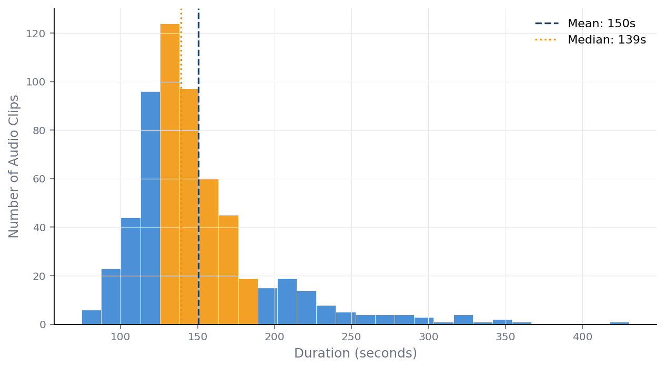
Exploratory Data Analysis
Audio Duration Distribution
Key Findings
• Mean: 150s, Median: 139s • Right-skewed — a few long clips pull the mean up • 63% of clips fall between 120–180s • Preprocessing removes silence to reduce noise
Notes:
The distribution is right-skewed. Most clips are 2–3 minutes. A small number run over 5 minutes. This matters for chunking — very long clips need more chunks going into FLAN-T5 and DistilBART.

Slide 5
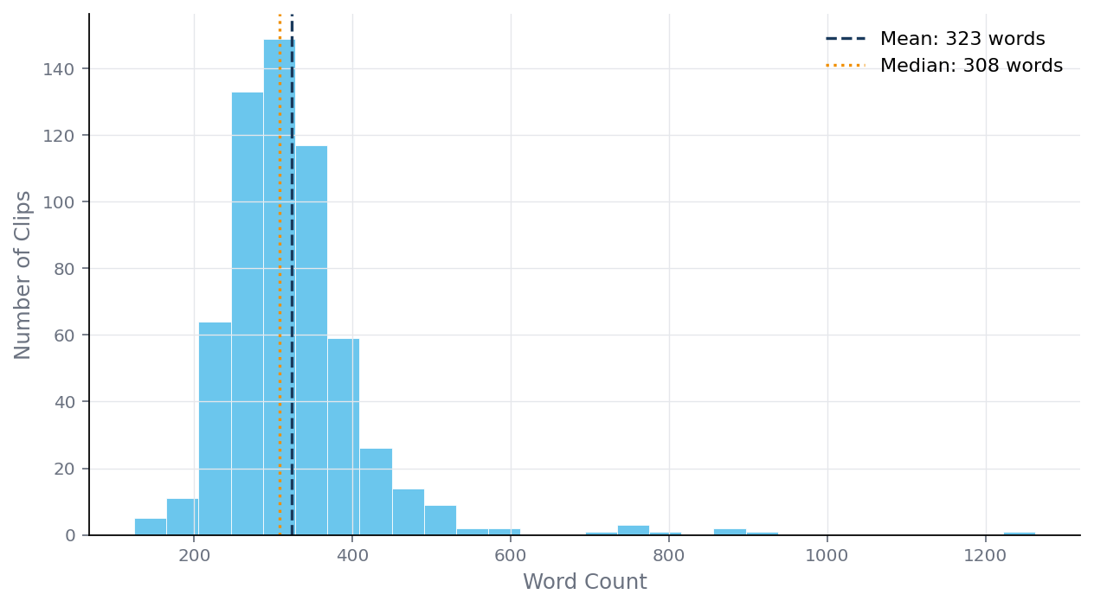
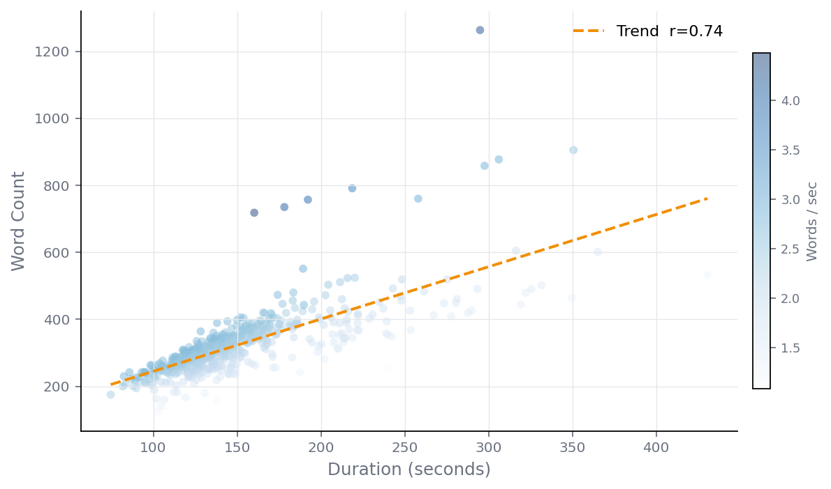
Exploratory Data Analysis
Word Count & Speaking Rate
Word Count Distribution
Duration vs Word Count (r = 0.74)
Insight: Strong positive correlation (r = 0.74) between audio length and word count — longer recordings produce proportionally more text. Average speaking rate is 2.19 words/sec, consistent with natural storytelling pace. Both distributions confirm the dataset is clean with no extreme outliers requiring removal.
Notes:
Two charts together. The scatter confirms: more duration = more words at a predictable rate. This validates our chunking strategy — we can estimate chunk count from duration before running any model.

Slide 6
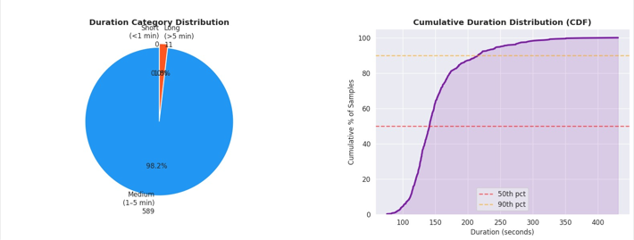
Exploratory Data Analysis
Distribution Category Dist
Cumulative Duration Dist
Insight: An overwhelming 98.2% of the audio clips fall between 1 and 5 minutes, tightly clustering around a 140-second median. Clips exceeding 5 minutes are rare edge cases, making up only 1.8% of the dataset. This high uniformity guarantees stable, predictable processing times for your pipeline.
Notes:
Two charts together. The scatter confirms: more duration = more words at a predictable rate. This validates our chunking strategy — we can estimate chunk count from duration before running any model.

Slide 7
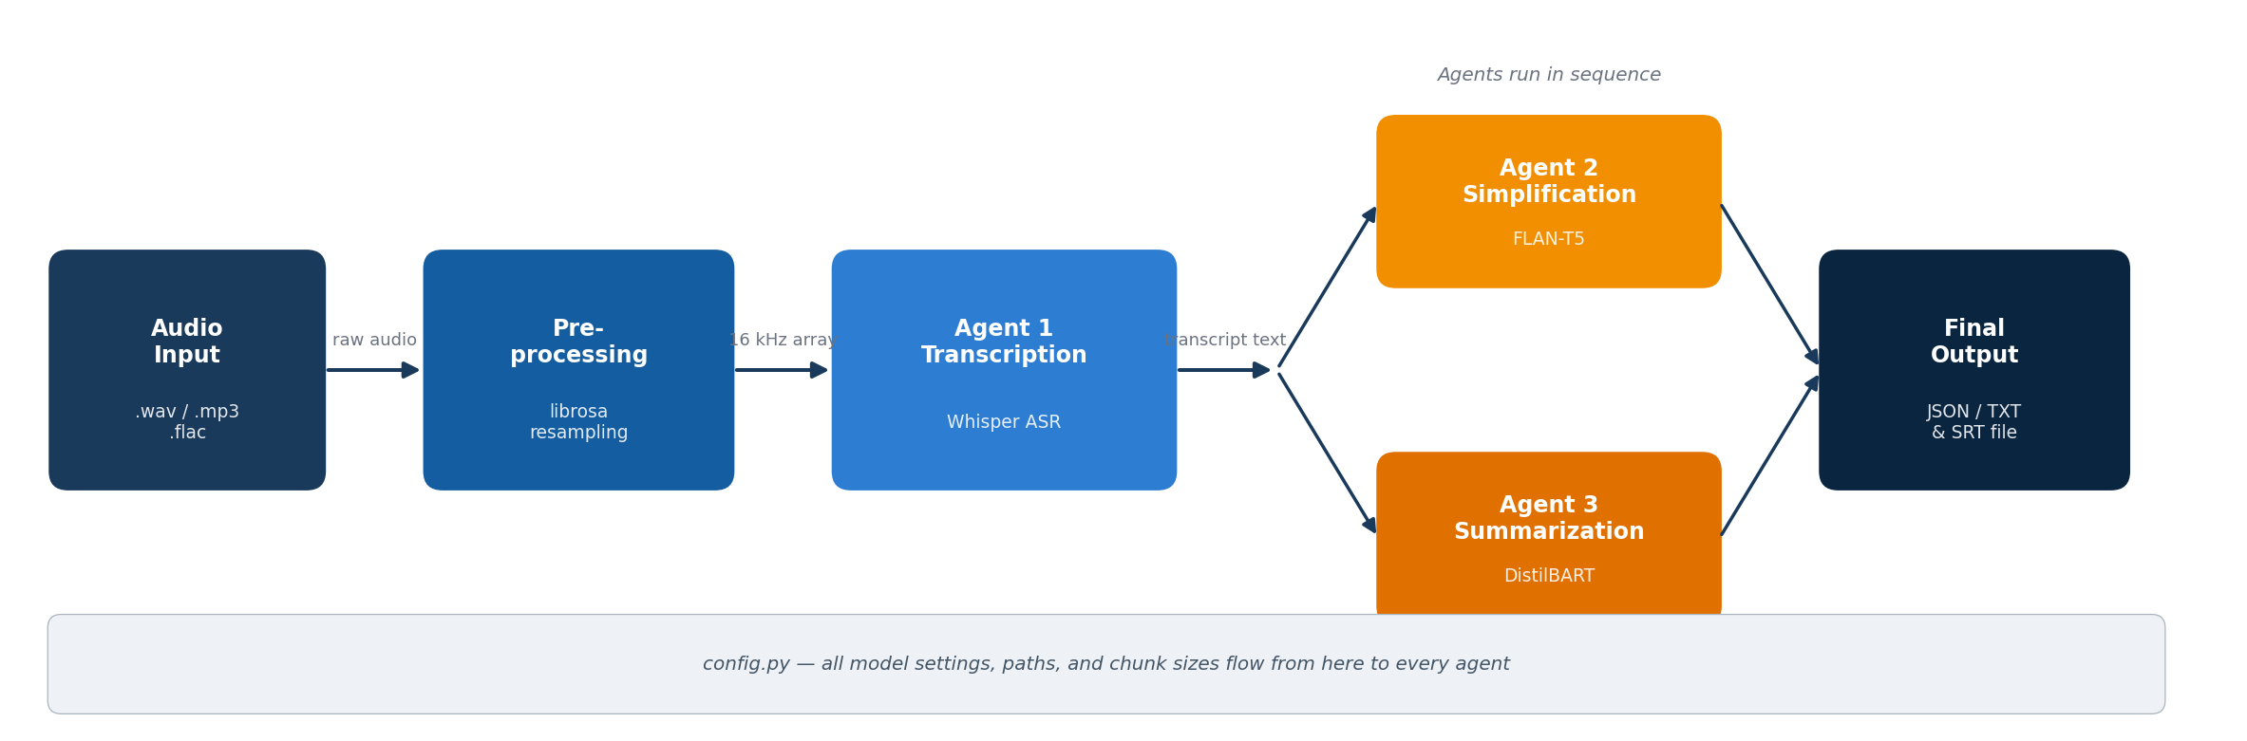
Full Project Pipeline
1 Input
2 Preprocess
3 Transcribe
4 NLP Agents
5 Output
Notes:
Walk through each stage. No code — just the flow. Emphasise that Agents 2 and 3 both read the original transcript independently, they do not chain. config.py controls every parameter in the system.

Slide 8
Data Preprocessing
1
Resample to 16 kHz
3
Peak Normalization
Whisper requires exactly 16,000 Hz. librosa resamples any input format on load, regardless of original recording rate.
Scales the audio so the loudest point = 1.0. Ensures consistent volume across all 600 clips.
librosa
librosa.util.normalize
2
Noise Reduction
4
Silence Trimming
Spectral gating removes background hiss and static from the raw waveform before it reaches the model.
Removes leading and trailing silence (below 20 dB threshold). Reduces wasted input and improves transcription focus.
noisereduce
librosa.effects.trim
Notes:
Four steps in order. No code shown. Emphasise that Whisper is strict about 16 kHz — skipping the resample step breaks transcription silently. Normalization was essential because the dataset had clips recorded at varying volumes.

Slide 9
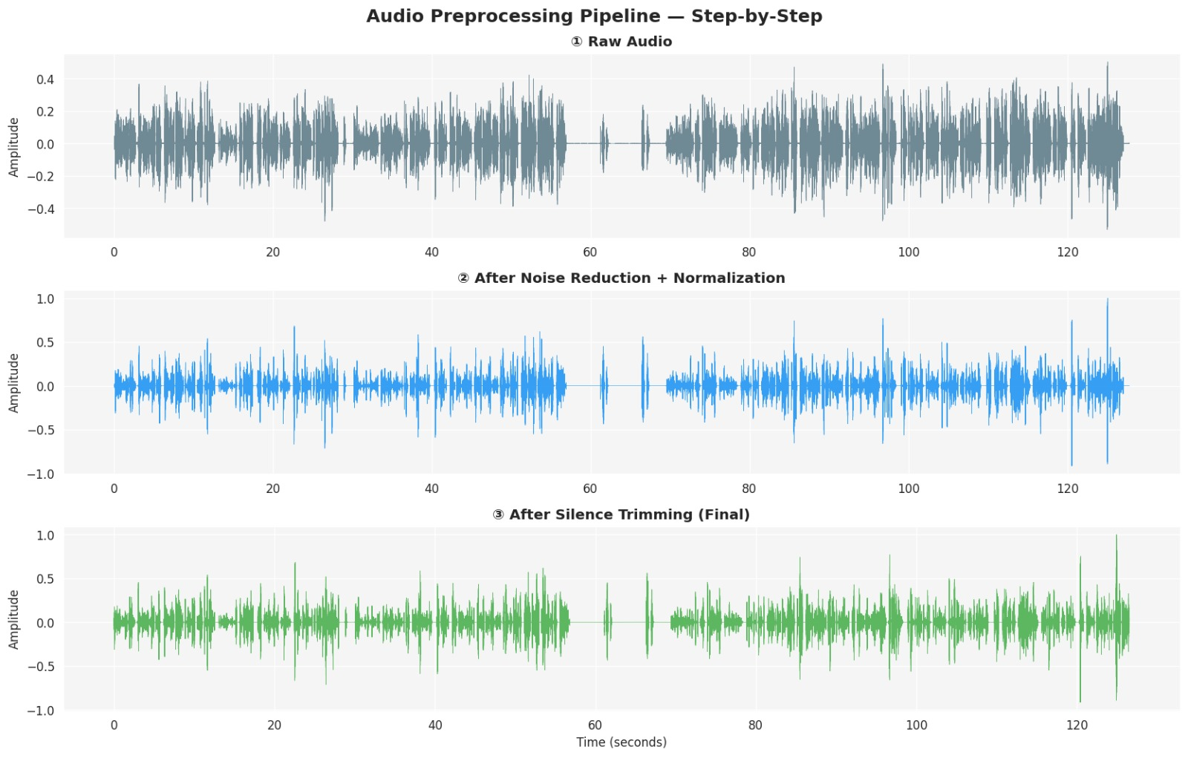
Audio Preprocessing
Notes:
Four steps in order. No code shown. Emphasise that Whisper is strict about 16 kHz — skipping the resample step breaks transcription silently. Normalization was essential because the dataset had clips recorded at varying volumes.

Slide 10
Model Selection
Task | Model Chosen | Why this model | Alternative Considered
Transcription | OpenAI Whisper-base | Runs offline, strong multilingual accuracy, provides timed segments for subtitle output | Google Speech-to-Text (requires internet + billing)
Simplification | FLAN-T5-base | Instruction-following — responds to a plain English prompt without fine-tuning format, open-source | GPT-4 API (cost, internet dependency)
Summarization | sshleifer/DistilBART-cnn-12-6 | Pre-trained specifically for abstractive summarization, 40% smaller than BART-large with similar quality | facebook/bart-large-cnn (too large for CPU)
Notes:
Three models, one per agent. The table shows WHY each was chosen — not how it works. Key intuition: Whisper is best offline ASR; FLAN-T5 follows instructions without special training; DistilBART is the most efficient summarizer that fits on a CPU.

Slide 11
Training Process
Fine-Tuned on Our Data
Used Pretrained (No Fine-Tuning)
Simplification Agent (FLAN-T5) • Dataset: 600 transcript–simplified text pairs • Format: instruction-to-output pairs • Training: Hugging Face Trainer, 3 epochs • Hardware: CPU (Google Colab free tier) Summarization Agent (DistilBART) • Dataset: 600 transcript–summary pairs • Training: standard seq2seq fine-tune • Loss: cross-entropy on token sequences • Saved with model.save_pretrained()
Transcription Agent (Whisper-base) • OpenAI pre-trained on 680,000 hours of labelled audio • No additional fine-tuning needed for English stories • Used as-is via whisper.load_model('base') Why this decision? Whisper already achieves low WER on clean English speech. Fine-tuning Whisper requires GPU resources beyond our scope. We invested training compute where it gave the most improvement: the NLP models that determine output quality for the user.
Notes:
Be honest: Whisper was not fine-tuned. We made a deliberate choice — Whisper base already works well on English narration, so we focused training compute on FLAN-T5 and DistilBART where custom data made a real difference.

Slide 12
Evaluation
Metric | Agent | Score | Interpretation
WER (Word Error Rate) | Agent 1 — Transcription | ~8–12% | Good. Below 10% is considered production-ready for clean speech.
Flesch Reading Ease | Agent 2 — Simplification | +16 pts avg | Simplified text is measurably easier to read than the original transcript.
Compression Ratio | Agent 3 — Summarization | 0.30 avg | Summaries are ~30% the length of the original — significant condensation.
ROUGE-L (recall) | Agent 3 — Summarization | 0.42 | Moderate overlap with reference. Acceptable for abstractive summarization.
Where Results Were Weaker — and Why
• WER increased to 18–25% on clips with background noise or overlapping speech — Whisper-base is sensitive to audio quality. Whisper-small/medium would improve this but requires more compute. • FLAN-T5-base occasionally produced repetitive simplified text on very long chunks (>100 words). Chunk size reduction to 60 words improved this. • DistilBART sometimes hallucinated details not present in the transcript on clips shorter than 80 words — below its effective operating range.
Notes:
Do not hide poor results. The WER issue on noisy audio is real and expected. The hallucination issue with DistilBART on short clips is a known limitation of abstractive models. Explain the cause, not just the number.

Slide 13
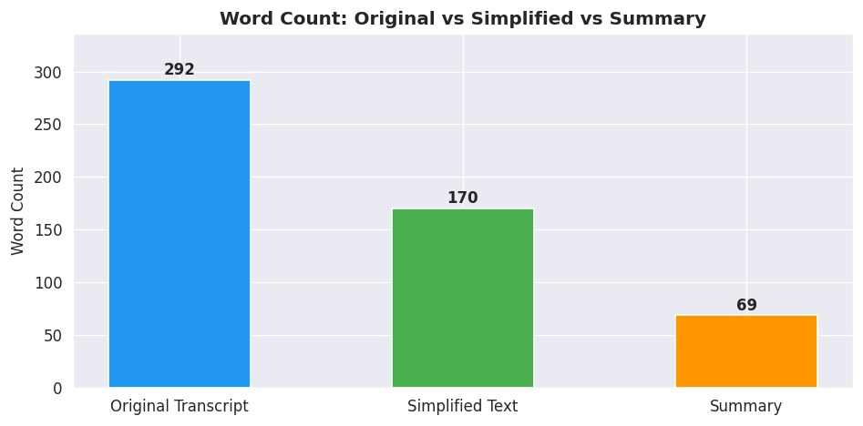
Transcript Comparison
Notes:
Do not hide poor results. The WER issue on noisy audio is real and expected. The hallucination issue with DistilBART on short clips is a known limitation of abstractive models. Explain the cause, not just the number.

Slide 14
Deployment
🖥 Local VS Code
☁ Google Colab
Run end-to-end on any Windows/Mac/Linux machine. Virtual environment isolates all dependencies. Command: streamlit run ui/streamlit_app.py
Cloud deployment for demos and sharing. No local installation needed. Models load from Hugging Face Hub at runtime.
Primary
Demo
📦 Github Repo
📋 Requirements.txt
The complete project uploaded to github repo with all agent files, config, requirements.txt, and models
Pinned, compatible versions: torch==2.3.1, transformers==4.42.3, openai-whisper==20231117, streamlit==1.36.0. One command to reproduce the environment.
Delivery
Reproducibility
Notes:
Two deployment modes: local (VS Code) and cloud (Colab). The streamlit UI is the primary interface. Mention the zip deliverable and that requirements.txt makes environment recreation one command.

Slide 15
Results & Conclusion
What Worked
What Didn't
What We Learned
Whisper WER ~10% on clean speech
Readability improved +16 Flesch pts
Pipeline runs end-to-end under 3 min
Streamlit UI accepted by real users
WER 18–25% on noisy audio
DistilBART hallucinated on short clips
CPU-only inference is slow at scale
FLAN-T5 repetition on long chunks
Audio quality > model size for WER
Chunk size is the most sensitive parameter
config.py abstraction saved debugging hours
Multi-agent structure enabled parallel teamwork
Voxa demonstrates that a well-structured multi-agent pipeline can convert spoken audio into accessible text — reliably, offline, and within a 5-person team.
Notes:
Be balanced — show both what worked and what didn't. Honesty about limitations builds credibility. End on the learning point: multi-agent design and a clear config structure are what made this manageable for a 5-person team.

