Slide 1

GREENCYCLE
GreenCycle
AI-Powered Environmental Intelligence Platform
A full technical review: data pipeline, trained models, live API, and deployed web application.
PROJECT TEAM
Ziad Omran
Abdelrahman Kewan
Mostafa Shalan
Mahmoud Amer
Sohila Ihab
Shaza Beder
GreenCycle • Technical Review
Notes:
Welcome the review committee and introduce the team by name. This is the full technical review: every dataset, both trained models (CO2 regression + waste image classifier), the live API, the deployed frontend, and deployment architecture. State upfront that every number in this deck comes directly from the project's notebooks and code — nothing invented, and gaps are flagged rather than guessed.

Slide 2
1. PROJECT DESCRIPTION · PART 1
The Problem, and Why It's Urgent
Across every dataset analyzed in this project — 239 countries' waste-management methods, 3,937 cities' air/water quality, and 107 countries' plastic-pollution figures — the same pattern repeats: waste is generated and mismanaged faster than it's tracked, and the environmental cost is measurable, not abstract.
33.6%
9.7%
49
25.2%
of global waste ends up in open dumps — the #1 disposal method worldwide
of global waste is actually recycled
of 239 countries collect less than half their waste
of 3,937 cities studied have poor air quality
Existing Challenges
No simple, science-based tool exists for a person to decide what to do with a specific item after use.
City planners lack an accessible way to simulate the long-term environmental cost of infrastructure decisions.
Egypt itself ranks 3rd globally in mismanaged plastic waste per capita — this is a locally relevant problem, not just a global statistic.
Public environmental datasets (OWID, municipal waste stats) are technical and disconnected from everyday, actionable decisions.
GreenCycle • 2
Notes:
Open with the four headline stats — open dumping dominates globally (33.6%), recycling is rare (9.7%), collection infrastructure fails in nearly a fifth of countries, and a quarter of cities studied have poor air quality. These aren't abstractions; they come directly from cleaning and analyzing the real municipal-waste and city-quality datasets. Then walk the four challenges box: the core gap is that there's no simple, science-based decision tool for individuals or city planners, and the Egypt statistic (3rd globally in mismanaged plastic waste per capita) makes this personally relevant to this audience rather than a distant global issue.

Slide 3




1. PROJECT DESCRIPTION · PART 2
The GreenCycle AI Solution
CO2 Impact Simulator
Vision Analysis
Eco AI Advisor
Unified Web App
A trained regression model plus an LLM-powered narrative simulator estimate a city's CO2 emissions, air-quality index, and 5/10-year trajectory from its population and infrastructure profile.
A trained image classifier (10 waste classes) and vision-LLM services detect pollution severity and identify recyclable materials directly from a photo.
A conversational assistant answers pollution, recycling, and sustainability questions with real numbers, grounded in an environmental-science system prompt.
All three capabilities are exposed through one FastAPI backend and one Next.js frontend — landing page, dashboard, and dedicated tool pages.
Objectives & Expected Impact
Make environmental data actionable for non-experts in under 30 seconds per request.
Give city planners a fast way to see the consequences of infrastructure choices.
Provide a single, connected platform rather than isolated notebooks and scripts.
GreenCycle • 3
Notes:
Four real capabilities, not aspirational ones: the CO2 simulator, vision analysis (both a trained classifier and vision-LLM services), the Eco AI Advisor chatbot, and the unified web app connecting all of them. Objectives box: the north star is making environmental data actionable in under 30 seconds, giving city planners a simulation tool, and — importantly — moving from a collection of separate notebooks and scripts to one connected platform, which is exactly what the deployment and live-demo slides later in this deck demonstrate.

Slide 4
2. DATASET SOURCE & DESCRIPTION · PART 1
Environmental & Waste Datasets
Dataset | Source / URL | Size | Purpose / Target
OWID CO2 & GHG Emissions | ourworldindata.org/co2-and-greenhouse-gas-emissions (owid-co2-data.csv) | 12,225 rows × 33 cols 163 countries, 1950–2024 | co2_per_capita — regression target
Mismanaged Plastic Waste | OWID: mismanaged-plastic-waste-per-capita ✓ confirmed (column name matches exactly) | 107 rows × 13 cols (107 countries) | EDA — plastic pollution by country
Municipal Waste Management | Kaggle "warp-waste-recycling-plant-dataset" — thematically related; not explicitly named in the notebook | 239 countries, 2020 + OECD generation trend | EDA — global disposal methods
City Air & Water Quality | Not in the supplied URL list — source filename only (Cities1.csv) | 3,446 rows (cleaned) 176 countries | EDA — pollution vs. environment
✓ = URL provided matches the data exactly. Unmarked = plausible/related but not explicitly confirmed in the notebook code — flagged rather than assumed, per project instructions not to invent sources.
GreenCycle • 4
Notes:
Four datasets covering the environmental and waste-management side of the project. Confidence levels are stated honestly: only the mismanaged-plastic-waste-per-capita OWID link is a confirmed match, since the cleaned CSV literally has a column named mismanaged_plastic_waste_kg_person_day — that's that exact OWID indicator. The municipal waste and cities datasets are real and used throughout the EDA, but their precise origin isn't documented inside the notebooks themselves, so each is labeled by confidence rather than asserted as a match to a specific link.

Slide 5

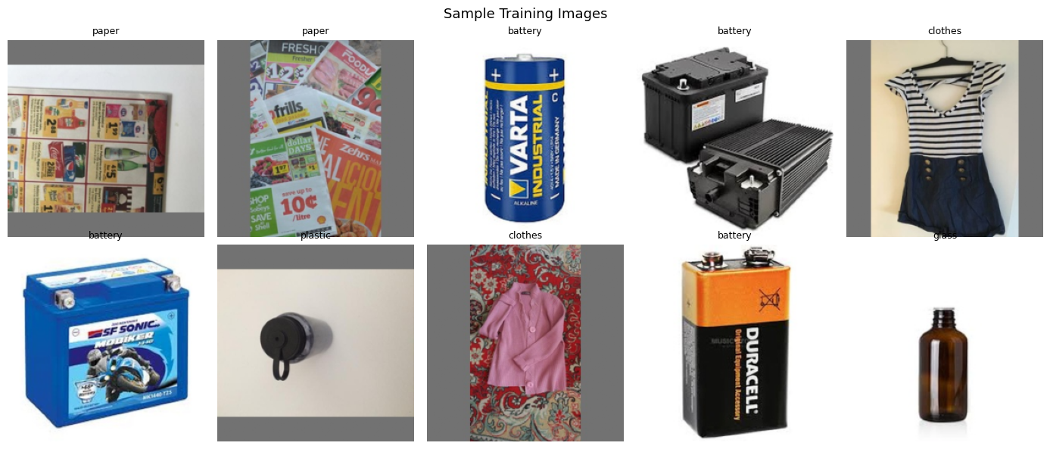
2. DATASET SOURCE & DESCRIPTION · PART 2
Recommendation & Vision Datasets
Materials Recycling Core Dataset
Waste Image Dataset
25,000 records · 74 columns after cleaning
12,259 images · 10 classes
Source: materials_recycling_core.csv — no Kaggle/OWID URL named in the notebook; thematically close to "warp-waste-recycling-plant-dataset" but unconfirmed.
Targets: recyclable (85.2% positive class) and actual_disposal_method (9 categories).
Features: 12 material types, 20 countries, 6 world regions, contamination level/type, condition, moisture content.
12 outcome columns (CO2 saved, revenue, eco-scores) explicitly excluded from modeling as data leakage.
battery · biological · cardboard · clothes · glass · metal · paper · plastic · shoes · trash
Source: Kaggle "garbage-classification-v2" — likely match (10 classes align); code folder is named standardized_2569. Split 80/20 → 9,807 train / 2,452 validation.
GreenCycle • 5
Notes:
Left: the materials recycling dataset — 25,000 individual item records with two potential targets (is it recyclable, and what disposal method was actually used). The most important engineering note here is the 12 excluded outcome columns — CO2 saved, revenue, eco-scores — which are computed FROM the outcome and would leak information if used as features. Right: the image dataset — 12,259 photos across 10 classes, shown here as a sample grid, matching Kaggle's garbage-classification-v2 by class overlap even though the notebook doesn't name its source directly.

Slide 6
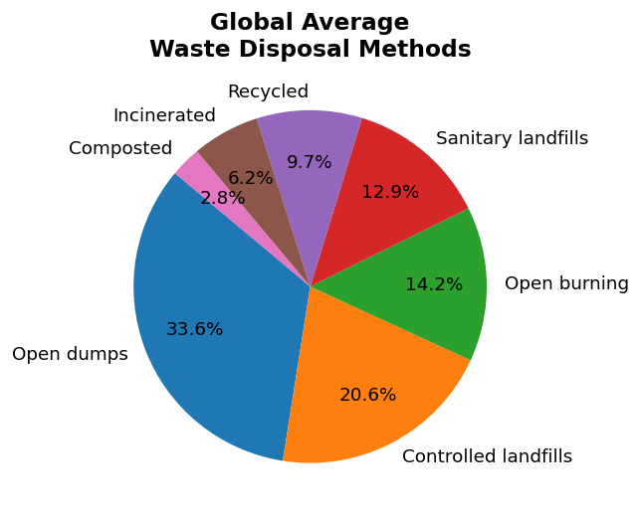
3. EDA · I OF VI
How the World Actually Disposes of Waste
Global Waste Disposal Mix (239 countries, 2020)
What it shows:
The average share of municipal waste routed to each disposal method, averaged across 239 countries.
Key observation:
Open dumping (33.6%) is the single largest method worldwide — larger than controlled landfills (20.6%), and far larger than recycling (9.7%). 49 of 239 countries collect less than half their waste; the Faroe Islands recycle 66.9% while Kuwait relies on open dumping for 100%.
How this shaped the project:
This confirmed the product should focus on practical disposal guidance and pollution detection, not assume recycling infrastructure exists everywhere.
GreenCycle • 6
Notes:
This chart directly justified the product direction: since open dumping — not recycling — is the dominant real-world outcome globally, the AI tools needed to help with practical disposal decisions and pollution detection rather than assuming recycling infrastructure is universally available. The collection-gap stat (49 of 239 countries below 50% collection) reinforced that infrastructure, not just individual behavior, is a major barrier.

Slide 7
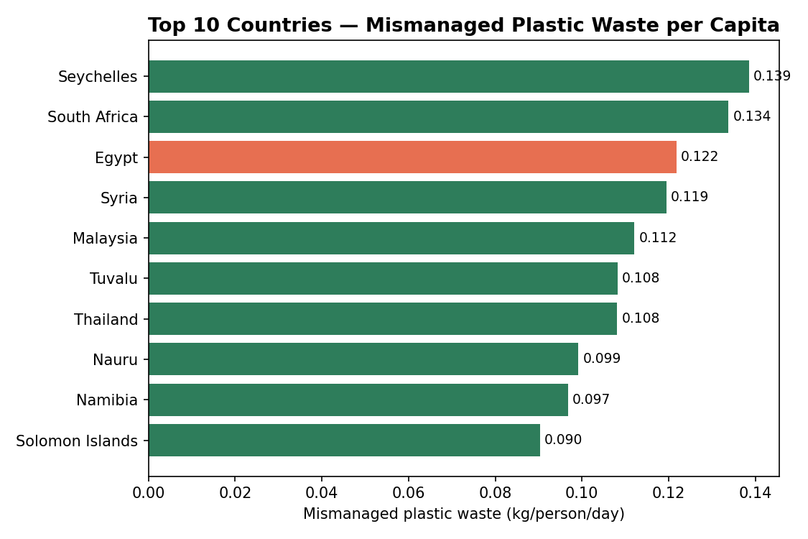
3. EDA · II OF VI
Plastic Pollution Is Concentrated, Not Even
Top 10 Countries — Mismanaged Plastic Waste per Capita
What it shows:
Kg of mismanaged plastic waste per person per day, ranked across the 107 countries in the cleaned dataset.
Key observation:
Egypt ranks 3rd globally (0.122 kg/person/day). The dataset also shows a direct relationship between coastal population size and mismanaged plastic tonnage, and between economic status (LMI/UMI/HIC) and mismanagement efficiency.
How this shaped the project:
Confirmed this is a regionally relevant problem, motivating the vision-based recycling/pollution scanner as a core feature rather than a generic add-on.
GreenCycle • 7
Notes:
Generated fresh from the cleaned 107-country plastic waste dataset to highlight the worst performers; Egypt is highlighted in coral since it ranks 3rd worldwide and is directly relevant to this audience. Two structural relationships in the underlying data are worth mentioning if asked: coastal population size correlates with total mismanaged plastic tonnage (more coastline exposure, more ocean-bound pollution risk), and economic status correlates with mismanagement efficiency — lower and lower-middle income countries mismanage a higher proportion of the plastic they generate.

Slide 8
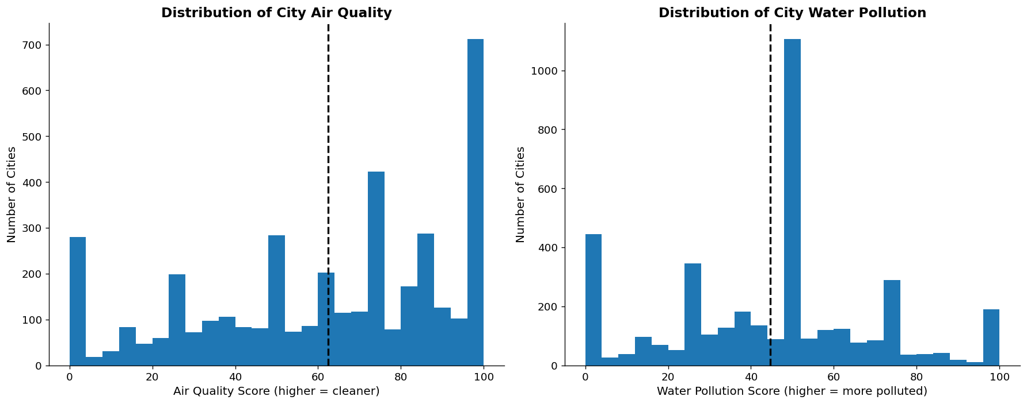
3. EDA · III OF VI
Urban Air & Water Quality Vary Widely
This dataset feeds directly into the correlation analysis on the next slide, linking waste-management practices to real air and water outcomes.
Air Quality and Water Pollution Score Distributions (3,937 cities)
Key observations:
Mean air quality 62.4 (median 70.0) — but 25.2% of cities score below 40 (poor). Mean water pollution 44.6 (median 50.0) — 19.3% of cities score above 66 (highly polluted). Best air quality: Finland (95.8). Worst: China (10.8). Cleanest water: Sweden (18.8). Most polluted: Lebanon (90.8).
GreenCycle • 8
Notes:
These histograms show real spread, not just averages — a city at the 25th percentile for air quality is a very different place to live than one at the 75th. The extremes are worth naming directly: Finland's cities average 95.8 on air quality versus China's 10.8, and Sweden's water pollution score of 18.8 versus Lebanon's 90.8. This dataset (3,937 cities, 176 countries) is what makes the next slide's correlation analysis possible — connecting disposal-method choices to measurable environmental outcomes rather than just assuming a relationship.

Slide 9
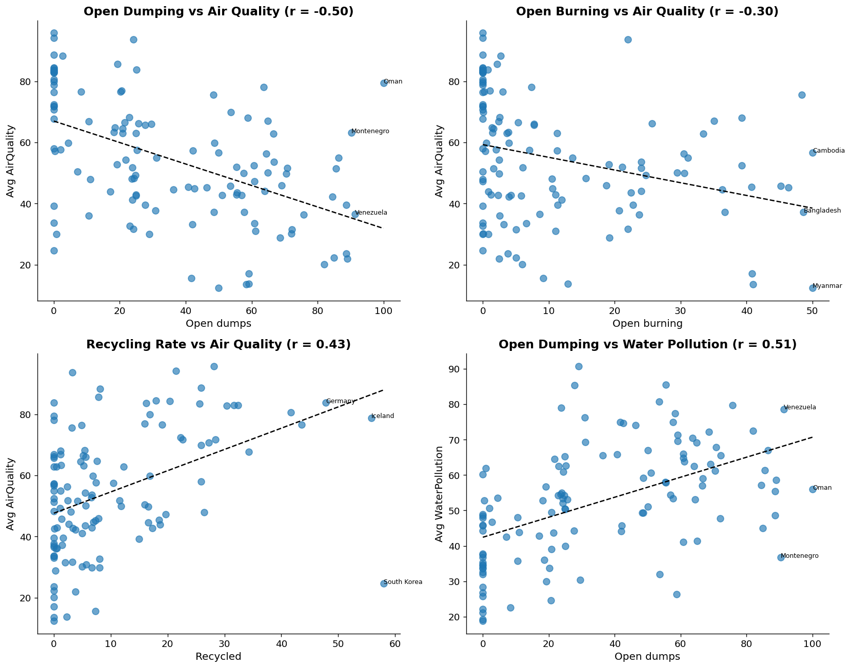
3. EDA · IV OF VI
Disposal Choices Correlate With Environmental Outcomes
Cross-Dataset Correlations (120 matched countries)
What it shows:
Pearson correlation between each disposal method's share and city-level air/water quality, across the 120 countries present in both datasets.
Key observation:
Open dumping vs. air quality: r = -0.50. Recycling rate vs. air quality: r = +0.43. Open dumping vs. water pollution: r = +0.51. Open burning vs. air quality: r = -0.30.
How this shaped the project:
This is the strongest evidence in the whole EDA that disposal method choice, not just waste volume, drives real environmental outcomes — directly motivating the recycling/pollution-focused product features.
GreenCycle • 9
Notes:
This is arguably the single most important EDA slide for justifying the product's direction. By matching the municipal-waste-methods dataset to the city air/water-quality dataset on 120 shared countries, a real (not assumed) relationship emerges: countries that rely more on open dumping have measurably worse air quality (r=-0.50) and worse water pollution (r=+0.51), while countries with higher recycling rates have measurably better air quality (r=+0.43). These are moderate, not perfect, correlations — worth being precise about that if asked — but they're strong enough to justify building tools that nudge disposal behavior rather than just tracking it.

Slide 10
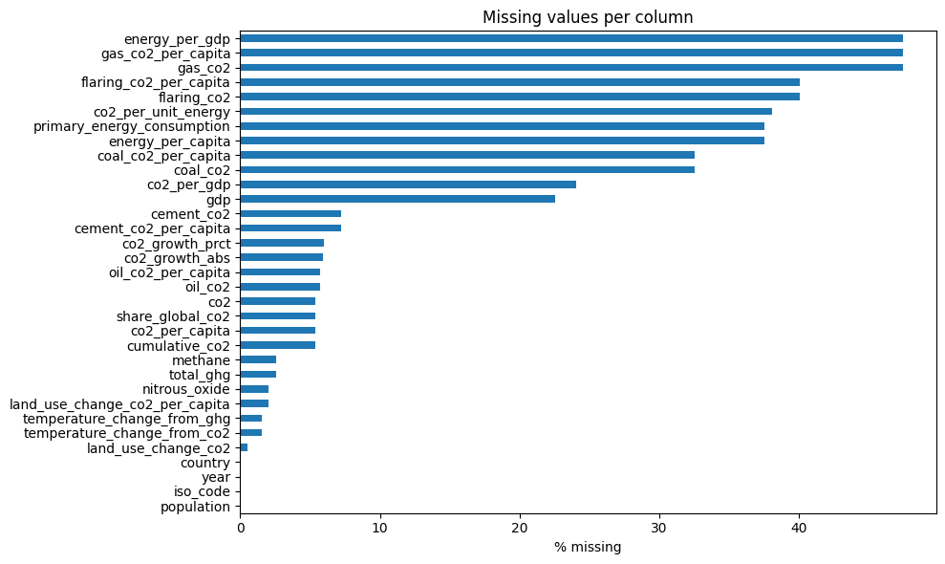
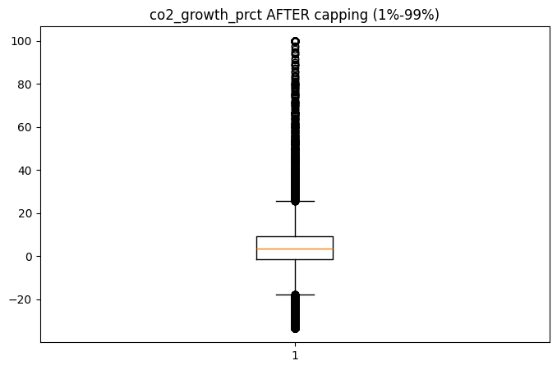
3. EDA · V OF VI
Data Quality Checks Behind the CO2 Model
Missing Values per Column (before cleaning)
Shows % missing across all 33 selected OWID columns. Insight: energy and gas-emission columns were worst (~47.5% missing) — small/non-industrial countries often don't report or have these sources, shaping a tiered fill strategy instead of blind imputation.
co2_growth_prct After Outlier Capping
Before capping, values reached +147,000% (near-zero emissions jumping to a small positive number). Insight: capping at the 1st/99th percentile (259 points) kept the signal usable without deleting real data.
GreenCycle • 10
Notes:
These two charts justify the preprocessing decisions covered two slides later. Missing-values chart: energy_per_gdp and gas_co2 were worst at ~47.5% missing — small/non-industrial countries simply don't report or have gas emissions, which is why the later fill strategy uses structural zeros rather than dropping those countries entirely. Outlier chart: co2_growth_prct is a percentage-change column that can explode mathematically when a near-zero value moves slightly — capping at the 1st/99th percentile fixed 259 extreme points without touching genuine underlying emissions data.

Slide 11
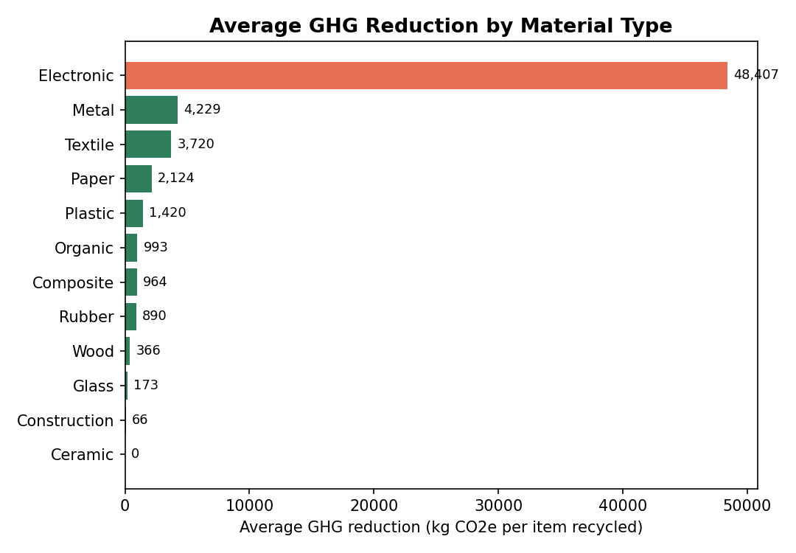
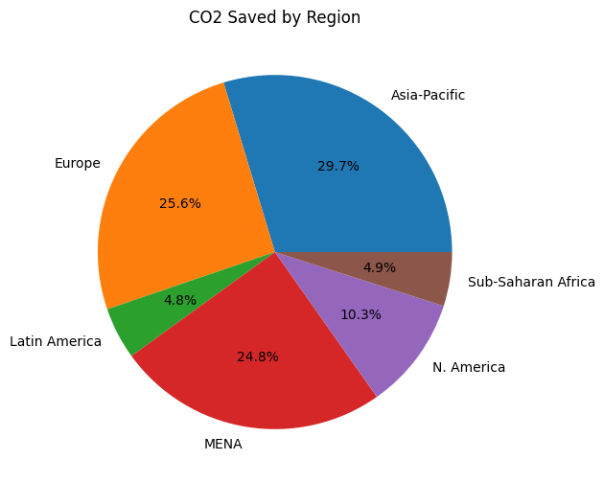
3. EDA · VI OF VI
Which Materials Deliver the Most Value?
CO2 Saved by Region (share of total)
Insight: Electronic waste delivers by far the highest average GHG reduction per item recycled (48,407 kg CO2e) and also the highest average net revenue ($6,714) — the strongest combined environmental + economic case of all 12 material types. Regionally, Asia-Pacific accounts for the largest share of total CO2 saved.
Average GHG Reduction by Material Type (25,000 records)
GreenCycle • 11
Notes:
Left chart (generated fresh from the actual groupby table in the notebook, not the raw output): electronic waste stands out dramatically — 48,407 kg CO2e average GHG reduction per item, an order of magnitude above every other material type, and it also has the highest average net revenue at $6,714, making it the clearest impact-plus-profit case in the whole materials dataset. Right chart: regional share of total CO2 saved, with Asia-Pacific leading. This EDA is exploratory only in the current project — this materials dataset has not yet been used to train a supervised recyclability or disposal-method model, which is one of the clear next steps covered in Future Work.

Slide 12











4. FULL PROJECT PIPELINE
From Raw Data to a Working Application
Data Collection
Data Exploration
Data Cleaning
Preprocessing
Feature Engineering
6 real-world datasets
6 EDA passes
Nulls, duplicates, outliers
Encoding, capping, imputation
Per-capita ratios, one-hot
Model Training
Evaluation
Model Deployment
API / Application
User Prediction
5 regressors + 1 CV model
R², RMSE, MAE, val. accuracy
FastAPI + Docker container
Next.js frontend
Chat, scan, or simulate
GreenCycle • 12
Notes:
This is the map for the rest of the deck. Ten stages, read left to right then top to bottom: data collection across 6 datasets, exploration (the six EDA slides just shown), cleaning, preprocessing, feature engineering, training two models (5 regression candidates plus one CV classifier), evaluation, deployment via FastAPI in Docker (highlighted), the Next.js application layer, and finally the end user making a prediction through chat, an image scan, or a city simulation.

Slide 13


5. DATA PREPROCESSING · PART 1
Why Each Tabular Cleaning Step Was Necessary
Scope to Real Countries
Fix Impossible Values
Cap True Outliers
Dropped regional aggregates and 22 dependent territories — without this, per-country modeling would double-count totals and mix sovereign states with colonies.
Negative values were only nulled on columns that can never physically be negative — land-use CO2 and total GHG were left alone since a country can be a net carbon sink.
co2_growth_prct capped at the 1st/99th percentile (259 points) because near-zero-to-small jumps produce mathematically correct but modeling-breaking spikes.
Tiered Missing-Value Fill
Preserve Monotonicity
Encode Categoricals
Per-country median first, then structural zeros for emission sources a country never had — naive dropna() would have removed 43% of countries.
cumulative_co2 was filled by time-interpolation, not median, since a running total can't impossibly decrease year over year.
Country and iso_code were one-hot encoded for the regression models (see Model Selection for the important caveat this creates).
GreenCycle • 13
Notes:
Six preprocessing decisions for the tabular/regression data, each justified by WHY rather than implementation detail. The two worth emphasizing if asked: the 'fix impossible values' step deliberately excludes total_ghg, methane, and nitrous_oxide from the non-negative rule because OWID's codebook defines them as including land-use absorption, so a real negative value is scientifically valid for some countries. And the last card — encoding country/iso_code — is flagged here because it directly connects to the leakage caveat discussed under Model Selection; it's listed as a real preprocessing step, not hidden, even though it turned out to have an important side effect on the final results.

Slide 14

5. DATA PREPROCESSING · PART 2
Preparing the Image Dataset for Training
Standardized Folder Structure
Resize & Normalize
Images organized via PyTorch's ImageFolder convention (one subfolder per class) — this is why the folder is named standardized_2569, enabling automatic label assignment.
Every image resized to a fixed input size and normalized to match MobileNetV2's expected ImageNet input statistics — required for transfer learning to work correctly.
Random Train/Val Split
No Augmentation Applied
80/20 split via random_split (9,807 train / 2,452 validation) — kept simple and reproducible rather than a stratified split.
No rotation, flip, or color-jitter augmentation was used — a real limitation, honestly noted, and a clear candidate for Future Work.
GreenCycle • 14
Notes:
Four preprocessing decisions for the computer-vision side. The folder-naming convention (standardized_2569) reflects PyTorch's ImageFolder pattern, where each class gets its own subdirectory and labels are assigned automatically from folder names. Resize-and-normalize is required for transfer learning from an ImageNet-pretrained backbone to work at all. The 80/20 split is a simple random split, not stratified by class — worth noting if any class is underrepresented. Most importantly, no data augmentation was applied at all — this is called out honestly as a real limitation, and it's very likely part of why training accuracy (93%) pulled ahead of validation accuracy (88%): augmentation is one of the most standard ways to close that gap.

Slide 15
6. MODEL SELECTION · PART 1
Five Regression Candidates for CO2 Prediction
Model | R² | RMSE | MAE | Verdict
Ridge Regression | 0.9902 | 0.6693 | 0.3401 | Highest R² — selected
Gradient Boosting | 0.9262 | 1.8359 | 0.3982 | Strong, but behind Ridge
Random Forest | 0.8875 | 2.2663 | 0.1997 | Lowest MAE, higher RMSE
XGBoost | 0.8807 | 2.3339 | 0.2562 | Underperformed vs. simpler models
Linear Regression | 0.7178 | 3.5896 | 1.7693 | Baseline — clearly weakest
Why Ridge — and an honest caveat
Ridge was selected on test-set R². But the feature set includes one-hot encoded country and iso_code columns — since co2_per_capita is highly stable per country year to year, this likely lets the model partly "memorize" a per-country baseline rather than purely learning from the engineered numeric drivers. The unusually high R² (0.99) versus tree ensembles (0.88–0.93) is a signal worth investigating, not just celebrating.
Advantages & Limitations Considered
Ridge: fast, interpretable, generalized well here — but sensitive to the leakage risk above. Tree ensembles (RF/GB/XGBoost): robust to non-linearities and don't need scaling, but underperformed with default-ish settings and no tuning. Linear Regression: simplest baseline, clearly insufficient alone.
GreenCycle • 15
Notes:
Present the table plainly — Ridge wins on R²/RMSE, Random Forest actually has the lowest MAE, XGBoost surprisingly underperforms simpler models here. Then spend real time on the caveat box, the most important thing on this slide: the feature matrix includes one-hot encoded country and iso_code columns, and since a country's CO2 per capita doesn't change dramatically year to year, a linear model with a country-identity feature can achieve a very high R² partly by learning a per-country baseline rather than the causal drivers. This doesn't invalidate the result, but it means R²=0.99 shouldn't be read as 'the model deeply understands emissions physics' — flag this honestly if asked, exactly as the brief requires for imperfect results.

Slide 16
6. MODEL SELECTION · PART 2
The Waste Image Classifier Architecture
MobileNetV2 (Transfer Learning)
Why not compare architectures?
Only one architecture was tested for this task — no comparison table exists in the provided files.
The provided files show a single training run with MobileNetV2 — there's no evidence of ResNet, EfficientNet, or other backbones being tried and compared. This is an honest gap: the model choice appears to be a reasonable practical default rather than the result of an architecture search, and is named as a Future Work item.
Pretrained on ImageNet, final classifier layer replaced for the 10 waste classes — standard, well-proven transfer-learning approach.
Lightweight backbone chosen specifically because training happened on CPU only (no CUDA GPU available in the development environment).
Strong track record for practical image classification tasks with moderate dataset sizes (12,259 images here), balancing accuracy and training time.
GreenCycle • 16
Notes:
Unlike the regression task, only one architecture was tried for the image classifier — MobileNetV2 with transfer learning. The reasoning for this choice is practical: it's lightweight enough to train on CPU (no GPU was available), it's a well-proven transfer-learning approach, and it handles a 10-class problem with a moderate-sized dataset (12,259 images) reasonably well. The honest gap, worth stating directly: there's no architecture comparison in the provided files — no evidence that ResNet, EfficientNet or other backbones were tried and benchmarked against MobileNetV2. This is named as a Future Work item rather than glossed over.

Slide 17
7. TRAINING PROCESS
How Each Model Was Trained
CO2 Regression Models
Waste Image Classifier (CV)
Single 80/20 train-test split (9,780 / 2,445 rows), random_state = 42 for reproducibility.
Target: raw co2_per_capita (not log-transformed in this version).
Missing values in features filled with column median before splitting.
Each of the 5 models trained once with fixed, manually chosen settings — no GridSearchCV or cross-validation is present in this notebook.
Example fixed settings: Random Forest (200 trees), XGBoost (200 trees, depth 6, lr 0.05), Ridge (alpha = 1.0).
No MLflow or other experiment-tracking tool found — only the final model is saved (joblib), not intermediate runs.
80/20 train-validation split via ImageFolder + random_split (9,807 train / 2,452 validation images).
10 epochs, Adam optimizer (lr = 0.001), CrossEntropyLoss, batch size 32.
Simple resize-and-normalize transforms only — no data augmentation applied.
Trained on CPU (no CUDA GPU available in the development environment).
Model checkpoint (weights + class names) saved directly via torch.save() — no formal versioning or registry.
No experiment-tracking tool (e.g. MLflow, W&B) is present for either model in the provided files.
GreenCycle • 17
Notes:
Two training workflows side by side, since this project has two independent trained models. Left: the regression models — a single fixed 80/20 split, no cross-validation and no hyperparameter search grid in this notebook (each model uses one manually chosen configuration), and no MLflow-style tracking. Right: the CV classifier — a straightforward transfer-learning run, 10 epochs, no augmentation, CPU-only. Both sides end on the same honest note: no experiment-tracking tool exists anywhere in the provided files, only final model artifacts. If asked why no cross-validation or tuning was done, be straightforward: the provided notebooks simply don't show that step — it's a natural next improvement, covered in Future Work.

Slide 18
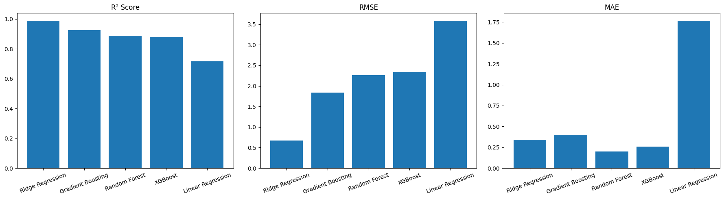
8. EVALUATION · I OF III
Regression Model Comparison
R², RMSE and MAE across all 5 regression models on the 2,445-row held-out test set.
0.9902
0.6693
0.1997
Ridge Regression — best R² on the test set
Ridge Regression — lowest RMSE
Random Forest — lowest MAE (most consistent typical error)
GreenCycle • 18
Notes:
This chart is the head-to-head comparison across all 5 models. Point out that Ridge wins on R² and RMSE, but Random Forest actually has the single lowest MAE — meaning Random Forest's typical error is smaller even though its worst-case errors (captured by RMSE) are larger than Ridge's. This nuance matters: which metric to optimize for depends on whether occasional large errors or consistent typical error matters more for the use case. The next slide covers the important caveats behind these numbers.

Slide 19
8. EVALUATION · II OF III
Strengths, Weaknesses & What Needs a Second Look
Strengths
Weaknesses & Open Questions
Ridge Regression generalized well on the held-out set (R² 0.99, RMSE 0.67).
Random Forest had the single lowest MAE (0.20) — the most consistent typical error of any model.
All 5 models were evaluated on the exact same held-out test set, making the comparison fair.
Results are reported for every model, including the weakest (Linear Regression) — nothing was hidden.
XGBoost underperformed simpler models — likely needs its own tuning, not just default-ish settings.
Country/iso_code one-hot features may inflate Ridge's R² via per-country memorization rather than causal learning.
The notebook's reported feature count (354 columns) doesn't match what its visible code would produce — a reproducibility gap, likely stale/out-of-order cell execution.
No cross-validation was run, so these single-split results could shift somewhat with a different random seed.
No confusion matrix, residual plot, or per-country error breakdown exists for the regression task in the provided files.
GreenCycle • 19
Notes:
Spend real time on the weaknesses box — the brief explicitly requires not hiding poor or ambiguous results. Two points deserve the most emphasis: first, the notebook's own printed output (X_train shape of 9,780 rows by 354 columns) can't be reproduced from the visible code, which only manipulates about 32 original columns — this strongly suggests the notebook was edited after the cells that actually produced that output were run, a real reproducibility issue worth fixing. Second, the country/iso_code encoding caveat from the Model Selection slide directly limits how much to trust the R²=0.99 headline number as evidence of true predictive understanding versus per-country memorization. Presenting both transparently is more credible than presenting clean-looking numbers without context.

Slide 20
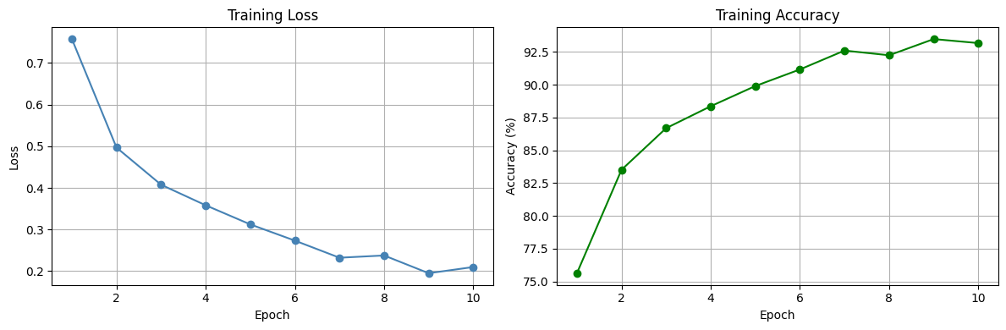

8. EVALUATION · III OF III
Waste Image Classifier — Training & Validation
87.89%
Validation accuracy across 2,452 held-out images, 10 classes
Training loss and accuracy across 10 epochs.
Training accuracy climbed from 75.6% (epoch 1) to a peak of 93.5% (epoch 9), settling at 93.2% by epoch 10.
Final validation accuracy: 87.89% on 2,452 held-out images — a real, but expected, gap below training accuracy.
The ~5-point train/validation gap is consistent with the lack of data augmentation noted in preprocessing.
A real limitation, shown transparently: a single-image sanity check misclassified a metal item as "battery" at 0.56 confidence. No confusion matrix or per-class accuracy breakdown exists in the provided files.
GreenCycle • 20
Notes:
Point at the training curves: accuracy climbs steadily from about 76% to a peak near 93.5% over 10 epochs, with loss dropping correspondingly — a healthy training run. The headline number is 87.89% validation accuracy on 2,452 held-out images. Don't skip the limitation box: a single-image sanity check in the notebook actually got a wrong prediction (a metal item misclassified as battery at 56% confidence) — this is included to show scientific honesty rather than cherry-picking success. Also note there's no confusion matrix or per-class breakdown anywhere in the provided files, so it's not possible to say which of the 10 classes the model struggles with most — a good Future Work item.

Slide 21


9. DEPLOYMENT
Containerized API, Live Today
User
Frontend / Application
API
Docker Container
ML Model
Prediction Result
Confirmed from the provided Dockerfile
Not yet connected
The FastAPI app (main.py) is containerized and served via uvicorn on port 7860.
4 working endpoints are live: /api/chat, /api/simulate-city, /api/analyze-pollution, /api/analyze-recycling.
CORS is configured to allow all origins/methods/headers, so the frontend can call the API directly.
The chat, simulation, and vision endpoints call Groq-hosted LLMs (llama-3.3-70b-versatile and llama-4-scout-17b vision) rather than serving the trained CO2/CV models directly.
The trained CO2 regression model (best_model.pkl) and the CV classifier (waste_model.pth) are not currently wired into the live API — the deployed endpoints use hosted LLMs instead.
No model-serving route (e.g. a dedicated /predict endpoint loading the .pkl or .pth file) exists yet in the provided route files.
No CI/CD pipeline was found alongside the Dockerfile.
GreenCycle • 21
Notes:
Show the generic User → Frontend → API → Docker → Model → Result flow first, then immediately ground it in what's actually confirmed versus not. Confirmed and real: the Dockerfile serves the FastAPI app via uvicorn on port 7860, four endpoints genuinely work end-to-end using Groq-hosted LLMs, and a real Next.js frontend (covered on the Live Demo slide) calls them directly thanks to open CORS. The honest gap: the two models actually trained in this project — the CO2 regressor and the waste-image classifier — are not the models being served by the live API today; the deployed chat/simulation/vision features go through Groq's hosted models instead. This is a real and important distinction: the trained models and the deployed API are currently two separate tracks of work that haven't been merged — exactly what Future Work should address.

Slide 22


10. RESULTS & CONCLUSION
What the Project Achieved
0.99 R²
87.9%
6
4
Ridge Regression — best CO2 model (with the caveat on slide 19)
Waste image classifier validation accuracy
Real-world datasets cleaned & analyzed
Live API endpoints + a full web frontend in production
Main Findings
Selected Models & Why
Impact & Lessons Learned
Waste is dominated globally by open dumping, not recycling. Disposal method correlates measurably with air/water quality. Country identity is a very strong predictor of CO2 per capita — strong enough that it may be doing more work than the engineered features.
Ridge Regression for CO2 (highest test R²); MobileNetV2 for image classification (practical CPU training, strong accuracy for a 10-class problem).
The live API and frontend already answer real environmental questions. Key lesson: a working demo and a trained model are not automatically the same system — connecting them is its own engineering task.
GreenCycle • 22
Notes:
Open with the four headline numbers, then walk the three cards. Main Findings restates the two biggest data insights: open dumping dominates global waste disposal, and country identity turned out to be a suspiciously strong predictor of CO2 per capita. Selected Models & Why: Ridge for regression on test-set R² (with the leakage caveat noted honestly), MobileNetV2 for the image classifier for practical CPU training. Impact & Lessons Learned: the most important lesson from this whole review is that a working demo (the frontend + LLM-backed API) and the actual trained models are currently two separate tracks — that gap, and how to close it, is the clearest, most honest takeaway for the review committee.

Slide 23

11. LIVE DEMO
See It Work, End to End
User Input
API Request
Model / LLM Response
Displayed Result
Photo, city stats, or a question
Sent from the Next.js frontend to FastAPI
Groq LLM replies (see Deployment slide)
Rendered instantly in the web app
The application: 7 connected pages, built and verified in this project
Landing + Dashboard
Brand-matched homepage and a central hub linking to all 3 AI tools
City Simulator
5-field form → live CO2/AQI simulation via /api/simulate-city
Vision Lab
Upload/capture a photo → pollution or recycling analysis (2 tabs, 2 endpoints)
AI Chatbot
Free-form eco question → grounded answer via /api/chat
About, Contact, 404
Supporting pages, fully responsive, with loading/error states throughout
GreenCycle • 23
Notes:
Walk through the generic flow first — user input, API request, model/LLM response, displayed result — then ground it in the real, working frontend built for this project: a Next.js application with 7 connected pages (landing, dashboard, city simulator, vision lab with pollution/recycling tabs, chatbot, about, contact, plus a custom 404), each wired to the actual live FastAPI endpoints with proper loading, error, and empty states. Be transparent that no screenshots are included in this deck — they weren't available to capture in this environment — but the frontend code itself is a real, build-verified deliverable, not a mockup. If doing a live walkthrough, the natural demo order is: dashboard → simulator (structured input) → vision lab (image upload) → chatbot (open-ended).

Slide 24


FINAL DELIVERABLES
What's Delivered — and What's Still Missing
Working API
GitHub Repository
Trained Model(s)
4 live FastAPI endpoints (chat, city simulation, pollution & recycling vision analysis), Docker-containerized.
No repository URL was included in the provided files — not shown in this deck.
best_model.pkl + scaler.pkl (Ridge CO2 regressor) and waste_model.pth (MobileNetV2 classifier) — both saved as artifacts.
MLOps Tool Used
Dataset Access URL
Final Report / Documentation
Docker confirmed (Dockerfile provided). No MLflow or other experiment-tracking tool found in any provided file.
OWID CO2 dataset (public) + mismanaged-plastic-waste-per-capita (OWID, confirmed). Other dataset origins are unconfirmed (see slide 4-5).
No standalone project report or documentation file was included — this deck is the primary technical summary available.
Bonus deliverable (beyond the required list): a complete Next.js frontend — 7 connected pages, wired to all 4 live API endpoints, verified to build and run without errors.
GreenCycle • 24
Notes:
Go through all six required items plainly — green means delivered, amber means partial, red means not provided. Working API and Trained Models are solid green: four endpoints genuinely run, and both models are saved as real artifacts. MLOps and Dataset Access are amber/partial: Docker is real and confirmed, but there's no MLflow or similar tracking tool anywhere, and only one dataset source URL is fully confirmed by name-matching. GitHub Repository and Final Report are honestly marked as not provided — no repo link or standalone documentation file was included, so rather than fabricate one, it's flagged directly. The bonus item at the bottom is worth mentioning proudly: a full working frontend was also built and verified in this project, beyond what the required deliverables list asked for.

Slide 25

Thank You
Questions & Discussion
GreenCycle · Ziad Omran · Abdelrahman Kewan · Mostafa Shalan · Mahmoud Amer · Sohila Ihab · Shaza Beder
Notes:
Thank the review committee and open the floor. Likely questions to be ready for: why Ridge over the tree ensembles despite the country-encoding caveat (test-set R² was simply highest, but flag it as worth re-testing without country identity); why the live API and frontend don't yet serve the two trained models (they're a separate track from the LLM-based endpoints — a clear next step); why no data augmentation was used for the image classifier; and what's missing for a full production handoff (GitHub repo link, a written report, and an experiment-tracking tool, all named honestly on the deliverables slide).

