Slide 1
Loan Default Risk Prediction
Graduation Project — Digital Egypt Pioneers Initiative
Team Members:
• Ahmed Mohamed Elsaid Bebars
• Ahmed Safwat Mohamed
• Ahmed Mahmoud Ahmed Osman
• Manar Ashraf Ibrahim
• Salma Ayman Mohamed
Instructor: Eslam Hussein Mohamed Elreedy

Slide 2
Agenda
From problem understanding to a production-ready model
Project Problem & Context
1
Dataset Overview
2
Exploratory Data Analysis (EDA)
3
Data Cleaning & Preprocessing
4
Feature Engineering
5
Handling Class Imbalance
6
Model Building & Evaluation
7
Hyperparameter Tuning & Cross-Validation
8
Feature Importance & Results Analysis
9
Production Pipeline & Conclusion
10
1

Slide 3
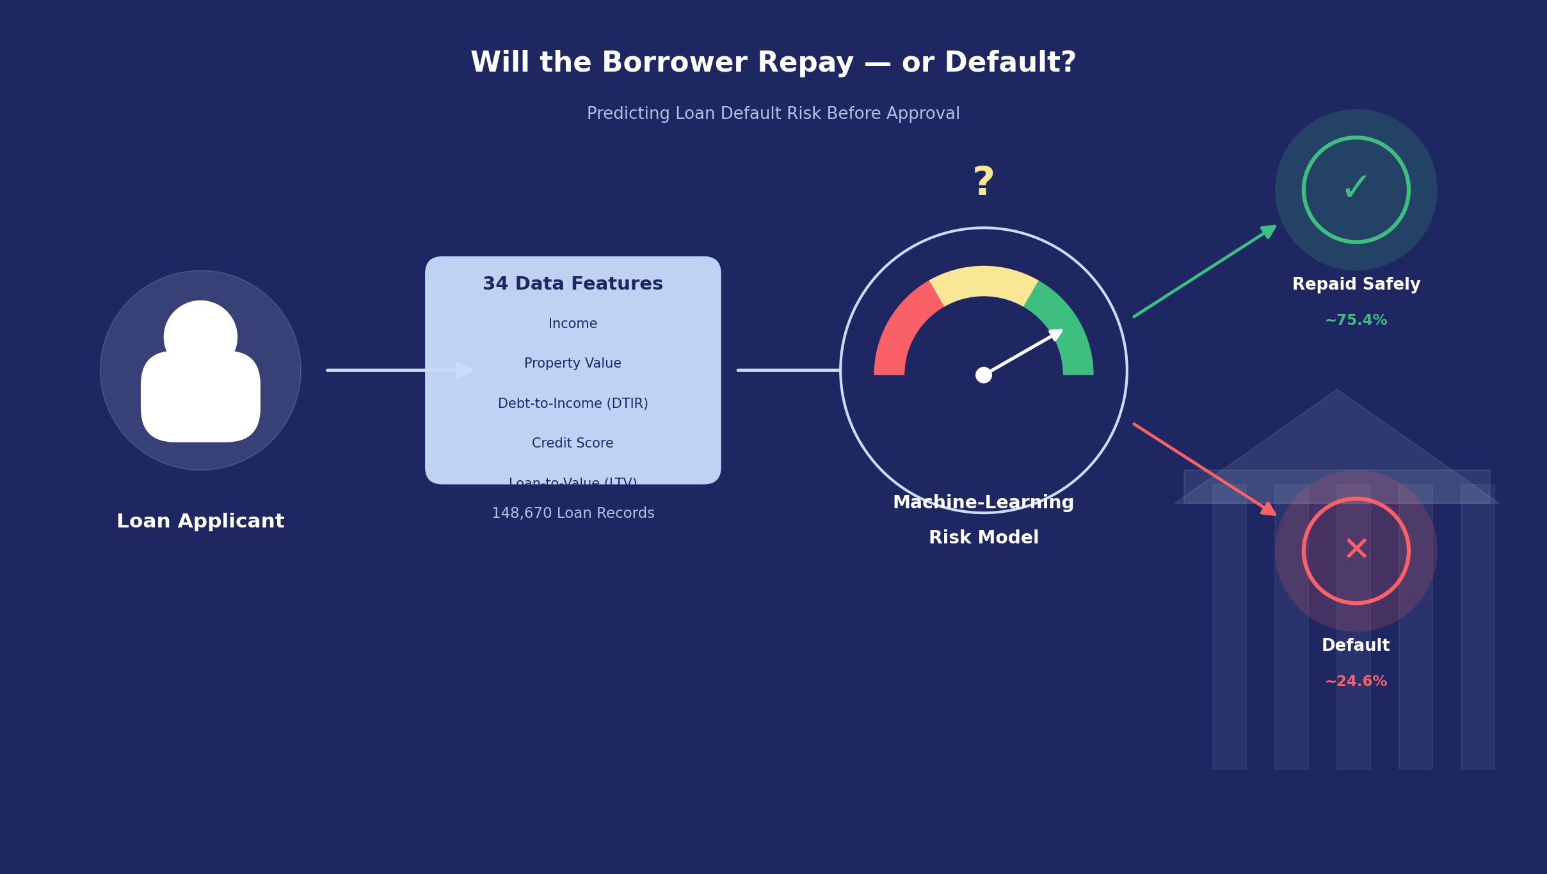
1 • The Problem
Why predict loan default risk?
Banks receive thousands of loan applications, with no way to know who will repay and who will default until it's too late.
Manual human assessment is slow, inconsistent, and prone to bias.
Goal: a machine learning model that predicts default probability (Status) before loan approval, based on 34 financial and demographic features.
2

Slide 4
2 • The Data
Dataset Overview
Loan Default Dataset
148,670
34
0
14
Rows / Loan Applications
Features (Columns)
Duplicate Rows
Columns with Missing Values
The Task
Binary Classification: predicting the Status column — whether a borrower will default or not.
Features include: income, property value, credit score, loan-to-value ratio (LTV), debt-to-income ratio (dtir1), interest rate, gender, region, loan type, and more.
Key challenge: moderate class imbalance (~75% vs ~25%) requiring special handling during training and evaluation.
3

Slide 5
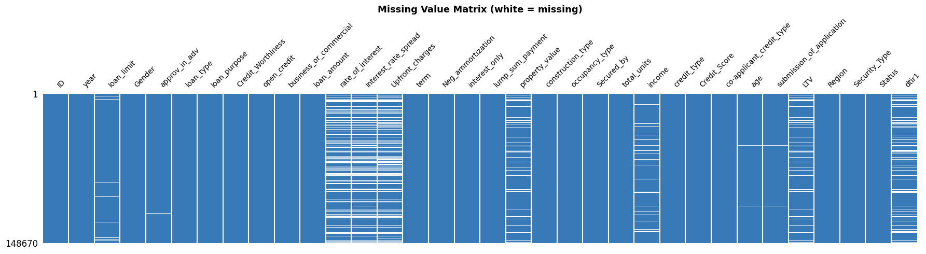
2 • Data Quality
Missing Value Map
Missing Value Matrix — white represents a missing value
4

Slide 6
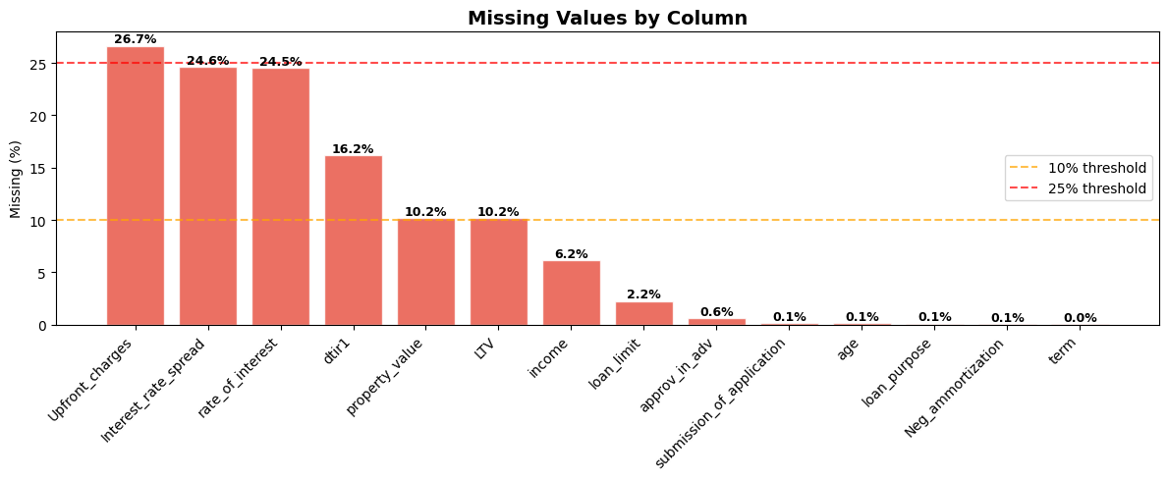
Missing Values by Column
and the imputation strategy used
Column | %
Upfront_charges | 26.7%
Interest_rate_spread | 24.6%
rate_of_interest | 24.5%
dtir1 | 16.2%
property_value / LTV | 10.2%
income | 6.2%
Strategy: numerical values imputed with the median (robust to outliers), and categorical columns imputed with the mode (most frequent value).
5

Slide 7
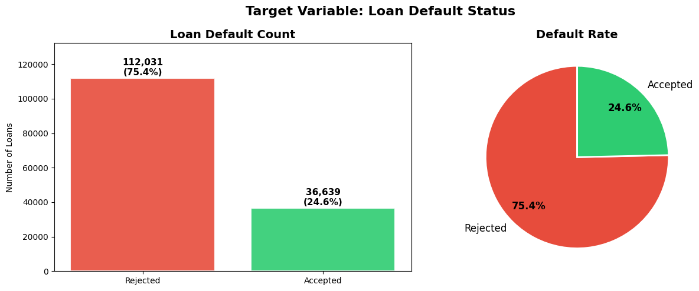
3 • EDA
Target Variable Distribution (Status)
3.1 Target Variable — Loan Default Distribution
75.4%
Rejected (Majority Class)
24.6%
Accepted (Minority Class)
Imbalance ratio ≈ 3.06 : 1
A naive model that always predicts the majority class would achieve ~75.4% accuracy — which is misleading!
6

Slide 8
Why is class imbalance a challenge?
Accuracy alone is a misleading metric under class imbalance — ROC-AUC, F1-Macro, and Recall must be used alongside it.
class_weight is used to give greater weight to minority-class (defaulter) errors during training.
SMOTE (synthetic sample generation) was tested during development but excluded from the final pipeline.
Reason: SMOTE generated unrealistic synthetic edge-case samples that hurt the model's ability to generalize to real test data.
Final choice: class_weight only — more stable, honest results without fabricating data.
7

Slide 9
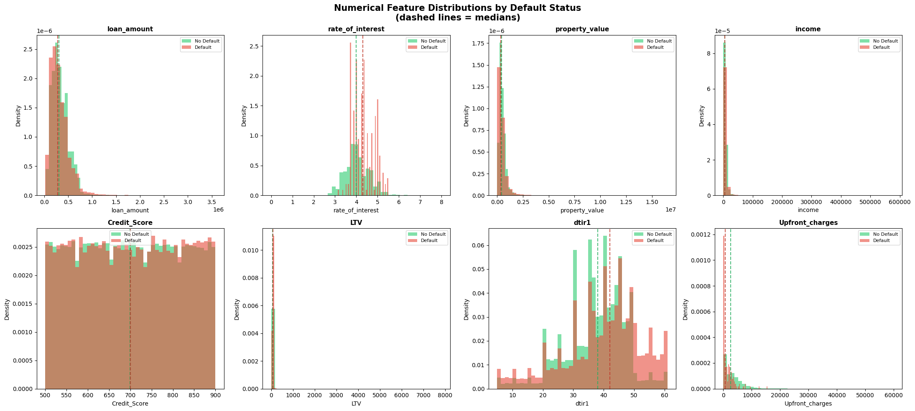
Numerical Feature Distributions
8

Slide 10
Key Observations — Numerical Features
Feature | Observation
Credit Score | Defaulters cluster between 500–650; non-defaulters tend toward higher scores
LTV | Defaulters have higher LTV — borrowing a larger share of the property value
Income | Lower-income borrowers show a higher default rate
Rate of Interest | Defaulters generally have a slightly higher interest rate (risk-based pricing)
Debt-to-Income (dtir1) | Higher debt-to-income ratios correlate with higher default rates
Loan Amount | Similar distribution across both classes — a weak predictive signal on its own
Upfront Charges | Wide spread among defaulters; higher charges may indicate higher-risk products
9

Slide 11
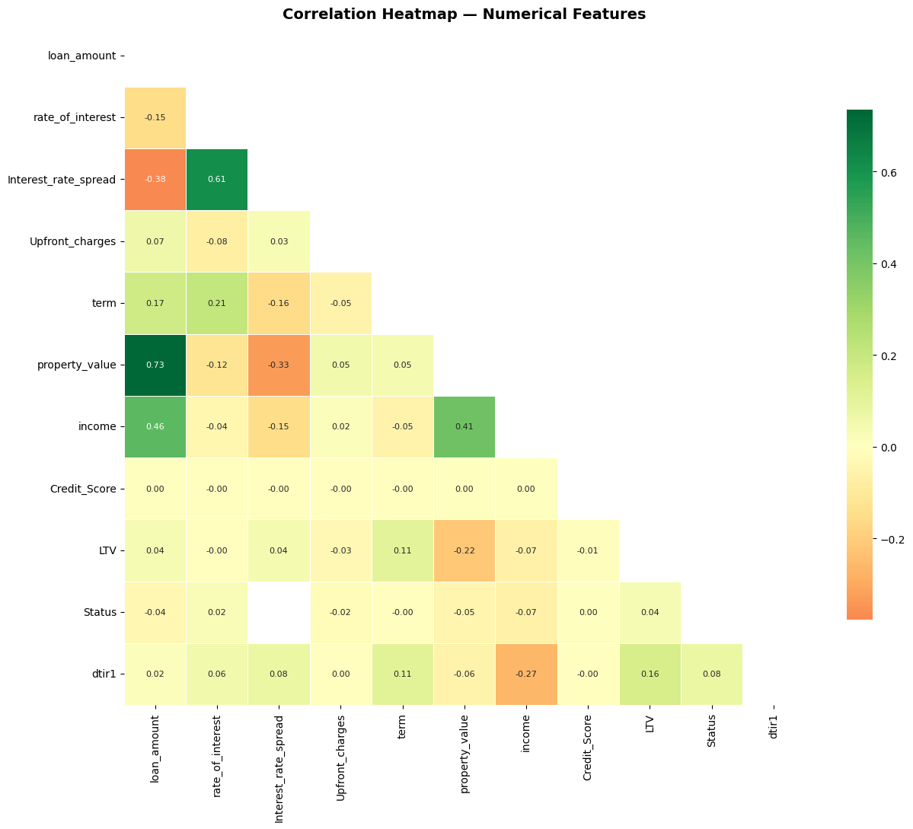
Feature Correlation Map
3.4 Correlation Heatmap
10

Slide 12
Key Correlation Findings
LTV vs property_value: moderate negative correlation — higher-value properties yield a lower LTV.
loan_amount vs property_value: positive correlation — larger loans for more expensive properties.
rate_of_interest vs Interest_rate_spread: very high correlation — prompting consideration of dropping one to avoid redundancy in linear models.
Status shows weak linear correlations with most individual features ← the relationship is non-linear and complex ← tree-based models are expected to outperform linear ones.
11

Slide 13
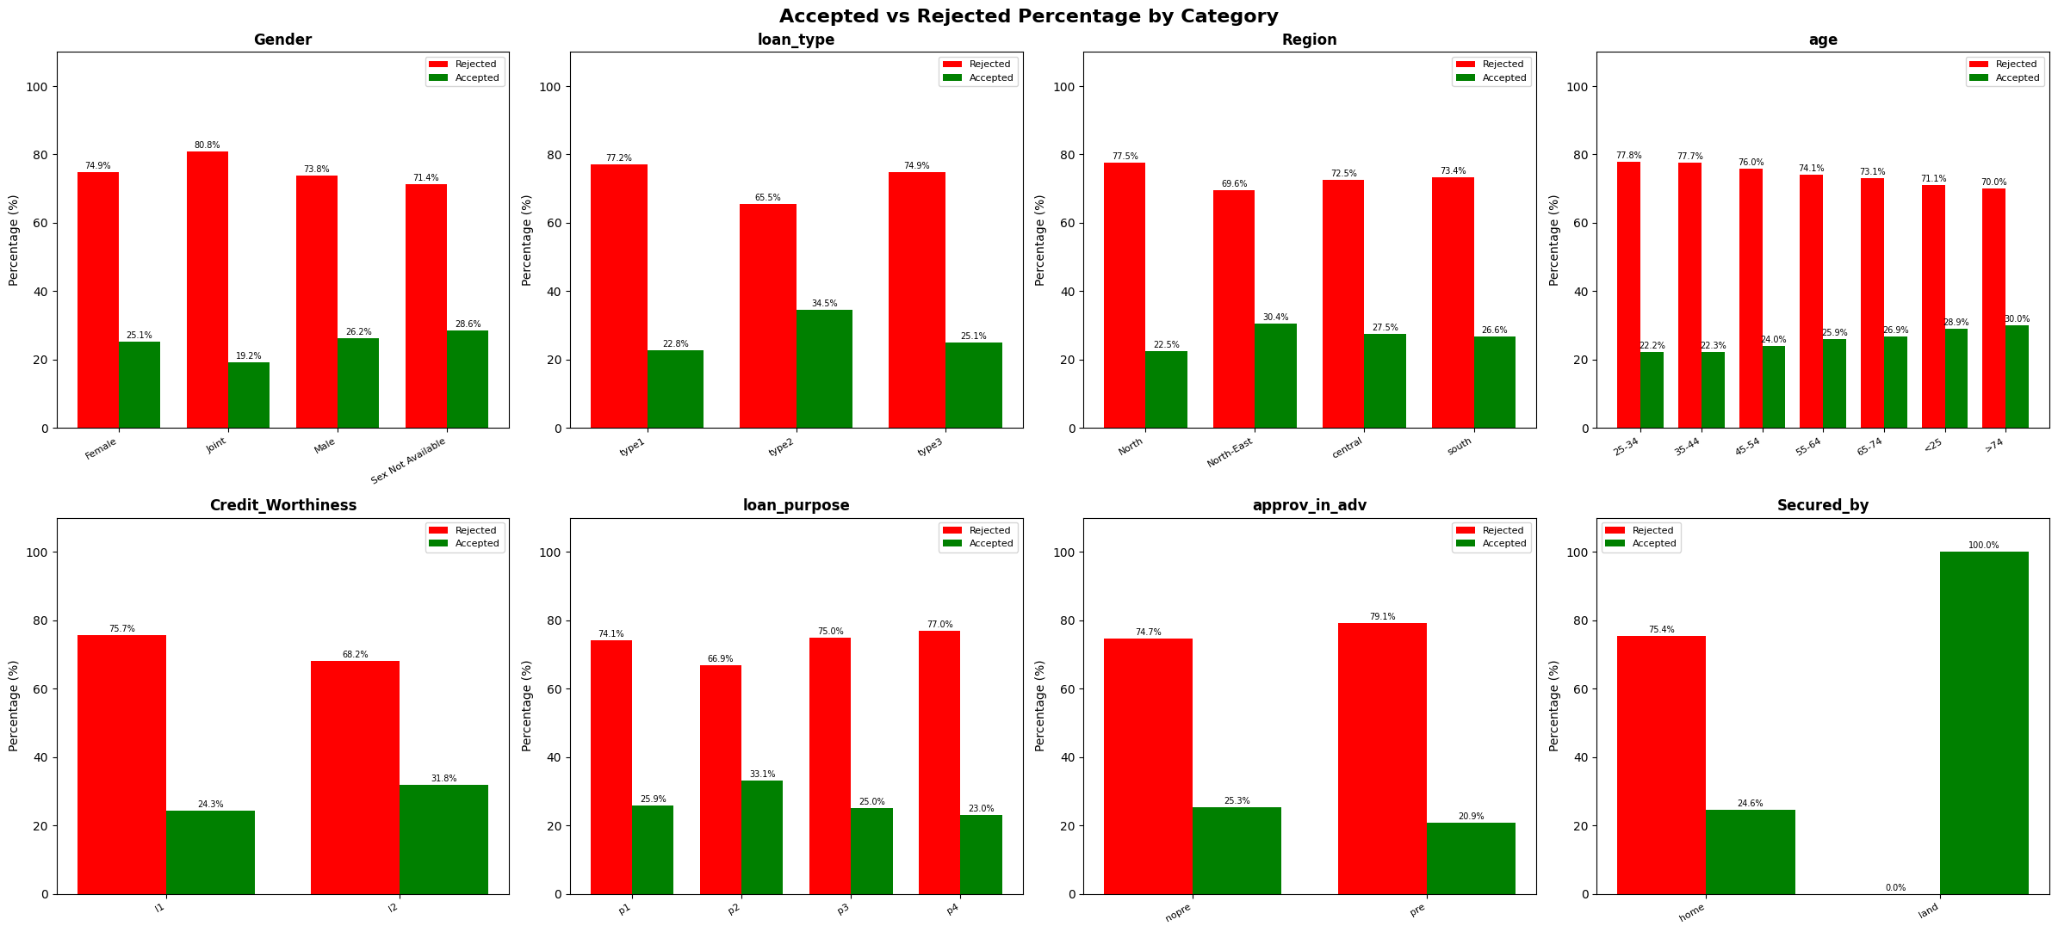
Categorical Feature Analysis
12

Slide 14
Key Observations — Categorical Features
Feature | Observation
Gender | Joint applicants show the highest rejection rate; ‘Sex Not Available’ shows the highest acceptance rate
Loan Type | Type2 has the highest acceptance rate; Type1 and Type3 are rejected more often
Region | North-East has the highest acceptance rate; North has the highest rejection rate
Age | Older applicants (≈75) show a slightly higher acceptance rate; overall effect is limited
Credit Worthiness | A value of 1 is associated with a higher acceptance rate than 0
Loan Purpose | P2 has the highest acceptance rate; P4 the lowest
Pre-approval | ‘nopre’ has a slightly higher acceptance rate than ‘pre’
Secured By | One category showed 100% acceptance — a very small group, to be interpreted with caution
13

Slide 15
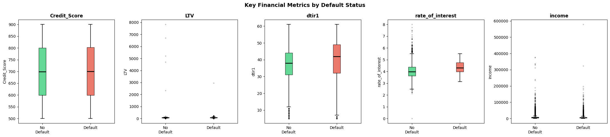
Key Financial Metrics
3.6 Boxplots: Key Financial Metrics by Default Status
14

Slide 16
Exploratory Analysis Summary
EDA Summary
Observation | Modeling Impact
75.4% Rejected vs 24.6% Accepted | Use class_weight; SMOTE tested and excluded
Credit Score separates the two classes well | Strong predictive feature
LTV strongly correlated with default | Important engineered ratio
Multiple columns with 10–27% missing values | Impute with median/mode
Weak linear correlations with the target | Tree-based/ensemble models expected to outperform
Regional and demographic differences | Categorical features add predictive value
15

Slide 17
4 • Cleaning
Data Cleaning & Preprocessing
Dropped the ID column — a unique identifier with no predictive value.
Dropped the year column — a single value (2019) across all rows, with no variance.
Checked for duplicates: 0 duplicate rows across the entire dataset.
Converted the age column from text categories (e.g., '25-34') to a numeric value (bucket midpoint, with 20 for '<25' and 75 for '>74').
Permanently dropped Upfront_charges and Interest_rate_spread.
Reason: both columns had a high proportion of missing values, requiring heavy imputation that led to overfitting and weaker generalization. Dropping them produced a more stable, robust model.
16

Slide 18
5 • Feature Engineering
Categorical Feature Encoding
Label Encoding — Binary (9 columns)
One-Hot Encoding — Nominal (12 columns)
Credit_Worthiness
open_credit
business_or_commercial
interest_only
lump_sum_payment
construction_type
Secured_by
co-applicant_credit_type
Security_Type
loan_limit
Gender
approv_in_adv
loan_type
loan_purpose
Neg_ammortization
occupancy_type
total_units
credit_type
age
submission_of_application
Region
17

Slide 19
Domain-Driven Engineered Features
Loan-to-Income Ratio
loan_amount / (income + 1)
Loan_to_Income
Loan-to-Property Ratio
loan_amount / (property_value + 1)
Loan_to_Property
Debt-to-Income Ratio
dtir1 / (income + 1)
Debt_to_Income
Credit Score-to-LTV Ratio
Credit_Score / LTV
Score_LTV_ratio
Interest Rate × LTV Interaction
rate_of_interest × LTV / 100
Interest_x_LTV
A log1p transform was also applied to loan_amount, property_value, income, and rate_of_interest to reduce the effect of skewed distributions.
18

Slide 20
6 • Class Imbalance
Handling Class Imbalance
Strategy | Description | Where Applied
class_weight = {0: 0.66, 1: 2.03} | Greater weight for minority-class misclassification during training | LR, DT, RF, and others
Evaluation Metrics | ROC-AUC and F1-Macro instead of relying on Accuracy alone | All models
SMOTE (experimental) | Synthetic sample generation for the minority class — tested, then excluded from the final version | Comparison experiment only
89,625 / 29,311
After applying SMOTE to the training data only: over 60,000 synthetic samples were generated to balance the two classes (89,625 vs 89,625). For tree-based models (Random Forest, XGBoost, LightGBM), however, this typically adds little benefit, can increase training time, and introduces synthetic noise that reduces generalization to real data.
Training Class Distribution (0 / 1)
19

Slide 21
7 • Models
Data Split & Preprocessing Pipeline
7.1–7.4 Train/Test Split & Preprocessing Pipeline
118,936
29,734
57
Training Samples (80%)
Test Samples (20%)
Features After Preprocessing
The Pipeline
Numerical features (23): median imputation followed by standardization (StandardScaler).
Categorical features (11): mode imputation followed by One-Hot Encoding, ignoring unknown categories.
Stratified split (Stratify=y) to preserve the same default ratio in training and test sets.
Class imbalance handled within the models themselves via class_weight — without modifying the training data.
20

Slide 22
Models Trained & Compared
9 different machine learning algorithms
Logistic Regression
Decision Tree
Random Forest
Gradient Boosting
Hist Gradient Boosting
AdaBoost
KNN
XGBoost
LightGBM
Each model was trained twice: once using class_weight only, and once on SMOTE-balanced data — for a fair comparison between the two strategies.
21

Slide 23
8 • Results
Model Comparison — class_weight
8.1 Final Model Comparison
Rank | Model | Accuracy | Precision | Recall | F1-Score | CV Score
1 | Decision Tree | 1.0000 | 1.0000 | 1.0000 | 1.0000 | 0.9998 ±0.0001
1 | LightGBM | 1.0000 | 1.0000 | 1.0000 | 1.0000 | 0.9999 ±0.0001
1 | Gradient Boosting | 1.0000 | 1.0000 | 1.0000 | 1.0000 | 0.9999 ±0.0001
1 | AdaBoost | 1.0000 | 1.0000 | 1.0000 | 1.0000 | 0.9999 ±0.0001
5 | Random Forest | 0.9997 | 0.9997 | 0.9997 | 0.9997 | 0.9997 ±0.0001
6 | XGBoost | 0.9992 | 0.9992 | 0.9992 | 0.9992 | 0.9991 ±0.0003
7 | Hist Gradient Boosting | 0.9991 | 0.9991 | 0.9991 | 0.9991 | 0.9995 ±0.0001
8 | KNN | 0.8562 | 0.8708 | 0.8562 | 0.8607 | 0.8524 ± 0.0028
9 | Logistic Regression | 0.5395 | 0.7894 | 0.5395 | 0.5568 | 0.5340 ± 0.0054
22

Slide 24
Model Comparison — After SMOTE
8.1 Final Model Comparison (SMOTE)
Rank | Model | Accuracy | Precision | Recall | F1-Score | CV Mean | CV Std
1 | Gradient Boosting | 1.000000 | 1.000000 | 1.000000 | 1.000000 | 0.999916 | 0.000096
1 | LightGBM | 1.000000 | 1.000000 | 1.000000 | 1.000000 | 0.999857 | 0.000105
3 | AdaBoost | 0.999966 | 0.999966 | 0.999966 | 0.999966 | 0.999849 | 0.000078
3 | Decision Tree | 0.999966 | 0.999966 | 0.999966 | 0.999966 | 0.999807 | 0.000121
5 | Random Forest | 0.999933 | 0.999933 | 0.999933 | 0.999933 | 0.999865 | 0.000131
6 | XGBoost | 0.999496 | 0.999496 | 0.999496 | 0.999496 | 0.999403 | 0.000163
7 | Hist Gradient Boosting | 0.998924 | 0.998926 | 0.998924 | 0.998924 | 0.999092 | 0.000145
8 | KNN | 0.841057 | 0.864018 | 0.841057 | 0.847441 | 0.835483 | 0.003729
9 | Logistic Regression | 0.838434 | 0.838688 | 0.838434 | 0.838560 | 0.835147 | 0.001892
Final Decision
SMOTE clearly boosted linear model (Logistic Regression) accuracy: from 53.9% to 83.8%.
But it barely improved the already-strong tree-based models — and may increase overfitting risk.
class_weight alone was adopted in the final production pipeline, since it introduces no synthetic data and yields more credible results.
23

Slide 25
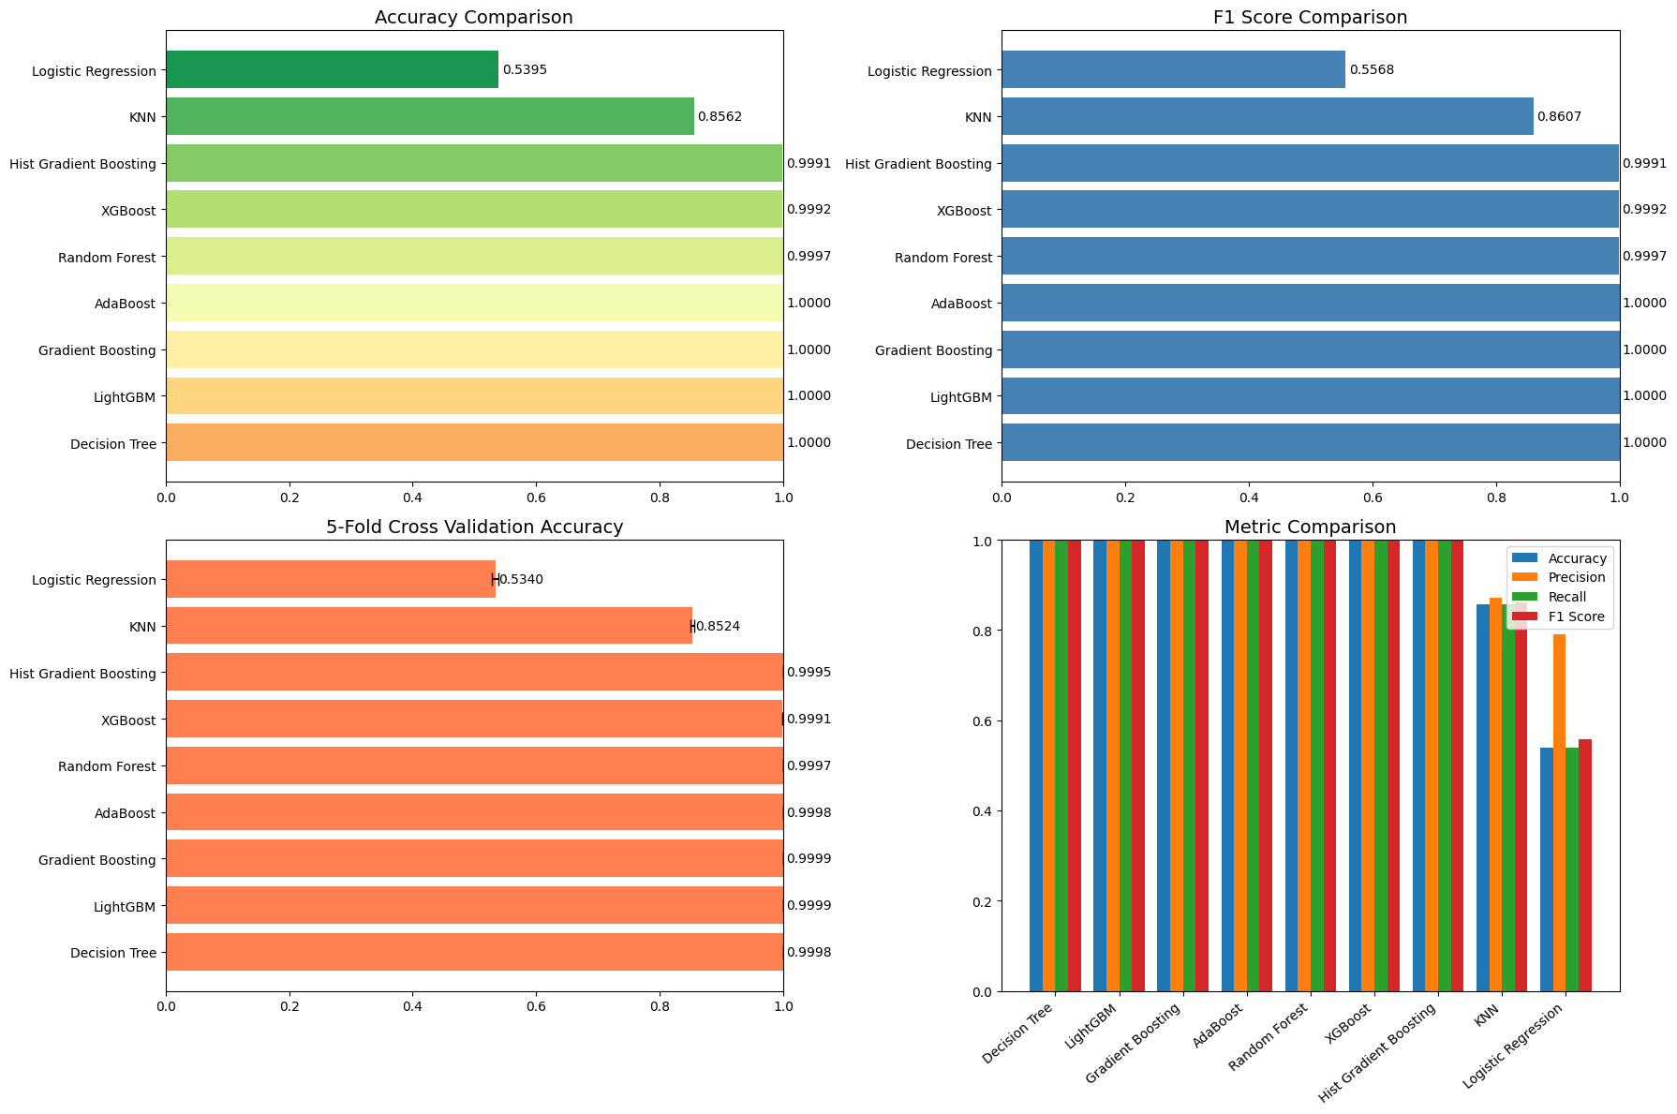
Performance Comparison Charts
24

Slide 26
9 • Best Model
Best Model: Decision Tree
1.0000
1.0000
9. Best Model Deep Dive
Accuracy
F1-Score
⚠ Important Methodological Note
Near-perfect accuracy (99.9%–100%) across several independent tree-based models is unusual for real-world credit classification problems.
This may indicate that certain features (such as Credit_Worthiness or approval rules) are near-deterministically linked to the target Status column, not necessarily data leakage.
Further review is recommended: examine each feature individually against Status, and test the model on entirely new data before any real production use.
25

Slide 27
10 • Tuning
Hyperparameter Tuning
RandomizedSearchCV then GridSearchCV — on Random Forest
RandomizedSearchCV
GridSearchCV (fine-tuning)
20 random parameter combinations, 5-fold CV
n_estimators: 300
max_depth: 30
min_samples_split: 20
criterion: log_loss
Best CV F1 = 0.9997
54 combinations around the best random result, 270 fits
n_estimators: 250
max_depth: 32
min_samples_split: 22
bootstrap: False
Best CV F1 = 0.9997
26

Slide 28
11 • Cross-Validation
Stratified Cross-Validation (5-Fold)
Fold | Train F1 | Val F1 | Val ROC-AUC | Val Precision | Val Recall
1 | 0.9999 | 0.9998 | 1.0000 | 0.9997 | 1.0000
2 | 0.9999 | 0.9998 | 1.0000 | 0.9997 | 1.0000
3 | 0.9993 | 0.9993 | 0.9999 | 0.9986 | 1.0000
4 | 0.9993 | 0.9995 | 1.0000 | 0.9990 | 1.0000
5 | 0.9999 | 1.0000 | 1.0000 | 1.0000 | 1.0000
0.9997 ± 0.0003
1.0000 ± 0.0000
Train/validation gap ≈ 0.0000 — no clear sign of overfitting within this split
F1 (mean ± std)
ROC-AUC
27

Slide 29
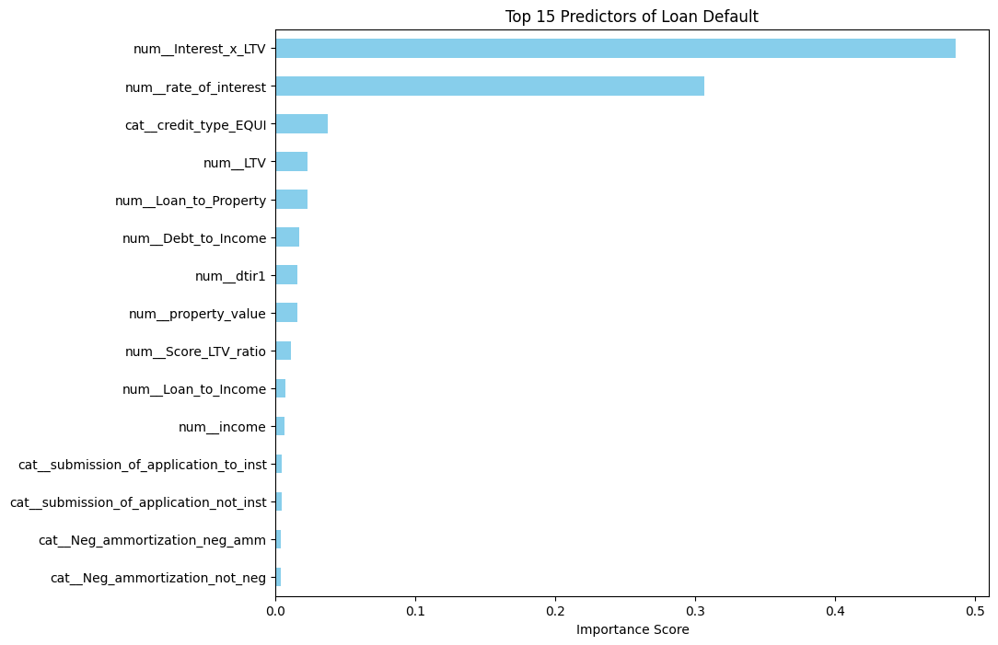
12 • Feature Importance
Feature Importance in the Final Model
Feature Importance — Random Forest
28

Slide 30
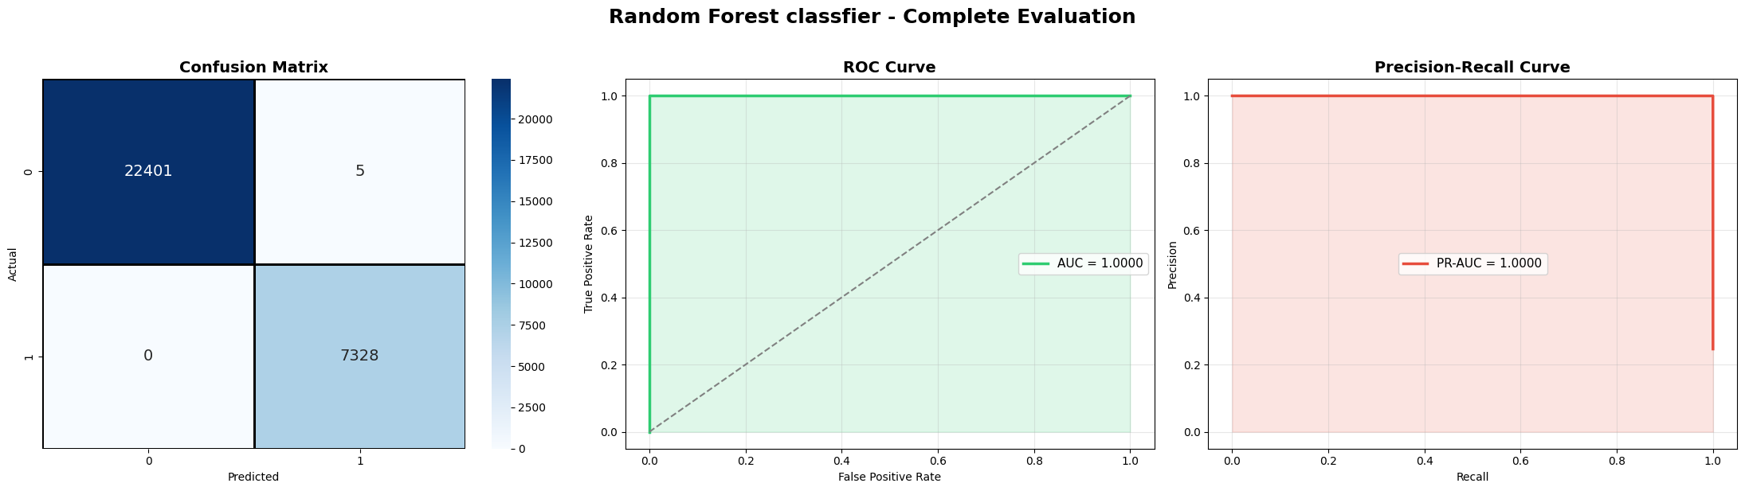
13 • Final Evaluation
ROC/PR Curves & Confusion Matrix
0.999832
Confusion Matrix (Random Forest): TN=22,401 FP=5 FN=0 TP=7,328 — ROC-AUC = 1.0
Test Accuracy / F1
29

Slide 31
14 • Production
Production Pipeline
Save the full pipeline (feature engineering + preprocessing + model) as a single file using joblib.
Reload the saved model (loan_default_pipeline.pkl) and verify its performance matches the original.
The reloaded model achieved ROC-AUC = 1.0000 on the test data — an exact match with pre-save performance.
Ready to deploy: a new loan application's data can be fed directly into the pipeline for an instant prediction, with no additional manual processing.
1.0000
loan_default_pipeline.pkl
Ready to integrate with any loan-application system via a simple API
ROC-AUC of the Reloaded Model
30

Slide 32
Limitations & Future Work
The near-perfect accuracy calls for further validation on fully independent data (out-of-time / out-of-sample) before full production adoption.
Some rare categories (such as Secured_by = 1) showed extreme rates (100%) due to small sample size — larger data is needed to confirm them.
Probability calibration could be explored to make model outputs more interpretable for lenders.
Model explainability (SHAP / LIME) could be added to clarify the reasoning behind each individual decision, supporting transparency and regulatory compliance.
Periodic model monitoring & retraining to keep pace with changing borrower behavior over time.
31

Slide 33
Conclusion & Key Takeaways
A complete machine learning model was built to predict loan default risk from 148,670 loan applications.
Class imbalance (75.4% vs 24.6%) was addressed using class_weight, after testing and excluding SMOTE for its unrealistic results.
Tree-based models (Decision Tree, LightGBM, Gradient Boosting) delivered the best performance, clearly outperforming linear models.
Hyperparameters were tuned via RandomizedSearchCV and GridSearchCV, and validated with 5-fold cross-validation to ensure reliable results.
The final model is saved within a complete, production-ready pipeline for real-world use.
32

Slide 34
Thank You
We appreciate your time and attention
Graduation Project — Digital Egypt Pioneers Initiative

