Slide 1

GoodBook

Slide 2

ABOUT US !
NGUYEN HONG NGUYEN HAI
CLASS: 22SE1
ID: 22IT076
WEB DESIGNER
WEB DESIGNER
Class : 22IT1
ID:

Slide 3
TABLE OF CONTENTS
01
02
03
04
INTRODUCTION
Programming language
Web structure
About our website
Some introductions about our website to see what we do
We will show you the specific structure of this website
We will show you what language we use to code this website
We will explore this website to see it's features

Slide 4
1.Introduction

Slide 5
1.Introduction
Calling all bookworms! Dust off your shelves and unleash your inner bibliophile – GoodBook is here to ignite your reading fire! Picture a treasure trove of pre-loved pages, whispering untold adventures, ageless wisdom, and hidden literary gems, all at prices that'll make your book dragon sing. Dive into a vast ocean of genres, navigate curated recommendations, and discover your next literary obsession with ease. Secure transactions, eco-friendly practices, and a passionate community of fellow readers await. So, what are you waiting for? Join the adventure at [Your Book Sale Website Name] and let your next chapter begin!

Slide 6
2. Programing language

Slide 7
MYSQL
5%
2. Programing language
SERVLET
5%
Method: Using CSS, HTML, JavaScript, Bootstrap to create the website interface. Utilizing JSP, Servlet, and MySQL to complete the website's backend.
-
Result: The website was built successfully with a clear and user-friendly interface, providing a satisfying experience for users.
HTML
40%
JSP
20%
JS/CSS/Bootstrap
30%

Slide 8
3. Website structure

Slide 9
3. Website structure
(This is our website structure present with hierachy form.)
This website include both front-end and back-end by using HTML ,CSS, bootstrap, JSP, servlet, MySQL .
We are still trying to give you the best experience .

Slide 10
4. About our website

Slide 11
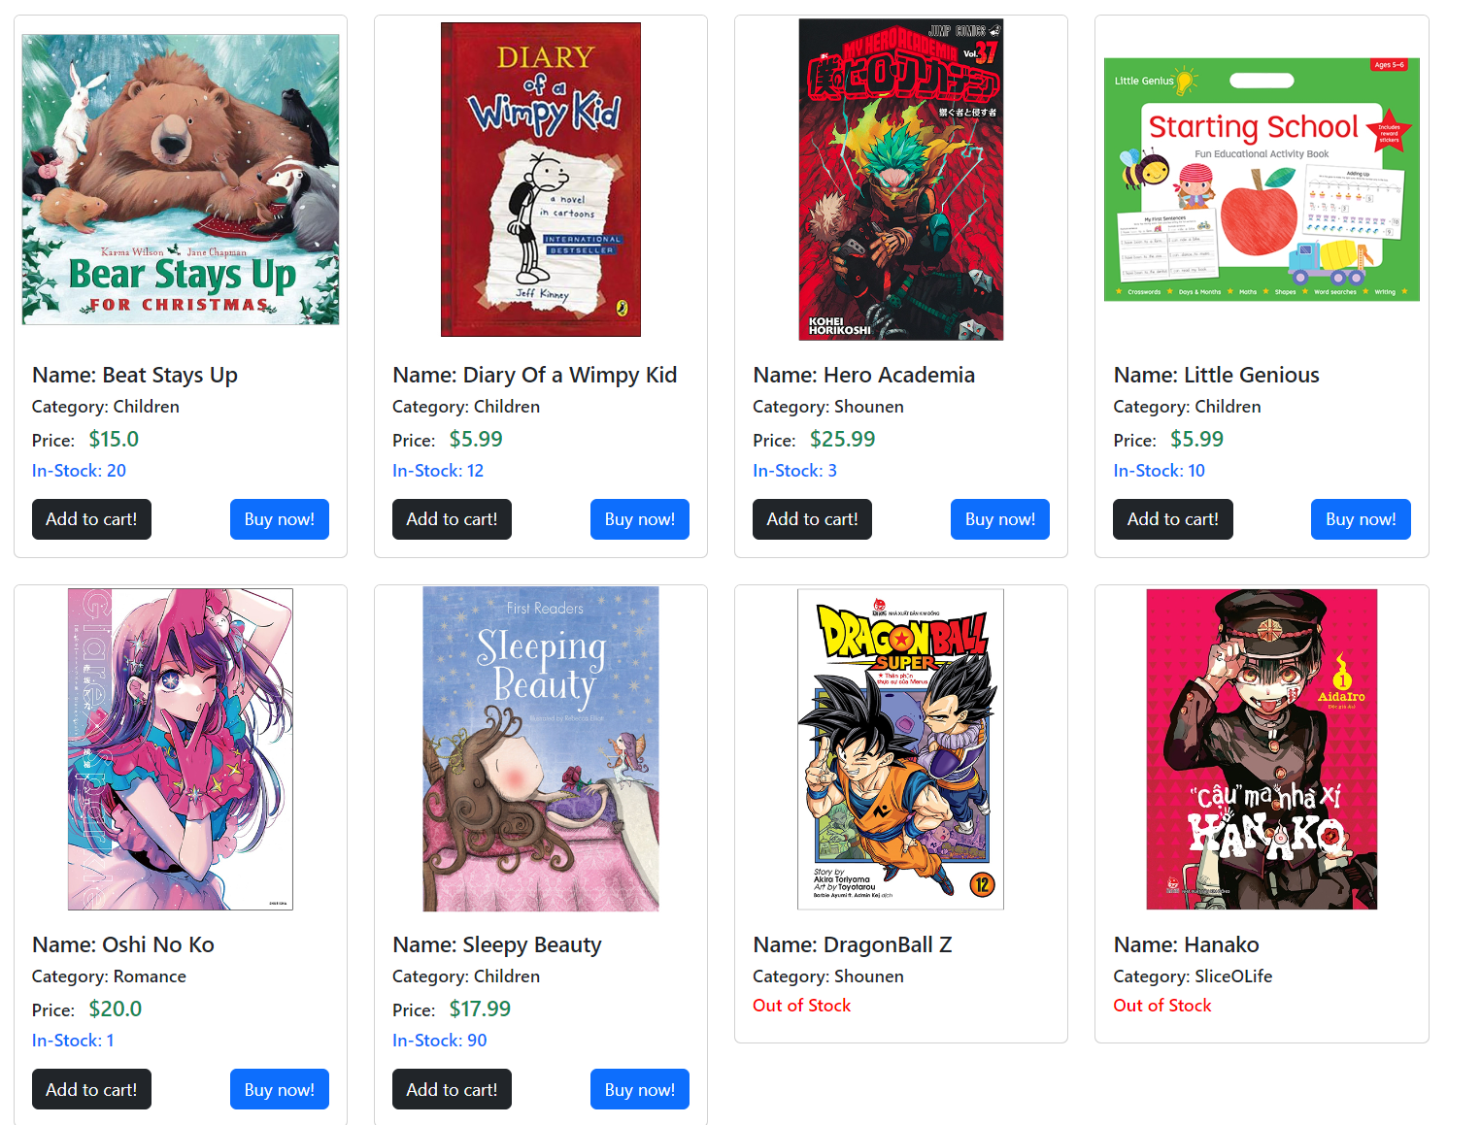

Slide 12
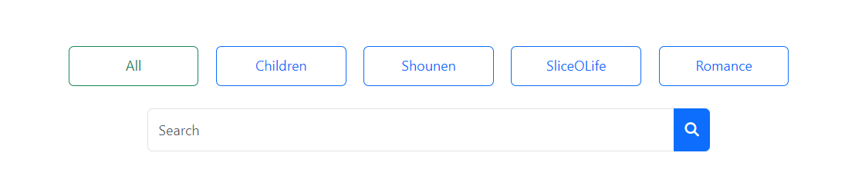

Slide 13
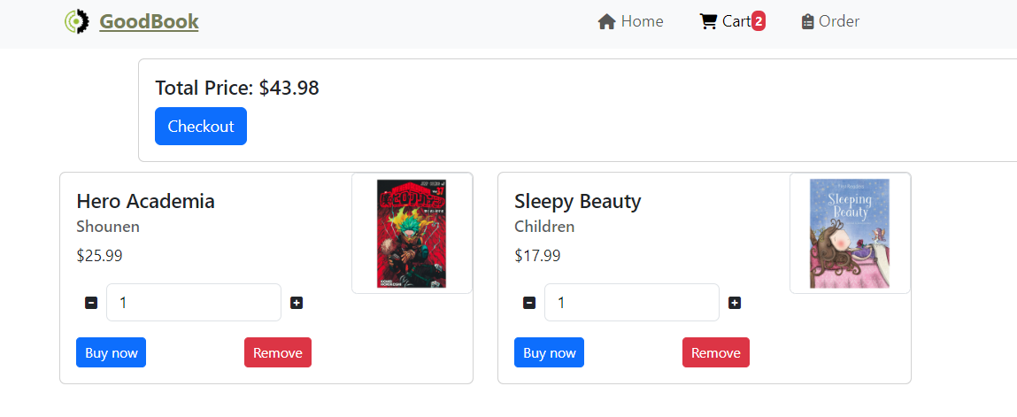

Slide 14
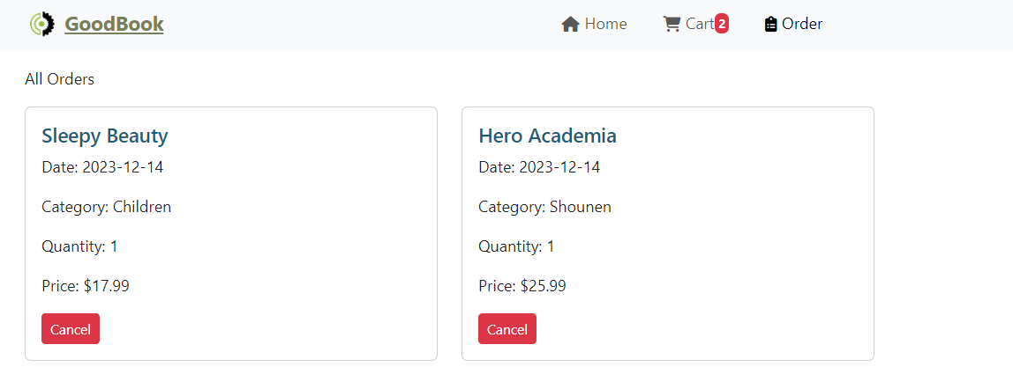

Slide 15
Thank you !

