Slide 1
Non-verbal Vocalizations for
Zero-shot Vietnamese TTS
Mentee: Tô Duy An
Mentor: Nguyễn Tùng Lương, Trần Hồng Nhật, Đỗ Văn Hải

Slide 2
Introduction
01
Table of contents
Method
02
Results
03
Conclusion
04

Slide 3


Introduction
Zero-shot TTS: clones any voice from a few seconds of audio
NVVs (laughter, sighs, breaths, coughs…) carry emotion and intent
Without them, speech sounds flat
Inline tags place the sound: “Thật à [laughter] mình không ngờ luôn”
Used in: voice agents, audiobooks, dubbing
và nguyễn đô này anh tùng chia sẻ cách. đợi vô địch ipo cho fan meeting tích mới ạ [laughter]

Slide 4
Introduction
Survey on commercial and open models
System tested | NVV recall ↑ | Unmatched target NVVs ↓
ElevenLabs | 78.7% | 21.3%
Orpheus TTS | 77.4% | 22.6%
Dia | 70.5% | 29.5%
Bark | 70.0% | 30.0%
CosyVoice 2 | 45.1% | 54.9%
Fish-Speech | 41.8% | 58.2%
Table 1: Performance of leading NVV TTS model on English
NVV-SuperBench: Xue et al., arXiv:2604.16211

Slide 5
Introduction
Goal: a Vietnamese sentence with a tag like [cough] → that sound, at that spot, in the cloned voice
Released OmniVoice on Vietnamese tags
OmniVoice demo
64%
of tags: no sound at all
11.5%
right sound, right place
Bởi vì. Chơi bóng đá mà lại chẳng có quả bóng trong chân [throatclearing] mà vẫn phải chơi
Bác Trịnh Lữ trong chương trình Happiness thì có nói một câu, là người trẻ mà cứ nghĩ đến chuyện là tôi phải làm khác người khác là là không được đấy khỏi bản chất của nghệ thuật [sniff]
OmniVoice: Zhu et al., arXiv:2604.00688, 2026

Slide 6
Introduction
01
No Vietnamese NVV control
Commercial TTS has NVV tags in 13 languages, none of them Vietnamese
02
Tags don't transfer
OmniVoice learned its tags from Chinese and English: 64% of Vietnamese tags make no sound
03
No labelled data
No public Vietnamese speech with NVVs marked where they occur
Our approach → synthesize Vietnamese NVV data (03), then fine-tune OmniVoice on it (01, 02)
OmniVoice: Zhu et al., arXiv:2604.00688, 2026
Fish Audio: Fish Audio, OpenAudio S1, huggingface.co/fishaudio/openaudio-s1-mini, 2025

Slide 7
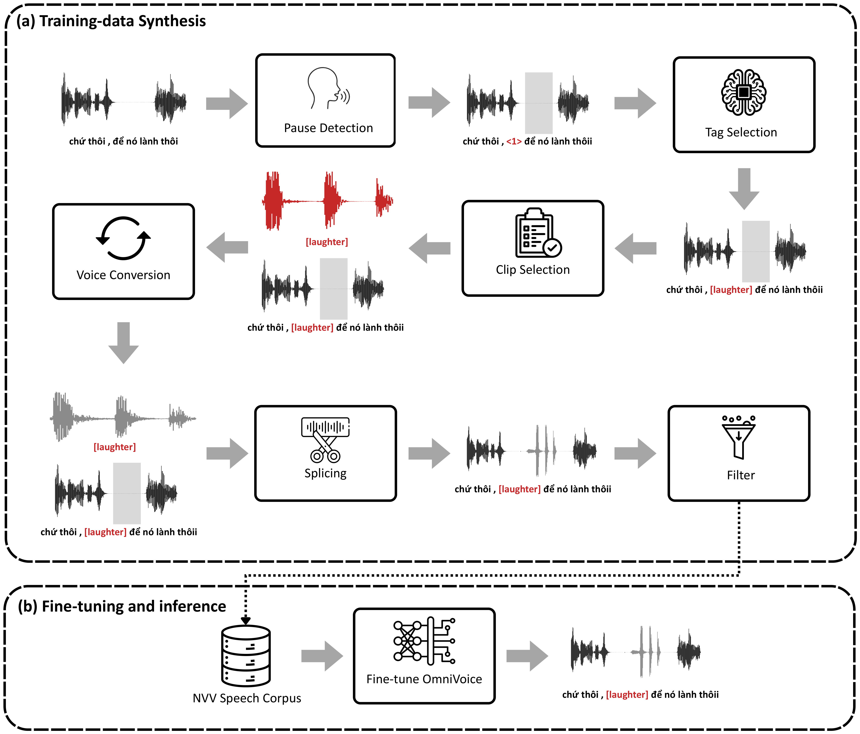
Overview
OmniVoice: Zhu et al., arXiv:2604.00688, 2026
Qwen3-Omni: Qwen Team, arXiv:2509.17765, 2025
Seed-VC: Liu, arXiv:2411.09943, 2024
NISQA: Mittag et al., Interspeech 2021

Slide 8
NVV clip pool
Built once before synthesis: clean, isolated NVV clips pooled from several corpora into 17 classes.
INPUT
PROCESS
OUTPUT
VocalSound
Right class (FlexSED)
No speech (Qwen3-ASR)
Plausible length
SNR ≥ 6 dB, no clipping
laughter
sigh
cough
throatclearing
Nonspeech7k
sneeze
sniff
breathing
crying
screaming
gasp
burp
yawn
FSD50K
snoring
grunt
yell
moan
NVS-38K
pant
Existing NVV corpora and a tagged speech corpus
Locate, trim and check each event; keep only clean, isolated ones
Clip pool: 17 NVV classes
Clip pool
1 Pause detection
2 Tag selection
3 Clip selection
4 Voice conversion
5 Splicing
6 Filter
FlexSED: Hai et al., arXiv:2509.18606, 2025
Qwen3-ASR / Qwen3-ForcedAligner: Qwen Team, arXiv:2601.21337, 2026

Slide 9
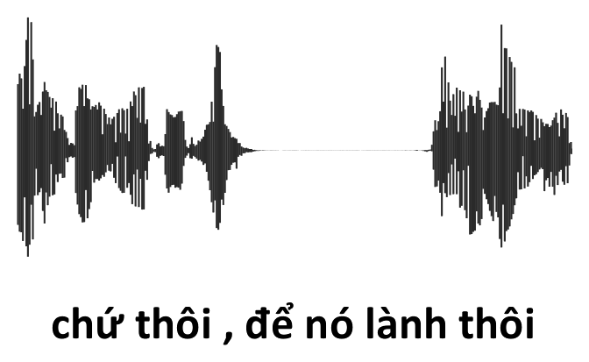
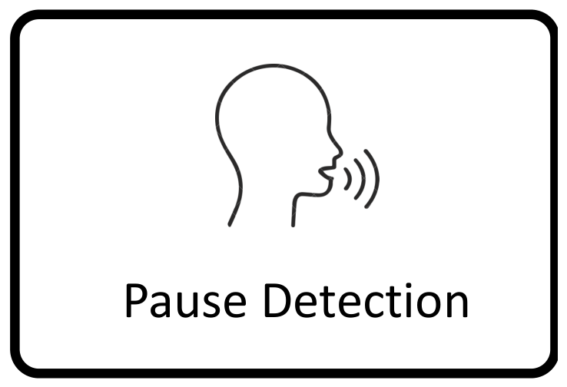
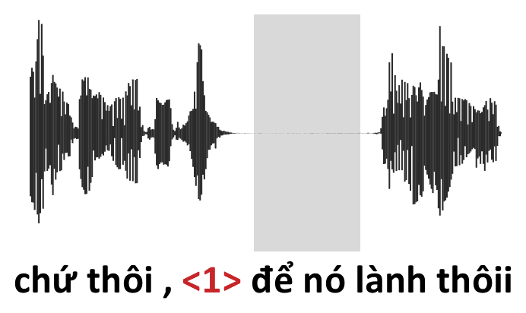
Pause detection
A voice activity detector and a forced aligner find the pauses between words, and each becomes a numbered slot in the transcript.
INPUT
PROCESS
OUTPUT
Vietnamese utterance:
audio + transcript
Silero VAD + Qwen3-ForcedAligner: a pause between two words becomes a slot
Transcript with numbered slots such as <1>
Clip pool
1 Pause detection
2 Tag selection
3 Clip selection
4 Voice conversion
5 Splicing
6 Filter
Silero VAD: Silero Team, github.com/snakers4/silero-vad, 2024
Qwen3-ASR / Qwen3-ForcedAligner: Qwen Team, arXiv:2601.21337, 2026

Slide 10

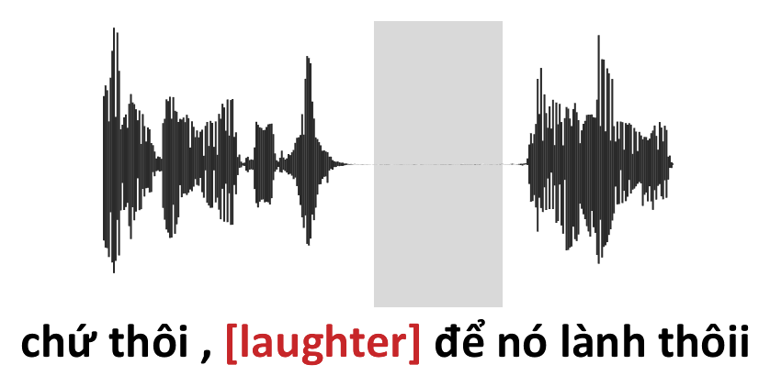
Tag selection
Qwen3-Omni listens to the recording and picks one slot and the NVV tag that best fits what the speaker is doing there.
* Qwen3-Omni: LLM model with capacity to tokenize and understand audio
INPUT
PROCESS
OUTPUT
Audio + slotted transcript
Qwen3-Omni picks the most plausible slot and tag, or none
One slot + one NVV tag
Clip pool
1 Pause detection
2 Tag selection
3 Clip selection
4 Voice conversion
5 Splicing
6 Filter
Qwen3-Omni: Qwen Team, arXiv:2509.17765, 2025

Slide 11

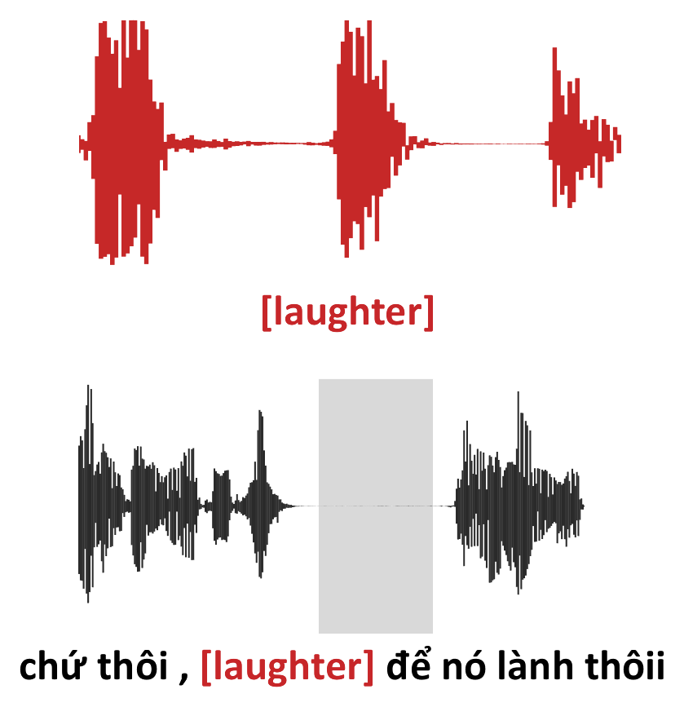
Clip selection
A clip of that class is sampled, weighted towards clips that match the speaker's intensity, clarity, tempo and tilt.
INPUT
PROCESS
OUTPUT
Chosen tag + the speech just before the cut
Weighted sampling by intensity, clarity, tempo and tilt
One NVV clip of that class
Clip pool
1 Pause detection
2 Tag selection
3 Clip selection
4 Voice conversion
5 Splicing
6 Filter

Slide 12
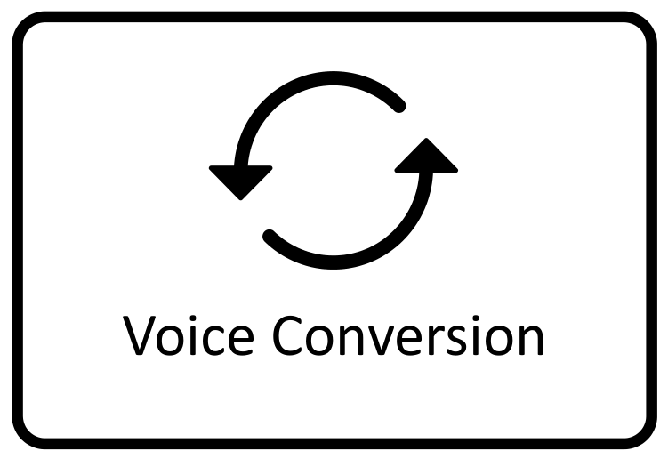
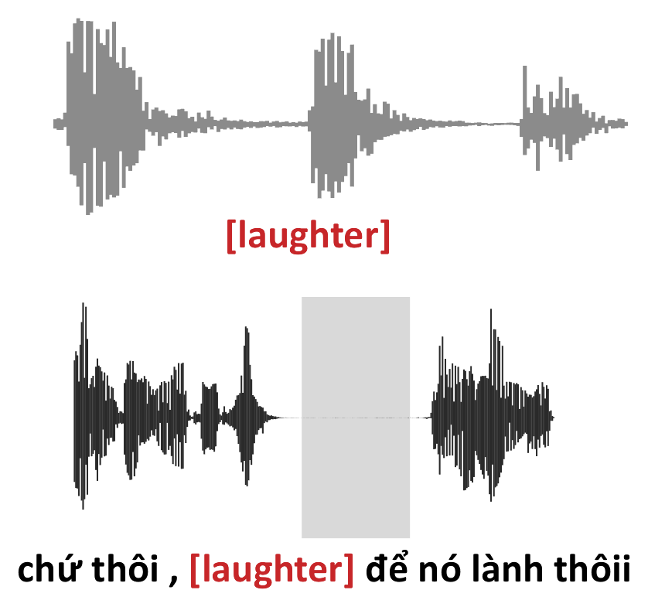
Voice conversion
Seed-VC converts the selected clip into the host speaker's voice, using the host utterance as the reference.
* Voice conversion system copy original prosody while changing timbre to prompted speaker
INPUT
PROCESS
OUTPUT
Selected clip + host utterance as voice reference
Seed-VC, pitch conditioning off
Clip in the host speaker's voice
Clip pool
1 Pause detection
2 Tag selection
3 Clip selection
4 Voice conversion
5 Splicing
6 Filter
Seed-VC: Liu, arXiv:2411.09943, 2024

Slide 13
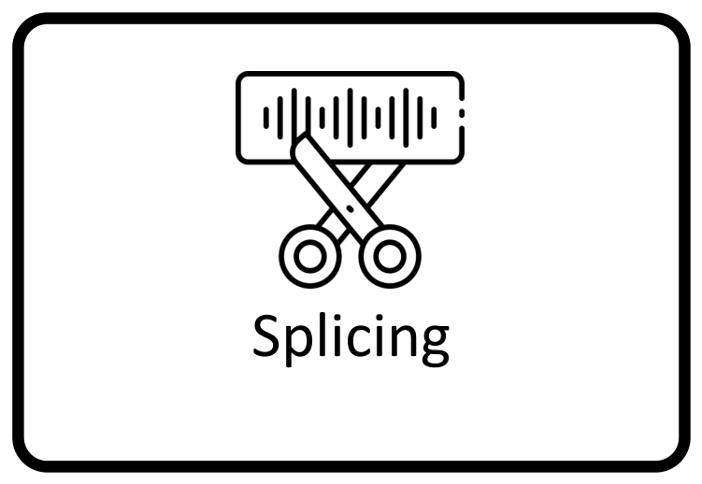
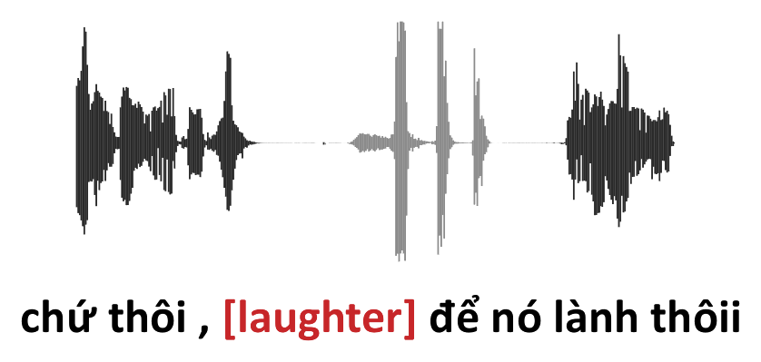
Splicing
The converted event is loudness-matched and spliced into the pause, with natural silence on each side.
INPUT
PROCESS
OUTPUT
Converted clip + host utterance + chosen slot
Match loudness, add a natural pause, short exponential fades; insert at the slot's midpoint
Spliced audio + tagged transcript
Clip pool
1 Pause detection
2 Tag selection
3 Clip selection
4 Voice conversion
5 Splicing
6 Filter

Slide 14
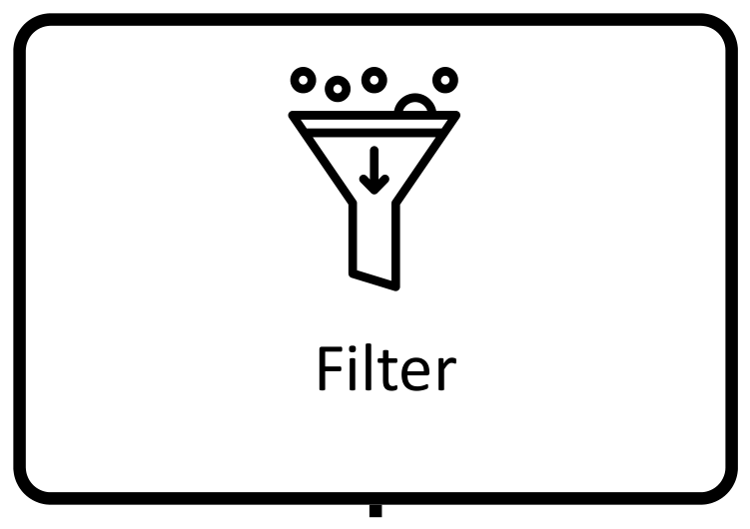

Filter
NISQA scores each result, and examples whose quality or continuity drops too much are discarded.
* NISQA is an automated metric to score how natural an utterance is on several conditions
INPUT
PROCESS
OUTPUT
Spliced example, scored against its source
NISQA: reject if quality or continuity drops too much
Kept → NVV speech corpus
Clip pool
1 Pause detection
2 Tag selection
3 Clip selection
4 Voice conversion
5 Splicing
6 Filter
NISQA: Mittag et al., Interspeech 2021

Slide 15
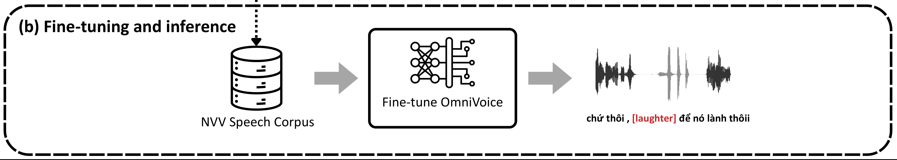
Fine-tuning & inference
OmniVoice is fine-tuned on our synthetic NVV data alone (224,064 utterances, 811 h, 17 tags) for 10,000 steps; at inference, an inline tag produces the sound in the cloned voice.
OmniVoice: Zhu et al., arXiv:2604.00688, 2026

Slide 16
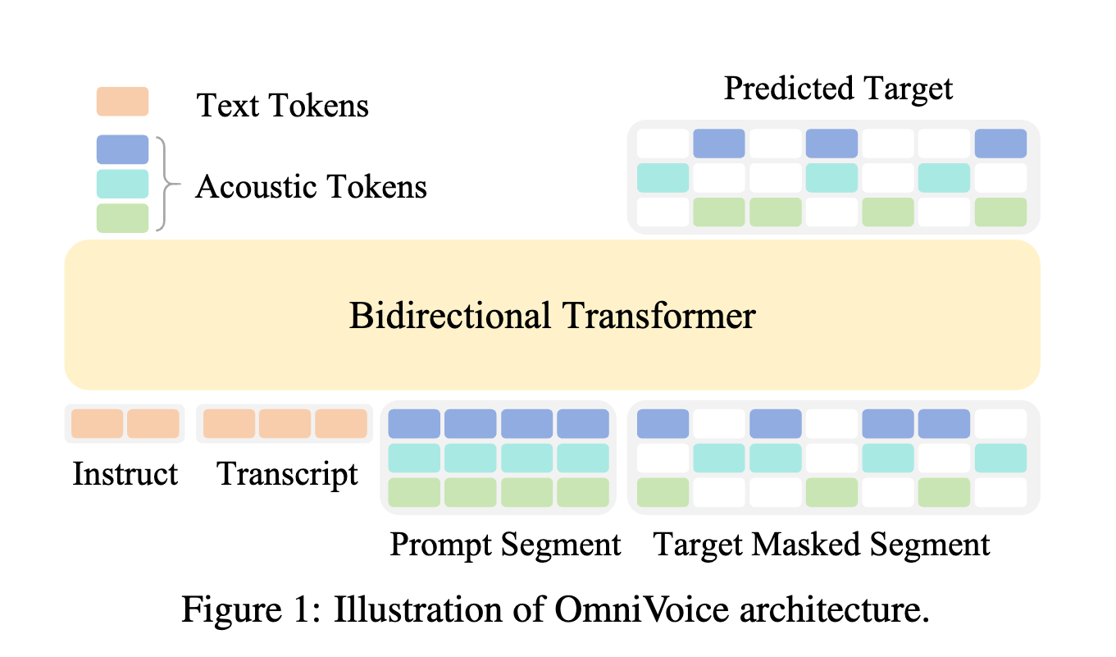
Fine-tuning & inference
OmniVoice is NAR TTS system finetune on many languages and NVV tags (mostly Chinese)
OmniVoice: Zhu et al., arXiv:2604.00688, 2026

Slide 17
Why fine-tune OmniVoice?
Few NVV tags
Only [laughter] and [sigh] are non-verbal; 15 of our 17 classes have no tag.
Easy integration
It can learn new NVV tags easily and give great result
No tag control
It often drops the tag or speak the tag in English when the context is Vietnamese.
Our fix
Fine-tune on our synthetic data alone: all 17 tags on Vietnamese speech, with the same objective.
OmniVoice: Zhu et al., arXiv:2604.00688, 2026

Slide 18
NVV clip pool
Built once before synthesis: clean, isolated NVV clips pooled from several corpora into 17 classes.
13,165 clips, 12.0 h in total
Figure 1: NVV clips per class in the clip pool

Slide 19
Result
The first synthesize TTS with nonverbal element for Vietnamese, able to scale up for more tags
224,064
utterances, one NVV each
810.8 h
of tagged Vietnamese speech
17
NVV tags, 10,190–13,522 utterances each
Figure 2: Hours of synthetic training speech per tag (built from ViVoice)

Slide 20
Evaluation metrics
Zero-shot TTS
238 plain-text utterances
WER ↓
word error rate (%) of a Zipformer ASR transcript vs the input text
SIM-o ↑
speaker similarity: ECAPA-TDNN cosine, output vs reference voice
RTF ↓
synthesis time ÷ audio length, one A100
NVV synthesis
2,940 tagged items, 7 unseen voices
NVMR ↓
miss rate: tags with no vocalization at all (skipped or read out)
NVPA ↑
placement accuracy: FlexSED finds the tagged class at the tag's position
WER, SIM-o, RTF
as in zero-shot
Listening test
10 native listeners × 40 samples, rated 1–5
MOS-Q ↑
audio quality
MOS-N ↑
naturalness: does it sound like a real person?
MOS-E ↑
expressiveness: the right sound, with the sentence's feeling
±
95% confidence interval
FlexSED: Hai et al., arXiv:2509.18606, 2025
Zipformer: Yao et al., ICLR 2024
ECAPA-TDNN: Desplanques et al., Interspeech 2020

Slide 21
Result
Zero-shot TTS on plain text: the same 238 utterances for every system
System | WER ↓ | SIM-o ↑ | RTF ↓
viXTTS | 3.27 | 0.70 | 0.67
F5-TTS | 3.02 | 0.82 | 0.47
VietVoice-TTS | 2.37 | 0.78 | 0.47
VieNeu-TTS | 2.00 | 0.65 | 0.89
Fish Audio | 11.31 | 0.79 | –
OmniVoice (base) | 3.93 | 0.84 | 0.06
OmniVoice fine-tuned (ours) | 4.78 | 0.84 | 0.06
Table 3: Zero-shot TTS evaluation (WER in %)
Fish Audio is only reachable through an API, so its RTF is not measured
OmniVoice: Zhu et al., arXiv:2604.00688, 2026
viXTTS: capleaf, huggingface.co/capleaf/viXTTS, 2024 (fine-tuned XTTS: Casanova et al., Interspeech 2024)
F5-TTS: Chen et al., arXiv:2410.06885, 2024
VietVoice-TTS: [source to add]
VieNeu-TTS: Pham, github.com/pnnbao97/VieNeu-TTS
Fish Audio: Fish Audio, OpenAudio S1, huggingface.co/fishaudio/openaudio-s1-mini, 2025
Zipformer: Yao et al., ICLR 2024
ECAPA-TDNN: Desplanques et al., Interspeech 2020

Slide 22
Result
NVV synthesis: 2,940 tagged items (420 sentences, 14 classes, 7 unseen voices)
System | NVMR ↓ | NVPA ↑ | WER ↓ | SIM-o ↑ | RTF ↓
Fish Audio | 0.6543 | 0.2280 | 60.48 | 0.32 | –
OmniVoice (base) | 0.6435 | 0.1153 | 8.11 | 0.75 | 0.06
OmniVoice fine-tuned (ours) | 0.3507 | 0.5000 | 6.73 | 0.74 | 0.06
Table 4: Vietnamese NVV synthesis (WER in %)
Fish Audio: API only, evaluated on a 280-item subset of the 2,940; RTF not measured
OmniVoice: Zhu et al., arXiv:2604.00688, 2026
Fish Audio: Fish Audio, OpenAudio S1, huggingface.co/fishaudio/openaudio-s1-mini, 2025
FlexSED: Hai et al., arXiv:2509.18606, 2025
Zipformer: Yao et al., ICLR 2024
ECAPA-TDNN: Desplanques et al., Interspeech 2020

Slide 23
Result
Listening test: 10 native listeners, 40 NVV samples each, balanced across the three systems
System | MOS-Q ↑ | MOS-N ↑ | MOS-E ↑
Fish Audio | 3.38 ± 0.04 | 2.12 ± 0.05 | 1.96 ± 0.04
OmniVoice (base) | 3.63 ± 0.03 | 2.19 ± 0.04 | 1.56 ± 0.03
OmniVoice fine-tuned (ours) | 3.89 ± 0.01 | 3.15 ± 0.04 | 2.96 ± 0.05
Table 5: Listening test on NVV synthesis (1–5, 95% CI)
OmniVoice: Zhu et al., arXiv:2604.00688, 2026
Fish Audio: Fish Audio, OpenAudio S1, huggingface.co/fishaudio/openaudio-s1-mini, 2025

Slide 24

Result
The first synthesize TTS system to speak with nonverbal cue effectively
Utterance (input text) | Reference voice | Fish Audio | OmniVoice (base) | OmniVoice fine-tuned (ours)
[laughter] cậu kể chuyện gì mà buồn cười thế làm tôi cười đau cả bụng
[throatclearing] Xin chào mọi người, chúng ta bắt đầu cuộc họp hôm nay nhé.
Cảm ơn ông trời [sniff] cuối cùng tôi cũng tìm được chìa khóa nhà
[throatclearing] Xin lỗi, cho tôi hỏi ga Hà Nội đi lối nào ạ [breathing] tôi chạy nãy giờ mệt quá.
✓
✗
✓
✗
✗
✓
✓
✗
✓
✗ ✗
✗ ✗
✓ ✓
▶ click to play ✓ / ✗ one mark per tag: FlexSED finds / misses the tagged NVV at its position Reference voice: the unseen speaker's prompt clip

Slide 25
Conclusion
Nonverbal element to enhance the naturalness of TTS system, suitable for expand our TTS and incorporate with agentic conversation
Built a pipeline that automatically creates Vietnamese TTS + NVV data: about 811 h over 17 sound types
Fine-tuned OmniVoice makes the right sound at the right place for 50% of tags (vs 11.5%) and misses 35% (vs 64%)
Small cost on plain text (WER 3.93% → 4.78%) at RTF 0.06; listeners rate it highest on quality, naturalness and expressiveness
Next: a ViVoice-only baseline, and a test set covering all 17 sound types

Slide 26
Thank you for listening

Slide 27
Appendix: Speech data
Host recordings: real Vietnamese speech
ViVoice: Vietnamese multi-speaker speech corpus
Internal Pod cast dataset: Vietnamese multi-speaker long speech corpus
Natural, conversational speech with real pauses: the slots where NVVs are inserted
Statistic | Value | Unit / detail
Total audio duration | 1,016.97 | hours
Number of utterances | 887,772 | utterances
Dataset size | 169 | GB
Estimated male proportion | 61.3% | ± 3.02 percentage points (95% CI)
Mean utterance duration | 4.12 | seconds
25th percentile duration | 1.96 | seconds
75th percentile duration | 5.55 | seconds
Reported speaking rate | 243 | words/minute
Estimated SI-SNR | 4.81 | dB
Why these choices
1,017 h 887,772 utterances of multi-speaker Vietnamese: enough hosts for 10k+ utterances per tag (Table 2)
In-domain untagged ViVoice is already in OmniVoice's training data: fine-tuning adds tags, not a new voice domain (Zhu et al., 2026)
Table 2: ViVoice statistics
ViVoice: capleaf, huggingface.co/datasets/capleaf/viVoice, 2024
OmniVoice: Zhu et al., arXiv:2604.00688, 2026

Slide 28
Appendix: NVV clip pool
Sources: VocalSound (test + validation splits only, so a classifier trained on its train split can still score our output), Nonspeech7k (breathing, crying, screaming, yawn), FSD50K and events cut from the tagged NVS-38K corpus
Locating events: NVS-38K captions are force-aligned (Qwen3-ForcedAligner) only to confirm the tag lies within 1 s of the dataset's own non-verbal region, which is what we cut; FSD50K clip labels are localised with FlexSED frame posteriors (≥ 0.5, gaps ≤ 0.3 s merged)
Trimming: edges tightened to the frame energy within ±0.2 s, then padded by 75 ms and faded by 10 ms
Kept only if: FlexSED scores its class ≥ 0.5 and no VocalSound class higher; no other labelled sound ≥ 0.5 over it; Qwen3-ASR hears no word; length is plausible for the class (e.g. 0.2–2.5 s breathing, 0.8–4.0 s yawn); SNR ≥ 6 dB; ≤ 0.1% clipped samples
Result: 17 classes, 6 from VocalSound and 11 added from the other sources (13,165 clips, 12.0 h)
Why these choices
6 → 17
classes: VocalSound alone has 6; three more sources add 11 (13,165 clips, 12.0 h)
Gong et al., 2022; our clip pool
0.45
PSDS1 of FlexSED on AudioSet-Strong, vs 0.40 Dasheng-SED and 0.38 ATST-SED; any class by text prompt
Hai et al., 2025
5,446
VocalSound clips, test + val only: a classifier trained on its train split can still judge our output
our clip pool
FlexSED: Hai et al., arXiv:2509.18606, 2025
Qwen3-ASR / Qwen3-ForcedAligner: Qwen Team, arXiv:2601.21337, 2026
VocalSound: Gong et al., ICASSP 2022
FSD50K: Fonseca et al., IEEE/ACM TASLP 2022
Nonspeech7k: IET Signal Processing; zenodo.org/records/6967442
NVS-38K: Ye et al., arXiv:2508.05385, 2025

Slide 29
Why these values: NVV clip pool
Choice | Value | Why | Basis
VocalSound split | test + validation only (5,446 clips) | Its train split stays unseen, so a classifier trained on it can still judge our output fairly; about 907 clips per class remain, speakers disjoint | design
Event detector | FlexSED | Open vocabulary: any class by text prompt, so one model locates and checks all 17 classes, also those outside fixed label sets; PSDS1 0.45 vs 0.40 Dasheng-SED | Hai et al., 2025
Speech check | Qwen3-ASR | Any recognised word means speech overlaps the event; it also reads the Chinese and English source recordings | design
Class score | FlexSED ≥ 0.5 | The posterior is a probability: ≥ 0.5 means the class is more likely present than not; the same value both locates and confirms an event | design
Event merging | gaps ≤ 0.3 s bridged | A laugh, sob or pant has short internal breaks; bridging keeps it one event instead of several fragments | design
NVS-38K tag check | tag within 1 s of the region | The aligner stretches the neighbouring words over the sound, so the tag only confirms which detected region the caption means; that region is cut | design
Edges | ±0.2 s search, 75 ms pad, 10 ms fade | Detector edges are coarse, so frame energy tightens them; the pad keeps the soft onset and tail; the fade removes the click at the cut | design
Length | per class, e.g. breathing 0.2–2.5 s, yawn 0.8–4.0 s | Rejects detector fragments (too short) and merged runs of several events (too long) | design
Level | SNR ≥ 6 dB, ≤ 0.1% clipped | 6 dB = event power at least 4× the noise floor; Seed-VC reproduces source noise and clipping faithfully, so neither can be fixed later | design
FlexSED: Hai et al., arXiv:2509.18606, 2025
Qwen3-ASR / Qwen3-ForcedAligner: Qwen Team, arXiv:2601.21337, 2026
Basis: design = follows from how the pipeline works

Slide 30
Appendix: Pause detection
Why pauses first: following SynParaSpeech, find where an NVV could go before choosing; placing a tag first and aligning it later put the nearest real pause a median 2.02 s away on a 20-utterance pilot
Pauses: Silero VAD finds speech regions; regions < 0.10 s apart are merged (stop closures and glottal breaks are not pauses); gaps are trimmed by 0.05 s each side and kept if ≥ 0.12 s; silence before the first and after the last word is ignored
Word boundaries: ViVoice transcripts have no timing, so Qwen3-ForcedAligner aligns the untagged transcript to the audio
Slots: a pause overlapping the gap between two aligned words becomes a slot (the longer one if two share a gap); each slot stores its midpoint and the character offset of the next word
Safety: if any word cannot be matched back to the transcript in order, the utterance gets no slots and is skipped
Why these choices
2.02 s
median gap from a text-placed tag to the nearest real pause; 3 of 20 rows had no pause at all
our 20-utterance pilot
32 ms
timestamp error of Qwen3-ForcedAligner, vs 101 ms NFA and 141 ms Monotonic-Aligner; aligned 20/20 pilot rows
Qwen Team, 2026 (human-labelled sets); our 20-utterance pilot
6,000+
languages in Silero VAD's training data; < 1 ms per 30 ms chunk on one CPU thread
Silero Team, 2024
SynParaSpeech: Bai et al., arXiv:2509.14946, 2025
Silero VAD: Silero Team, github.com/snakers4/silero-vad, 2024
Qwen3-ASR / Qwen3-ForcedAligner: Qwen Team, arXiv:2601.21337, 2026

Slide 31
Why these values: Pause detection
Choice | Value | Why | Basis
Order | find pauses, then pick one | A tag placed from text lands on continuous voicing (boundary activity median 0.85); the nearest real pause was a median 2.02 s away | pilot
Moving the cut later | rejected | Within 0.5 s it reached a pause for 1 of 17 utterances, within 2.0 s for 7 of 17, by which point the event no longer sits between the words the transcript says | pilot
Voice activity | Silero VAD | A breath in a pause is not silent, but it is not speech: an energy threshold calls it speech and smears speech about one 128 ms frame into the pause | design
Merge | regions < 0.10 s apart | Stop closures and glottal breaks are not pauses | design
Trim and minimum | 0.05 s off each edge; keep ≥ 0.12 s | Pause edges still carry the neighbouring words' energy; a shorter gap is a stop closure, not room for an event | design
Word timing | Qwen3-ForcedAligner | No pronunciation dictionary: MFA, which we also tried, marks fillers like “à”, “ha”, “thì” unknown and guesses their timing, the words a tag sits next to; 32 ms error vs 101 ms NFA | pilot; Qwen Team, 2026
Two pauses in one gap | keep the longer | More silence around the cut, which sits at the pause midpoint, furthest from either word | design
Word not matched | skip the utterance | A wrong character offset would put the tag between different words than the audio cut | design
Yield | 16 of 20 kept, 47 slots | The 4 utterances with no qualifying pause are dropped (about 20%), so every kept example is spliced into real silence; slots were 0.20–1.20 s | pilot
Silero VAD: Silero Team, github.com/snakers4/silero-vad, 2024
Qwen3-ASR / Qwen3-ForcedAligner: Qwen Team, arXiv:2601.21337, 2026
Montreal Forced Aligner: McAuliffe et al., Interspeech 2017
Basis: pilot = measured on our 20-utterance pilot; design = follows from how the pipeline works

Slide 32
Appendix: Tag selection
Model: Qwen3-Omni-30B-A3B-Instruct, served locally with vLLM; it receives the recording and the transcript with numbered slot markers
Task: listen to the delivery and answer in JSON with the one slot where a non-verbal sound is most plausible and the one tag that fits, or {"slot": null} if none suits
Decoding: temperature 0.2, top-p 0.95; an invalid reply is retried (up to 3 attempts); a null answer skips the utterance
Alignment by construction: the LLM never writes transcript text; the tag is inserted in code at the chosen slot and the audio is spliced at the same slot
Tag balancer: on the pilot the model chose only laughter and sigh; the balancer withholds any tag holding too large a share until the others catch up, giving 10,190–13,522 utterances per tag
Why these choices
32 / 36
audio benchmarks where Qwen3-Omni is open-source SOTA; Vietnamese is one of its 19 speech-input languages
Qwen Team, 2025
2 of 17
tags the model used on the pilot without balancing (laughter and sigh only)
our 20-utterance pilot
10,190–13,522
utterances per tag after balancing, across all 17 tags
our training set
Qwen3-Omni: Qwen Team, arXiv:2509.17765, 2025

Slide 33
Why these values: Tag selection
Choice | Value | Why | Basis
Model type | audio LLM, not text-only | A numbered slot means little from text alone; listening tells a breath pause from a hesitation, and whether a laugh or a sigh fits (SynParaSpeech reads text only) | design
Model | Qwen3-Omni-30B-A3B-Instruct | Open-source SOTA on 32 of 36 audio and audio-visual benchmarks; Vietnamese is one of its 19 speech-input languages; only 3B of its 30B parameters active per token | Qwen Team, 2025
Serving | local, through vLLM | Recordings stay on our own servers: no external API and no key | design
Answer | JSON {slot, tag}, never transcript text | The tag is inserted in code at the chosen slot and the audio is cut at the same slot, so text and audio agree by construction | design
Decoding | temperature 0.2, top-p 0.95 | A constrained choice, not free writing: low randomness keeps replies valid JSON and stable across runs | design
Retries | up to 3 attempts | At this temperature the same prompt mostly returns the same answer, so each retry states what was wrong (unreadable reply, unknown or withheld tag) | design
Option to decline | {"slot": null} skips | Forcing a tag on every utterance would put a sound where none fits | design
Balancer cap | 25% share | Unbalanced, the pilot's 16 tags were all laughter (9) or sigh (7); a tag above the cap is withheld until the others catch up | pilot
Warm-up | share over ≥ 20 tags | The first tag is 100% of picks; with a 20-tag warm-up a tag is first withheld on its 6th pick within the first 20 | design
Qwen3-Omni: Qwen Team, arXiv:2509.17765, 2025
SynParaSpeech: Bai et al., arXiv:2509.14946, 2025
Basis: pilot = measured on our 20-utterance pilot; design = follows from how the pipeline works

Slide 34
Appendix: Clip selection
Pre-filter: clips with peak < 0.05, shorter than 0.35 s after trimming, or > 1% samples at full scale are excluded
Four measures, on the clip and on the 2.5 s of speech before the cut: intensity (crest-factor and duration rank vs. the speaker's loudness rank), clarity (SNR from the 90th/10th percentile of 20 ms frame RMS), tempo (envelope peaks per second, laughter only), tilt (slope of the log envelope)
Not matched: timbre and pitch, because voice conversion rebuilds them
Weighting: each distance d is divided by a tolerance (0.35 rank, 12 dB, 1 octave, 18 dB) and weighted by w = 1.0, 1.5, 1.0, 0.5; a clip is drawn with probability proportional to exp(−Σ w·d)
Sampling, not nearest: every usable clip stays in play, and the intensity target is drawn around the speaker's own rank, so a soft-spoken speaker still sometimes gets a loud laugh
Why these choices
+0.04
weight of the clip's own pitch in the converted pitch (contour corr. +0.14): Seed-VC rebuilds it, so no pitch matching
our measurement, clip vs converted clip
0.06 oct
median crest-factor change through conversion: intensity survives, so it is matched (tempo: 0.15 oct)
our measurement, clip vs converted clip
−38%
clarity mismatch vs a uniform random pick (tempo −35%), 400 draws × 20 rows
our 20-utterance pilot

Slide 35
Why these values: Clip selection
Choice | Value | Why | Basis
Pre-filter | peak < 0.05, < 0.35 s, > 1% at full scale | Drops near-silent clips, clips too short to hold an event, and clipped ones: clipping is distortion Seed-VC reproduces, not a mismatch to weigh | design
Not matched | timbre, pitch | Seed-VC rebuilds them: the clip's pitch weighs +0.04 in the converted pitch vs 0.84 for the speaker; pitch contour correlation only +0.14 | pilot
Matched | intensity, clarity, tempo, tilt | They survive conversion: crest factor changes a median 0.06 octave, tempo 0.15 octave, and the clip's recording hiss is kept | pilot
Reference window | 2.5 s of speech before the cut | The speaker's level at that moment, not over the whole take; splicing sets loudness from the same window, so both stages agree | design
Tolerances | 0.35 rank, 12 dB, 1 octave, 18 dB | Each about a third of that measure's spread, so a distance of 1 is a clearly audible mismatch on every axis and the weights compare | pilot
Weights w | 1.0, 1.5, 1.0, 0.5 | Clarity highest: VocalSound microphones vary far more than speakers' loudness; tilt half: its premise is not yet confirmed by listening | design
Tempo | laughter only | Cough, sneeze, sniff and throat-clearing timing is set by airway mechanics, not by speaking rate | design
Intensity target | drawn from N(r, 0.2²) | A soft-spoken speaker still sometimes gets a loud laugh; a spread of 0.2 keeps most rows within a fifth of the speaker's rank r | design
Draw | ∝ exp(−Σ w·d), not the nearest | Every usable clip stays in play, so the data keeps its variety; against a uniform pick, mismatch fell 38% on clarity and 35% on tempo | pilot
Seed-VC: Liu, arXiv:2411.09943, 2024
Basis: pilot = measured on our 20-utterance pilot; design = follows from how the pipeline works

Slide 36
Appendix: Voice conversion
Pre-processing: the clip is trimmed of silence, peak-normalised to 0.95 and zero-padded to at least 1 s, as Seed-VC's input chunking requires
Conversion: Seed-VC v1, 50 diffusion steps, classifier-free guidance 0.7, length adjustment 1.0, at 22.05 kHz; the output is trimmed again
Voice reference: the host utterance itself, so the event takes on the host speaker's timbre
Pitch conditioning off: its pitch tracker (RMVPE) is built for speech and singing and fails on coughs, sniffs and throat clearing
Not seeded: diffusion is random, so a take rejected by the filter can simply be re-rendered
Why these choices
0.868
speaker similarity of Seed-VC, vs 0.755 OpenVoice and 0.844 CosyVoice; WER 12.0% vs 15.5% and 19.0%
Liu, 2024 (zero-shot VC on LibriTTS)
0.41 vs 0.07
median similarity to the host speaker, converted event vs original clip; conversion wins on 20/20 rows
our 20-utterance pilot (CAM++)
Seed-VC: Liu, arXiv:2411.09943, 2024

Slide 37
Why these values: Voice conversion
Choice | Value | Why | Basis
Model | Seed-VC v1 | Zero-shot, so the host utterance itself is the reference; speaker similarity 0.868 vs 0.755 OpenVoice, 0.844 CosyVoice; SynParaSpeech uses it for the same step | Liu, 2024
Diffusion steps | 50 | Top of the 30–50 range Seed-VC recommends for best quality; the data is built offline, so quality outweighs speed | Seed-VC docs
Guidance | CFG rate 0.7 | Seed-VC's default; its docs note the rate makes only a subtle difference | Seed-VC docs
Length adjust | 1.0 | Keeps the event's own timing: a cough or sneeze lasts as long as the airway makes it, and time-stretching smears noisy sounds | design
Pitch conditioning | off | Its pitch tracker (RMVPE) is built for speech and singing and fails on coughs, sniffs and throat clearing; off, pitch comes from the speaker | design
Sample rate | 22.05 kHz | Seed-VC v1's vocoder rate; the pipeline runs at it throughout, so nothing is resampled in between | design
Input | peak 0.95, padded to ≥ 1 s | Seed-VC's input chunking needs at least 1 s; the ~140 ms of padding it returns is trimmed, so splice fades act on the event, not on silence | pilot
Seed | none | A take the filter rejects can be re-rendered; re-rendering the 20 pilot rows changed the kept count from 10 to 13 | pilot
Speaker check | CAM++, diagnostic only | The encoder Seed-VC itself conditions on; WavLM, tried first, rated an unconverted clip closer (0.539 vs 0.410). Not a filter: 1–3 s of non-speech embeds weakly | pilot
Seed-VC: Liu, arXiv:2411.09943, 2024
CAM++: Wang et al., Interspeech 2023
SynParaSpeech: Bai et al., arXiv:2509.14946, 2025
Basis: pilot = measured on our 20-utterance pilot; design = follows from how the pipeline works

Slide 38
Appendix: Splicing
Loudness: event RMS set to that of the 2.5 s of speech before the cut plus a per-class offset (laughter +3 dB, sneeze +4, cough +2, throat clearing −2, sigh −4, sniff −5); peak capped at 1.5× the speech's 99.9th percentile
Cut and fades: the recording is cut at the slot midpoint; 50 ms exponential fades on all four edges keep the sharp onset of a laugh or cough that a cosine fade would soften
Pause targets: target pause T = Tp · s_g on each side of the event, with Tp the speaker's median pause (0.04–0.40 s) and s_g = 1
Never shorten: only max(0, T − T_existing) of silence is added, filled with the recording's own quietest 100 ms (generated white noise audibly hissed)
Output: peak-normalised to 0.95, 16-bit PCM at 22.05 kHz, with the tag inserted at the same slot in the transcript
Why these choices
13.7×
smaller sample jump across the cut than a plain cut (0.00163 → 0.00012); smaller on 15/16 rows
our 20-utterance pilot
40–400 ms
range of speakers' median pause (median ≈ 130 ms): no single fixed gap fits, so ours scales with the speaker
our 20-utterance pilot
82% → 1.3%
high-frequency share of the added silence (true floor 1.5%): white noise hissed, the recording's own floor does not
our test on a synthetic take

Slide 39
Why these values: Splice level & fades
Choice | Value | Why | Basis
Level reference | RMS of the 2.5 s before the cut | Referencing the utterance peak let one stray full-scale sample move the event +10.4 dB; the local RMS moved it 0 dB | test take
Class offset | laughter +3, sneeze +4, cough +2, throat clearing −2, sigh −4, sniff −5 dB | A laugh or sneeze is louder than conversational speech and a sigh or sniff quieter; one target would be wrong for both, in opposite directions. Other classes 0 dB | prior
Peak cap | 1.5 × the speech's 99.9th percentile | The file is peak-normalised, so a hot event would turn the whole recording down; above 1 because a laugh legitimately peaks above speech | design
Cap reference | 99.9th percentile, not the maximum | Ignores lone clicks: with the true maximum, a single 0.99 sample moved the event 8.4 dB | test take
Cut point | slot midpoint | The point furthest from both neighbouring words | design
Fade shape | exponential, curvature k = 5 | Mirrored, it reaches half level in the first 14% of the fade, so the sharp onset of a laugh, cough or sneeze survives; a cosine fade softens it | design
Fade placement | 50 ms on all four edges | Each edge can leave a step; across the cut the largest sample jump fell from 0.00163 to 0.00012, smaller on 15 of 16 rows | pilot
Silence fill | recording's quietest 100 ms, tiled | Digital silence between two noisy segments sounds like a mute; white noise put 82% of its energy above 2 kHz vs 1.5% in the real floor, tiling 1.3% | test take
Vocoder resynthesis | rejected | It would regenerate the whole recording, not just the two junctions, changing audio that should stay the speaker's own | design
Basis: pilot = measured on our 20-utterance pilot; prior = direction from how the sound is made, size tuned by ear; design = follows from how the pipeline works; test take = measured on one synthetic recording

Slide 40
Why these values: Splice pause timing
target pause on each side: T = Tp · s_g silence added = max(0, T − T_existing)
Choice | Value | Why | Basis
Base Tp | speaker's median pause | Speakers' median pauses span 40–400 ms (median ≈ 130 ms), so no fixed gap fits; the original fixed 10 ms pad was shorter than any real pause and sounded pasted in | pilot
Clamp on Tp | 0.04–0.40 s | The measured speaker range: a take with no detectable pause cannot shrink the gap to 0, and one long dramatic silence cannot stretch every gap | pilot
Global scale s_g | 1.0 | Keeps exactly the speaker's own rhythm: the event gets the pause this speaker would leave, no longer and no shorter | design
Budget, not addition | add max(0, T − T_existing) | Never shortens the speaker's own silence; adding the full gap left up to ~0.9 s of dead air (600 ms pause: 1,389 → 857 ms of total silence) | test take
Existing silence | 0.30–0.53 s per side | A slot cut sits in the middle of a real pause, so each side already carries silence; the budget mostly keeps the speaker's own pause rather than adding new | pilot
Basis: pilot = measured on our 20-utterance pilot; design = follows from how the pipeline works; test take = measured on one synthetic recording

Slide 41
Appendix: Filter
Scorer: NISQA v2.0, a no-reference predictor of MOS and four quality dimensions, run on both the source and the spliced recording
Kept if: MOS drops by ≤ 0.5, discontinuity drops by ≤ 0.22 (an audible seam at the splice), and boundary activity at the cut is ≤ 1.2
Boundary activity: RMS of the 50 ms on each side of the cut ÷ RMS of that whole side, on the source (0 = cut in silence, ≈ 1 = cut in speech); catches cuts inside loud speech that the fades hide from NISQA
Drops, not absolute scores: an absolute floor would mostly measure how clean the source corpus was
Calibration: thresholds set on a 20-utterance pilot (MOS threshold removes one clear outlier; the others chosen by listening)
Why these choices
r = 0.90
NISQA vs listener MOS on real phone calls, vs 0.70 for ITU-T P.563; discontinuity r = 0.83
Mittag et al., 2021
13 / 16
spliced pilot rows kept: 2 cut by discontinuity drop, 1 by MOS drop; boundary activity cut none
our 20-utterance pilot
2 of 3
boundary-activity rejects pass every NISQA check: the cut-in-speech test catches what NISQA cannot hear
our 20-utterance pilot
NISQA: Mittag et al., Interspeech 2021

Slide 42
Why these values: Filter
Choice | Value | Why | Basis
Scorer | NISQA v2.0 | A spliced recording has no clean reference to compare with; NISQA predicts listener MOS and a discontinuity score from one recording (r = 0.90 vs 0.70 for P.563) | Mittag et al., 2021
Drops, not floors | spliced vs its own source | An absolute floor mostly measures how clean the source corpus was: source MOS was 4.17–4.92, so a 2.5 floor would never fire | pilot
MOS drop | ≤ 0.5 | Drops ranged −0.09 to +0.75 (median +0.12); any threshold from 0.40 to 0.55 removes the same single outlier | pilot
Discontinuity drop | ≤ 0.22 | The score that hears a seam, so the strict one: 14 of 16 drops are ≤ +0.10 and any value 0.10–0.23 keeps the same rows; 0.22 rejects 2 of 16 | pilot + listening
Boundary activity | ≤ 1.2 | NISQA cannot hear a cut inside loud speech once fades smooth it; on tag-first cuts 1.2 rejected 3 of 20, 1.0 rejected 7, 0.8 rejected 11 | pilot + listening
Boundary measure | 50 ms each side ÷ that side's RMS | Relative, because a quiet speaker's vowel can be louder in absolute terms than a loud speaker's pause | design
Loudness score | not used | The output is peak-normalised, so a loudness change measures that step, not the splice | design
Result | 13 of 16 rows kept | 2 rejected on discontinuity, 1 on MOS drop; boundary activity rejects none here, since slot cuts sit in silence (0.002–0.056) | pilot
A rejection | re-render, not discard | Seed-VC is unseeded: re-rendering moved discontinuity drops by up to 0.25, so a rejected take can pass on a new render | pilot
NISQA: Mittag et al., Interspeech 2021
Basis: pilot = measured on our 20-utterance pilot; listening = picked by ear; design = follows from how the pipeline works

Slide 43
References
[1] H. Zhu, L. Ye, W. Kang, Z. Yao, L. Guo, F. Kuang, Z. Han, W. Zhuang, L. Lin, D. Povey. OmniVoice: Towards Omnilingual Zero-Shot Text-to-Speech with Diffusion Language Models. arXiv:2604.00688, 2026.
[2] Qwen Team. Qwen3-Omni Technical Report. arXiv:2509.17765, 2025.
[3] Qwen Team. Qwen3-ASR Technical Report (incl. Qwen3-ForcedAligner). arXiv:2601.21337, 2026.
[4] Silero Team. Silero VAD: pre-trained enterprise-grade Voice Activity Detector. github.com/snakers4/silero-vad, 2024.
[5] J. Hai, H. Wang, W. Guo, M. Elhilali. FlexSED: Towards Open-Vocabulary Sound Event Detection. arXiv:2509.18606, 2025.
[6] S. Liu. Zero-shot Voice Conversion with Diffusion Transformers (Seed-VC). arXiv:2411.09943, 2024.
[7] G. Mittag, B. Naderi, A. Chehadi, S. Möller. NISQA: A Deep CNN-Self-Attention Model for Multidimensional Speech Quality Prediction with Crowdsourced Datasets. Proc. Interspeech, 2021.
[8] B. Bai, Q. Lu, et al. SynParaSpeech: Automated Synthesis of Paralinguistic Datasets for Speech Generation and Understanding. arXiv:2509.14946, 2025.
[9] capleaf. viVoice: Enabling Vietnamese Multi-Speaker Speech Synthesis. huggingface.co/datasets/capleaf/viVoice, 2024.
[10] Y. Gong, J. Yu, J. Glass. VocalSound: A Dataset for Improving Human Vocal Sounds Recognition. Proc. ICASSP, 2022.
[11] E. Fonseca, X. Favory, J. Pons, F. Font, X. Serra. FSD50K: An Open Dataset of Human-Labeled Sound Events. IEEE/ACM TASLP 30:829–852, 2022.
[12] Nonspeech7k dataset: Classification and analysis of human non-speech sound. IET Signal Processing; data: zenodo.org/records/6967442.
[13] R. Ye, Y. Zhou, R. Yu, Z. Lin, K. Li, X. Li, X. Liu, G. Zeng, Z. Wu. A Scalable Pipeline for Enabling Non-Verbal Speech Generation and Understanding (NonVerbalSpeech-38K). arXiv:2508.05385, 2025.
[14] capleaf. viXTTS (XTTS-v2 fine-tuned on viVoice). huggingface.co/capleaf/viXTTS, 2024; base model: E. Casanova et al. XTTS: a Massively Multilingual Zero-Shot Text-to-Speech Model. Proc. Interspeech, 2024.
[15] Y. Chen et al. F5-TTS: A Fairytaler that Fakes Fluent and Faithful Speech with Flow Matching. arXiv:2410.06885, 2024.
[16] VietVoice-TTS. [source to add]
[17] P. N. N. Bao. VieNeu-TTS: Vietnamese on-device TTS with voice cloning. github.com/pnnbao97/VieNeu-TTS.
[18] Fish Audio. OpenAudio S1. huggingface.co/fishaudio/openaudio-s1-mini, 2025.
[19] Z. Yao et al. Zipformer: A Faster and Better Encoder for Automatic Speech Recognition. Proc. ICLR, 2024.
[20] B. Desplanques, J. Thienpondt, K. Demuynck. ECAPA-TDNN: Emphasized Channel Attention, Propagation and Aggregation in TDNN Based Speaker Verification. Proc. Interspeech, 2020.

