Slide 1
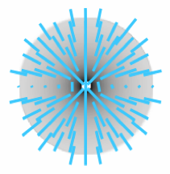
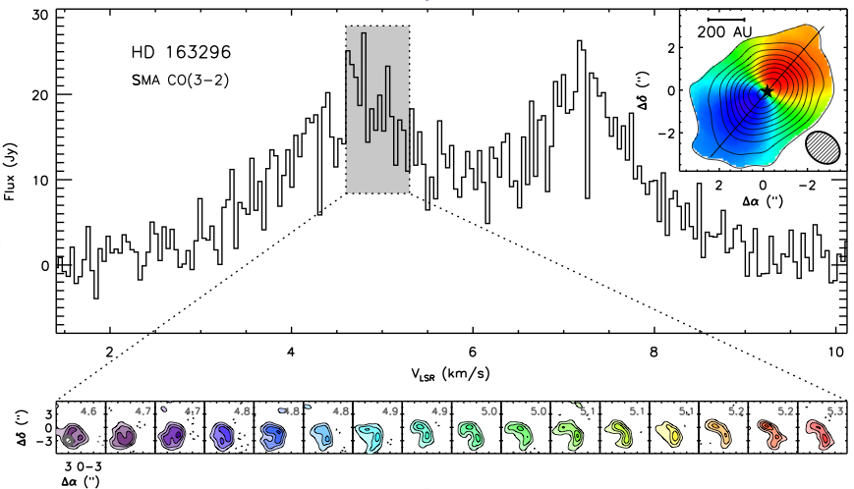
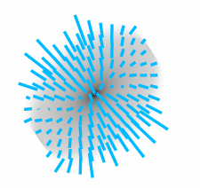
Magnetic Fields in T Tauri Disks
What Millimeter Polarimetry Can Tell Us
A. Meredith Hughes
Wesleyan University
Chat Hull, David Wilner, Sean Andrews, Jungyeon Cho, Dick Plambeck, Dan Marrone, Ram Rao, Alex Lazarian

Slide 2
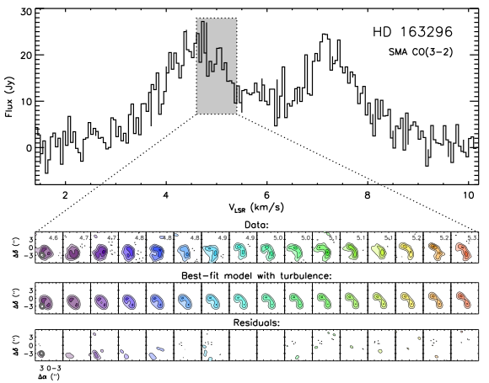
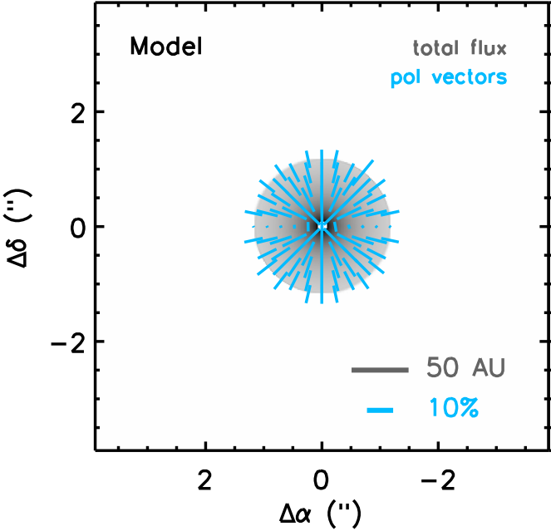
Circumstellar disks as accretion disks
The mass distribution in a disk changes over time as material is transported by viscosity of unspecified origin.
Theories of disk evolution generally invoke MRI-driven turbulence as source of anomalous viscosity.
Balbus & Hawley (1991), Stone et al. (2000)
What is observable?
B-field needed to drive MRI
Aligned dust grains should generate polarized emission
Turbulence that generates viscosity
Nonthermal widths of molecular lines
HD 163296 CO(3-2)

Slide 3
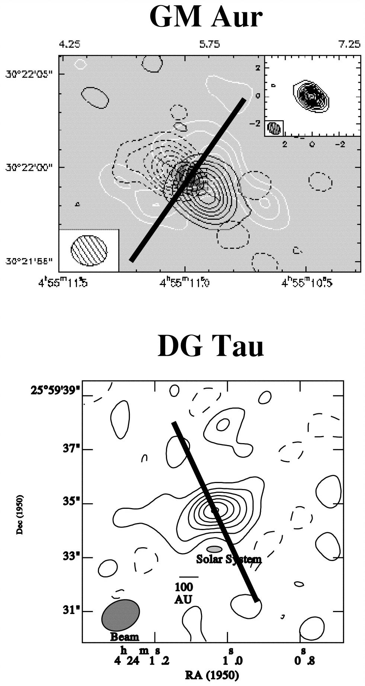
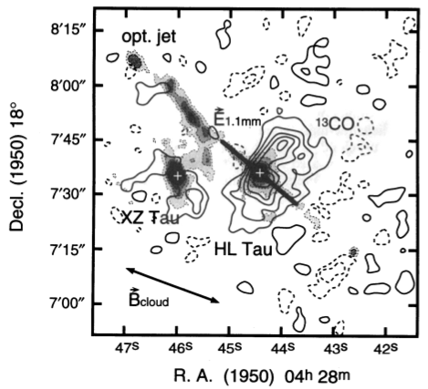
History: Single-dish observations
Tentative (3σ) 3% polarization detection in two T Tauri disks with JCMT
Previously: HL Tau and an upper limit on GG Tau
Tamura et al. (1999)
Tamura et al. (1995)

Slide 4
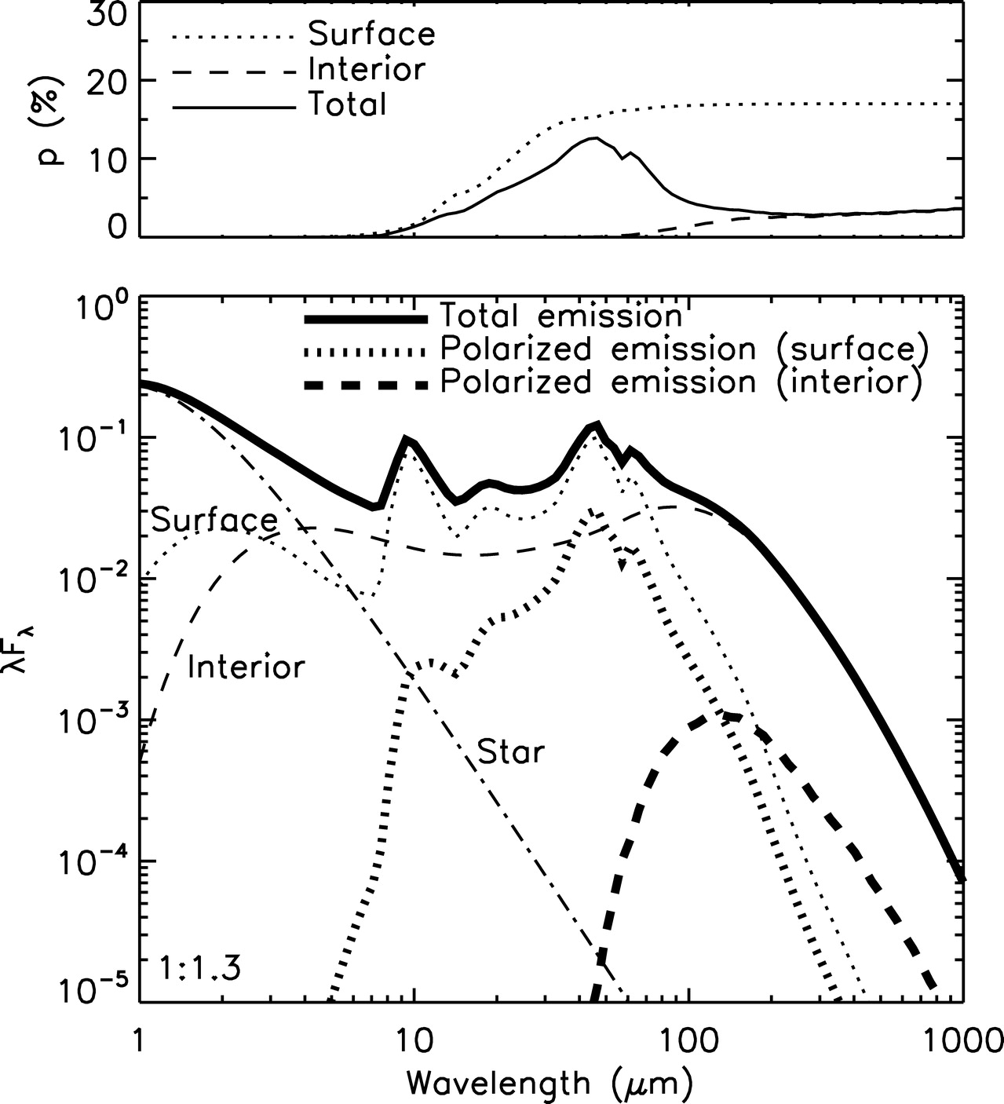
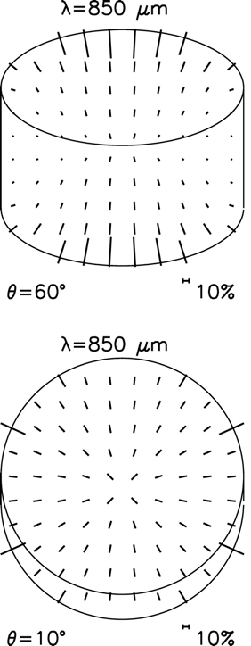
Theory: Predicting Resolved Observations
First realistic models of polarized emission from disks predict 2-3% polarization at mm wavelengths
Grains aligned by radiative torque
Chiang & Goldreich disk model
Toroidal B-field
Cho & Lazarian (2007)

Slide 5
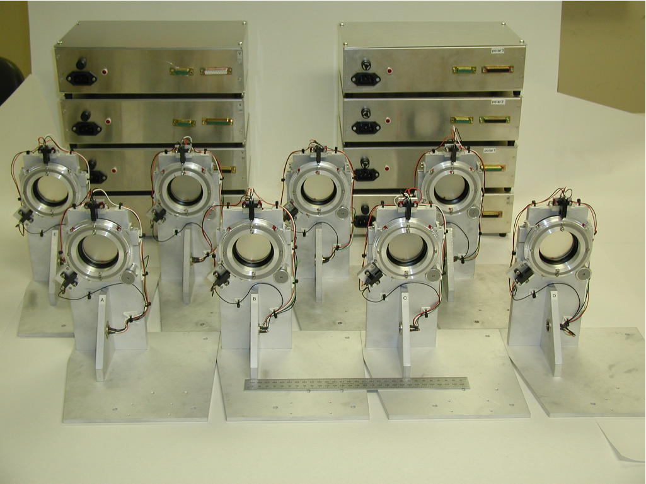
Instrumentation: The SMA Polarimeter
Marrone & Rao (2008)

Slide 6
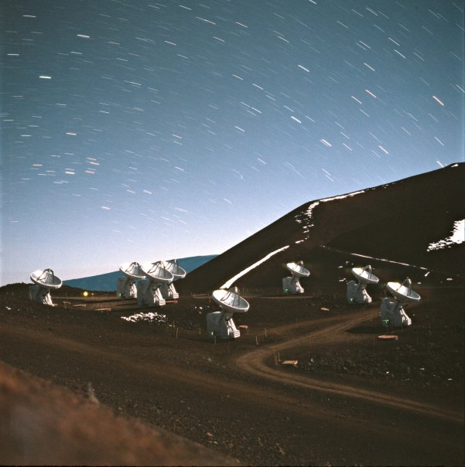
New Observations

Slide 7
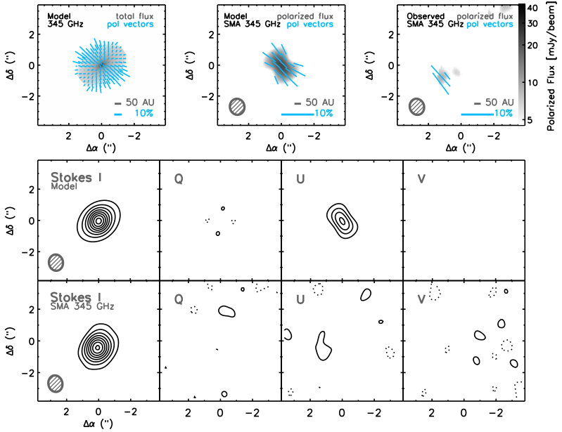
Round 1: Two Disks with the SMA
HD 163296
Hughes et al. (2009)

Slide 8
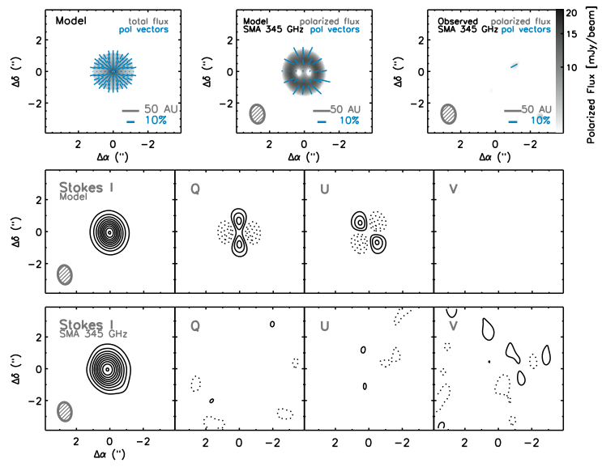
Round 1: Two Disks with the SMA
TW Hya
Hughes et al. (2009)

Slide 9
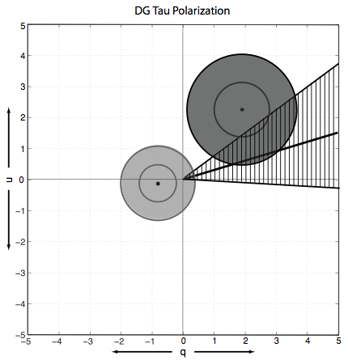
The Plot Thickens: DG Tau at 350 μm
Same source, similar resolution, shorter wavelength…
No polarization!
Krejny et al. (2009)

Slide 10
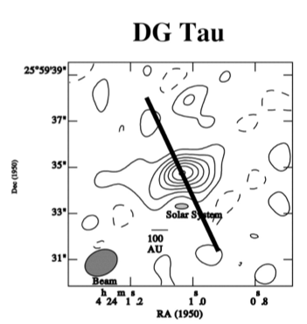
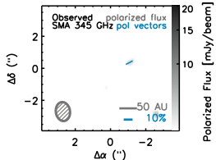
Round 2: Plugging the Gaps
And now, the field is a mess!
Tamura et al. (1995, 1999)
3σ polarization detections in 2-3 T Tauri sources
Indicate toroidal magnetic field
Krejny et al. (2009)
Revisited one source, different wavelength
No polarization
Hughes et al. (2009)
Two new sources
No polarization

Slide 11
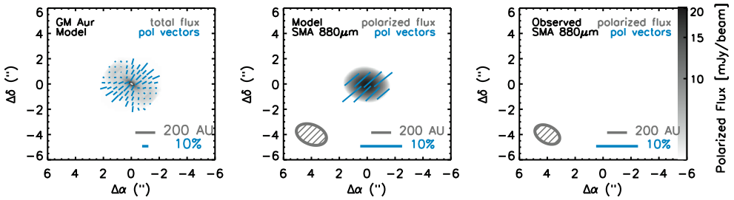
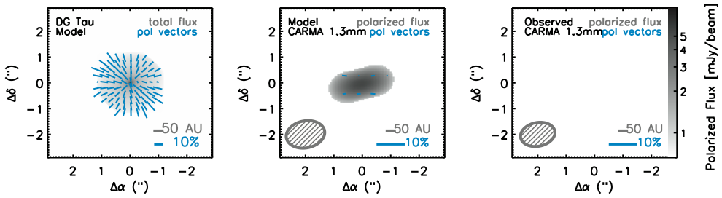
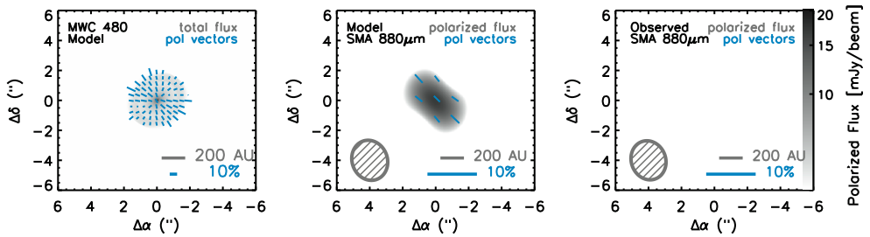
Round 2: Plugging the Gaps
Hughes et al. (2013)

Slide 12
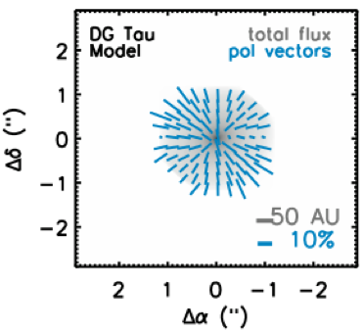
Does size matter?
Two possibilities:
JCMT detections were spurious (low-significance, after all…)
Continuum emission is polarized only on large (~1000 AU) scales

Slide 13
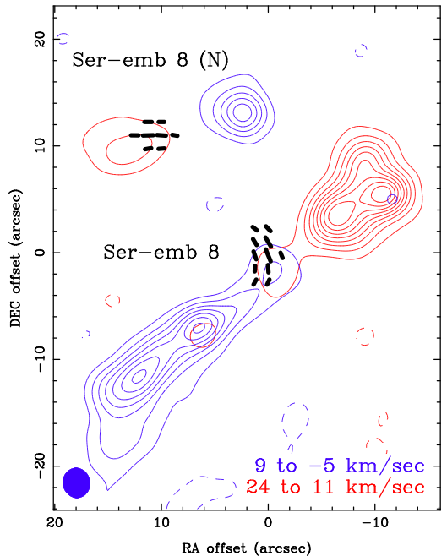
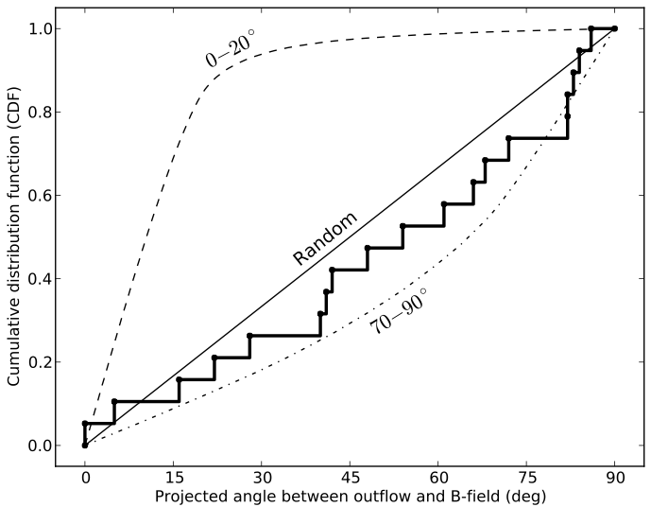
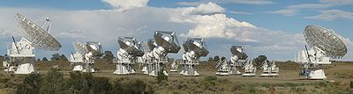

A quick word about TADPOL
Hull et al. (2013)

Slide 14
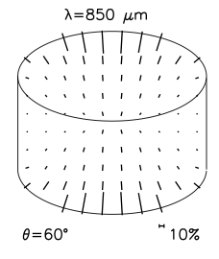
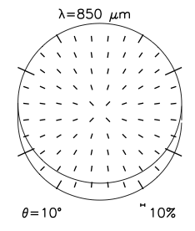
Model Comparison

Slide 15
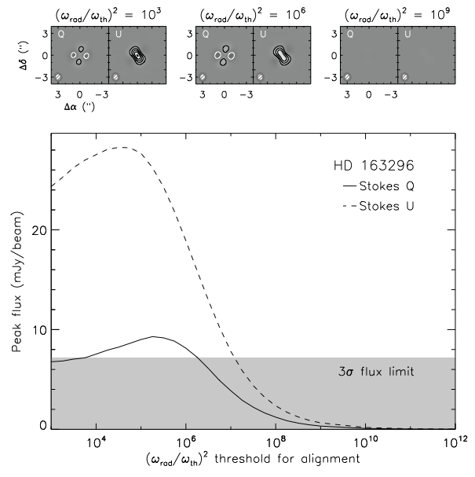
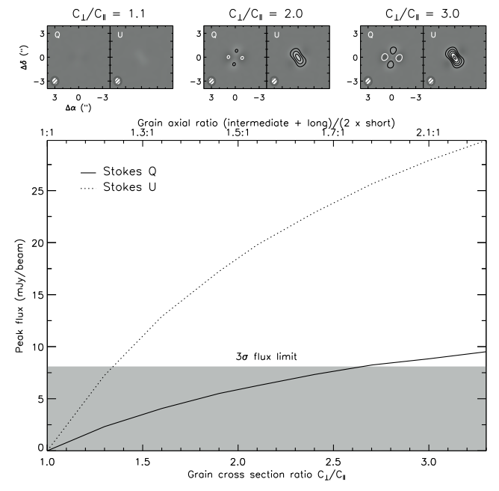
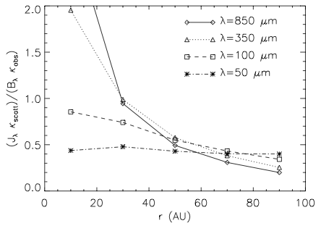
Turning Knobs
Identify model inputs that most strongly affect pol %, given Stokes I
1) Grain elongation
2) Alignment efficiency
3) Grain size distribution
4) B-field strength
Cho & Lazarian (2007)
5) B-field regularity
6) Scattering…
Hughes et al. (2009)

Slide 16
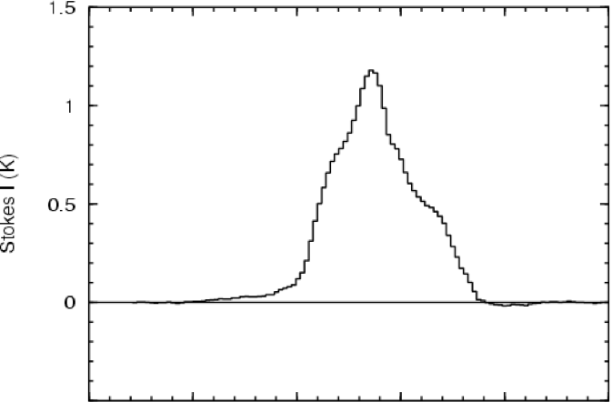
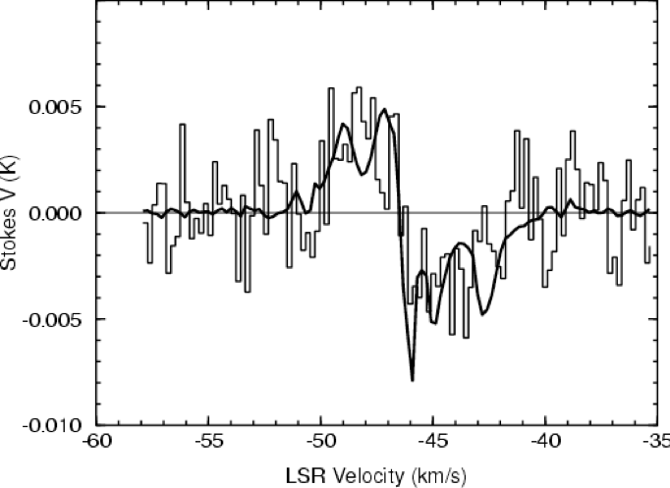
The Future: Polarization with ALMA
IF grains are aligned but fields are tangled, then it is worthwhile to push to higher angular resolution < scale height (easier)
IF grains are not aligned, then next best bet may be Zeeman effect in CN, to get los magnetic field (harder)
Falgarone et al. (2008)

