Slide 1
Money and banking
Economics 308
Lecture 11
Pricing an option on a futures contract

Slide 2
Arbitraging the yield curve
Given
a price process for a 4 period zero coupon bond
The spot rate process
Find the no arbitrage prices for the remaining zero coupon bond prices

Slide 3
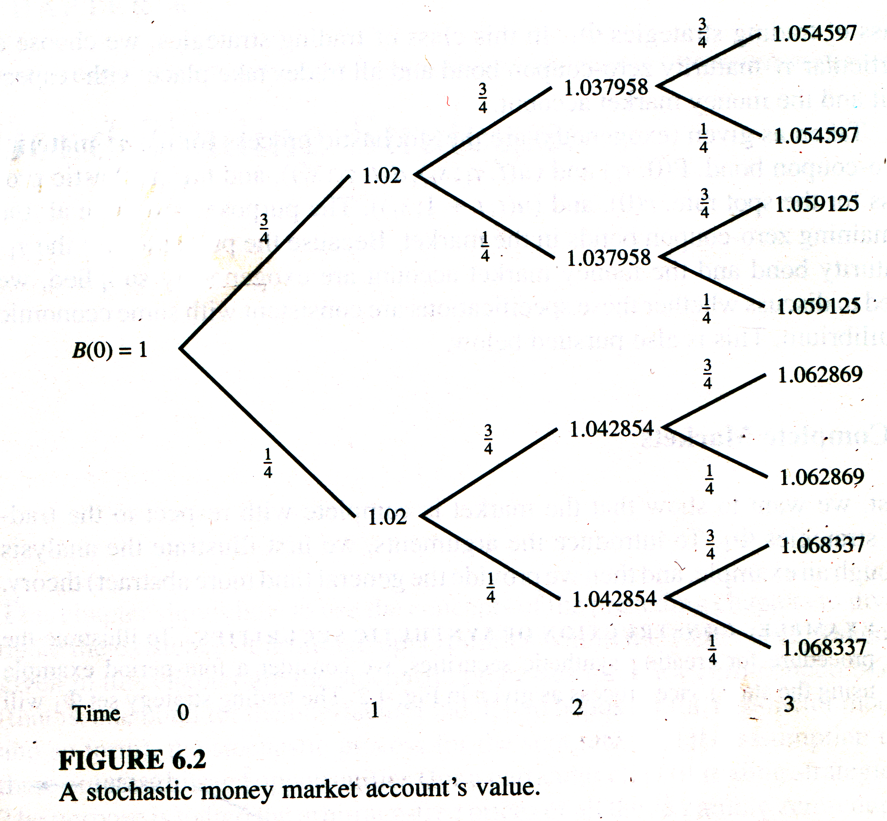
Money market account value

Slide 4
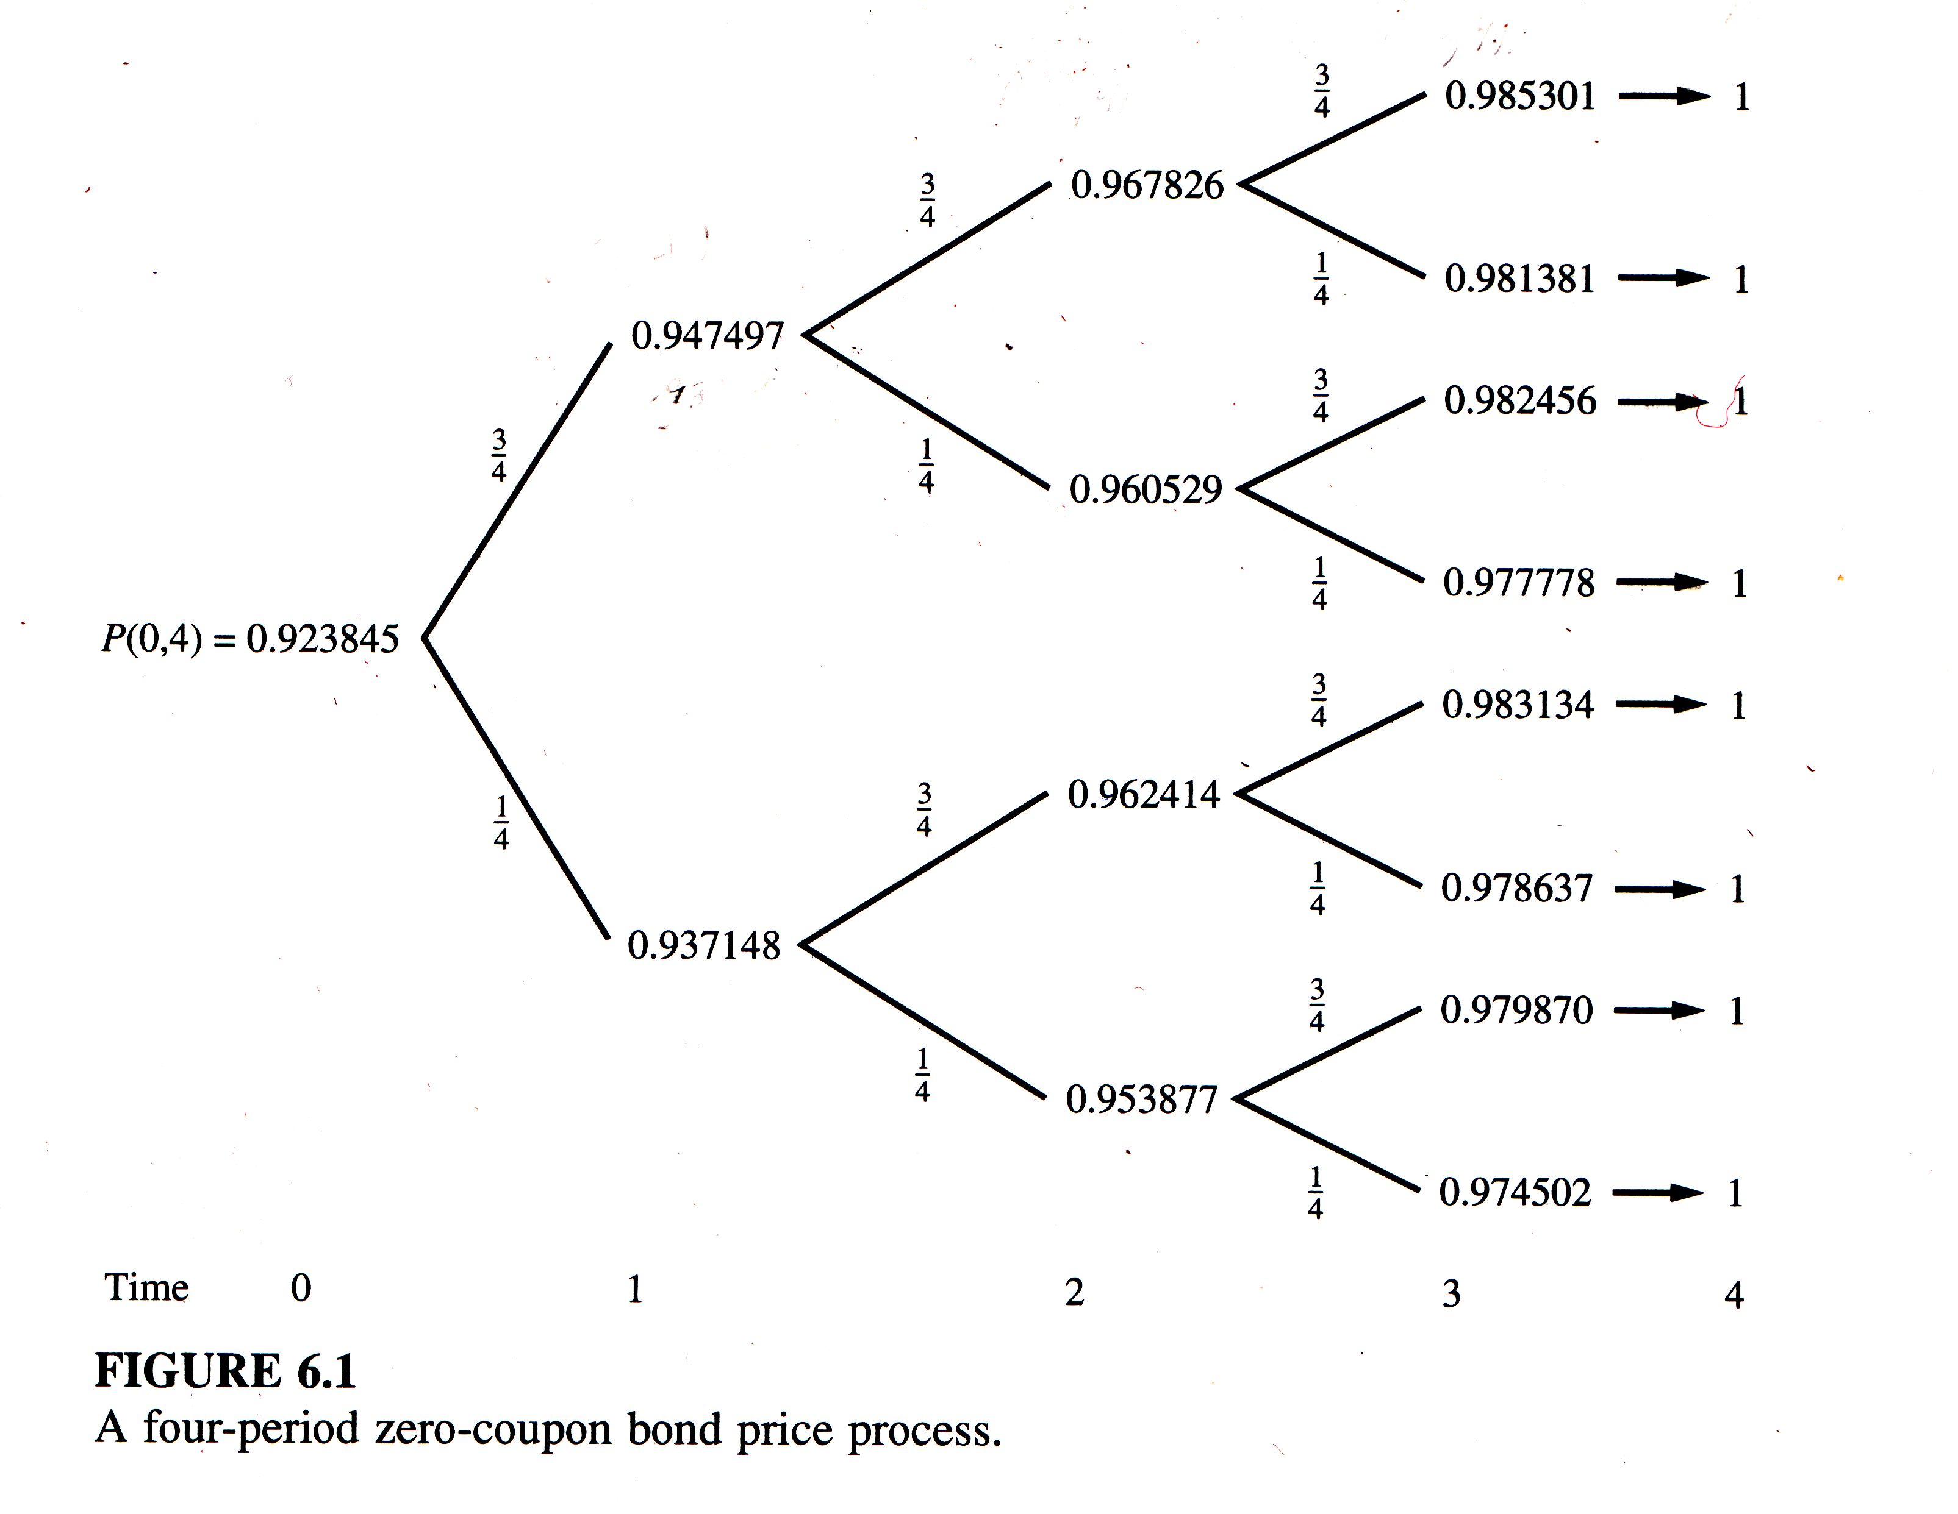
A four period zero-coupon bond price process

Slide 5
Construct synthetic 4-period maturity zero coupon bond
Construct synthetic zero using a self financing trading strategy with two assets:
a 4 period zero
a money market account

Slide 6
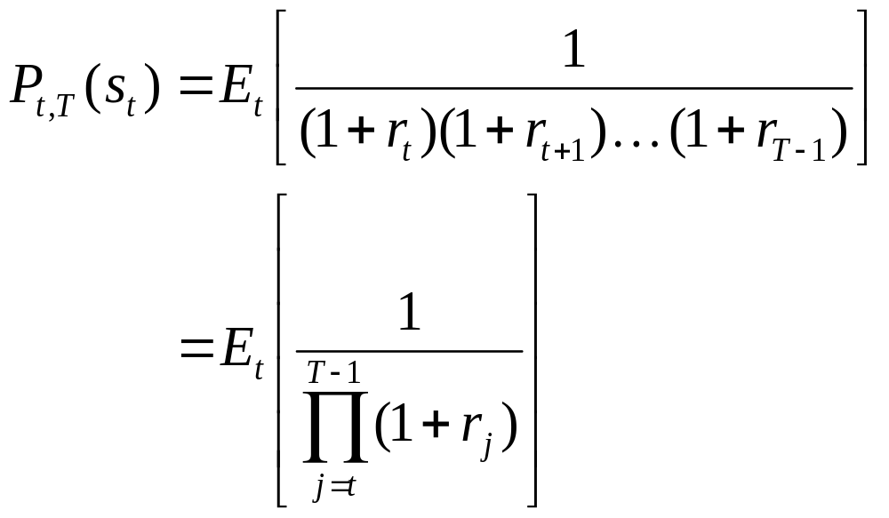
Arbitrage free price of 4 period discount bond

Slide 7
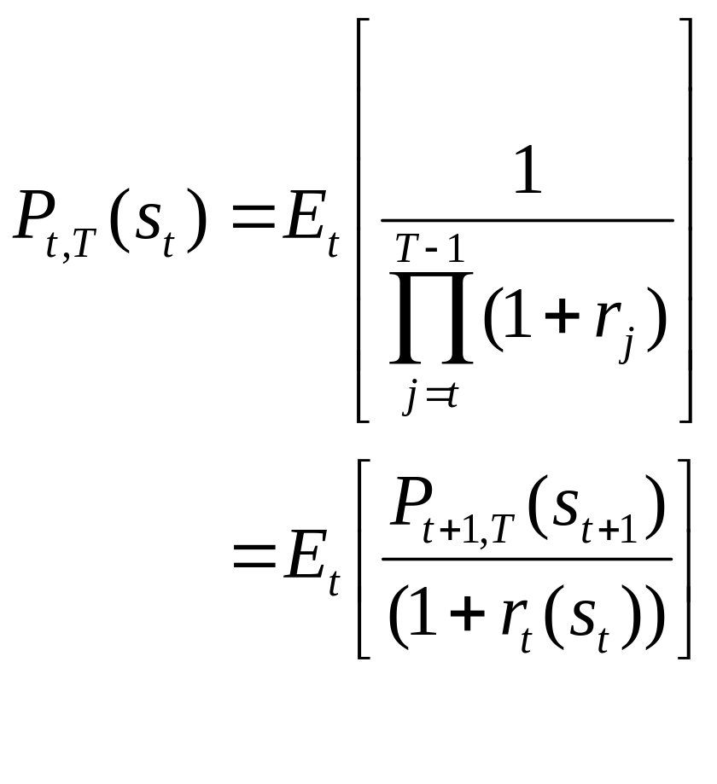
Arbitrage free price of 4 period discount bond

Slide 8
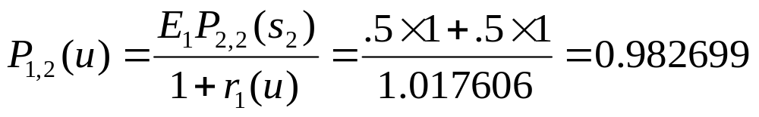
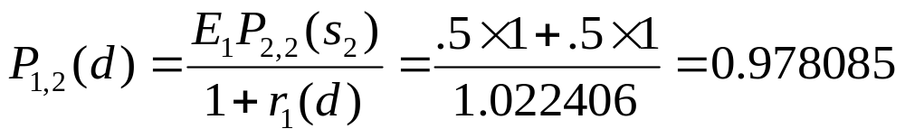
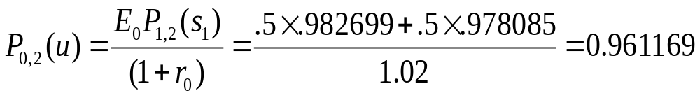
Example: price a 2 period zero

Slide 9
Arbitrage and the delta hedge
Suppose the traded price P(0,2) = 0.97 > the arbitrage free price 0.96119
What is the portfolio that takes advantage of this arbitrage opportunity
Construct the number of units of P(0,4) and the money market B(0) that generates the synthetic two period bond

Slide 10
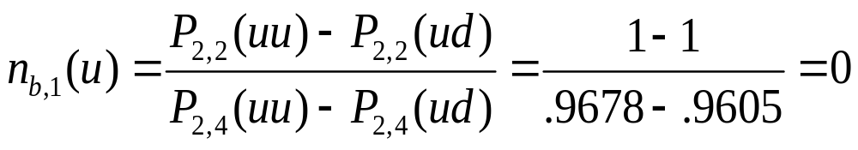
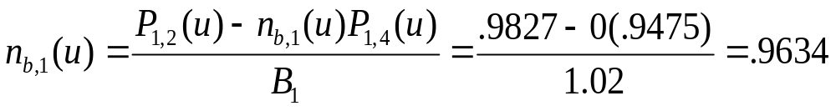
Delta: the change in value of the derivative security, the two period bond, relative to the underlying P(0,4)
Delta for 2-period bond at time 1, the change in the 2-period zero’s price relative to the 4-period zero’s p
Delta for money market

Slide 11
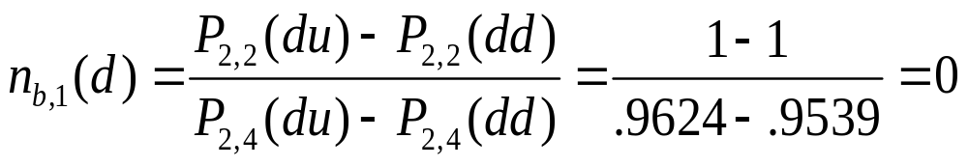
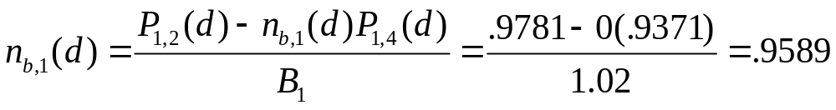
Delta: the change in value of the derivative security, the two period bond, relative to the underlying P(0,4)
Delta for 2-period bond at time 1, the change in the 2-period zero’s price relative to the 4-period zero’s p
Delta for money market

Slide 12
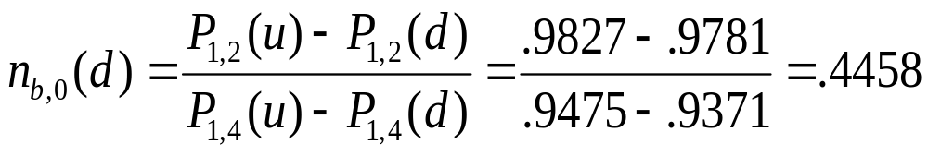
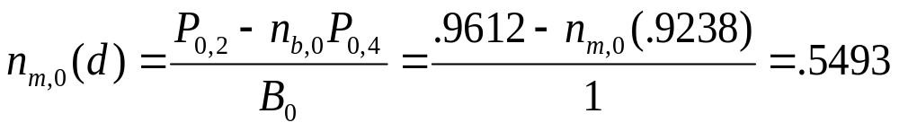
Delta: the change in value of the derivative security, the two period bond, relative to the underlying P(0,4) at t=0
Delta for 2-period bond at time 1, the change in the 2-period zero’s price relative to the 4-period zero’s p
Delta for money market

Slide 13
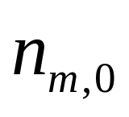
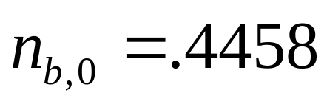
The arbitrage opportunity
Sell 2-period bond at t=0 for .9700
Put in money market
Buy of P(0,4)
At cost 0.9612
Excess cash at t=0: .9700-.9612 = .0088

Slide 14
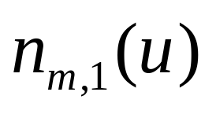
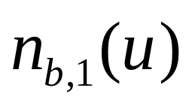
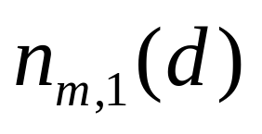
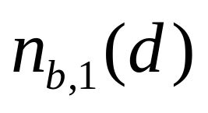
The arbitrage opportunity t=1
In state u, rebalance MM and 4-period bond to
Excess cash equals 0
In state d, rebalance MM and 4-period bond to
Excess cash equals 0

Slide 15
The arbitrage opportunity at t-2
The long position in the money market and 4 period bond offset the short position in the 2 period bond

Slide 16
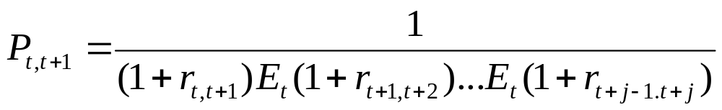
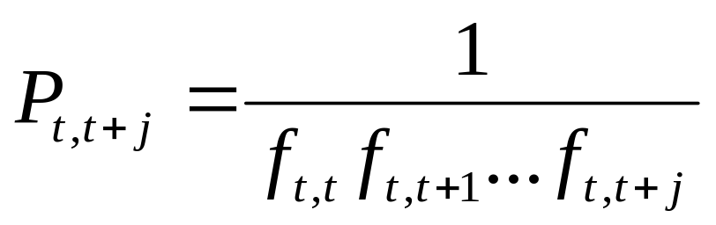
The expectations hypothesis gives a relation between discount bond prices and forward rates
From the expectations hypothesis, the yield on a T period bond is the average of current and expected spot rates
Where expected future spot rates are given by forward rates f

Slide 17
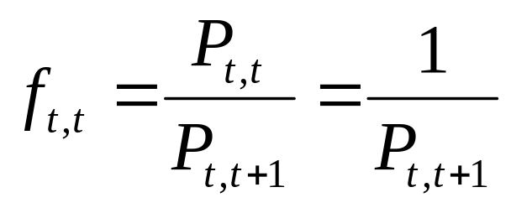
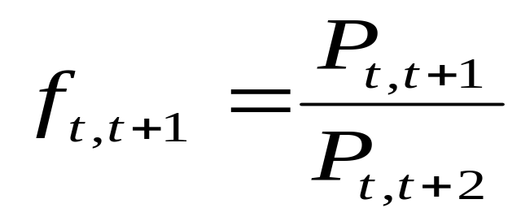
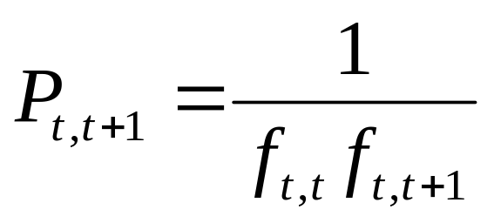
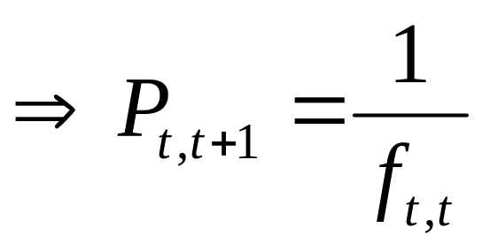
The forward rate is the rate on a riskless loan contracted at t for the period [T,T+1]

Slide 18

Bond prices spot rates

Slide 19
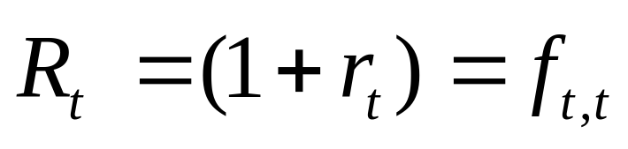
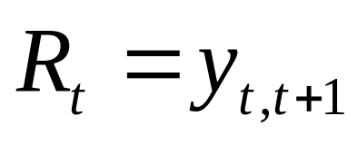
From bond price to spot rate
The spot rate r is the rate on a riskless loan starting at current period t to t+1
The spot rate is the holding period return on the shortest maturity bond

Slide 20
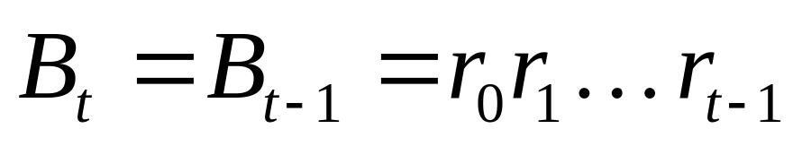
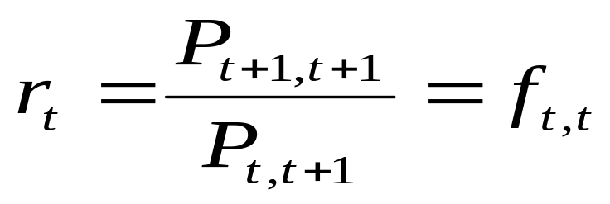
The spot rate is the return on a money market instrument
Invest $1 in a money market and compound at the spot rate each period
The forward rate on a contract for immediate delivery is the spot rate of the zero coupon bond in its last period

Slide 21
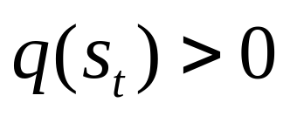
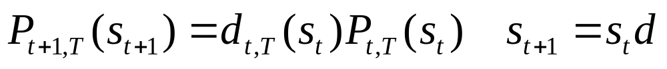
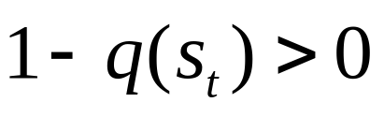
The bond price process
with probability
with probability

Slide 22
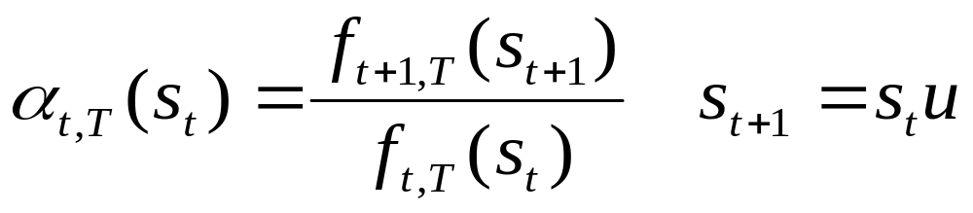
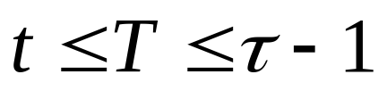
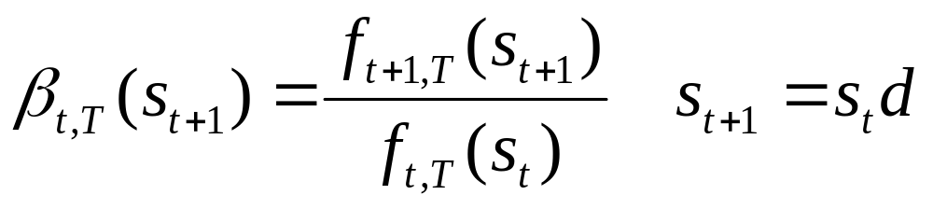
The forward rate process
with probability
with probability

Slide 23
Example deriving P and f

Slide 24
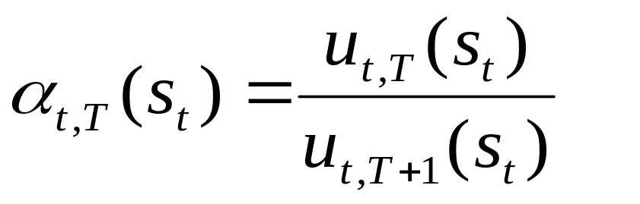
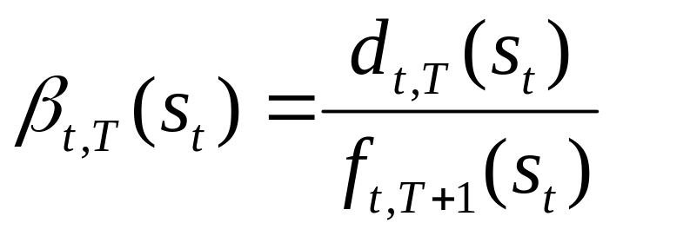
The forward rate process
with probability
with probability

Slide 25
Example deriving P and f

Slide 26
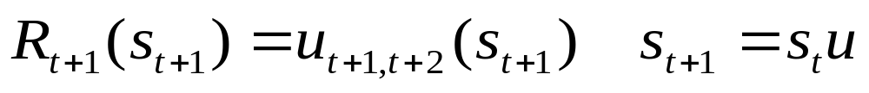
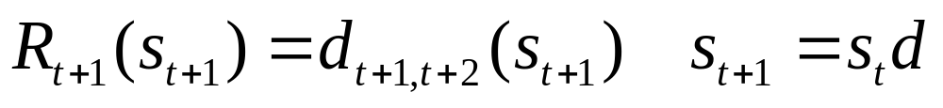
The spot process
with probability
with probability

Slide 27
Example deriving the spot rate R from P and f

Slide 28
Comparing expectation hypotheses of the term structure of interest rates
The equivalent expected returns hypothesis predicts there are no excess returns from holding bonds of different maturities
Forward rates are unbiased predictors of future spot rates

Slide 29
Example expected rate hypothesis

Slide 30
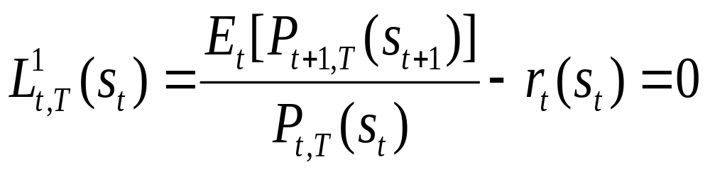
The equivalent expected return hypothesis of the term structure of interest rates
The equivalent expected returns hypothesis predicts there are no excess returns from holding bonds of different maturities
Test: does there exist a liquidity premium on longer maturities of zero coupon bonds?

Slide 31
Example unbiased forward rate hypothesis

Slide 32
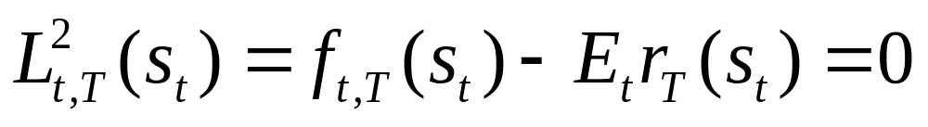
The unbiased forward rate hypothesis of the term structure of interest rates
The unbiased forward rate hypothesis predicts there future spot rates equal the forward rate
Test: is there a bias in using the forward rate as an estimate on the future spot rate?
Define the liquidity premium

Slide 33
Arbitrage opportunities within the yield curve
Given the processes for one zero coupon bond and the spot rate, the one factor bond pricing model calculates the arbitrage free prices of the remaining zero coupon bonds

Slide 34
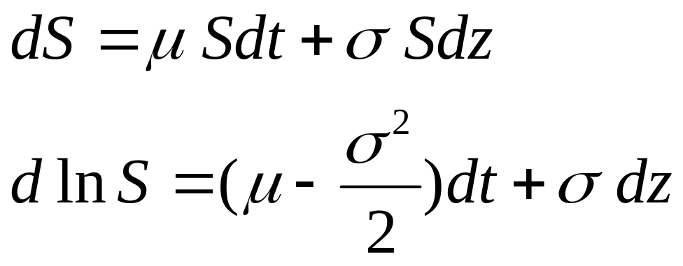
Option pricing
Black-Scholes option price solves a differential equation

Slide 35
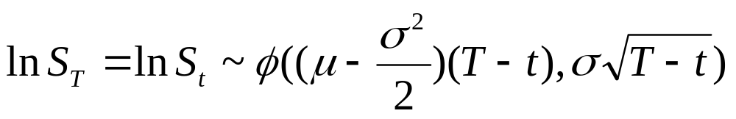
Distribution of stock price S
The stock price S is assumed to be lognormally distributed when the log of the stock price is normally distributed

Slide 36
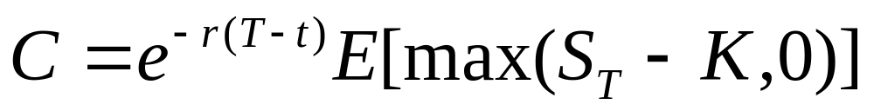
The price of a call
For strike price K
C is the option price discounted by the risk free rate r

Slide 37
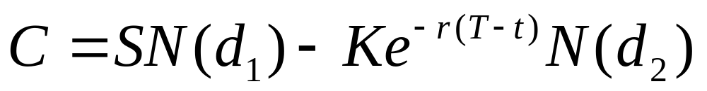
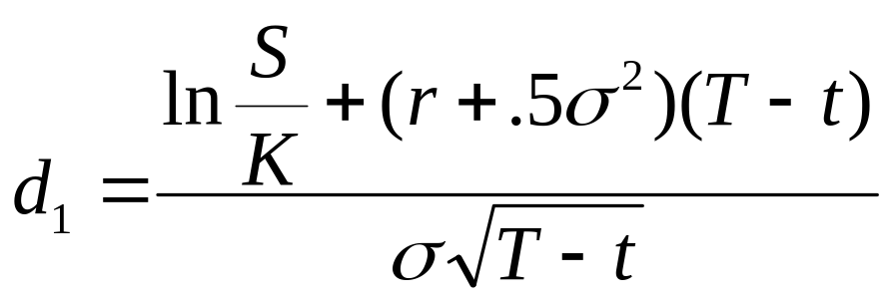
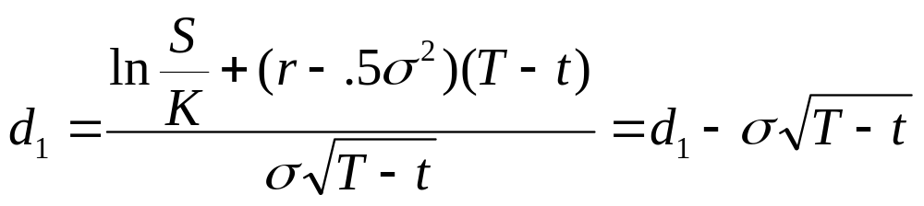
Where

