Slide 1
Money and banking
Economics 308
Lecture 2
Interest Rates, Pricing credit instruments

Slide 2
Money and banking
Economics 308
Pricing credit market instruments
Today we are going to use the concept of present value
to price these four types credit market instruments
A simple loan
A fixed payment loan
A coupon bond …
A discount bond (or zero-coupon
bond)

Slide 3
Money and banking
Economics 308
Interest rates
Present value
Future value
Yield to maturity
Term structure of interest rates

Slide 4
Money and banking
Economics 308
An interest rate is the price we use to make decisions about the future
It is the percent rate of return on money
a borrower pays to a lender at some future date

Slide 5
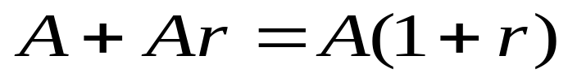
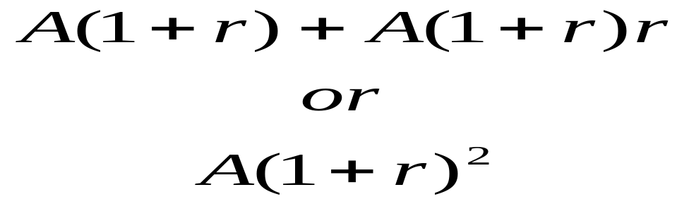
Money and banking
Economics 308
Let’s say you lend $A dollar for 2 years at a rate of interest r=0.10 or ten percent
At the end of the first period, you receive
At end of year 2, you receive

Slide 6
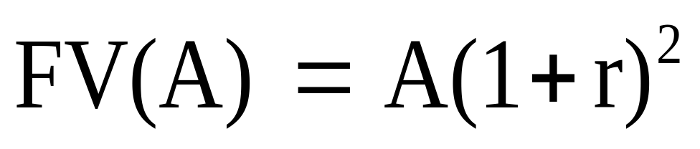
Money and banking
Economics 308
The future value FV(A)
of A dollars today two periods from now
The total return on $A in two years is the

Slide 7
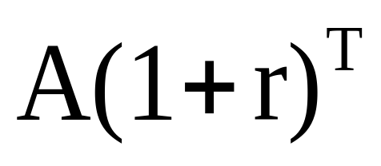
Money and banking
Economics 308
The future value of A is the value of your investment A with compound interest
What is the value of A in T years?

Slide 8
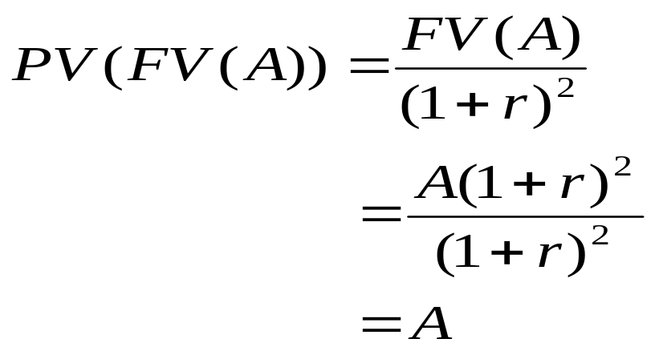
Money and banking
Economics 308
So let’s work backwards: at time T=2, how much is the value of A at date T-2, that is, the present value today of FV(A)?

Slide 9
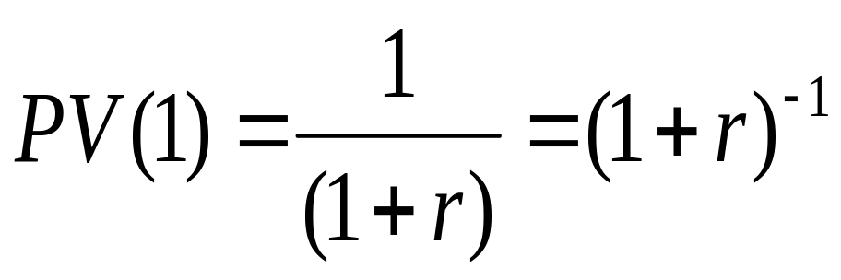
Money and banking
Economics 308
Suppose we want to know the present value of A=$1 that we receive tomorrow, that is, the value today of a $1 we receive tomorrow
the value of a dollar tomorrow today

Slide 10
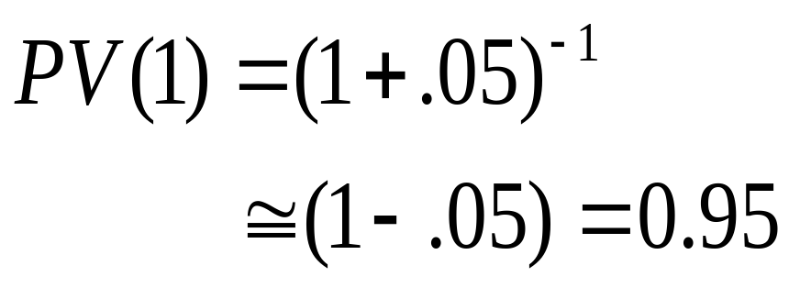
Money and banking
Economics 308
Let’s look at the present value of $1 today that can earn interest of 5 percent between today t, and tomorrow, t+1
This discount factor is the price of a one period bond you hold from today to tomorrow

Slide 11
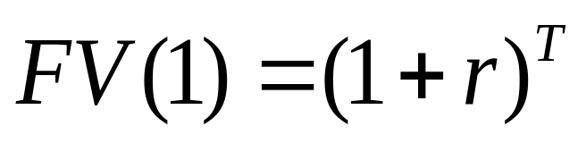
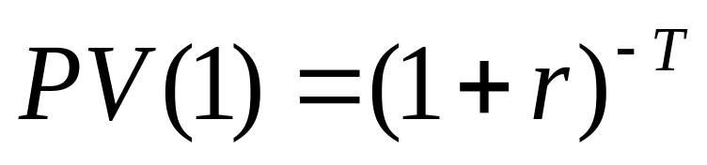
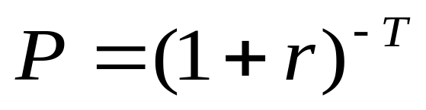
Money and banking
Economics 308
Summing up
Future value
Present value
Price of discount bond

Slide 12
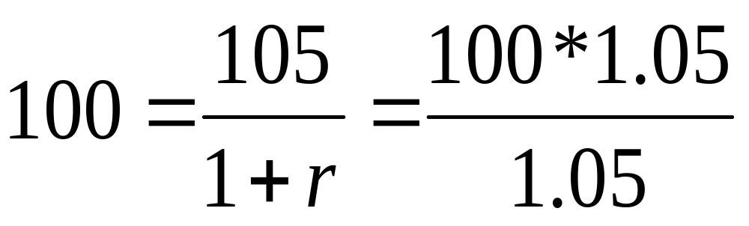
Money and banking
Economics 308
Now let’s price another credit instrument,
a simple loan
Today, the price of a loan of $100 at 5% interest, tomorrow is

Slide 13
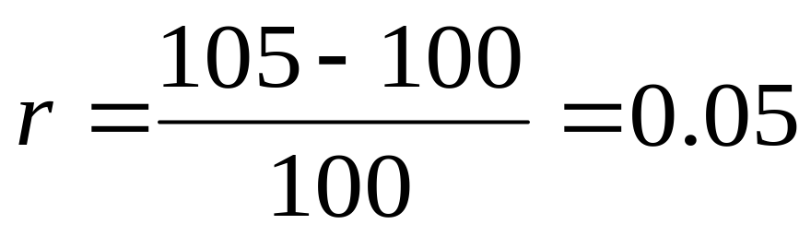
Money and banking
Economics 308
The interest rate that equates the present value of payments of the loan to its value today is the yield to maturity r

Slide 14
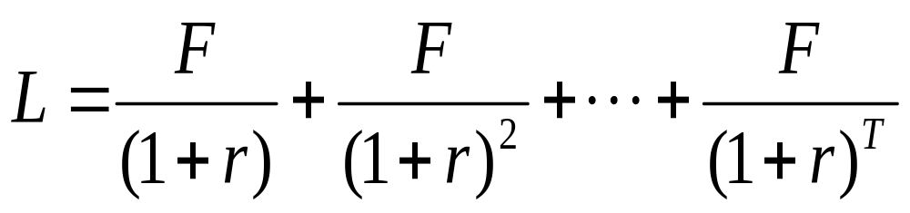
Money and banking
Economics 308
Now let’s price another credit instrument,
a fixed payment loan
A buyer pays F each period, t=1,…,T

Slide 15
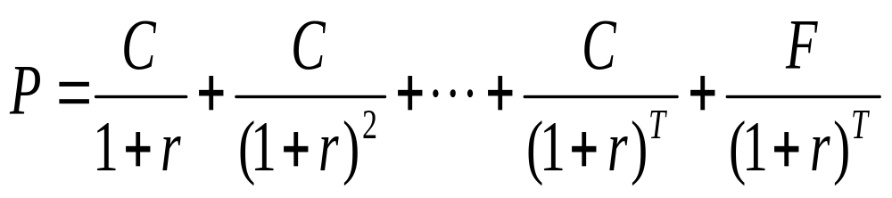
Money and banking
Economics 308
Now let’s price another credit instrument,
a T period par value coupon bond
that pays a coupon of $C every period and returns the principal in the last period T

Slide 16
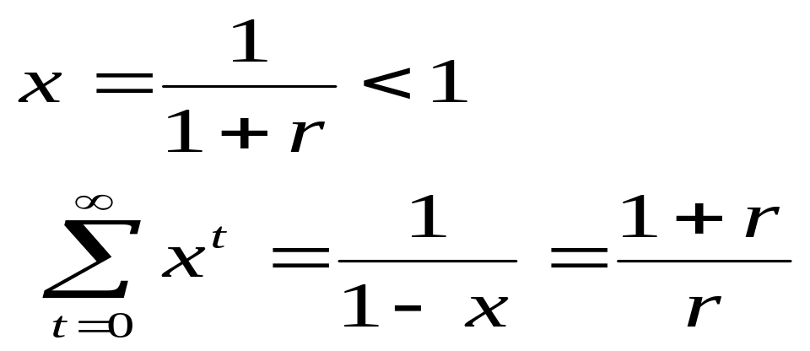
Money and bankinf
So now a little math to find out the yield on a coupon bond
First, start with a discount bond that pays r forever
Let

Slide 17
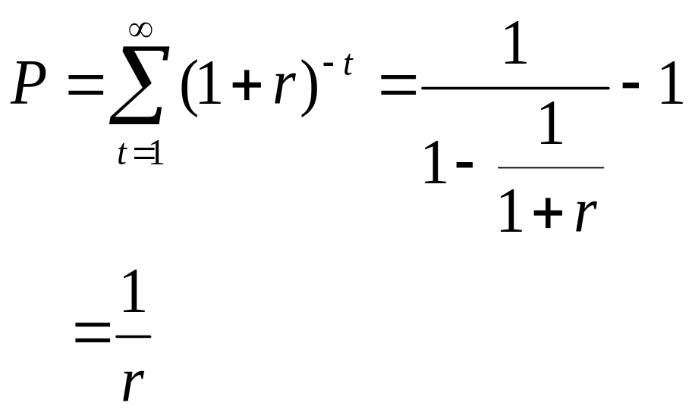
Money and banking
Economics 308
Then we can back out the yield r from the price of a consol P

Slide 18
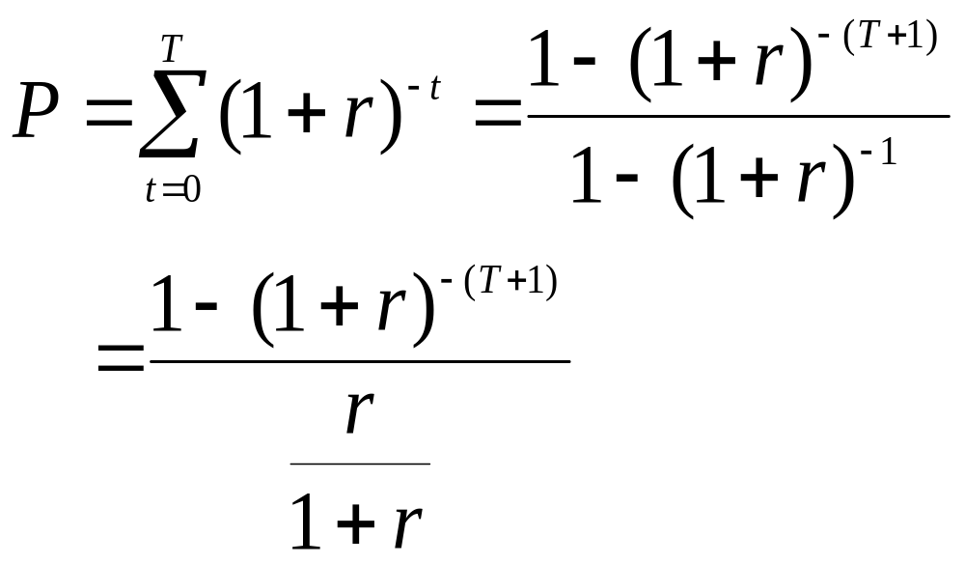
Money and banking
Economics 308
Then we can back out the yield r from the price of a consol P for a T period bond, numerically

Slide 19
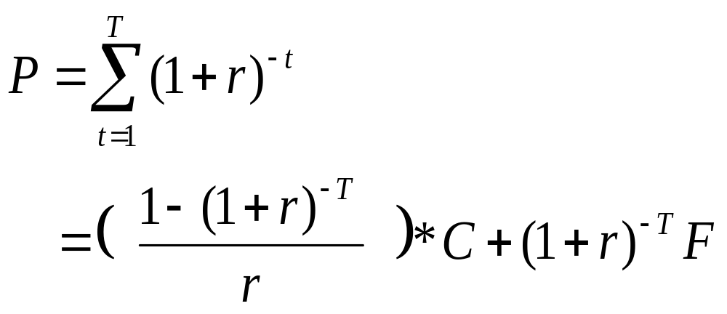
Money and banking
Economics 308
So the price of a T period coupon bond is

Slide 20
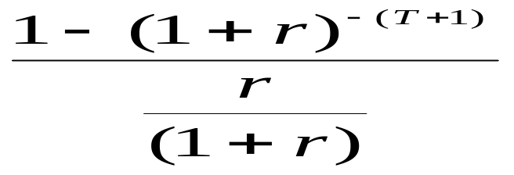
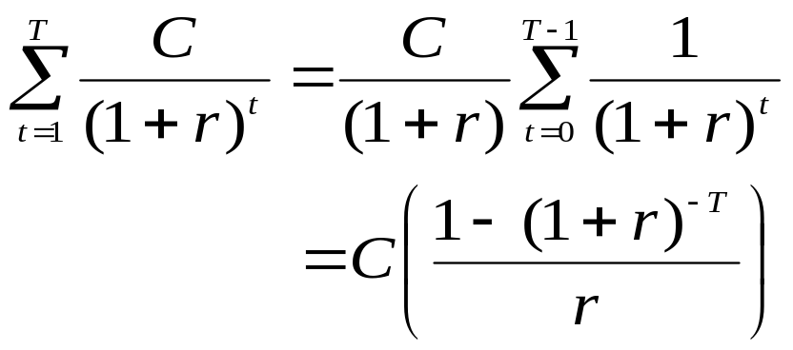
Money and banking
Economics 308
Oops! How do we get this term to look right?
Here:

Slide 21
Money and banking
Economics 308
Now, once again, the price of a T period coupon bond is

Slide 22
Money and banking
Economics 308
NO! You don’t have to figure out ‘r’ in your head
If you know the face value F, the coupon C, the maturity T and the current price P, you can calculate the yield on a programmable computer

Slide 23
Money and banking
Economics 308
But you do have to know -- in real life, and on an exam that
The yield to maturity is the interest rate that sets the price of the asset equal to the present discount value of its stream of payments, i.e. its income stream

Slide 24
Money and banking
Economics 308
Break time...
Enough for awhile!

Slide 25
Money and banking
Economics 308
Arbitrage
The rate of return holding a two year discount bond
should be equal to ...
The rate of return from rolling over two one year discount bonds
Let’s see...

Slide 26
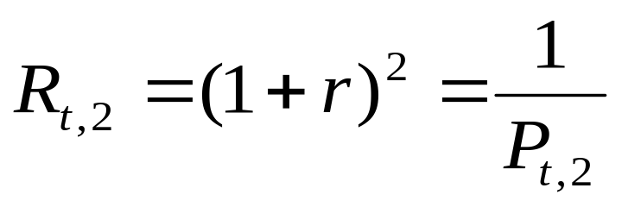
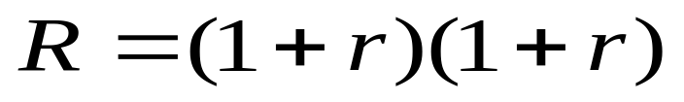
Money and banking
Economics 308
The rate of return from holding a 2 period discount bond from t to t+2
The rate of return from rolling over 2 one period discount bonds

Slide 27
Money and banking
Economics 308
Arbitrage argument
If the return on a long term bond is higher than the return on rolling over short term bonds, it’s because short term rates are expected to go up in the future
But, if future short term rates go up, what happens to the capital gain on the long term bond?

Slide 28
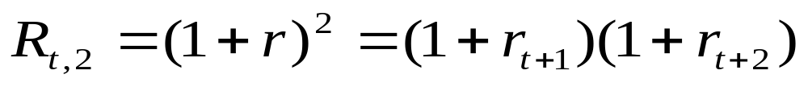
Money and banking
Arbitrage continued…
The price of the long term bond will fall, reducing the capital gain from going long
So, over time, the rise in short term rates will improve the return on the strategy of rolling over short term bonds…until…

Slide 29
Money and banking
So, this arbitrage argument sets us up to talk about different beliefs about how the term structure of interest rates behaves….

Slide 30
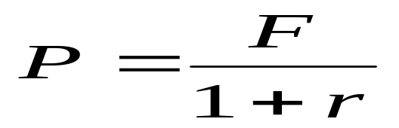
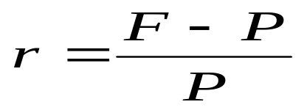
Money and banking
Economics 308
But let’s finish off with some trader talk
The price P of a one period discount bond is
so the yield to maturity is

Slide 31
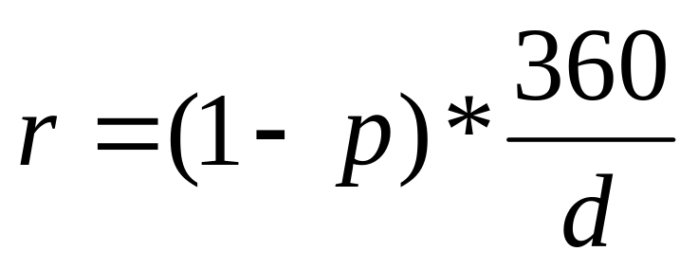
Money and banking
Economics 308
Traders calculate the yield on a discount basis
where p=P/F and d = number of days to maturiry

Slide 32


