Slide 1

Game Testing (who is the millionare)
Member:
Lê Quốc kiệt
Dương trọng nhân
Trương thanh nhã
Phạm nhật cường

Slide 2

Content
Test purpose
Test requirement
Test Strategy
Risk
Demo

Slide 3
I.Test Purpose
Identify the function of the game
Identify features to help player
Identify the testing methods and strategies to use
Specify test functions and non-test functions
List the test environment

Slide 4
II.Test Requirement
Test function, high-priority component inspection first
Evaluating quality and quality must ensure requirements of players
Find as many errors as possible

Slide 5
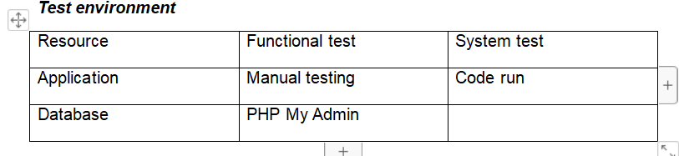
III.Test Strategy
Review user documentation, user interfaces, and error-prone functions
Check if the function has been implemented in accordance with the description.
Valid data has produced the expected results.
Error and display the correct message when the data is invalid.
Check out scenarios ranging from simple to complex.
Technical use: black box, white box
All error information must be recorded from which to evaluate the product quality.

Slide 6
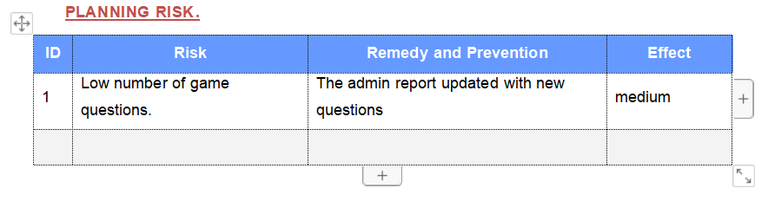
IV. RISK

Slide 7
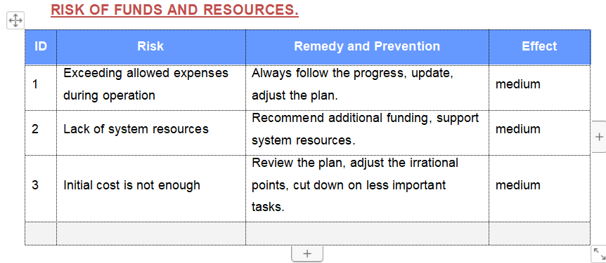

Slide 8
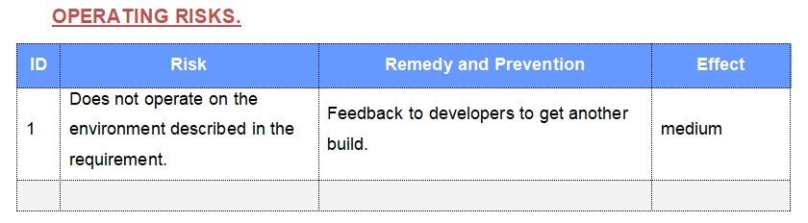

Slide 9
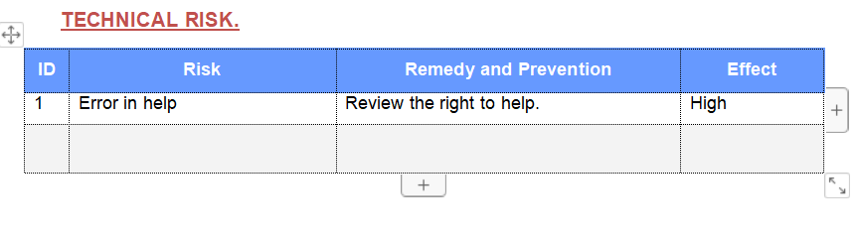

Slide 10
DeMO

Slide 11

Thank You

