Slide 1




MagicBox
Deploy thousands of reels,
on autopilot.
MagicBox is an AI marketing agent built for scale — spin up dozens of on-brand reels, posts and videos from a single brief, then publish them everywhere that matters.
Nhancio Technologies Private Limited
magicboxai.in
Notes:
Cover. MagicBox: one brief becomes on-brand, human-approved posts published direct to Instagram, LinkedIn and YouTube.

Slide 2




PROBLEM
MagicBox
Making marketing shouldn't be this hard — but it is.
Every brand still posts by hand
Tools automate tasks, not outcomes
Even now, content is made manually — briefs, designs, approvals, posts — repeated endlessly for each channel.
AI can write a caption or make an image, but no tool owns the whole job across Instagram, LinkedIn and YouTube.
Generic AI drifts off-brand
Teams and agencies don't scale
Off-the-shelf models ignore your voice and rules. Even Samsung's AI-made Galaxy S26 ads drew backlash for eroding trust.
Cost rises with output and quality depends on people, not systems. Creativity never compounds.
“What if marketing could compound like code — not repeat like manual labor?”
magicboxai.in
02 / 11
Notes:
Problem: content is still made by hand; point tools don't own outcomes; generic AI goes off-brand; people-based teams don't scale.

Slide 3
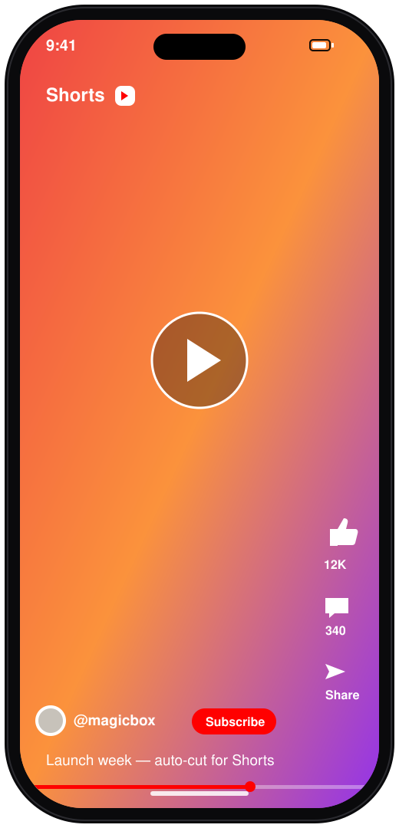

SOLUTION
MagicBox
One brief in. A month of reels out.
MagicBox is a brand-aware marketing agent built for volume. Give it one theme, voice and cadence, and it produces reels, posts and images at scale — on-brand, routed through optional approval, and published direct to every channel.
Brand-aware generation — Voice, palette and rules baked into every draft.
Human-in-the-loop — Approve from a queue, or let trusted automations ship.
Direct multi-channel publishing — Live to your channels — no copy-paste, no export.
“What if one brief could become a month of reels?”
magicboxai.in
03 / 11
Notes:
Solution: brand-aware generation + human-in-the-loop approval + direct multi-channel publishing, in one loop.

Slide 4


WHY NOW
MagicBox
The perfect storm.
Three forces are converging into an unprecedented opening.
10×
Now
25%
Content volume
AI quality crossed the line
Market pull
Algorithms reward constant, fresh, channel-specific content. Brands need far more than they can make by hand.
AI copy and visuals rival human work — even Samsung's Galaxy S26 ads (Feb 2026) were fully AI-generated.
AI-in-marketing spend compounds ~25% a year — $35B in 2026 toward $82B by 2030.
2020–22 AI quality gap
2023 Content explosion
2026 The perfect storm
magicboxai.in
04 / 11
Notes:
Why now: content volume 10x, AI quality now indistinguishable (Samsung S26), market compounding 25% — the timeline converges in 2026.

Slide 5




HOW IT WORKS
MagicBox
Three steps from brief to published.
01
02
03
Connect your channels
Describe one brief
Review or auto-publish
Link Instagram, LinkedIn and YouTube. Credentials stay server-side; MagicBox only publishes to accounts you authorize.
Give it a theme, voice and cadence. Your brand kit automatically shapes copy, palette and imagery for each channel.
Approve drafts from the queue, or let trusted automations ship on schedule to every connected channel.
magicboxai.in
05 / 11
Notes:
How it works: connect channels, describe one brief, review or auto-publish.

Slide 6



THE PLATFORM
MagicBox
Built for the whole marketing loop.
Prompt to post
On-brand by default
Approve & auto-schedule
Describe a campaign in a sentence — MagicBox writes copy, generates the image and prepares a post per channel.
Your brand kit — voice, palette, do's and don'ts — is applied to every generation. No off-message posts.
Route everything through an approval queue, or let trusted automations run on the cadence you choose.
Publish where it counts
Images & short video
Multi-channel, one workspace
Direct publishing to Instagram, LinkedIn and YouTube, in the formats each platform actually accepts.
Generate on-brand images and short video clips ready for Reels, Shorts and feed posts.
Every channel, brand and draft lives in a single place — no fragmented stack.
magicboxai.in
06 / 11
Notes:
Platform capabilities across the whole loop: prompt-to-post, on-brand, approve/schedule, publish, images+video, one workspace.

Slide 7
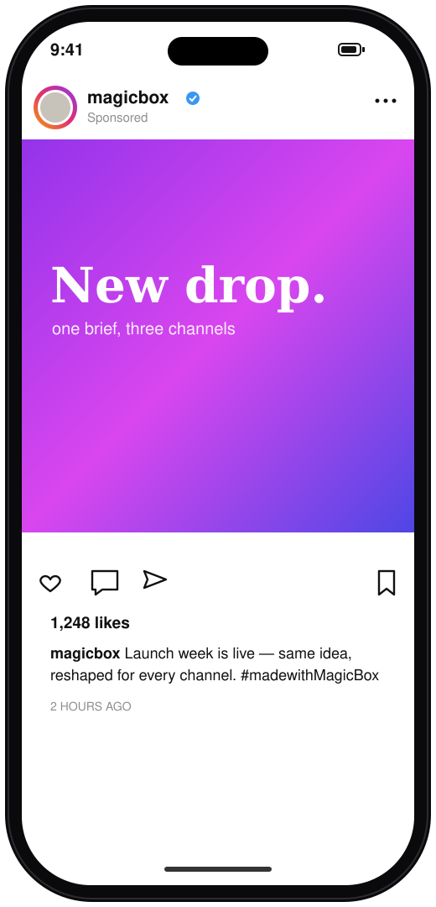
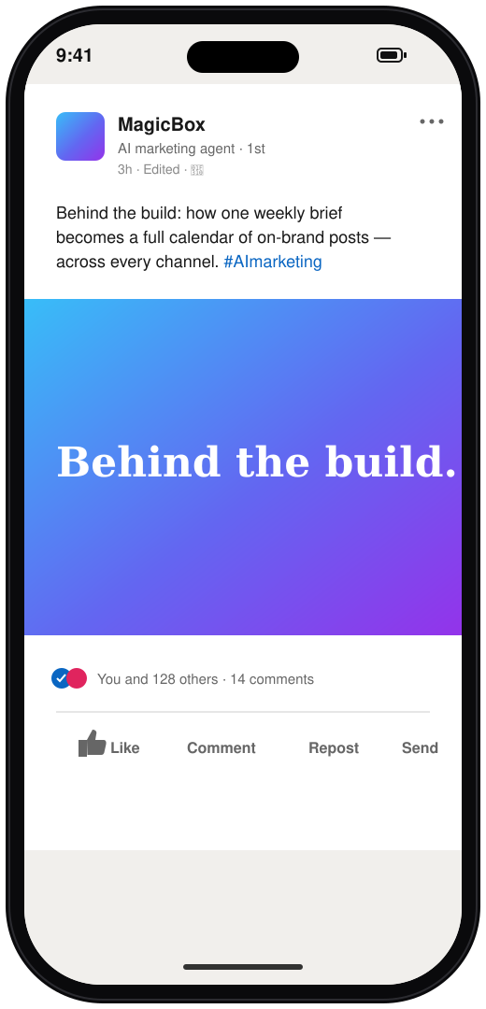
THE PRODUCT
MagicBox
One brief. Every channel.
Spin up reels, image posts and scheduled drops at scale — the same idea, reshaped for every platform, all on-brand.
magicboxai.in
07 / 11
Notes:
Product showcase: image post (Instagram), short video (YouTube), scheduled post (LinkedIn) — icon-only, generated from one brief.

Slide 8
MARKET OPPORTUNITY
MagicBox
A large market, compounding at ~25% a year.
$82B
$6.7B
SMB
TAM
SAM
SOM
Global AI-in-marketing spend by 2030
India digital marketing today (30% CAGR)
Founders, creators & agencies first
Segment
2025
Projected
CAGR
Global AI in marketing
$35B (2026)
$82.2B by 2030
25%
Social media management
$29.9B
$171.6B by 2033
~25%
India digital marketing
$6.7B
$72B by 2034
30%
Where we win first: India — 460M+ social users and a fast-growing base of SMBs, creators and D2C brands that need on-brand output, not enterprise complexity.
Sources: Grand View Research; MarketsandMarkets; Expert Market Research (India); DataReportal.
magicboxai.in
08 / 11
Notes:
Market: TAM $82B global AI-marketing by 2030; SAM India digital $6.7B (30% CAGR); SOM SMB/creator/agency. Segment table with sourced figures.

Slide 9



COMPETITION
MagicBox
Others do a piece. MagicBox closes the loop.
Brand-aware
content
End-to-end
workflow
Multi-channel
publishing
Human
approval
Cost
Content / AI tools
$
Jasper · Copy.ai · OpusClip
Schedulers
$$
Hootsuite · Buffer · Sprout
Agencies
$$$
Human creative teams
MagicBox
$
One AI marketing agent
“What if your rivals used yesterday's tools while you had tomorrow's?”
magicboxai.in
09 / 11
Notes:
Competition matrix: content/AI tools, schedulers and agencies each own a piece; MagicBox is the only one with brand-aware content, end-to-end workflow, publishing and human approval — at low cost.

Slide 10



WHO IT'S FOR
MagicBox
Made for teams without a content team.
Founders
Solo creators
Marketing agencies
D2C brands
Build in public and stay top-of-mind without hiring a content team.
One brief a week becomes a full calendar across your core channels.
Run multiple brands, each on-voice, from a single workspace.
Turn products into scroll-stopping posts across visual-first channels.
magicboxai.in
10 / 11
Notes:
Target users: founders, solo creators, agencies, D2C brands.

Slide 11
MagicBox
From an AI marketing agent
to the
marketing OS for every brand.
Thousands of reels. Everywhere that matters.
magicboxai.in
Notes:
Vision/close: MagicBox grows from an AI marketing agent into the marketing OS for every brand.

