Slide 1
Home Automation
Derek Nhan
CPE 403
Fall 2016

Slide 2
Goal
Main Goal
Increase convenience and security within a household
Implement sensors to detect visitors at the door and determine when to turn on a light
Detailed/Sub-Goals
IR sensor used to detect whether or not someone is at the door
Use lux sensor to determine the light intensity and determine whether or not to turn on a light
Plot data on a cloud service

Slide 3
Accomplishments
IR distance sensor was implemented to detect the presence of someone at the door
Lux sensor was implemented to determine the amount of light present
Enabled Beagle bone black to read sensor data and push the data to a cloud service
Send an e-mail to the user as well as plot the data on the cloud when an event happens

Slide 4
Components Used in Design
Beagle bone black Rev C. board
TSL2591 light sensor
Sharp GP2Y0D815Z0F IR Sensor
LED

Slide 5
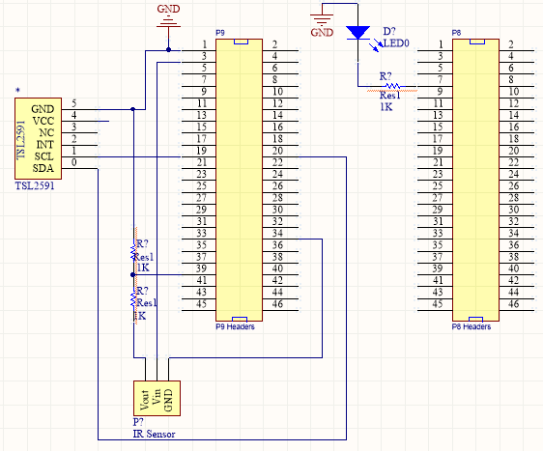
Schematics

Slide 6
Tools used in Design
Eclipse with Cross Compiler for Windows
Ubuntu Host System
I2C tools in Beagle bone Linux for debugging

Slide 7
Implementation Details
Light on/off
TSL2591
Implemented through I2C communication (P9 GPIO 19/20) on Beagle Bone
LED used with GPIO 66 (P8) to control on/off states
When the light sensor reads a value of 0, GPIO 66 will be set to 1 and kept there until lux reads a value >= 1
Email is sent to user when the lights are turned on

Slide 8
Implementation Details
IR Sensor
Analog to Digital pin (P9 GPIO 40)
When object is within range of sensor, the ADC value will drop close to 0
Voltage divider created to drop output voltage to <= 1.8V (max voltage for ADC pins)
When an object is within the detecting range of the sensor, an email will be sent via the Beagle bone to notify the user that there is someone at the door
When they leave, the Beagle bone will send another email notifying that the person has left

Slide 9
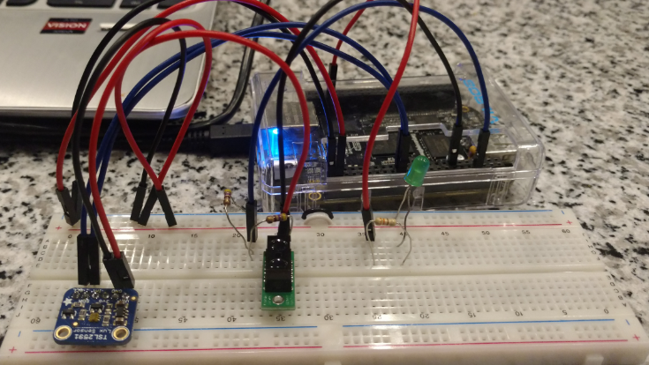
Prototype

Slide 10
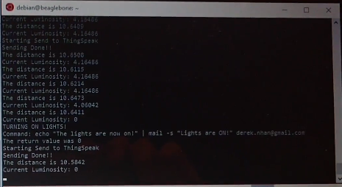
Terminal output

Slide 11
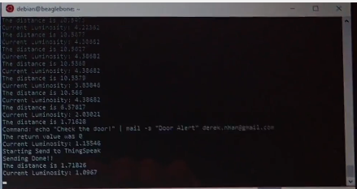
Terminal output

Slide 12
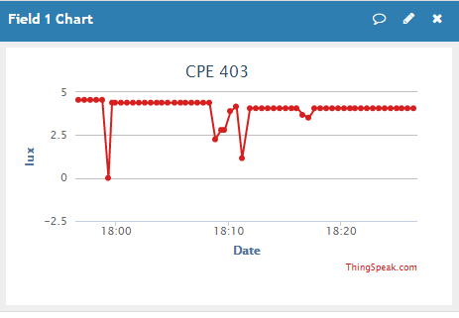
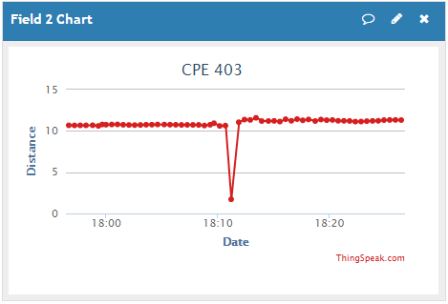
Thingspeak results

Slide 13
Demo
https://youtu.be/bYZIfyEgFkI

Slide 14
Results and Conclusions
Took TSL2591 data and plotted on Thingspeak
Turned on an LED when the luminosity was less than 0 (no light)
Also send an email to the user to notify that the light is on
Turned off LED when luminosity was greater than 0
Detect an object within the range of the IR sensor
Sent an email to notify whether the person was at the door or left

Slide 15
Reference
http://tinyurl.com/unlvcpe403f16
http://derekmolloy.ie/beaglebone/

