Slide 1

Introduction to Information Security
Group: 5

Slide 2
Group member:
Đặng Thành Nhân 522H006
Ngô Đức Huy 522H0038
Lê Trung Hưng 522H0032

Slide 3
Table of Contents:
SQL INJECTION
CROSS - SITE SCRIPTING (XSS) INJECTION
COUNTERMEASURES

Slide 4
SQL INJECTION

Slide 5

What is SQL Injection (SQLi) ?
SQL injection is a web security vulnerability that allows an attacker to interfere with the queries that an application makes to its database.
A successful SQL injection attack can badly affect websites or web applications using relational databases such as MySQL, Oracle, or SQL Server

Slide 6
What is impact of successful SQL injection attack ?
A successful SQL injection attack can result in unauthorized access to sensitive data, such as:
This can allow an attacker to view data that they are not normally able to retrieve.
This might include data that belongs to other users, or any other data that the application can access.
In many cases, an attacker can modify or delete this data, causing persistent changes to the application's content or behavior.

Slide 7
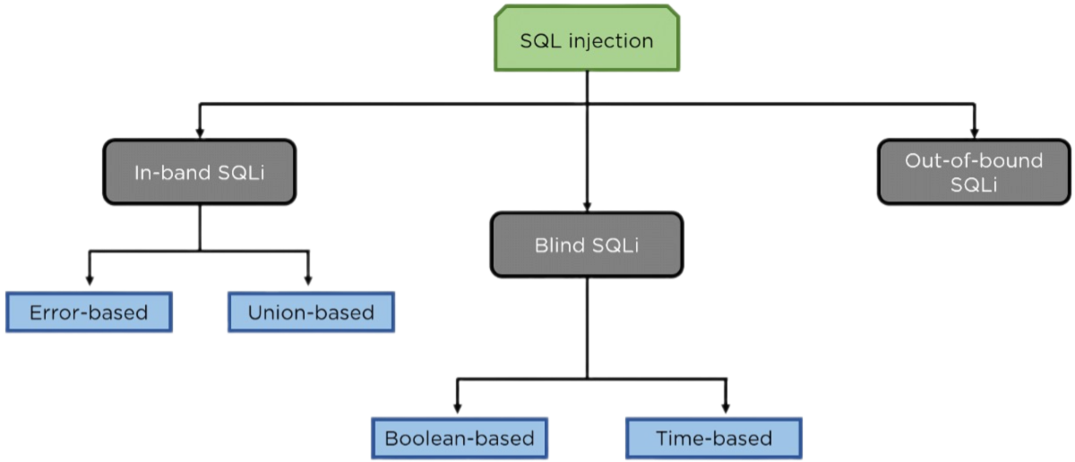
Types of SQL Injection
Out- of-band
SQLi

Slide 8
In-Band SQL Injection
The most common and simplest type to exploit information.
In-band SQLI is when the attacker inserts malicious code and directly receives the results on the same channel.
Two common forms of In-band SQLI are Error-based SQLI and UNION-based SQLI

Slide 9
Error-Based SQL injection
In error-based SQL injection, the attacker tries to insert a malicious query with the goal of receiving an error message that provides sensitive information about the database.
This example shows a URL that accepts a parameter from the user, in this case the required item: https://example.com/index.php?item=123
The attacker can try adding a single quote at the end of the parameter value:
https: /example.com/index.php?name=123’
If the database returns an error like this, the attack succeeded: You have an error in your SQL syntax; check the manual that corresponds to your MySQL server version for the right syntax to use near ‘‘VALUE’’.
This error message provides the attacker with:
Information about the database used—MySQL
The exact syntax that caused the error—single quote
Where the syntax error occurred in the query—after the parameter value

Slide 10
Union-Based SQL Injection
Union-based SQL injection is a specific technique used in SQL injection attacks. It takes advantage of the UNION operator in SQL, which is used to combine the results of two or more SELECT statements into a single result set.
For example, consider a web application that displays product details based on a product ID passed in the URL. An attacker could inject a UNION SQL query like this:
http://example.com/product.php?id=1 UNION SELECT username, password FROM users
If the application fails to sanitize the input, the database will execute the injected query, effectively combining the product details with the usernames and passwords from the "users" table, allowing the attacker to retrieve sensitive credentials.

Slide 11
Inferential(Blind) SQL Injection
This type of attack arises when an application is vulnerable to SQLI attacks, but has slightly higher security by not returning SQL query results but being entered as input as InBand.
Inferential(Blind) SQLI is slow because it must be observed and analyzed based on the server's response, but the damage is no different from Inband.
Two common forms of Inferential(Blind) SQLI are Boolean-based SQLI and Time-based SQLI.

Slide 12
Boolean-Based SQL Injection
In a boolean-based SQL injection attack, the attacker sends specially crafted SQL queries to the application that include boolean (true/false) conditions. By observing the application's behavior and responses, the attacker can determine if the injected query returned true or false, even though no data is directly returned.
For example: ' AND (SELECT SUBSTRING(DATABASE(),1,1)='a' checks if the first character of the database name is 'a'.
The attacker reconstructs information by sending payloads and observing the application's behavior.

Slide 13
Time-Based SQL Injection
The Time-based SQL injection is a technique where an attacker can extract data from a database by observing time delays in the application's responses, even when the application does not return any error messages or data from the queries.
For example, an attacker could inject: '; IF (1=1) WAITFOR DELAY '0:0:10'--
If the application takes 10 seconds to respond, the condition is true,indicating a potential SQL injection vulnerability.
The attacker can then construct queries to extract data bit-by-bit by testing conditions like: '; IF SUBSTRING(DatabaseName, 1, 1) = 'a' WAITFOR DELAY '0:0:10’—

Slide 14
Out-of-band SQL Injection
This method is typically used when the application needs to use the database's capabilities that cannot be provided by the server or the web app itself.
This attack cannot be detected or blocked by web application firewalls (since it does not interact directly with the web application), either when the server is overloaded or when the server is stable (does not use Inferential techniques).
OOB will cause the web application to send the query results to an attacker-controlled server or channel that the attacker can monitor

Slide 15
SQL INJECTION
COUNTERMEASURE

Slide 16
SQL INJECTION
COUNTERMEASURE
"Clean" user input
Websites need filters to sanitize all user input.
For example, the "Enter email address" field should only allow valid email formats (with @, periods, no special characters, etc.)
This method can block and filter out many attacks by exploiting user input fields.
Using a Web Application Firewall (WAF)
WAFs have built-in filters and are constantly updated to detect and block malicious user inputs.
Some popular WAF solutions: ModSecurity, AppTrana, Managed Web Application Firewall, etc.

Slide 17
SQL INJECTION
COUNTERMEASURE
Tightening permissions.
A common entry point for attacks is exploiting SQL queries (insert, update, search, delete, etc.)
To reduce SQL injection attacks, users should only have the minimum required permissions.
Restricting permissions will limit the damage potential of a successful SQL injection attack.
Input validation through code.
In addition to filters, input should be validated directly in the application code.
For example: only allow certain input patterns into SQL variables and stored procedures for extra security.

Slide 18
CROSS - SITE - SCRIPTING (XSS)

Slide 19

What is cross-site scripting (XSS) ?
Cross-site scripting (also known as XSS) is a web security vulnerability that allows an attacker to compromise the interactions that users have with a vulnerable application.
It allows an attacker to circumvent the same origin policy, which is designed to segregate different websites from each other.
Cross-site scripting vulnerabilities normally allow an attacker to masquerade as a victim user, to carry out any actions that the user is able to perform, and to access any of the user's data. If the victim user has privileged access within the application, then the attacker might be able to gain full control over all of the application's functionality and data.

Slide 20
How serious is the XSS vulnerability?
Problem 1
Attackers can use XSS vulnerabilities to steal cookies, take over accounts, perform ActiveX, execute Flash content, trick users into downloading software, etc.
Problem 2
Phishing attacks often exploit XSS vulnerabilities to masquerade as legitimate websites. If the attacker is really wise, they can carry out an XSS attack targeting administrator.
It is possible by sending a letter titled "Help! This website URL keeps bugging me!" After an administrator opens the URL, the attacker can do a lot of damage such as stealing their information and hijacking administrator rights.
Problem 3

Slide 21
CATEGORIES OF XSS
Reflected
XSS
Stored XSS
DOM
based XSS
Use HTTP request
Use malicious code hosted on the server side
Saturn was named after a Roman god
01
02
03

Slide 22
What are the types of XSS attacks?
Reflected XSS
Cross-site scripting (XSS) is one the most common ways hackers attack websites. XSS vulnerabilities permit a malicious user to execute arbitrary chunks of JavaScript when other users visit your site.
XSS is the most common publicly reported security vulnerability, and part of every hacker's toolkit.
Where the malicious script comes from the current HTTP request.
Reflected XSS attacks, also known as non-persistent attacks, occur when a malicious script is reflected off of a web application to the victim’s browser.

Slide 23
Reflected XSS
The script is activated through a link, which sends a request to a website with a vulnerability that enables execution of malicious scripts. The vulnerability is typically a result of incoming requests not being sufficiently sanitized, which allows for the manipulation of a web application’s functions and the activation of malicious scripts.
To distribute the malicious link, a perpetrator typically embeds it into an email or third party website (e.g., in a comment section or in social media). The link is embedded inside an anchor text that provokes the user to click on it, which initiates the XSS request to an exploited website, reflecting the attack back to the user.
Unlike a stored attack, where the perpetrator must locate a website that allows for permanent injection of malicious scripts, reflected attacks only require that the malicious script be embedded into a link. That being said, in order for the attack to be successful, the user needs to click on the infected link.

Slide 24
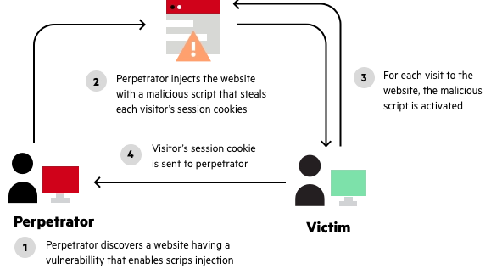
Reflected XSS
As such, there are a number of key differences between reflected and stored XSS attacks, including:
Reflected attacks are more common.
Reflected attacks do not have the same reach as stored XSS attacks.
Reflected attacks can be avoided by vigilant users.

Slide 25
Reflected XSS
Reflected XSS attacks are less dangerous than stored XSS attacks, which cause a persistent problem when users visit a particular page, but are much more common.
Any page that takes a parameter from a GET or POST request and displays that parameter back to the user in some fashion is potentially at risk. A page that fails to treat query string parameters as untrusted content can allow the construction of malicious URLs.
An attacker will spread these malicious URLs in emails, in comments sections, or in forums. Since the link points at a site the user trusts, they are much more likely to click on it, not knowing the harm that it will do.

Slide 26
Reflected XSS
Reflected XSS vulnerabilities are easy to overlook in your code reviews, since the temptation is to only check code that interacts with the data store. Be particularly careful to check the following types of pages:
Search results - does the search criteria get displayed back to the user? Is it written out in the page title? Are you sure it is being escaped properly?
Error pages - if you have error messages that complain about invalid inputs, does the input get escaped properly when it is displayed back to the user? Does your 404 page mention the path being searched for?
Form submissions - if a page POSTs data, does any part of the data being submitted by the form get displayed back to the user?

Slide 27
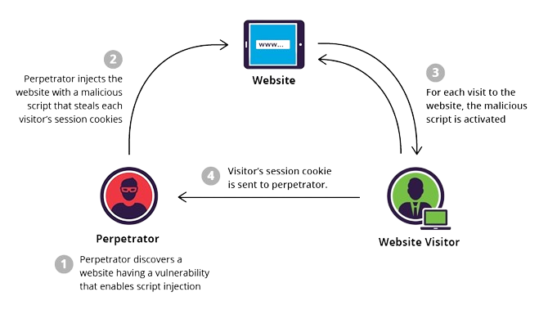
2. Stored XSS
Stored XSS, also known as persistent XSS, is the more damaging of the two. It occurs when a malicious script is injected directly into a vulnerable web application.
To successfully execute a stored XSS attack, a perpetrator has to locate a vulnerability in a web application and then inject malicious script into its server (e.g., via a comment field).

Slide 28
2. Stored XSS
XSS allows arbitrary execution of JavaScript code, so the damage that can be done by an attacker depends on the sensitivity of the data being handled by your site. Some of the things hackers have done by exploiting XSS:
Spreading worms on social media sites. Facebook, Twitter and YouTube have all been successfully attacked in this way.
Session hijacking. Malicious JavaScript may be able to send the session ID to a remote site under the hacker's control, allowing the hacker to impersonate that user by hijacking a session in progress.
Identity theft. If the user enters confidential information such as credit card numbers into a compromised website, these details can be stolen using malicious JavaScript.
Denial of service attacks and website vandalism.
Theft of sensitive data, like passwords.
Financial fraud on banking sites.

Slide 29
3. DOM - Based XSS
Where the vulnerability exists in client-side code rather than server-side code.
In this section, we'll describe DOM-based cross-site scripting (DOM XSS), explain how to find DOM XSS vulnerabilities, and talk about how to exploit DOM XSS with different sources and sinks.
DOM-based XSS vulnerabilities usually arise when JavaScript takes data from an attacker-controllable source, such as the URL, and passes it to a sink that supports dynamic code execution, such as eval() or innerHTML. This enables attackers to execute malicious JavaScript, which typically allows them to hijack other users' accounts.
To deliver a DOM-based XSS attack, you need to place data into a source so that it is propagated to a sink and causes execution of arbitrary JavaScript.

Slide 30
3. DOM - Based XSS
Protecting against DOM-based XSS attacks is a matter of checking that your JavaScript does not interpret URI fragments in an unsafe manner. There are a number of ways to ensure this.
Use a JavaScript Framework Frameworks like AngularJS and React use templates that makes construction of ad-hoc HTML an explicit (and rare) action.
This will push your development team towards best practices, and make unsafe operations easier to detect. AngularJS.
How to test for DOM-based cross-site scripting?
The majority of DOM XSS vulnerabilities can be found quickly and reliably using Burp Suite's web vulnerability scanner. To test for DOM-based cross-site scripting manually, you generally need to use a browser with developer tools, such as Chrome. You need to work through each available source in turn, and test each one individually.

Slide 31
WHAT CAN XSS BE USE FOR
An attacker who exploits a cross-site scripting vulnerability is typically able to:
Impersonate or masquerade as the victim user.
Carry out any action that the user is able to perform.
Read any data that the user is able to access.
Capture the user's login credentials.
Perform virtual defacement of the web site.
Inject trojan functionality into the web site.

Slide 32
IMPACT OF XSS VULNERABILITIES
The actual impact of an XSS attack generally depends on the nature of the application, its functionality and data, and the status of the compromised user.
For example:
In a brochureware application, where all users are anonymous and all information is public, the impact will often be minimal.
In an application holding sensitive data, such as banking transactions, emails, or healthcare records, the impact will usually be serious.
If the compromised user has elevated privileges within the application, then the impact will generally be critical, allowing the attacker to take full control of the vulnerable application and compromise all users and their data.

Slide 33
XSS ATTACK COUNTERMEASURE

Slide 34
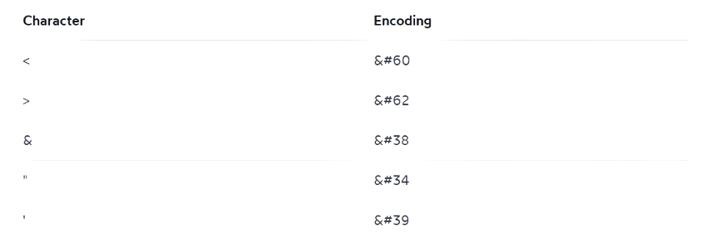
XSS ATTACK COUNTERMEASURE
Escaping dynamic contents generally consists of replacing significant characters with the HTML entity encoding:
Most modern frameworks will escape dynamic content by default -- see the code samples below for details.
Escaping editable content in this way means it will never be treated as executable code by the browser. This closes the door on most XSS attacks.

Slide 35
XSS ATTACK COUNTERMEASURE
Input Validation: Validate and sanitize all user inputs before rendering them in the web application. This includes properly escaping or encoding special characters such as <, >, &, ', and ". Example JavaScript Code:
<script>
var userInput = "<script>malicious();</script>";
var escapedInput = userInput.replace(/&/g, "&amp;")
.replace(/</g, "&lt;")
.replace(/>/g, "&gt;")
.replace(/"/g, "&quot;")
.replace(/'/g, "&#39;");
console.log(escapedInput); // Outputs: &lt;script&gt;malicious();&lt;/script&gt;
</script>

Slide 36
Thank you for listening 🫶

