Slide 1

Notes:
Good afternoon. Today I'm presenting my senior project on constraint-preserving physics-informed neural networks for quantum dynamics. I'll cover the motivation, my approach, results, and two related research projects.

Slide 2
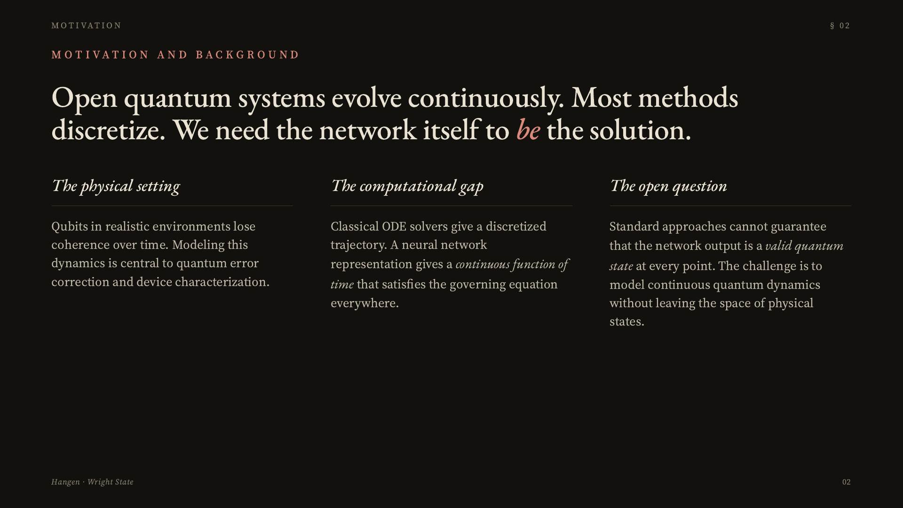
Notes:
The setting: we want to model how an open quantum system loses coherence over time. The standard tool is the Lindblad master equation, a differential equation for the density matrix rho of t. Rather than solve it numerically on a grid, I want a neural network that represents rho as a continuous function of time — but there's a fundamental catch that the standard approach doesn't handle well.

Slide 3
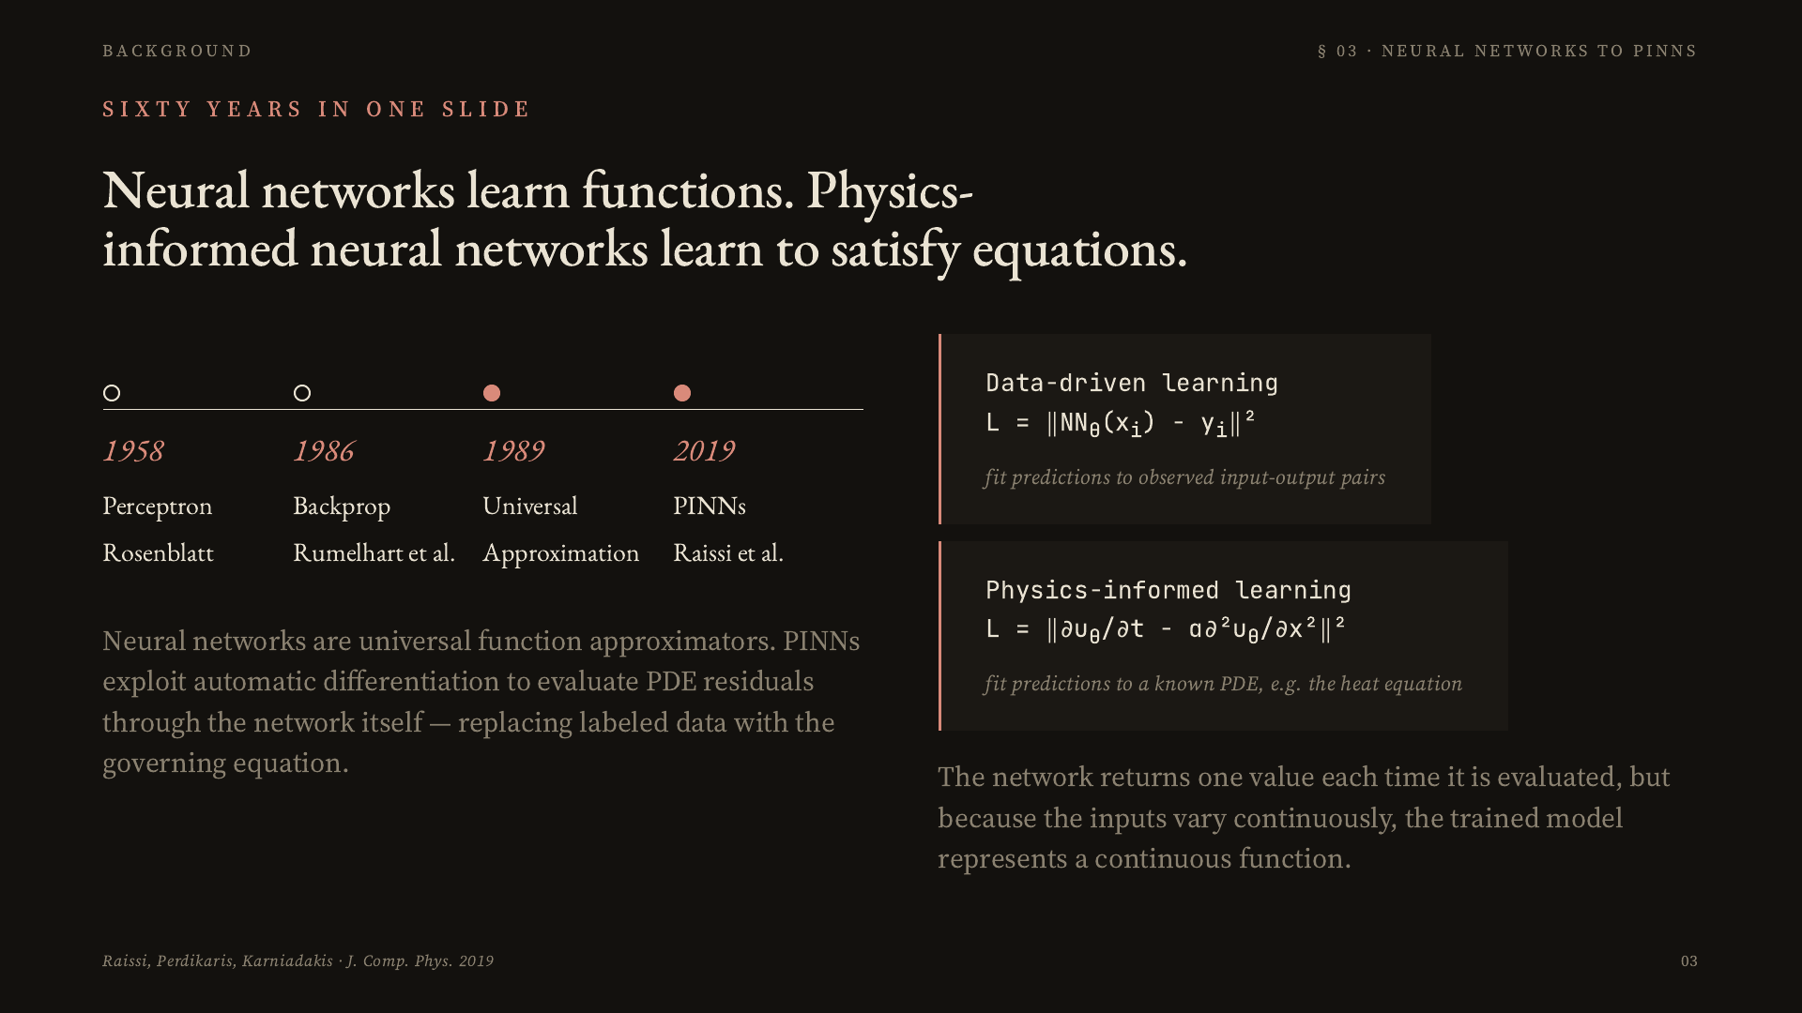
Notes:
Before I get to my solution, some brief background. Neural networks have been around since 1958, but the key development for this work is from 2019: physics-informed neural networks, introduced by Raissi, Perdikaris, and Karniadakis. The core idea is that instead of training on labeled data, you train the network to satisfy a differential equation directly, using the equation's residual as the loss. Automatic differentiation lets you compute derivatives of the network's own output and plug them straight into the PDE.

Slide 4
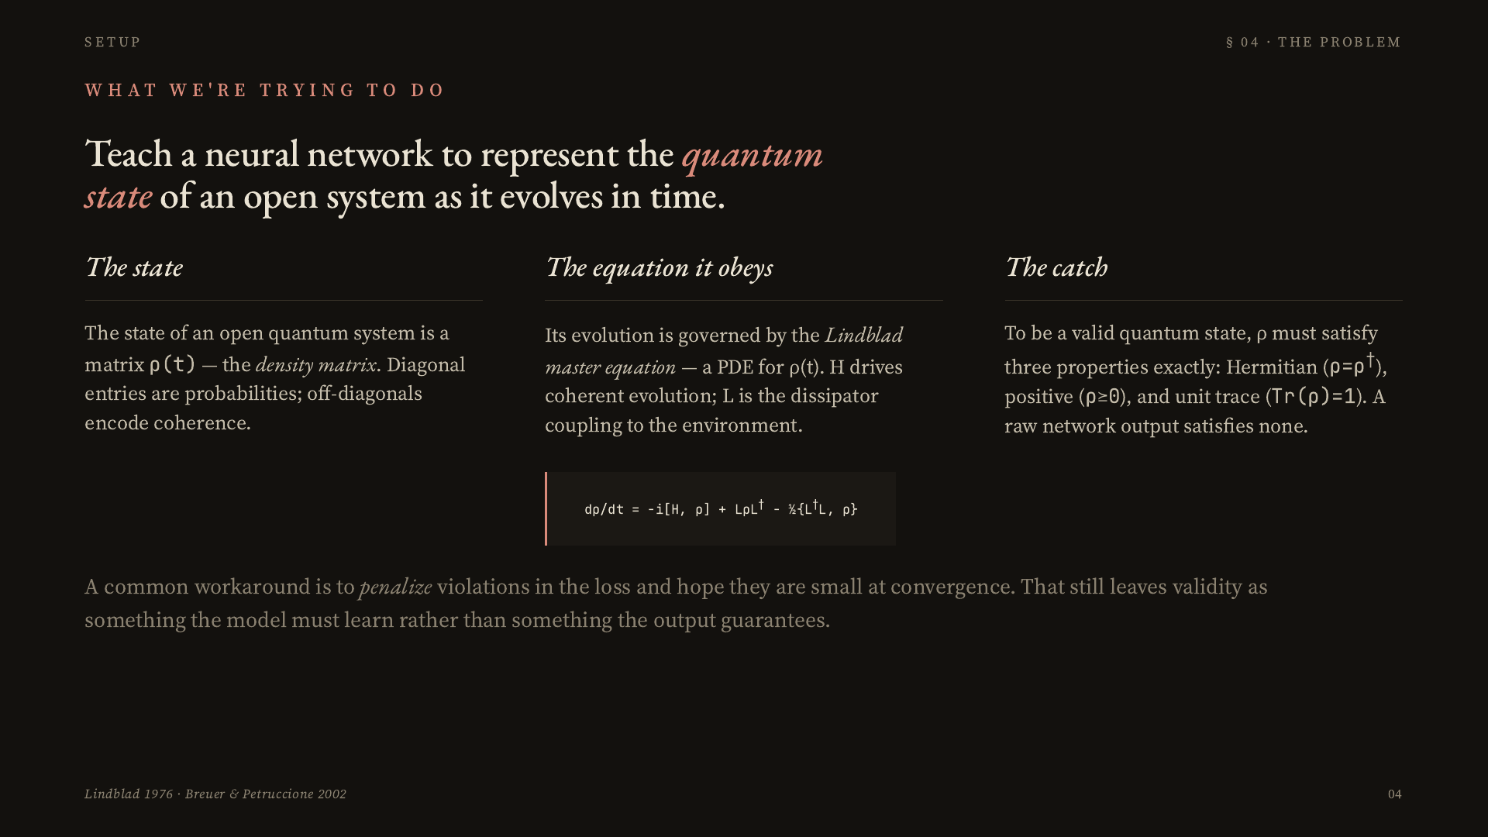
Notes:
Here's the specific problem. The density matrix rho is the object we want the network to output. It describes the quantum state of the system at each time t. Its evolution is governed by the Lindblad equation, which is our PDE. But to be a valid quantum state, rho must satisfy three algebraic properties exactly — Hermitian, positive semidefinite, and unit trace. Traditional neural networks cannot guarantee valid density-matrix output, and that's the problem I set out to solve.

Slide 5
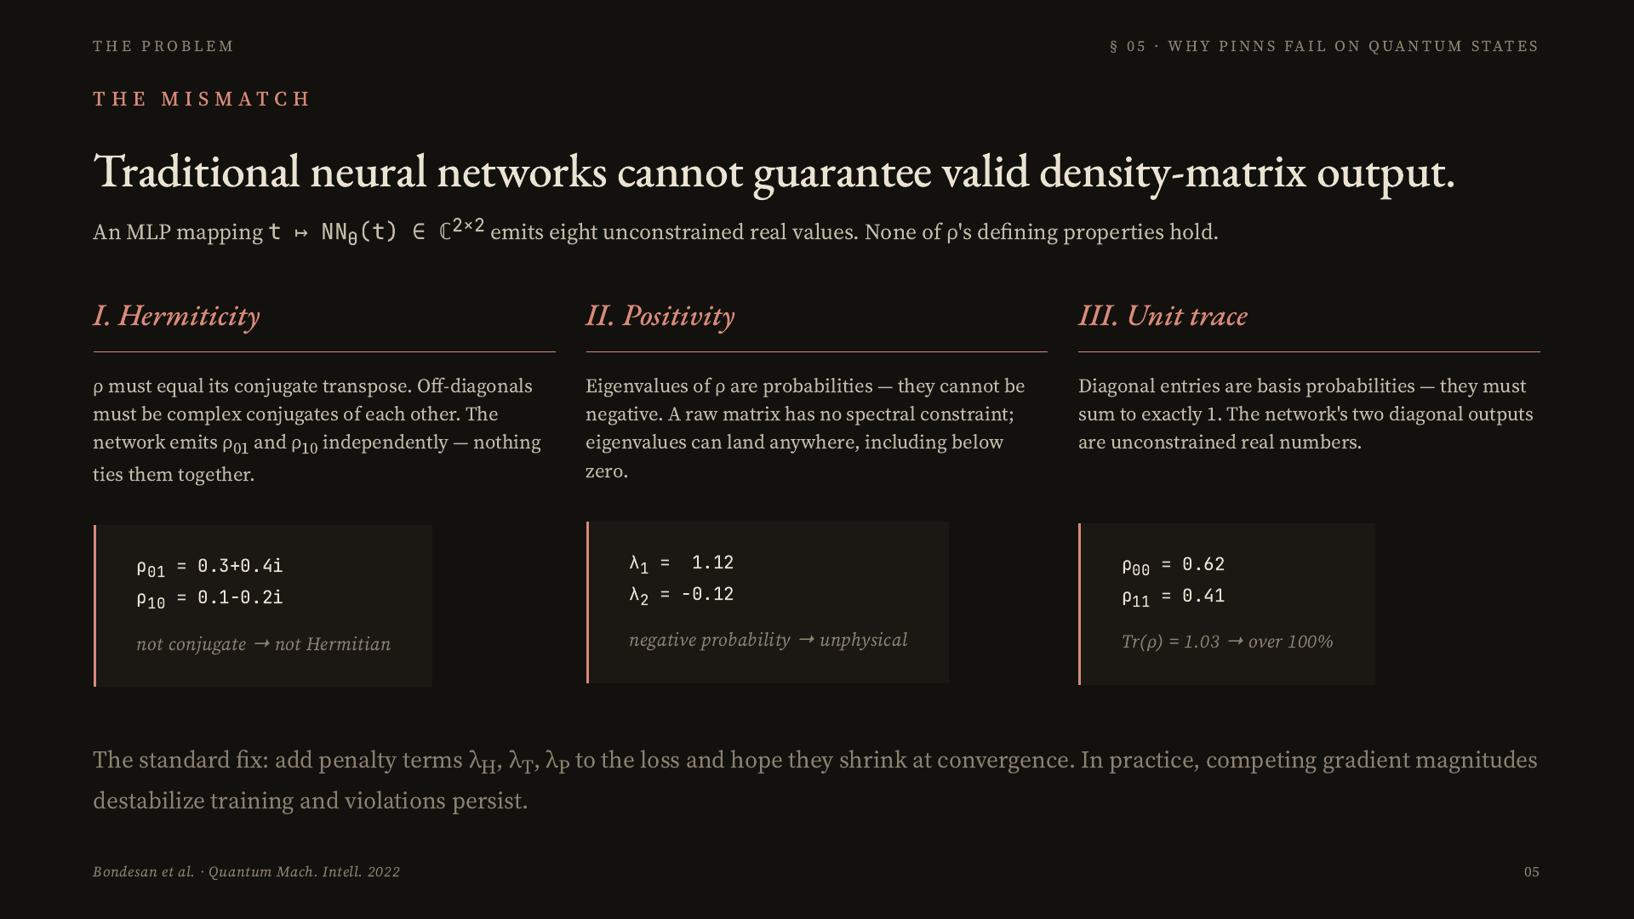
Notes:
Here is exactly why a generic PINN fails for density matrices. The network emits eight unconstrained real numbers. Hermiticity fails because off-diagonal entries are independent — nothing ties rho-01 to the conjugate of rho-10. Positivity fails because eigenvalues can be negative — meaning the output assigns negative probability to some measurement outcome. Unit trace fails because the diagonal doesn't sum to one. The standard remedy is to add penalty terms for each violation, but as I'll show, that creates its own problems.

Slide 6
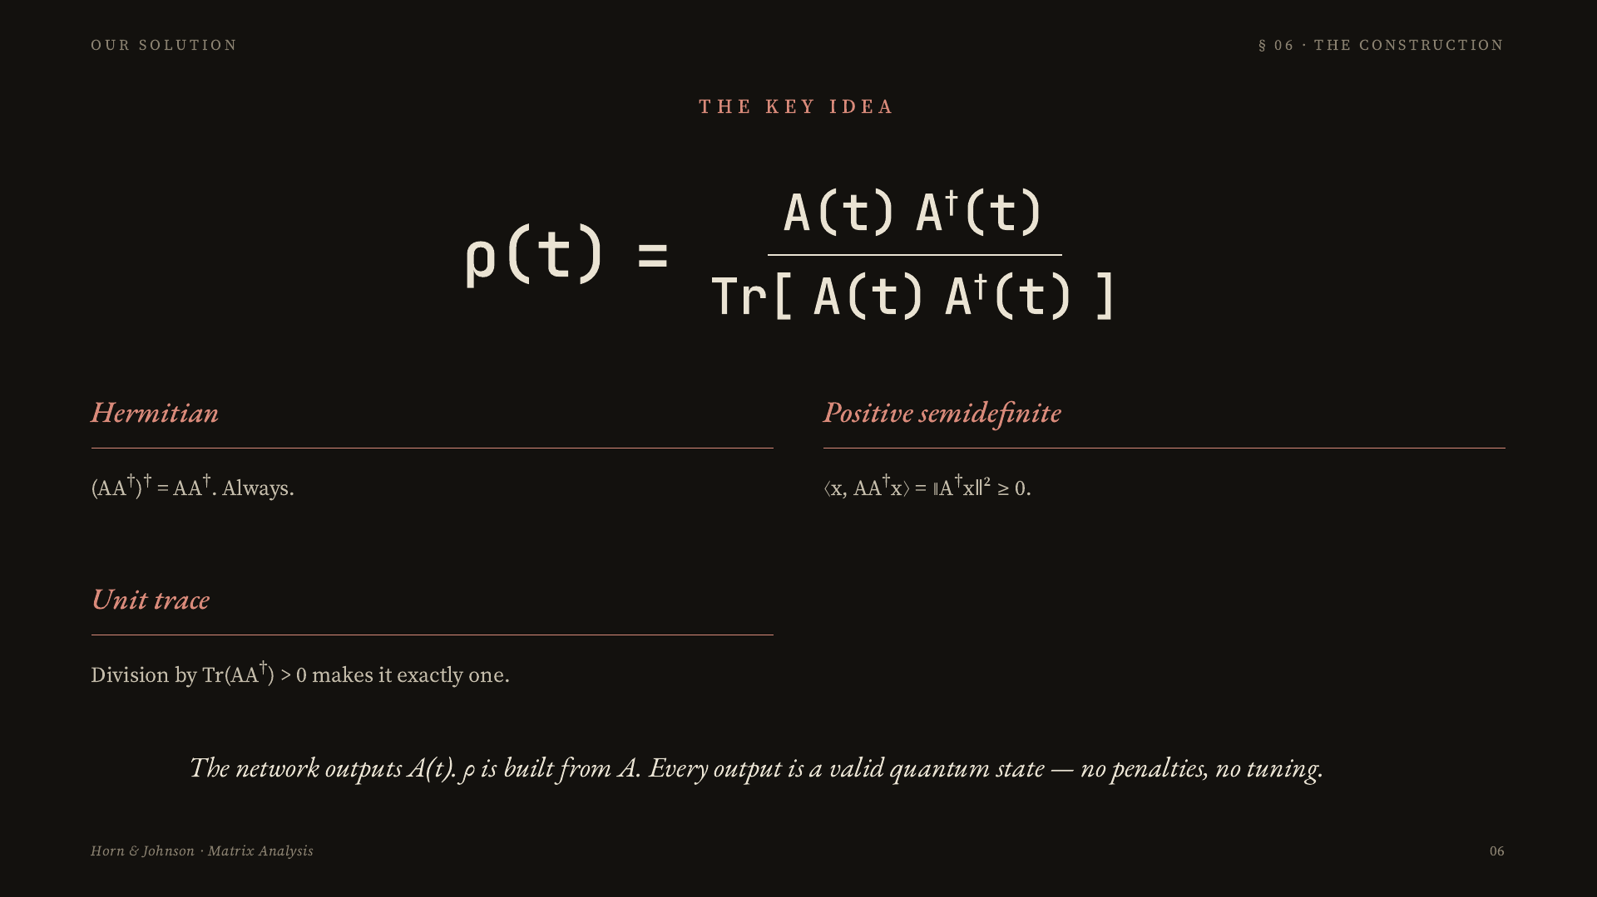
Notes:
My fix is to change what the network outputs. Instead of predicting rho directly, the network predicts an auxiliary lower-triangular matrix A of t. Rho is then constructed as A A-dagger divided by its trace. Because A A-dagger is a Gram matrix, it is automatically Hermitian and positive semidefinite. Dividing by the trace makes it exactly trace-one. This holds for every possible A, at every time, throughout training. No penalties needed.

Slide 7
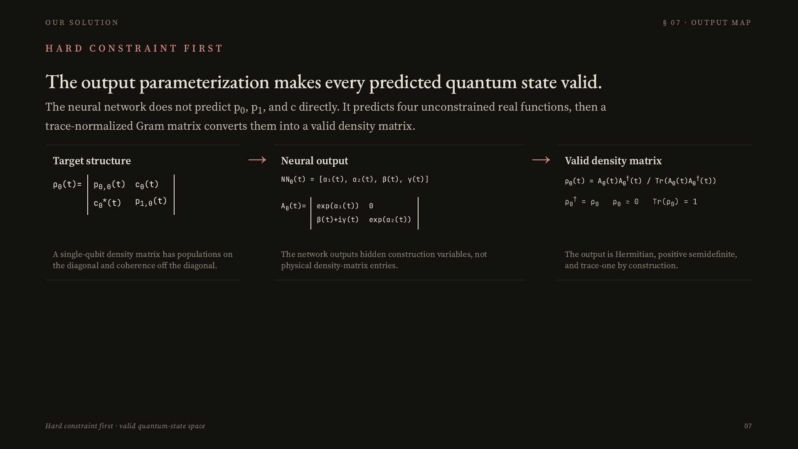
Notes:
This slide shows the constraint-preserving output parameterization from the paper. The target structure is a single-qubit density matrix: populations on the diagonal and coherence off diagonal. The neural network does not predict those physical entries directly. It predicts four unconstrained real functions: alpha one, alpha two, beta, and gamma. Those define a triangular helper matrix A theta, and the trace-normalized Gram matrix produces a valid density matrix before the loss is evaluated.

Slide 8
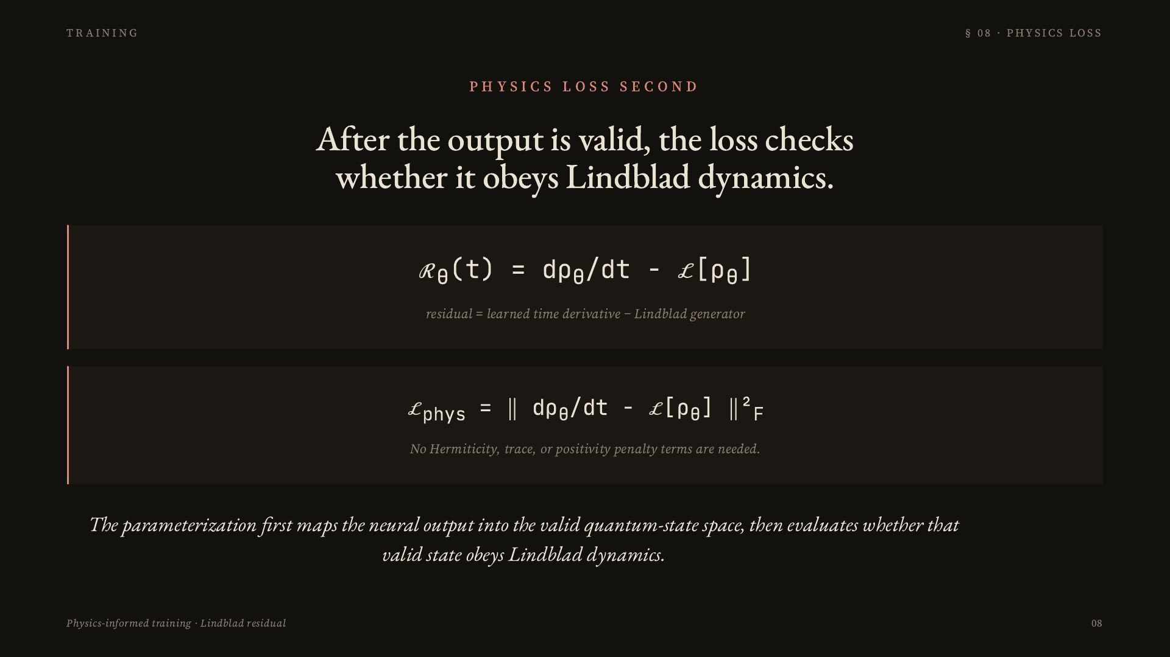
Notes:
Now that rho sub theta is a valid density matrix, we can ask whether it follows the physics. The residual is d rho sub theta over dt minus the Lindblad generator applied to rho sub theta. The loss is the squared Frobenius norm of that residual. This is hard constraint first, physics loss second.

Slide 9
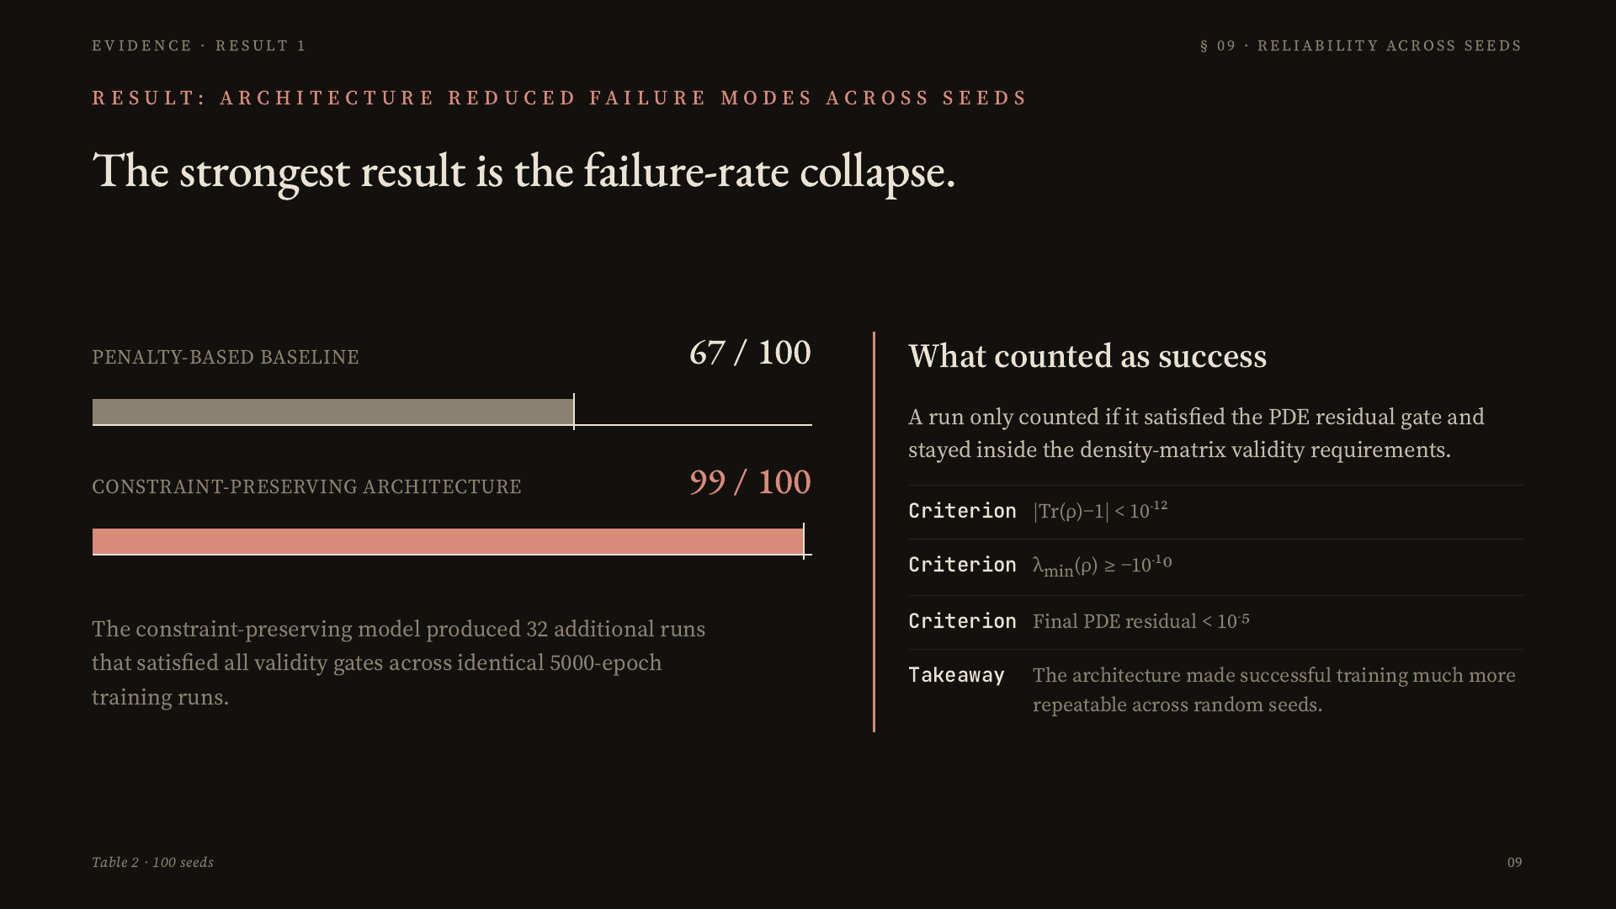
Notes:
This is the first main result. Across 100 independent seeds, the baseline succeeded 67 times and the constraint-preserving model succeeded 99 times. That means the architecture produced 32 additional successful trainings under the same hyperparameters and the same formal success criteria.

Slide 10
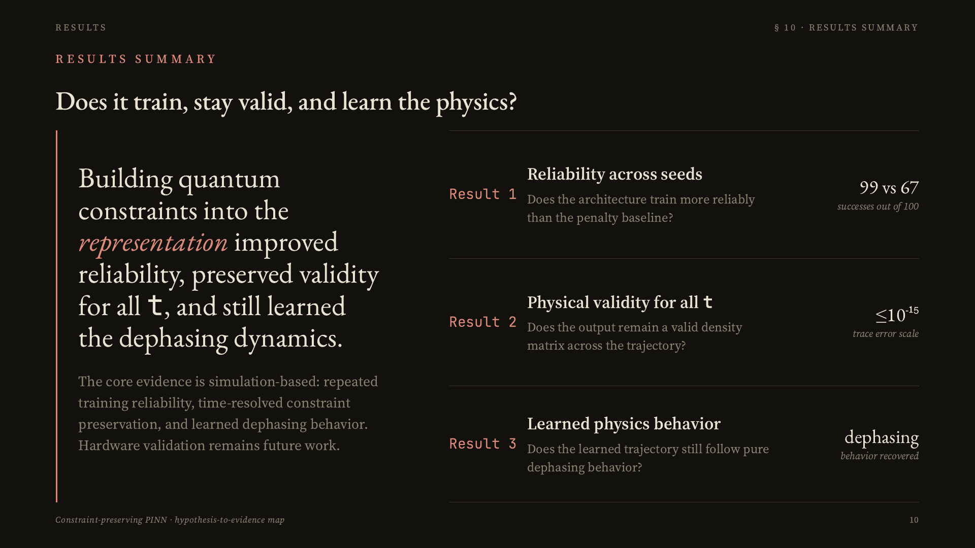
Notes:
This slide summarizes how the results connect back to the hypothesis. The results answer three questions: does the model train more reliably, does it stay physically valid over time, and does it still follow the known dephasing behavior? The answer is yes across the simulation evidence.

Slide 11
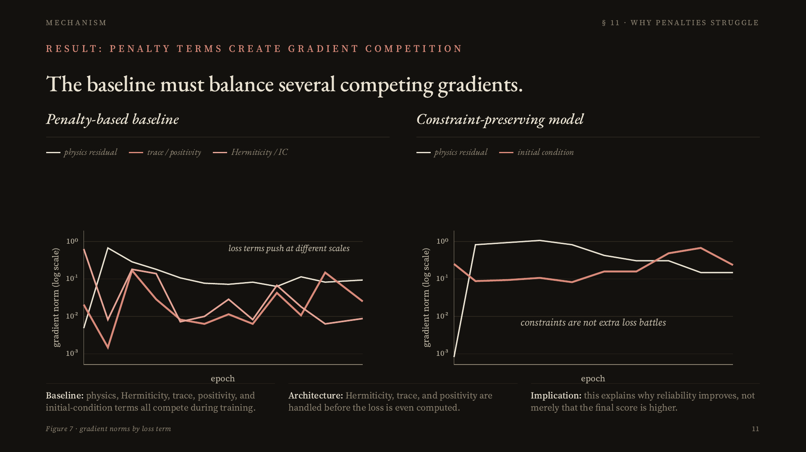
Notes:
This gradient diagnostic shows why penalties are fragile. The baseline has several loss terms pushing with different gradient scales — physics residual, Hermiticity, trace, positivity, and initial condition. The constraint-preserving model has a much cleaner optimization problem because the validity constraints are already handled by the representation.

Slide 12
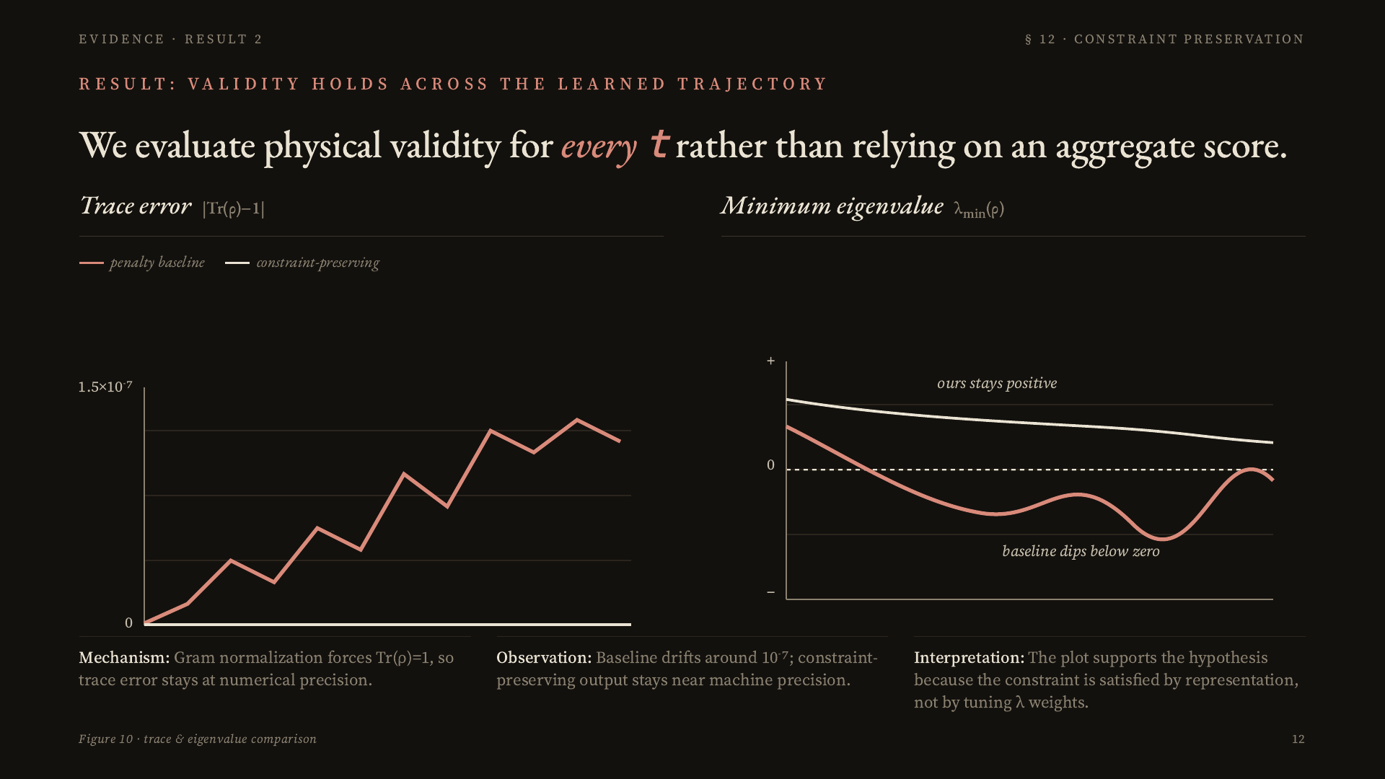
Notes:
This is the second main result. A final success rate is useful, but it does not show whether the network remains physically valid throughout the trajectory. On the left, trace error versus time — the baseline drifts around ten to the minus seven while ours sits at machine precision. On the right, the minimum eigenvalue shows the baseline dipping below zero, while the constraint-preserving output stays non-negative. This is the mechanism behind the reliability result.

Slide 13
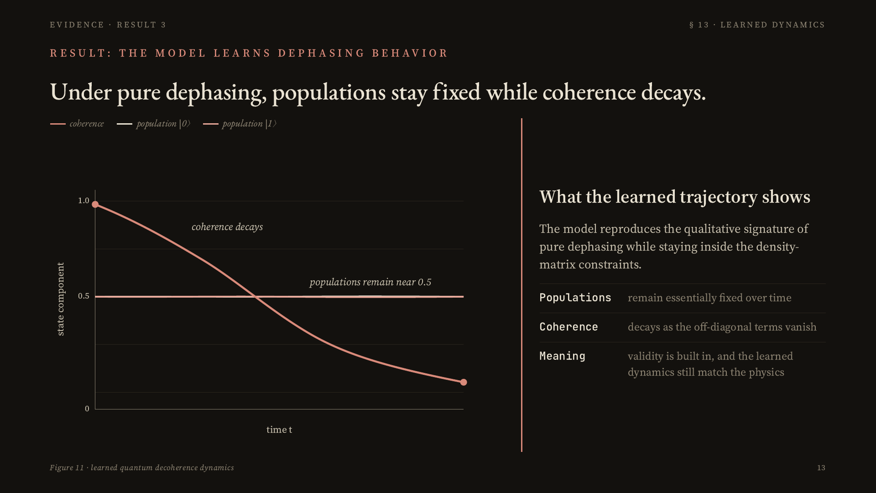
Notes:
This is the third main result: the model does not merely output legal matrices; it learns the expected physics. For pure dephasing, populations stay essentially fixed while coherence decays. The learned dynamics match that qualitative behavior, so the architecture preserves the density-matrix rules without destroying the physical trajectory.

Slide 14
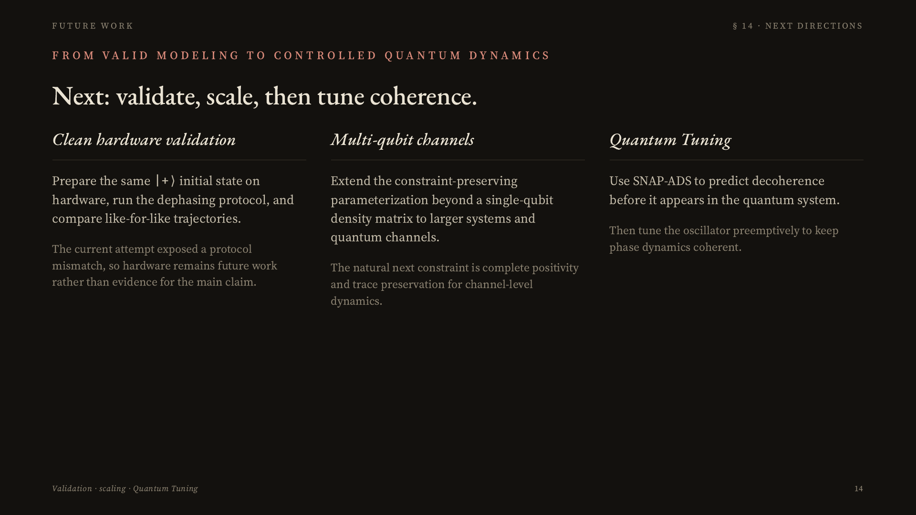
Notes:
This future-work slide separates immediate validation work from the longer-term direction. First, a clean hardware validation needs to prepare the same |+> initial state on the device and compare like-for-like trajectories. Second, the architecture should be extended beyond single-qubit density matrices toward multi-qubit systems and channel-level constraints. Third, the longer horizon is Quantum Tuning: using SNAP-ADS to predict decoherence before it appears in the quantum system, then tuning the oscillator preemptively to keep phase dynamics coherent.

Slide 15
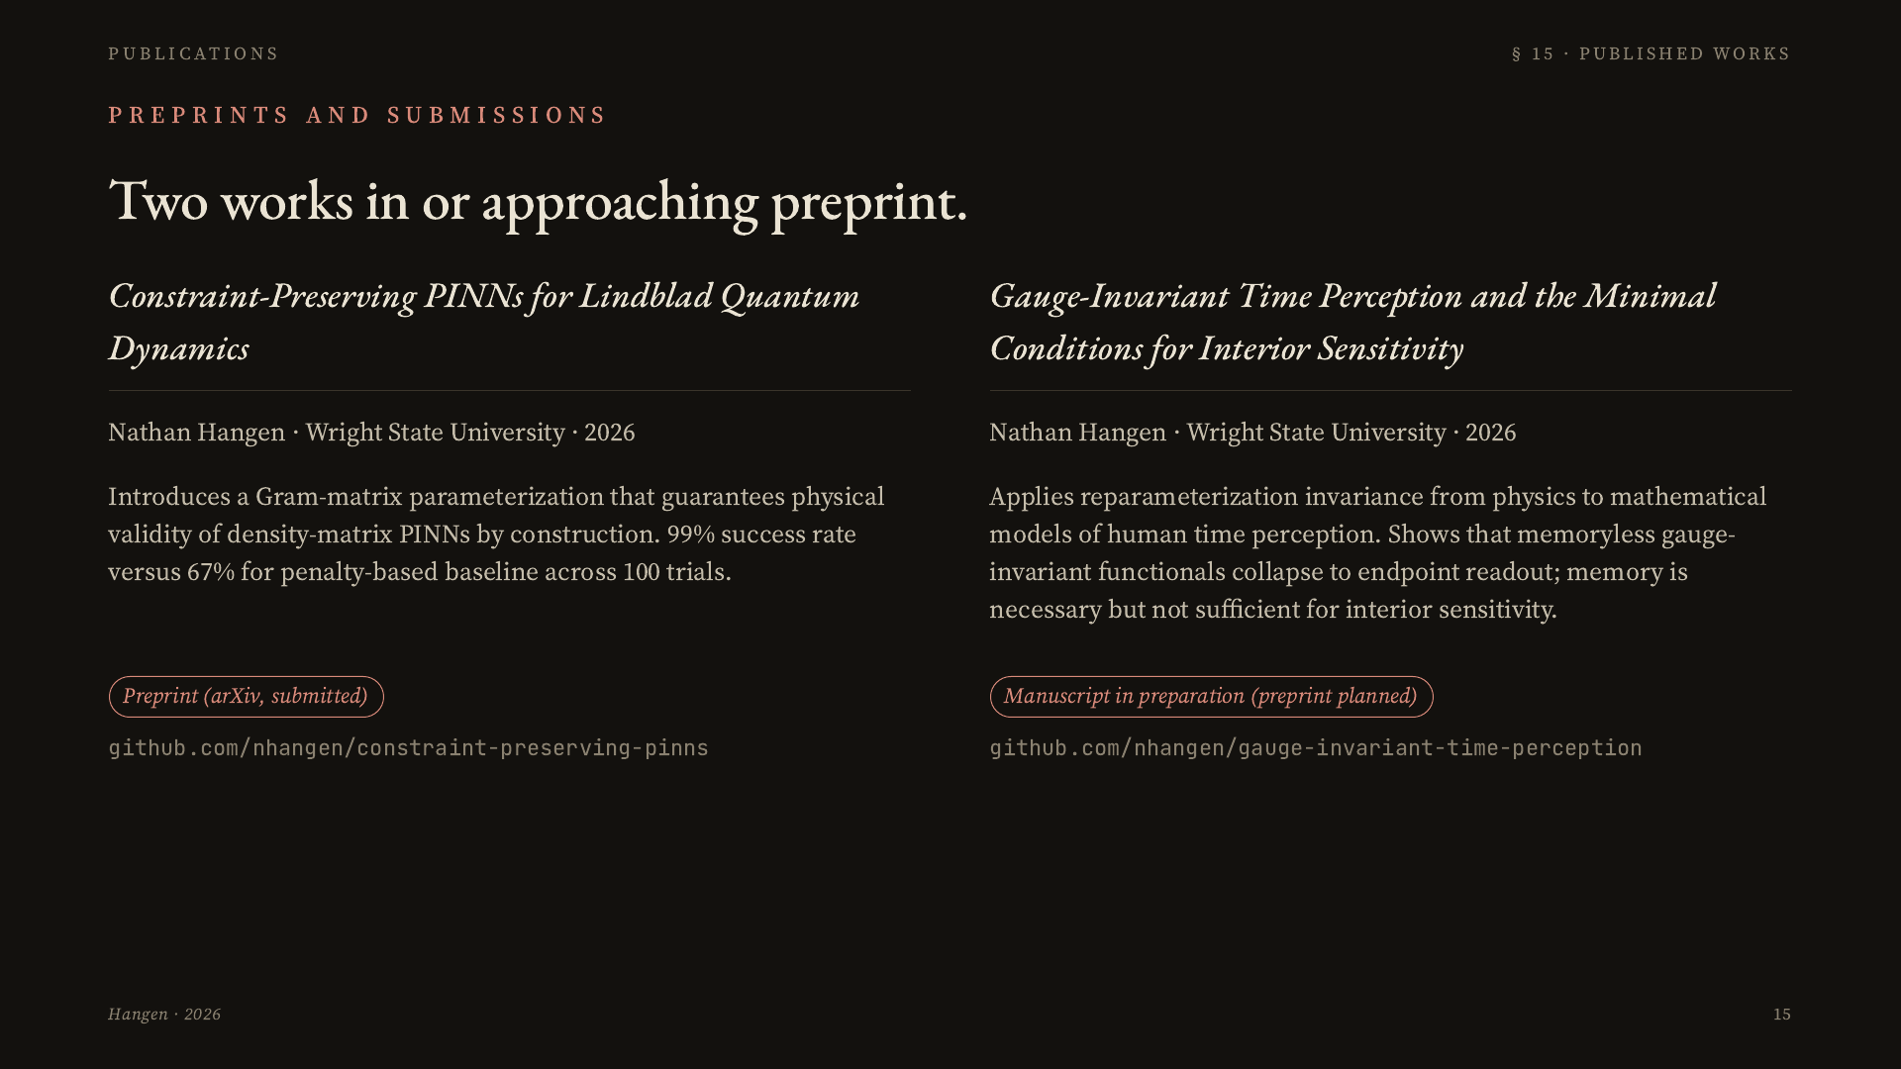
Notes:
I have two works in or approaching preprint. The first is the PINN work I've been presenting today, in pre-print submission on arXiv, with code available on GitHub. The second is on gauge-invariant time perception — it applies reparameterization invariance from physics to mathematical models of how humans perceive time, showing that memoryless gauge-invariant models collapse to reading only the endpoints of a temporal trajectory, and that memory is necessary but not sufficient for interior sensitivity. That project also has a public GitHub repository.

Slide 16
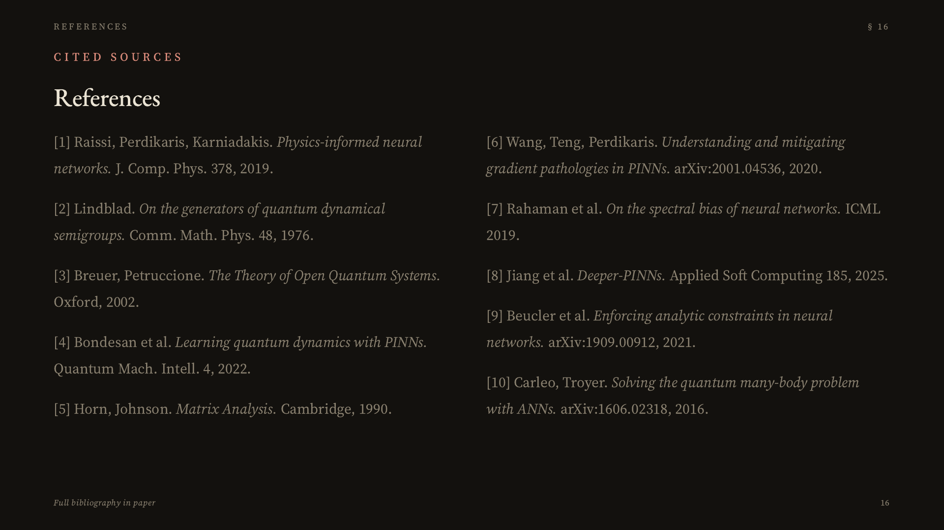
Notes:
These are the primary sources. Happy to discuss any of them during questions.

Slide 17
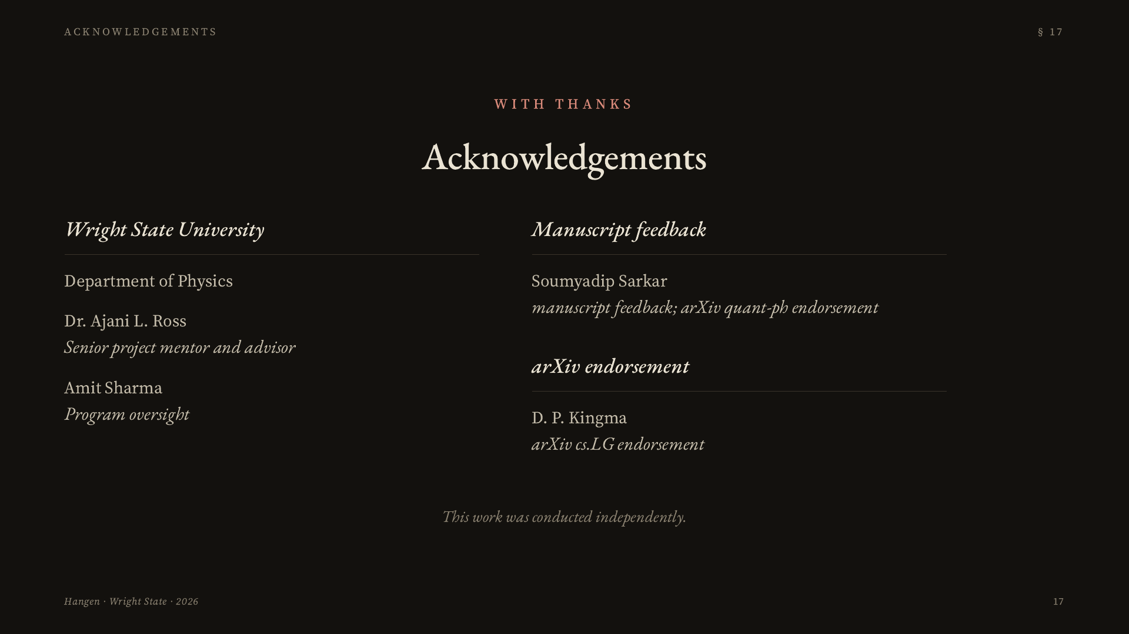
Notes:
Thank you to Dr. Ajani Ross, my senior project advisor and mentor, to Amit Sharma for program oversight, and to Wright State University Department of Physics. This work was conducted independently.

