Slide 1

RT AG CONNECT
Church Membership, Attendance & Follow-Up
Management System
A Smart Digital Platform for Effective
Church Membership Management
Redemption Temple AG · Board briefing · September 2026
Notes:
Introduce it in ONE sentence and resist explaining anything yet:
"This is a system for knowing our people - not just counting them."
Then move straight to the next slide. Do not open with features.
The system is already built and online; the screens in this deck are real
captures with demonstration data (fictional names). Say so if asked.

Slide 2
A member stops coming.
How long before someone notices?
Notes:
This is the emotional centre of the whole presentation.
ASK THE QUESTION, THEN STOP TALKING. Let it sit for a few seconds. The silence
is doing the work.
Then answer it honestly:
"In most churches the answer is months. And usually it is noticed by accident -
when someone happens to ask after them. By then the person has often already
decided they are no longer part of us."
Immediately protect the room:
"Nobody has failed here. The information simply was not in front of anyone.
That is what we are fixing."
Return to this question on the final slide.

Slide 3

THE SITUATION TODAY
What we currently rely on
Today | The cost
Attendance counted, not recorded by name | We know how many came, never who stopped coming
Membership register in a book or spreadsheet | Out of date, one copy, easily lost
Follow-up depends on someone remembering | Quiet members are missed; the same few get called twice
Birthdays remembered informally | Missed birthdays, no consistency
Reports assembled by hand before meetings | Hours of work, often for figures nobody trusts
Redemption Temple AG · RT AG Connect
Notes:
WATCH YOUR TONE HERE. This is not a criticism of anyone's faithfulness - it is a
description of what happens when good people work without good information.
Say that out loud. It keeps the room with you:
"None of this is anyone's fault. It is what happens when committed people are
asked to hold hundreds of names in their heads."
Do not read all five rows. Read the first one, and let them scan the rest.

Slide 4
WHAT WE GET
Seven questions the system answers
Who are our members?
Who attended church?
Who has been absent?
Who needs follow-up?
Whose birthday is coming up?
How is our membership growing?
Which departments and groups are active?
Redemption Temple AG · RT AG Connect
Notes:
Point at the two questions in gold.
"Every church can answer the first two with enough effort. Almost none can
answer the two in gold - and those are the two that actually decide whether
a person stays with us."
That is where most of the value of this system sits. Everything else is
housekeeping by comparison.

Slide 5
IN PLAIN TERMS
What it is
A secure web application
Computer, tablet or phone
Nothing to install
Reached through a browser, protected by a personal sign-in
The same information wherever you are
No app store, no software on anyone’s machine
Redemption Temple AG · RT AG Connect
Notes:
Keep this slide SHORT - about twenty seconds. It exists only to close off the
"what am I actually looking at" question so nobody is distracted for the rest of
the talk.
"It runs in a browser. The usher marks the register on a phone, the pastor
reads the alerts on a tablet, the administrator works at a desk. Same system,
same information, at the same moment."
Then move on.

Slide 6
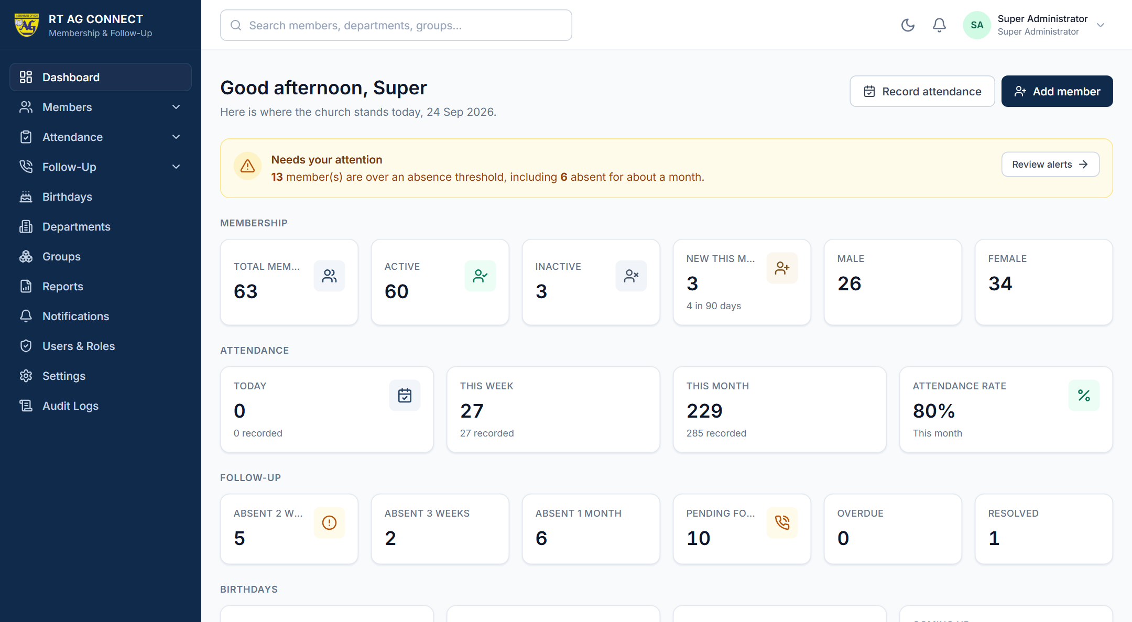
THE DASHBOARD
Everything leadership needs, on one screen
Membership
Total, active, inactive, new this month, male, female
Attendance
Today, this week, this month, attendance rate
Follow-up
Absent 2 / 3 weeks / 1 month, pending, overdue
Birthdays
Today, this week, this month
Redemption Temple AG · RT AG Connect
Notes:
Walk the four bands top to bottom in about 45 seconds. Do not linger on numbers.
Then make the point that actually matters:
"Notice the ORDER. What needs attention is at the top - the people, not the
totals. This screen is arranged by pastoral urgency, not by what was easiest
to build."
There are also six charts further down the page: attendance trend over twelve
weeks, membership growth, gender split, members by department, members by age,
and attendance by service type. Mention them; do not tour them.

Slide 7
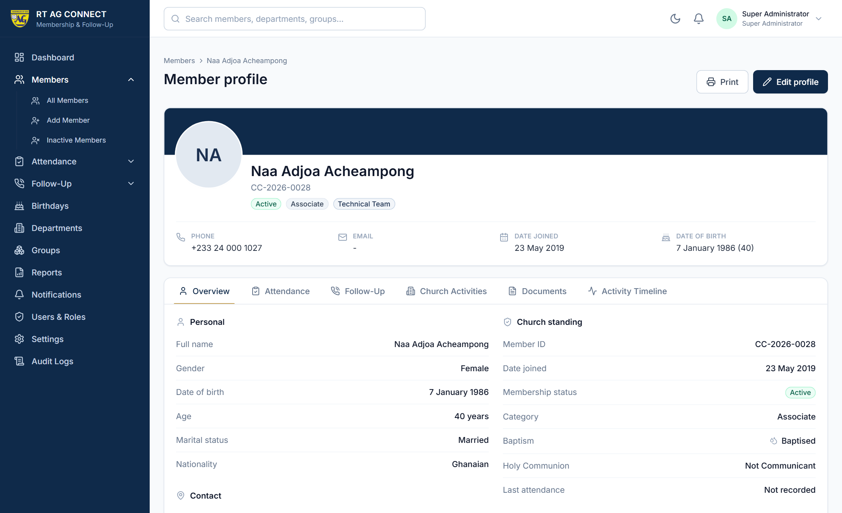
MEMBER MANAGEMENT
One complete record per member
Each profile holds
Photograph
Personal and contact details
Date joined, baptism, Holy Communion
Department, group and ministry
Emergency contact
Six tabs
Overview · Attendance · Follow-Up ·
Church Activities · Documents ·
Activity Timeline
Redemption Temple AG · RT AG Connect
Notes:
Run through the record quickly - it is the least surprising part of the system.
Spend your time on the PHOTOGRAPH, which matters more than it sounds:
"A leader who has recently joined this congregation can put a face to a name
before making a call. So can an usher looking for someone who has been away
for a month."
The Activity Timeline is worth one sentence: every change to a record is kept,
so you can see what happened to it and when.

Slide 8
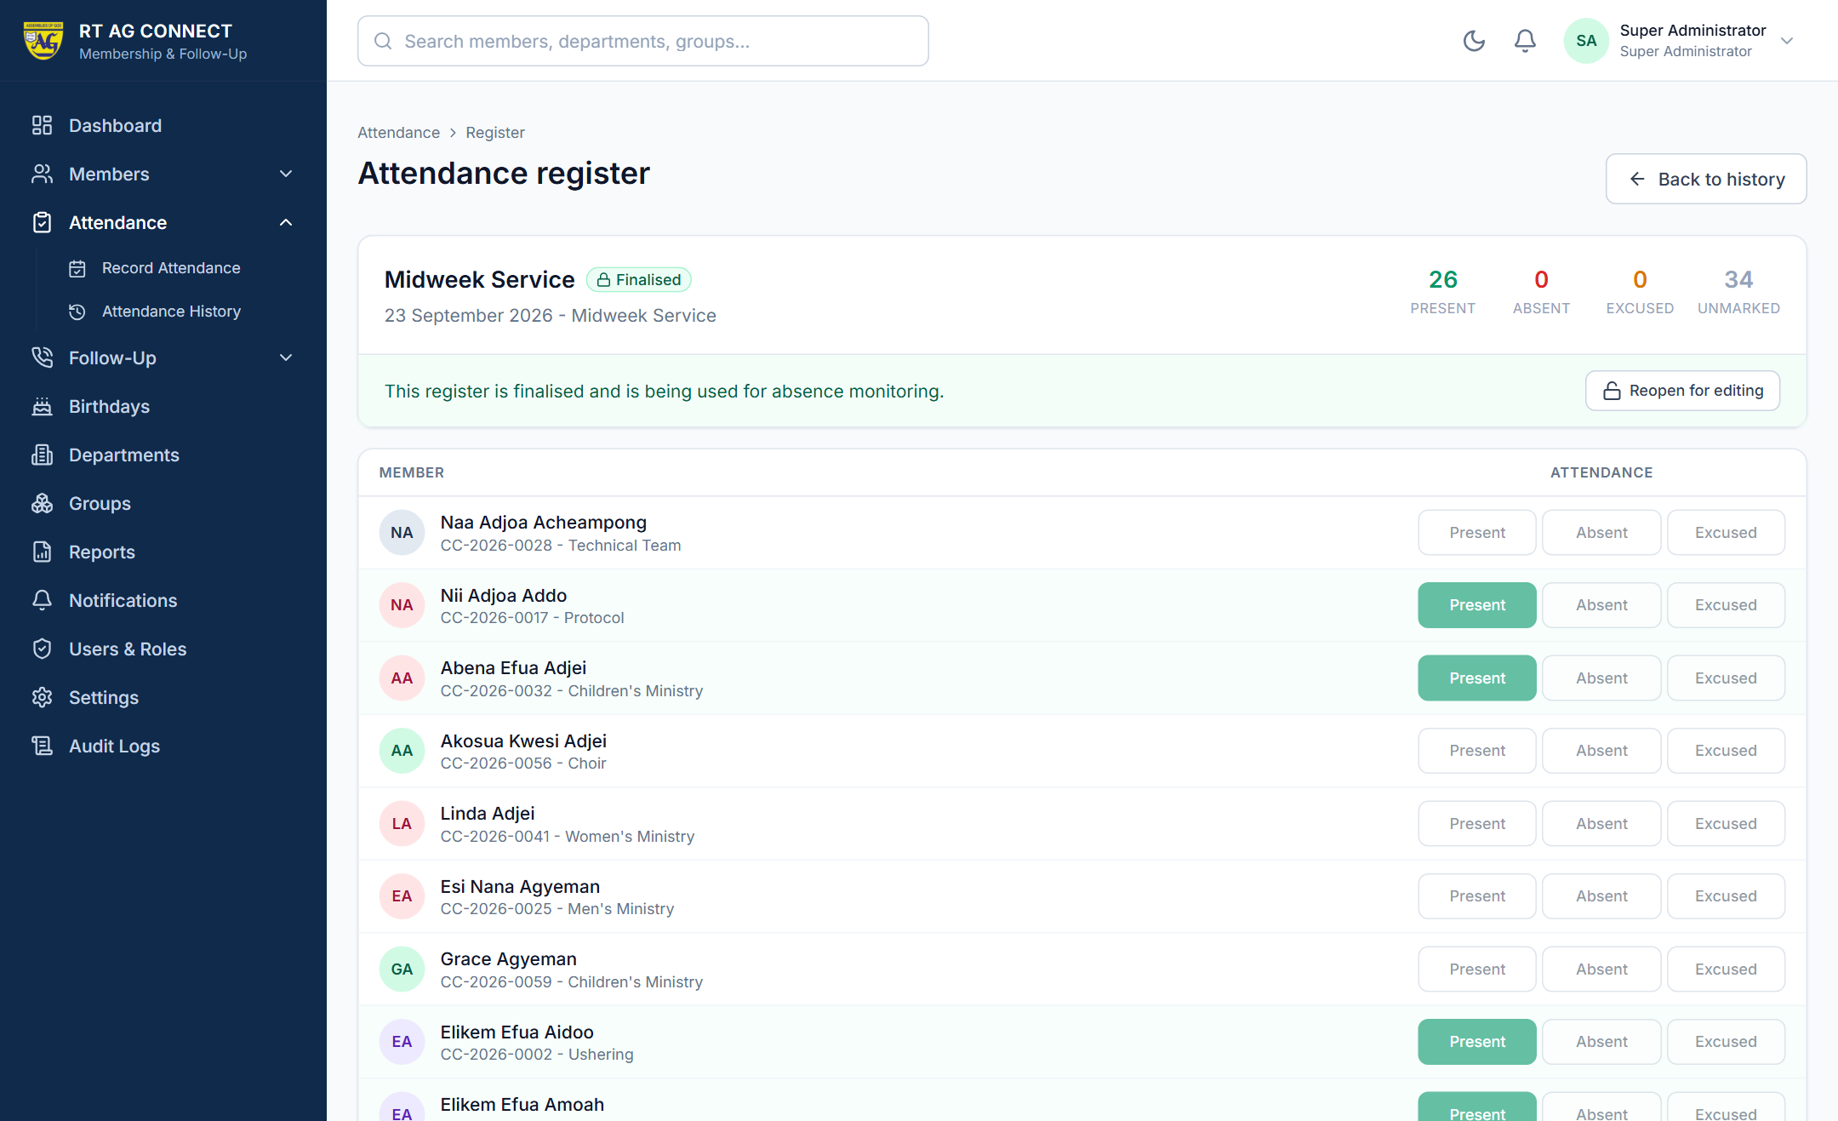
RECORDING ATTENDANCE
Choose the service. Mark the register. Save.
Three states
Present
Absent
Excused
Mark All Present, then adjust
One tap sets the common case. Change only the handful who are not there.
Eight service types
Sunday · Midweek · Bible Study ·
Prayer Meeting · Youth · Women’s ·
Men’s · Special Programme
Redemption Temple AG · RT AG Connect
Notes:
Demonstrate the speed, because that is the objection you will get:
"Mark All Present in one tap, then change the handful who are not there. A
register of several hundred is a few minutes' work, and it saves in one
action - not one member at a time."
A register can cover the whole congregation, or a single department or cell.
IF ASKED ABOUT UNMARKED PEOPLE: anyone not marked is recorded as "not recorded",
never as absent. A half-finished register never makes the congregation look
absent, and never triggers a false alert. That safeguard is deliberate.

Slide 9
THE HEART OF THE SYSTEM
Absence is noticed automatically
The system reviews attendance every night. Nobody has to remember to check.
2
3
4
services missed
services missed
services missed
Level 1
Level 2
Level 3
Follow-Up Reminder
Urgent Follow-Up
Pastoral Follow-Up
A friendly check-in
A proper phone call this week
A visit — roughly a month away
These thresholds are ours to set — they can be changed in Settings at any time.
Redemption Temple AG · RT AG Connect
Notes:
SLOW DOWN HERE. This is the slide the whole presentation is built towards.
"Nobody has to remember to check. Every night the system reviews who has been
missing, and raises a graded alert. Two missed services is a friendly
check-in. Three is a proper phone call this week. Four - about a month - is a
pastoral visit."
Then hand back control, which matters to a room being asked to adopt something:
"The thresholds are ours. If two weeks is too quick for our pattern, we change
the number ourselves in Settings. It is not fixed by whoever built this."
Do not click away until someone has had a chance to react.

Slide 10
The system never decides that
someone has left the church.
It raises an alert for a person.
A person decides what it means.
Notes:
Say this CLEARLY and without hurrying. It is the concern a thoughtful pastor will
already be forming, and answering it before it is asked buys you enormous
credibility.
"Absence has many innocent explanations - travel, illness, a new baby, night
shifts, a work posting, caring for a relative. A computer cannot tell the
difference between those and someone drifting away, and it should not try."
So the system:
- never changes anyone's membership status
- never marks anyone as backslidden or lapsed
- never contacts a member on its own
Its only output is an alert addressed to a church worker.
SECOND SAFEGUARD, worth mentioning here: if someone tells us in advance that they
will be away and we mark them EXCUSED, the count resets. We do not chase people
who already told us.

Slide 11
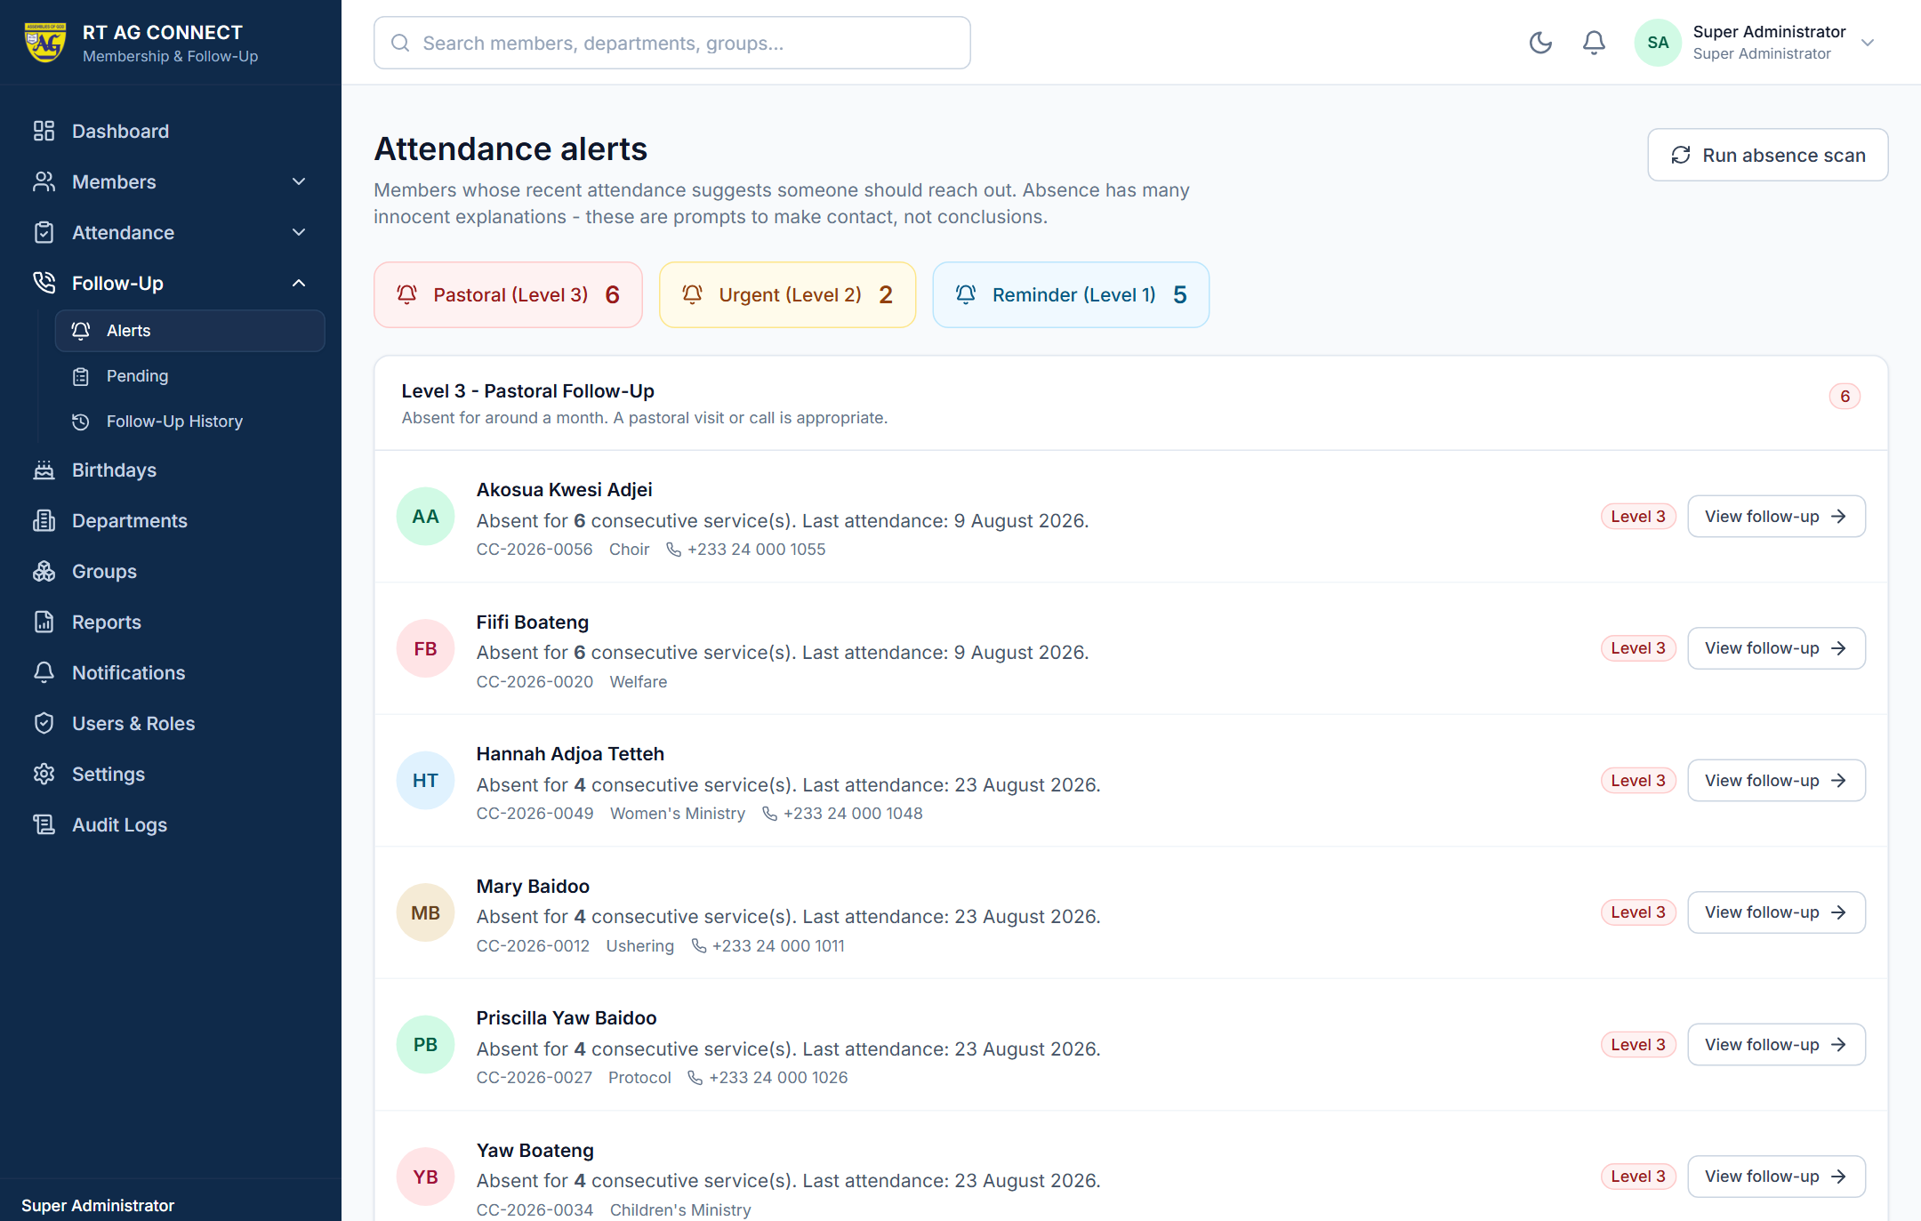
ATTENDANCE ALERTS
What an alert looks like
ATTENDANCE ALERT
John Mensah
Absent for 3 consecutive weeks
Last attendance: 19 July 2026
Department: Ushering
Phone: 024 000 0000
Start Follow-Up
In our sample data the system flagged 13 members from twelve weeks of attendance — 5 at Level 1, 2 at Level 2, 6 at Level 3.
Redemption Temple AG · RT AG Connect
Notes:
Read the card out loud, exactly as it appears. Hearing a name makes it real in a
way that a bullet point never does.
"Everything needed to act is on the row: who, how long, when they were last
with us, which department they serve in, and the phone number. The leader
presses Start Follow-Up, and the case opens."
THE NUMBERS ON THIS SLIDE ARE SAMPLE DATA. Replace them with your own before
presenting, or say so plainly. Either way, land the point:
"Thirteen conversations that would otherwise not have happened."
John Mensah is a fictional example, not a member of this church.

Slide 12
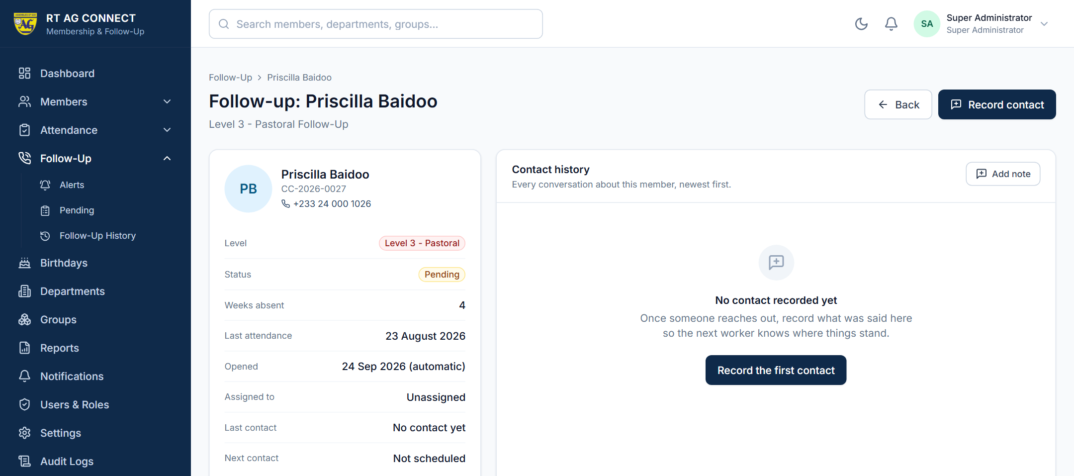
FOLLOW-UP MANAGEMENT
Follow-up is a conversation, not a tick-box
Six statuses
Pending
Contacted
Responded
Needs Further Follow-Up
Resolved
Unable to Reach
“Member was contacted and stated that he travelled for work.
Expected to return next Sunday.”
Overdue cases are flagged automatically.
Redemption Temple AG · RT AG Connect
Notes:
A case carries the member, the level, the officer responsible, and the date of
the next contact. Every attempt is written down - what was said, how contact was
made, what happens next.
READ THE QUOTED NOTE ALOUD, then explain why it matters:
"That single sentence means the next person to open this case knows exactly
where it stands. No repeated calls. No awkward second conversation. No case
quietly dropped because the person handling it travelled."
Then the safeguard:
"Overdue cases are flagged automatically. A case cannot be forgotten simply
because it stopped feeling urgent."

Slide 13
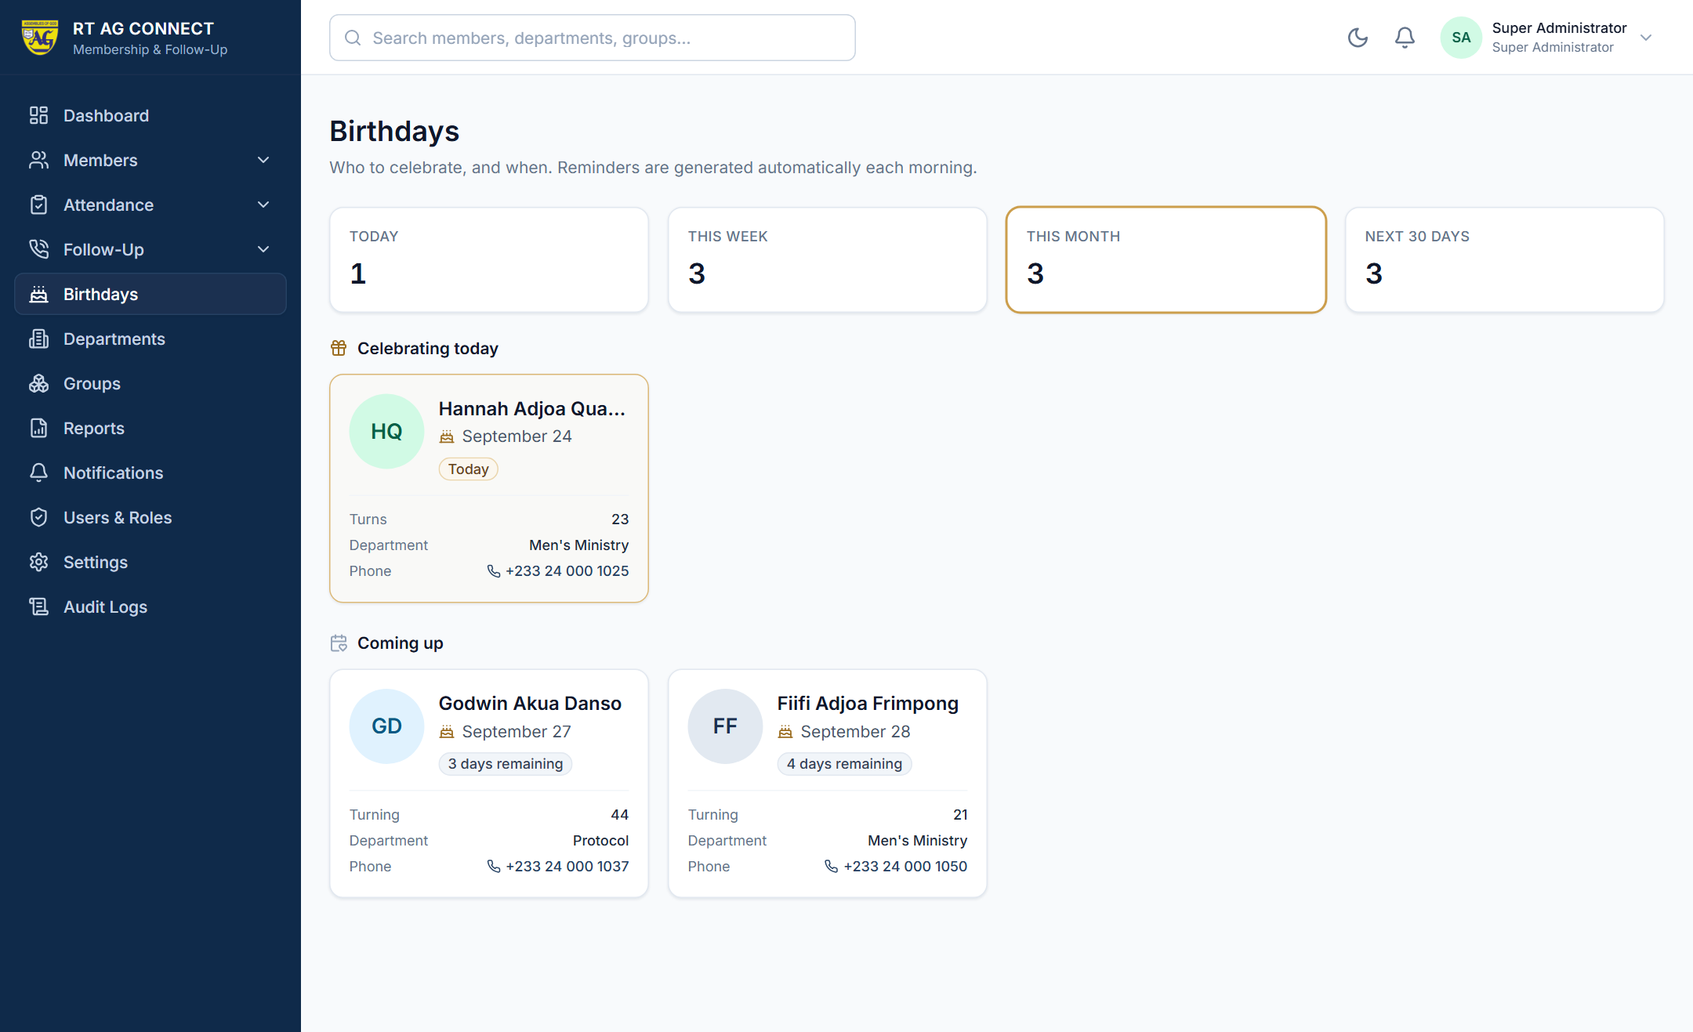
BIRTHDAYS
Nobody is forgotten
Reminders are generated automatically
7 days before
3 days before
1 day before
On the day
The system does not message the member.
It reminds us.
Redemption Temple AG · RT AG Connect
Notes:
Keep this one light - it is a breather between two heavy sections.
Birthdays today, this week and this month, each card showing the photograph,
name, date, age, department and phone number. Reminder points are configurable.
STATE THIS PLAINLY, because it is the same principle as the absence alerts:
"The system does not message the member. It reminds US. Sending greetings stays
a human act - which is the whole point of it."

Slide 14
CHURCH STRUCTURE
Departments and groups
Departments
Groups
What a member does
Where a member belongs
Choir · Ushering · Media · Youth
Children’s · Evangelism · Welfare
Protocol · Men’s · Women’s · Technical
Cell groups · Prayer groups
Bible study groups
Zones · Fellowships
Each has a leader, a meeting day and time, its own roster and its own attendance figures.
Redemption Temple AG · RT AG Connect
Notes:
The distinction is worth stating once, clearly:
"A department is what a member DOES. A group is where a member BELONGS."
Every member can have one of each.
Then the payoff, which is the real reason this slide exists:
"This tells us something we usually only guess at - which parts of the church
are genuinely active, and which have quietly stopped meeting."
That last point often prompts the first honest question of the meeting.

Slide 15
REPORTING
Ten reports, ready in seconds
Membership | Attendance & care
Membership summary | Attendance by service
New members | Attendance by department
Members by department | Members with low attendance
Members by age group | Absentee register
Birthday register | Follow-up register
Export to Excel
Export to PDF
Print
Every report carries the church name and the date it was produced.
Redemption Temple AG · RT AG Connect
Notes:
"No more assembling figures by hand the night before a council meeting. Choose
a report, choose the dates, export it."
The small detail at the bottom is worth saying, because anyone who has sat
through a disputed council meeting will recognise it:
"Every report carries the church name and the date it was produced - so there
is never confusion about which version is on the table."

Slide 16
ACCESS AND ROLES
Who sees what
Role | Access
Super Administrator | Everything, including user accounts and settings
Pastor | Full visibility of members, attendance, alerts and reports; manages follow-ups
Church Administrator | Registers members, records attendance, manages departments and groups
Department Leader | Their own department only
Viewer | Read-only
Access is enforced by the system — not by trust, and not by hiding menus.
Redemption Temple AG · RT AG Connect
Notes:
"A Department Leader who signs in sees only the people in their department. In
our sample data that is 5 members instead of 62. They cannot reach anyone
else's record even by trying."
Then the sentence that unlocks the practical benefit:
"This is what makes it safe to give a dozen leaders access, rather than keeping
everything with one overloaded administrator."
That reframing usually converts the last sceptic in the room.

Slide 17
PRIVACY AND TRUST
Protecting our members’ information
Every person signs in with their own account
Passwords are stored so that even we cannot read them
Access is limited by role
Every action is recorded — who did what, and when
Photographs are visible only to signed-in church workers
Before going live we will confirm our handling meets Ghana’s Data Protection Act, 2012 (Act 843).
Redemption Temple AG · RT AG Connect
Notes:
Open by naming the responsibility rather than the feature:
"This system holds personal information about our congregation - addresses,
phone numbers, dates of birth, photographs of children. That is a trust, and
it should be treated as one."
DWELL ON THE AUDIT LOG. It is the point that reassures leaders most:
"Every view, every change, every deletion is recorded against a named person.
If a member ever asks 'who has looked at my record?', we can answer. That
protects our members - and it protects our workers from suspicion."
The Data Protection Act line signals that we have thought past the software.

Slide 18
THE SYSTEM IS ONLINE TODAY
Where our data lives
1
2
3
The website
The application
The database
What staff open in a browser. Served over a secure (HTTPS) connection, the same protection a bank's site uses.
The part that enforces who may see what and records every action. Runs in a data centre in Frankfurt.
Member records, attendance and follow-ups. Hosted in Dublin, in the EU, with daily backups kept for seven days.
church-connect-omega.vercel.app
Render
Supabase
Only the application can reach the database. Nothing about our members is reachable from the public internet, and the member register has been checked against direct access.
Redemption Temple AG · RT AG Connect
Notes:
This slide answers the question someone will otherwise ask at the worst moment:
"where is all this information actually kept?"
Three pieces, three reputable hosting companies, all in Europe. The database is
backed up every day. Nothing is on anyone's laptop.
If asked about cost: the website and database are on free tiers today; the
application server costs a few dollars a month once we want it to stay awake
around the clock. This is a fraction of what one printed register costs a year.

Slide 19
BEING STRAIGHT WITH YOU
What it does not do
It does not send SMS or emails — planned, not yet built
It does not replace pastoral visiting
It does not decide who is committed
It does not manage finances, tithes or donations — future
This system tells us who to visit.
It does not visit them. The ministry is still ours.
Redemption Temple AG · RT AG Connect
Notes:
PUT THIS SLIDE IN DELIBERATELY, and say why:
"A presentation that only lists strengths invites suspicion. So here is what
this does not do."
Naming the limits earns trust now and prevents disappointment in month two.
EMPHASISE THE SECOND POINT. Read the navy panel aloud, slowly:
"This system tells us who to visit. It does not visit them. The ministry is
still ours - the system just makes sure we are pointed at the right people."
If the room only remembers one sentence from the whole presentation, this is a
good candidate.

Slide 20
DECISIONS NEEDED TODAY
What we are asking for
1
Approval to adopt the system — it is built, online and ready
2
A decision on our absence thresholds — is 2 / 3 / 4 services right for us?
3
Names for the roles: who administers, who follows up
4
Agreement to record attendance BY NAME, every Sunday
5
A start date for entering the existing register
Point 4 decides whether this succeeds or fails.
Redemption Temple AG · RT AG Connect
Notes:
Go straight to point 4 and be blunt about it:
"Everything this system does depends on someone marking a register by name,
every Sunday. If we cannot commit to that, the alerts will be empty and the
reports meaningless."
"Better that we settle it now than discover it in three months."
Do not soften this. A leadership team that agrees to point 4 with their eyes open
is worth far more than one that agrees to everything vaguely.
Get names against points 2 and 3 before leaving the room if you can.

Slide 21
GETTING THERE
Suggested rollout
Phase | What happens | Rough time
✓ | System set up and online; departments and groups entered | Done
1 | Enter existing members | Weeks 1–3
2 | Train the administrator and ushers | Week 3
3 | Record attendance every Sunday | From week 4
4 | First alerts appear; train leaders on follow-up | Week 6
5 | First full report to the board | Week 8
Alerts cannot appear until there are a few weeks of attendance to compare. Expect roughly two months to the first genuinely useful alert.
Redemption Temple AG · RT AG Connect
Notes:
Set the expectation about timing explicitly, because it is where enthusiasm
usually turns into disappointment:
"The system needs history before it can spot a pattern. Alerts cannot appear
until there are a few weeks of attendance to compare - roughly two months from
start to the first genuinely useful alert."
"Say that now, so nobody thinks it has failed in week three."
Phase 2 is the heaviest lift. If asked: roughly two to three minutes per member,
so about 20 hours for 500 members - two or three people over a fortnight.

Slide 22
BEFORE
A member stops coming, and we notice months later.
AFTER
A member misses two services, and someone is
holding their name by the following week.
Redemption Temple AG — Connecting People. Strengthening the Church.
Notes:
Return to the question you asked on slide 2, and answer it.
Read the AFTER line, then STOP TALKING. Do not add a summary, do not thank the
software, do not list the features again. Let the contrast do the work and take
questions.
If you need a single closing line, use:
"We are not asking to change how we care for people. We are asking to stop
losing track of who needs it."

