Slide 1
Introduction to Databases
DATA 2401 – Dr. Shoemaker

Slide 2
Learning Objectives
Learn general information about databases and their structure
See how we can query databases in a tool like SQLite
Learn how to connect to databases directly via R
Practice using R to query databases using SQL

Slide 3
Databases
Like data.frames, databases are a way to structure and organize complex data sets.
Unlike data.frames, databases can be much more complex system of structure and tables.
They allow us to wrangle extremely complex databases, as well as accessing datasets that are too large to fit into your computer's memory all at once.
  Ever opened a spreadsheet that made your whole computer slow down? This keeps that from happening.
Notes:
Structure complex data using SQL

Slide 4
Database Management
A database management system is a specialized application used to save, organize, and access information.
  Kinda like git, but now just for lots of .csv files.
Many different organizations store their data in a database of some kind, so as a data scientist, you need to be able to access that data to analyze it.

Slide 5
Relational Databases
The most common type of database
Organizes data into tables
  Each row (or record) is an observation.
  Each column (or field) is a data "property" of that observation.
This is similar to a data.frame, right?
Except now we can have dozens, if not hundreds/thousands of tables
Example: One table of music playlists, another table about the songs, another about the artists, and so on.

Slide 6
The relations in relational
The relationships between the tables are specified by a field/column called the primary key
  This is a unique value for each row in the table, and refers to a particular record.
  Even if there are two songs with the same name and artist, you can distinguish between them by referencing the primary key.
These keys are always unique
  They are usually numbers
  They are usually automatically generated by the database
  They are NOT the row numbers – records can be added/removed/sorted!
Notes:
On main table , the key call Primary key, when it join to other table, the is in the other table is now call Foreign key

Slide 7
The relations in relational
Each record in one table can be associated with a record in another
  Every record in a “songs” table might have an associated record in the “artists” table, indicating which artist performed the song.
This is done through a foreign key, a field in the table that has the corresponding key (from the foreign/other table)
  Think of this as a formal/strict way to do dplyr’s “by” argument for join()

Slide 8
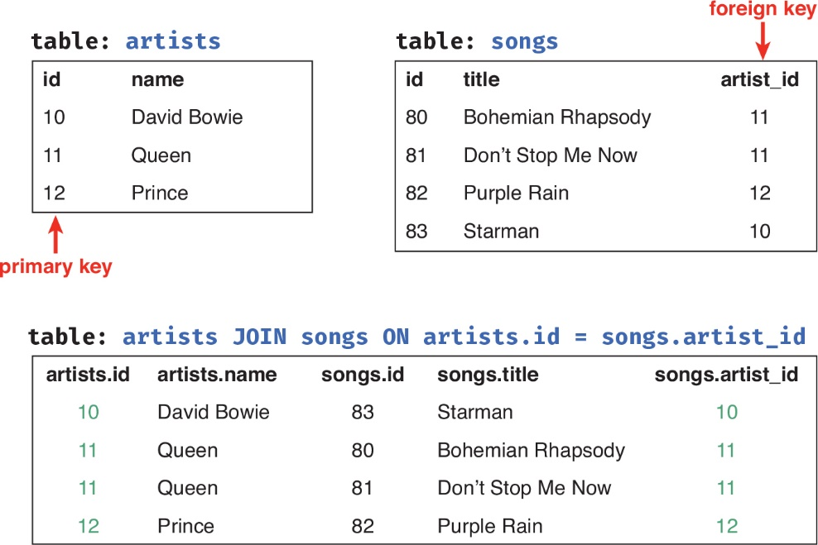
An example database
Figure 13.1 An example pair of database tables (top). Each table has a primary key column id. The songs table (top right) also has an artist_id foreign key used to associate it with the artists table (top left). The bottom table illustrates how the foreign key can be used when joining the tables.
From Programming Skills for Data Science: Start Writing Code to Wrangle, Analyze, and Visualize Data with R, 1/e by Michael Freeman and Joel Ross (9780135133101) Copyright © 2019 Pearson Education, Inc. All rights reserved

Slide 9
The key is keys
Databases can be so complex that you may need a table that just has foreign keys to link together other tables.
  The records are just linking the keys together!
Example, if you want a database to represent data such that each playlist can have several songs, and songs can be on many playlists (a many-to-many relationship) you may want a “bridge table” that links your two tables.

Slide 10
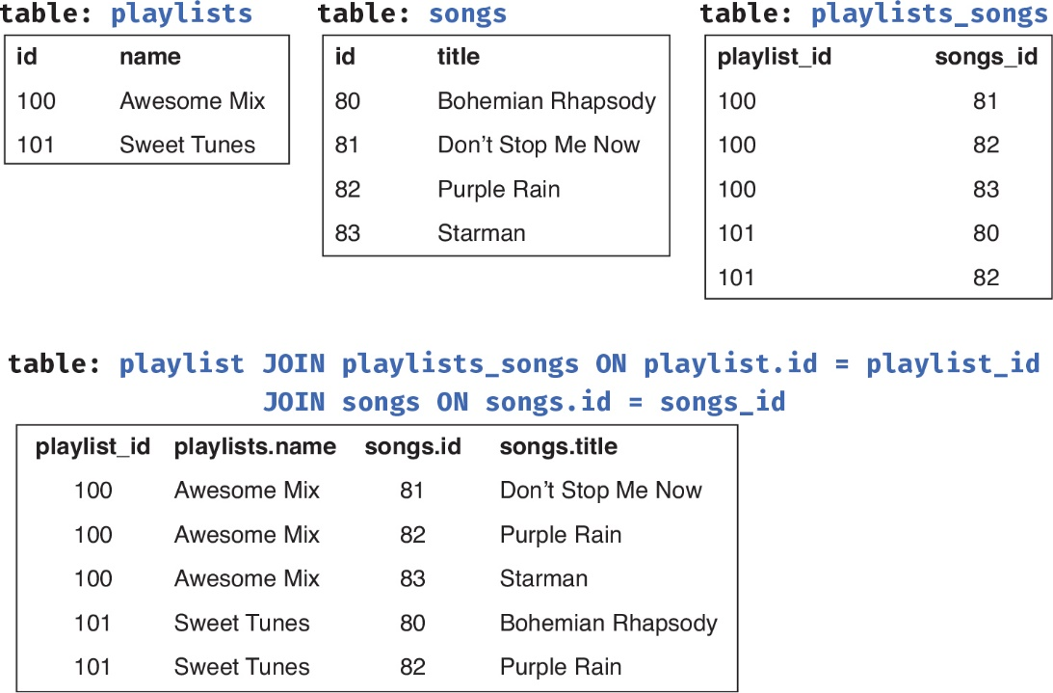
Figure 13.2 An example “bridge table” (top right) used to associate many playlists with many songs. The bottom table illustrates how these three tables might be joined.
From Programming Skills for Data Science: Start Writing Code to Wrangle, Analyze, and Visualize Data with R, 1/e by Michael Freeman and Joel Ross (9780135133101) Copyright © 2019 Pearson Education, Inc. All rights reserved

Slide 11
Going Further
Database design, development, and use is its own (very interesting) problem and field.
Efficient, reliable, and user friendly databases is a broad question beyond the scope of this class.

Slide 12
Setting this up
To work with relational databases you need a …. Relational Database Management System (RDMS)
There are several different popular RDMS, each of them provides the same syntax (more or less), called SQL, for manipulating the tables.

Slide 13
The most popular RDMS
SQLite – The simplest SQL database system, commonly used for testing and development, less often in “real world”.
  Self contained – each database is stored in a single .sqlite file, like a really efficient fancy .csv
  Download here: https://sqlite.org/index.html, click Download, go to the “Precompiled Binaries” for your system.
  OR you can use an application like DB Browser for SQLite which gives a graphical interface for interacting with the data.

Slide 14
The most popular RDMS
PostgreSQL – more robust, with more features (like speeding up data access and ensuring data integrity) and functions than SQLite, often used in “real world”.
  Not a simple system and doesn’t have a single file that can easily be loaded/shared.
  Download here: https://www.postgresql.org
  Download installs the manager on your machine, and provides a graphical application (pgAdmin) to administer the databases.
  You can also use psql in the command line if you add it to your PATH

Slide 15
The most popular RDMS
MySQL – free (but closed source) RDMS, with similar features to Postgres. It’s more popular than Postgres, but more difficult to install and setup.
  If you need/want to use MySQL, I’ve been told that it’s best to install the community Server Edition from the MySQL website (and you don’t need to sign up for an account)
In general, if you’re just experimenting, use SQLite, if you need more features, use Postgres.

Slide 16
SQL….?
I’ve been saying SQL a lot. What is this?
Syntax (programming language) for manipulating data stored in a database.
Structured Querying Language.
It provides commands (statements) that interact with the database
  Similar to dplyr verbs!
You can use databases through R (without these commands), but it’s also useful to know these terms and ideas.

Slide 17
SELECT
The most commonly used SQL statement is SELECT, it extracts data from a database without modifying the data.
  This is known as a query statement
/* a generic SELECT query statement for accessing data*/
SELECT column FROM table
(SQL comments are on their own line, between /* and */)
This returns the data from that column in that table.

Slide 18
Select
So, let’s model how this would go with the popular Chinook Database (https://github.com/lerocha/chinook-database), a free sample database that models an iTunes music library.
(I’ve also put the .sqlite file on BB)

Slide 19
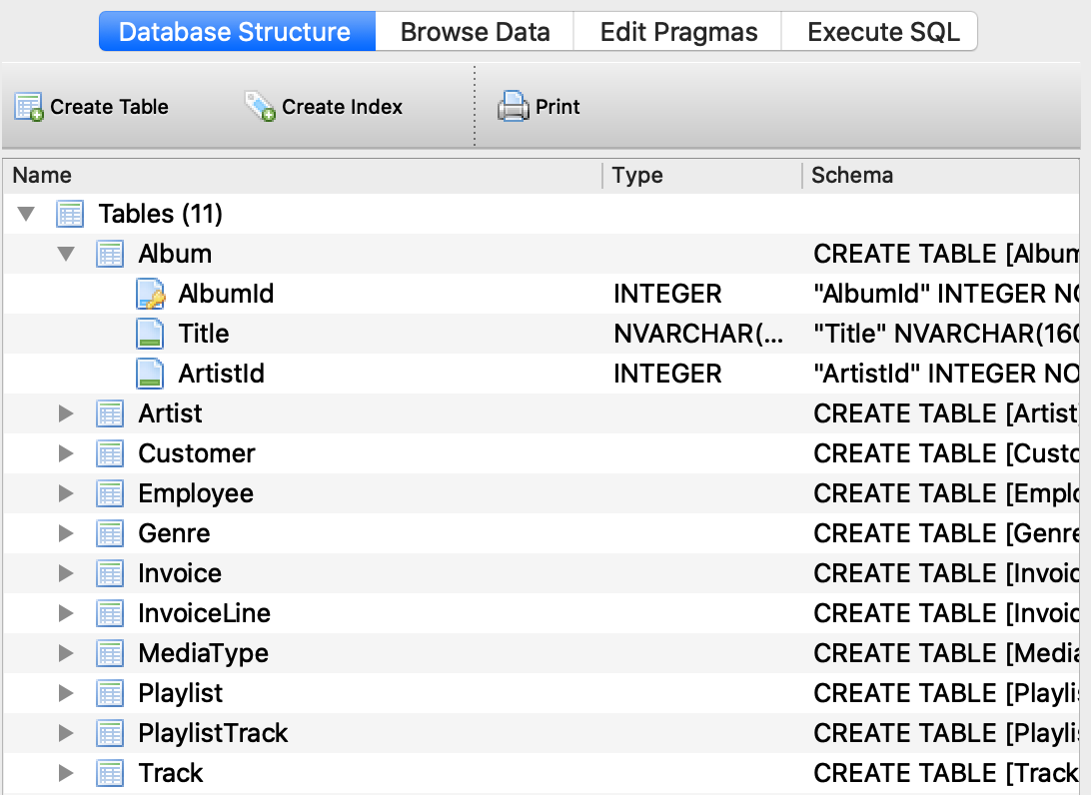
Database
From the SQLite Browser:

Slide 20
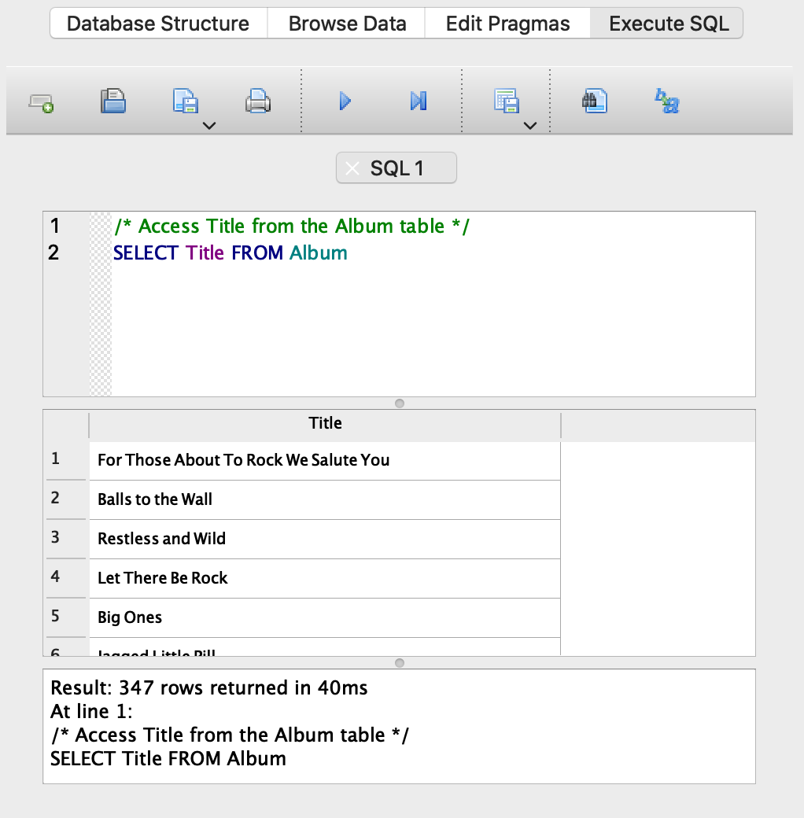
Select
In the browser, you can see the database in the database structure tab
If you want to execute SQL, you can use the “execute SQL”
In the database, there is a table “Album” with a column “Table”

Slide 21
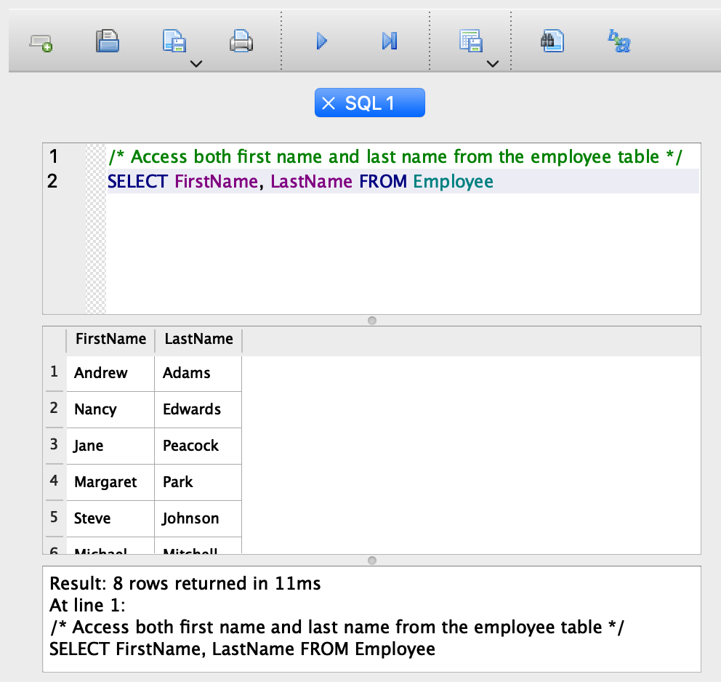
Select
To select two columns, you separate the ones you want with commas.
  This is the same as select(FirstName,LastName) in dplyr
To select all columns, use the `*` symbol

Slide 22
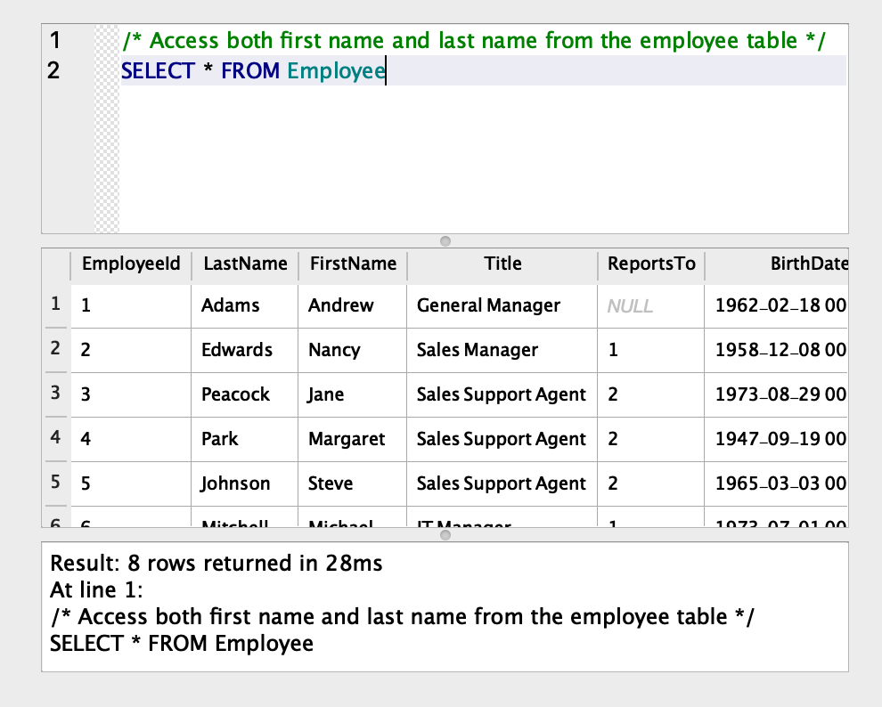
Select
To select two columns, you separate the ones you want with commas.
  This is the same as select(FirstName,LastName) in dplyr
To select all columns, use the `*` symbol

Slide 23
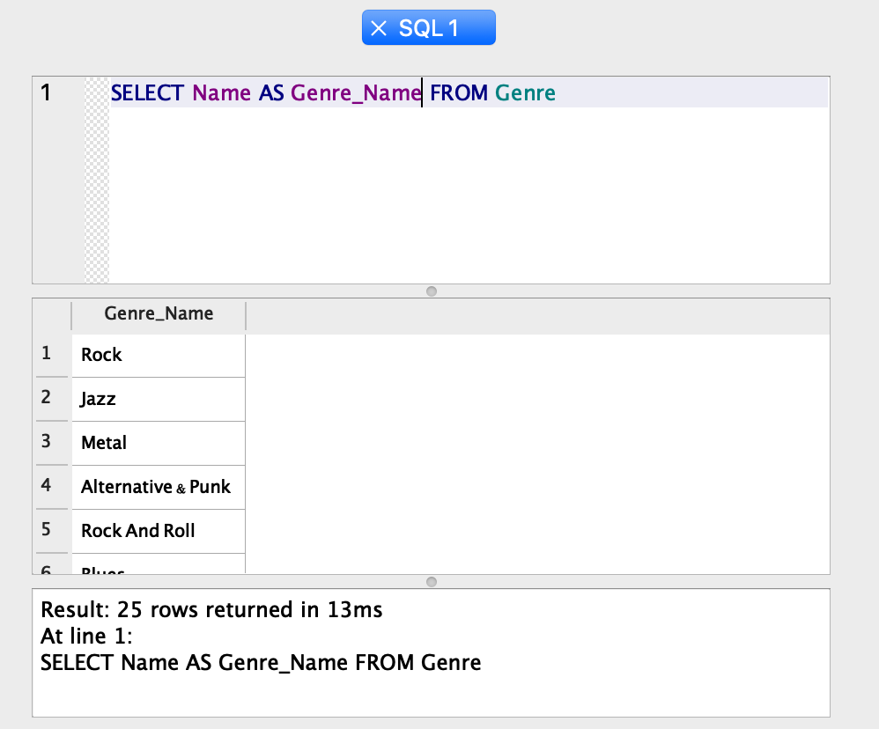
Select
You can rename the column by using AS
  This is similar to rename() in dplyr
This doesn’t change the table itself, just the subtable that is returned by the statement.

Slide 24
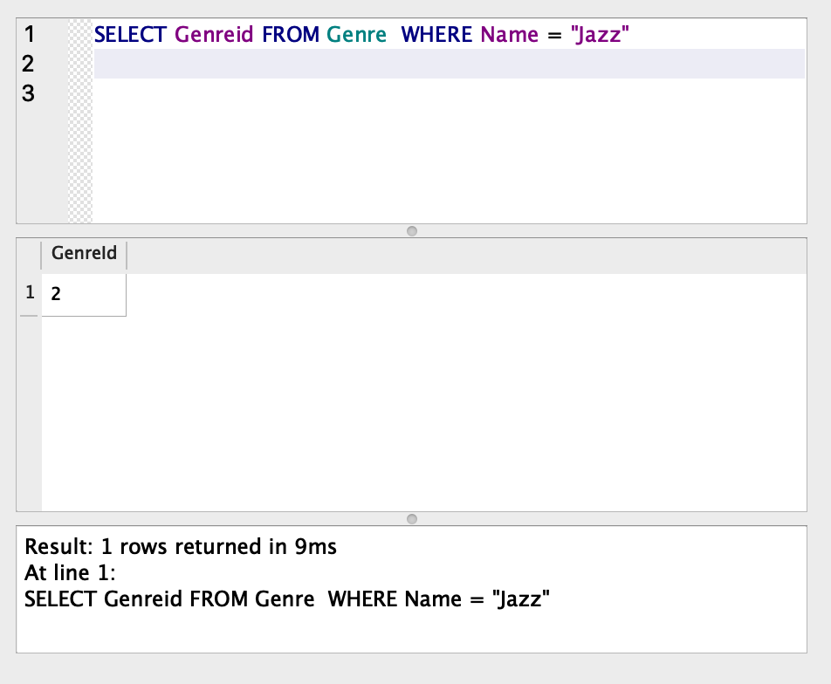
Select
If you want to filter your results, use WHERE with a Boolean (logical) condition statement.
SELECT column FROM table WHERE this_is_true
  Is the same as
  table %>% filter(this_is_true) %>% select(column)

Slide 25
Filter
The filter condition is applied to the whole table, not just the selected columns,
  In other words, the filtering happens before the selection
Also note that WHERE uses one = instead of two ==.
You can combine filters using AND, OR, or NOT.
  SELECT * FROM table WHERE condition1 OR condition2
You can arrange with ORDER_BY, and group with GROUP_BY, which can then be aggregated with functions like MAX() and MIN()
  See the documentation for the system you’re using to see what the commands are.

Slide 26
JOINS
The whole point of databases is that you can work with many different tables!
To do this, you use a joining manipulation like we did in dplyr.
You use a JOIN clause
SELECT columns FROM table1 JOIN table2
If there are headings that match, that’s done automatically. More likely, they won’t match, and you use ON to specify which columns should be matched.
  SELECT columns FROM table1 JOIN table2 ON table1.id = table2.other_id

Slide 27
JOINS
Just like in dplyr, you can have INNER JOIN, LEFT JOIN, RIGHT JOIN, and OUTER JOIN.
Just using JOIN will do an inner join.
As before with dplyr, you need to carefully consider which observations you want included when you join.
  Most of the time, you want an inner join (thus why that is the default)

Slide 28
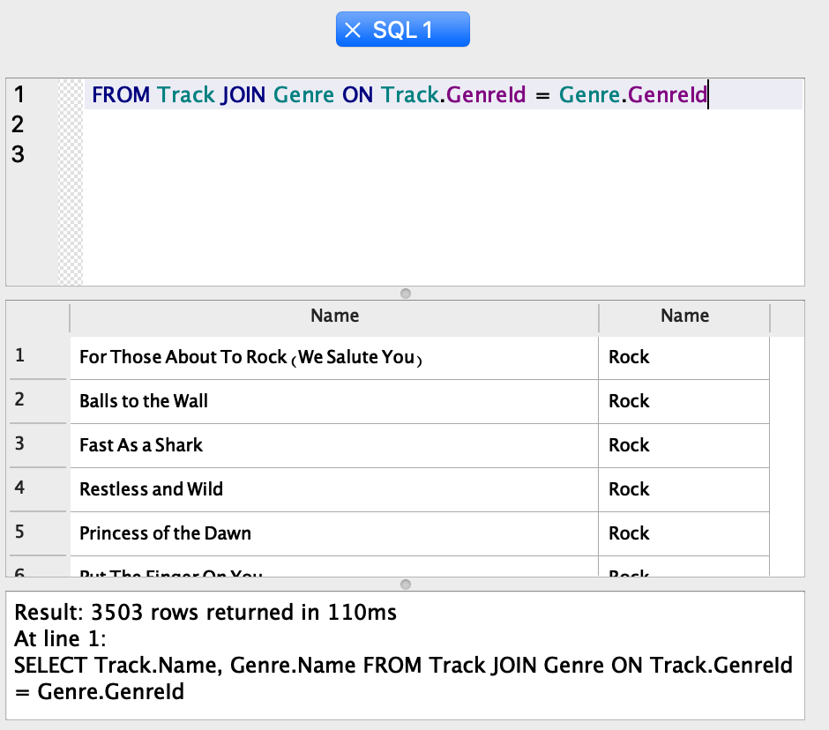
Select
Since the tableTrack only has the genre id, we have to join it with Genre to see which Genre those are.

Slide 29
Accessing a database with R
There is an alternative to using these RDMS programs!
You can connect to databases directly from R!
A package called dbplyr allows you to query a database using dplyr functions.
  That’s what we’re going to work with today

Slide 30
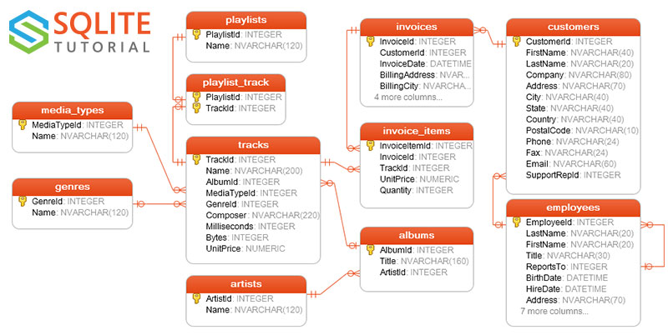
Database for Today
https://www.sqlitetutorial.net/sqlite-sample-database/

Slide 31
More learning
Today is only a very brief introduction to get you familiar with the concepts and the terms.
https://www.w3schools.com/sql/ has a “newbie-friendly” tutorial on the syntax and usage I suggest playing around with.
You will cover SQL much more in depth in DATA 3.

