Slide 1

Podio
Website: https://glip.com/
History:
The Service that was founded in 2009 and acquired by Citrix in 2012
Mobile support:
  iOS
  Android
Logo

Slide 2
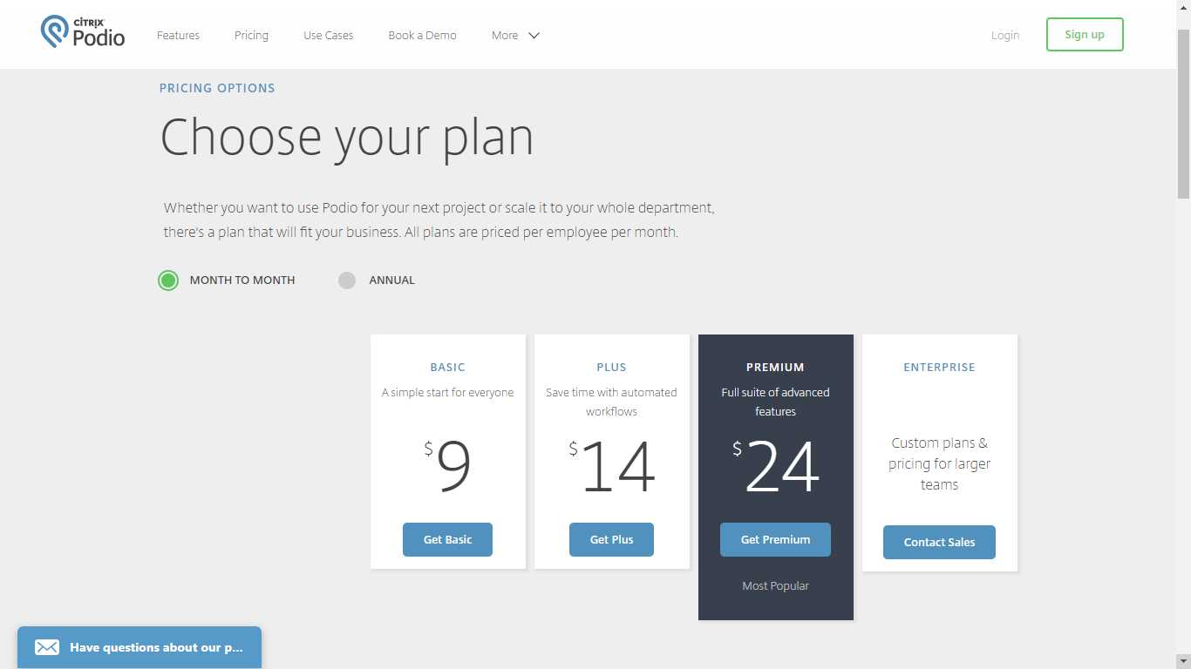
Podio

Slide 3
Podio
Some features:
Web and Mobile Device
Social Collaboration
Intergrated Chat
Task Management
Project Management
Schedule Meetings
Granular Access
Grim Connected
Automatic Worklows
Unlimitted Hosting

Slide 4
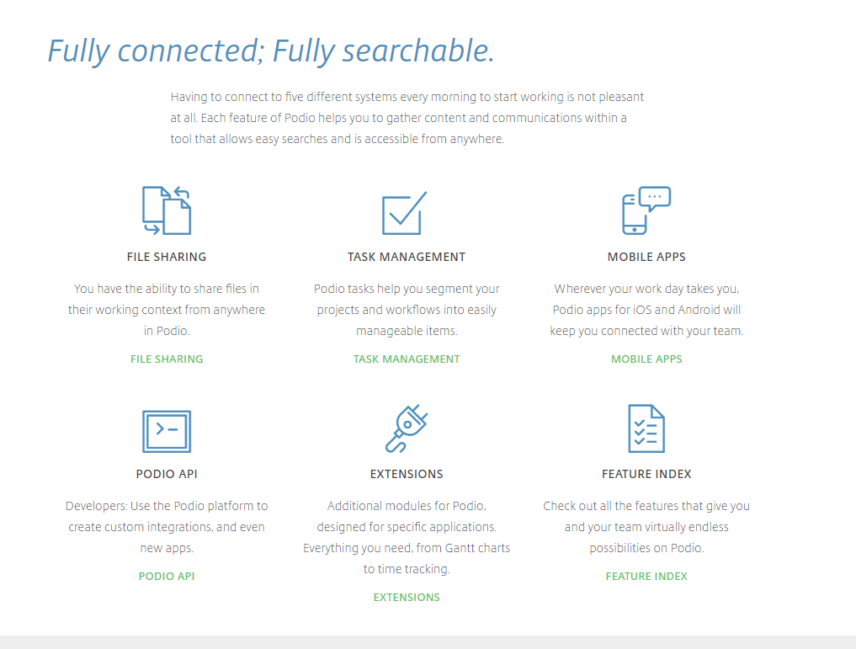

Slide 5
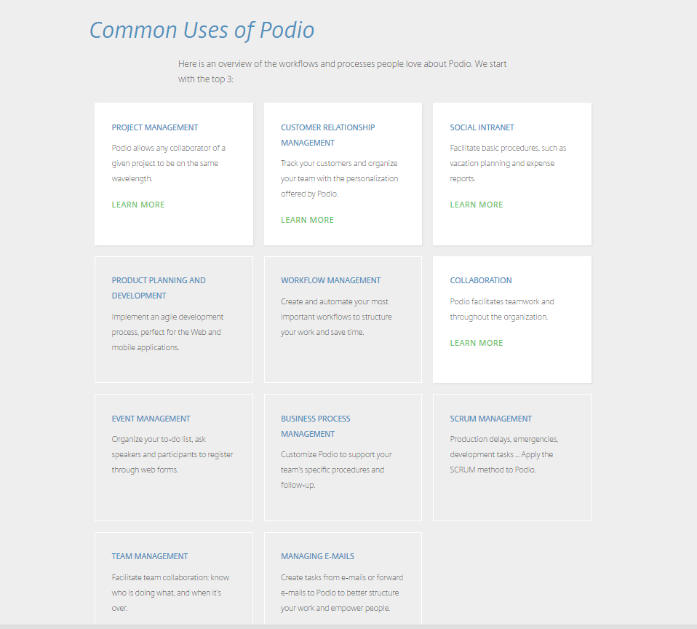

Slide 6
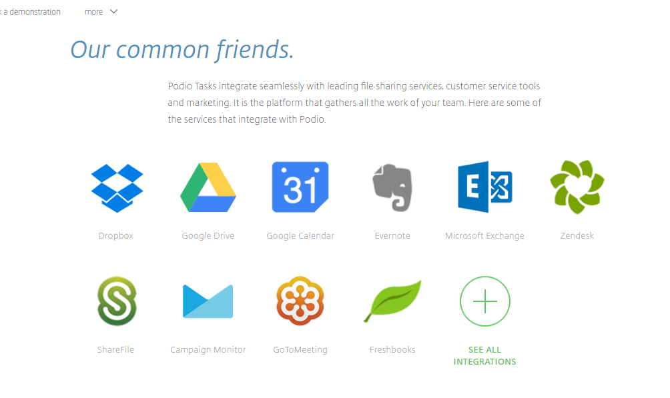

Slide 7
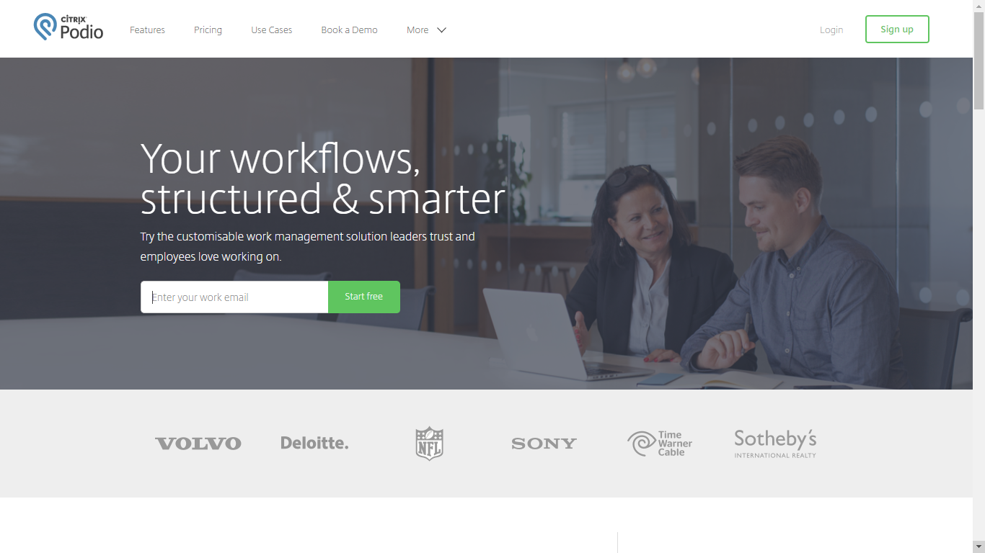

Slide 8
Podio
Awards:
Editor's choice for “The Best Online Collaboration Sofware of 2016”
The Podio App Market has hundreds of vertical solutions from 14 industries and 23 functional groups for you to choose from
Group B comment:
Podio is a general project management service, with rich features and many management type: SCRUM management, workflow management, event management.

