Slide 1

Quire
Website:
www.quire.io
History:
Founded by Potix
Mobile support:
  iOS
Logo

Slide 2
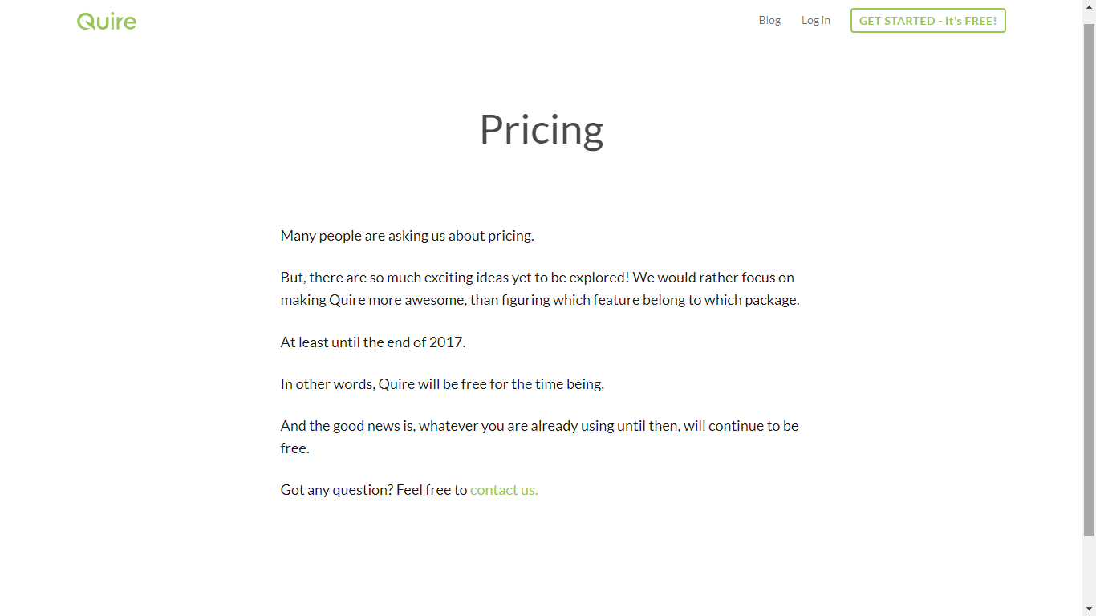

Quire

Slide 3
Quire
Some features:
Collaboration
File Sharing
Idea Management
Issue Management
Project Planning
Task Management
Resource Management
Percent-Complete Tracking

Slide 4


Slide 5
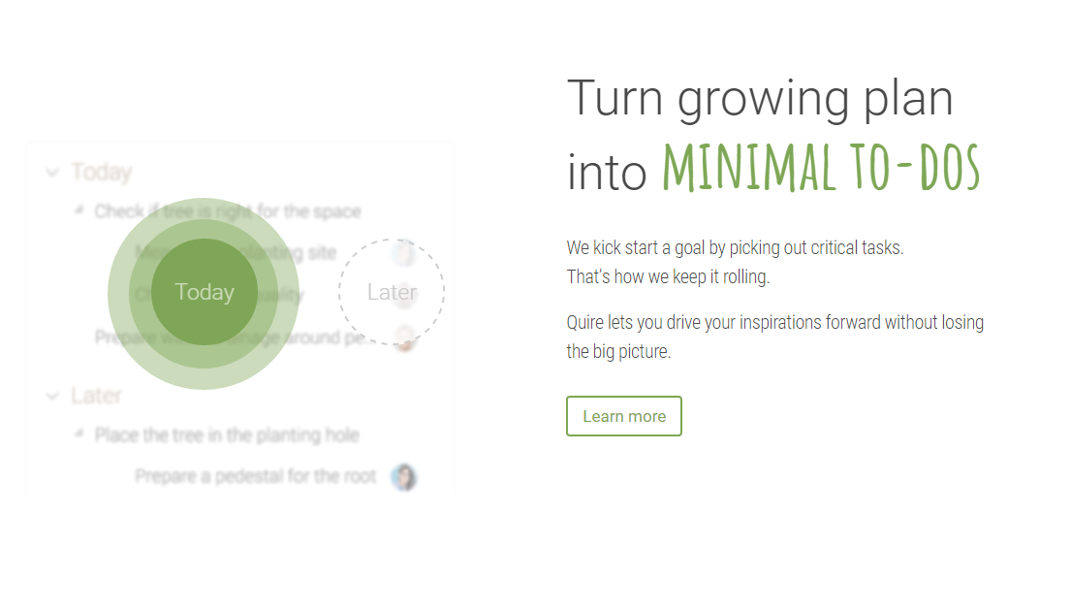

Slide 6
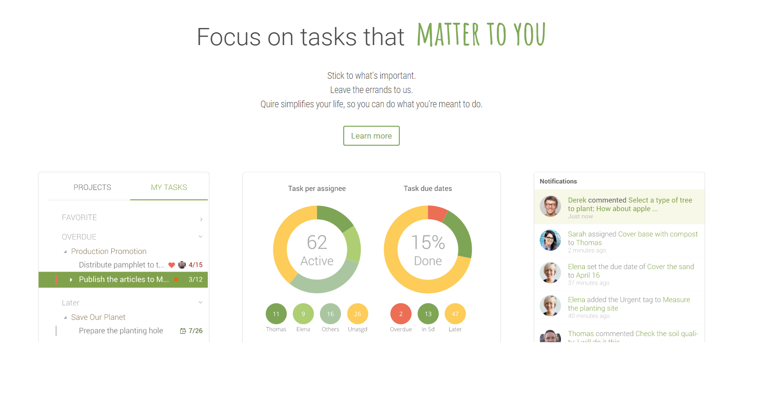

Slide 7


Slide 8
Quire
Awards:
Group B comment:
Quire is a new, yet promising task management service.

