Slide 1


REVIEW REAL STTATE
Across Border
CE130431 – ma anh hoang
CE130377 – Nguyen ThanH nhan
CE130252 – NGUYEN CHI LINH
CE130242 – Mac Truong Hai
Approved by Khanh VH
[24/07/2019]

Slide 2
CONTENT
1
Problem definition
Information of customer and team
2
3
Database
4
Class diagram
USE-CASE diagram
5
6
Demo program

Slide 3
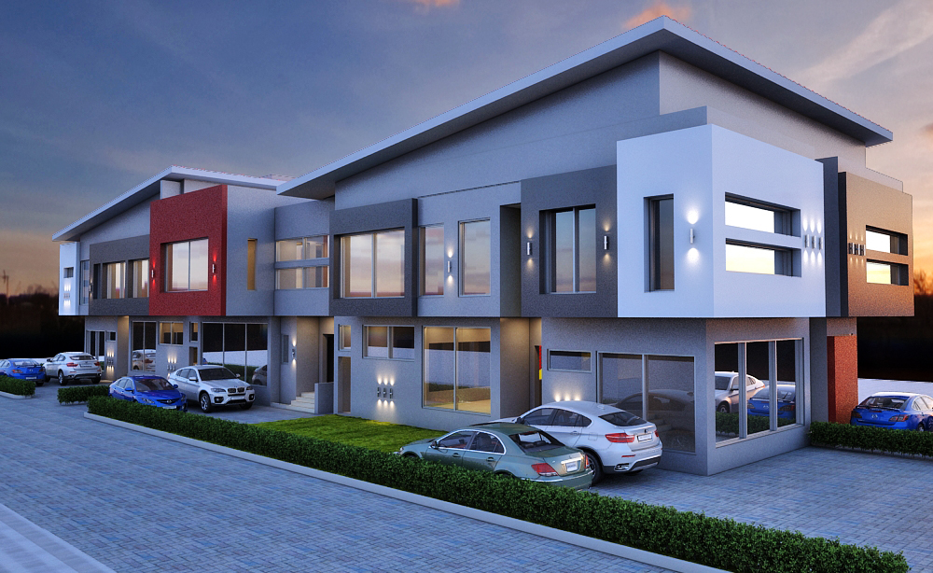
Problem definition
Today, when society is development technology 4.0 is applied a lot in many fields such as business, medicine, study, and sales... Today we will apply technology to the real estate. We will design a website to help buyers and sellers have more advantages in real estate trading.

Slide 4
2. INFORMATION OF CUSTOMER
Client o Name of customer/company: Vo Hong Khanh o Address: Road no. 5, Hung Phu residential area, Cai Rang district, Can Tho city o Email: khanhvohong@gmail.com o Phone number: 077 2144 007

Slide 5
2. INFORMATION OF MY TEAM
About Team:
Name of customer / company: Across Border Group
Address: FPT university, Nguyen Van Cu Street, An Binh Ward, Ninh Kieu DisTrict, Can Tho City
Email:
linhncce130252@fpt.edu.vn
hoangmace130431@fpt.edu.vn
nhanntce130377@fpt.edu.vn
haimtce130242@fpt.edu.vn
Phone Number: 0974440621

Slide 6
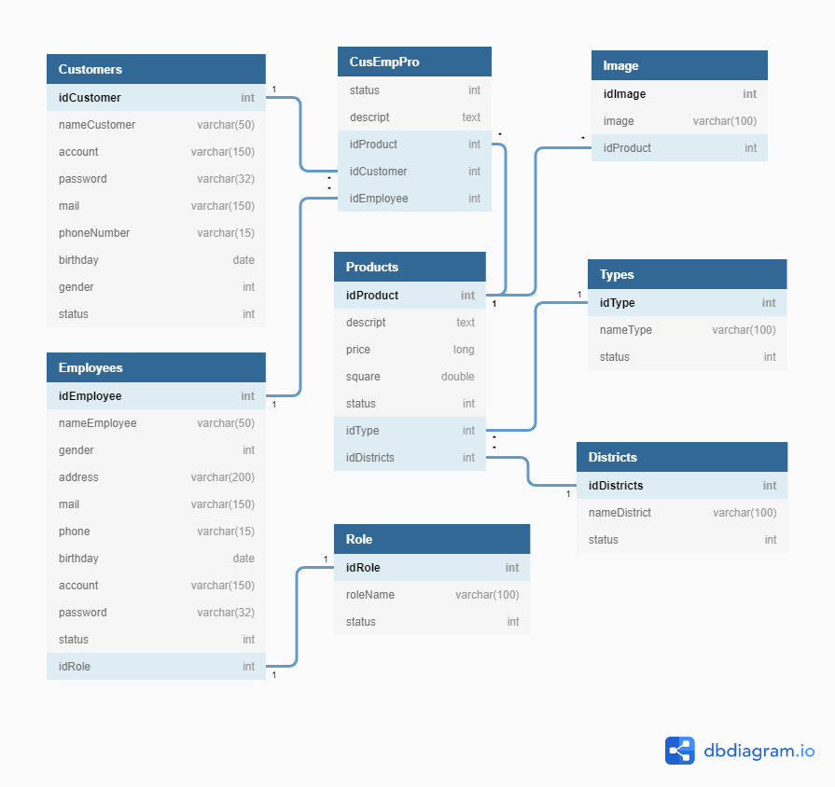
3. Database

Slide 7
4. Class diagram

Slide 8
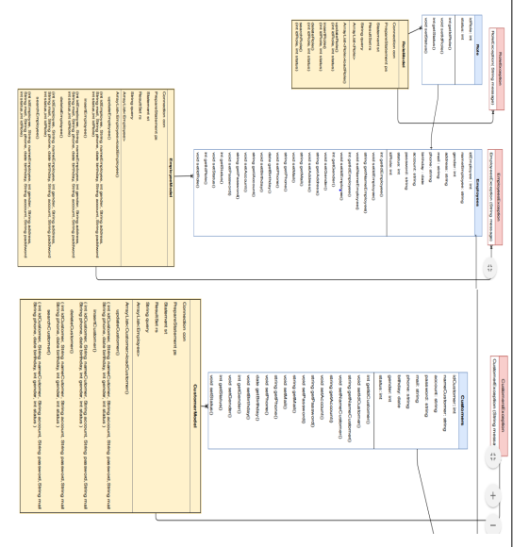

Slide 9
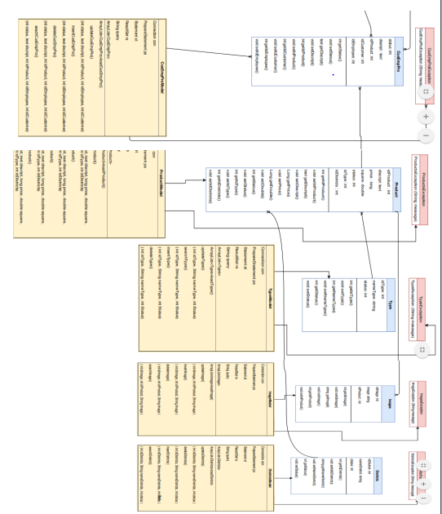

Slide 10
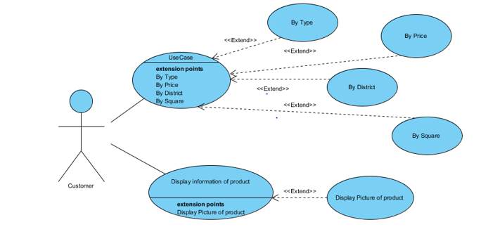
5. use-case diagram

Slide 11
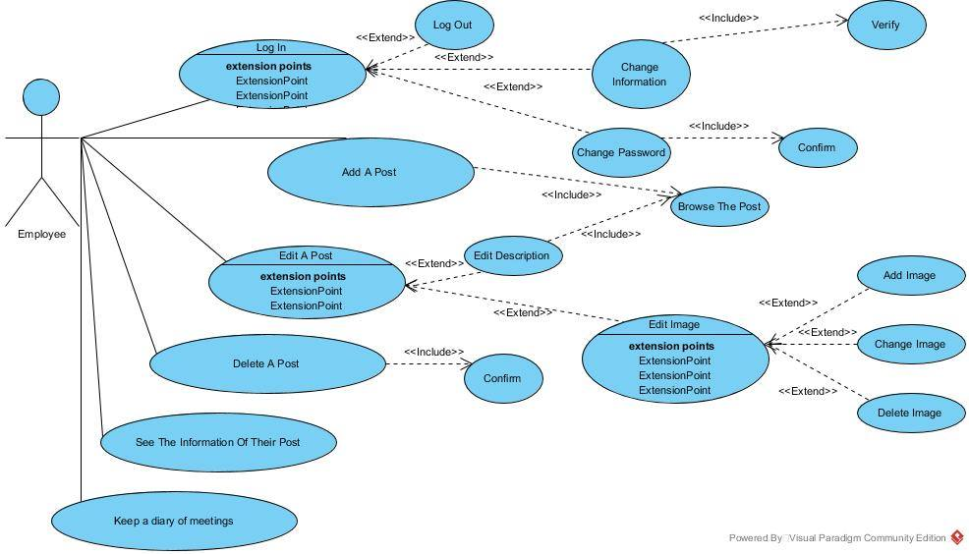

Slide 12
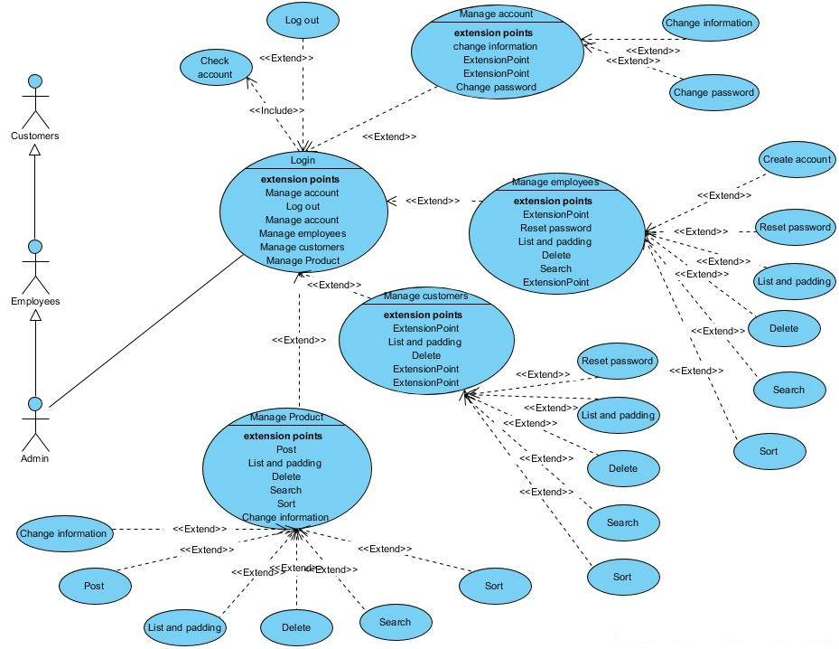

Slide 13
DEMO PROGRAM

