Slide 1
DIGICOM-ET · ETHIOPIA
Silent Authentication for Banks
Business story + MAP/Diameter message flows (ATI · PSI · SAI · S6a)
Citizen / e-Gov login without SMS · Digicom VAS adapter on Ethio Telecom
Digicom-ET · Silent Auth Mix v3 (story + MAP/Diameter) · 1/28

Slide 2
Agenda
• Why government & banks need Silent Auth (e-Gov, SMS OTP pain, threats)
• Digicom-ET offer: VAS adapter — not a competing SMSC
• Technical core: two-stage Resolver + Verifier (ATI / PSI / SAI / S6a)
• FSM, timeouts, fallback SMS, FS.11 security
• Standards tables: CAMARA APIs + GSMA FASG (FS.07–FS.36, SG.22)
• jSS7 hooks, value, Ethio Telecom partnership, roadmap
Digicom-ET · Silent Auth Mix v3 (story + MAP/Diameter) · 2/28

Slide 3
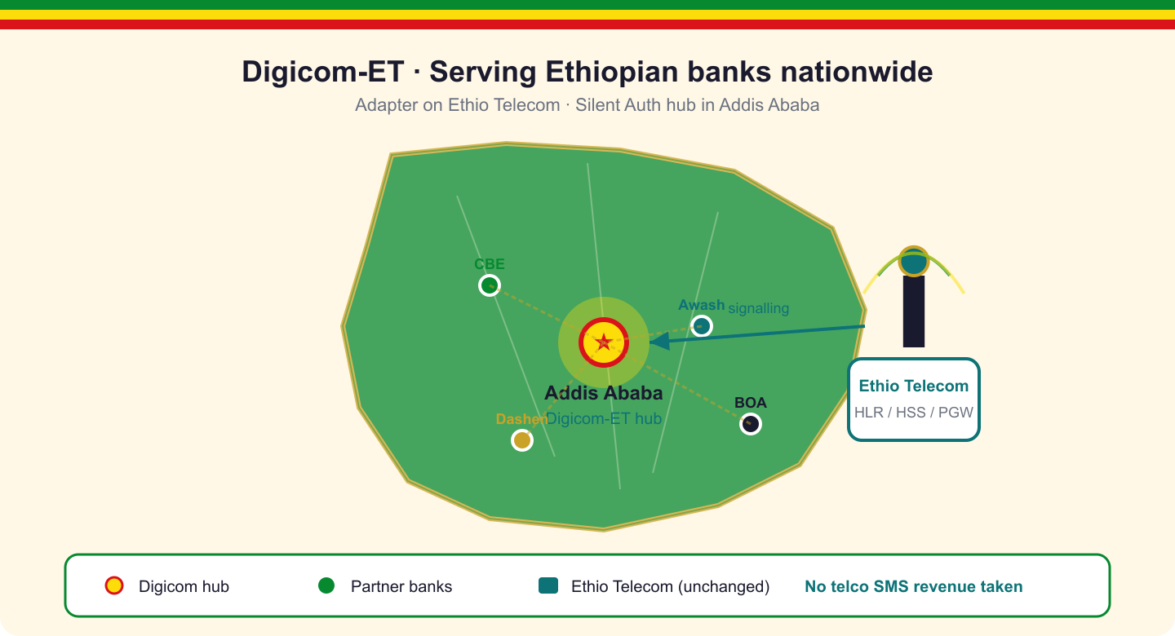
Why Ethiopia, why now
• Mobile-first banking growth across Addis and the regions
• SMS OTP still default — slow, fragile, costly for banks
• Need frictionless login without losing fraud controls
• Opportunity: network-side identity as VAS on Ethio Telecom
• Digicom-ET brings Silent Auth to government & banks
Digicom-ET · Silent Auth v3 (story + MAP/Diameter) · 3/28

Slide 4
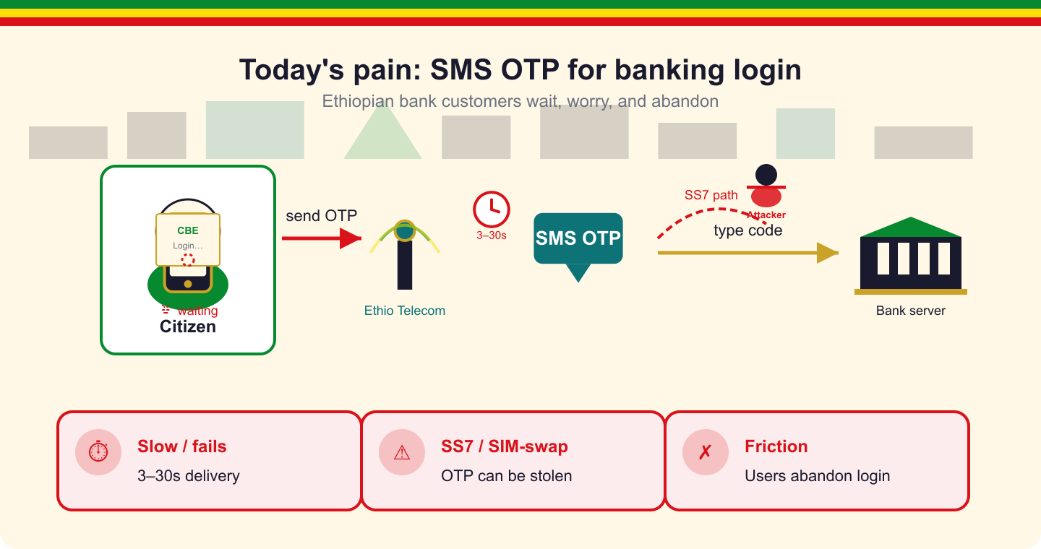
The SMS OTP problem
• Customers wait 3–30s for a code — many abandon login
• SS7 / interconnect can intercept or redirect MT-SMS
• SIM-swap: attacker receives OTP on a new SIM
• Phishing / real-time OTP proxies steal typed codes
• Banks pay SMS costs and still absorb fraud losses
Digicom-ET · Silent Auth Mix v3 (story + MAP/Diameter) · 4/28

Slide 5
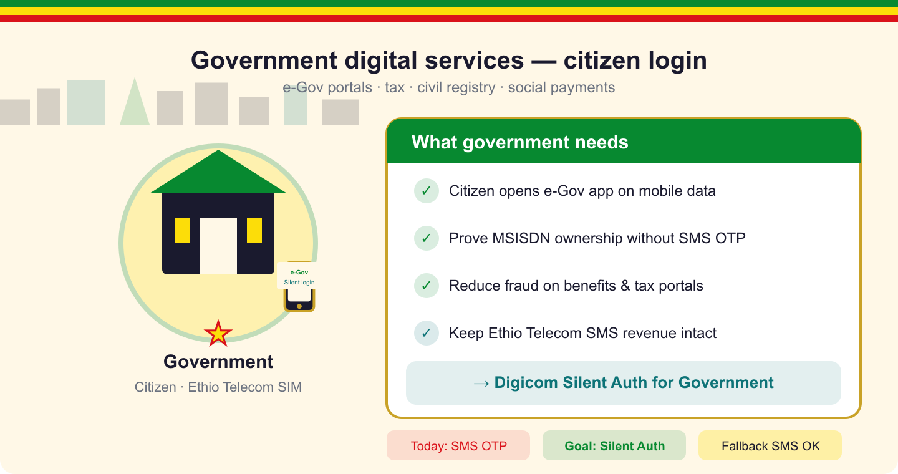
Government digital services
• Citizens access e-Gov portals: tax, civil registry, social payments
• Want: open app → prove phone number → done
• Do not want: wait for SMS OTP, type 6 digits, fail delivery
• Must stay safe against SIM-swap and SS7 intercept
• Digicom Silent Auth for government + bank partners
Digicom-ET · Silent Auth Mix v3 (story + MAP/Diameter) · 5/28

Slide 6
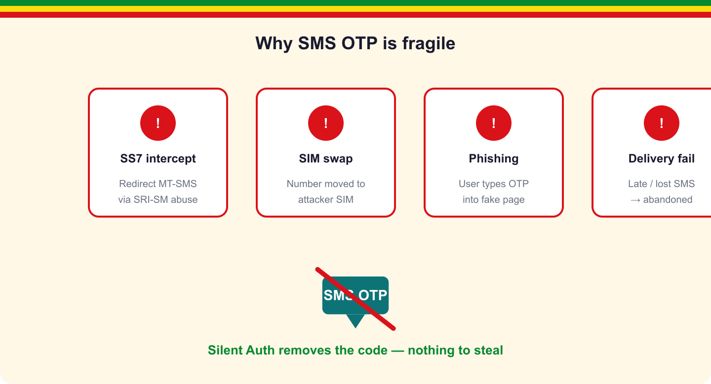
Threats Silent Auth removes
• SS7 intercept — no SMS payload to steal
• Phishing / OTP relay — nothing for the user to leak
• Premium-rate / AIT abuse — no OTP blast to fraud numbers
• Delivery failure — login not hostage to SMS latency
• SIM-swap — SAI / lastUpdateLocation freshness check
Digicom-ET · Silent Auth Mix v3 (story + MAP/Diameter) · 6/28

Slide 7
The solution
Digicom-ET Silent Auth = business VAS + MAP/Diameter verification
Digicom-ET · Silent Auth Mix v3 (story + MAP/Diameter) · 7/28

Slide 8
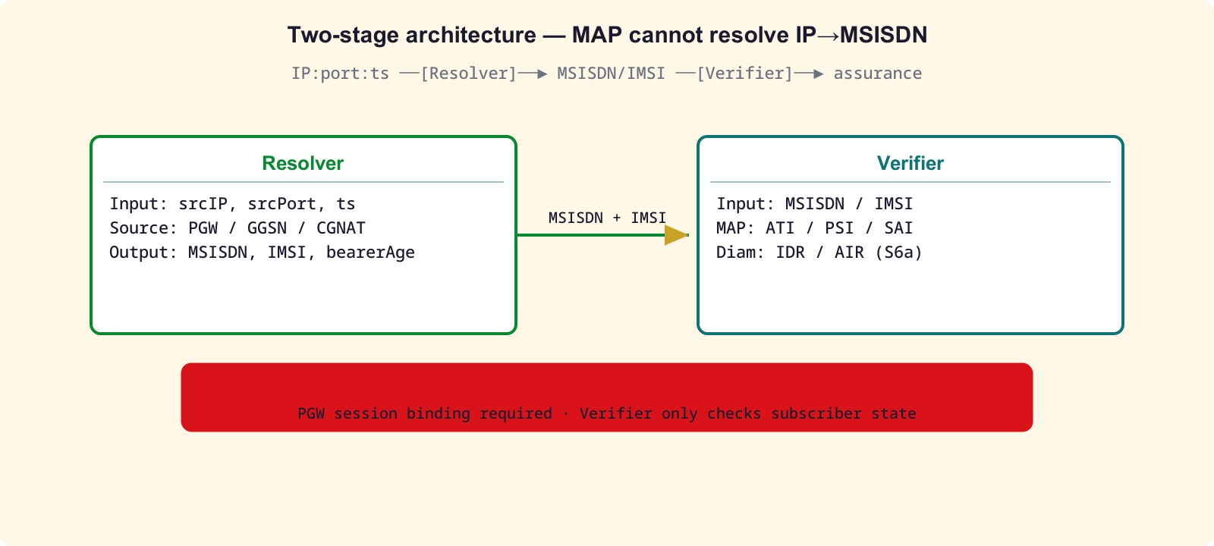
Hard fact: two stages (not one MAP call)
• MAP / Diameter cannot map IP → MSISDN
• Stage 1 RESOLVER: IP:port:ts → MSISDN via PGW/PCRF/CGNAT
• Stage 2 VERIFIER: ATI / PSI / SAI or Diameter S6a → assurance
• CGNAT ⇒ app MUST send IP + source port + timestamp
• Reject if resolver returns >1 MSISDN → FALLBACK
• Happy path: Approve in ≤3s — no SMS, no OTP typing
Digicom-ET · Silent Auth Mix v3 (story + MAP/Diameter) · 8/28

Slide 9
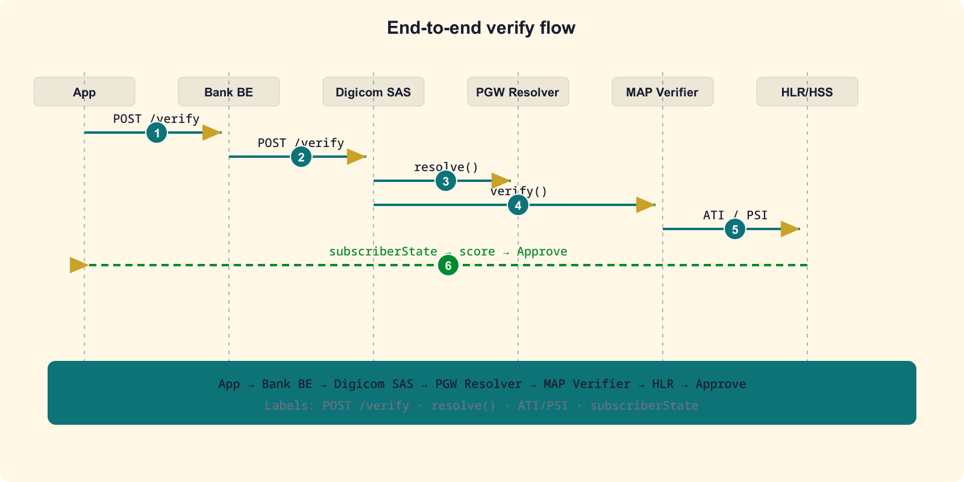
End-to-end message flow
App → Bank BE → Digicom SAS → PGW resolve → MAP/Diameter verify → HLR/HSS → Approve
Digicom-ET · Silent Auth v3 (story + MAP/Diameter) · 9/28

Slide 10
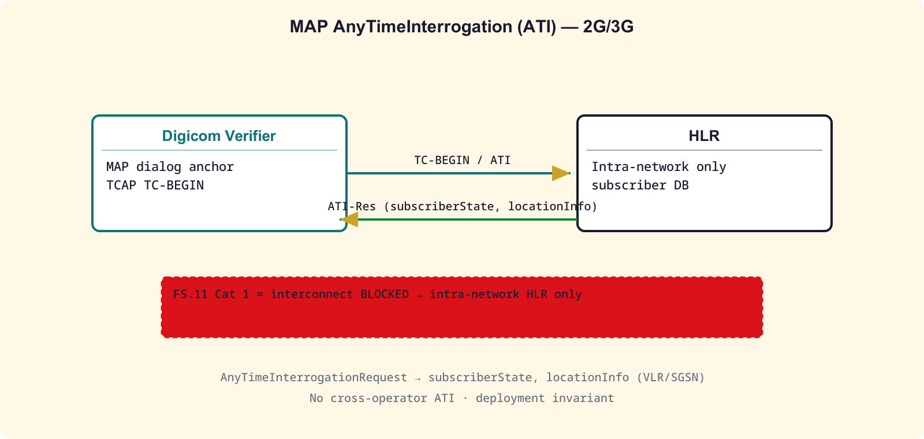
ATI — AnyTimeInterrogation (MAP)
• Verifier opens TC dialog → sends ATI to home HLR
• Response: subscriberState, locationInfo, VLR address
• FS.11 Category 1 on interconnect → BLOCKED externally
• Deployment invariant: Digicom SAS inside operator only
• Queries own HLR/HSS — never cross-operator ATI
• jSS7: AnyTimeInterrogationRequestImpl (coral-valley)
Digicom-ET · Silent Auth v3 (story + MAP/Diameter) · 10/28

Slide 11
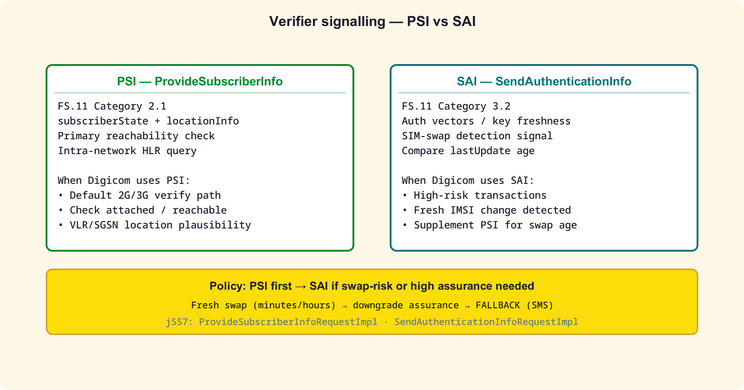
Verifier messages: PSI · SAI · Diameter S6a
• PSI (ProvideSubscriberInfo) — Cat 2.1: state + location
• SAI (SendAuthenticationInfo) — Cat 3.2: SIM-swap freshness
• Prefer PSI for reachability; SAI when swap risk is high
• 4G/5G: Diameter S6a IDR/IDA + AIR/AIA (FS.19)
• One dialog max per request; abort on timeout
• jSS7: ProvideSubscriberInfoRequestImpl, SendAuthenticationInfoRequestImpl
Digicom-ET · Silent Auth v3 (story + MAP/Diameter) · 11/28

Slide 12
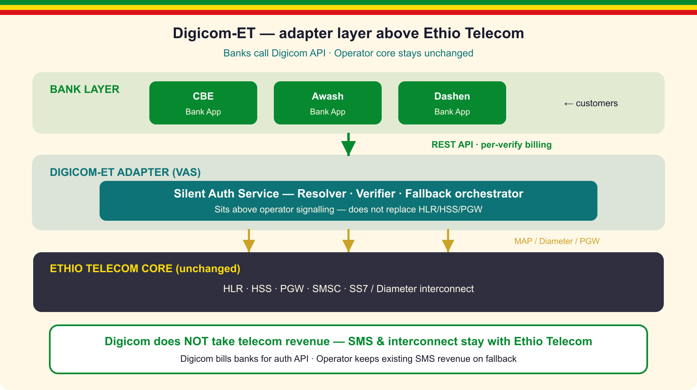
Adapter on top — we do NOT take telco SMS revenue
• Digicom-ET = thin VAS between bank backends and Ethio Telecom
• Reuses PGW, HLR/HSS, SMSC — no core rewrite
• Banks pay Digicom per /verify — not SMS wholesale
• A2P / interconnect SMS stays 100% with the operator
• Fallback OTP still billed through Ethio Telecom SMSC
• Optional API revenue share — additive, not cannibalizing
Digicom-ET · Silent Auth v3 (story + MAP/Diameter) · 12/28

Slide 13
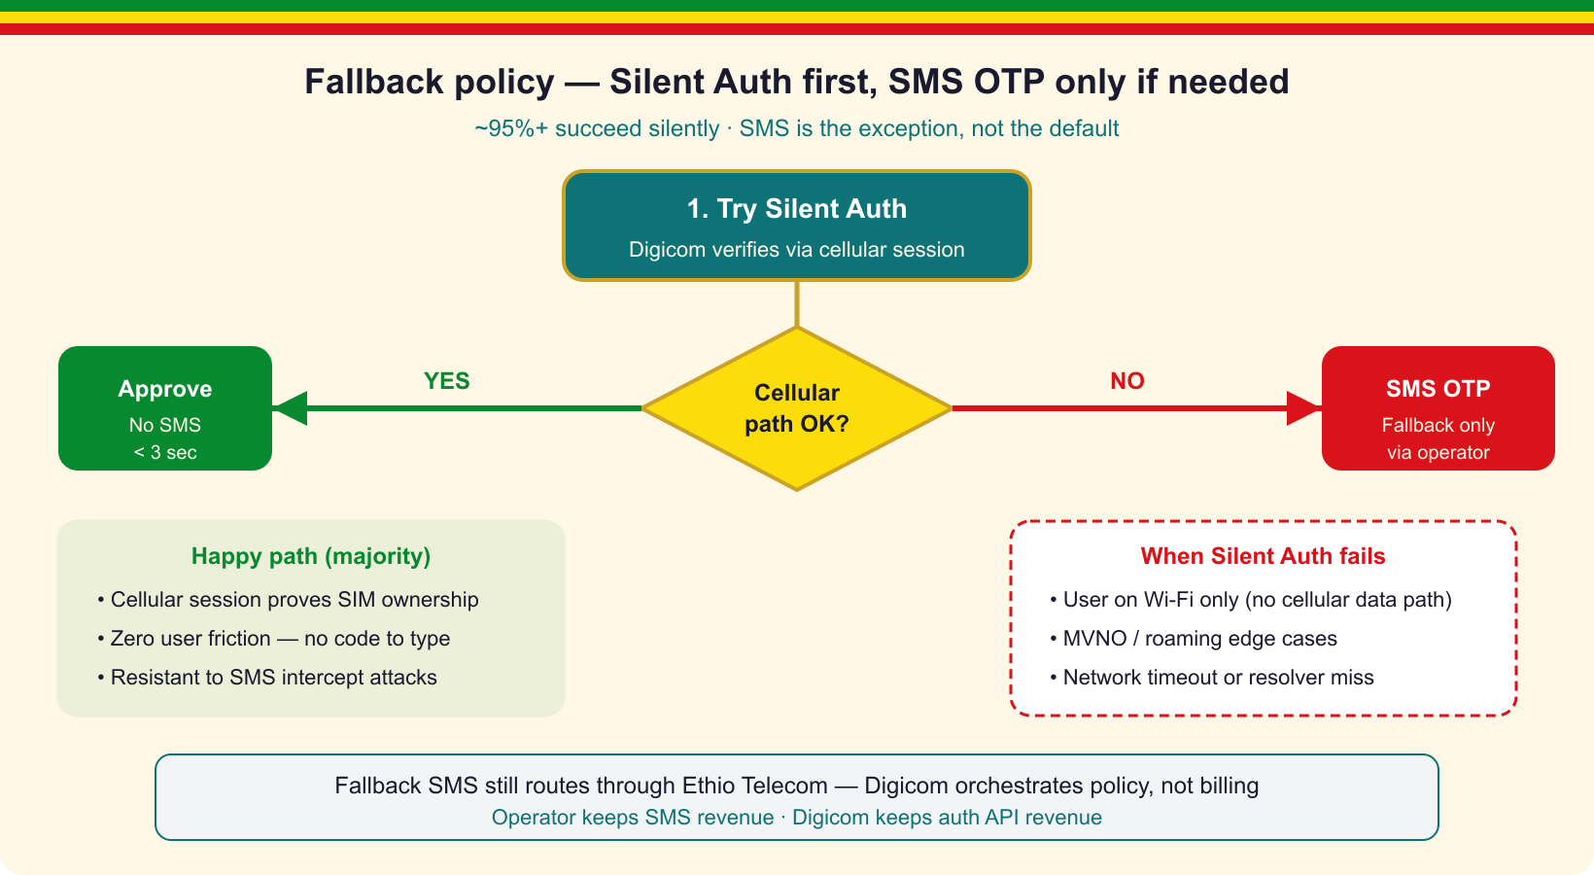
Fallback: Silent first → SMS OTP if needed
• Wi-Fi-only, no binding, timeout, low assurance → FALLBACK
• Fail-closed: never soft-approve without evidence
• SMS is safety net — silent path is primary
• Digicom orchestrates policy; SMS rides operator rails
• Residual OTP can sit behind SMS Home Routing / SS7 FW
Digicom-ET · Silent Auth v3 (story + MAP/Diameter) · 13/28

Slide 14
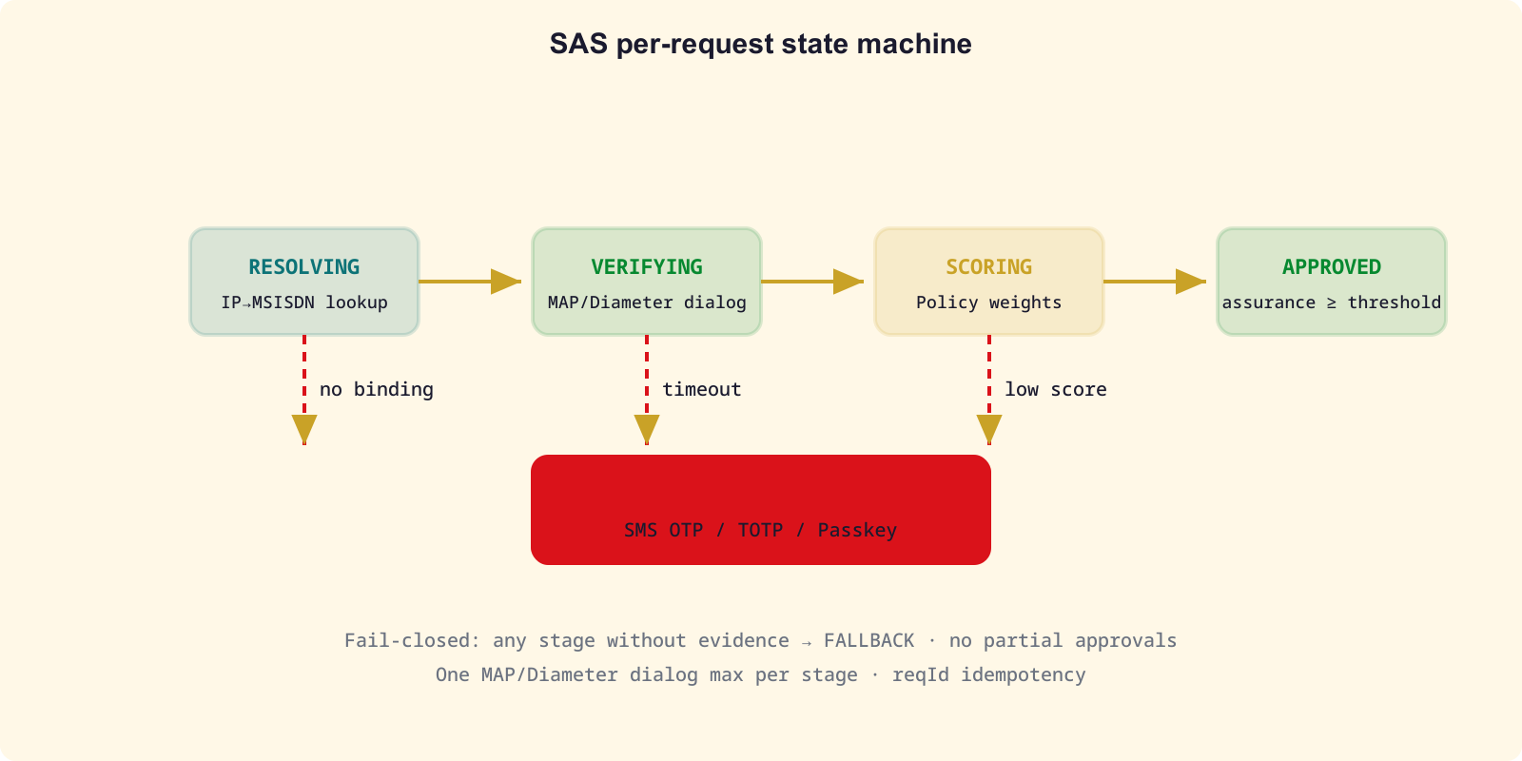
SAS FSM + timeout / dialog-leak strategy
• RESOLVING → VERIFYING → SCORING → APPROVED
• Any missing evidence → FALLBACK (fail-closed)
• Resolver budget: 300 ms
• MAP / Diameter dialog: 2 s — then abort()
• Total SAS budget: ≤ 3 s
• SAS is dialog anchor — no hung HSS stalls the bank app
Digicom-ET · Silent Auth v3 (story + MAP/Diameter) · 14/28

Slide 15
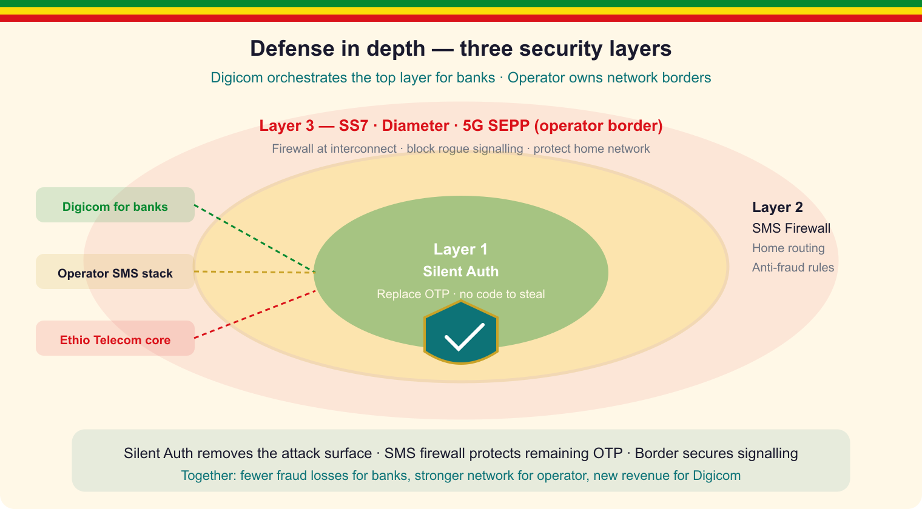
Security checklist + defense in depth
• No interconnect ATI (FS.11 Cat.1) — intra-HLR only
• Idempotent reqId; mTLS bank→SAS; ts window anti-replay
• MSISDN/IMSI never returned to the mobile app
• Layer 1 Silent Auth · Layer 2 SMS FW · Layer 3 SS7/Diameter/SEPP
• Aligned with GSMA FS.11 / FS.19 / FS.21 / FS.36
Digicom-ET · Silent Auth v3 (story + MAP/Diameter) · 15/28

Slide 16
Bank integration + jSS7 hooks (coral-valley)
• 1. Enable Digicom SDK in bank app
• 2. App sends deviceCred + IP:port:ts to bank BE
• 3. BE → Digicom POST /verify
• 4. Digicom returns match + assurance (or FALLBACK)
• 5. Bank issues session — or triggers SMS OTP
jSS7 MAP classes
• AnyTimeInterrogationRequestImpl — ATI
• ProvideSubscriberInfoRequestImpl — PSI
• SendAuthenticationInfoRequestImpl — SAI
• MAPProviderImpl → MAPServiceMobility
• Open: jDiameter S6a client module
Digicom-ET · Silent Auth v3 (story + MAP/Diameter) · 16/28

Slide 17
Standards & APIs
CAMARA Open Gateway · GSMA FASG security (FS / SG / FF)
Digicom-ET · Silent Auth v3 (story + MAP/Diameter) · 17/28

Slide 18
CAMARA / Open Gateway APIs (identity & fraud)
API | What it does | Digicom role
Number Verification (NV) | Match claimed MSISDN to live cellular session | Core Silent Auth /verify
Number Verification 2 / TS.43 | SIM EAP-AKA — works on Wi-Fi too | Phase 3 coverage expand
SIM Swap | Detect recent SIM / number change | Assurance / step-up signal
OTP SMS | Legacy OTP delivery (fallback path) | Orchestrate only — SMSC = telco
Scam Signal | Fraud / scam indicators on number | Risk policy input
KYC Match | Match subscriber KYC attributes | e-Gov / bank onboarding
Number Recycling | Detect recycled MSISDN | Avoid wrong-person auth
Digicom implements / adapts these for Ethio Telecom + government & bank apps
Digicom-ET · Silent Auth v3 (story + MAP/Diameter) · 18/28

Slide 19
How CAMARA maps onto Digicom SAS
• NV /verify ≡ Digicom two-stage: PGW resolve + MAP/Diameter verify
• SIM Swap API ≡ SAI / lastUpdateLocation age + HSS signals
• OTP SMS ≡ FALLBACK branch — Digicom policy, Ethio Telecom SMSC bills
• TS.43 NV2 ≡ future Wi-Fi silent path (SIM credential, not bearer IP)
• KYC Match / Number Recycling ≡ optional e-Gov onboarding checks
• App-facing contract: CAMARA-aligned HTTPS; signalling stays operator-internal
Digicom-ET · Silent Auth v3 (story + MAP/Diameter) · 19/28

Slide 20
GSMA FASG — signalling & SMS security documents
PRD | Title | Scope | Digicom relevance
FS.07 | SS7 & SIGTRAN Security | Threats / attack methods | SS7 SMS threat model
FS.11 | SS7 Interconnect FW | MAP/CAMEL Cat 1/2/3 rules | ATI Cat.1 · SRI-SM · MT-spoof
FS.19 | Diameter Interconnect | LTE/5G Diameter attacks | S6a/S6c/SGd SMS path
FS.20 | GTP Security | GRX/IPX GTP-C/U | Bearer / PGW context
FS.21 | Interconnect Recommendations | Umbrella categorise→filter | Policy consistency
FS.31 | Baseline Security Controls | Roaming / interconnect catalogue | Border checklist
FS.36 | 5G Interconnect Security | SEPP / N32 / PRINS | 5G SMSF + N32
SG.22 | SMS Firewall Best Practices | SMS content / AIT policy | Fallback OTP hygiene
FF.09 | SMS Fraud | Fraud taxonomy | SIM-swap / spam context
Most members-only; FS.11 v4.0 publicly circulated. Digicom aligns SAS + residual SMS protection.
Digicom-ET · Silent Auth v3 (story + MAP/Diameter) · 20/28

Slide 21
FS.11 — MAP packet categories (Silent Auth impact)
Cat | Meaning | Examples | Digicom rule
1 | Unauthorised on interconnect — BLOCK | ATI, SendIMSI, unknown opcode | ATI only to OWN HLR (intra-net)
2.1 | Operator traffic — needs answer | PSI, PRN, PSL | Primary verifier (state+location)
2.2 | Operator traffic — no answer | ISD, DSD | Filter IMSI↔SCCP
3.1 | Inter-op + VLR/SGSN check | MO-FSM, USSD, IDP | Home Routing / SMS FW
3.2 | Inter-op + time/location | UL, SAI | SIM-swap freshness (SAI)
3.3 | IPSM-GW / SMS-specific | SMS checks | Fallback OTP path
Silent Auth Verifier lives inside operator — never fires Cat.1 ATI over interconnect
Digicom-ET · Silent Auth v3 (story + MAP/Diameter) · 21/28

Slide 22
Replace OTP vs Protect OTP — which standard applies
Strategy | Mechanism | Primary standards | Owner
A — Replace OTP | Silent Auth (NV / TS.43) | CAMARA NV, TS.43, FS.11/19 (intra) | Digicom SAS
B — Protect OTP | Home Routing + signalling FW | FS.11, FS.19, FS.36, SG.22, FF.09 | Telco + Digicom policy
Umbrella | Categorise → monitor → filter | FS.21 + FS.31 baseline | Operator border
5G path | SEPP / N32 / SMSF | FS.36, 3GPP TS 33.501 | Operator + Digicom
Every OTP Digicom cannot eliminate must still be protected (Strategy B)
Digicom-ET · Silent Auth v3 (story + MAP/Diameter) · 22/28

Slide 23
Ethiopia Open Gateway positioning
• Digicom exposes CAMARA-shaped APIs to government & banks
• Ethio Telecom remains network source of truth (HLR/HSS/PGW/SMSC)
• Compliance story: FS.11/19/21/36 for signalling; CAMARA for app contract
• No SMS revenue taken — Open Gateway VAS layer on top of the operator
• Roadmap: NV pilot → SIM Swap signal → TS.43 / NV2 Wi-Fi path
Digicom-ET · Silent Auth v3 (story + MAP/Diameter) · 23/28

Slide 24
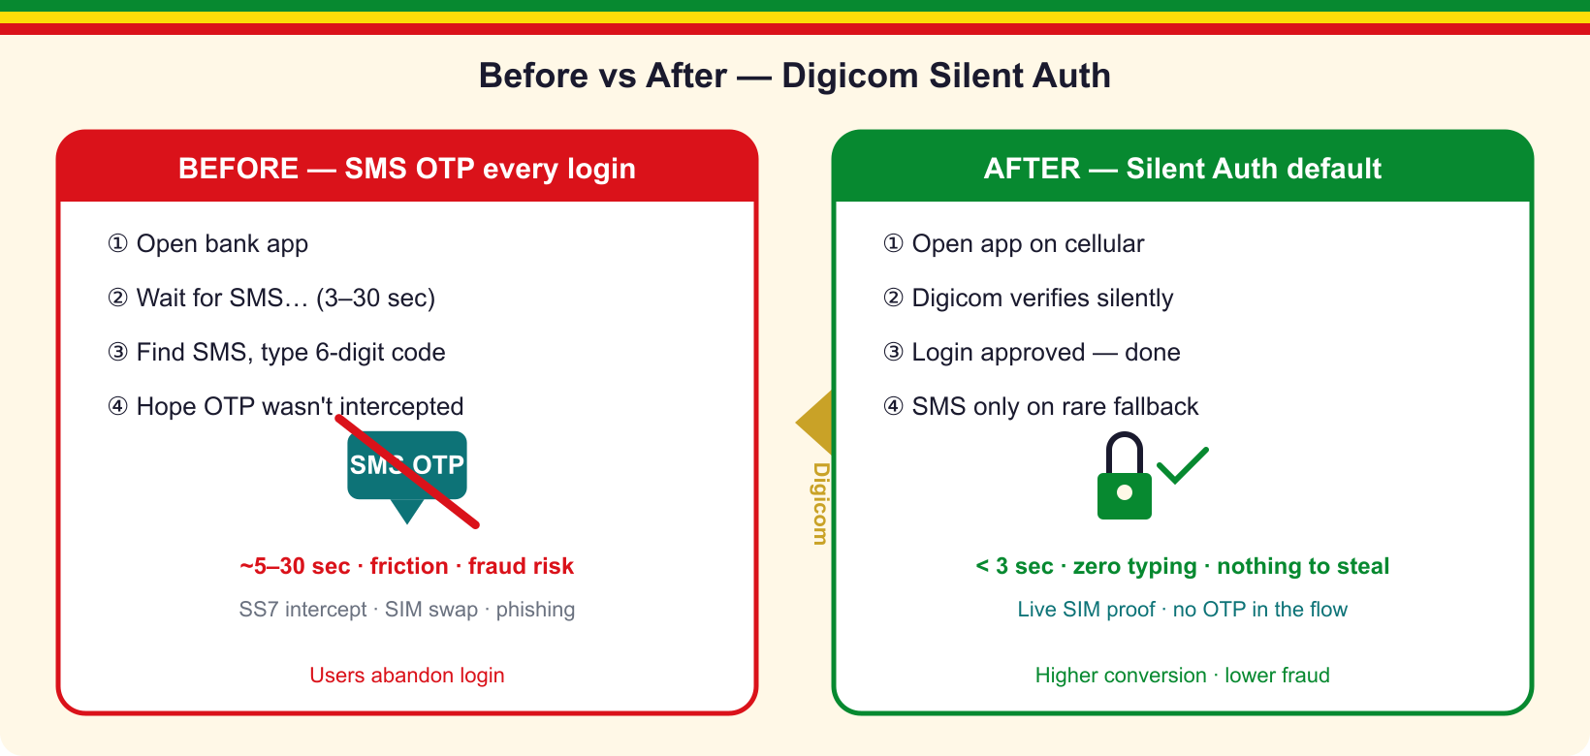
Value for government & banks
• Higher login conversion on e-Gov and banking apps
• Lower SMS OTP spend on the silent happy path
• Stronger posture vs SS7 intercept & phishing
• CAMARA-aligned API — portable across Open Gateway markets
• Risk-based step-up for high-value / benefit transfers
Digicom-ET · Silent Auth v3 (story + MAP/Diameter) · 24/28

Slide 25
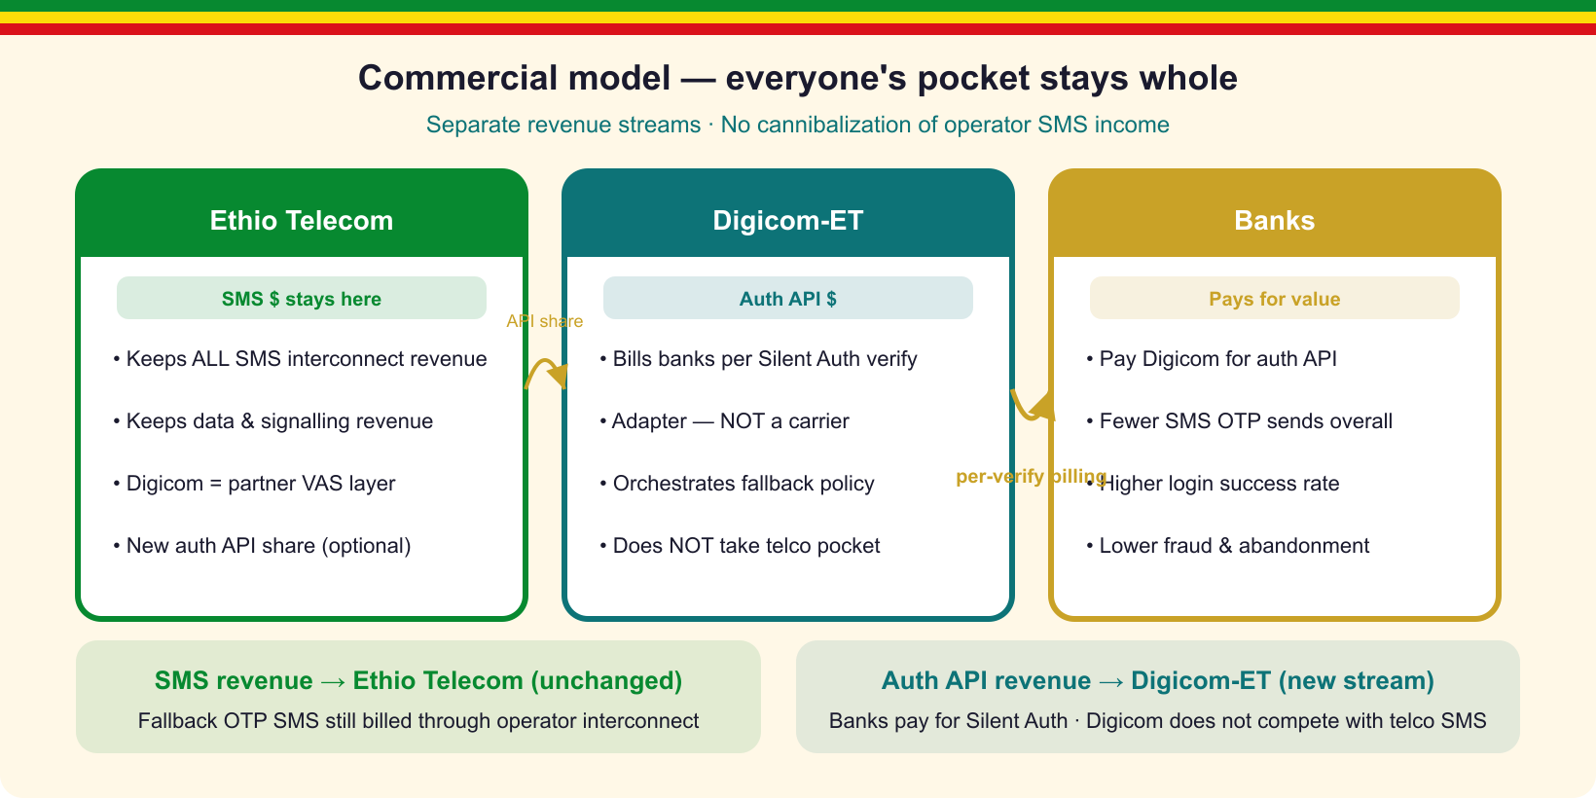
Ethio Telecom partnership + roadmap
• New enterprise VAS without cannibalizing SMS wholesale
• Government & banks stay on cellular — Digicom prefers data bearer
• Digicom sells/integrates; telco supplies network truth
• Phase 1: pilot IP-match + MAP ATI/PSI
• Phase 2: Diameter S6a + CAMARA SIM Swap
• Phase 3: TS.43 / NV2 Wi-Fi · FS.36 5G path
Digicom-ET · Silent Auth v3 (story + MAP/Diameter) · 25/28

Slide 26
Open items
• Resolver source: PGW RADIUS vs PCRF Sd vs CGNAT log
• jDiameter S6a client (mirror jSS7 MAP verifier)
• CAMARA Number Verification adapter: SAS /verify ↔ NV contract
• Assurance weights + per-risk thresholds (e-Gov vs bank transfer)
• Shared identity-policy store between SAS and signalling FW
Digicom-ET · Silent Auth v3 (story + MAP/Diameter) · 26/28

Slide 27
Let's make government login silent
Pilot Digicom-ET Silent Auth for e-Gov and banks.
CAMARA-aligned · MAP/Diameter verify · GSMA FS.11/19 · no telco pocket touched.
contact@digicom-et.example · Addis Ababa
Digicom-ET · Silent Auth v3 (story + MAP/Diameter) · 27/28

Slide 28
Thank you
Digicom-ET — Silent Authentication for Government & Banks
CAMARA + GSMA FASG · ATI/PSI/SAI for the engineers
Digicom-ET · Silent Auth v3 (story + MAP/Diameter) · 28/28

