Slide 1
DIGICOM-ET
Silent Authentication for Banks
Phone on the network — no SMS, under 3 seconds
Ethiopia · VAS adapter on Ethio Telecom · 2026
Digicom-ET · Silent Authentication for Ethiopian Banks · 1/20

Slide 2
Agenda
• Why Ethiopia — mobile banking at scale, OTP pain everywhere
• The SMS OTP problem & the threats banks face today
• Meet Chú Phỉnh — frictionless login, real security
• Digicom-ET Silent Auth: how the VAS adapter works
• Architecture on top of Ethio Telecom — not inside it
• Fallback SMS stays operator-billed; telco revenue protected
• Security, integration, roadmap, next steps
Digicom-ET · Silent Authentication for Ethiopian Banks · 2/20

Slide 3
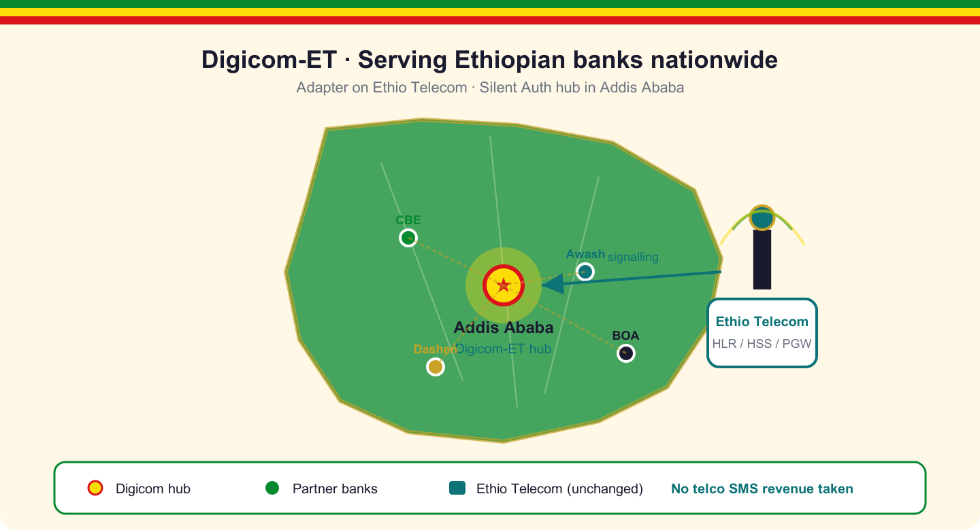
Why Ethiopia
• 70M+ mobile subs — banking runs on the phone
• SMS OTP still default: slow, expensive, easy to attack
• Banks need instant login without weakening fraud controls
• Network-side identity as a VAS layer — no core rebuild
• Digicom-ET: Silent Auth built for Ethiopian banks
Digicom-ET · Silent Authentication for Ethiopian Banks · 3/20

Slide 4
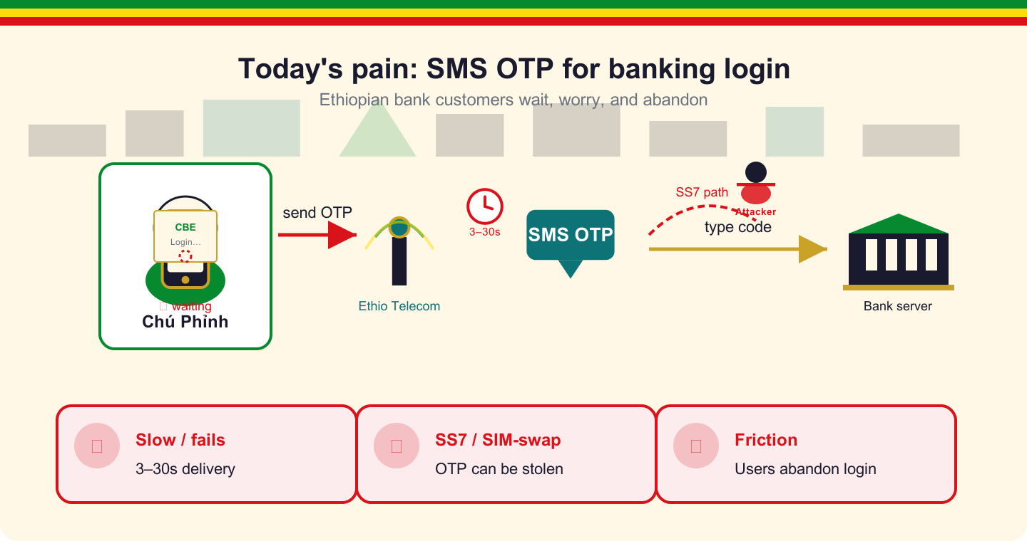
The SMS OTP problem
• 3–30 s wait → abandoned logins and support calls
• SS7 / interconnect: OTP redirected before the user sees it
• SIM-swap: attacker owns the number, receives the code
• Phishing proxies harvest codes in real time
• Banks pay per SMS and still eat fraud losses
Digicom-ET · Silent Authentication for Ethiopian Banks · 4/20

Slide 5
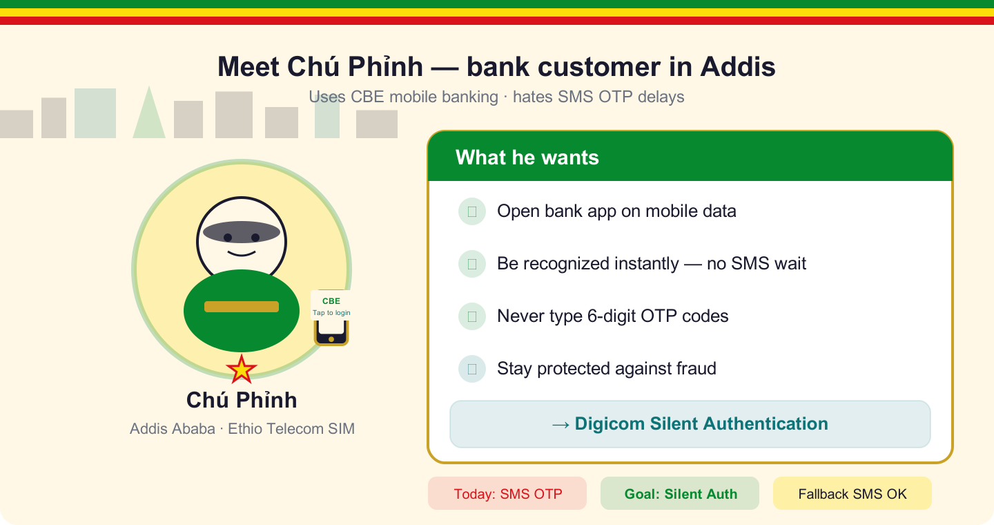
Meet Chú Phỉnh
• Daily mobile-banking user in Addis Ababa
• Wants: open app → recognized → done
• Refuses: wait, hunt for SMS, type six digits
• Must feel safe — and actually be safe — from fraud
• Silent Auth delivers both: speed and assurance
Digicom-ET · Silent Authentication for Ethiopian Banks · 5/20

Slide 6
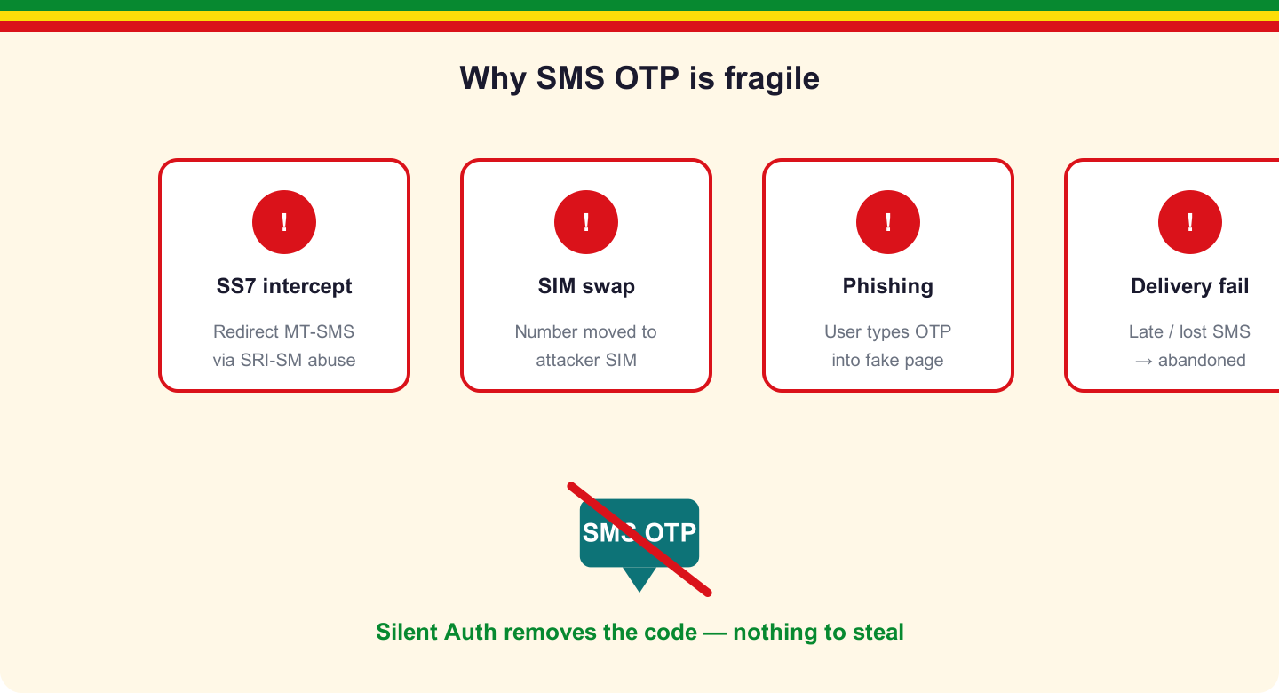
Threats Silent Auth removes
• SS7 intercept — no SMS payload to steal
• Phishing / OTP relay — nothing for the user to leak
• Premium-rate / AIT abuse — no OTP blast to fraud numbers
• Delivery failure — login not hostage to SMS latency
• SIM-swap — network signals flag recent handset changes
Digicom-ET · Silent Authentication for Ethiopian Banks · 6/20

Slide 7
The solution
Digicom-ET Silent Auth — VAS adapter that proves the phone is on-network
Digicom-ET · Silent Authentication for Ethiopian Banks · 7/20

Slide 8
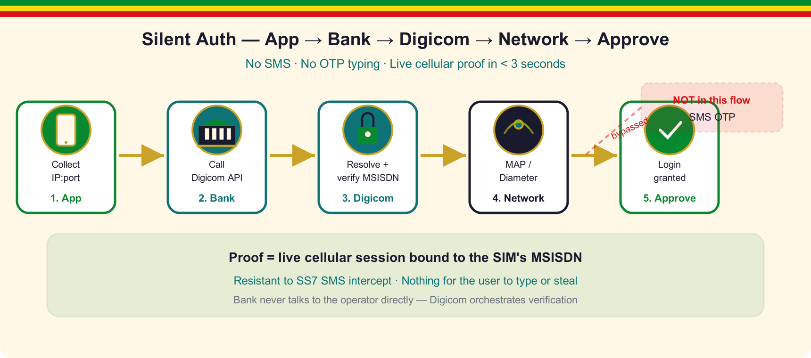
How Silent Auth works
• App on cellular captures IP + port + timestamp
• Bank backend calls Digicom-ET POST /verify
• Resolver binds IP:port → MSISDN via PGW session
• Verifier queries HLR/HSS: MAP (PSI/ATI/SAI) or Diameter S6a
• Policy engine: APPROVE silently or route to SMS fallback
Digicom-ET · Silent Authentication for Ethiopian Banks · 8/20

Slide 9
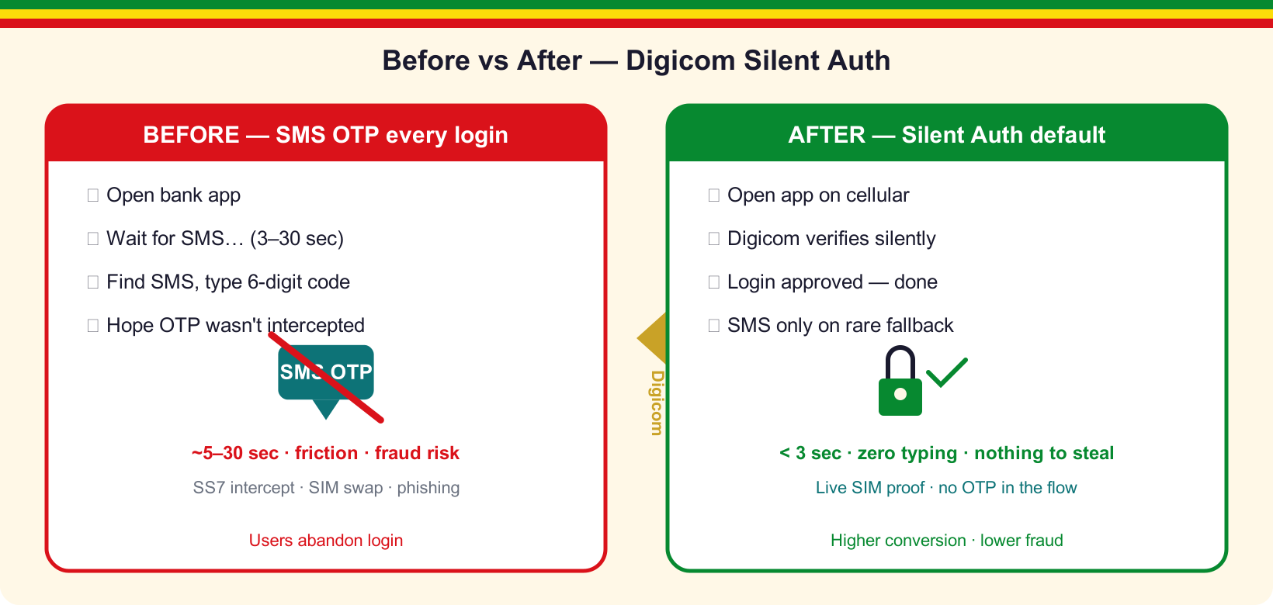
Before vs After
• Before: wait → type OTP → pray it wasn't intercepted
• After: silent verify → session in under 3 seconds
• Happy path: zero SMS, zero typing
• Same bank app — Digicom VAS plugs in behind the API
• Chú Phỉnh: open app, you're in
Digicom-ET · Silent Authentication for Ethiopian Banks · 9/20

Slide 10
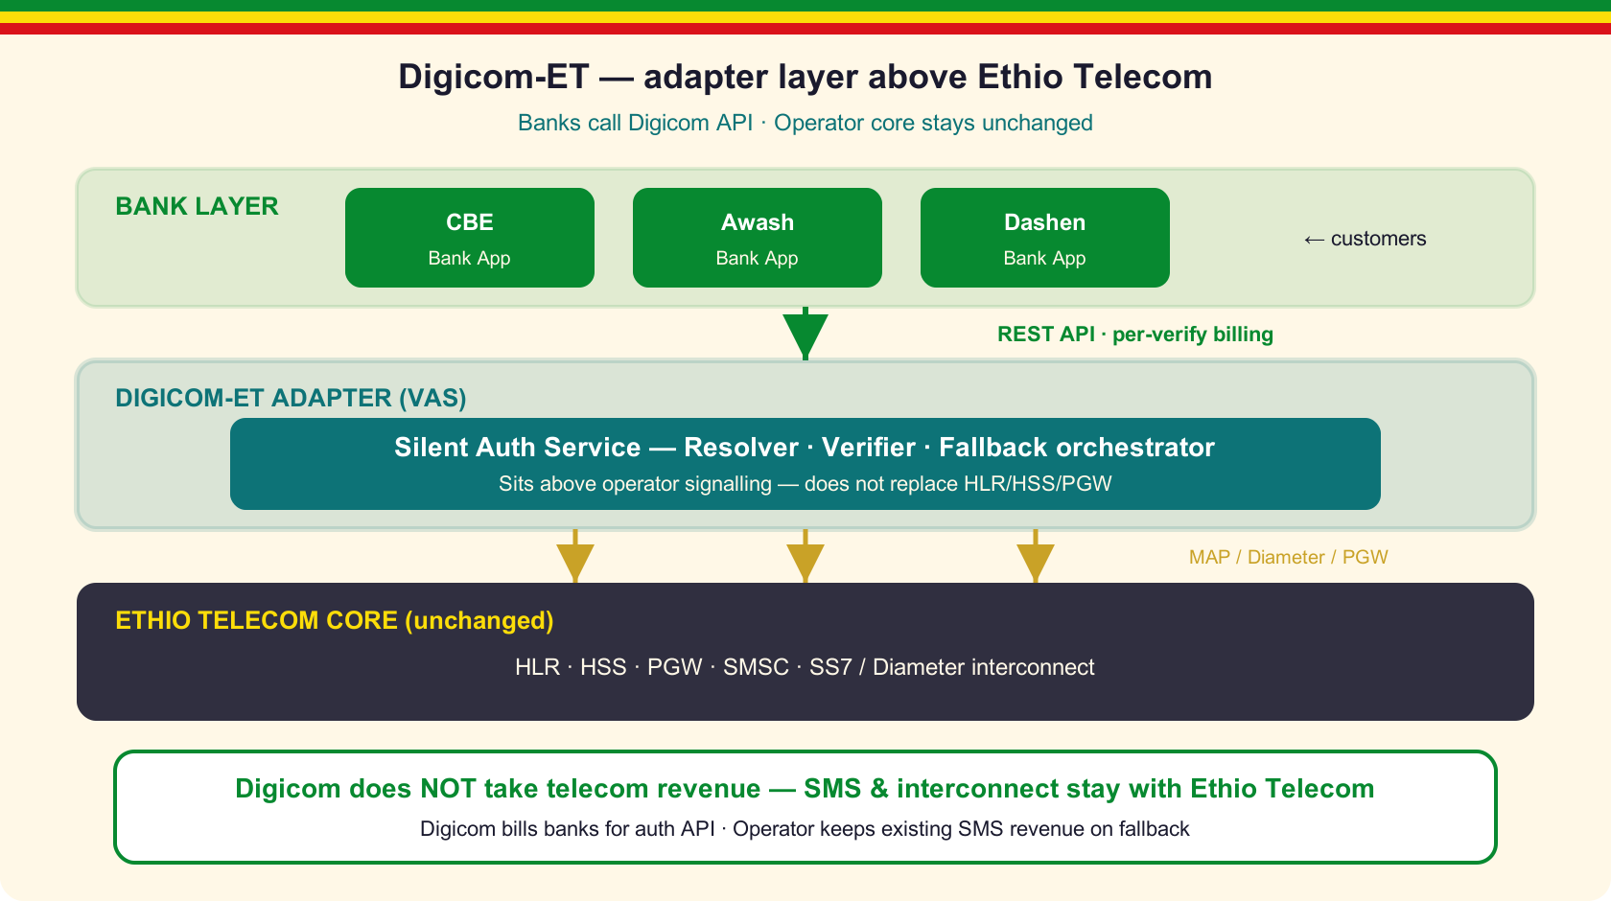
Architecture — adapter on top
• Digicom-ET = thin VAS layer between banks and Ethio Telecom
• Reuses existing PGW, HLR/HSS, SMSC — zero core rewrite
• Banks call HTTPS API; Digicom handles signalling orchestration
• Operator network remains source of truth for identity
• We adapt on top — we never replace the telecom stack
Digicom-ET · Silent Authentication for Ethiopian Banks · 10/20

Slide 11
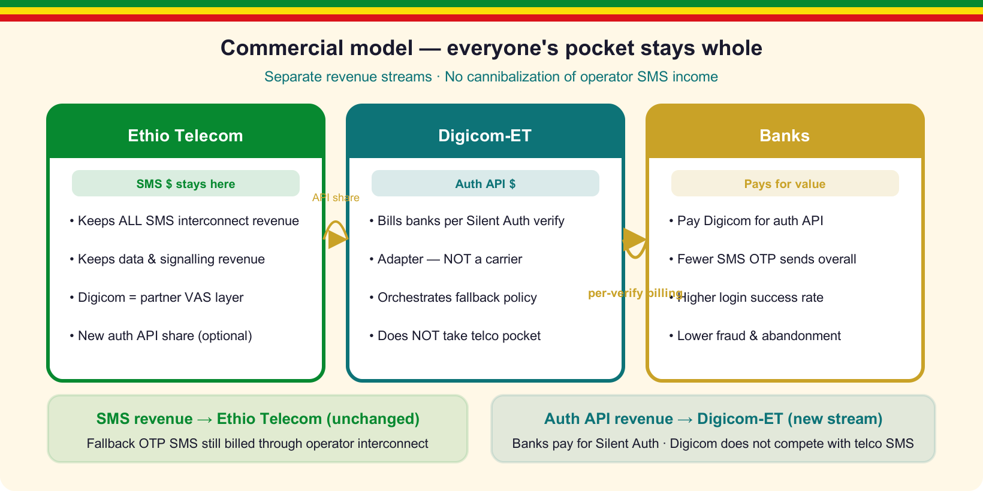
We do NOT touch Ethio Telecom's pocket
• Digicom sells verification to banks — not SMS wholesale
• A2P / interconnect SMS revenue stays 100% with the operator
• Signalling, data, and subscriber records remain carrier-owned
• Optional API revenue share — additive VAS, not cannibalization
• Every fallback OTP is operator-billed through Ethio Telecom SMSC
Digicom-ET · Silent Authentication for Ethiopian Banks · 11/20

Slide 12
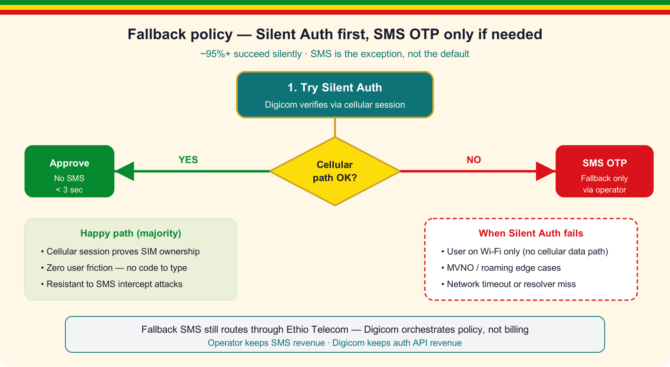
Fallback to SMS
• Wi-Fi-only, timeout, or low assurance → SMS OTP safety net
• Fail-closed: never approve without cryptographic evidence
• SMS is backup — silent path is primary
• Digicom orchestrates policy only; SMS rides operator rails
• Fallback traffic = operator revenue, not Digicom bypass
Digicom-ET · Silent Authentication for Ethiopian Banks · 12/20

Slide 13
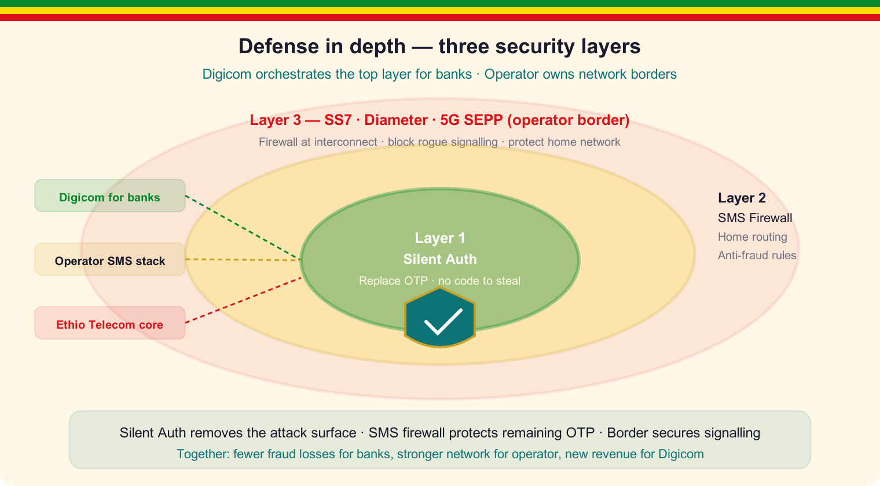
Defense in depth
• Layer 1: Silent Auth eliminates most OTP exposure
• Layer 2: SMS Home Routing / firewall for residual OTP
• Layer 3: Operator SS7, Diameter, 5G SEPP border controls
• Digicom orchestrates bank-facing identity policy
• Aligned with GSMA FS.11 / FS.19 / FS.21 / FS.36
Digicom-ET · Silent Authentication for Ethiopian Banks · 13/20

Slide 14
Value for Ethiopian banks
• Higher conversion — fewer abandoned logins
• Lower OTP SMS spend on the silent happy path
• Stronger fraud posture vs SS7, phishing, SIM-swap
• Drop-in integration: HTTPS API + mobile SDK
• Risk-based step-up for high-value transactions
Digicom-ET · Silent Authentication for Ethiopian Banks · 14/20

Slide 15
Value for Ethio Telecom partnership
• New enterprise VAS revenue — SMS wholesale untouched
• Banks stay on cellular; operator keeps subscriber engagement
• Digicom sells to banks; telco supplies network truth
• Shared policy + optional per-verify API revenue share
• Positions Ethiopia for Open Gateway / CAMARA leadership
Digicom-ET · Silent Authentication for Ethiopian Banks · 15/20

Slide 16
Security highlights
• Intra-network HLR/HSS queries only (FS.11 Cat. 1 on interconnect)
• IP + port + timestamp — CGNAT-safe binding
• SIM-swap freshness via SAI / lastUpdateLocation
• Hard timeouts: resolver 300 ms, MAP/Diameter 2 s, total ≤ 3 s
• MSISDN never exposed to the app — bank backend only
Digicom-ET · Silent Authentication for Ethiopian Banks · 16/20

Slide 17
Bank integration
• 1. Embed Digicom SDK in the mobile banking app
• 2. On login: app sends deviceCred + cellular binding to bank
• 3. Bank backend calls Digicom POST /verify
• 4. Digicom returns match + assurance level (or FALLBACK)
• 5. Bank issues session — or triggers operator-billed SMS OTP
Digicom-ET · Silent Authentication for Ethiopian Banks · 17/20

Slide 18
Roadmap
• Phase 1: Pilot 1–2 banks — IP-match + MAP verifier
• Phase 2: Diameter S6a + SIM-swap signal API
• Phase 3: TS.43 / Wi-Fi silent path for wider coverage
• Phase 4: CAMARA Number Verification alignment
• Ongoing: SMS Home Routing for operator-protected fallback
Digicom-ET · Silent Authentication for Ethiopian Banks · 18/20

Slide 19
Let's make Chú Phỉnh's login silent
Pilot Digicom-ET Silent Auth with your bank.
VAS adapter on Ethio Telecom — telco SMS revenue stays intact.
contact@digicom-et.example · Addis Ababa
Digicom-ET · Silent Authentication for Ethiopian Banks · 19/20

Slide 20
Ameseginalehu · Thank you
Digicom-ET — VAS Silent Authentication for Ethiopian Banks
Adapter on top · Operator revenue protected · Built for Ethiopia
Digicom-ET · Silent Authentication for Ethiopian Banks · 20/20

