Slide 1
DIGICOM-ET
Silent Authentication — Technical Design
Two-stage resolver + MAP/Diameter verifier · Ethiopia deployment
Protocol flows · Fail-closed FSM · GSMA FS.11 / FS.19
Digicom-ET · Silent Auth Technical Design · 1/17

Slide 2
Scope & Non-Goals
• IN SCOPE: auth without SMS OTP on cellular data bearer
• IN SCOPE: VAS adapter deployed on / inside operator network
• IN SCOPE: bank backend calls SAS POST /verify server-to-server
• NOT replacing SS7 / Diameter signalling firewall (Strategy B)
• NOT taking operator SMS revenue — fallback OTP stays operator-billed
• NOT cross-operator ATI — intra-network HLR/HSS only (FS.11 Cat.1)
Digicom-ET · Silent Auth Technical Design · 2/17

Slide 3
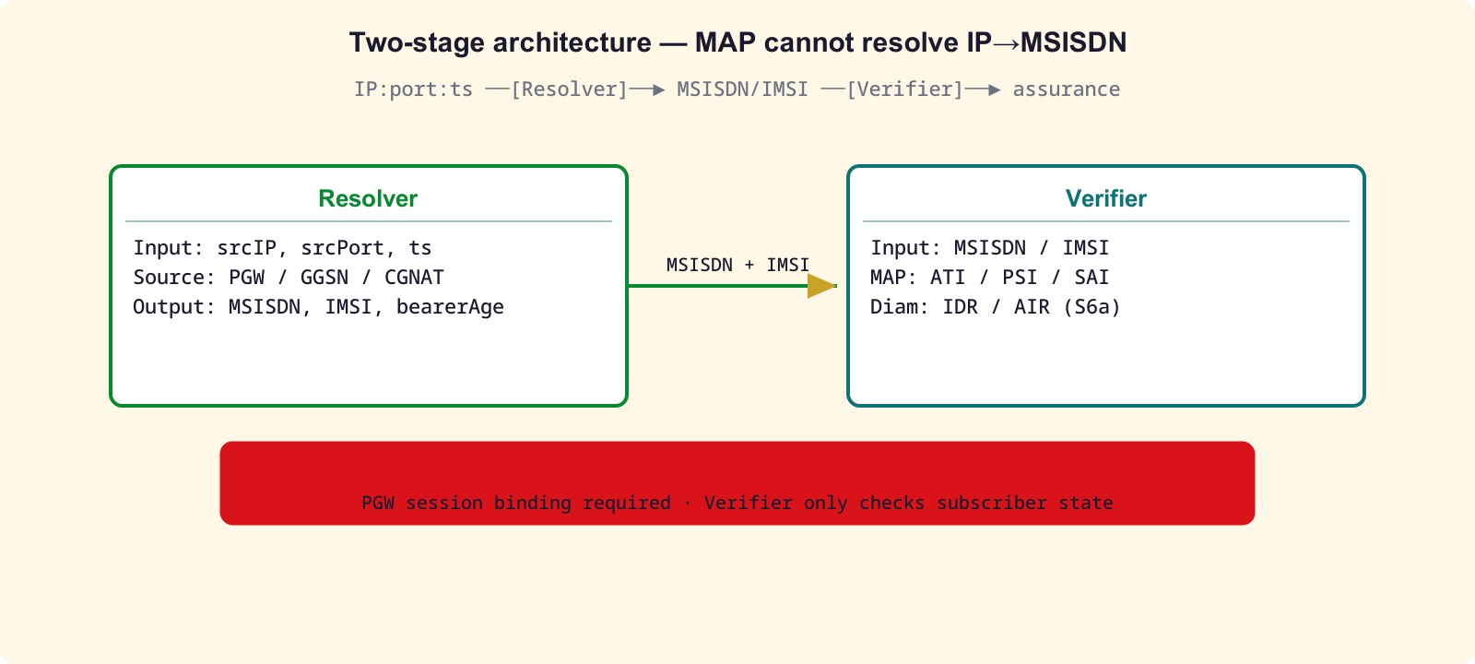
Hard Constraint: Two Stages Required
• MAP / Diameter cannot map IP → MSISDN — protocol limitation
• Stage 1 RESOLVER: PGW/GGSN session binding → MSISDN/IMSI
• Stage 2 VERIFIER: MAP ATI/PSI/SAI or Diameter S6a IDR/AIR
• CGNAT ⇒ app MUST send IP + port + timestamp
• Reject if resolver returns >1 MSISDN for same binding
Digicom-ET · Silent Auth Technical Design · 3/17

Slide 4
Actors
Actor | Role
Bank App (mobile) | Cellular data; collects {srcIP, srcPort, ts, deviceCred}
Bank Backend | Login decision; calls SAS POST /verify
Digicom SAS | Resolver + Verifier + Policy engine
PGW Resolver | PGW/GGSN / PCRF / CGNAT log → MSISDN+IMSI
MAP/Diameter Verifier | jSS7 (2G/3G) + jDiameter S6a (4G/5G)
HLR / HSS | Operator subscriber DB — intra-network only
Digicom-ET · Silent Auth Technical Design · 4/17

Slide 5
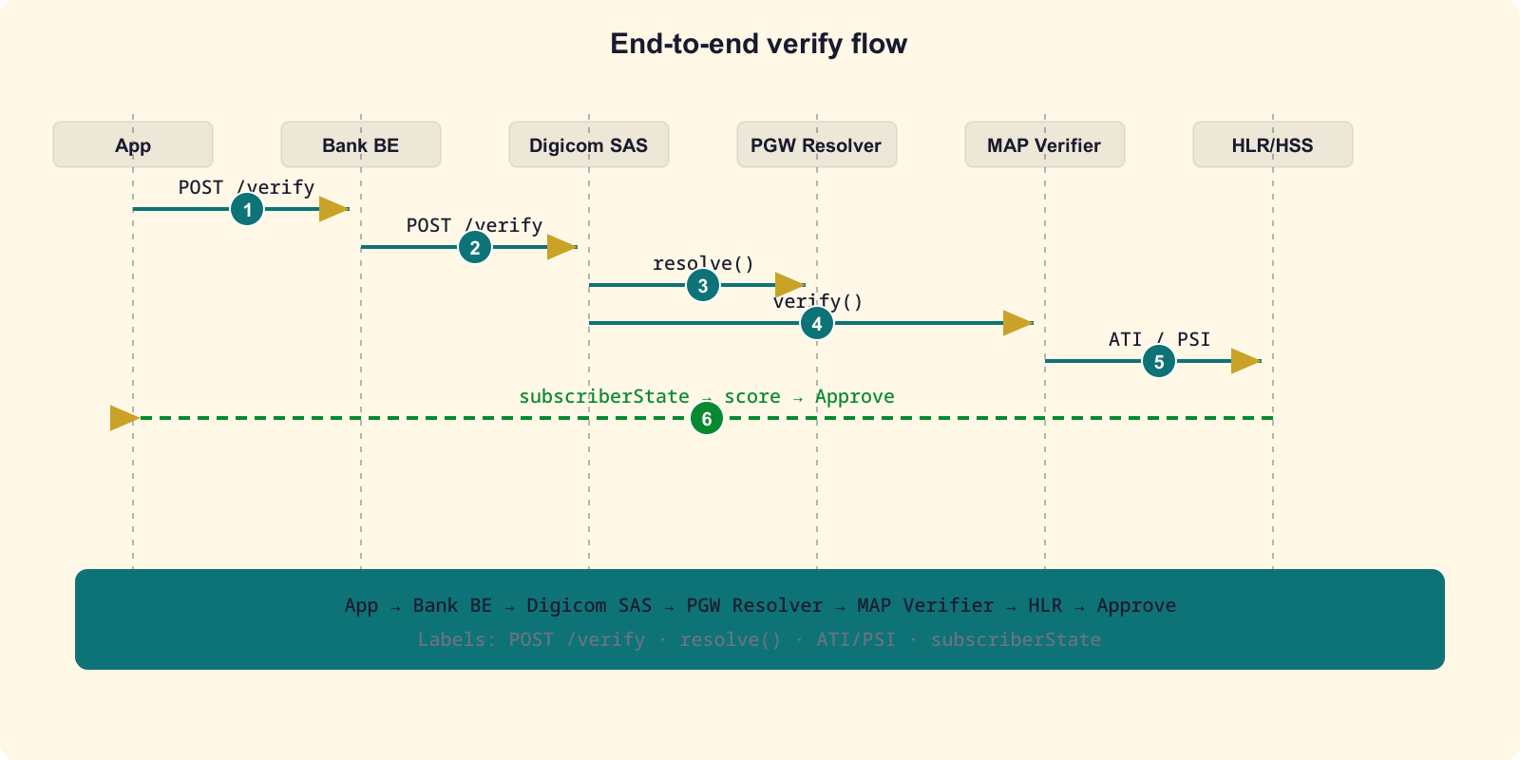
End-to-End Message Flow
Numbered steps match silent-auth-flow.md — happy path, cellular bearer
Digicom-ET · Silent Auth Technical Design · 5/17

Slide 6
Stage 1: IP Resolver
• Input: {srcIP, srcPort, ts} from SAS
• Sources: PGW/GGSN Gi/SGi accounting, PCRF Gx/Sd, CGNAT log
• Output: MSISDN + IMSI + bearerAge (point-in-time at ts)
• Reject if >1 MSISDN — CGNAT ambiguity → FALLBACK
• No binding / Wi-Fi-only / stale bearer → FALLBACK
• Budget: 300 ms — on expiry → FALLBACK
Digicom-ET · Silent Auth Technical Design · 6/17

Slide 7
Stage 2: MAP/Diameter Verifier
One MAP/Diameter dialog max per request. SIM-swap = lastUpdateLocation age vs request time.
Access | Message | Purpose | FS Category
2G/3G | PSI | subscriber state + location, intra-net | Cat 2.1
2G/3G | ATI | any-time interrogation (intra-net ONLY) | Cat 1 interconnect
2G/3G | SAI | auth vectors / SIM-swap freshness | Cat 3.2
4G/5G | IDR/IDA | insert/inspect subscriber data | FS.19
4G/5G | AIR/AIA | authentication info request/answer | FS.19
Digicom-ET · Silent Auth Technical Design · 7/17

Slide 8
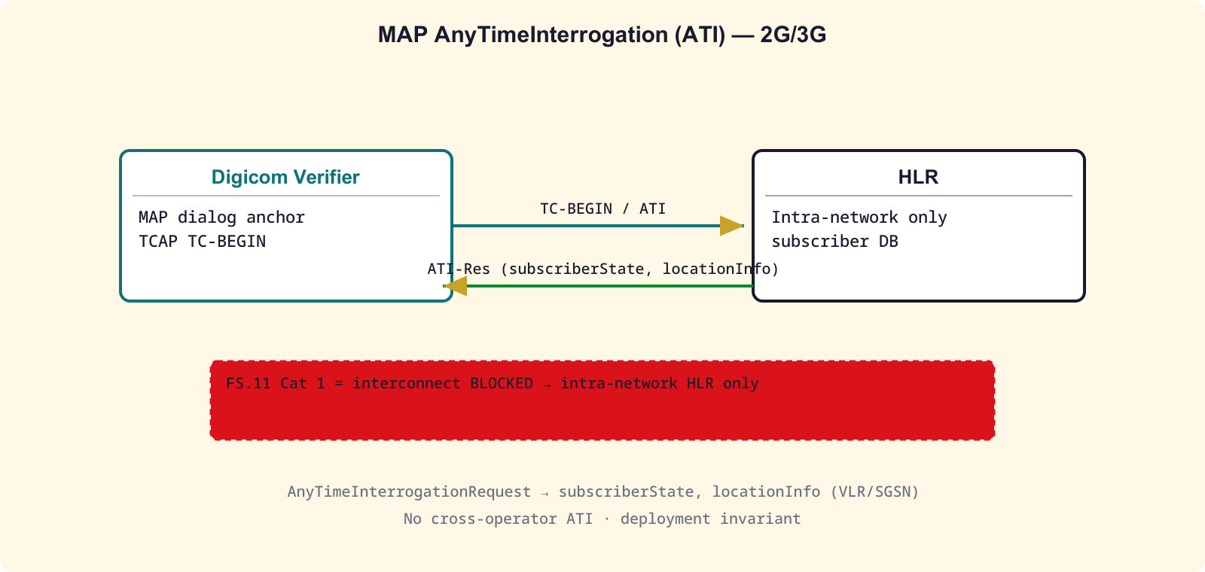
ATI Deep Dive (FS.11 Cat.1)
TC dialog · ATI request/response fields · deploy Digicom inside operator
Digicom-ET · Silent Auth Technical Design · 8/17

Slide 9
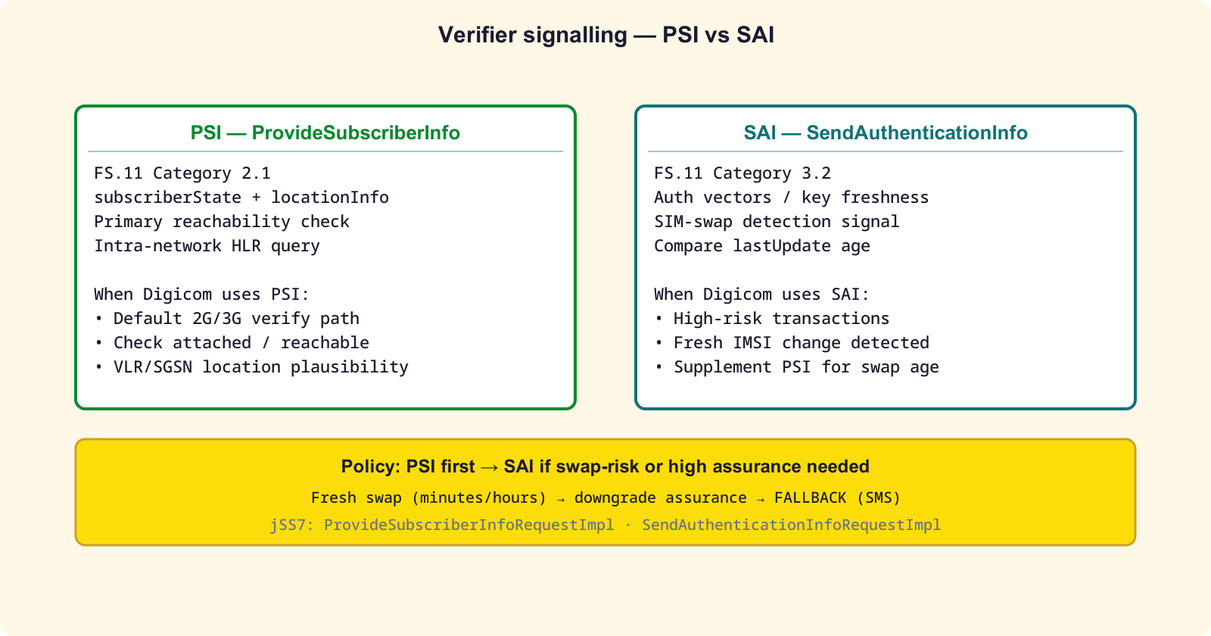
PSI vs SAI
Digicom-ET · Silent Auth Technical Design · 9/17

Slide 10
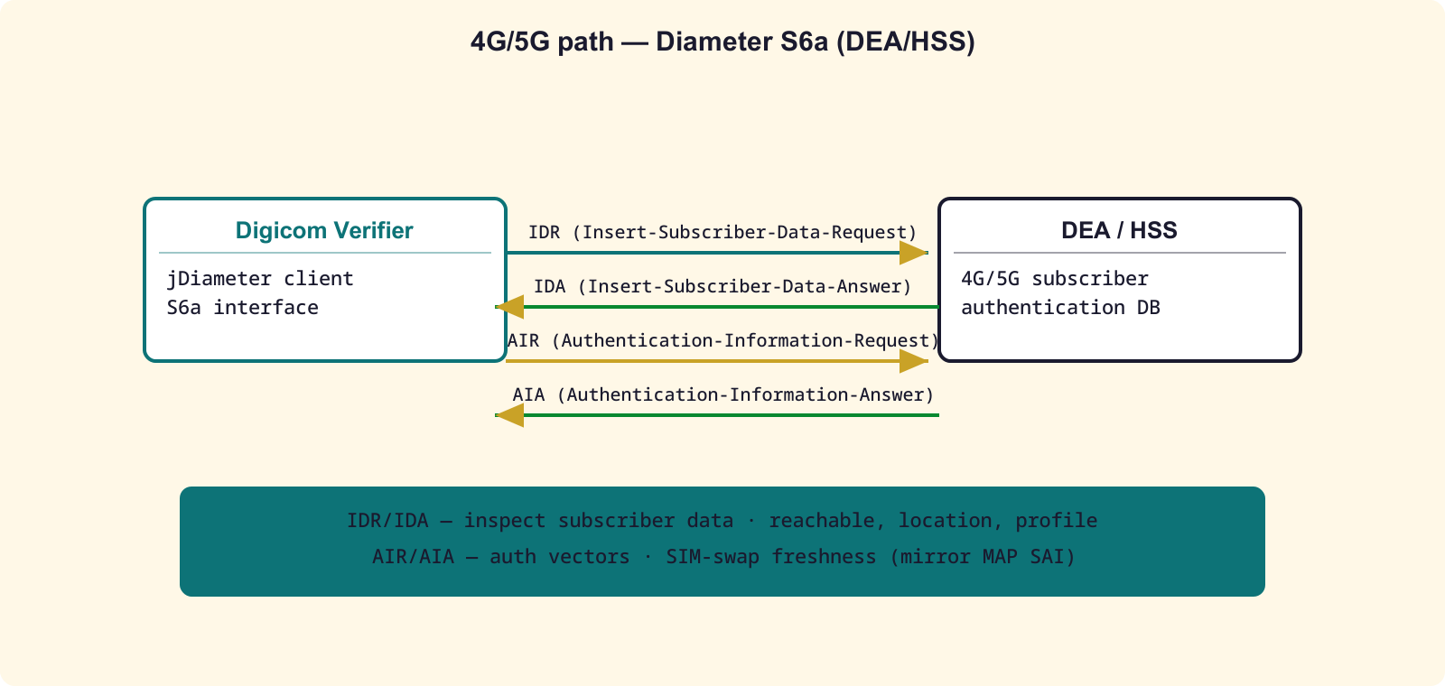
Diameter S6a Path (4G/5G)
IDR/IDA + AIR/AIA — GSMA FS.19
Digicom-ET · Silent Auth Technical Design · 10/17

Slide 11
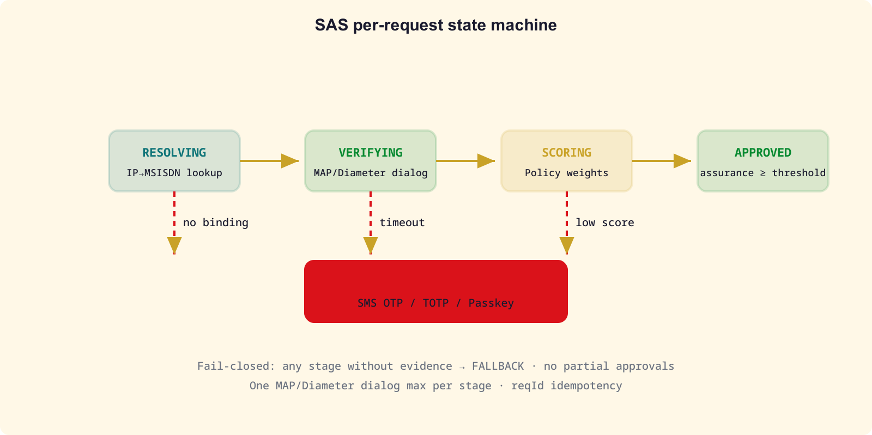
SAS Request FSM — Fail-Closed
No partial approvals — any missing evidence → FALLBACK
Digicom-ET · Silent Auth Technical Design · 11/17

Slide 12
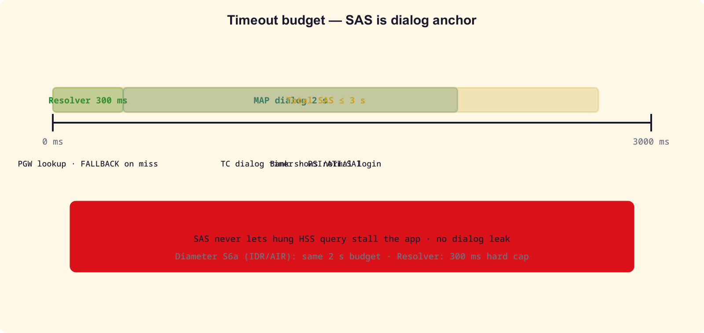
Timeout & Dialog Leak Strategy
• Resolver: 300 ms → FALLBACK
• MAP dialog (PSI/ATI): 2 s TC timer → abort() → FALLBACK
• Diameter S6a (IDR/AIR): 2 s → FALLBACK
• Total SAS budget: 3 s — bank shows normal login
• SAS is dialog anchor — never let hung HSS query stall the app
• Every MAP dialog has bounded TC timer — no dialog leak
Digicom-ET · Silent Auth Technical Design · 12/17

Slide 13
Fallback SMS Policy
• Trigger: Wi-Fi-only, resolver miss, MAP/Diameter timeout, low assurance
• SAS returns FALLBACK — bank triggers step-up (TOTP / Passkey / SIM-OTP)
• SMS OTP is safety net — silent path is primary
• Operator bills every fallback SMS via own SMSC
• Digicom orchestrates policy only — SMS rides operator rails
• Fail-closed: never approve without cryptographic network evidence
Digicom-ET · Silent Auth Technical Design · 13/17

Slide 14
Security Checklist
• No interconnect ATI — FS.11 Cat.1 blocked; intra-network HLR only
• Fail-closed — missing evidence never approves
• Idempotent reqId — dedup retries; one dialog per stage
• MSISDN/IMSI never returned to mobile app — bank backend only
• SIM-swap check via SAI / lastUpdateLocation age
• CGNAT: IP+port+ts required; reject >1 MSISDN; point-in-time read at ts
• Replay: mTLS bank→SAS; reqId + ts window; spoofed GT rejected
Digicom-ET · Silent Auth Technical Design · 14/17

Slide 15
jSS7 Hooks (coral-valley)
• AnyTimeInterrogationRequestImpl — ATI (subscriberInformation)
• ProvideSubscriberInfoRequestImpl — PSI (subscriberInformation)
• SendAuthenticationInfoRequestImpl — SAI (authentication)
• MAPProviderImpl → MAPServiceMobility — dialog open / TC timer
• Dialog lifecycle: open → send → await → close or abort on timeout
• jDiameter S6a client module — open item (mirror MAP verifier)
Digicom-ET · Silent Auth Technical Design · 15/17

Slide 16
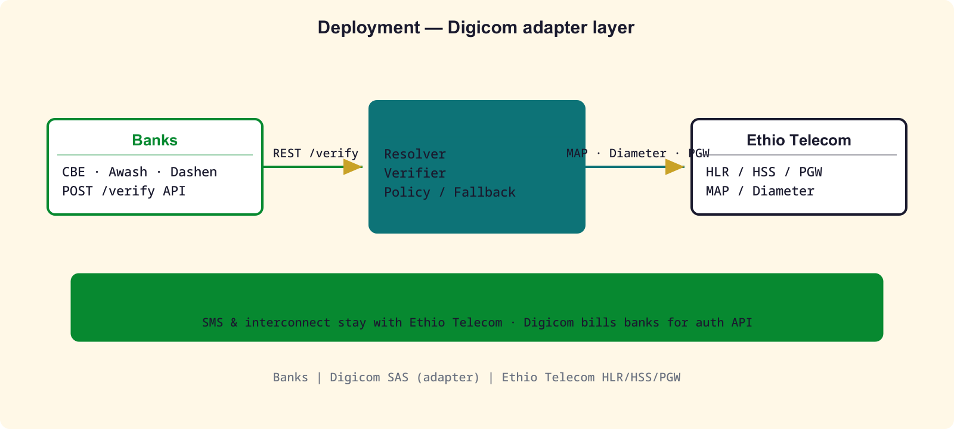
Summary — One Page
• Two stages: IP:port:ts → RESOLVER → MSISDN → VERIFIER → assurance
• ATI intra-network only (FS.11 Cat.1) — Digicom SAS inside operator
• Fail-closed FSM → FALLBACK SMS (operator-billed) / step-up MFA
• Adapter: Digicom VAS on Ethio Telecom HLR/HSS/PGW — no SMS revenue taken
• Budgets: resolver 300 ms · MAP/Diameter 2 s · total ≤ 3 s
• jSS7: ATI/PSI/SAI; open: jDiameter S6a + resolver source
Digicom-ET · Silent Auth Technical Design · 16/17

Slide 17
Open Items
• Resolver interface: PGW RADIUS accounting vs PCRF Sd vs CGNAT log
• jDiameter S6a client module (mirror jSS7 MAP verifier)
• CAMARA Number Verification adapter: SAS /verify → CAMARA contract
• Assurance weights + per-risk thresholds (login vs money transfer)
• Shared identity-policy store between SAS and signalling firewall
Digicom-ET · Silent Auth Technical Design · 17/17

