Slide 1
OpenWork Fork
Tich hop AionUi — Cowork ca nhan voi File Preview + Skills Research
Hackathon: AI Cowork / Personal AI Agent / Productivity Tools
Nhan · 11/07/2026

Slide 2
Van de & Co hoi
Van de
Co hoi
OpenWork: engine OpenCode manh, nhung UI
thieu preview file Office (PPTX, DOCX, PDF)
Pain point: Moi file .pptx / .docx / .pdf phai
mo app ngoai, mat flow lam viec
~30 phut/ngay chuyen doi giua cac app
= 500 gio/thang cho enterprise 1000 nguoi
AionUi: co preview + 21 assistants + 30+ LLM
nhung engine dev tools yeu hon OpenCode
Giai phap: Fork OpenWork, port tinh nang
tu AionUi co chon loc
Giu engine manh + them UX dep = ca 2
OpenWork Fork — 2/11

Slide 3
Muc tieu du an
OpenWork co day du tinh nang user-friendly cua AionUi ma van giu engine OpenCode manh
📄 File Preview
🧠 Research Workflow
⚡ Automation
Xem moi format ngay trong app PPT / Word / PDF / Excel / Code / MD / Diff
Skill agents cho doc tai lieu, tom tat, tong hop kien thuc
Cron tasks, file management, remote access, scheduled research
OpenWork Fork — 3/11

Slide 4
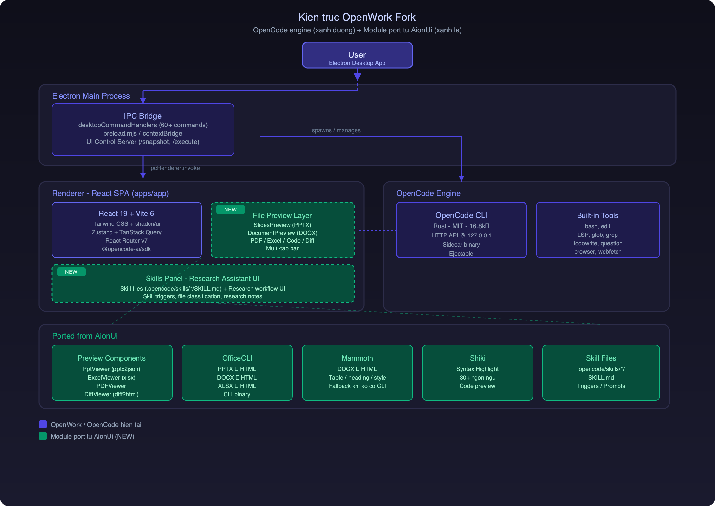
Dinh huong kien truc
OpenWork Fork — 4/11

Slide 5
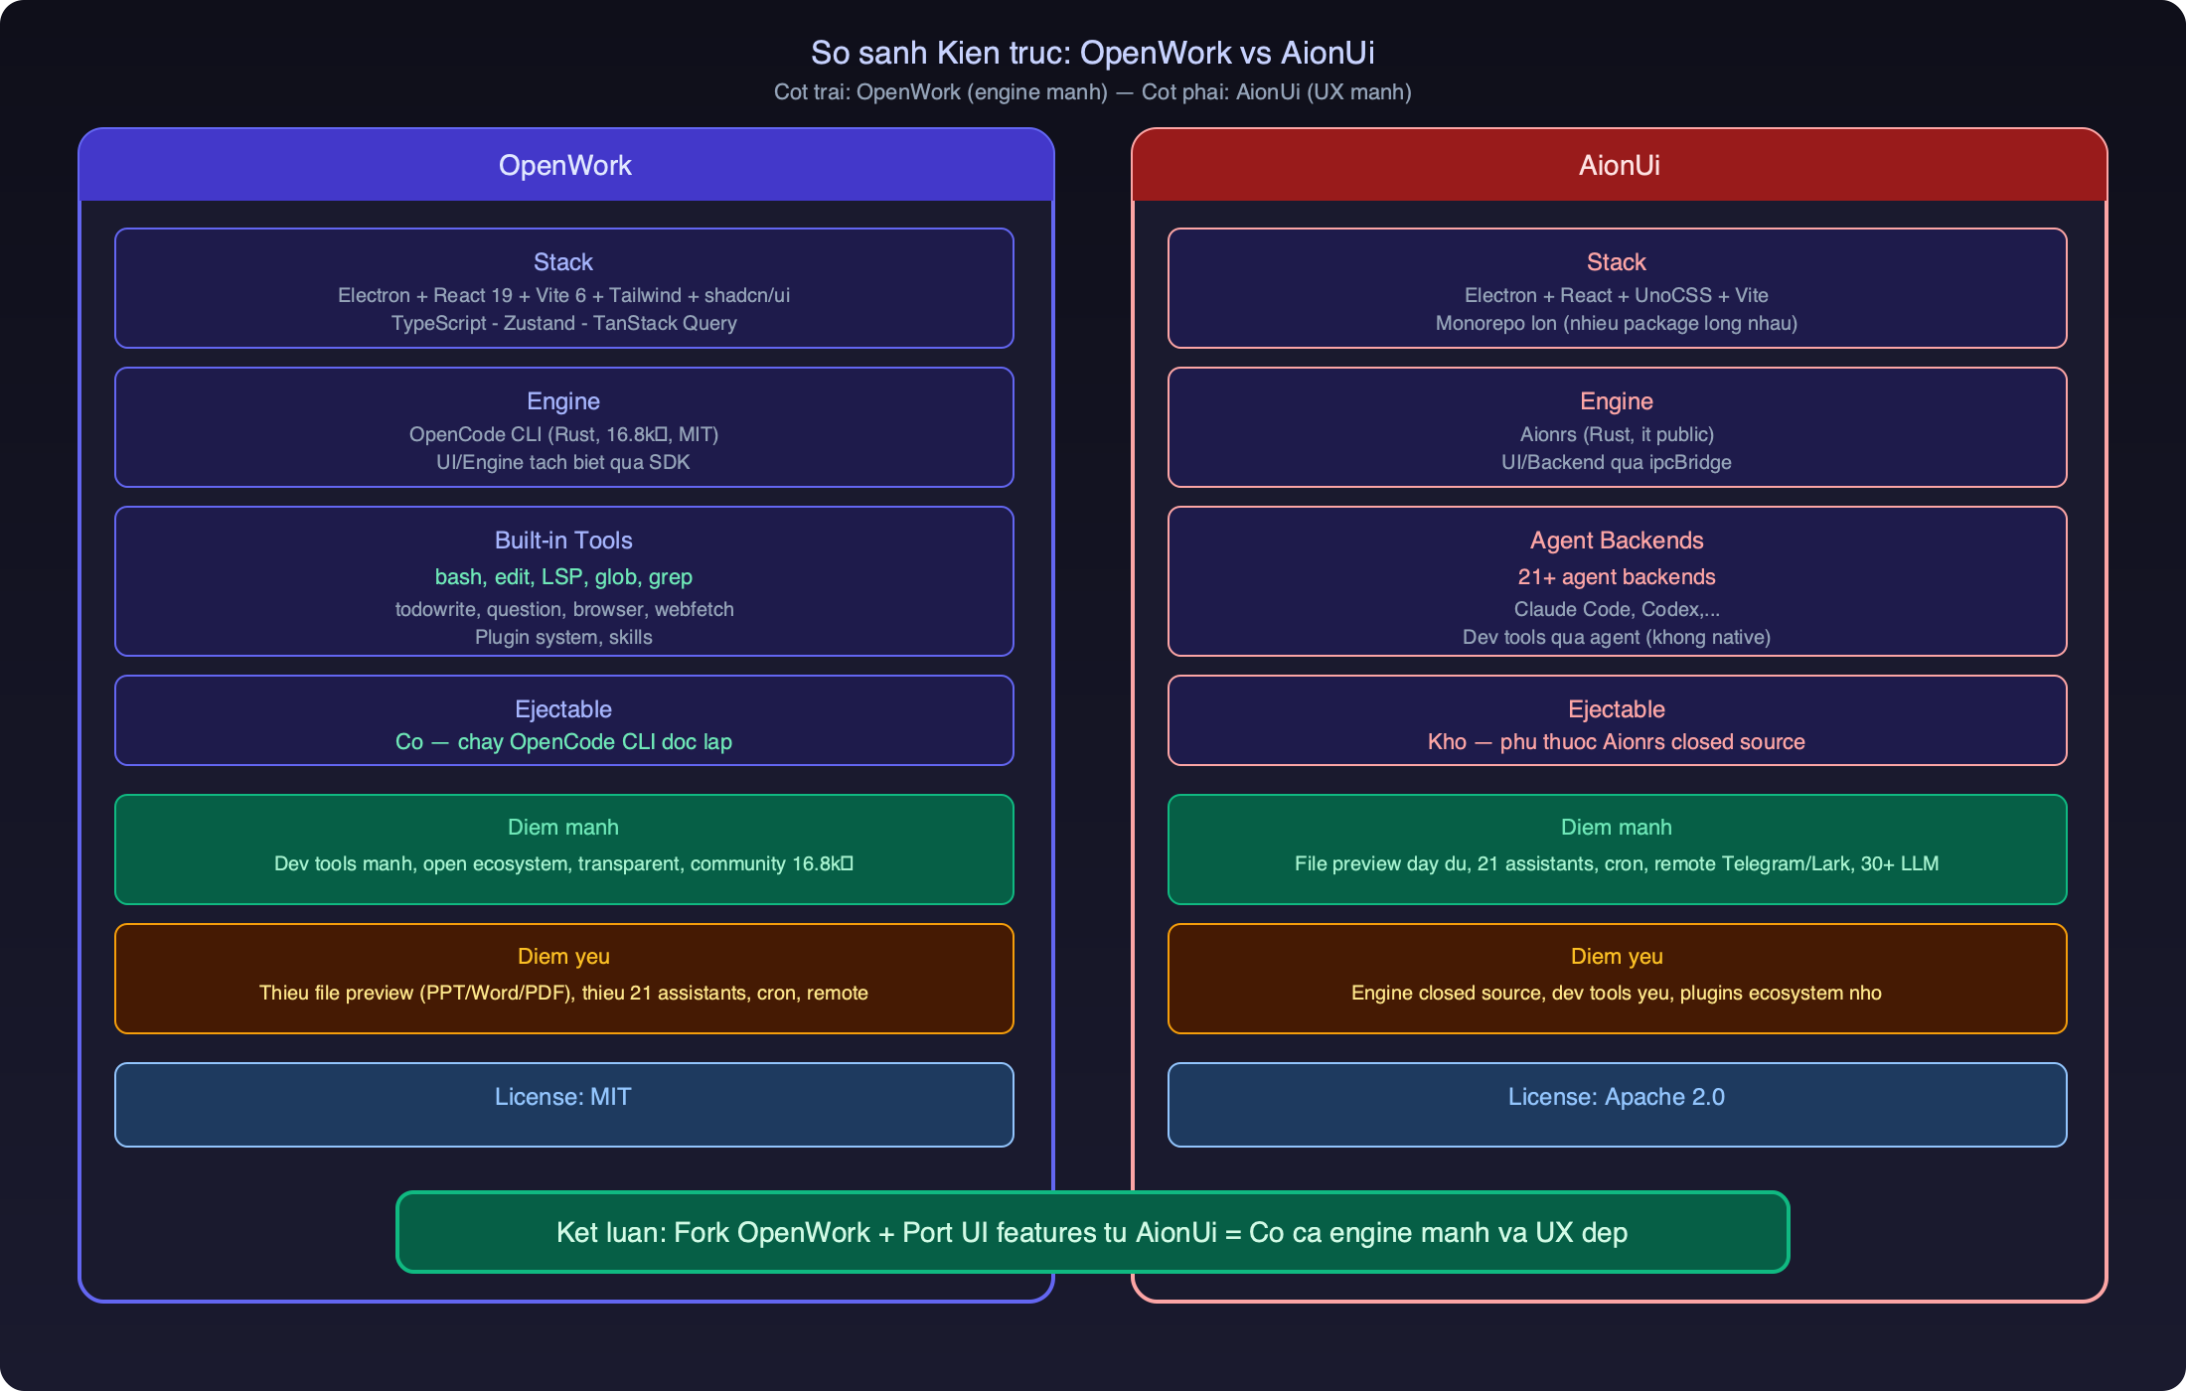
So sanh kien truc: OpenWork vs AionUi
OpenWork Fork — 5/11

Slide 6
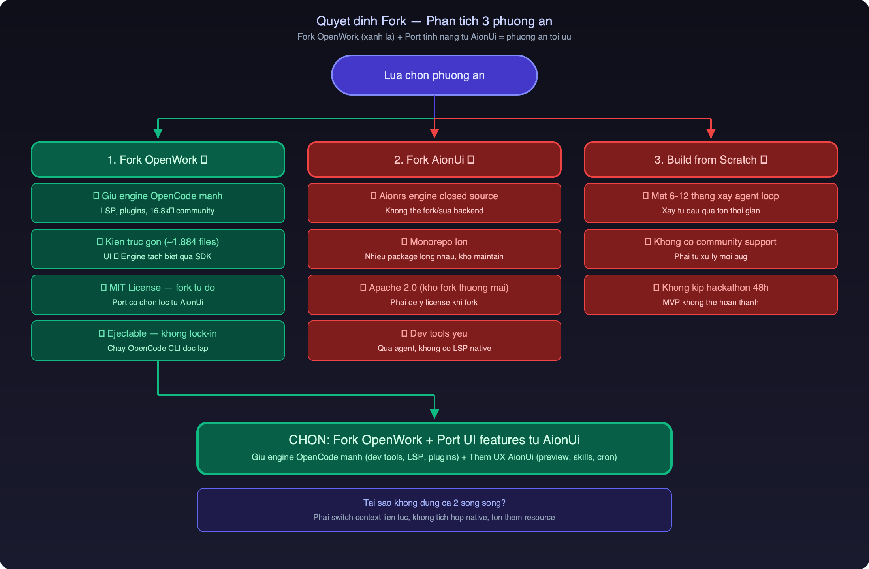
Vi sao chon Fork OpenWork + Port tu AionUi
OpenWork Fork — 6/11

Slide 7
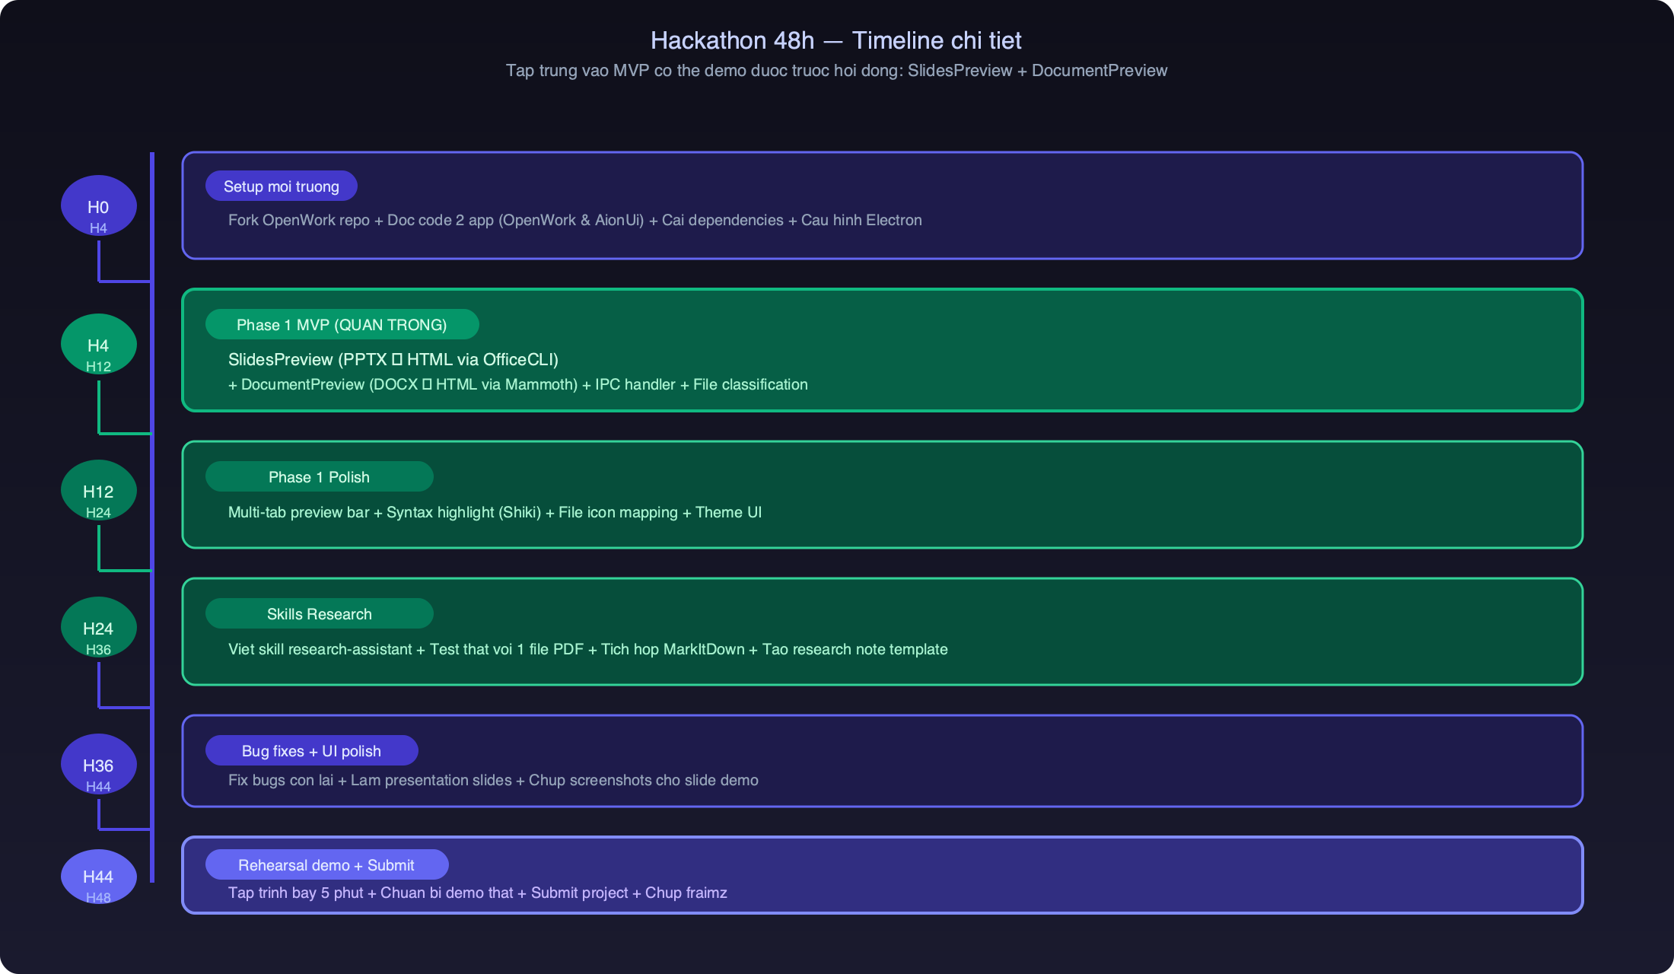
Hackathon 48h — Pham vi & Timeline
Deliverables: App chay duoc (Electron + OpenCode) | 2 file preview (PPTX, DOCX) | 1 skill research-assistant | GitHub public | Slide demo 5 phut
OpenWork Fork — 7/11

Slide 8
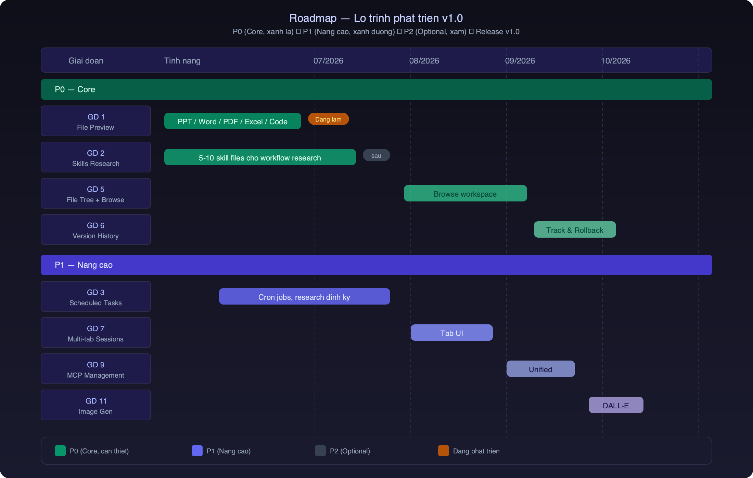
Lo trinh phat trien v1.0
OpenWork Fork — 8/11

Slide 9
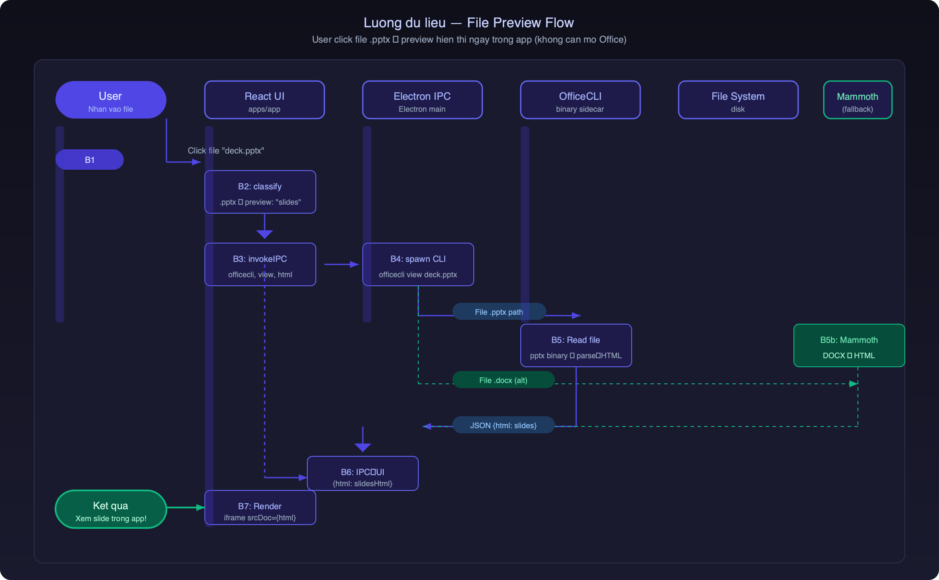
File Preview — Cach hoat dong
OpenWork Fork — 9/11

Slide 10
KPI & Rui ro
Do luong thanh cong
Rui ro & Giam thieu
File preview: >= 8 formats
(PPT, Word, PDF, Excel, anh, code, MD, diff)
>= 5 skills research hoat dong
>= 80% workflow nghien cuu
chay noi bo app (khong can app ngoai)
Thoi gian research 1 tai lieu
giam 50% so voi baseline
OpenCode API thay doi
Trung binh
Pin version, abstract wrapper
AionUi license conflict
Thap
Ca 2 deu MIT/Apache, port tu do
Scope creep
Cao
Theo P0 truoc, review sau
Maintain bi abandon
Trung binh
Fork co community, OW tach biet
OpenWork Fork — 10/11

Slide 11
Cam on!
Q&A
Tai lieu tham khao:
OpenWork: github.com/different-ai/openwork (16.8k★)
AionUi: github.com/iOfficeAI/AionUi (29.8k★)
OpenCode: opencode.ai
OfficeCLI: github.com/iOfficeAI/OfficeCLI
OpenWork Fork — 11/11

