Slide 1
CPE403 Final Project
Nathan Hanuscin
Jose Mendoza

Slide 2
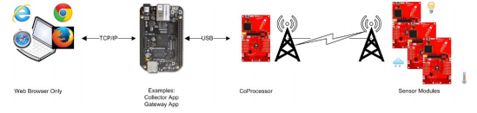
Goal
Main Goal
Our goal was to use the TI 15.4-Stack Linux SDK to create a star topology network with the BBB and two CC1350 launchpads.
With this network wanted to set up multiple sensors to send data to a web application.
Objectives
Our objective was to set up a sensor and co-processor module that sent data to the BBB which was acting as our embedded host.
Connect Si7021 temperature sensor to the sensor launchpad to transmit data.

Slide 3
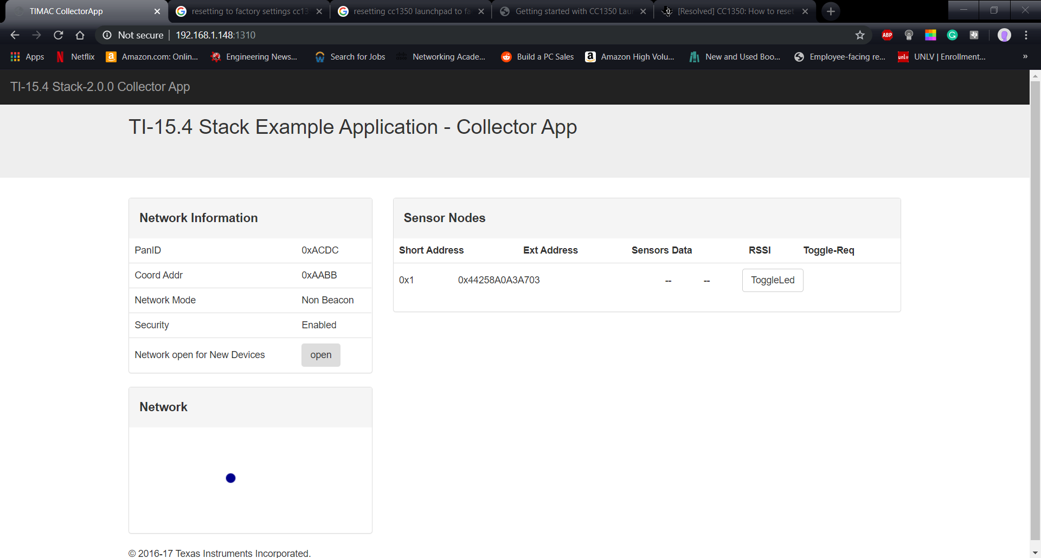
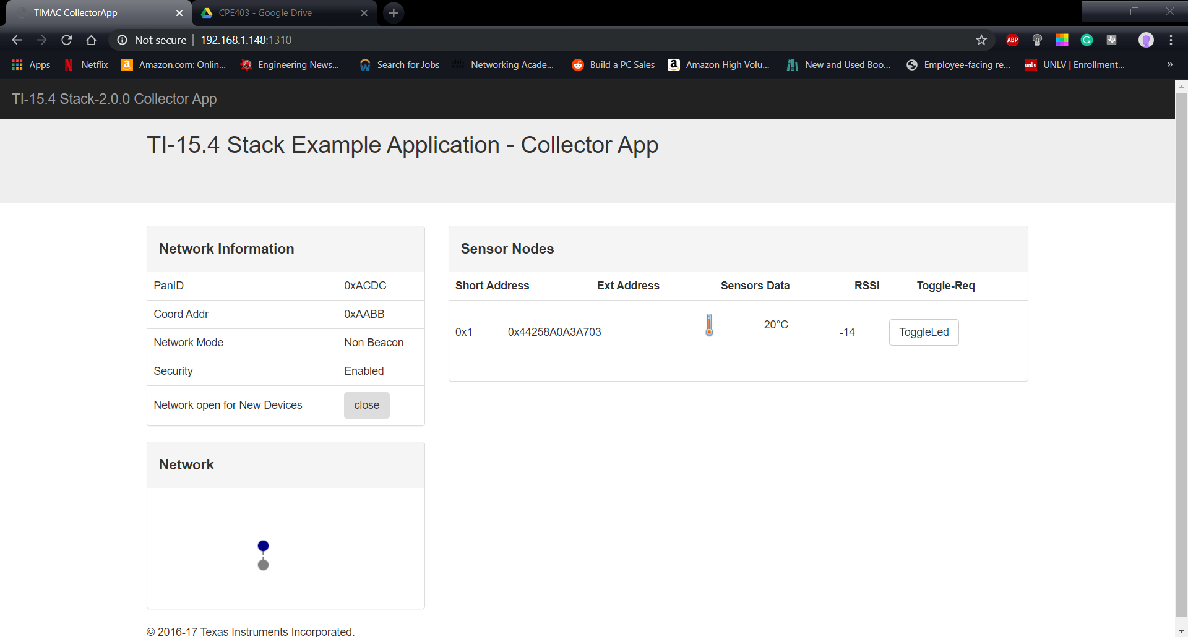
Outcome - Accomplishments
The sensor node was configured to the Si7021 temperature and humidity sensor via I2C and the data from it was transmitted to the co-processor collector node.
The co-processor sent the data to the BBB which was displayed in the web application.
Initial connection to web application
Data transmitted to web application

Slide 4
Components Used in Design
2 CC1350s
Beagle Bone Black
Si7021 Temperature and Humidity Sensor
Spark Fun FTDI Chip

Slide 5
Tools used in Design
Code Composer Studio
Uniflash
Ubuntu VM
Putty
TI Stack Linux SDK

Slide 6
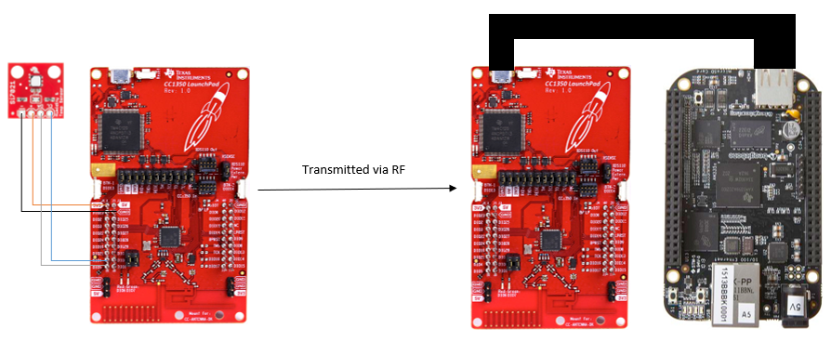
Schematics
I couldn’t find files to add to fritzing for the cc1350

Slide 7
Pre-requisites used in Design
TI 15.4 Stack Linux Gateway SDK
TI am335x-evm-linux SD file
CC1350 sensor_oad CCS project
Commands to install prerequisites
chmod +x ti15.4stack_linux_x64_x_xx_xx_xx.run ./ti15.4stack_linux_x64_x_xx_xx_xx.run
$ scp bbb_prebuilt.tar.gz root@:/home/root/
$ tar -xvf bbb_prebuilt.tar.gz

Slide 8
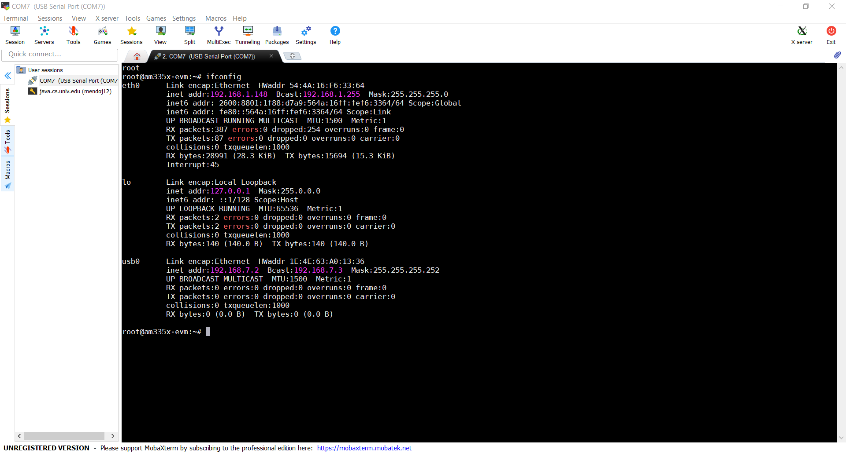
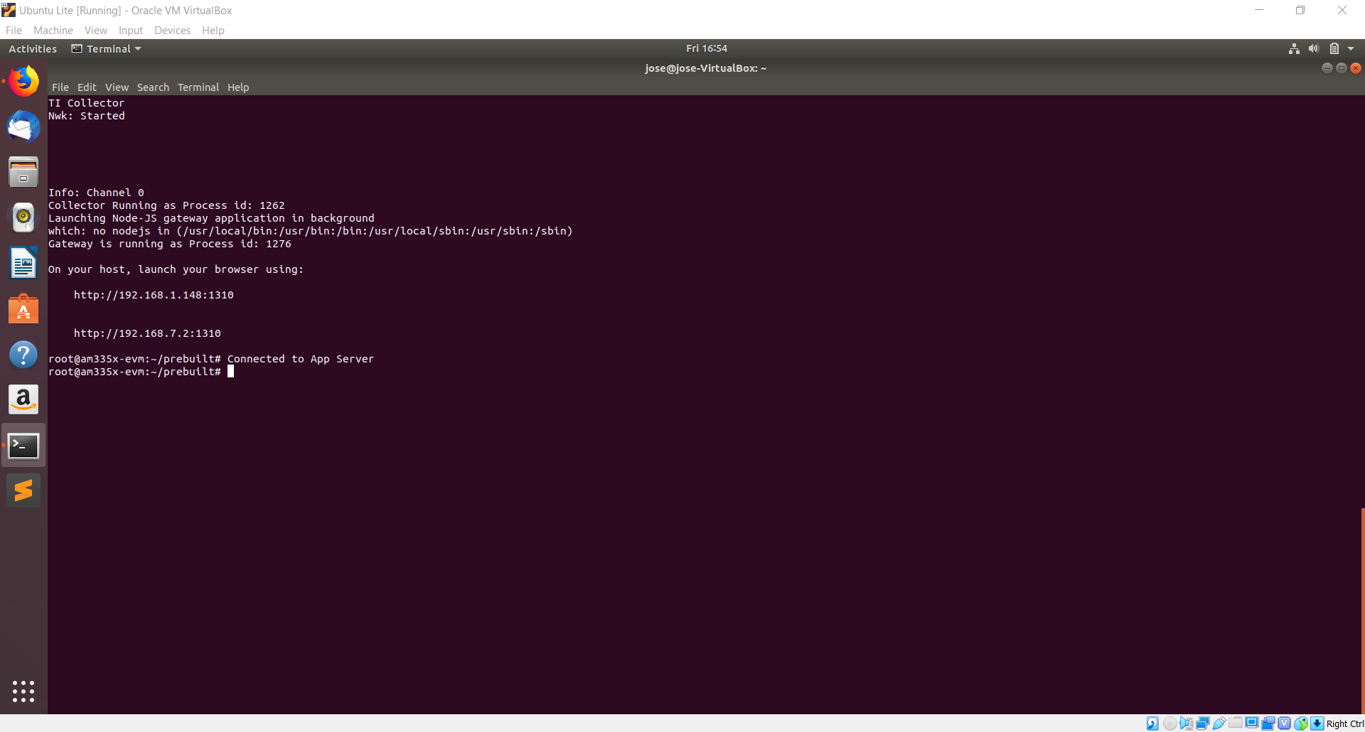
Implementation Details
The initial steps:
Flash sensor and co-processor launchpads in UniFlash
Configure BBB to act as embedded host
Launch Web Application
Booting BBB from SD card with SDK
Connecting to web application with provided IP address and port number

Slide 9
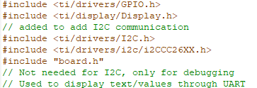
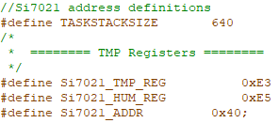
Implementation Details
Final Steps: Program the sensor launchpad to read from Si7021 sensor and send data
Include Files:
Address definitions:

Slide 10
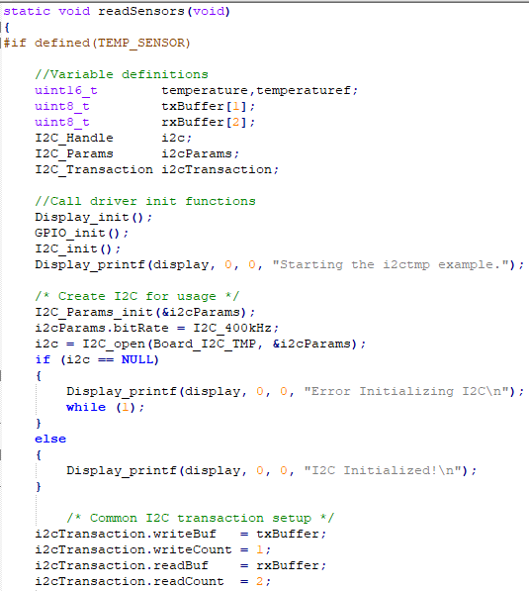
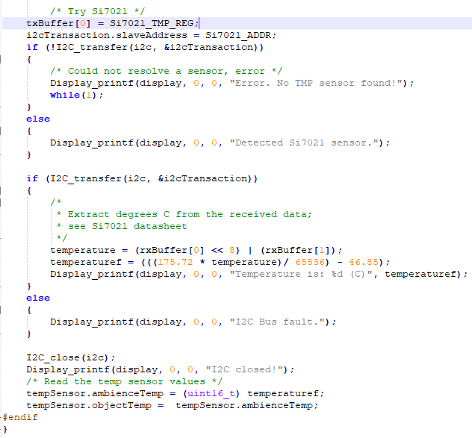
Implementation Details
Update readSensors function to use Si7021 sensor

Slide 11
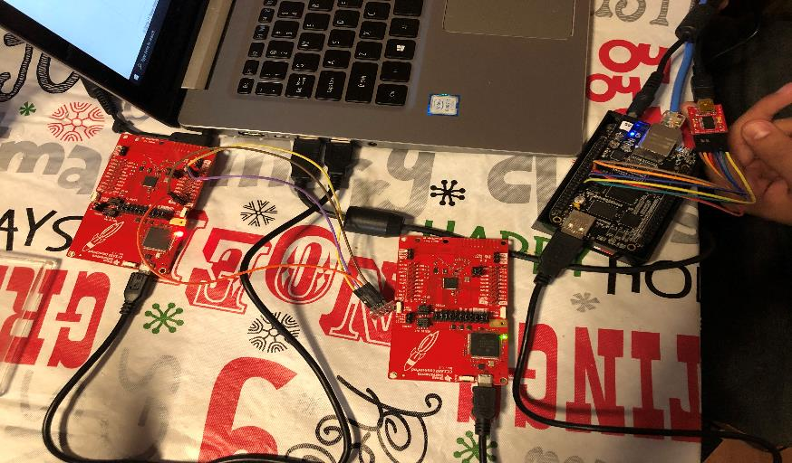
Actual project set-up
Screenshot of the project will all components

Slide 12
Demo
https://youtu.be/INwq8uz3WdU

Slide 13
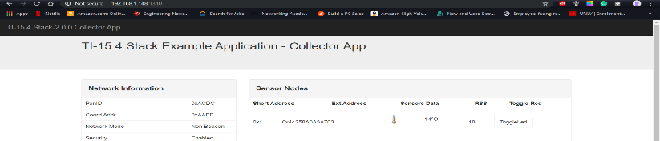

Results and Conclusions
To change the temperature quickly we put an ice pack on the sensor and it dropped all the way to 2 degrees Celsius as shown in the photos on the next slide

Slide 14
Results and Conclusions
We were able to successfully send data with the temperature sensor
However we didn’t have enough time to set up another sensor to send data

Slide 15
Reference
CC1350: http://www.ti.com/lit/ds/swrs183b/swrs183b.pdf
BeagleBone Black: https://cdn-shop.adafruit.com/datasheets/BBB_SRM.pdf
PDFs provided for the final project

